Slide 1

NeuroDOT
Tutorial:
Loading Raw Data

Slide 2
Tutorial: Loading Raw Data
This tutorial will cover the following topics:
Loading Raw Data in NeuroDOT
*.mat: NeuroDOT native format
*.snirf: Shared Near Infrared Spectroscopy Format
*.nirs: Near Infrared Spectroscopy Format
This PowerPoint will follow the “Script_for_Loading_Raw_Data” which will show you how to load raw data in NeuroDOT from *.mat, *.snirf, and *.nirs file formats.

Slide 3
Before you begin
If your data is in the SNIRF format, you will need to download an additional toolbox from GitHub: https://github.com/fNIRS/snirf
This is required to load the SNIRF file to be converted to NeuroDOT format.
In order to run the “snirf2ndot” code, this entire directory needs to be on your Matlab path.

Slide 4
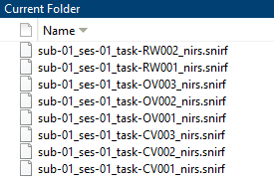

How to Load Data
Before running this script, change your current directory to the folder containing your raw data.
First, select which file you want to load by changing ‘filename’.
Here, the dataset “sub-01_ses-01_task-RW001_nirs.snirf” is used as an example

Slide 5
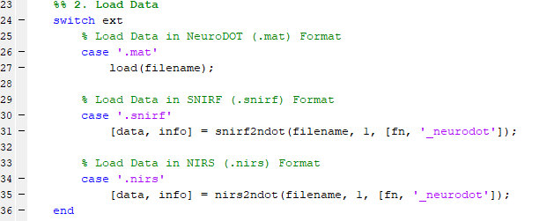
How to Load Data
The following section of code will run the appropriate function to load the raw data in a NeuroDOT compatible format
*.mat
Files can be loaded with Matlab’s built-in ‘load’ function
*.snirf
‘snirf2ndot’ loads the the *.snirf file in NeuroDOT format.
The optional input ‘save_file’ allows for saving an output file with the *.mat extension
*.nirs
‘nirs2ndot’ converts the NIRS data and info to NeuroDOT format
The optional input ‘save_file’ allows for saving an output file with the *.mat extension

Slide 6
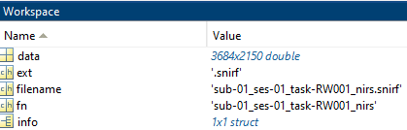
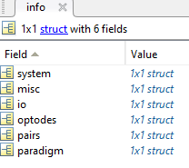
After Loading Data
After loading the data from a file with either a *.mat, *.snirf, or *.nirs extension, you will have two variables ‘data’ and ‘info’ in your workspace.
‘data’ is arranged by # channels x # samples.
‘info’ contains the necessary information about the data to analyze with NeuroDOT.

Slide 7
Help Expand NeuroDOT’s Utility!
Please fill out the NeuroDOT registration form to help us better develop the NeuroDOT toolbox and expand its utility to address your fNIRS/DOT data analysis needs:
https://forms.gle/8QNGnx7ZbKuUHg3bA
Additionally, please provide specific feedback, or ask questions to the development team:
https://forms.gle/jv6RkX5s784LgQC89
Note: you will not be contacted by the NeuroDOT development team unless you opt-in to receiving communications.

Slide 8
That’s It (For Now)
Congratulations! You have finished the NeuroDOT Tutorial for Loading Raw Data
You are now ready to start the other NeuroDOT Tutorials
Recommended order for the tutorials is:
Preprocessing
Image Reconstruction
Generating a Light Model
Full Data Processing
Generating a Light Model PAD Adult 96x92
If you have any questions about the material presented in this tutorial, please consult the WUSTL Bio-photonics Research Center (BRC) GitHub page https://github.com/WUSTL-ORL/NeuroDOT in the documentation folder, or contact NeuroDOT Support: neurodot-support@wustl.edu

