Slide 1
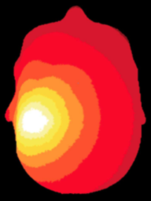
NeuroDOT
Tutorial:
Pad File Generation

Slide 2
Pad File Tutorial Overview
What is a pad file?
NeuroDOT representation of the imaging system
Optode array positions
Measurement list: all information about each measurement for a given array design
Where are pad files used?
One of three key components for generating a light model
Anywhere a measurement list is needed
Preprocessing
Postprocessing
Visualization
What will this tutorial will teach you
The necessary inputs for building a pad file, and how to build it
How to visualize a pad file in 2D and 3D
How to adjust a pad file so the measurement list matches what is in the data

Slide 3
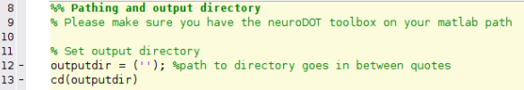
NeuroDOT Set-Up – Output Directory
Example output directory
Once you’ve set your path, the next thing you should do is set your output directory.
The output directory must be located within your path
If it isn’t already in your path, you must add it to your path
You can set your own path to an output directory in the line shown above
An output directory specifies the location where files will be saved
MATLAB, by default, will save files to the current directory
The following line of code will change your current directory to the output directory that you just specified →
Now you can save outputs directly to your output directory
Full example code section →

Slide 4
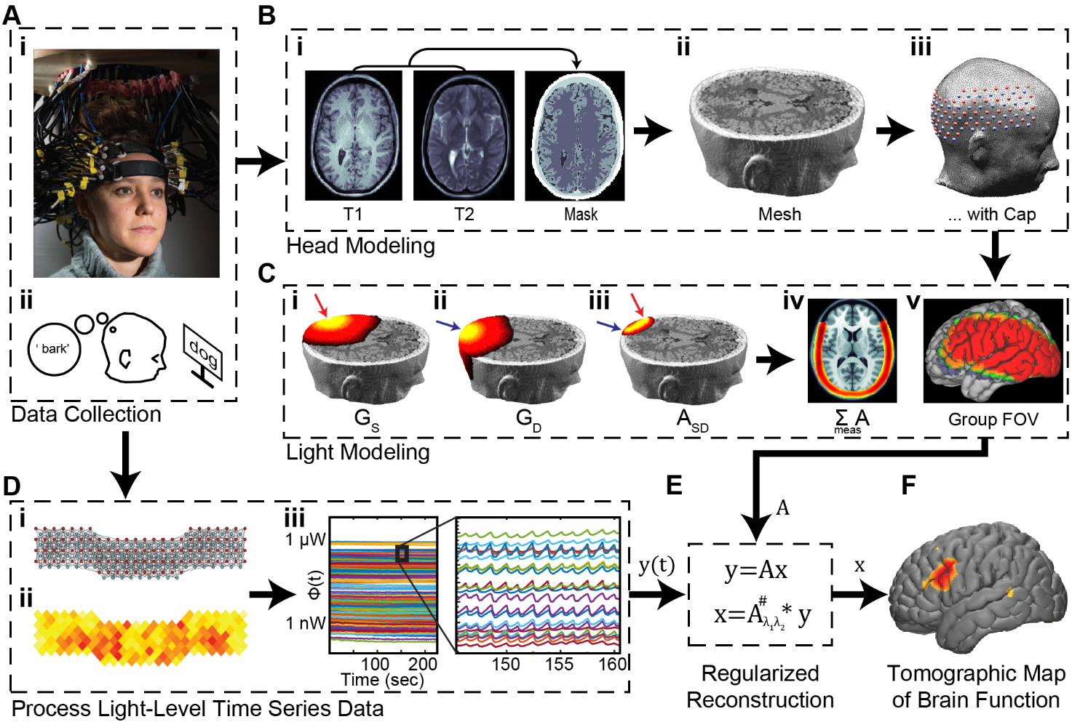
Diffuse Optical Tomography
In diffuse optical tomography (DOT), arrays of optical sources and detectors are used to perform functional neuroimaging experiments on task-based or resting state modes of human brain function.
Analyses are broken into several pipelines:
B: modeling of the tissue shape, optical property distribution, and source/detector locations
C: modeling of the light emission, diffusion, and detection through the head
D: preprocessing of the raw source-detector measurements
E: reconstruction and spectroscopy of the preprocessed data and light model into a functional neuroimaging volume
F: post-processing analysis of these results.

Slide 5
Generating a Pad File
This tutorial will follow the Generating_a_pad_file_tutorial.m Matlab file which can be found in the Documentation/Scripts folder.
The tutorial will:
Create an array of sources and detectors based a set of NeuroDOT sample data
Populate an info structure with measurement information
Visualize and double check aspects of the pad file to validate
Demonstrate optional steps that may be necessary during pad file generation

Slide 6
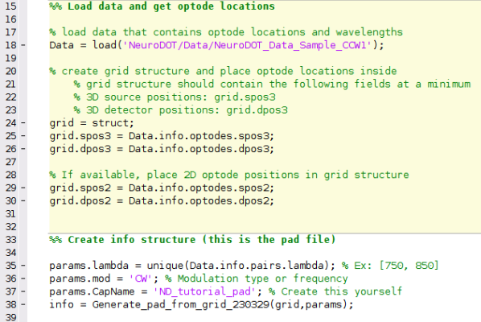
Running the script – Author’s Note
How the author runs the script
Highlight and execute each section of code
Ex: highlight lines 24-26 → right click → hit “Evaluate Selection”
Alternate way of running the script
For each section (beige) hit ctrl+enter
Note: DO NOT HIT THE GREEN “RUN” BUTTON to run this script
MATLAB versions to use
Optimal version: MATLAB 2020b
Example
section

Slide 7
What information goes into a pad file?
The Pad file for a given grid design contains a structure variable info that contains the spatial and topological information for the array as follows:
info.optodes
Structure containing spatial coordinates for sources and detectors in array
info.optodes.spos2 – 2D coordinates of each sources
info.optodes.spos3 – 3D coordinates of each source
info.optodes.dpos2 – 2D coordinates of each detector
info.optodes.dpos3 – 3D coordinates of each detector
info.pairs
Structure containing topological information for each source-detector measurement pair
Each row of the subfields in info.pairs corresponds to a measurement and must be in the same order as the optical data for valid processing
Generally, full list of sources and detectors is repeated for each wavelength/lambda.
info.pairs.Src – source in measurement
info.pairs.Det – detector in measurement
info.pairs.NN – Nearest Neighbor class in array (e.g., info.pairs.NN=1 means this measurement is one of the closest in the grid design)
info.pairs.WL – wavelength index of measurement
info.pairs.lambda – actual wavelength of measurement (e.g., info.pairs.lambda=750 is a 750 nm measurement)
info.pairs.Mod – Modulation type of measurement (e.g., ‘CW’, or, ‘FD’)
info.pairs.r2d – 2D source-detector distances
info.pairs.r3d – 3D source-detector distances

Slide 8
Load nirs data and create grid
First, we’ll need to populate a grid with 2D and 3D optode locations
3D optode locations are mandatory, the pad file cannot be created without these
2D optode locations are ideal, but not necessary to generate the pad file
NeuroDOT is compatible with various raw data file formats including *.mat (shown in this tutorial), *.snirf, and *.nirs.
The PowerPoint “Tutorial_for_Loading_Raw_Data” and corresponding script “Script_for_Loading_Raw_Data” provide details on how to load raw data in these formats.
%% Load data and get optode locations
% Load data that contains optode locations and wavelengths
Data = load('NeuroDOT/Data/NeuroDOT_Data_Sample_CCW1');
% Create grid structure and place optode locations inside
% grid structure should contain the following fields at a minimum
% 3D source positions: grid.spos3
% 3D detector positions: grid.dpos3
grid = struct;
grid.spos3 = Data.info.optodes.spos3;
grid.dpos3 = Data.info.optodes.dpos3;
% If available, place 2D optode positions in grid structure
grid.spos2 = Data.info.optodes.spos2;
grid.dpos2 = Data.info.optodes.dpos2;

Slide 9
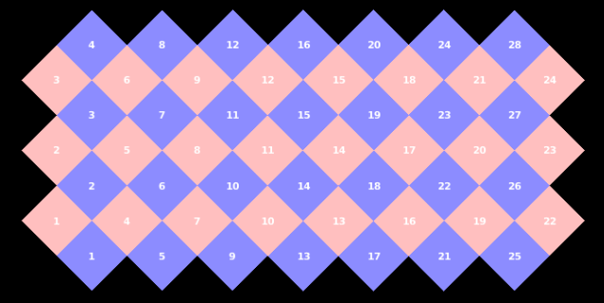
Create info structure, visualize layout in 2D
First, set parameters for pad file generation
Lambda: wavelengths used by the nirs/DOT system
Mod: modulation type or frequency
Can be a string or frequency in Hz
Cap name: name for the nirs/DOT system used in data collection
After that, visualize the pad in 2D and 3D
%% Create info structure (this is the pad file)
params.lambda = unique(Data.info.pairs.lambda); %Ex: [750, 850]
params.mod = 'CW'; %Modulation type or frequency
params.CapName = 'ND_tutorial_pad'; %Create this yourself
info = Generate_pad_from_grid (grid,params);
%% Visualize pad file
% 2D layout - PlotCap (sources in red, detectors in blue)
PlotCap(info)

Slide 10
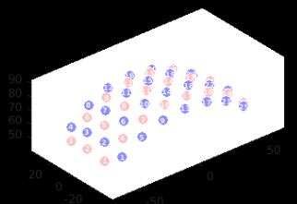
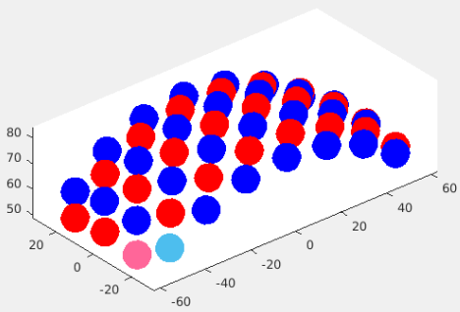
Visualize layout in 3D
PlotCap
To use PlotCap for 3D visualizations set:
params.dimension = ‘3D’
Dimension defaults to 2D unless otherwise specified
Can also use Draw_Foci to visualize optode positions
Array of all SD positions organized as: [source pos; detector pos]
RGB array for all optodes: sources in red, detectors in blue
Optional: setting the color of S1 and D1 to a lighter version of the SD colors
Draw_Foci
% 3D layout - PlotCap
params_cap.dimension = '3D';
PlotCap(info, params_cap);view([-40,30])
% 3D layout – Draw_Foci (sources in red, detectors in blue)
tpos=cat(1,info.optodes.spos3,info.optodes.dpos3); %SD positions
Ns=size(info.optodes.spos3,1); %Number of sources
Nd=size(info.optodes.dpos3,1); %Number of detectors
paramsFoci.color=cat(1,repmat([1,0,0],Ns,1),repmat([0,0,1],Nd,1));
paramsFoci.color(1,:) = [1 0.4 0.6]; %Pink for s1
paramsFoci.color(Ns+1,:) = [0.3010, 0.7450, 0.9330]; %Light blue for d1
figure;Draw_Foci_191203(tpos,paramsFoci);view([-40,30])

Slide 11
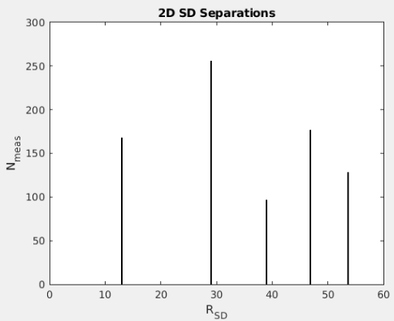
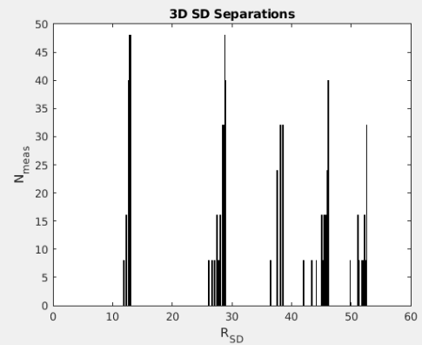
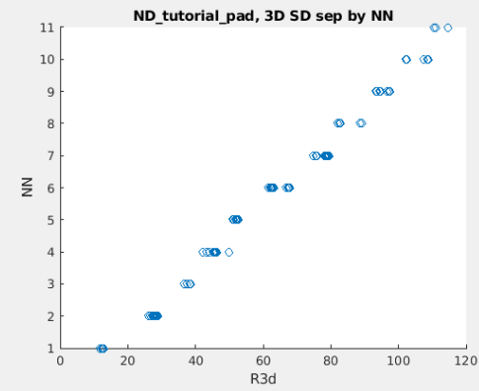
Sanity checks, then save
Check the source detector separations via histogram
Only looking at measurements with a separations <= 60 mm
Make sure that nearest neighbors increase monotonically as a function of source detector separation: bottom
%% Make sanity check plots
% Visualize r2d by itself (hist)
figure;histogram(info.pairs.r2d,1000);xlabel('R_S_D');...
ylabel('N_m_e_a_s');title('2D SD Separations');xlim([0 60])
% Visualize r3d by itself (hist)
figure;histogram(info.pairs.r3d,1000);xlabel('R_S_D');...
ylabel('N_m_e_a_s');title('3D SD Separations');xlim([0 60])
% Visualize r3d by NN (scatter)
figure;scatter(info.pairs.r3d,info.pairs.NN);xlabel('R3d');ylabel('NN');
title([info.optodes.CapName, ', 3D SD sep by NN'], 'interpreter', 'none');
%% Save pad file
save(['Pad_', info.optodes.CapName, '.mat'], 'info')

Slide 12
Cropping measurement list to match data (1) Overview
NeuroDOT generates an info.pairs structure containing all possible measurements with
Monotonically increasing sources within monotonically increasing detectors
Some data use only a subset of the total measurements
Only NN’s 1, 2, 3, 4 and 5
Only measurement pairs with a SD separation <= 30mm
Some data is ordered differently than we do in NeuroDOT
Monotonically increasing detectors within monotonically increasing sources
The next 3 slides will serve as a mini tutorial for cropping info.pairs to match the measurements in the data
Load in a neuroDOT data sample (NeuroDOT_Data_Sample_GV1) that uses a subset of the full measurement list
Generate a pad file from optode positions given within the data file
This will make a full pad file that will need to be trimmed down to match the measurement list in the data
Adjust the newly made pad file to match the measurements seen in the data

Slide 13
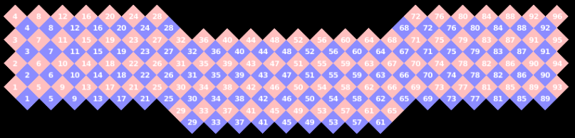
Cropping measurement list to match data (2) Generate Pad
Load the data and generate the pad file
Then, visualize the pad in 2D
%% Load data file
Data = load('NeuroDOT/Data/NeuroDOT_Data_Sample_GV1');
%% Generate and visualize pad file
% Optode positions
grid = struct;
grid.spos3 = Data.info.optodes.spos3;
grid.dpos3 = Data.info.optodes.dpos3;
grid.spos2 = Data.info.optodes.spos2;
grid.dpos2 = Data.info.optodes.dpos2;
% Params
params.lambda = unique(Data.info.pairs.lambda); % Ex: [750, 850]
params.mod = 'CW'; % Modulation type or frequency
params.CapName = 'ND_tutorial_pad_cropSection'; % Create this yourself
% Generate
info = Generate_pad_from_grid(grid,params);
% Visualize 2D
PlotCap(info)

Slide 14
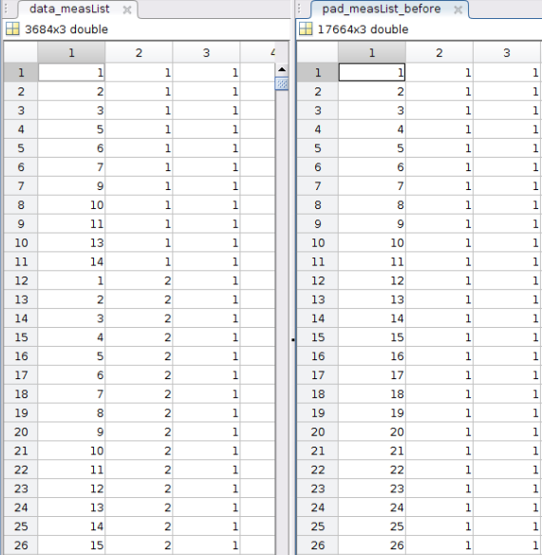

Cropping measurement list to match data (3) Get measurement lists
Data
Pad
Next, create a temporary structure that’s a copy of info.pairs
We’ll crop this structure, then place it back in the pad file
Make measurement lists from the pad and the data
Measurement lists contain the following info for each pair:
Source number, Detector number, Wavelength
We’ll also check if the measurement lists are identical
They shouldn’t be at this point
%% Get Measurement lists from Pad and from Data
% Create temp pairs structure, this will get modified to match data
temp = info.pairs;
% Make measurement list from pad
pad_measList_before = [temp.Src, temp.Det, temp.WL];
% Make measurement list from data
data_measList = [Data.info.pairs.Src, Data.info.pairs.Det,...
Data.info.pairs.WL];
% Are measurement lists in the same order?
order_before = isequal(Data.MeasList, pad_measList_before)

Slide 15
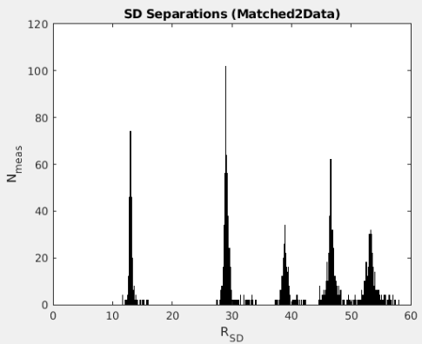

Cropping measurement list to match data (4) Crop pad
Now, get the correct order and measurements for the cropped pad and reorder the temp pairs structure
Validate that both measurement lists are identical and perform a final sanity check
%% Crop to match data
% Get order of measurements in data
[~,Idx]=ismember(Data.MeasList,pad_measList_before,'rows');
% Re-order pairs structure
temp.r3d=[temp.r3d(Idx)];
temp.r2d=[temp.r2d(Idx)];
% temp.r2d = temp.r3d; %for sparse pads, uncomment this line - set r2d = to r3d
temp.NN = [temp.NN(Idx)];
temp.Src = [temp.Src(Idx)];
temp.Det = [temp.Det(Idx)];
temp.WL = [temp.WL(Idx);]; %Get correct size
temp.lambda = [temp.lambda(Idx)]; %Get corect size
temp.Mod = [temp.Mod(Idx,:),];
% Make sure measurements are identical
pad_measList_after = [temp.Src, temp.Det, temp.WL];
order_after = isequal(Data.MeasList, pad_measList_after)
% Sanity Check
% Visualize r3d by itself (hist)
figure;histogram(temp.r3d,1000);xlabel('R_S_D');ylabel('N_m_e_a_s');
title('SD Separations (Matched2Data)');xlim([0 60])

Slide 16
Cropping measurement list to match data (4) Save the cropped pad
Finally, replace info.pairs with the cropped temp pairs structure
Then save your pad file
%% Replace info.pairs with temp pairs and save pad file matched to data
info.pairs = temp;
save(['Pad_' info.optodes.CapName, '_matched2Data' '.mat'], 'info')

Slide 17
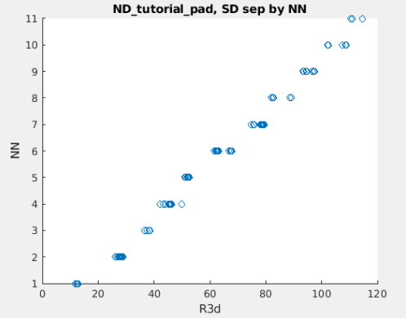
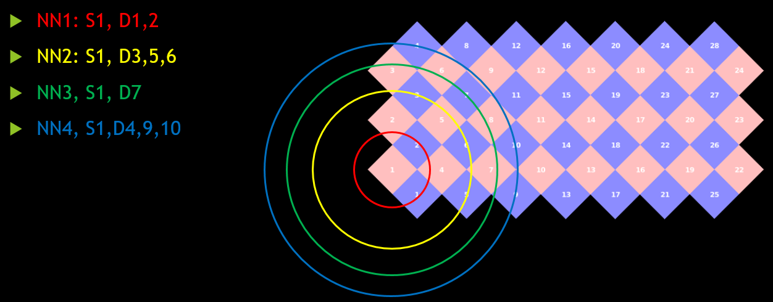
Appendix: Explaining NN’s
Nearest Neighbors (NN’s) are an ordinal classification denoting how close a Source-Detector (SD) pair are to each other
NN’s are stored within info.pairs.NN
NN’s can be used to threshold the data
i.e. only use measurements from NN1’s, 2’s, etc.
Top right: NN’s organized by SD separation distance
Bottom : example NN classifications on 2D layout

Slide 18
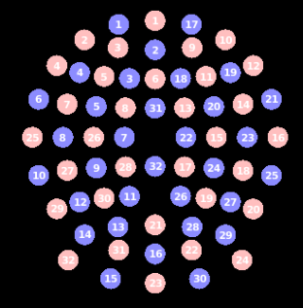
Appendix: Visualizing 2D layout in EEG style
Some arrays from commercial companies, such as NIRx utilize an EEG style layout for their 2D visualizations
NeuroDOT is equipped to visualize arrays in both EEG style and grid style
Set params.eeg_style = 1 when using PlotCap to visualize the 2D layout
params.eeg_style defaults to 0 in PlotCap
% Load NIRx fullHead pad used in sparse pad light modeling tutorials
padname='FullHead_32x32';
load(['Pad_',padname,'.mat']);
% Turn eeg_style on and visualize
params_cap.eeg_style = 1;
PlotCap(info, params_cap)

Slide 19
Help Expand NeuroDOT’s Utility!
Please fill out the NeuroDOT registration form to help us better develop the NeuroDOT toolbox and expand its utility to address your fNIRS/DOT data analysis needs:
https://forms.gle/8QNGnx7ZbKuUHg3bA
Additionally, please provide specific feedback, or ask questions to the development team:
https://forms.gle/jv6RkX5s784LgQC89
Note: you will not be contacted by the NeuroDOT development team unless you opt-in to receiving communications.

Slide 20
That’s It (For Now)
Congratulations! You have finished the NeuroDOT Tutorial for Pad File Generation. Continue on to the NeuroDOT_Tutorial_Generating_a_Light_Model_Pad_24x28_With_AlignMe next to build the corresponding light model with your pad file.
See other Sample Results Appendices for example visualizations of these same processing steps on the other Sample Data included in the toolbox.
Also, see the PreProcessing and Reconstruction tutorials to gain a deeper understanding of the effects of altering the processing parameters.
NeuroDOT Support: neurodot-support@wustl.edu

