Slide 1
This Episode:
GitHub Git Commands Git Desktop
Windows, MacOS and Linux

Slide 2
Elish Consulting
www.elishconsulting.com
ELISH.IO provide full software development, training and support facilities for progressive web apps, desktop software, ERP Implementations including HR, HCM, Finance and Supply chain management.
We develop custom mobile apps, Big Data, Artificial intelligence, machine learning and deep learning tools and libraries for enterprise, and for all kind of mobile & IOT devices.

Slide 3
Like and Subscribe
Please see, this video is as good and current as information available at this time is. I can't come back and change this video as new Node, NPM, Cordova or Angular release comes out, but I will be updating my documentation on GITHUB to support my videos. So, for most current version, always check out my website and GITHUB documentations.
https://github.com/elishconsulting
www.elishconsulting.com
And in case if you have any questions or need any assistance, please open an issue log over GITHUB or post your comments here. At Last Please do NOT forget to like this video and subscribe my channel.
Thanks for watching this video.
Let’s get started..

Slide 4
GIT GITHUB GIT Desktop
What is Git >. Most popular and widely used modern version control system. >. Why it is used – it’s going to make your development life miraculously easy.
How to Install it? Desktop version : https://desktop.github.com/ Command Line : https://git-scm.com/downloads
How to use it? https://desktop.github.com/ For Commands: https://github.com/elishconsulting/GitHub-Hello-World
Git Documentation https://git-scm.com/doc
Git Explore https://github.com/explore
Notes:
For Commands: https://github.com/joshnh/GitHub

Slide 5
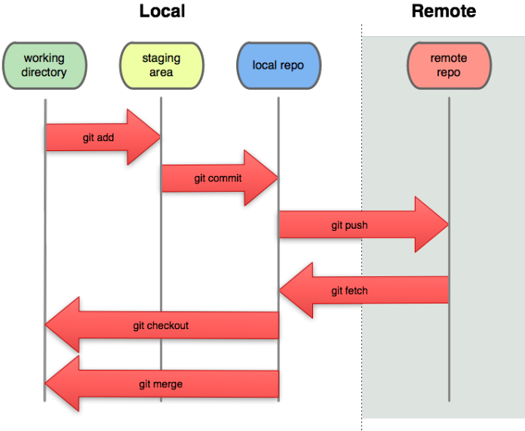
GitHub

Slide 6
Git Commands
https://github.com/elishconsulting/GitHub-Hello-World

Slide 7
DEMO - topics
Sign up for Git Hub
Sign in
Install Github Desktop and Command Line
Commands
.gitignore
Github.io / Stackblitz https://blog.angular.io/run-angular-cli-repos-directly-in-your-browser-41332fd80901
ReadMe.md
Google Cloud and Firebase App use Git.

