Slide 1
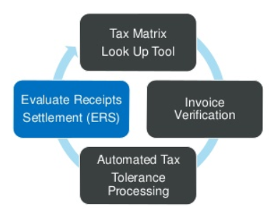
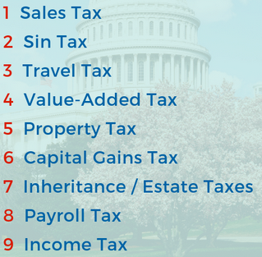
TaxAnalytics.ai
Realtime AI Interceptor Engine
Accrual’s correction
Duplicate Invoices
Tax Assessments
Tax Calculator Engine
3 Way Matching
Discount Calculations
Fraud Detection
Pay Schedule Recommender
Procure to Pay KPI
Custom AI
……....
Vendor Invoice
Vendor Invoice

Slide 2













TaxAnalytics.ai Process Flow
ELT
JSON, XML, CSV, XLSX, TXT BLOB,RDBMS/NOSQL DOCUMENTDB,BLOB, Images….
AI
Text Analysis NLP Data Mining Finance Analytics Statistical Model P-Value/Null Hypothesis ODE (Ordinary Differential equations) Network graph theory
Analytics
Live Reporting Canned Report, Analytics, Visualization Data Science Predictive Analytics
Supported Cloud Platforms:

