Slide 1

ATLIQ HARDWARE
BUSINESS INSIGHTS 360

Slide 2

ATLIQ HARDWARE
ABOUT COMPANY
AtliQ Hardware is a leading provider of computer hardware and peripherals, specializing in:
Personal Computers (PC)
Storage Devices
Computer Peripherals
Networking Devices

Slide 3

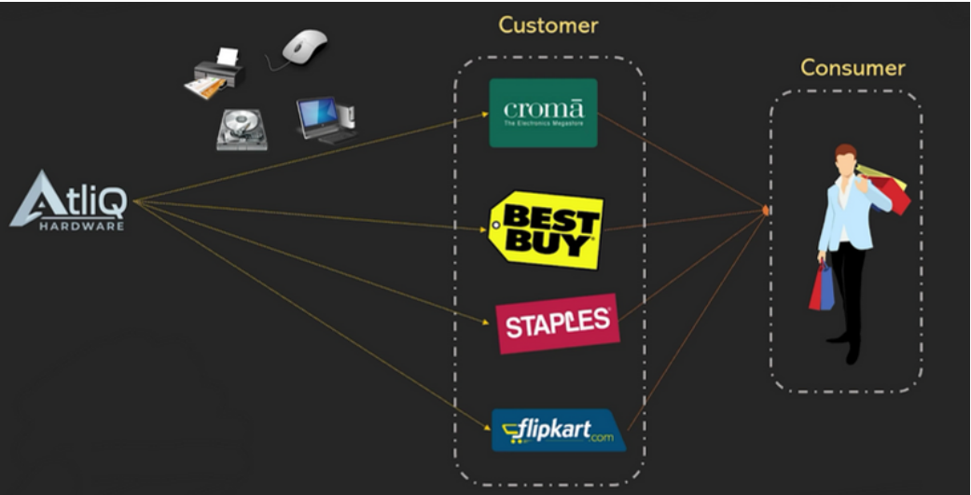
COMPANY MODEL

Slide 4
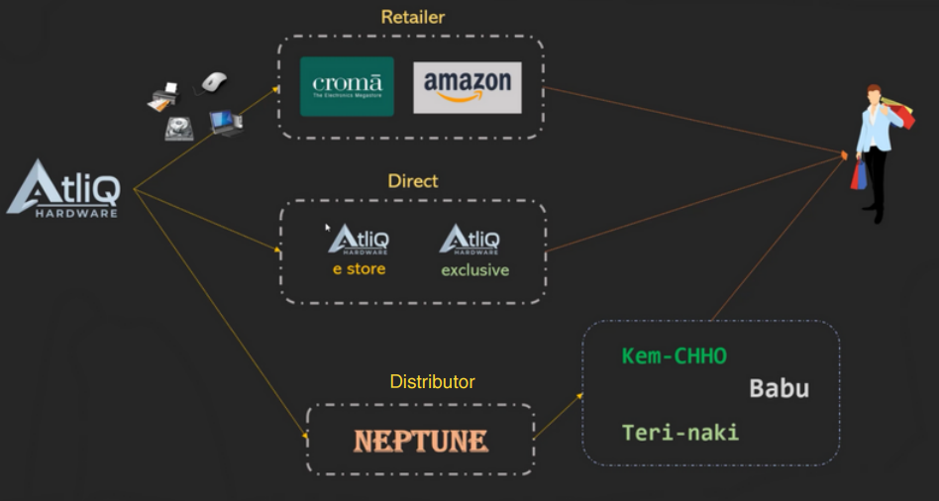
CHANNEL STRUCTURE

Slide 5

PLATFORM OVERVIEW

Slide 6
𝐏𝐫𝐨𝐛𝐥𝐞𝐦 𝐒𝐭𝐚𝐭𝐦𝐞𝐧𝐭: AtliQ Hardware, a rapidly expanding global consumer electronics company, has been grappling with unwieldy Excel files for data analytics. This outdated approach has been hindering effective decision-making and causing significant losses. In response, they urgently sought agile, data-driven decision-making. 𝐎𝐛𝐣𝐞𝐜𝐭𝐢𝐯𝐞: Develop an interactive report offering invaluable insights across finance, sales, marketing, supply chain, and executive teams, using provided mockup dashboards as a reference.

Slide 7
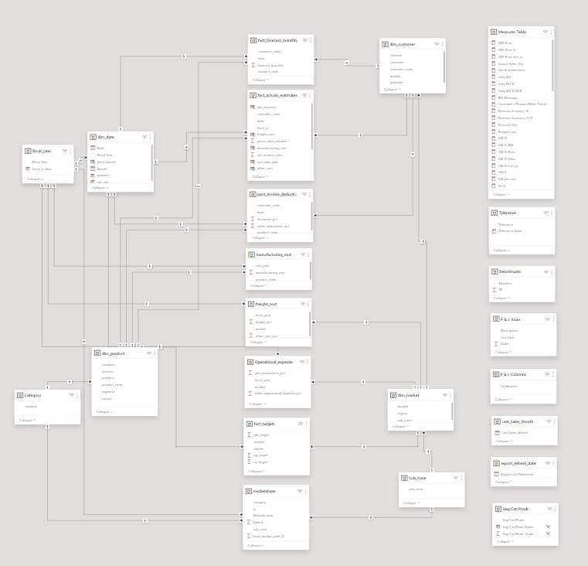
DATA MODEL
DAX - Explicit Measures
Star Schema - with fact tables in the center.
Snowflake Schema - Normalizes dimension tables.

Slide 8
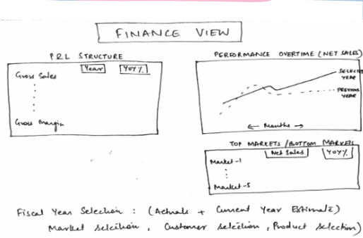
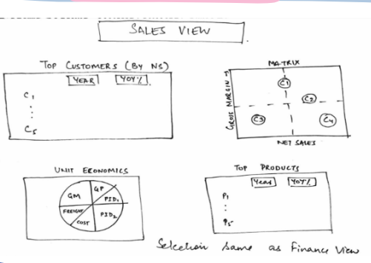
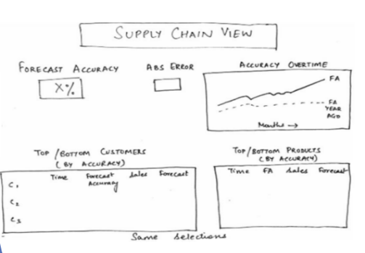
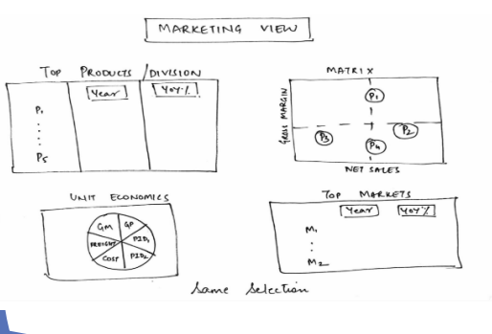
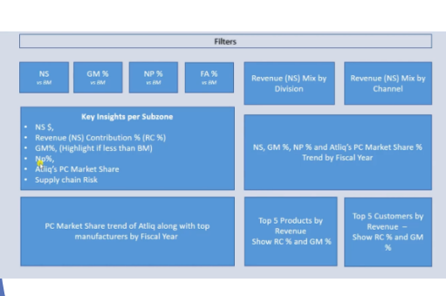
MOCK REPORTS

Slide 9
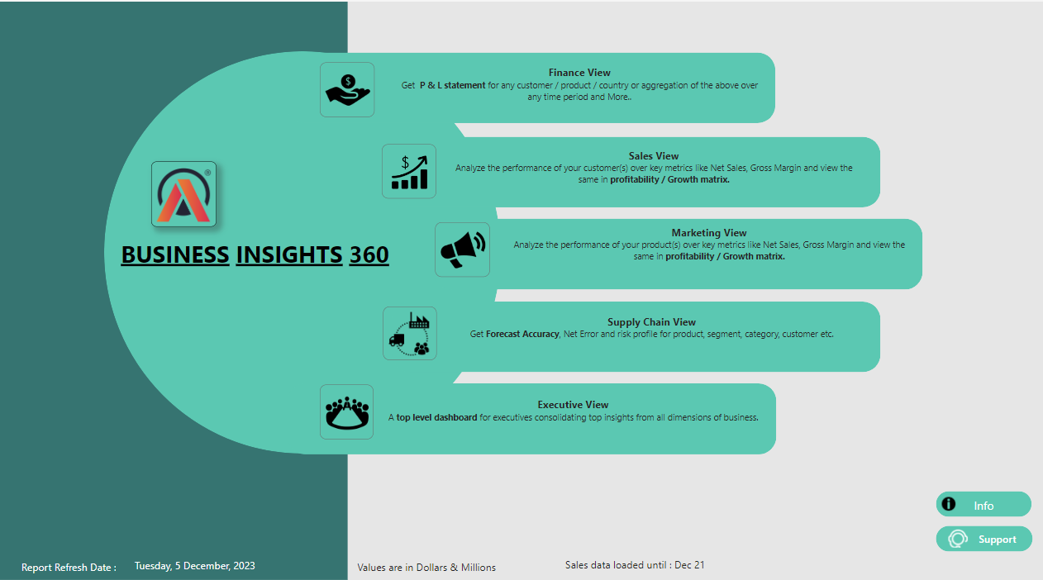

Slide 10
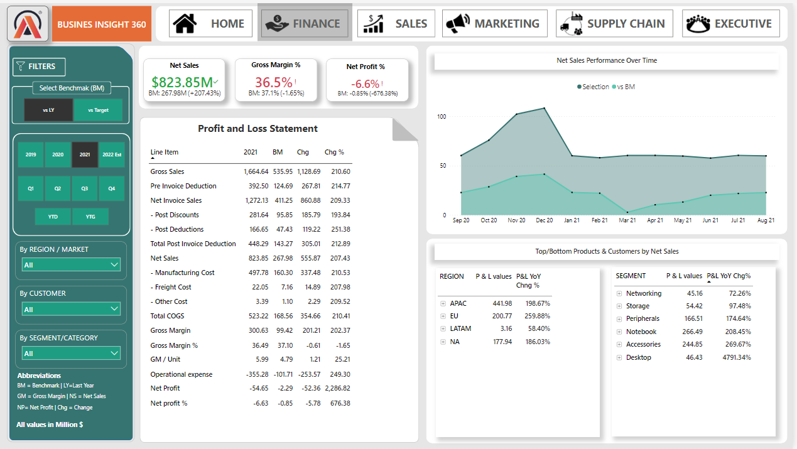

Slide 11
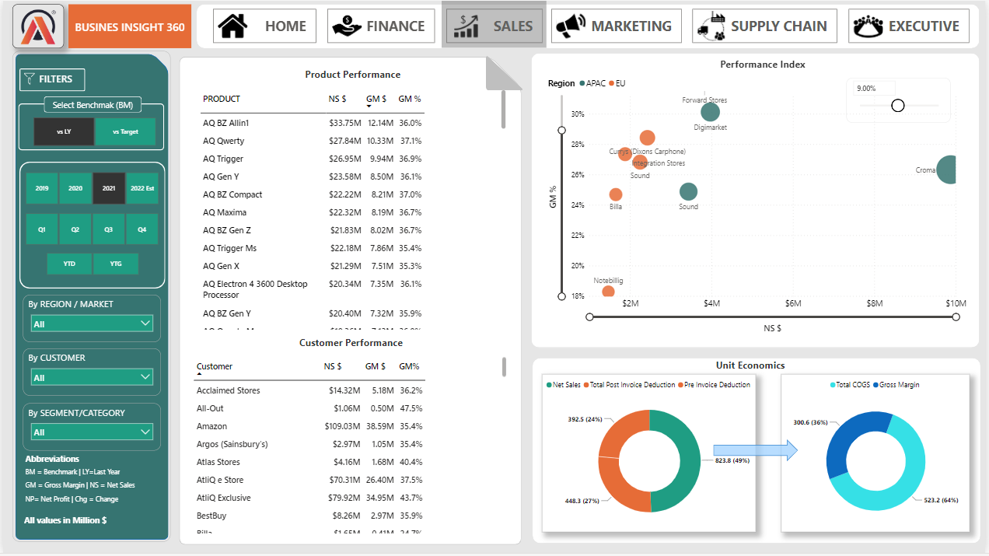

Slide 12
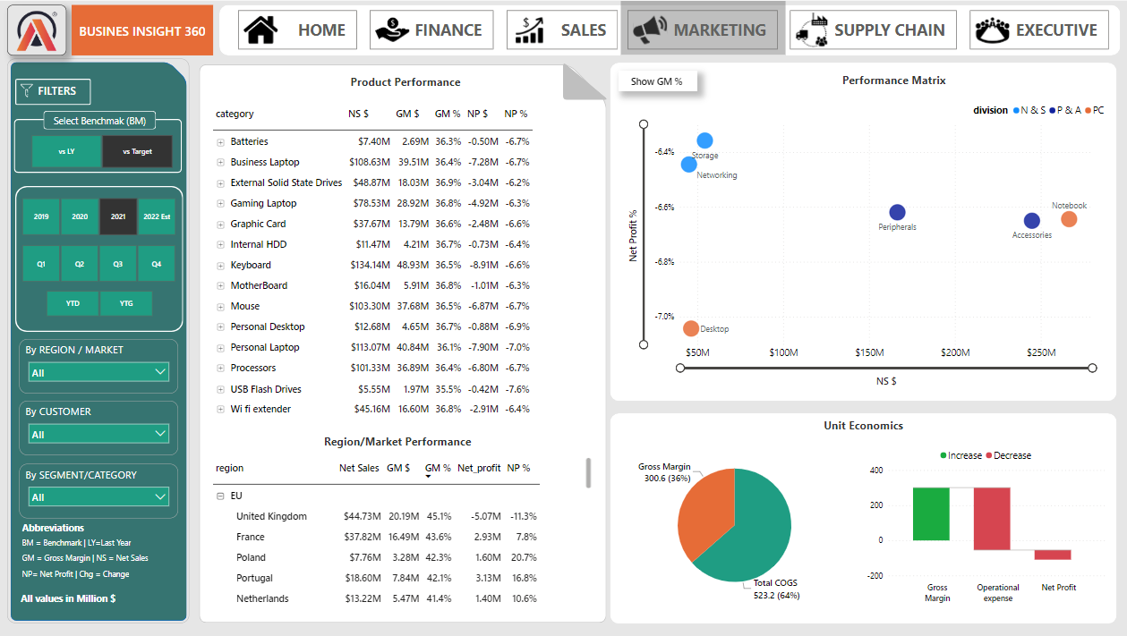

Slide 13
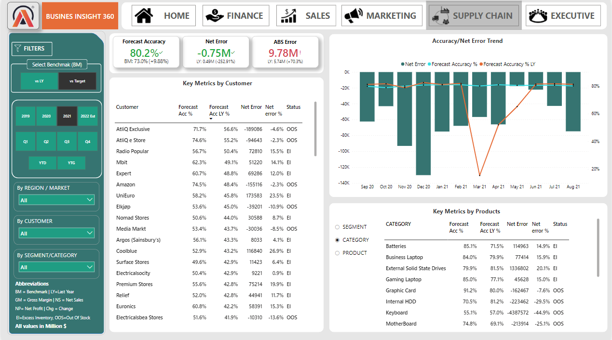

Slide 14
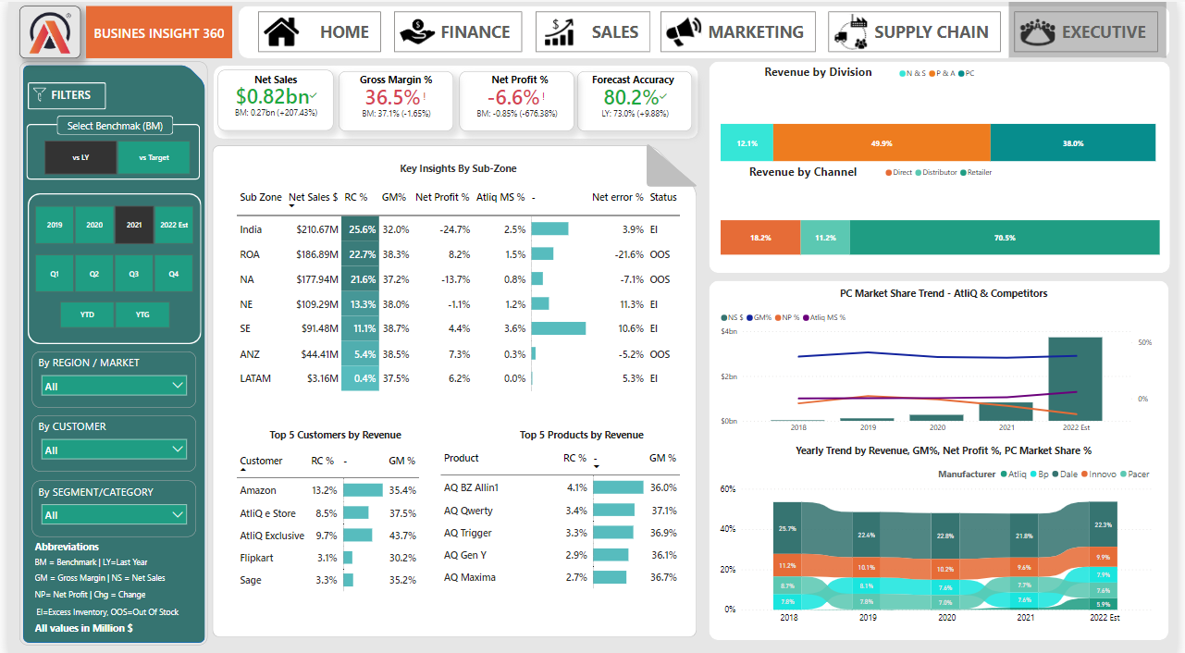

Slide 15
THANK YOU !
For Live Dashboard : CLICK HERE

