Slide 1

Facebook Data Analysis
BDA Mini Project Presentation on
Under the Guidanace of Asst. Prof.Asmita Deshmukh
Group Members: Amita Kashid (Roll No:22) Pranali Khilari(Roll No:24) Shalaka Naik(Roll No:34)

Slide 2


Introduction
Smart phone without social media usage in daily lifestyle of people is unthinkable.
Petabytes of data is generated by Facebook users.
That much effect has been created in the lifestyle of people by smartphone and social media.
There are many social media such as Facebook, Twitter, etc., As per 2017 statistics, nearly 1.37 billion daily active users for Facebook.
Every user contributes some type of data to in structured or semi-structured or unstructured data format.
Business owners utilize this data to understand customer need and their behavior to make profit in their business.
Facebook data analysis is the process of collecting, analyzing Facebook data and visualizing extracted results to the end user.

Slide 3
For many people around the world, Facebook is one of the most useful and ubiquitous social media platforms for connecting with friends and family, as well as meeting new people with common interests.
But for businesses, Facebook is not just about maintaining social connections. The social media platform can also be a crucial marketing tool.
Facebook Analysis will track likes, page views, and more.
For certain types of digital marketing, Facebook can be an integral channel used to reach out to the desired audience.
However, the effectiveness of that marketing increases—by orders of magnitude—for businesses that take advantage of the rich analytics provided by tools like Facebook Insights.

Slide 4

Facebook is a preferred social network by marketers, not only because of the sheer number of users represented but also because of its incredibly insightful analytics suite.
The main idea of Facebook Data Analysis is to give organizations a better understanding of who engages with their brand and how they do it.
The main idea of this project is to process the raw data that is generated by the platform and find out useful patterns in that data that can be applied to marketing insight and action.
So Hadoop, Hive and related big data concepts are used in this project to analyze the data.
The implementation will help you understand who your audience is and how they’re interacting with your page.

Slide 5

Problem Statement
Facebook provides a treasure trove of user information and performing efficient analysis will allow businesses to gain almost unparalleled levels of insight into their customers, whether that be where they live, how old they are, their gender, or even the device they use to access the internet most regularly.
The main objective of this project is to demonstrate by using Hadoop concepts, how data generated from Facebook can be mined and utilized to make targeted, real time and informed decisions.
There are multiple applications of this project. Organizations can use this project to understand how effective and penetrative their marketing programs are.
For those not running an e-commerce business, this project can help track social interactions, enabling businesses to increase social engagement and adapt posts according to what has worked in the past(and what hasn't).

Slide 6

Dataset
Facebook Data
Date Set is provided by Facebook as part of open source exploratory analysis for data scientists to learn and grow their skills.
Facebook Data set was collected from kaggle website.
The data set consists of 15 features with 99004 entries in it. DATA SOURCE:
https://www.kaggle.com/sheenabatra/facebook-data

Slide 7

Variables
userid: The account number of the facebook user age: Age of the facebookuser
dob_day: Date of birth day of the facebook user dob_year: Year of birth of facebook user dob_month: Date of month of the facebook user
gender: tenure:
Gender of the facebook user level of the facebook user
friend_count: Friend count of the facebook user friendship_initiated: Friendship initiated by the facebook user likes: likes received on facebook users posts
mobile likes: mobile likes received on facebook users posts
mobile likes_received: mobile likes received on facebook users posts www_likes: desktop likes received on facebook users posts www_likes_received: desktop likes received on facebook users posts

Slide 8

Tools
Hive
Hive is a data warehouse infrastructure tool to process structured data in Hadoop. It resides on top of Hadoop to summarize Big Data, and makes querying and analyzing easy.
Hive provides the ability to store large amounts of data in HDFS. Hive was designed to appeal to a community comfortable with SQL.
Hive uses an SQL like language known as HIVEQL. Hive is widely used in Facebook, with analyst comfortable with SQL as well as data miners programming in Python.

Slide 9
Tools
Power BI
Power BI is a collection of software services, apps, and connectors that work together to turn your unrelated sources of data into coherent, visually immersive, and interactive insights.
Power BI lets you easily connect to your data sources, visualize and discover what's important, and share that with anyone or everyone you want.

Slide 10

Methodology
Facebook data is collected from Kaggle website
Preprocess the data by dropping the entries with null values
Loaded that processed data from local machine into HDFS using Hadoop query Created database in Hive to store the facebook data
Created table in database and stored facebook data in it
Data Processing is done using HIVE query language

Slide 11
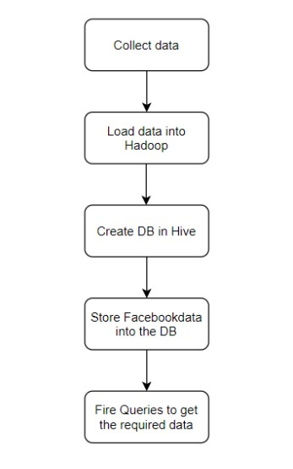
Sequence Diagram

Slide 12

Data Computation
Using frameworks such pandas data processing is done
We explored the dataset and found that there are 175 missing values in gender and 2 missing values in tenure.
There are 99003 objects within our data set. Considering the amount of objects, we dropped the entries having missing values.

Slide 13

Result Analysis
Facebook data analysis is the collecting, analyzing Facebook
process of data and
visualizing extracted results to the end user.
Facebook is the most popular social media worldwide. A comment analysis can further be conducted to understand the sentiments of people towards the specific post.
The proposed model will help to analyze Facebook data using Hadoop through which one can make better decisions in business.

Slide 14
Conclusion
Various queries are applied on the dataset and operations are performed in order to get results which are then visualized using Power BI. Currently the project scope is limited to 15 specified attributes.
As far as future use, this project was compartmentalized in such a way that it can easily be recycled and used with a different set of keywords.

Slide 15

References
https://hadoop.apache.org/docs/r2.10.1/ https://intellipaat.com/blog/tutorial/hadoop- tutorial/ https://projectsgeek.com/2018/02/facebook-data- analysis-using-hadoop-project.html https://intellipaat.com/big-data-hadoop-training/

