Slide 1
Python To-do List Manager
GUI Application with Tkinter & MySQL
Presented by: [Amitabh Soojani]
Date: [02/06/2025]

Slide 2
Introduction
Objective: To manage daily tasks efficiently using a custom-built desktop application.
Tools Used:
- Python for application logic
- Tkinter for GUI
- MySQL for data storage

Slide 3
Problem Statement
Traditional task management is:
- Often manual
- Prone to forgetfulness
- Lacks reminders or structured categorization
Need for a personalized, offline task management solution.

Slide 4
Project Goals
Create, update, and delete tasks.
Store tasks persistently using a database.
Mark tasks as 'pending' or 'completed.'
Display due dates and times.
Use color indicators for task status.

Slide 5
Project Architecture
Frontend: Tkinter (Python GUI library)
Backend: MySQL Database
Middle Layer: Python with PyMySQL connector

Slide 6
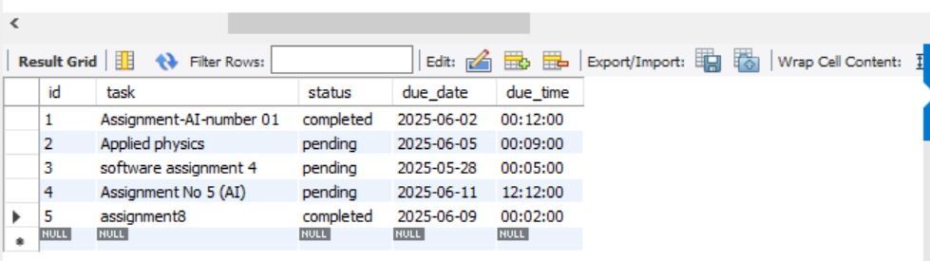
Database Design
Table: to-dos
Fields:
- id (INT, Primary Key)
- task (VARCHAR)
- status (ENUM: pending/completed)
- due_date (DATE)
- due_time (TIME)

Slide 7
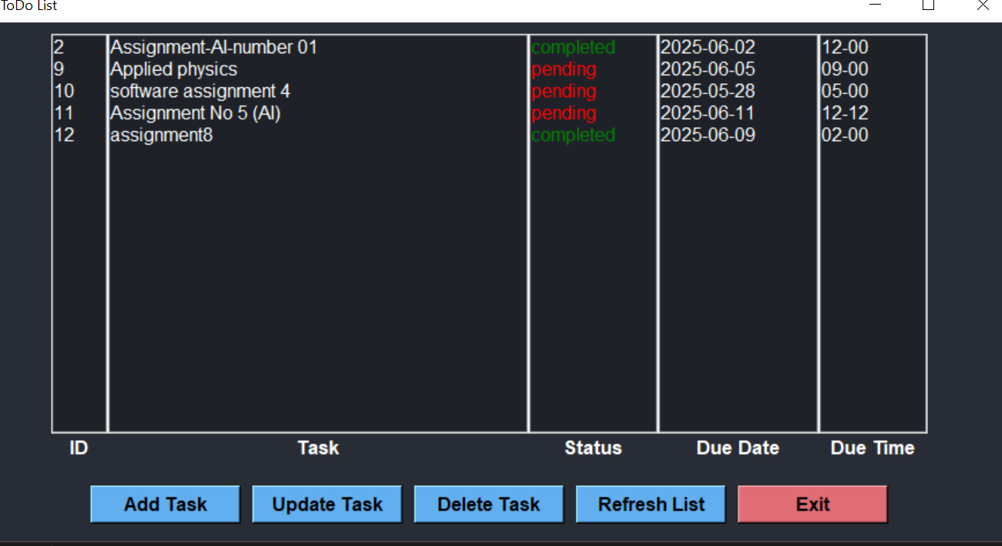
GUI Layout
Organized interface:
- Multiple list boxes for ID, Task, Status, Date, Time
- Buttons for Add, Update, Delete, Refresh, Exit

Slide 8
Core Functionalities
Add Task
Update Task (with validation)
Delete Task
View Task List
Color Indicators: Green = Completed, Red = Pending

Slide 9
Code Highlight – Database Interaction
Connects using PYMySQL
Uses SQL statements for CRUD operations
Exception handling and commit control

Slide 10
Code Highlight – Tkinter GUI
Dynamic forms
Pop-up dialogues for input
Interactive list boxes

Slide 11
What Was Learned
Integration of GUI with database
Input validation and error handling
Modular code development
User experience design in desktop apps

Slide 12
Challenges Faced
Handling different data types (date, time)
GUI refresh and data binding
Managing updates without empty fields

Slide 13
Future Enhancements
Add task reminders/notifications
Implement search/filter/sort functionality
Sync tasks to cloud or mobile app
Add user login system
Export tasks to PDF/Excel

Slide 14
Conclusion
Developed a fully functional, GUI-based ToDo app.
Learned full-stack development using Python.
The app has potential for real-world productivity use.

