Slide 1
PREDICTION OF INCIDENCE AND
SEVERITY OF COFFEE LEAF RUST
Under the guidance of
Prof. Chiranjit Mukhopadhyay
By:
Amitabh Gunjan
Organisation:
eka Analytics
Department of Management Studies 21st June 2018 Indian Institute of Science

Slide 2
AGENDA
Introduction
Problem Statement & Data Description
Literature Review
VAR Modelling
Long short-term Memory(LSTM)
Results
Granger causality
Impulse Response Analysis
LSTM hyper parameters
Comparison of VAR and LSTM
Forecast
Conclusion
References
Department of Management Studies 21st June 2018 Indian Institute of Science

Slide 3
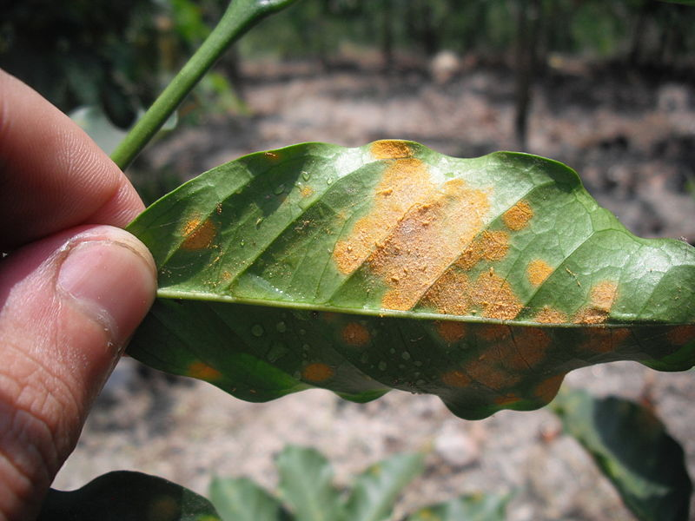
INTRODUCTION
Leaf rust:
caused by a fungus called Hemileia Vastatrix.
Leads to premature fall of infected leaves.
Symptoms include appearance of spots on the upper leaf surface of plants.
Impacts:
Decreased quality and quantity of yield produced.
Increased cost to control and combat the disease.
Source: Wikipedia
Key definitions:
Rust incidence: (Number of infected leaves/Total number of leaves observed)*100
Severity: (Sum of severity ratings of all observed leaves/(5* Total number of leaves observed))*100
Scale for grading of severity ranges from 0 to 5.
Department of Management Studies 21st June 2018 Indian Institute of Science

Slide 4
PROBLEM STATEMENT
DATA DESCRIPTION
Category | Description
Weather conditions | Average maximum temperature(◦c) Average minimum temperature(◦c) Relative humidity Sunshine(hours) Rainfall(mm)
Leaf rust | Population infected: (Number of plants infected/Total number of plants observed)*100 Rust incidence: (Number of infected leaves/Total number of leaves observed)*100 Severity: ((Sum of severity ratings of all observed leaves/5)* Total number of leaves observed)*100 *Scale for grading of severity ranges from 0 to 5.
Client of EKA analytics has coffee plantations which face the severe problem of leaf rust that leads to huge losses of yield.
The client had initiated an experimental trial on one of the plantations and recorded leaf rust incidence and severity on fortnightly basis over the span of 8 years.
They want forewarning model on the outbreak of disease.
The aim of this project is to predict coffee leaf rust incidence and severity.
Department of Management Studies 21st June 2018 Indian Institute of Science

Slide 5
LITERATURE SURVEY
Journal, Issue / Publication No | Title & Author | Description | Dataset | Techniques used/ referred
International Journal of Agricultural and Environmental Information Systems , Volume 7, Issue 3, July-September 2016 | Two-Level Classifier Ensembles for Coffee Rust Estimation in Colombian Crops Author - David Camilo Corrales et. al | Proposed classifier ensembles for coffee rust estimation in Colombian crops. | The dataset is composed of 13 attributes that are divided in 3 categories: 1) Weather conditions (6 attributes), 2) Physic crop properties (3 attributes) 3) Crop management (4 attributes) | Neural Networks, Regression Tree and Support Vector Regression
Sixth European Workshop on Probabilistic Graphical Models, Granada, Spain, 2012 | Prediction of Coﬀee Rust Disease Using Bayesian Networks Author - P´erez-Ariza et. al | Presented an agricultural case study for learning Bayesian networks (BNs) for prediction of coﬀee rust. | Dataset comprises: 1) monthly information of the incidence of the coﬀee rust 2) a daily summary of all the weather observations taken that day. | Bayesian networks
International Journal on Ecological Modelling and Systems Ecology, Vol 197, Issue 3, 2006, Pages- 431-447 | The intensity of a coffee rust epidemic is dependent on the production situation Author – J. Avelino et. al | They focus on coffee tree characteristics, crop management patterns, and the environment and show that a link can be found between certain production situations and intensity of coffee leaf rust. | Did a survey on 73 plots. Plots had 170 coffee trees on average. Five coffee trees were marked and on each of the trees 3 branches were identified and a large number of variables were recorded. | Correspondence analysis
Department of Management Studies 21st June 2018 Indian Institute of Science

Slide 6
LITERATURE SURVEY
Journal, Issue / Publication | Title & Author | Description | Dataset | Techniques used
Expert Systems with Applications Volume 38, Issue 11, October 2011, Pages 14276-14283 | Using nondeterministic learners to alert on coffee rust disease Author - Oscar Luaces et. al | In the application studied, the aim was to alert on high incidences of coffee rust, by learning functions able to predict whether the value of a continuous target variable will be greater than a given threshold. | Dataset comprises of 1) monthly accounts of incidence of disease on an experimental farm in Brazil, 2) weather conditions 3) fruit load of the plantation 4) spacing between plants | Support vector regression, Logistic regression, support vector machines multi class classification.
journal Ingeniería y Universidad, Pontificia Vol 19, No 1 (2015), pp- 207-228 | Towards Detecting Crop Diseases and Pest by Supervised Learning Author - David Camilo Corrales et. al | Presented an overview of supervised learning algorithms commonly used in agriculture for the detection of pests. |  | Decision trees, Bayesian Networks, artificial neural networks, support vector machines, K-nearest neighbour
Department of Management Studies 21st June 2018 Indian Institute of Science

Slide 7
LITERATURE SURVEY
Journal | Title & Author | Description | Dataset | Techniques used/ referred
arXiv library | A Critical Review of Recurrent Neural Networks for Sequence Learning - Zachary C. Lipton, John Berkowitz, Charles Elkan | Have provided a review of the state of the art together with a historical perspective of recurrent neural networks. | None | RNN
 | Supervised sequence labelling with recurrent neural networks – Alex Graves | Book on sequence labelling using RNN and LSTM |  | RNN, LSTM
arXiv library | Recurrent Neural Network Regularization – Wojciech Zaremba et. al. | Presented dropout regularization for Recurrent Neural Networks. | Penn Tree Bank Dataset. | RNN
arXiv library | LSTM: A Search Space Odyssey – Klaus Greff et. al. | Large scale analysis of eight LSTM variants on three tasks. Guidelines for hyperparameter tuning. | TIMIT dataset IAM online dataset JSB chorales dataset | LSTM
Department of Management Studies 21st June 2018 Indian Institute of Science

Slide 8
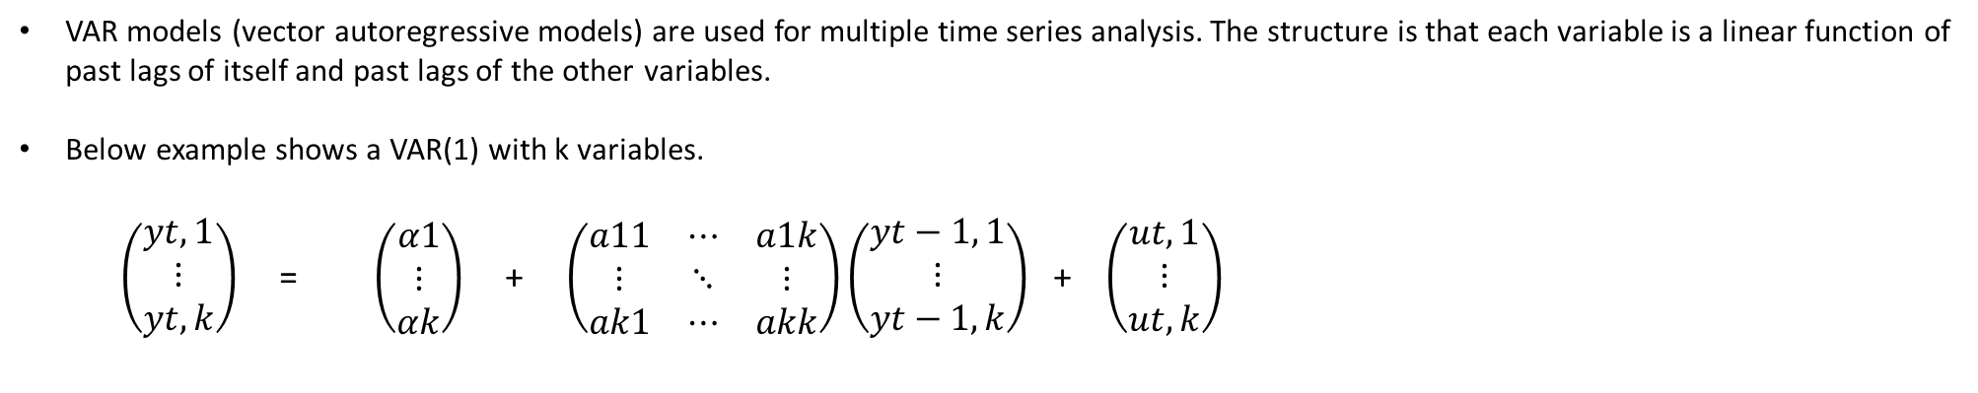
Vector Auto regression (VAR)
VAR models (vector autoregressive models) are used for multiple time series analysis. The structure is that each variable is a linear function of past lags of itself and past lags of the other variables.
Below example shows a VAR(1) with k variables.
$\left(\begin{aligned}yt,1 \\ ⋮ \\ yt,k\end{aligned}\right)$ = $\left(\begin{aligned}α1 \\ ⋮ \\ αk\end{aligned}\right)$ + $\left(\begin{matrix}a11 & ⋯ & a1k \\ ⋮ & ⋱ & ⋮ \\ ak1 & ⋯ & akk\end{matrix}\right)\left(\begin{aligned}yt−1, 1 \\ ⋮ \\ yt−1, k\end{aligned}\right)$ + $\left(\begin{aligned}ut,1 \\ ⋮ \\ ut, k\end{aligned}\right)$
In this case k = 8.
Order selection: Used the Schwartz criteria for VAR order selection which gave the order of the lag to be 1.
Department of Management Studies 21st June 2018 Indian Institute of Science

Slide 9
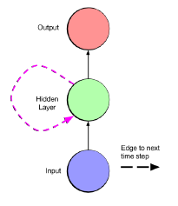
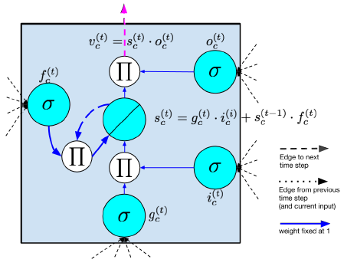
Recurrent Neural networks (RNN)
Natural architecture for sequence learning tasks.
Nodes are self connected across time steps
Suffers from vanishing and exploding gradients problem over long time lags
long short-term memory (LSTM)
Tasks LSTM has been successfully applied to:
Image captioning
Natural language translation
Time series forecasting
Source: A critical review of recurrent neural networks, Lipton et. al.
Department of Management Studies 21st June 2018 Indian Institute of Science

Slide 10
Granger causality:
Variety C:
Variety A:
$Granger
H0: TempMax TempMin RelativeHumidity Sunshine RainFall do not Granger-cause Population Infected RustIncidence Severity
data: VAR object VarA
F-Test = 2.2692, df1 = 15, df2 = 1288, p-value = 0.003674
$Granger
H0: TempMax TempMin RelativeHumidity Sunshine RainFall do not Granger-cause Population Infected RustIncidence Severity
data: VAR object VarC
F-Test = 3.3586, df1 = 15, df2 = 1288, p-value = 1.365e-05
Variety B:
$Granger
H0: TempMax TempMin RelativeHumidity Sunshine RainFall do not Granger-cause Population Infected RustIncidence Severity
data: VAR object VarB
F-Test = 1.7349, df1 = 15, df2 = 1304, p-value = 0.03914
Department of Management Studies 21st June 2018 Indian Institute of Science

Slide 11
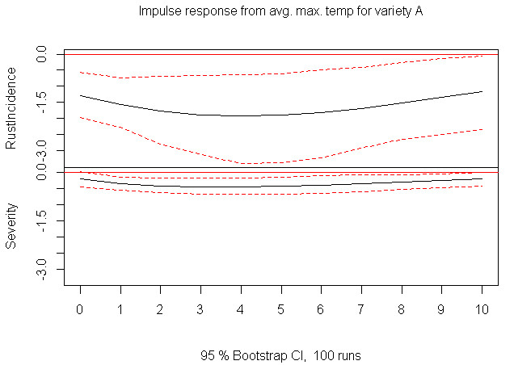
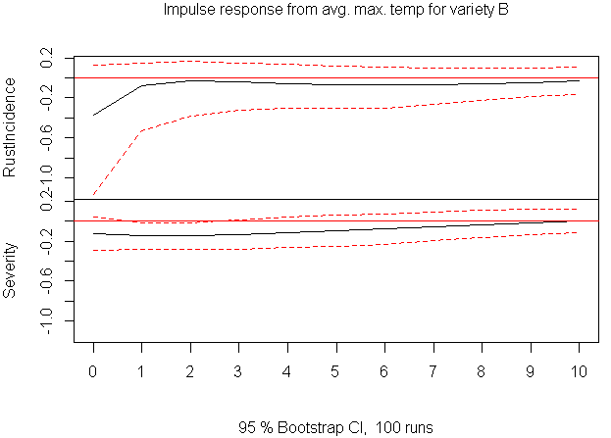
Impulse Response Analysis
Department of Management Studies 21st June 2018 Indian Institute of Science

Slide 12
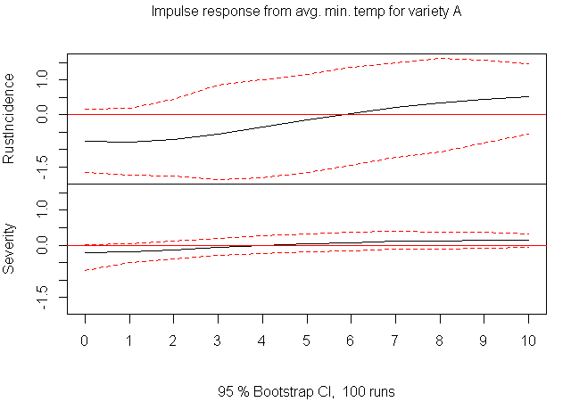
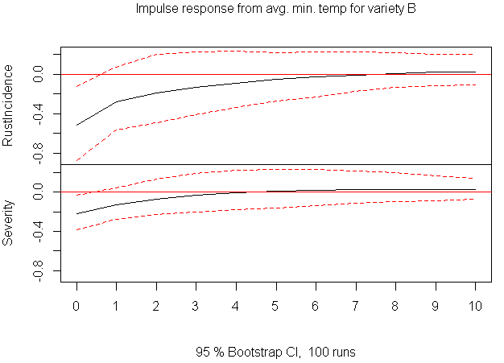
Department of Management Studies 21st June 2018 Indian Institute of Science

Slide 13
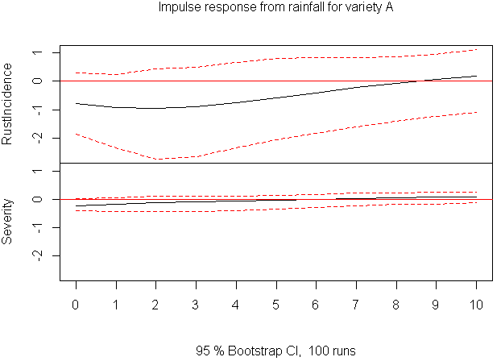
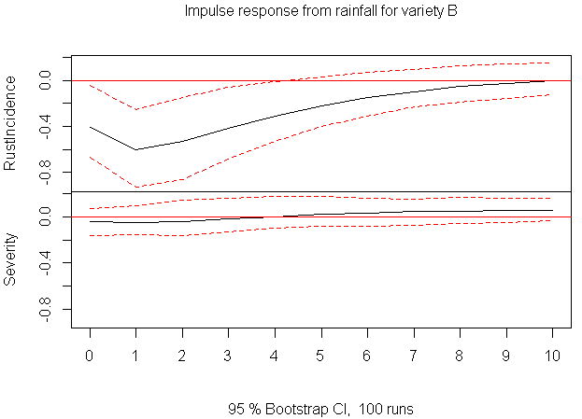
Department of Management Studies 21st June 2018 Indian Institute of Science

Slide 14
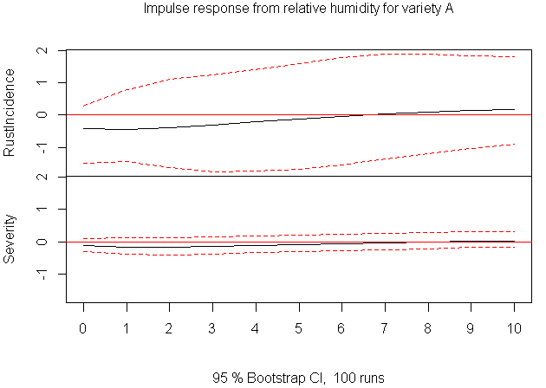
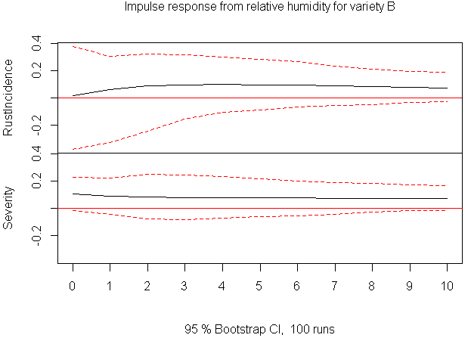
Department of Management Studies 21st June 2018 Indian Institute of Science

Slide 15
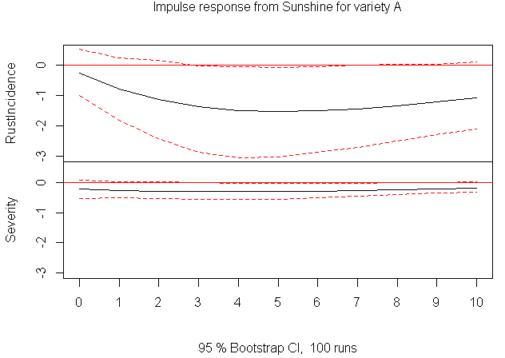
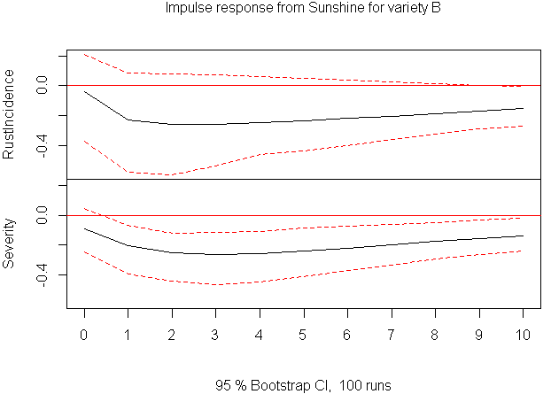
Department of Management Studies 21st June 2018 Indian Institute of Science

Slide 16

LSTM hyper parameters tuning:
Hyper parameters | S795 rust | S795 severity | Sln5B rust | Sln5B severity | CXR rust | CXR severity
Layers | 1 | 1 | 1 | 1 | 1 | 1
Neurons | 3 | 3 | 5 | 10 | 5 | 8
Initializer | Glorot normal | Glorot Normal | Glorot Normal | Glorot Normal | Glorot Normal | Glorot Normal
activation | elu | elu | elu | elu | elu | elu
Optimizer | Nadam | Nadam | Nadam | Nadam | Nadam | Nadam
Regularizer | L2 | L2 | L2 | L2 | L2 | L2
Dropout | 0.005 | None | None | 0.03 |  | 0.005
Recurrent dropout | None | 0.40 | 0.01 |  | 0.5 | 0.5
Batch size | 1 | 1 | 1 | 1 | 1 | 1
Epochs | 100 | 60 | 100 | 100 | 100 | 100
Department of Management Studies 21st June 2018 Indian Institute of Science

Slide 17
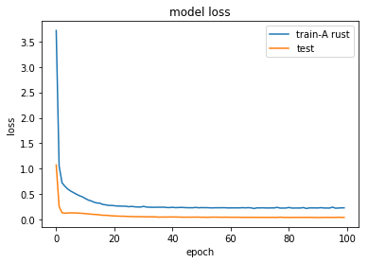
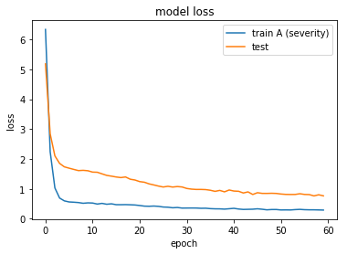
Department of Management Studies 21st June 2018 Indian Institute of Science

Slide 18
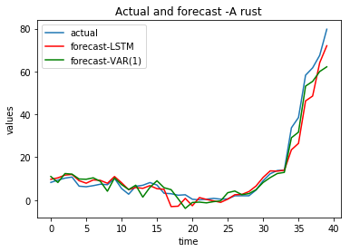
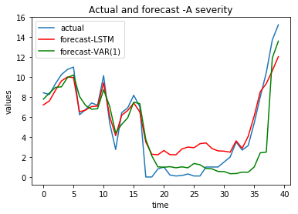
Rolling forecasts
 | RMSE | MRSE
LSTM | 4.41 | 0.22
VAR | 4.16 | 0.21
 | RMSE | MRSE
LSTM | 1.64 | 0.38
VAR | 2.17 | 0.52
Department of Management Studies 21st June 2018 Indian Institute of Science

Slide 19
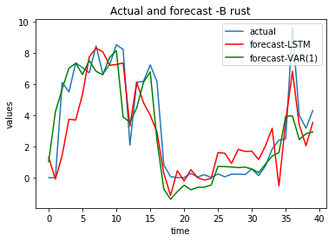
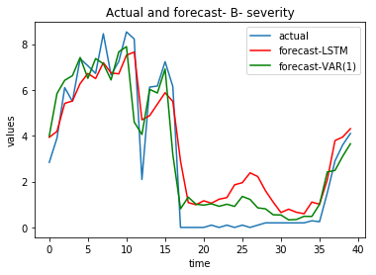
 | RMSE | MRSE
LSTM | 1.65 | 0.511
VAR | 1.67 | 0.516
 | RMSE | MRSE
LSTM | 1.18 | 0.37
VAR | 1.11 | 0.35
Department of Management Studies 21st June 2018 Indian Institute of Science

Slide 20
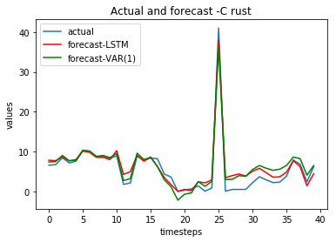
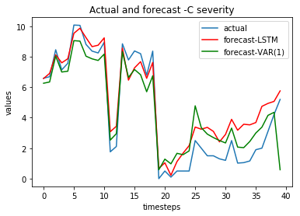
 | RMSE | MRSE
LSTM | 1.73 | 0.26
VAR | 1.93 | 0.29
 | RMSE | MRSE
LSTM | 1.22 | 0.36
VAR | 1.26 | 0.37
Department of Management Studies 21st June 2018 Indian Institute of Science

Slide 21
Conclusions:
In this work I used VAR and LSTM for predicting coffee leaf rust incidence.
Inferences using impulse response analysis was done which basically showed how a unit shock in a variable induces other variable to change in the coming period.
VAR along with forecasts provides tools for interpretation. LSTM is good for forecasting but the model is so complex that interpretation is not possible.
LSTM is performing better than VAR for forecasting the disease variables. LSTM can be used as forecasting model and could well outperform VAR with arrival of more data.
For further improvements in forecast hybrid models can be used as done in R2N2: Residual Recurrent Neural Networks for Multivariate Time Series Forecasting – Hardik Goel et. al.
Department of Management Studies 21st June 2018 Indian Institute of Science

Slide 22
References:
Supervised sequence labelling with recurrent neural networks – Alex Graves
LSTM: A Search Space Odyssey – Klaus Greff et. al.
Recurrent Neural Network Regularization – Wojciech Zaremba et. al.
A Critical Review of Recurrent Neural Networks for Sequence Learning - Zachary C. Lipton, John Berkowitz, Charles Elkan
R2N2: Residual Recurrent Neural Networks for Multivariate Time Series Forecasting – Hardik Goel et. al.
Lütkepohl, H. (2007) New Introduction to Multiple Time Series Analysis , Springer.
http://colah.github.io/posts/2015-08-Understanding-LSTMs/
https://keras.io/
https://keras.io/getting-started/sequential-model-guide/
Department of Management Studies 21st June 2018 Indian Institute of Science

Slide 23
Thank You!
Department of Management Studies 5th April 2018 Indian Institute of Science

