Slide 1
PREDICTION OF INCIDENCE AND
SEVERITY OF COFFEE LEAF RUST
Under the guidance of
Prof. Chiranjit Mukhopadhyay
By:
Amitabh Gunjan
Organisation:
eka Analytics
Department of Management Studies 20th Feb 2018 Indian Institute of Science

Slide 2
AGENDA
INTRODUCTION
PROBLEM STATEMENT
LITERATURE SURVEY
DATA DESCRIPTION
VAR MODELING
ROAD AHEAD
Department of Management Studies 20th Feb 2018 Indian Institute of Science

Slide 3
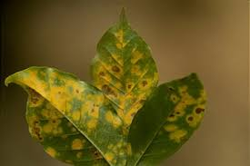
INTRODUCTION
Leaf rust:
caused by a fungus called Hemileia Vastatrix.
Leads to premature fall of infected leaves.
Symptoms include appearance of spots on the upper leaf surface of plants.
Impacts:
Decreased quality and quantity of yield produced.
Increased cost to control and combat the disease.
Key definitions:
Rust incidence: (Number of infected leaves/Total number of leaves observed)*100
Severity: (Sum of severity ratings of all observed leaves/(5* Total number of leaves observed))*100
Scale for grading of severity ranges from 0 to 5.
Department of Management Studies 20th Feb 2018 Indian Institute of Science

Slide 4
PROBLEM STATEMENT
Client of EKA analytics has coffee plantations which face the severe problem of leaf rust that leads to huge losses of yield.
The client had initiated an experimental trial on one of the plantations and recorded leaf rust incidence and severity on fortnightly basis over the span of 8 years.
They want forewarning model on the outbreak of disease.
The aim of this project is to predict coffee leaf rust incidence and severity.
Department of Management Studies 20th Feb 2018 Indian Institute of Science

Slide 5
LITERATURE SURVEY
Journal, Issue / Publication No | Title & Author | Description | Dataset | Techniques used/ referred
International Journal of Agricultural and Environmental Information Systems , Volume 7, Issue 3, July-September 2016 | Two-Level Classifier Ensembles for Coffee Rust Estimation in Colombian Crops Author - David Camilo Corrales et. al | Proposed classifier ensembles for coffee rust estimation in Colombian crops. | The dataset is composed of 13 attributes that are divided in 3 categories: 1) Weather conditions (6 attributes), 2) Physic crop properties (3 attributes) 3) Crop management (4 attributes) | Neural Networks, Regression Tree and Support Vector Regression
Sixth European Workshop on Probabilistic Graphical Models, Granada, Spain, 2012 | Prediction of Coﬀee Rust Disease Using Bayesian Networks Author - P´erez-Ariza et. al | Presented an agricultural case study for learning Bayesian networks (BNs) for prediction of coﬀee rust. | Dataset comprises: 1) monthly information of the incidence of the coﬀee rust 2) a daily summary of all the weather observations taken that day. | Bayesian networks
International Journal on Ecological Modelling and Systems Ecology, Vol 197, Issue 3, 2006, Pages- 431-447 | The intensity of a coffee rust epidemic is dependent on the production situation Author – J. Avelino et. al | They focus on coffee tree characteristics, crop management patterns, and the environment and show that a link can be found between certain production situations and intensity of coffee leaf rust. | Did a survey on 73 plots. Plots had 170 coffee trees on average. Five coffee trees were marked and on each of the trees 3 branches were identified and a large number of variables were recorded. | Correspondence analysis
Department of Management Studies 20th Feb 2018 Indian Institute of Science

Slide 6
LITERATURE SURVEY
Journal, Issue / Publication | Title & Author | Description | Dataset | Techniques used
Expert Systems with Applications Volume 38, Issue 11, October 2011, Pages 14276-14283 | Using nondeterministic learners to alert on coffee rust disease Author - Oscar Luaces et. al | In the application studied, the aim was to alert on high incidences of coffee rust, by learning functions able to predict whether the value of a continuous target variable will be greater than a given threshold. | Dataset comprises of 1) monthly accounts of incidence of disease on an experimental farm in Brazil, 2) weather conditions 3) fruit load of the plantation 4) spacing between plants | Support vector regression, Logistic regression, support vector machines multi class classification.
journal Ingeniería y Universidad, Pontificia Vol 19, No 1 (2015), pp- 207-228 | Towards Detecting Crop Diseases and Pest by Supervised Learning Author - David Camilo Corrales et. al | Presented an overview of supervised learning algorithms commonly used in agriculture for the detection of pests. |  | Decision trees, Bayesian Networks, artificial neural networks, support vector machines, K-nearest neighbour
Department of Management Studies 20th Feb 2018 Indian Institute of Science

Slide 7
DATA DESCRIPTION
Contains eight time series (fortnightly) variables in two categories:
Weather conditions (5)
Leaf rust (3)
Category | Description
Weather conditions | Average maximum temperature(◦c) Average minimum temperature(◦c) Relative humidity Sunshine(hours) Rainfall(mm)
Leaf rust | Population infected: (Number of plants infected/Total number of plants observed)*100 Rust incidence: (Number of infected leaves/Total number of leaves observed)*100 Severity: (Sum of severity ratings of all observed leaves/5* Total number of leaves observed)*100 Scale for grading of severity ranges from 0 to 5.
Department of Management Studies 20th Feb 2018 Indian Institute of Science

Slide 8
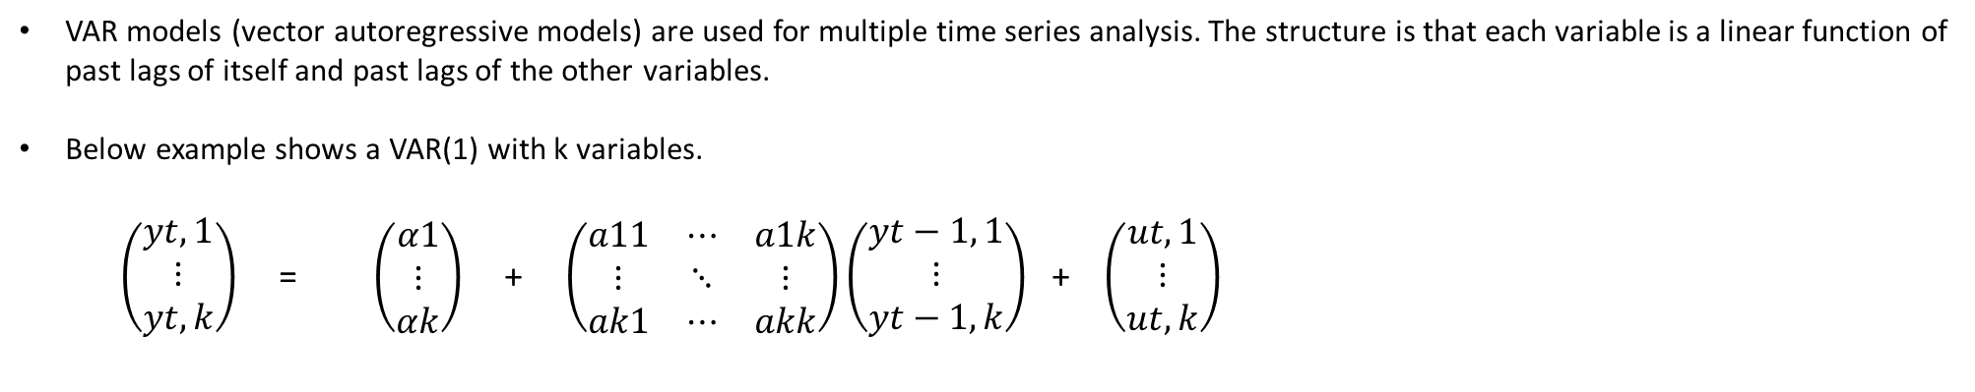
VAR MODELING
VAR models (vector autoregressive models) are used for multiple time series analysis. The structure is that each variable is a linear function of past lags of itself and past lags of the other variables.
Below example shows a VAR(1) with k variables.
$\left(\begin{aligned}yt,1 \\ ⋮ \\ yt,k\end{aligned}\right)$ = $\left(\begin{aligned}α1 \\ ⋮ \\ αk\end{aligned}\right)$ + $\left(\begin{matrix}a11 & ⋯ & a1k \\ ⋮ & ⋱ & ⋮ \\ ak1 & ⋯ & akk\end{matrix}\right)\left(\begin{aligned}yt−1, 1 \\ ⋮ \\ yt−1, k\end{aligned}\right)$ + $\left(\begin{aligned}ut,1 \\ ⋮ \\ ut, k\end{aligned}\right)$
In this case k = 8.
Order selection: Used the Schwartz criteria for VAR order selection which gave the order of the lag to be 1.
Department of Management Studies 20th Feb 2018 Indian Institute of Science

Slide 9
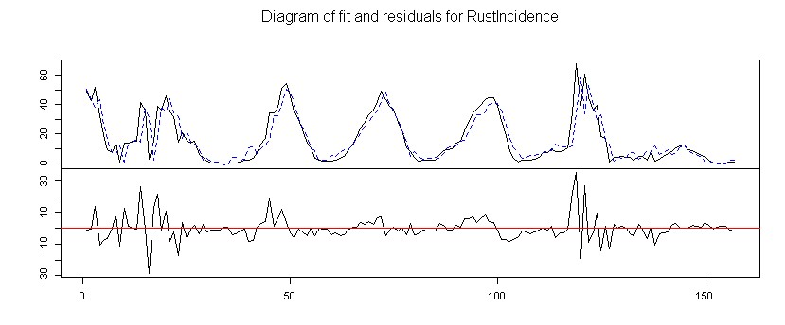
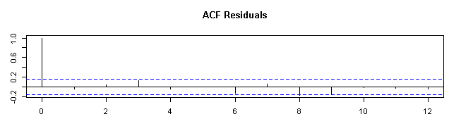
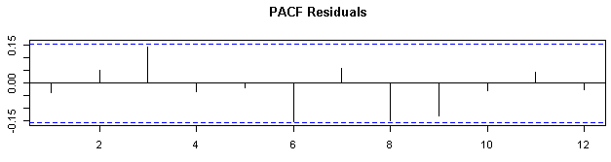
Department of Management Studies 20th Feb 2018 Indian Institute of Science

Slide 10
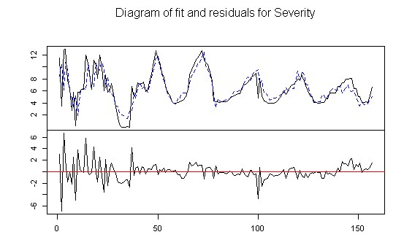
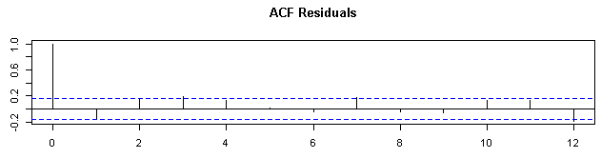
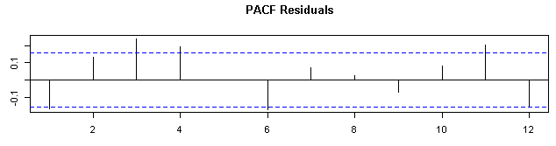
Department of Management Studies 20th Feb 2018 Indian Institute of Science

Slide 11
normality(VarS795)
$JB
JB-Test (multivariate)
data: Residuals of VAR object x
Chi-squared = 1400.9, df = 16, p-value < 2.2e-16
$Skewness
Skewness only (multivariate)
data: Residuals of VAR object x
Chi-squared = 90.256, df = 8, p-value = 4.441e-16
$Kurtosis
Kurtosis only (multivariate)
data: Residuals of VAR object x
Chi-squared = 1310.6, df = 8, p-value < 2.2e-16
Portmanteau Test (asymptotic)
data: Residuals of VAR object x
Chi-squared = 1240, df = 960, p-value = 2.167e-09
Department of Management Studies 20th Feb 2018 Indian Institute of Science

Slide 12
Variable | Actual | Forecasts | Lower bound | Upper bound
Rust incidence | 2.02 | 2.83 | 0 | 17
Severity | 4.96 | 6.41 | 4.05 | 8.78
Forecasts:
ROAD AHEAD
The next steps:
Fine tune the VAR model.
Replicate that has been done for all the four varieties.
Prediction using machine learning techniques
Comparison of the two approaches and show how can VAR answer the questions that machine learning models could not answer.
Department of Management Studies 20th Feb 2018 Indian Institute of Science

Slide 13
THANK YOU
Department of Management Studies 20th Feb 2018 Indian Institute of Science

