Slide 1



IIT Roorkee
MACHINE LEARNING HACKATHON
The AI Pirates
Team 3

Slide 2
Topics covered
Problem Statement
Understanding the Data : 1
Understanding the Data : 2
Sample Business Questions
Hypothesis
Data Insights : 1
Data Insights : 2
Data Insights : 3
Model Selection and Accuracy Scores
Recommendations

Slide 3
PROBLEM STATEMENT
Objective : Increase Business Coupon usage
Requirement : Robust model to determine Coupon acceptance
Data Availability :
train.csv
test.csv
Data challenge :
Mix of data types
Missing values for various categories
Non numerical data columns

Slide 4
UNDERSTANDING THE DATA - 1
RangeIndex: 10147 entries, 0 to 10146
Data columns (total 27 columns):
# Column Non-Null Count Dtype
--- ------ -------------- -----
0 customer_id 10147 non-null int64
1 destination 10147 non-null object
2 passanger 10147 non-null object
3 weather 10147 non-null object
4 temperature 10147 non-null int64
5 time 10147 non-null object
6 coupon 10147 non-null object
7 expiration 10147 non-null object
8 gender 10147 non-null object
9 age 10147 non-null object
10 maritalStatus 10147 non-null object
11 has_children 10147 non-null int64
12 education 10147 non-null object
13 occupation 10147 non-null object
14 income 10147 non-null object
15 car 84 non-null object
16 Bar 10059 non-null object
17 CoffeeHouse 9975 non-null object
18 CarryAway 10025 non-null object
19 RestaurantLessThan20 10050 non-null object
20 Restaurant20To50 9999 non-null object
21 toCoupon_GEQ5min 10147 non-null int64
22 toCoupon_GEQ15min 10147 non-null int64
23 toCoupon_GEQ25min 10147 non-null int64
24 direction_same 10147 non-null int64
25 direction_opp 10147 non-null int64
26 Y 10147 non-null int64
dtypes: int64(9), object(18)
Categorical Data Insight
Historical Data of Customer (+ several details) and Coupons acceptance / rejection
Customer data : Demographic (age, gender, education, occupation etc.) & behavioral data(# visits/month/time etc.)
Coupons Type : Bar, Coffee, etc
There are two CSV files which contains unique customers
train.csv : 10,147 records.
test.csv : 2,537 records
Null Values
car 10063
Bar 88
CoffeeHouse 172
CarryAway 122
RestaurantLessThan20 97
Restaurant20To50 148
All categorical data
All discrete values for all categorical variables
Choice of Model on data inspection : Category based Regression model

Slide 5

UNDERSTANDING THE DATA - 2 :
Missing Value treatment, Feature dropping decisions
Correlation analysis of Features with Target variable
Missing Data Treatment : Using Mode of Column
Some customers’ behavior data was found to be missing in columns for example “Bar”, “CoffeeHouse”
How many time a customer goes to “Bar” or “Coffeehouse” or “CarryAway” and how much do they spent is very important data to decide whether coupon is accepted by these customers or not.
Hence rather dropping these customers, we have decided to take most frequent value.
Y 1.000000
coupon 0.096304
weather 0.093026
temperature 0.053147
passanger 0.051481
education 0.045973
gender 0.041871
maritalStatus 0.016873
direction_same 0.014182
occupation 0.001004
destination -0.001158
customer_id -0.004595
RestaurantLessThan20 -0.008489
direction_opp -0.014182
income -0.033099
age -0.033502
has_children -0.040851
CarryAway -0.044647
Restaurant20To50 -0.048680
time -0.052033
Bar -0.078595
toCoupon_GEQ15min -0.081642
toCoupon_GEQ25min -0.098778
expiration -0.133069
CoffeeHouse -0.143582
Total features | 27 | 1 column is numeric data type 26 columns are categorical data type
Dropped column(s) | Car | ~ 99% customer’s car data is missing; hence we have decided to drop this column.
 | ToCoupon_GEQ5min* | As per the data it seems customers always has to travel more than 5 min drive, hence 5 min drive to avail any coupon doesn’t impact on coupon accept/reject decision.
 | Direction Same | Negligible contribution to data as it has same correlation to direction same and vice versa
 | Temperature | Strong correlation with Weather column
 | Destination | Strong correlation with time column
 | Direction Oppo | Negligible contribution
 | RestaurantLessThan20 | Has a very weak correlation to the target variable

Slide 6
SAMPLE BUSINESS QUESTIONS
There are various questions business wants to know to increase acceptance of coupon and what are key driving factors do they consider while providing coupons? Some of sample questions could be as below
Who will have high chance to accept “Bar” Coupon - Single with his/her friends or alone in age group 21-31?
Who will have a high chance to reject the “Bar” coupon - Divorced male or Divorced female?
Does female student accept “Restaurant” coupon(less than $20) more than male student in Sunny weather? Does weather play a role in-case weather turns to Snowy - does it still holds true?
Does married partner accept “Carry out & Take Away” coupons more as compare to Unmarried Partner in income $50000 - $62499 range?
Who will have a high chance to accept the “Restaurant(20-50) coupon - married partner having kids or unmarried partner having kids in income group $87500 - $99999?
Are single men/women more likely to use coupon than married men/women?
Answering such hypothesis using the Data Insights.

Slide 7
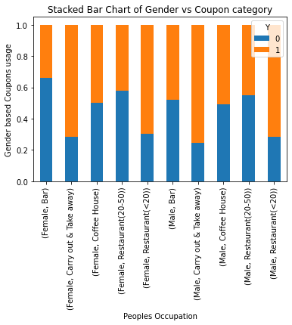
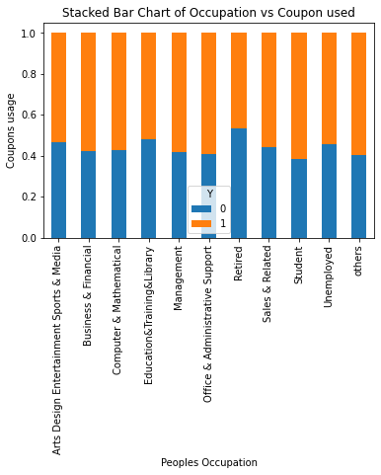
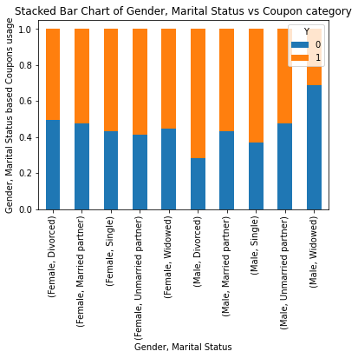
HYPOTHESIS
Q. What coupons are favourite for both genders? Ans : Coupon category “Carry Out & Take Away” are most opted for | Q. Does Occupation play any role in coupon usage? Ans : We see that the data is pretty flat when seen along with occupation | Q. Does coupon acceptance rate vary based on Gender and Marital Status? Ans : We see that Male, Divorced tends to accept coupons more (around 70%)

Slide 8
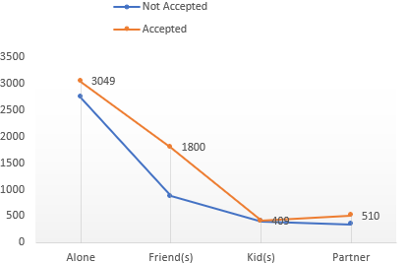
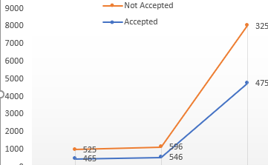
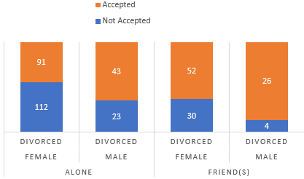
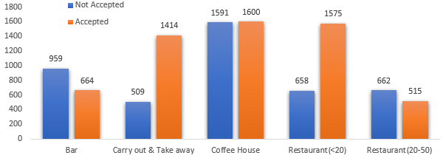
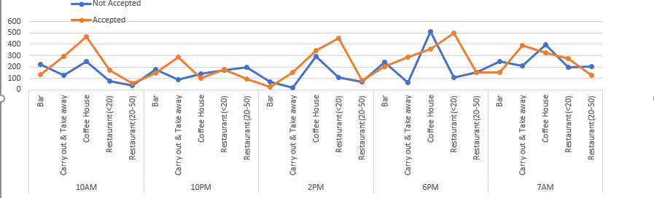
DATA INSIGHTS : 1
Customer having friends are more likely to accept the coupon
More customers tend to accept coupon on a Sunny day
Divorced Males having friends are likely to use coupon more as compared to Divorced Female having friends
Carryout & Takeaway & Restaurants(<20) Coupon Types are more likely to accepted by customers.
Coffeehouse coupons have higher chance to get accepted in morning 10 AM
Carryout & TakeAway coupons have higher chance to get accepted in night & early morning.
Restaurant(<20) coupons have higher chance to get accepted during lunch & dinner time.

Slide 9
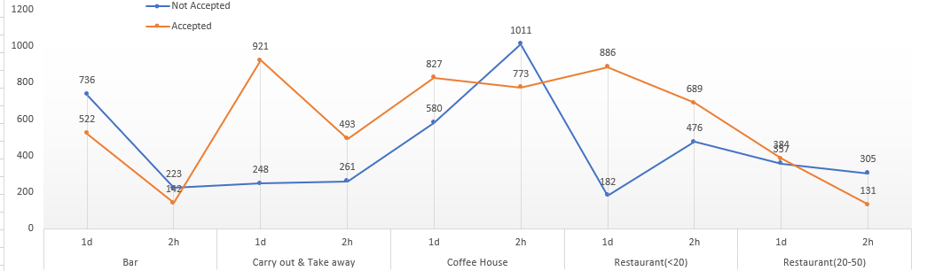
DATA INSIGHTS : 2
Does coupons expiration play any role?
Customer prefer to accept Carryout & TakeAway coupons when they are given with 1 day expiration.
Customers don’t prefer Coffeehouse & Restaurant(20-50) coupons if expiration is 2 hours as compared to 1 day expiration.
More Customer accept Restaurant(<20) coupons when they are given with 1 day expiration as compared to 2 hours

Slide 10
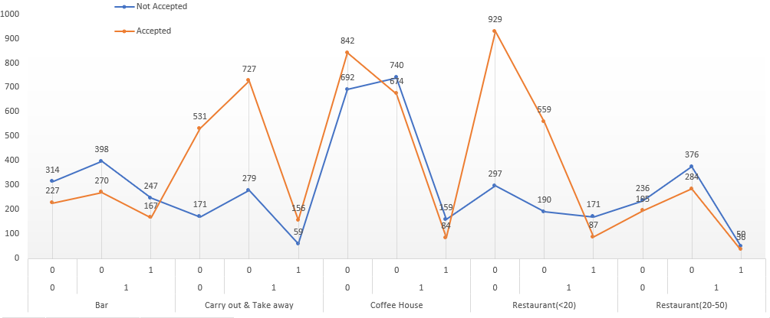
DATA INSIGHTS : 3
Does distance of travel play any role?
Customer prefer to accept Carryout & TakeAway & Restaurant(<20) coupons if travel distance is between 15 and 25 min as compare to other coupons.
However less customer prefer to accept Bar and Restaurant(20-5) coupon if travel distance is between 15 and 25 min.

Slide 11
Model Selection and Accuracy Scores
Algorithm | Score
0 | Decision Trees with GridSearchCV | 0.750683
1 | Random Forest with GridSearchCV | 0.792849
2 | Random Forest with Random Classifier | 0.752735
3 | Gradient Boosting with GridSearchCV | 0.757392
The problem was approached with 4 different models
On accuracy score comparison, RANDOM FOREST with GRID SEARCH gave the best result.
On sample submission, the accuracy score was found to be 0.7525

Slide 12
RECOMMENDATIONS
Correlation data between Features and Target variable suggests Weakly Correlated Data set.
Weather plays important role in Coupon usage. Data suggests “SUNNY” day has more Coupon acceptances.
“Carry Out and Take Away” coupons increases on “RAINY DAY”.
“Carry Out and Take Away” is most favourite coupon irrespective of Customer gender.
Data pertaining to Restaurant drive distance of less than 20 minutes does not seem to affect Coupon usage.
If weather is “RAINY” and if a Customer has never visited, chances are he/she are not going to accept the coupon.
Businesses can try more attractive Coupon strategies (like Happy Hours, X% off, Cashbacks, Free Delivery, etc) and collect data.
Data suggests that when Customer is accompanied with a Friend, Partner, the coupons acceptance goes up.
Above data suggests trying more Group based / Couple centric coupons and offers may lead to better coupon acceptance / footfall.

Slide 13
Thank you!

