Slide 1
React

Slide 2
Pre-requisite for ReactJS
NodeJS and NPM
React and React DOM
Webpack
Babel
HTML and CSS
JavaScript and ES6
JSX (Javascript XML) & Babel
Git and CLI (Command Line Interface).

Slide 3
Introduction
ReactJS, also known as React, is a popular JavaScript library for building user interfaces. It is also referred to as a front-end JavaScript library. It was developed by Facebook and is widely used for creating dynamic and interactive web applications. In this article, we’ll explore the key concepts of React.

Slide 4
What is React ?
React is a JavaScript library for building user interfaces (UIs) on the web. React is a declarative, component based library that allows developers to build reusable UI components and It follows the Virtual DOM (Document Object Model) approach, which optimizes rendering performance by minimizing DOM updates. React is fast and works well with other tools and libraries.

Slide 5
Fundamentals
React JSX:
React JSX is a syntax extension of JavaScript for writing React Code in a simple way. Using JSX it is easier to create reusable UI components with fewer lines of code in a template-type language with the power of JavaScript.

Slide 6
Features
1. Component-Based Architecture
React provides the feature to break down the UI into smaller, self-contained components. Each component can have its own state and props.
2. JSX (JavaScript Syntax Extension)
JSX is a syntax extension for JavaScript that allows developers to write HTML-like code within their JavaScript files. It makes React components more readable and expressive.
3. Virtual DOM
React maintains a lightweight representation of the actual DOM in memory. When changes occur, React efficiently updates only the necessary parts of the DOM.

Slide 7
Features
4. One-way Data Binding
One-way data binding, the name itself says that it is a one-direction flow. The data in react flows only in one direction i.e. the data is transferred from top to bottom i.e. from parent components to child components. The properties(props) in the child component cannot return the data to its parent component but it can have communication with the parent components to modify the states according to the provided inputs.
5. Performance
As we discussed earlier, react uses virtual DOM and updates only the modified parts. So , this makes the DOM to run faster. DOM executes in memory so we can create separate components which makes the DOM run faster.

Slide 8
Features
6. Components
React divides the web page into multiple components as it is component-based. Each component is a part of the UI design which has its own logic and design as shown in the below image. So the component logic which is written in JavaScript makes it easy and run faster and can be reusable.
7. Single-Page Applications (SPAs)
React is recommended in creating SPAs, allowing smooth content updates without page reloads. Its focus on reusable components makes it ideal for real-time applications.

Slide 9
ReactJS Lifecycle
Every React Component has a lifecycle of its own, lifecycle of a component can be defined as the series of methods that are invoked in different stages of the component’s existence. React automatically calls these methods at different points in a component’s life cycle. Understanding these phases helps manage state, perform side effects, and optimize components effectively.
1. Initialization
This is the stage where the component is constructed with the given Props and default state. This is done in the constructor of a Component Class.

Slide 10
ReactJS Lifecycle
2. Mounting Phase
Constructor: The constructor method initializes the component. It’s where you set up initial state and bind event handlers.
render(): This method returns the JSX representation of the component. It’s called during initial rendering and subsequent updates.
componentDidMount(): After the component is inserted into the DOM, this method is invoked. Use it for side effects like data fetching or setting timers.

Slide 11
ReactJS Lifecycle
3. Updating Phase
componentDidUpdate(prevProps, prevState): Called after the component updates due to new props or state changes. Handle side effects here.
shouldComponentUpdate(nextProps, nextState): Determines if the component should re-render. Optimize performance by customizing this method.
render(): Again, the render() method reflects changes in state or props during updates.
4. Unmounting Phase
componentWillUnmount(): Invoked just before the component is removed from the DOM. Clean up resources (e.g., event listeners, timers).

Slide 12
What is JSX ?
JSX stands for JavaScript XML. JSX is basically a syntax extension of JavaScript.
React JSX helps us to write HTML in JavaScript and forms the basis of React Development. Using JSX is not compulsory but it is highly recommended for programming in React as it makes the development process easier as the code becomes easy to write and read.
JSX creates an element in React that gets rendered in the UI. It is transformed into JavaScript functions by the compiler at runtime. Error handling and warnings become easier to handle when using JSX

Slide 13
Why JSX ?
It is faster than normal JavaScript as it performs optimizations while translating to regular JavaScript.
It makes it easier for us to create templates.
Instead of separating the markup and logic in separate files, React uses components for this purpose. We will learn about components in detail in further articles.
As JSX is an expression, we can use it inside of if statements and for loops, assign it to variables, accept it as arguments, or return it from functions.

Slide 14
Example:
const example = "JSX"
const ele = <div>This component uses {example} </div>

Slide 15
ReactJS Babel Introduction
What is babel?
Babel is a very famous transpiler that basically allows us to use future JavaScript in today’s browsers. In simple words, it can convert the latest version of JavaScript code into the one that the browser understands. Transpiler is a tool that is used to convert source code into another source code that is of the same level. The latest standard version that JavaScript follows is ES2020 which is not fully supported by all browsers hence we make use of a tool such as ‘babel’ so that we can convert it into the code that today’s browser understands.

Slide 16
Using Babel with React
We use Babel with React to transpile the JSX code into simple React functions that can be understood by browsers. Using this way we can assure that our JSX code can work in almost any browser. This combination is widely used in modern-day web development.

Slide 17
ReactJS Virtual DOM
React JS Virtual DOM is an in-memory representation of the DOM. DOM refers to the Document Object Model that represents the content of XML or HTML documents as a tree structure so that the programs can be read, accessed and changed in the document structure, style, and content.

Slide 18
What is DOM ?
DOM stands for ‘Document Object Model’. In simple terms, it is a structured representation of the HTML elements that are present in a webpage or web app. DOM represents the entire UI of your application. The DOM is represented as a tree data structure. It contains a node for each UI element present in the web document. It is very useful as it allows web developers to modify content through JavaScript, also it being in structured format helps a lot as we can choose specific targets and all the code becomes much easier to work with.

Slide 19
Disadvantages of real DOM :
Every time the DOM gets updated, the updated element and its children have to be rendered again to update the UI of our page. For this, each time there is a component update, the DOM needs to be updated and the UI components have to be re-rendered.

Slide 20
When writing the above code in the console or in the JavaScript file, these things happen:
The browser parses the HTML to find the node with this id.
It removes the child element of this specific element.
Updates the element(DOM) with the ‘updated value’.
Recalculates the CSS for the parent and child nodes.
Update the layout.
Finally, traverse the tree and paint it on the screen(browser) display.
Recalculating the CSS and changing the layouts involves complex algorithms, and they do affect the performance. So React has a different approach to dealing with this, as it makes use of something known as Virtual DOM.

Slide 21
Virtual DOM
React uses Virtual DOM exists which is like a lightweight copy of the actual DOM(a virtual representation of the DOM). So for every object that exists in the original DOM, there is an object for that in React Virtual DOM. It is exactly the same, but it does not have the power to directly change the layout of the document.

Slide 22
Manipulating DOM is slow, but manipulating Virtual DOM is fast as nothing gets drawn on the screen. So each time there is a change in the state of our application, the virtual DOM gets updated first instead of the real DOM.
How does virtual DOM actually make things faster?
When anything new is added to the application, a virtual DOM is created and it is represented as a tree. Each element in the application is a node in this tree. So, whenever there is a change in the state of any element, a new Virtual DOM tree is created. This new Virtual DOM tree is then compared with the previous Virtual DOM tree and make a note of the changes. After this, it finds the best possible ways to make these changes to the real DOM. Now only the updated elements will get rendered on the page again.

Slide 23
How virtual DOM Helps React?
In React, everything is treated as a component be it a functional component or class component. A component can contain a state. Whenever the state of any component is changed react updates its Virtual DOM tree. Though it may sound like it is ineffective the cost is not much significant as updating the virtual DOM doesn’t take much time.
React maintains two Virtual DOM at each time, one contains the updated Virtual DOM and one which is just the pre-update version of this updated Virtual DOM. Now it compares the pre-update version with the updated Virtual DOM and figures out what exactly has changed in the DOM like which components have been changed. This process of comparing the current Virtual DOM tree with the previous one is known as ‘diffing’. Once React finds out what exactly has changed then it updates those objects only, on real DOM.

Slide 24
React uses something called batch updates to update the real DOM. It just means that the changes to the real DOM are sent in batches instead of sending any update for a single change in the state of a component.
We have seen that the re-rendering of the UI is the most expensive part and React manages to do this most efficiently by ensuring that the Real DOM receives batch updates to re-render the UI. This entire process of transforming changes to the real DOM is called Reconciliation.
This significantly improves the performance and is the main reason why React and its Virtual DOM are much loved by developers all around.

Slide 25
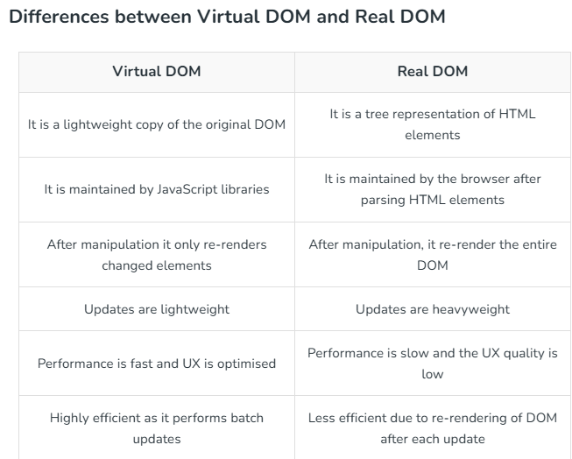

Slide 26
React JS ReactDOM
React JS ReactDOM or react-dom is the most widely used package of React. React provides the developers with a package react-dom to access and modify the DOM. Let’s see in brief what is the need to have the package.
What is ReactDOM ?
ReactDOM is a package in React that provides DOM-specific methods that can be used at the top level of a web app to enable an efficient way of managing DOM elements of the web page. ReactDOM provides the developers with an API containing the various methods to manipulate DOM.
How to use ReactDOM ?
To use the ReactDOM in any React web app we must first install the react-dom package in our project. To install the react-dom package use the following command.

Slide 27
Important functions provided by ReactDOM
render(): This is one of the most important methods of ReactDOM. This function is used to render a single React Component or several Components wrapped together in a Component or a div element.
findDOMNode(): This function is generally used to get the DOM node where a particular React component was rendered. This method is very less used like the following can be done by adding a ref attribute to each component itself.
unmountComponentAtNode(): This function is used to unmount or remove the React Component that was rendered to a particular container.
hydrate(): This method is equivalent to the render() method but is implemented while using server-side rendering.
createPortal(): It allow us to render a component into a DOM node that resides outside the current DOM hierarchy of the parent component.

Slide 28
React Lists
Lists are very useful when it comes to developing the UI of any website. React Lists are mainly used for displaying menus on a website, for example, the navbar menu. In regular JavaScript, we can use arrays for creating lists. In React, rendering lists efficiently is critical for maintaining performance and ensuring a smooth user experience. React provides powerful tools to handle lists, allowing developers to create dynamic and responsive applications.

Slide 29
Rendering Lists with the map() Function
We can create lists in React just like we do in regular JavaScript i.e. by storing the list in an array. To traverse a list we will use the map() function.
Step 1: Create a list of elements in React in the form of an array and store it in a variable. We will render this list as an unordered list element in the browser.
Step 2: We will then traverse the list using the JavaScript map() function and update elements to be enclosed between <li> </li> elements.
Step 3: Finally we will wrap this new list within <ul> </ul> elements and render it to the DOM.

Slide 30
React Forms
React Forms are the components used to collect and manage the user inputs. These components includes the input elements like text field, check box, date input, dropdowns etc.
In HTML forms the data is usually handled by the DOM itself but in the case of React Forms data is handled by the react components.
React forms are the way to collect the user data in a React application. React typically utilize controlled components to manage form state and handle user input changes efficiently. It provides additional functionality such as preventing the default behavior of the form which refreshes the browser after the form is submitted.

Slide 31
ReactJS Key
s
React JS keys are a way of providing a unique identity to each item while creating the React JS Lists so that React can identify the element to be processed.
What is a key in React ?
A “key” is a special string attribute you need to include when creating lists of elements in React. Keys are used in React to identify which items in the list are changed, updated, or deleted.
Keys are used to give an identity to the elements in the lists. It is recommended to use a string as a key that uniquely identifies the items in the list.

Slide 32
ReactJS Refs
ReactJS Refs are used to access and modify the DOM elements in the React Application. It creates a reference to the elements and uses it to modify them.
What is Refs in React?
Refs are a function provided by React to access the DOM element and the React elements created in components. They are used in cases where we want to change the value of a child component, without making use of props and state.
They allow us to interact with these elements outside the typical rendering workflow of React.

Slide 33
React Conditional Rendering
React allows us to conditionally render components which means that the developer can decide which component to render on the screen on on the basis of some predefined conditions. This is known as conditional rendering.

Slide 34
Implementing Conditional Rendering
There may arise a situation when we want to render something based on some condition. For example, consider the situation of handling a login/logout button. Both the buttons have different functions so they will be separate components. Now, the task is if a user is logged in then we will have to render the Logout component to display the logout button and if the user is not logged in then we will have to render the Login component to display the login button.

Slide 35
React components

Slide 36
Code Splitting in React
Code-Splitting is a feature supported by bundlers like Webpack, Rollup, and Browserify which can create multiple bundles that can be dynamically loaded at runtime.
As websites grow larger and go deeper into components, it becomes heavier. This is especially the case when libraries from third parties are included. Code Splitting is a method that helps to generate bundles that are able to run dynamically. It also helps to make the code efficient because the bundle contains all required imports and files.
Bundling and its efficiency: Bundling is the method of combining imported files with a single file. It is done with the help of Webpack, Rollup, and Browserify as they can create many bundles that can be loaded dynamically at runtime.
With the help of code splitting, ‘lazy load’ can be implemented, which means just using the code which is currently needed.

Slide 37
What are React Components?
Components in React serve as independent and reusable code blocks for UI elements. They represent different parts of a web page and contain both structure and behavior. They are similar to JavaScript functions and make creating and managing complex user interfaces easier by breaking them down into smaller, reusable pieces.
What are React Components?
React Components are the building block of React Application. They are the reusable code blocks containing logics and and UI elements. They have the same purpose as JavaScript functions and return HTML. Components make the task of building UI much easier.

Slide 38
A UI is broken down into multiple individual pieces called components. You can work on components independently and then merge them all into a parent component which will be your final UI.
Components promote efficiency and scalability in web development by allowing developers to compose, combine, and customize them as needed.

Slide 39
Types of Components in React
In React, we mainly have two types of components:
Functional Components
Class based Components

Slide 40
Functional Component in React
Functional components are just like JavaScript functions that accept properties and return a React element.
We can create a functional component in React by writing a JavaScript function. These functions may or may not receive data as parameters, we will discuss this later in the tutorial.

Slide 41
Class Component in React
The class components are a little more complex than the functional components. A class component can show inheritance and access data of other components.
Class Component must include the line “extends React.Component” to pass data from one class component to another class component. We can use JavaScript ES6 classes to create class-based components in React.

Slide 42
Functional Component vs Class Component
A functional component is best suited for cases where the component doesn’t need to interact with other components or manage complex states. Functional components are ideal for presenting static UI elements or composing multiple simple components together under a single parent component.
While class-based components can achieve the same result, they are generally less efficient compared to functional components. Therefore, it’s recommended to not use class components for general use.

Slide 43
React Lifecycle
React lifecycle starts from its initialization and ends when it is unmounted from the DOM. There are several methods defined for different phases of the lifecycle of React Components.
React Lifecycle
React Lifecycle is defined as the series of methods that are invoked in different stages of the component’s existence. The definition is pretty straightforward but what do we mean by different stages? A React Component can go through four stages of its life as follows.
Lifecycle of React Components:
Each React Component go though the given Phases.

Slide 44
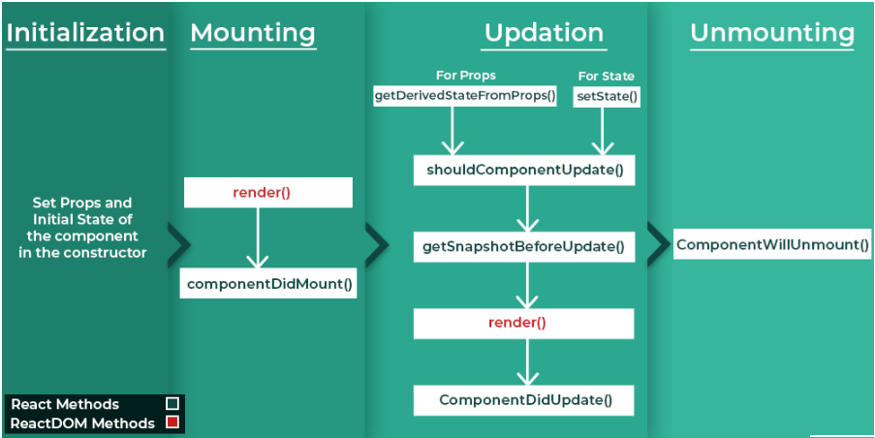
React Lifecycle

Slide 45
1. Initialization phase
This is the stage where the component is constructed with the given Props and default state. This is done in the constructor of a Component Class.
2. Mounting Phase
Mounting is the stage of rendering the JSX returned by the render method itself.
3. Updating
Updating is the stage when the state of a component is updated and the application is repainted.
4. Unmounting
As the name suggests Unmounting is the final step of the component lifecycle where the component is removed from the page.
React provides the developers with a set of predefined functions that if present are invoked around specific events in the lifetime of the component. Developers are supposed to override the functions with the desired logic to execute accordingly. We have illustrated the gist in the following diagram.

Slide 46
React props & states

Slide 47
What are props?
We know that everything in ReactJS is a component and to pass in data to these components, props are used. Whenever we call child components from parents we can pass data as props. This helps the parent component communicate with the child.
Although passing in props like this is great, it surely lacks flexibility in an application. For example, we cannot let the child communicate with the parent in this way. This, nonetheless, can be done by passing methods as props in ReactJS.

Slide 48
Passing methods as props
We will learn passing props as methods with the help of an example. To use a method as a prop all the steps are described below order wise:
Step 1: Create a new react application using the following command.
npx create-react-app
Step 2: We will create components in our file namely App.js. After using this ParentComponent.js and ChildComponent.
Step 3: Write the following code in respective files.
App.js: This file imports our ParentComponent and renders it on the page.
ParentComponent.js: This file sends methods as props to child component.
ChildComponent: This file calls the method passed prom parent as props.

Slide 49
React hooks
Hooks were added to React in version 16.8.
Hooks allow function components to have access to state and other React features. Because of this, class components are generally no longer needed.
Although Hooks generally replace class components, there are no plans to remove classes from React.
What is a Hook?
Hooks allow us to "hook" into React features such as state and lifecycle methods.

Slide 50
Hook Rules
There are 3 rules for hooks:
Hooks can only be called inside React function components.
Hooks can only be called at the top level of a component.
Hooks cannot be conditional

Slide 51
React useState Hook
The React useState Hook allows us to track state in a function component.
State generally refers to data or properties that need to be tracking in an application.

Slide 52
React useEffect Hooks
The useEffect Hook allows you to perform side effects in your components.
Some examples of side effects are: fetching data, directly updating the DOM, and timers.
useEffect accepts two arguments. The second argument is optional.
useEffect(<function>, <dependency>)

Slide 53
React useContext Hook
React Context is a way to manage state globally.
It can be used together with the useState Hook to share state between deeply nested components more easily than with useState alone.
The Problem
State should be held by the highest parent component in the stack that requires access to the state.
To illustrate, we have many nested components. The component at the top and bottom of the stack need access to the state.
To do this without Context, we will need to pass the state as "props" through each nested component. This is called "prop drilling".

Slide 54
React useRef Hook
The useRef Hook allows you to persist values between renders.
It can be used to store a mutable value that does not cause a re-render when updated.
It can be used to access a DOM element directly.
Does Not Cause Re-renders
If we tried to count how many times our application renders using the useState Hook, we would be caught in an infinite loop since this Hook itself causes a re-render.
To avoid this, we can use the useRef Hook.

Slide 55
React useReducer Hook
The useReducer Hook is similar to the useState Hook.
It allows for custom state logic.
If you find yourself keeping track of multiple pieces of state that rely on complex logic, useReducer may be useful.
The reducer function contains your custom state logic and the initialStatecan be a simple value but generally will contain an object.
The useReducer Hook returns the current stateand a dispatchmethod.

Slide 56
React useCallback Hook
The React useCallback Hook returns a memoized callback function.
Think of memoization as caching a value so that it does not need to be recalculated.
This allows us to isolate resource intensive functions so that they will not automatically run on every render.
The useCallback Hook only runs when one of its dependencies update.
This can improve performance.
Problem
One reason to use useCallback is to prevent a component from re-rendering unless its props have changed.

Slide 57
React useMemo Hook
The React useMemo Hook returns a memoized value.
Think of memoization as caching a value so that it does not need to be recalculated.
The useMemo Hook only runs when one of its dependencies update.
This can improve performance.
The useMemo and useCallback Hooks are similar. The main difference is that useMemo returns a memoized value and useCallback returns a memoized function.
Performance
The useMemo Hook can be used to keep expensive, resource intensive functions from needlessly running.

Slide 58
End

