Slide 1
E-retail factors for customer activation and retention: A case study from Indian e-commerce customers

Slide 2
Customer satisfaction has emerged as one of the most important factors that guarantee the success of online store; it has been posited as a key stimulant of purchase, repurchase intentions and customer loyalty. A comprehensive review of the literature, theories and models have been carried out to propose the models for customer activation and customer retention. Five major factors that contributed to the success of an e-commerce store have been identified as: service quality, system quality, information quality, trust and net benefit. The research furthermore investigated the factors that influence the online customers repeat purchase intention. The combination of both utilitarian value and hedonistic values are needed to affect the repeat purchase intention (loyalty) positively. The data is collected from the Indian online shoppers. Results indicate the e-retail success factors, which are very much critical for customer satisfaction.

Slide 3
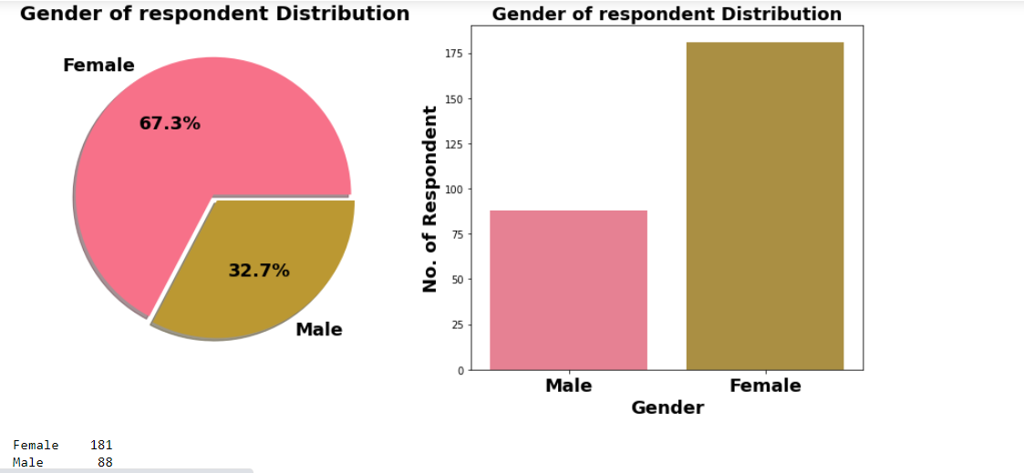
Female are doing more online shopping

Slide 4
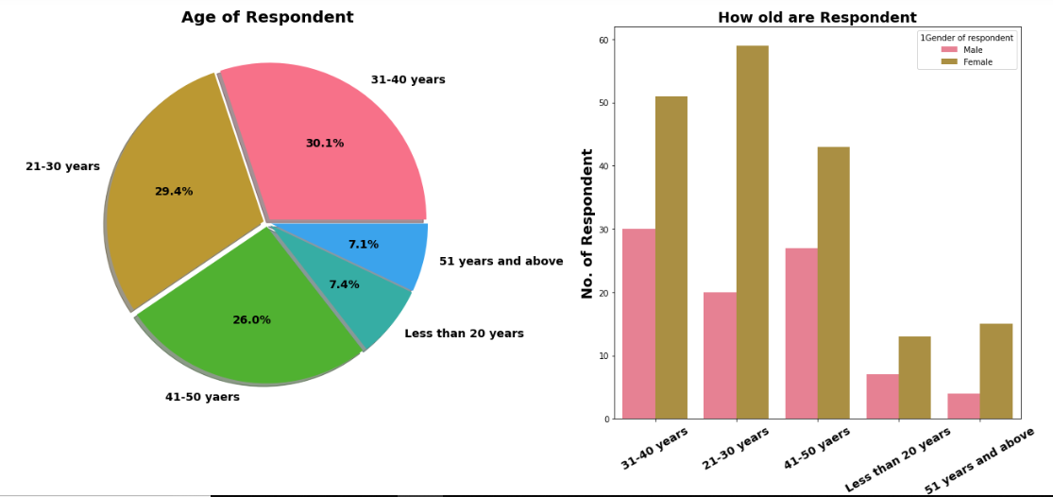
Majority of female customers are between age group of 21-40 years.
Within Male Customers Tendency of online shopping seen among age group of 31-50 years.

Slide 5
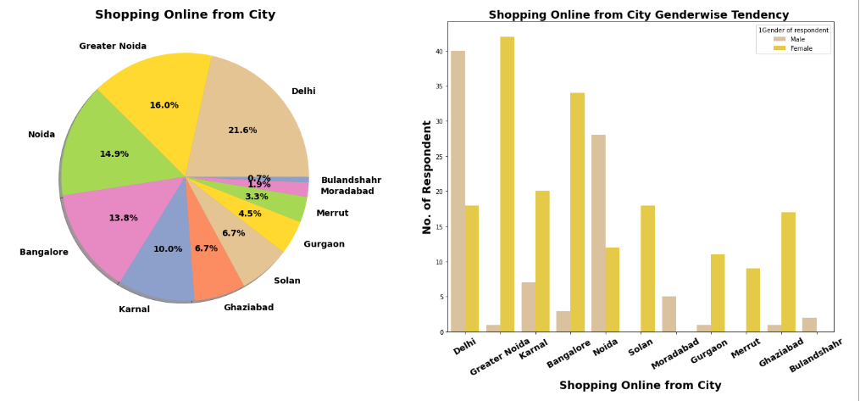
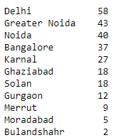
Most of the online shopping customers are from Delhi NCR & major cities. So, other cities can be focussed for sale increment.

Slide 6
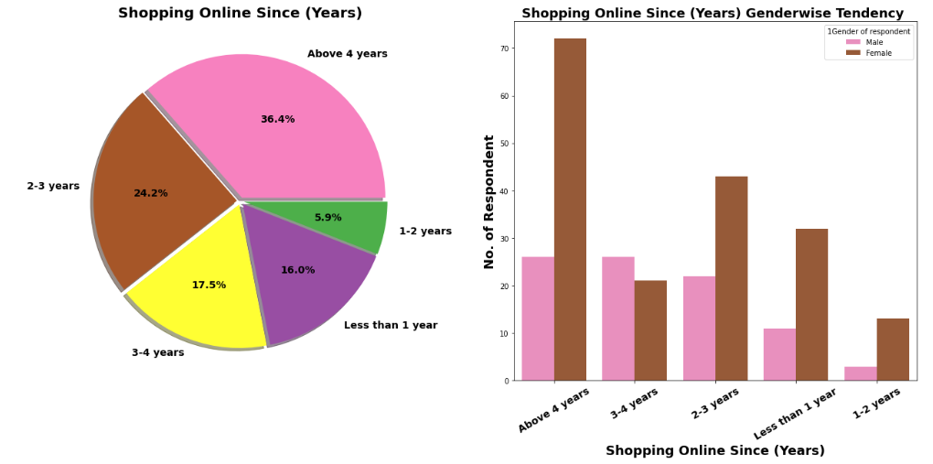
36.4% Shop online from 4 years. Most female shopping from 4 years. Let's check the age effect on it

Slide 7
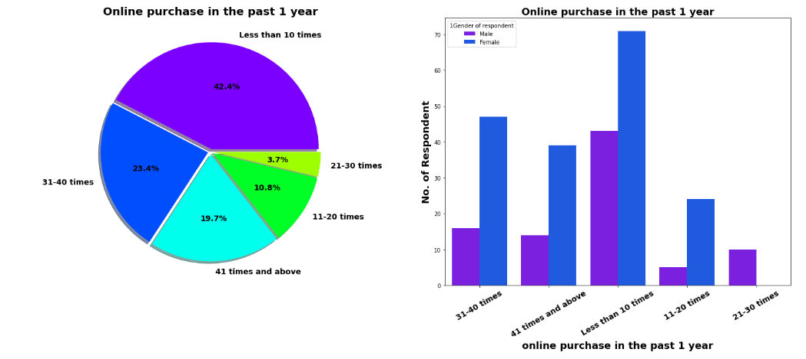
42.4% Customers in last 1 year made online purchase less than 10 times.
Around 19.7% customers have made online shopping for 41 times & more in last 1 year. Out which Majority are females.

Slide 8
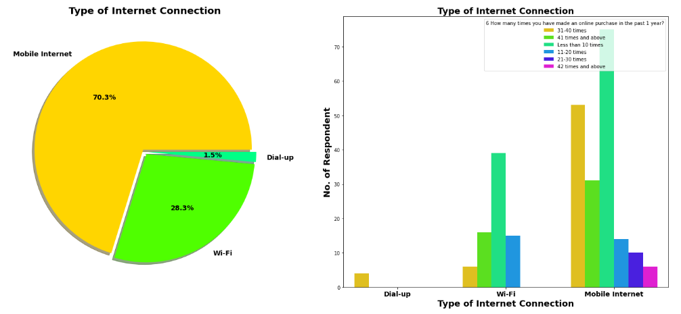
70.3% Customers are mobile internet user followed by WiFi User.
all customers who made online shopping for 41 times & more are using Mobile internet.

Slide 9
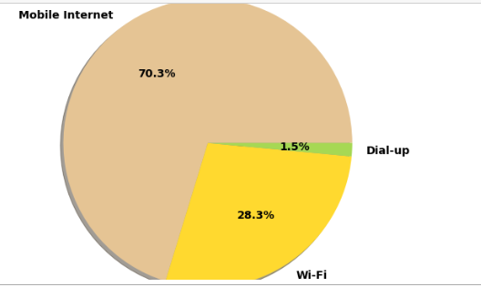
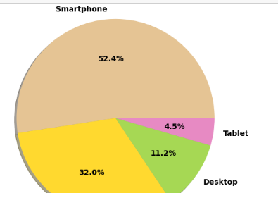
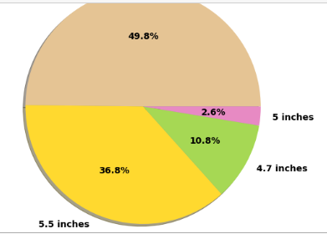
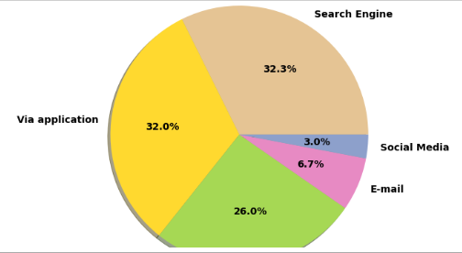
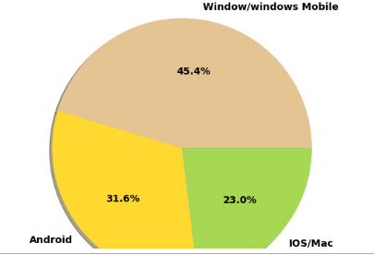
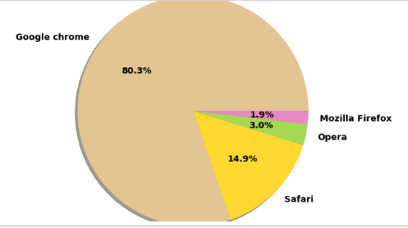
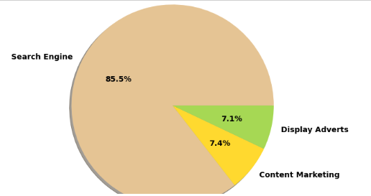
70.3% Customer uses mobile internet for shopping. 52.4% Uses Smartphone followed by Laptop for online shopping. Company can make device oriented marketing strategy for different customers as per use of device. Out of 52.4% Mobile users majority have 5.5 inch mobile display screen. 45.4% customer have Windows operating system on their smartphone & laptop. In terms of browser google chrome dominate market. 85.5 % of Customer arrived on shopping platform through search engine. Ads & Marketing campaign do not bring much lead. Most of customer who made online purchase because they want to buy product or due to discount on online shopping. After 1st Purchase 32% customer visit online store through mobile application and 32.3% by search engine.

Slide 10
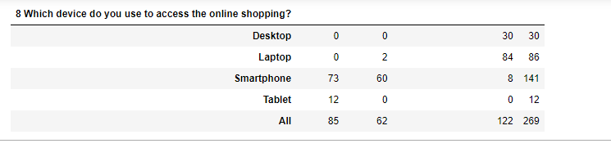
No Tablet with IOS operating system.
45.4% Customer uses Windows Os and here we can see that almost all them come from desktop & laptop user.
Surprising only 2 Customer with Apple laptop and no customer with Apple desktop.
73 customers using android and 60 customers using Apple Iphone.

Slide 11
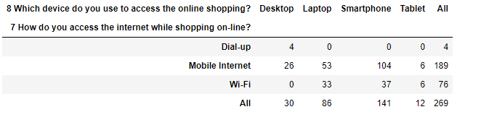
No desktop with WiFi. All 30 desktop users are using mobile internet or dialup connection.
Out of 141 Smartphone users 104 using mobile internet while rest using WiFi.

Slide 12
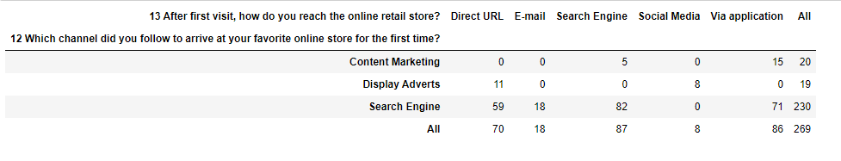
For 2nd & afterward visit 71 customer arrived online store via application, followed by 59 via Direct URL & 18 Customer Via Promotional Email Marketing.
Display adverts have very poor performance in landing customer on online store. Similar with Social Media marketing. For 2nd Purchase no one landed through display adverts on search engine.

Slide 13
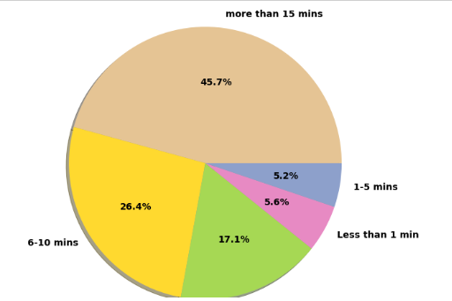
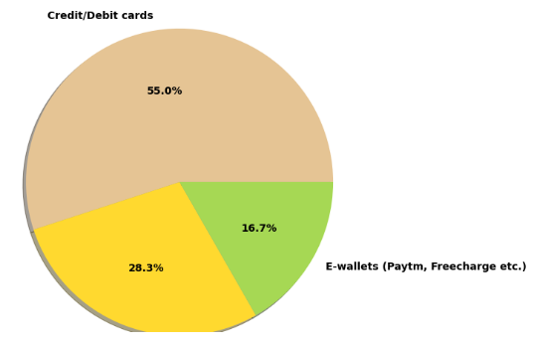
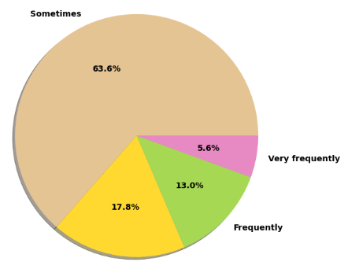
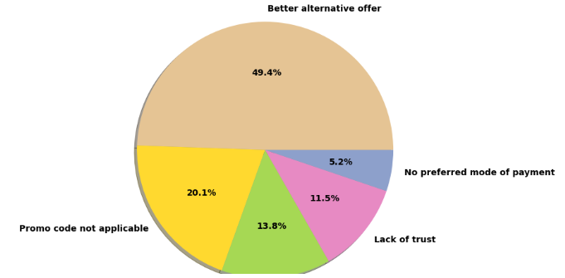
45.7% of Customer spend more than 15 mins before making Purchase decision. Followed by the 17.1% customers with 11-15 mins before making purchase decision.
5.6% of customers purchase product less than 1 min. 55% of customer paid using credit/debit cards while 28.3% customers still prefer cash on delivery.
63.6% of customer add product in cart but later leave without making payment. Surprising there is category of 17.8% customer who never abandon product without making payment.
Around 50% customers abandon cart due to better alternative offer which is obvious reason. If we add reason mention in previous point we can conclude that 84% customer abandon cart due to cost & discount trade off.

Slide 14
171 Customer out of total 269 customer Sometimes abandon shopping cart.
Customer spend more than 15 mins (Count=123 Customer) on online shopping store before making purchase decision have More Tendency to Abandon
Customer who spend less than 5 mins before making purchase decision have seen with very less tendency to abandon cart, more specifically they never leave cart or rare abandon cart.
61 % customer strongly agree and 29.7% customer agree that content on website must be easy to read and understand.
43.1% customer strongly agree and 34.2% customer agree that information on similar product to hightlighted on website for product comparison.
More than 60% of customer agree or strongly agree that complete information on listed seller and product being offered is important for purchase decision.
More than 90% of customer agree or strongly agree that all relevant information on listed products must be stated clearly.
Around 93% of customer agree or strongly agree that website should be easy for navigation.
42.8 % customer strongly agree and 41.6 % customer agree over high loading & processing speed.
70.3 % customer strongly agree and 16.7 % customer agree that website should be user friendly.

Slide 15
72.1% Customer strongly agree thinks that companies readiness to assist customer queries related to product is important factor in purchase decision.
Pie plot also show that being able to guarantee the privacy of the customer is important silent feature for product selection.
Another most important for product companies is availability of communication channels.
Most of people enjoy physical shopping , we can see that for 32% customer enjoyment from online shopping strongly matter and for around 46% customer this online shopping enjoyment do not matter.
Online shopping is 24/7 available with lot of varieties of product and with product return facility. This lead to thinking among almost 85 % of customer thinks, online shopping is convenient & flexible than physical shopping.
73.6% customer thinks that return & replacement policy of e-seller is important factor for making purchase decision.
49.4% customer strongly agree and 29.7% customer agree that displaying quality information on website helps in decision making in turn improves customer satisfaction.
45.4% of customer strongly agree over fact that user satisfaction cannot exist without trust.
50.2% Customer strongly agree & 36.4% customer agree that for good online shopping complete and relevant product information.
Around 83% customer pursue online shopping for Monetary Savings.
For 37.5 % customers Online shopping on website strongly gives the sense of adventure.
We can see different peoples have different opinions about connection between e-tailer & social status. Same with gratification on favourite e-tailer.
55.4% people strongly agree and 30.5% people agree that they prefer online shopping because they get value of money spent.

Slide 16
Majority, 64 customers agree that Amazon.in, Flipkart.com, Paytm.com, Myntra.com, Snapdeal.com are Easy to use website or application. But Overall if we look at countplot of easy to use application & website Amazon.in got individually 1st Rank.
87 customers agree that Amazon.in, Flipkart.com have Visual appealing web-page layout than most of other market players.
Around according to 125 people Amazon.in, Flipkart.com provides wide variety of offer on product.
We know 50.2% Strongly agree over providing complete relevant product information, and here we can see that 100 customer think that Amazon.in, Flipkart.com provides complete information compare to others.
42.8 % customer strongly agree and 41.6 % customer agree over high loading & processing speed of website. Here we can see Majority of people think that loading speed of Amazon.in is fastest while Flipkart.com slowest website to load.
In terms of Reliability of website or application again Amazon top list.
Majority of people also think that Amazon.in tops the chart in terms of quickness purchase process compare to others.
Majority of customers think that Amazon.in, Flipkart.com provides several payment options compare to others.
Safe & Speed delivery very much deciding factor in terms of purchase. In terms of speed of delivery Amazon.in is much better than other online shopping platform and Flipkart.com worst among all in terms of speed delivery of product.
More than 90% Customer thinks that guarantee on privacy of their information is important for them. Majority of customers trust Amazon.in more than other shopping platform for Privacy of customers’ information
Majority of customer trust Amazon.in followed by Flipkart.in over Security of their financial information. We also see very few peoples trust payment platform paytm.
Amazon.in, Flipkart.com, Myntra.com, Snapdeal.com provide assistance through different multi channel.
Longer time to get logged in can annoyed customer. Amazon.in take longer time to logged in while Flipkart.com take least time among all.
Majority of people agree that Amazon.in, Flipkart.com takes longer time in displaying and photos.
Myntra.com followed by Paytm.com take longer page loading time.
Most of people want shorter delivery time frame, majority customer agree that Paytm.com takes longest time for delivery compare to others.
Amazon.in website is as efficient as earlier after updation.
Majority 80 peoples recommended Amazon.in to their friends.
.

Slide 17
Thank you

