Slide 1
Display User List
A K

Slide 2
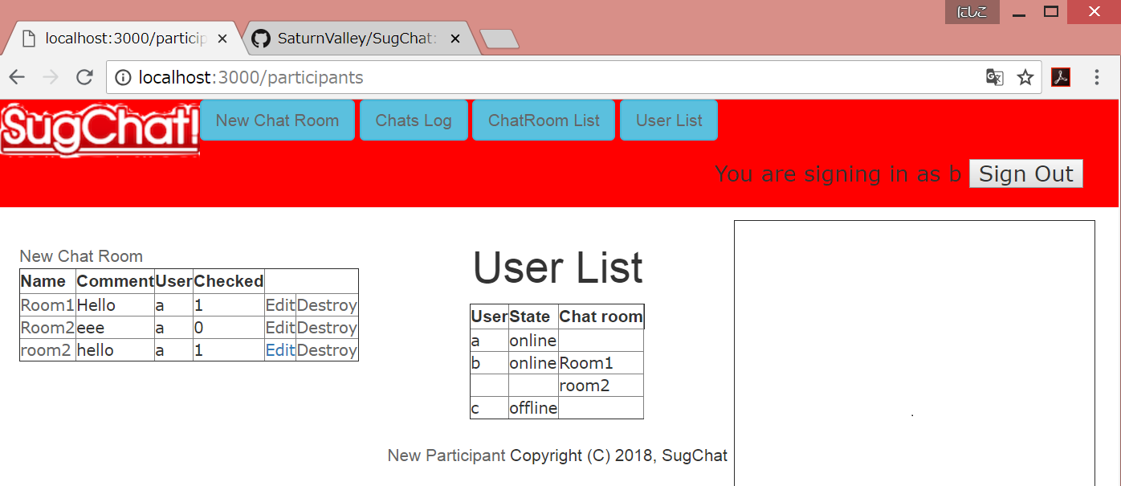
Display user list
Display all users who have their own accounts.
Include information about users. (online/offline, room?)
Notes:
My role is to display user list.
This explanation is quoted from Sugai’s slide
Function is to display all users who have their own accounts.
It includes information about users.(state of online/offline, where room users is)
User clicks “user list”, then this page appears.
This page shows all users information, user names, states, and room names.

Slide 3
When is user.online field updated ?
User chats within 5 minutes (Chat.user_id)
or
User draws within 5 minutes (Stroke.user_id)
or
User sign in within 30 minutes (User.last_sign_in_at)
users
id | name | online | room_id | email | introduction
integer | string | boolean | integer | string | string
Online field
“true”
Notes:
These are related tables.
Display User List needs two more field for users table.
Online field is boolean field, and it shows user’s online/offline state
Room_id field is integer field related rooms table.
It shows a room user enter.
User names and states are from users table.
And room names are from name field in rooms table.
If users table has image field, image also shows in this page.

Slide 4
When is participant table updated ?
participants
User chats within 5 minutes in one chatroom (Chat.user_id)
or
User draws within 5 minutes in one chatroom (Stroke.user_id)
id | user_id | chat_room_id
integer | integer | integer
“create”
Participation record
Notes:
These are related tables.
Display User List needs two more field for users table.
Online field is boolean field, and it shows user’s online/offline state
Room_id field is integer field related rooms table.
It shows a room user enter.
User names and states are from users table.
And room names are from name field in rooms table.
If users table has image field, image also shows in this page.

Slide 5
system
User clicks “User List” Button
Update Online field and create Participation records
Display
“User List”
Delete all Participation records

