Slide 1
Display User List
A K

Slide 2
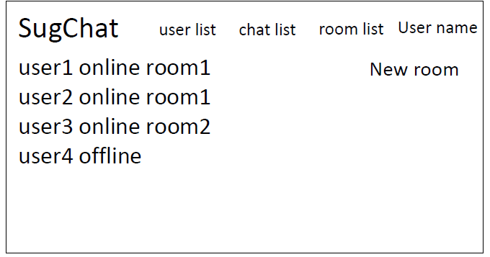
Display user list
Display all users who have their own accounts.
Include information about users. (online/offline, room?)
Notes:
My role is to display user list.
This explanation is quoted from Sugai’s slide
Function is to display Display all users who have their own accounts.
It includes information about users.(state of online/offline, where room users is)
User clicks “User name”, then this page appears.
This page shows all users information, user names, states, and room names.

Slide 3
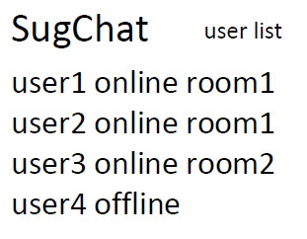
Related tables
users
id | name | online | room_id | email | introduction | Image
integer | string | boolean | integer | string | string | binary
rooms
id | name | comment | created_date | Created_time
integer | string | string | string | string
Notes:
These are related tables.
User names and states room names is from users table.
But I think users table has not room name but room id.
And room names are from name field from rooms table.
Because room names are deceded by users and it can become same room names.
If room name dosen’t be allowed already exist name, id field in Rooms table isn’t need.

