Slide 1
Functions of Identification
15K0118

Slide 2
Index
Necessary
Top Page to Identify
Sign Up
Sign In
Sign Out
Addition
Change Setting

Slide 3
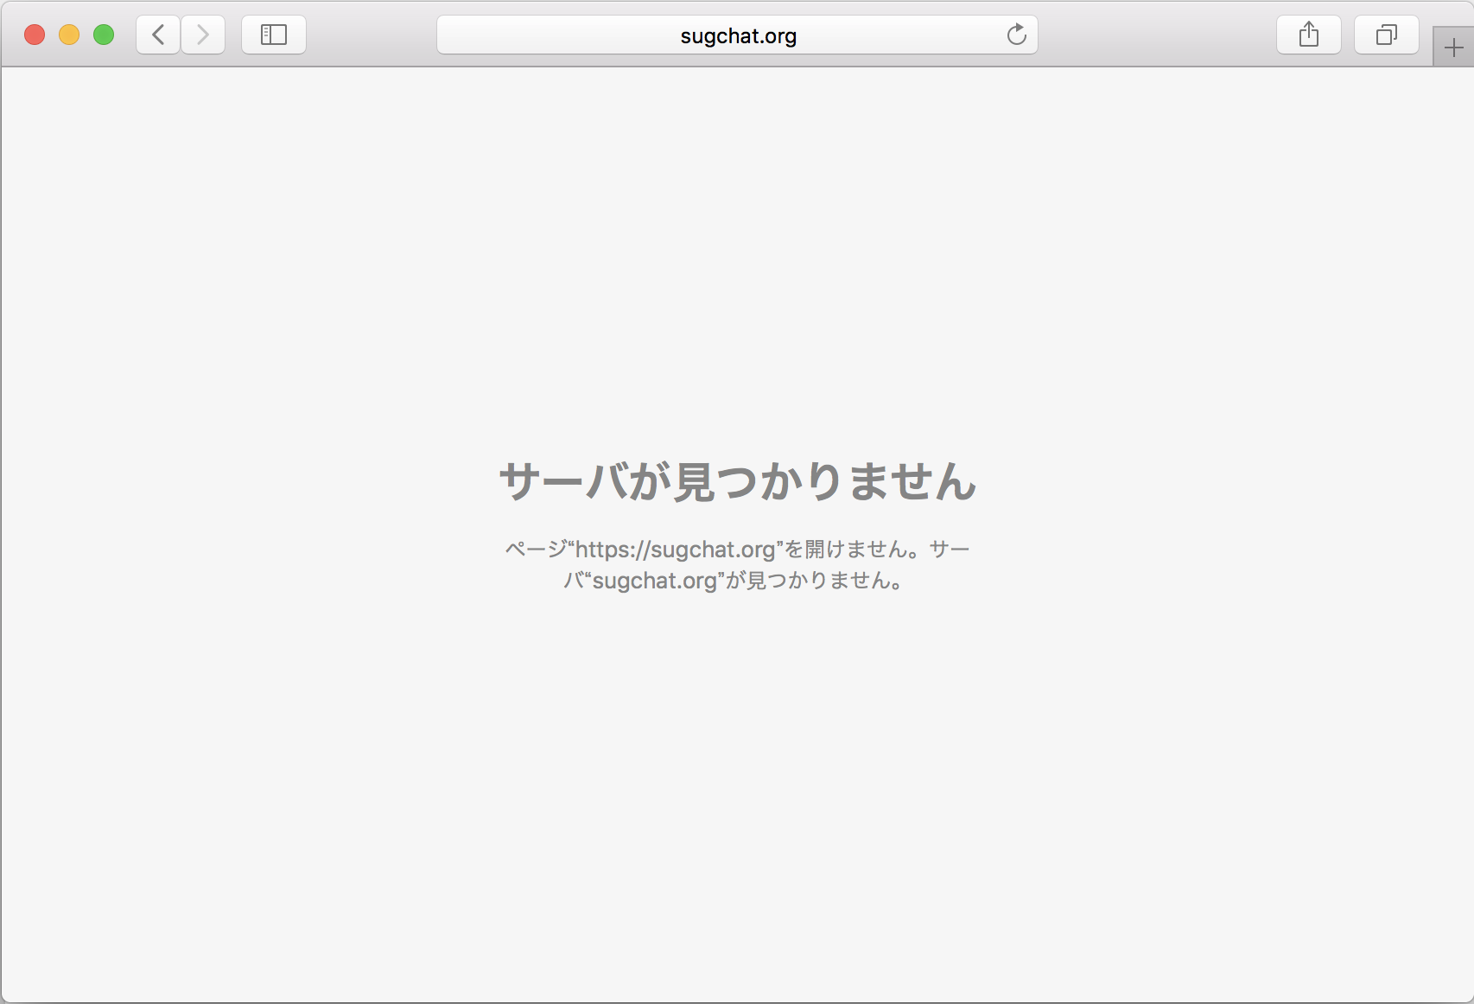
Necessary/Top Page to Identify
Already User
ID :
Pass :
Not Registered
Email :
Sign In
Sign Up

Slide 4
Necessary/Sign Up
Registration
Username :
Password(8~16 words) :
Password(Again) :
Register

Slide 5
Necessary/Sign In
There is nothing to explain the detail.
Because users just click the “Sign In” button at the top page and I only need to make a path to the page for each users.

Slide 6
Necessary/Sign Out
There should be a menu bar for a user in wherever pages after signed in.
There should be a button to sign out below.

Slide 7
Addition/Change Setting
These datas could be changed:
Username
Email address
Password
Comment

