Slide 1
Object Oriented WEB Programming Using Ruby
15K0020 SK

Slide 2
Theme: Chat room with drawing function
We can use this application in a browser.
This application supply not only chat rooms but also a function to draw pictures.
Notes:
I want to tell you a chat application which has a function to draw pictures.

Slide 3
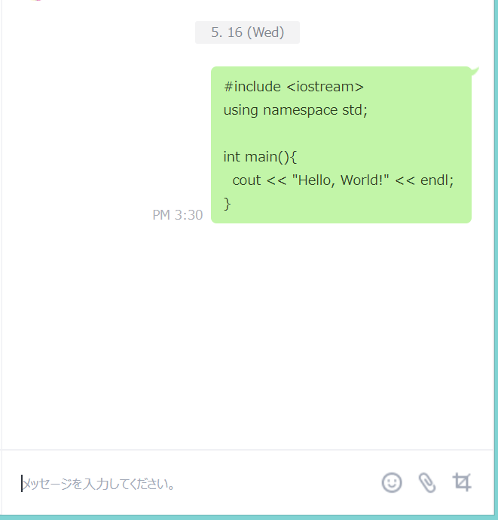
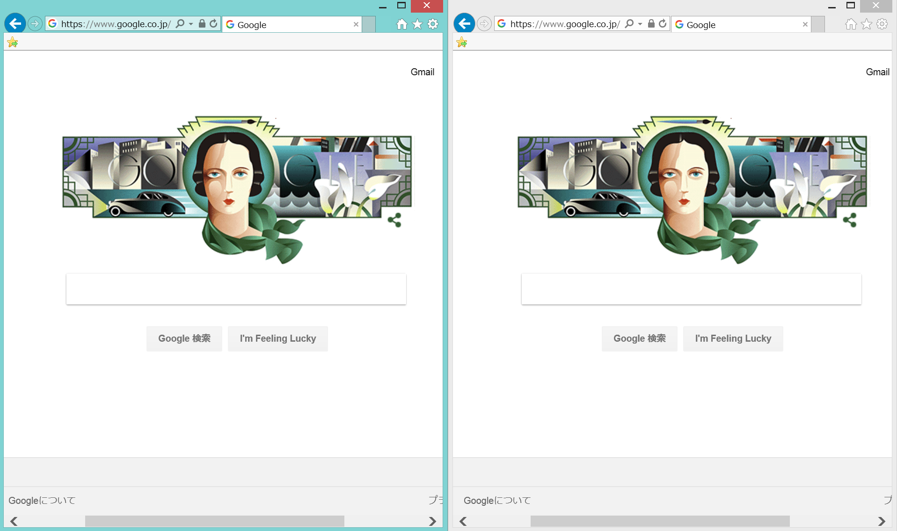
Chat application
We can see several chat pages .
LINE
browser
Chat Page1
Chat Page2
Notes:
Browser makes chat convenient
LINE application supplies only one chat page.
We can see several chat pages at the same time by using browser.

Slide 4
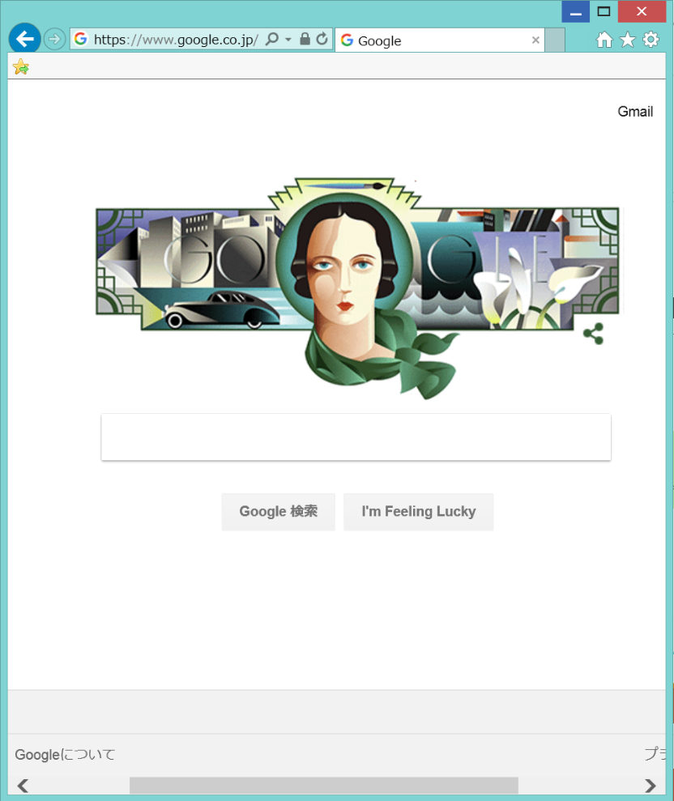
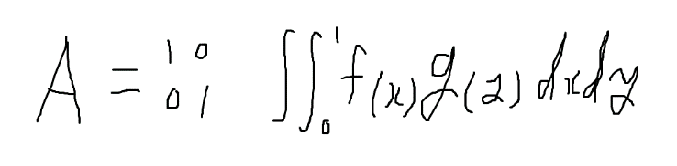
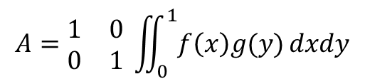
Handwriting
I want to make a space to draw.
Chat application cannot display mathematical formulae completely.
Drawing space
Chat space
$$A=\begin{matrix}1 & 0 \\ 0 & 1\end{matrix} \iint_{0}^{1}{f\left(x\right)g(y)}dxdy$$
Notes:
In a normal chat application, it is difficult to tell how formulae deform
University students use drawing application to explain mathematical formulae when they chat online.
I want to draw pictures with several colors to emphasize the important point of formulae.
And I also want to draw one picture by multiple people.

Slide 5
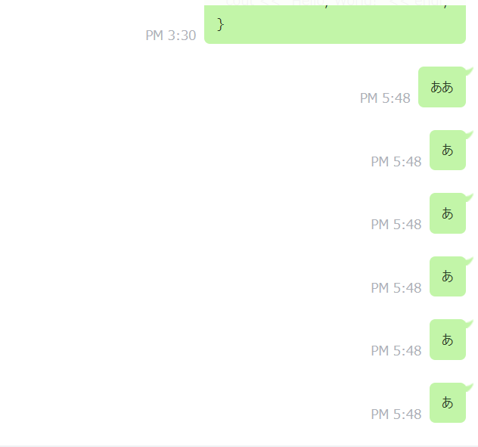
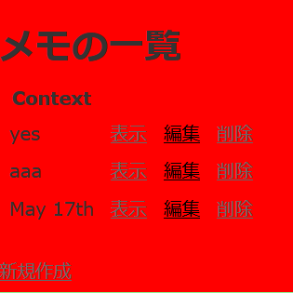
Database
We can recall what we talk
LINE
This application
Notes:
This is “memopad” example.
In LINE application, It is difficult to check our history.
In this application, we store chat log and recall it easily.
I also want to store the picture we draw.

Slide 6
Discussion
Several chat rooms?
How we store entire chat log?
A few references about the drawing.
User name?
Notes:
I don’t know how we make 2 or more chat rooms.
It is not clear to store entire chat log.
There are a few references about the drawing.
I don’t decide whether or not to attach names to the users of this application.
I think that divide the member of this class into two groups.
The one is chat team and the other is drawing team.

Slide 7
Reference
Chat
https://qiita.com/jnchito/items/aec75fab42804287d71b
https://codezine.jp/article/detail/10153
Drawing
http://hamasyou.com/blog/2013/12/03/rails/
Notes:
I found some references.

Slide 8
Thank you for listening.

