Slide 1
OBJECT ORIENTED WEB PROGRAMMING USING RUBY
Day 9: 14/June/2018
System Design Review
For Day 9

Slide 2
Find latest slides from…
https://github.com/webdbhosei/SugChat
Now our lecture materials had been moved to github.com

Slide 3
Drawing Table Design
How to handle drawings?
Design review: --> K_S_day9.pdf (Furisaka)
Discussion: Relational structure with chats and chat_rooms table
--> hk_nyao

Slide 4
Current User
Now current_user variable is available.
Design Review: by BanFunDamn
about: What changed had been done.

Slide 5
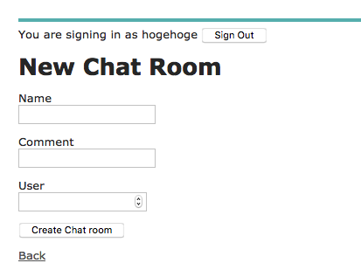
Chat Rooms
Design Review: --> sakuttozosan
About: changes done, and
Functional Links from the top screen

Slide 6
Chat Table Design
Reconsideration on chat tables
--> Tomofumi?
About: Relational structure between chat rooms and drawings

Slide 7
Entry (Top) View Design
Any Changes? --> Yu-san

Slide 8
Installation and Test Run review
Let us see the Changes to register “Home” page.

