Slide 1
MALIGNANT COMMENTS CLASSIFICATION
FlipRobo Project
Submitted by:
Amitava Sarkar

Slide 2
Project Details
Project Source : Flip Robo Technologies
Mentor : Nitin Mishra
Guidelines Source : Youtube, Medium,Kaggle
Platforms : Jupyter Notebook
Libraries :NLTK, Pandas, Matplotlib, Seaborn, Sklearn

Slide 3
Malignant comment Project
Problem statement:
The proliferation of social media enables people to express their opinions widely online. However, at the same time, this has resulted in the emergence of conflict and hate, making online environments uninviting for users. Although researchers have found that hate is a problem across multiple platforms, there is a lack of models for online hate detection.
Online hate, described as abusive language, aggression, cyberbullying, hatefulness and many others has been identified as a major threat on online social media platforms. Social media platforms are the most prominent grounds for such toxic behaviour.
There has been a remarkable increase in the cases of cyberbullying and trolls on various social media platforms. Many celebrities and influences are facing backlashes from people and have to come across hateful and offensive comments. This can take a toll on anyone and affect them mentally leading to depression, mental illness, self-hatred and suicidal thoughts.
Internet comments are bastions of hatred and vitriol. While online anonymity has provided a new outlet for aggression and hate speech, machine learning can be used to fight it. The problem we sought to solve was the tagging of internet comments that are aggressive towards other users. This means that insults to third parties such as celebrities will be tagged as unoffensive, but “u are an idiot” is clearly offensive.

Slide 4
Data Preprocessing
The first step in the data pre-processing is to obtained the whole information about the dataframe including the index datatype, row and columns, non-null values and memory usage.
Given dataset is a text data and there is no null value.
Dropping id column because it does not give any predictive information.
Removing all frequent words and string punctuations so that dataset will only hold importance token.
Word embedding techniques of CountVectorizer is applied to the text features to convert the text to the vector form.

Slide 5
PERFORMANCE METRICS
The most important metrics to be taken into consideration are as follows:
F1-Score
Precision
Recall
ROC-AUC Curve

Slide 6
Algorithms Used
Following are the algorithms that is applied on this dataset:
LogisticRegression
KNeighborsClassifier
MultinomialNB, BernoulliNB
LinearSVC
RandomForestClassifier

Slide 7
Best Model Performance
LinearSVM and Random Forest models perform best (purple and brown lines seem to be the highest).

Slide 8
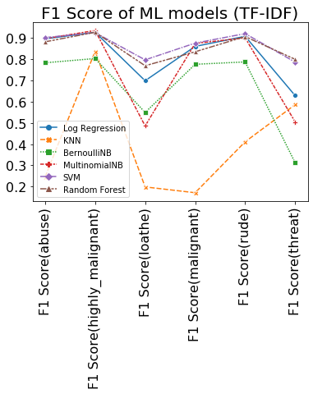
GRAPH OF BEST MODELS

Slide 9
Thank you

