Slide 1
EDA of Mall Customers
CA1: Data Mining (PEC-AIML601B)
Descriptive Statistics & Analysis

Slide 2
Introduction & Objectives
Objectives:
- Understand dataset structure (Mall Customers)
- Apply descriptive statistics (Central Tendency, Dispersion)
- Analyze distributions and outliers
- Visualize relationships
- Derive business insights

Slide 3
Data Understanding
Dataset Overview:
- Records: 200
- Attributes: 5 (ID, Gender, Age, Income, Spending Score)
- Missing Values: 0
Data Types:
- CustomerID: Integer
- Gender: Categorical (Male/Female)
- Others: Numerical (Integer)

Slide 4
Measures of Central Tendency
Age:
- Mean: 38.85
- Median: 36.00
- Mode: 32 (Young Adults)
Annual Income (k$):
- Mean: 60.56
- Median: 61.50 (Middle Class)
Spending Score:
- Mean: 50.20
- Median: 50.00 (Balanced)

Slide 5
Measures of Dispersion
Age:
- Range: 52, Std Dev: 13.97
Income:
- Range: 122, Std Dev: 26.26 (High Variance)
Spending Score:
- Range: 98, Std Dev: 25.82

Slide 6
Distribution & Outliers
Skewness Check:
- Age: 0.48 (Symmetric)
- Income: 0.32 (Symmetric)
- Score: -0.05 (Symmetric)
Outliers:
- Annual Income has 2 potential outliers (> 130k).
- Others have no significant outliers.

Slide 7
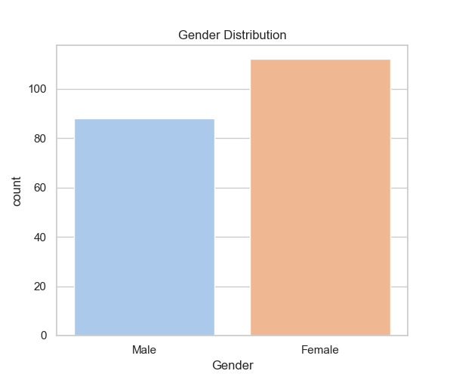
Gender Distribution
Females: 56%
Males: 44%

Slide 8
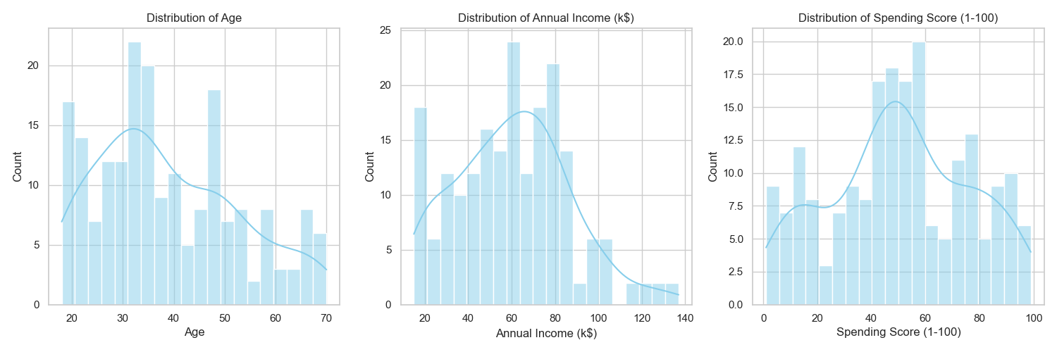
Distributions (Histograms)

Slide 9
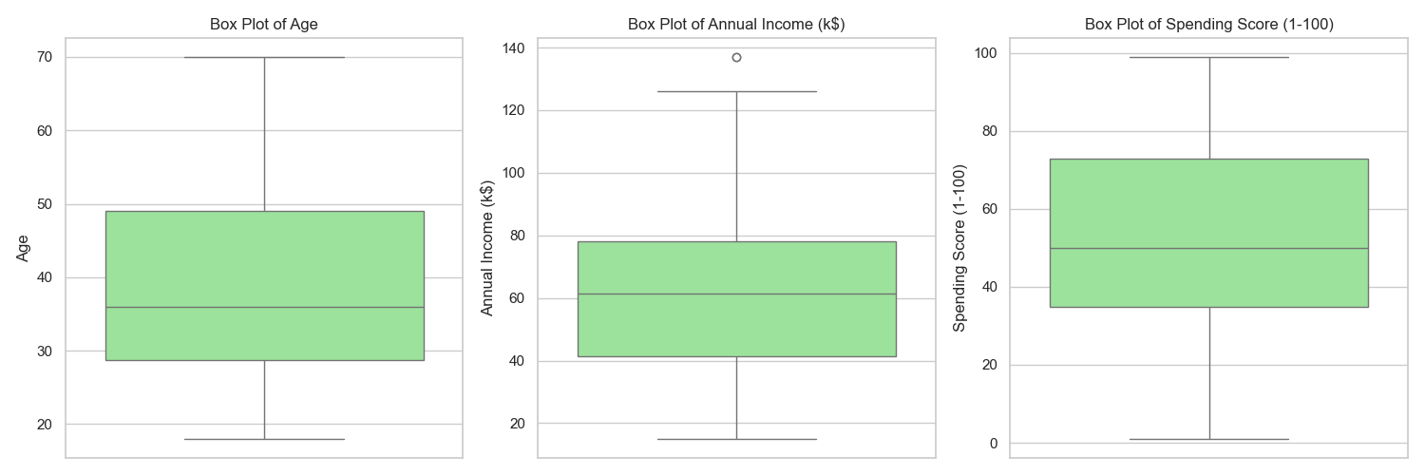
Outlier Detection (Box Plots)

Slide 10
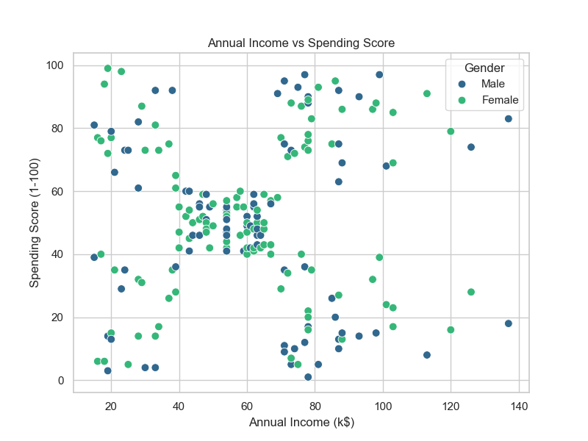
Income vs Spending Score

Slide 11
Business Insights
1. Target High Spenders: Distinct groups for High Income and Low Income high spenders.
2. Female Focus: 56% majority implies potential for female-centric campaigns.
3. Prime Age: Target young to middle-aged adults (30-40).
4. Retention: Sustain the large 'Average Income, Average Spend' group.
5. Luxury: Exclusive offers for the high-income outliers.

Slide 12
Thank You
Questions?

