Slide 1
DC COURSE PROJECT
19EECC201
Digital Circuits Course Project
Div: B
Name USN
1. Amit Kumar 01FE22BEC045
2. Bhoomika Gowda 01FE22BEC043
Sohail Nagaralli 01FE22BEC044
Katyayini Patil 01FE22BEC042

Slide 2
Problem statement :
Design and implement a digital system using suitable logic for scoreboard monitoring system for the Basketball game

Slide 3
SPECIFICATIONS :
A] Touch/Switch based input :Switch
B] Option for type of game :Basket ball
C] Digital Display :Common Anode 7 segment display.

Slide 4
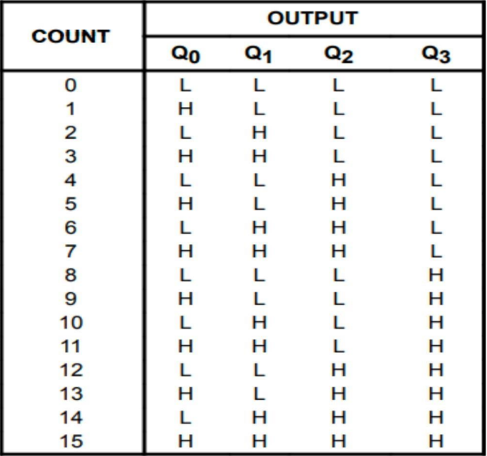
TRUTH TABLE:

Slide 5
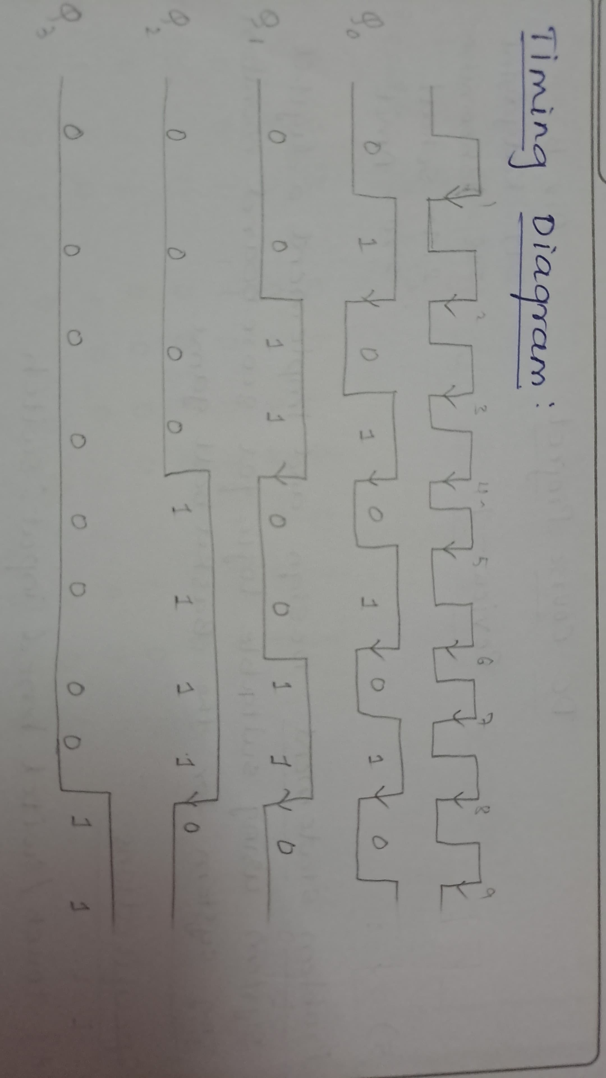
TIMING DIAGRAM:

Slide 6
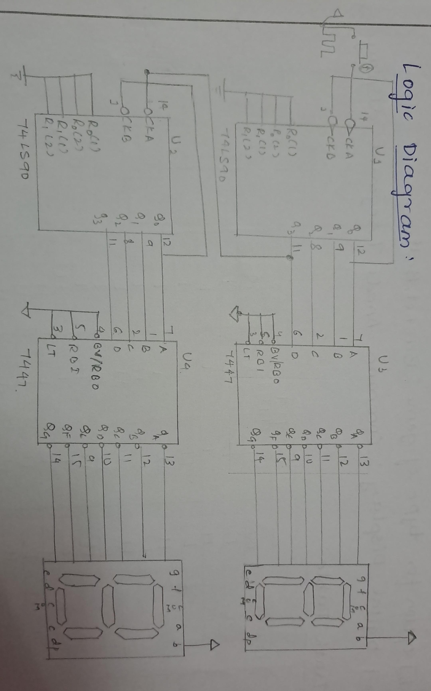
LOGIC DIAGRAM :

Slide 7
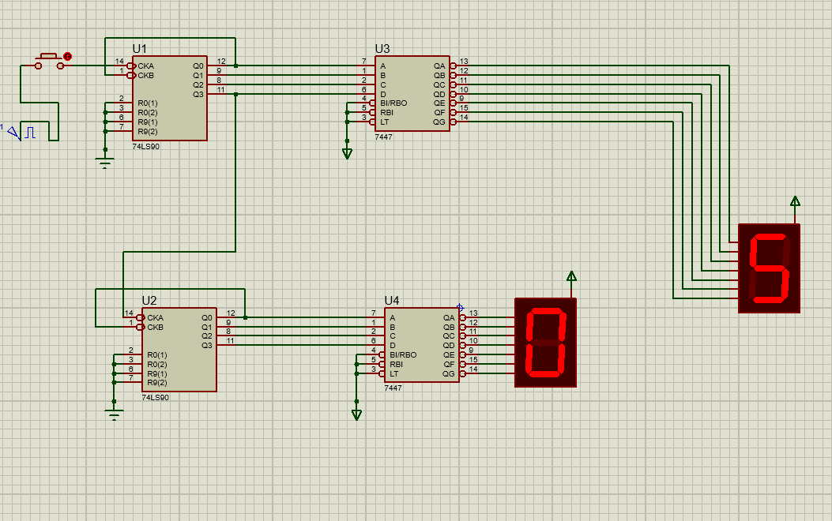
SIMULATION RESULTS :

Slide 8
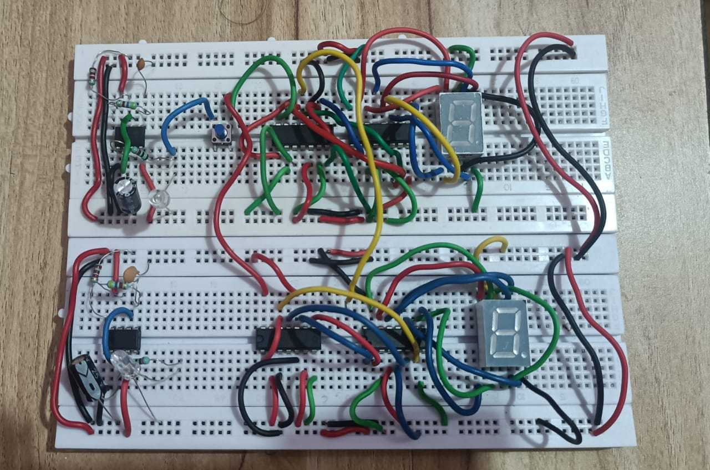
SNAP SHORT OF THE CIRCUIT :

Slide 9
THEORY:
• The problem statement is to design and implement a digital system that can be used as a scoreboard monitoring system for basketball games. The system will be responsible for keeping track of the score.
• The system will need to be able to accept input from various sources, such as scorekeepers or referees, and display the information in a clear and easy-to-read format for both players and spectators.
• The system will also need to be able to handle real-time updates and changes to the score .
• To accomplish these tasks, the system will need to use suitable logic and components, such as digital counters, registers, and display units. The design should be efficient, reliable, and easy to use, with a focus on accuracy and precision in recording and displaying the game's progress.
• Overall, the goal of the project is to create a robust and user-friendly digital system that can help ensure a smooth and enjoyable basketball game experience for all involved.

Slide 10
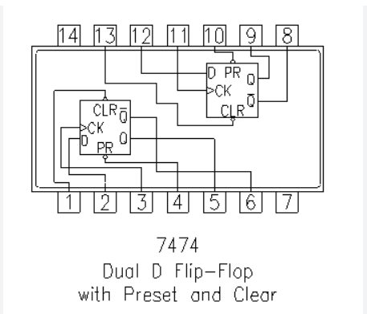
7447 IC Specifications
What is the function of IC 7474?
The 7474 is an edge-triggered device. The Q output will change only on the edge of the input trigger pulse. The small triangle on the clock (Cp) input of the symbol indicates that the device is positive edge-triggered. The D and the clock inputs are synchronous inputs.

Slide 11
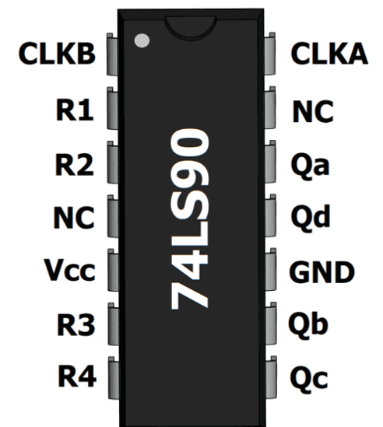
74LS90 IC SPECIFICATION
IC 7490 can count the binary numbers from 0000 to 1001. After 1001 it gets reset and again starts counting. As the IC 7490 gets reset after counting ten numbers, it is called MOD-10 Decade Counter

Slide 12
7 SEGMENT DISPLAY SPECIFICATIONS:
Available in two modes Common Cathode (CC) and Common Anode (CA) .
• Available in many different sizes like 9.14mm,14.20mm,20.40mm,38.10mm,57.0mm and 100mm (Commonly used/available size is 14.20mm) .
• Available colors: White, Blue, Red, Yellow and Green (Res is commonly used) .
• Low current operation.

Slide 13
LEARNING OUTCOME
1. Practical Application of Digital Circuit Design
2. Team Collaboration and Communication Skills
3. Problem-Solving and Troubleshooting Skills
4. Integration of Theoretical Knowledge
5. Documentation and Presentation Skills

Slide 14


