Slide 1
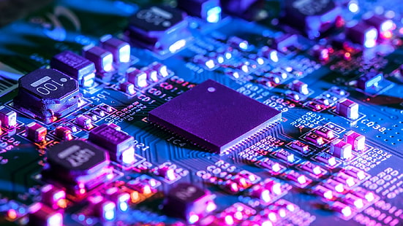
Attendance System for Students using Face recognition
Domain – Python
Supervisor – Ravinder Saini

Slide 2

Identification OF Client
Efficiency Improvement:
An automated attendance system using face recognition aims to enhance efficiency by eliminating the need for manual attendance marking. This reduces the time spent on traditional methods, allowing for more focus on educational activities.
Accuracy and Transparency:
The face recognition technology ensures accurate identification of students, reducing the chances of errors associated with manual attendance. This promotes transparency and reliability in recording attendance data.
Notes:
Security , Data Analysis and Reporting, Advanced productivity, Integration with existing systems.

Slide 3
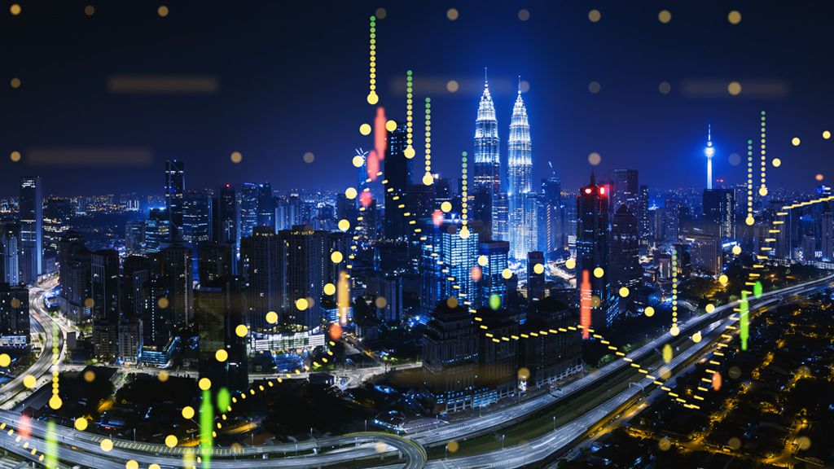
NEED of the hour
Adaptability to Dynamic Learning Environments:
"In an era of dynamic and evolving learning environments, the need of the hour is for attendance systems that adapt to diverse educational settings. Face recognition technology proves versatile, accommodating various class sizes and structures with ease."
Data-Driven Decision Making:
"As educational institutions strive for data-driven decision-making, the need of the hour is a comprehensive attendance system. Face recognition not only provides accurate attendance records but also offers valuable data for analyzing student engagement and informing strategic decisions."

Slide 4



Identification of Problem:
The Complexity of Accuracy
Reliability in Dynamic Environments
"As we delve into the heart of our challenge, we encounter the pressing issue of accuracy. The demand for a reliable system that can precisely identify and record student attendance poses a significant hurdle. Explore with us the nuanced landscape where technology aims to bridge the gap between expectation and execution."
"Education is dynamic, and so are the environments in which attendance systems operate. Unruly conditions, varying lighting, and diverse facial expressions pose challenges to the reliability of facial recognition. Let's dissect the complexities and strive for a system that adapts seamlessly to the ever-changing classroom dynamics."

Slide 5


Challenges:
"As we embrace this mission, we confront the challenge of mitigating biases inherent in facial recognition technology. Join us in developing algorithms and practices that ensure fairness and impartiality, transcending stereotypes and promoting a system that celebrates the richness of diversity. Our commitment extends beyond mere representation – we aspire to cultivate a technology that not only recognizes but respects the unique identities within our educational community, fostering an atmosphere where every student feels seen, valued, and included."
Scalability for Tomorrow's Education
"Within this dynamic landscape, we must anticipate the complexities of not only numerical growth but also evolving technological requirements. Join us in deciphering the intricacies of accommodating diverse educational environments, from traditional classrooms to virtual spaces. As we chart the course for scalability, we delve into optimizing resource utilization and ensuring seamless integration with emerging educational technologies”.
Inclusive Design

Slide 6
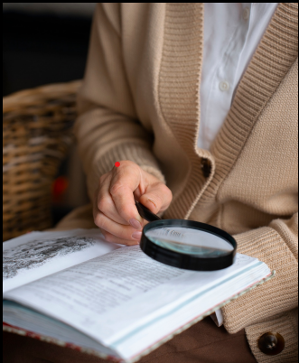
IDENTIFICATION OF TASKS
In to the task identification procedure used in the creation of facial recognition systems. Discover the fundamentals and techniques for effective task identification.

Slide 7

problems
1. Variability in Facial Features:
Expressions, positions, and lighting conditions on faces vary naturally.
2. Security Vulnerabilities:
Mitigating security threats, including spoofing attempts using fake images.

Slide 8

SOLUTION
1. Complex Algorithms : Applying complex facial recognition algorithms (OpenCV, Dlib, etc.) to precisely extract and match features..
2. Counter-Spoofing Techniques: using liveness detecting methods to reduce security flaws.

Slide 9
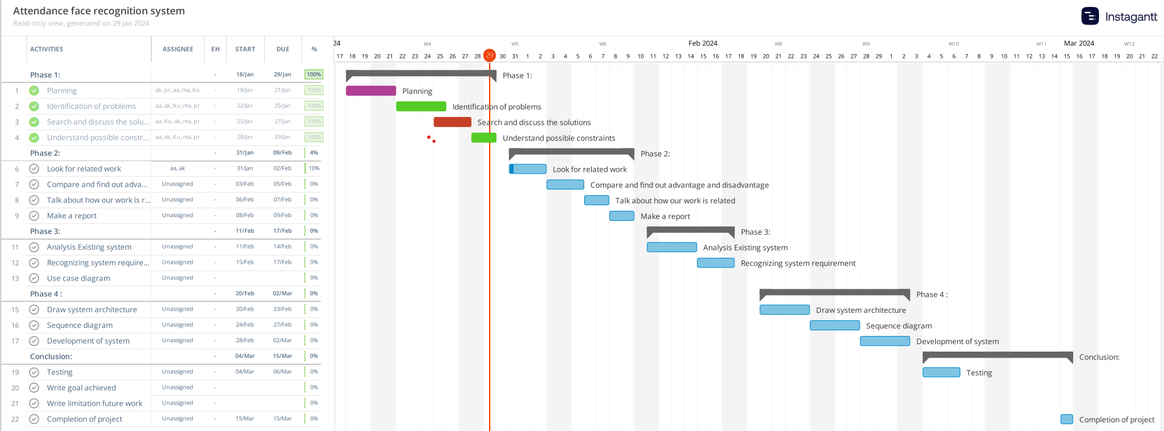
Timeline of our Project

Slide 10
conclusion
Our face recognition attendance system addresses a critical need in today's fast-paced educational and corporate environments by offering a reliable solution to the challenges of traditional attendance tracking methods. By identifying the problem of time-consuming manual attendance processes prone to errors and the need for a more secure and efficient alternative, our system emerges as a timely and relevant response to contemporary issues facing institutions worldwide. Our system enables institutions to track attendance more efficiently, freeing up administrators' time and resources for more productive uses. Furthermore, the use of biometric authentication strengthens security protocols, protecting private information and assets from fraud and illegal access.

Slide 11

Thank you!
teamshanks@gmail.com
www.realpython.com

