Slide 1
Minimal Effort, Maximum Effect? An Evaluation of Parameter-Efficient Fine-Tuning in Varying Data Regimes Amitesh Badkul May 20, 2025

Slide 2
Contents
Motivation
Methodology
Results

Slide 3
Motivation: Fine-tuning is expensive
Full parameter fine-tuning:
Update all model parameters → require large GPU memory
Eg. 16-bit fine-tuning cost per parameter
Weight: 16 bits (2 bytes)
Weight Gradient: 16 bits (2 bytes)
Optimizer States: 65 bits (8 bytes)
96 bits (12 bytes) per parameter
65B model → 780GB of GPU memory

Slide 4
Methodology: Dataset
Datasets:
ETHOS (onlinE haTe speecH detectiOn dataSet) – hate speech detection
998 comments
565 positive class (no hate speech)
433 negative class (hate speech)
QQP (Quora Question Pairs) – paraphrase identification
400k labeled pairs:
149k positive (questions have same meaning)
255k negative (questions have different meaning)

Slide 5
Methodology: Methods
For fine-tuning we test out:
Low Rank Adaption (LoRA)
BitFit
Full fine-tuning
No fine-tuning
Adapter Training
Prefix Tuning
We train a classifier on top of the existing bert model for the classification task

Slide 6
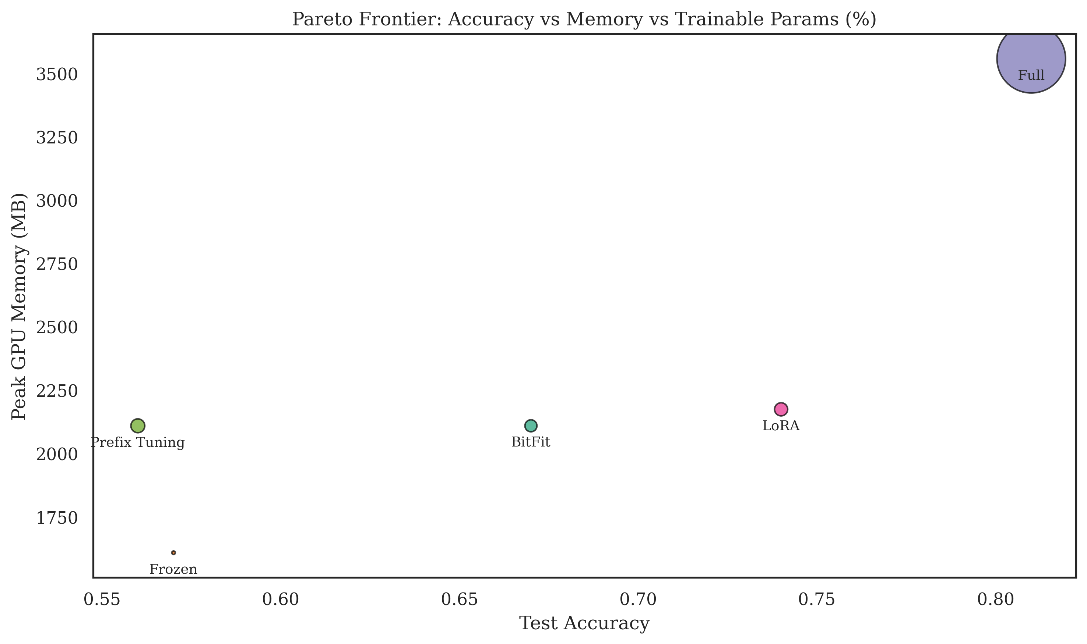
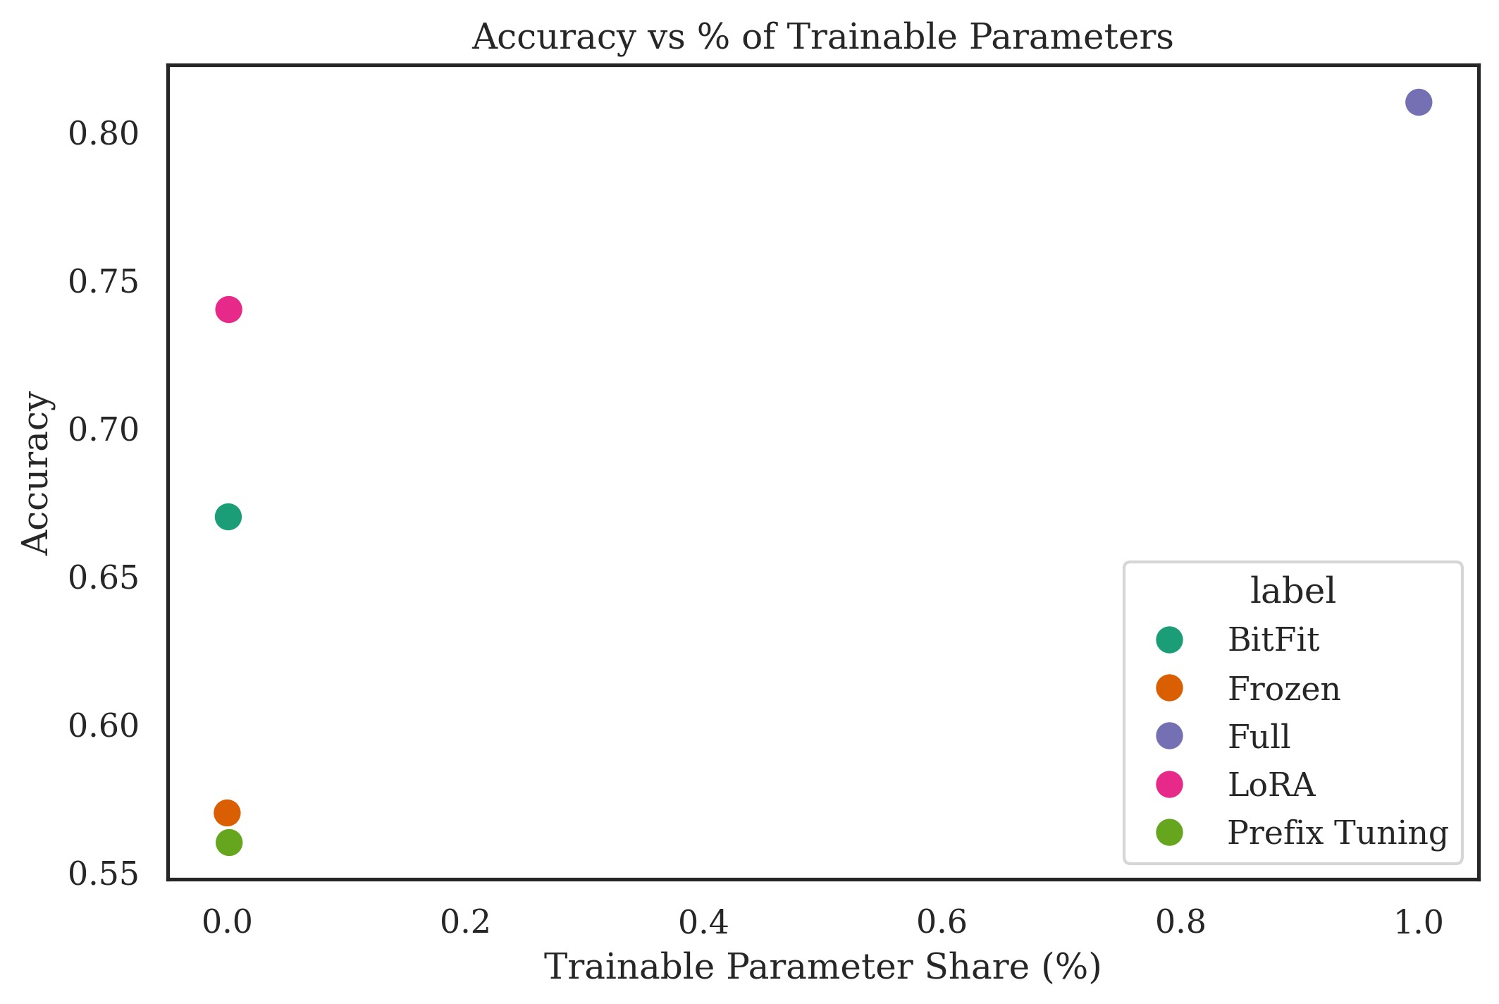
Results
Full fine-tuning achieves the highest accuracy but at a very high cost in memory and trainable parameters.
LoRA achieves competitive accuracy with much lower memory and parameter cost, making it efficient
Prefix Tuning and Frozen are extremely lightweight but less accurate

Slide 7
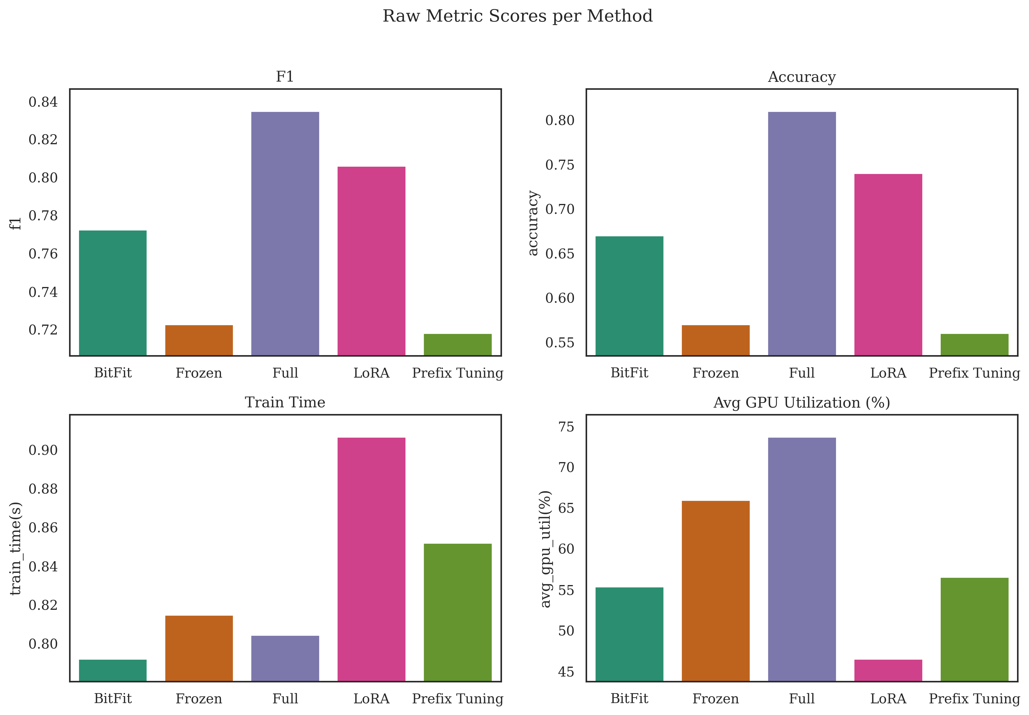
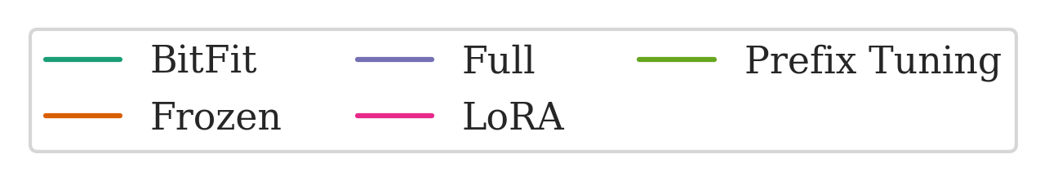
Results
None should utilize the least GPU, maybe here some other process was running
Full outperforms all
LoRA occupies the least memory and is most memory efficient
LoRA follows closely
Full occupies most memory
Prefix tuning has the worst performance

Slide 8
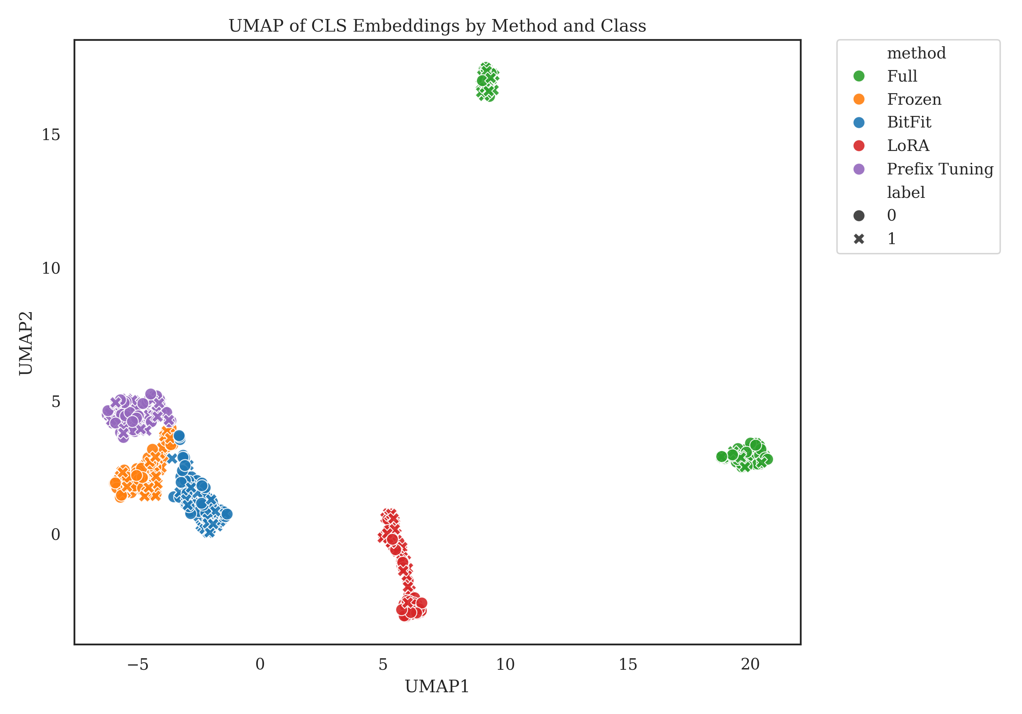
Results
All 110 M parameters were updated, so the representation space has drifted furthest from the original BERT space.
No weights move; embeddings stay closest to vanilla BERT and cluster near BitFit.
None of the methods show clear class separation.
Prefix adds train-time prompt vectors, nudging the space differently from bias-moving, so it forms its own lobe above Frozen/BitFit.
LoRA only re-projects through a handful of low-rank matrices, so it moves the space, but not as far as full FT. It forms its own cohesive cluster a moderate distance from the origin.
BitFit changes only bias terms, so the space stays close to the frozen model but does shift a bit—hence it lives next to Frozen, but slightly offset.

Slide 9
Questions?
Thank you!

