Slide 1
FITNESS BUDDY
IBM Hackathon Project
Presented By:
Name: Amit Gupta
College Name: Netaji Subhas University of Technology
Department: Information Technology

Slide 2
OUTLINE
Problem Statement
Technology Used
Wow Factor
End Users
Result
Conclusion
GitHub Link
Future Scope
References
IBM Certificate

Slide 3
PROBLEM STATEMENT
The challenge - In today’s fast-paced world, many individuals struggle to maintain a healthy lifestyle due to lack of personalised guidance, time constraints, and inconsistent motivation. Traditional fitness solutions often require expensive subscriptions, in-person consultations, or rigid schedules that don’t adapt to personal preferences or daily routines.
There is a growing need for an accessible, friendly, and intelligent virtual assistant that can provide on- demand fitness advice, healthy lifestyle suggestions, and basic nutrition guidance—all tailored to individual needs and available at any time.
Fitness Buddy aims to solve this problem by offering a conversational, AI-powered health and fitness coach that can:
Recommend home workouts and routines based on user input
Provide motivational tips and daily fitness inspiration.
Suggest simple, nutritious meal ideas.
Encourage habit-building and consistency.

Slide 4
TECHNOLOGY USED
IBM Cloud Lite Services
IBM Granite Model (LLM)
IBM Watsonx.ai Studio
Natural language processing (NLP)

Slide 5
WOW FACTOR
By using this AI Agent, user now keep generate friendly, flexible and on-demand workout plans.
It try to keep his users consistent toward their fitness journey.
Helps in suggesting his user simple yet nutritious meal ideas.
Provide motivational tips and daily achievable fitness goals to keep them motivated and consistent.

Slide 6
END USERS
Busy Professional, students and Young adult.
Stay-at-home individuals.
Fitness enthusiasts.
Beginners in fitness journey.
Remote workers, senior citizens or people with health goals.

Slide 7
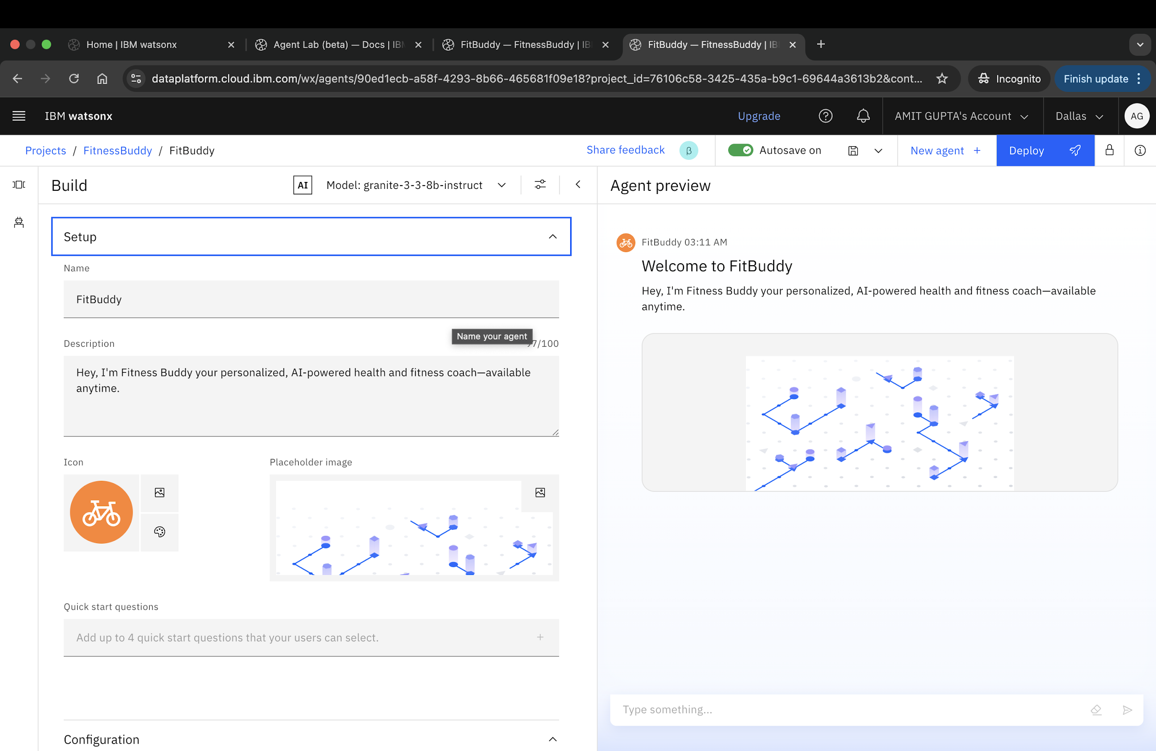
RESULT

Slide 8
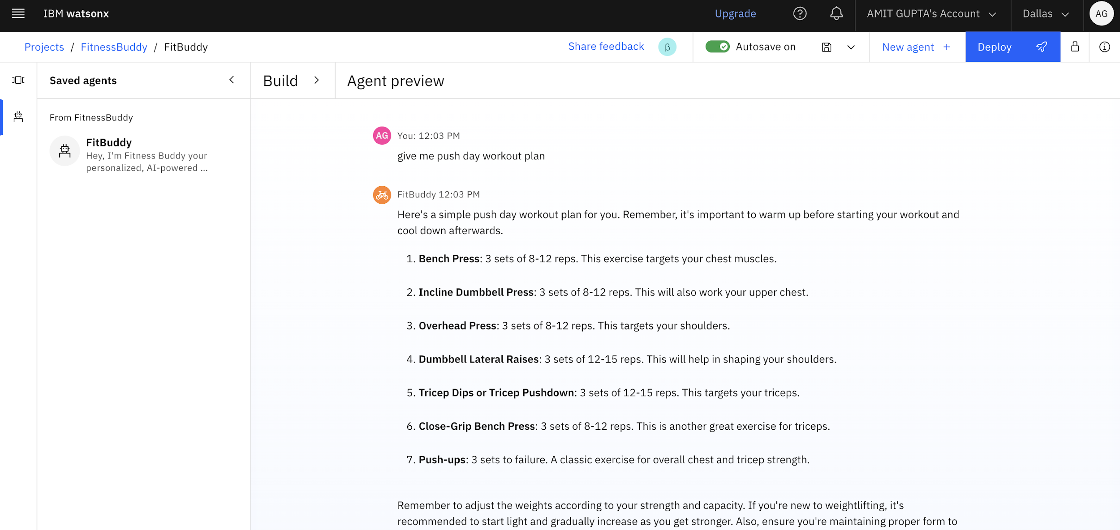
RESULT

Slide 9
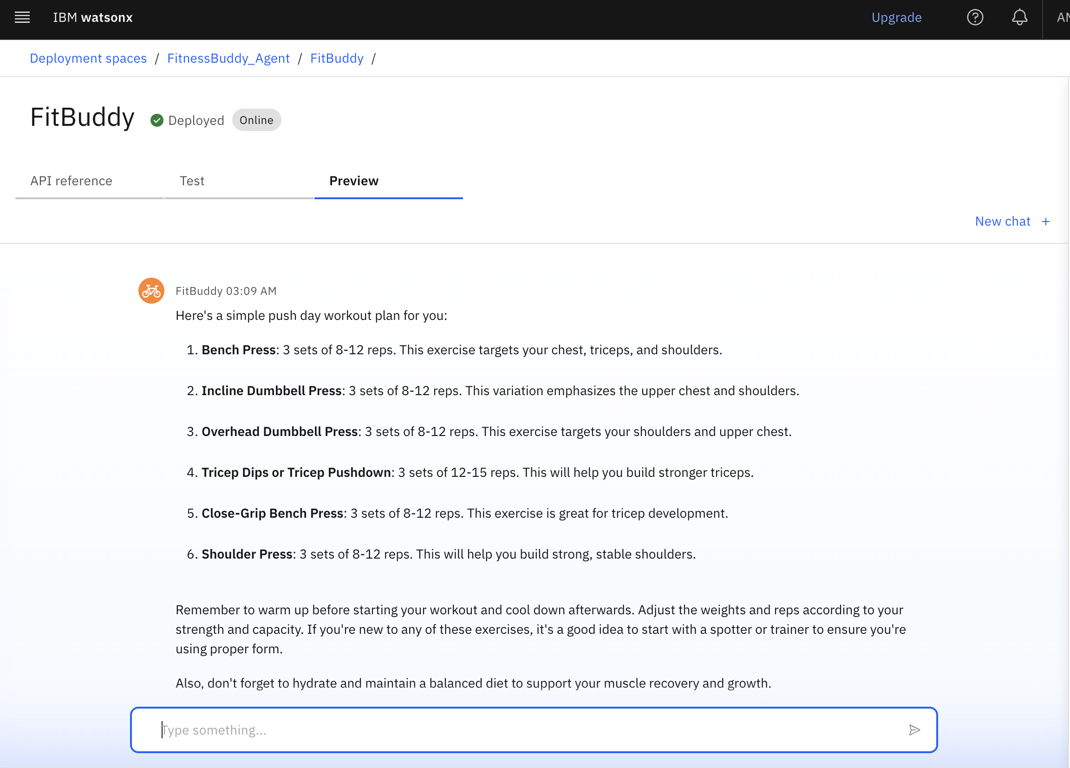
RESULT
Deployed AI Agent

Slide 10
CONCLUSION
Solves issue of time constraints, inconsistent motivation, and lack of expert access.
The AI Agent can generate customised home workout plans, motivation and basic nutritions tips.
Encourage habit-building and consistency through daily engagement and inspirations.
Focus on creating a friendly, flexible and on-demand experiences.

Slide 11
GITHUB LINK
Github link: https://github.com/Amitg7606/Fitness-Buddy/tree/main

Slide 12
FUTURE SCOPE
Voice Activated Fitness Assistant
Multilingual Assistant Support
Predicting Disengagement and proactively offering re-engagement tips
Personal Nutrition Plans with Dietary Restrictions Support
Create Virtual training Session
Track fitness goals and Progress

Slide 13
REFERENCES
IBM Cloud
IBM Watsonx Assistant
IBM Watson NLU

Slide 14
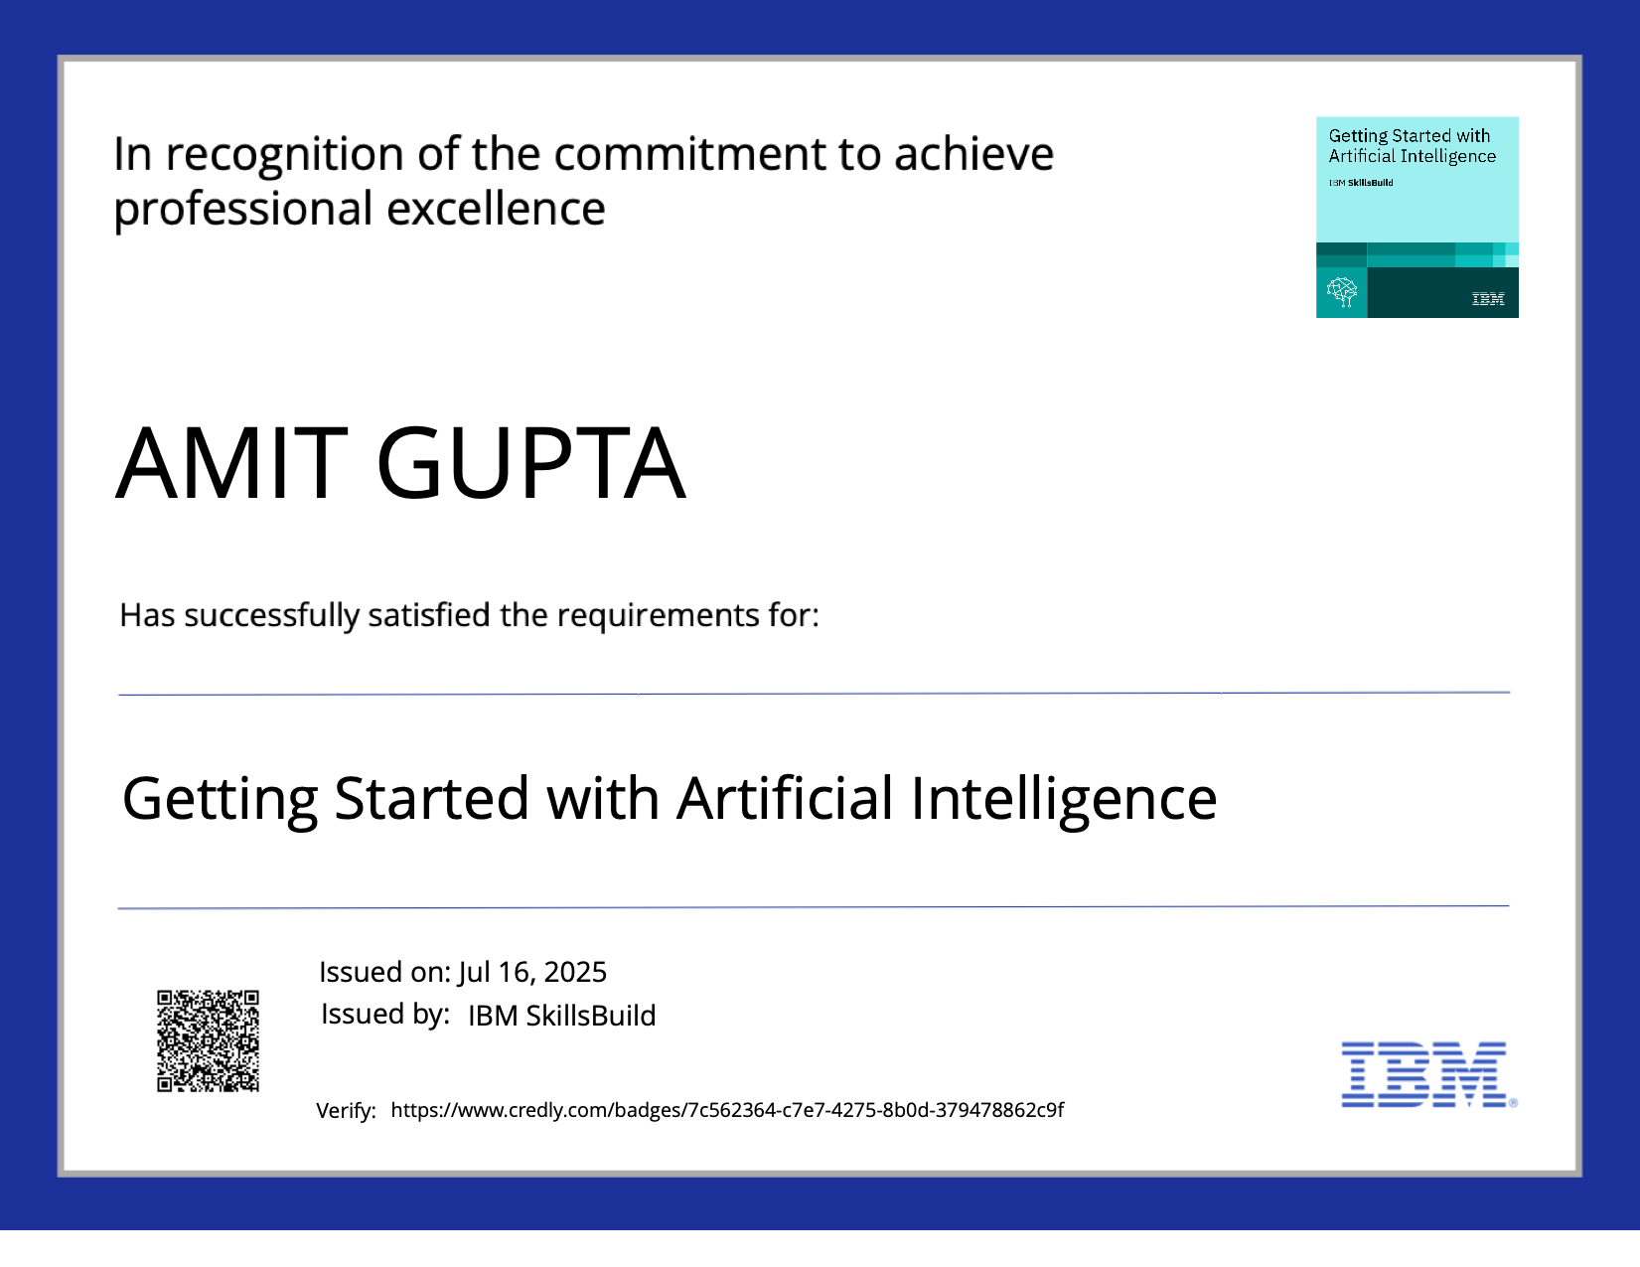
IBM CERTIFICATIONS

Slide 15
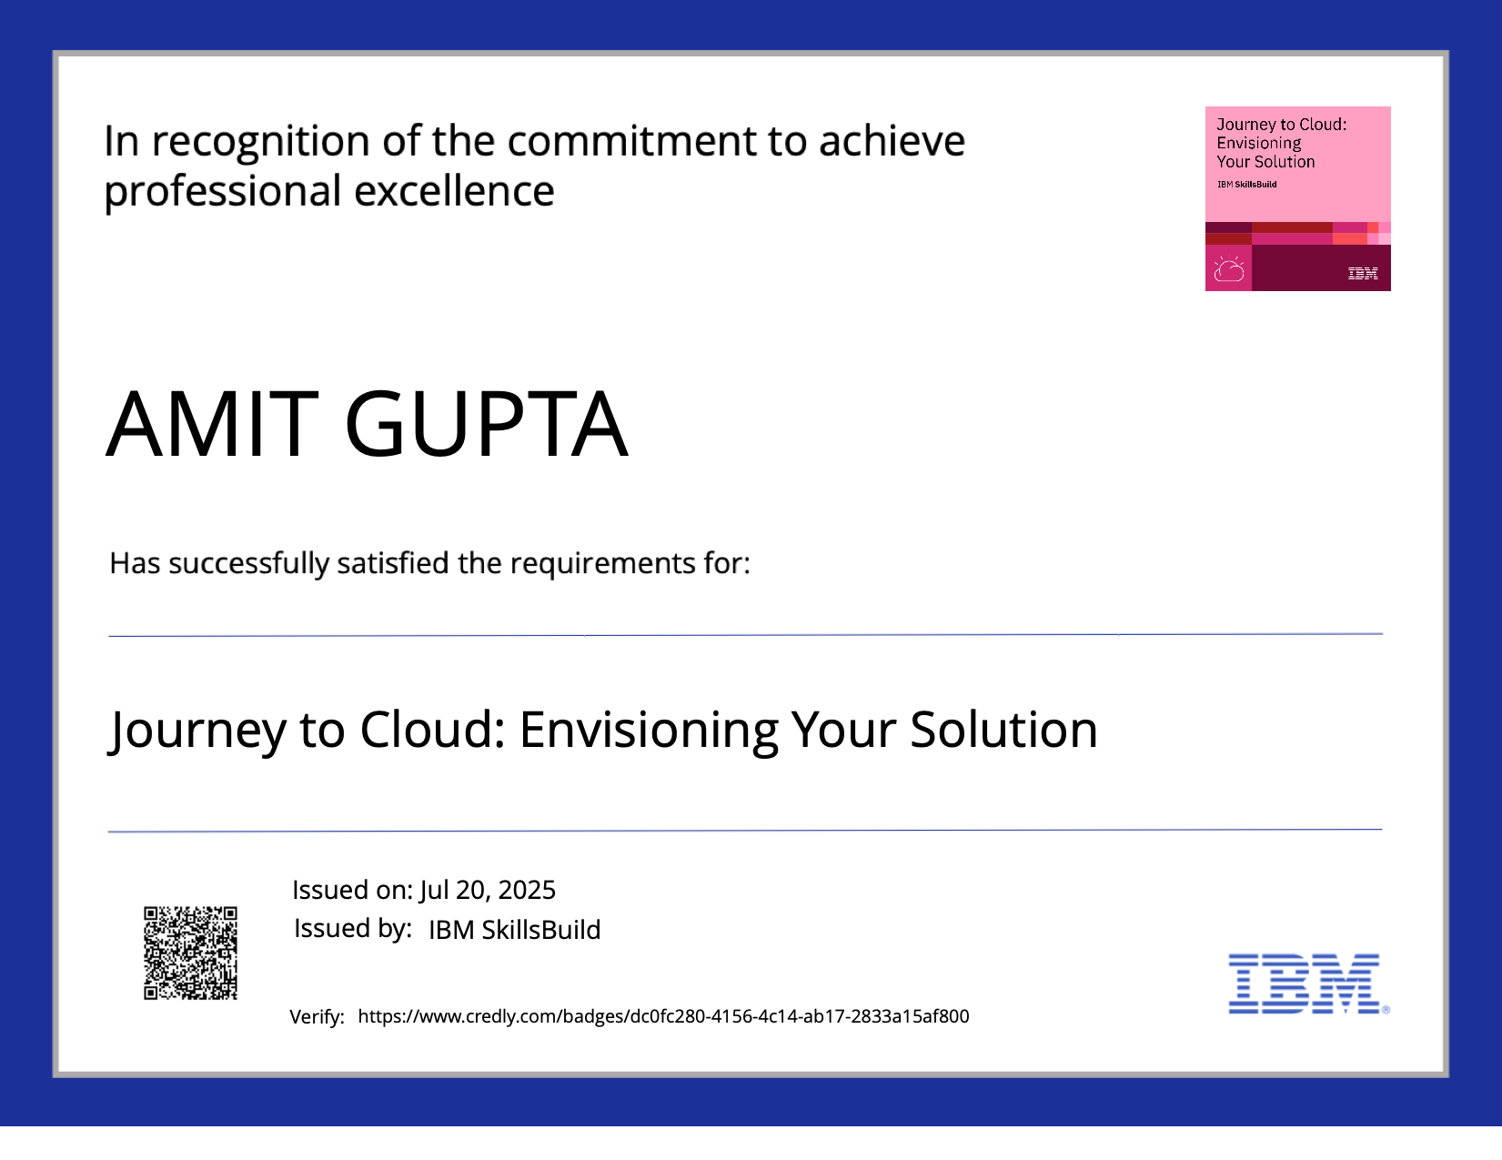
IBM CERTIFICATE

Slide 16
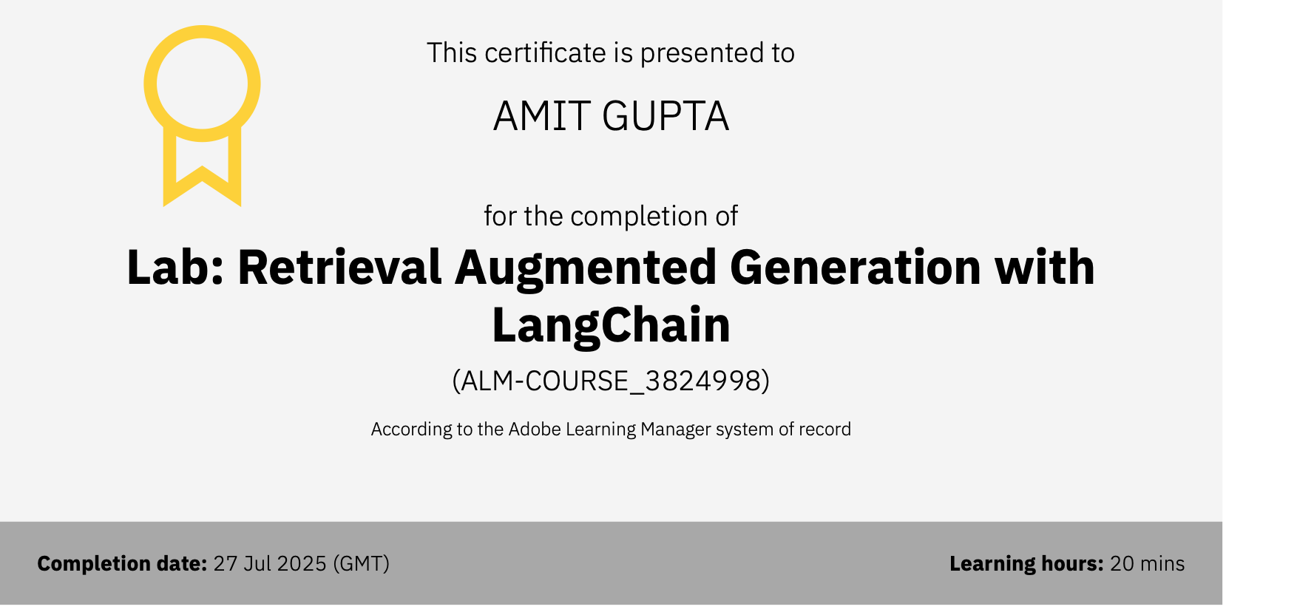
IBM CERTIFICATIONS

Slide 17
THANK YOU

