Slide 1
AWS Fundamentals & Core concepts - Training for New Joiner
-Amit Sapre (CIS Practice Team)
Agenda - This course is for individuals who seek an overall understanding of the Amazon Web Services (AWS) Cloud, independent of specific technical roles. & to learn AWS Cloud concepts, services, security, architecture, pricing etc. to build AWS Cloud knowledge. This course also helps prepare for the AWS Certified Cloud Practitioner exam.
Module – 1 Cloud computing Overview/Introduction.
Cloud computing Models (IaaS, PaaS, SaaS) & Cloud Computing Deployment Models (Cloud, Hybrid, On-Premise)
Module – 2 Cloud computing with AWS & Overview AWS Global Infrastructure-Basic Terminologies.
AWS Region, Availability Zone, Edge Location. (AWS GI Map, AWS service offerings listing , pay-as-you-go concept )
Module – 3 AWS FUNDAMENTALS
AWS Core Concepts & AWS Well-Architected and the Five Pillars
Module – 4 Getting Started with AWS
Creating AWS account, Connecting to AWS Console. Using Free Tier offerings.
Module – 5 Lab Session/Tutorials.
COMPUTE - Launch a Windows Virtual Machine
COMPUTE - Launch a WordPress Website
COMPUTE, STORAGE - Create object storage buckets
STORAGE- Store and Retrieve a File
SERVERLESS - Run a Serverless "Hello, World!"

Slide 2
AWS Fundamentals & Core concepts - Training for New Joiner
-Amit Sapre (CIS Practice Team)
Module – 1 Cloud computing Overview/Introduction.
Cloud Service Models (IaaS, PaaS, SaaS)
IaaS - Infrastructure-as-a-Service
This model is the closest to managing physical servers; a cloud provider will keep the hardware up-to-date, but operating system maintenance and network configuration is up to you as the cloud tenant.
PaaS-Platform-as-a-Service
This model is a managed hosting environment. The cloud provider manages the virtual machines and networking resources, and the cloud tenant deploys their applications into the managed hosting environment.
SaaS-Software-as-a-Service
In this model, the cloud provider manages all aspects of the application environment, such as virtual machines, networking resources, data storage, and applications. The cloud tenant only needs to provide their data to the application managed by the cloud provider.

Slide 3
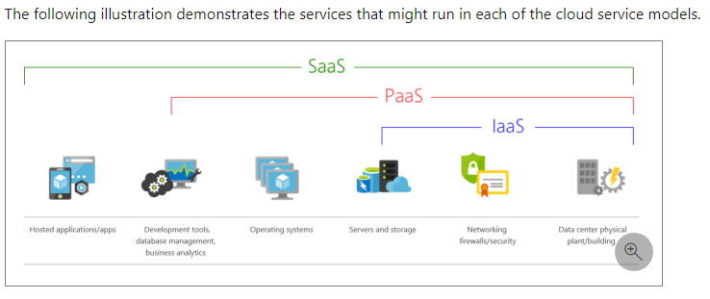
AWS Fundamentals & Core concepts - Training for New Joiner
-Amit Sapre (CIS Practice Team)
Module – 1 Cloud computing Overview/Introduction.
Cloud Service Models (IaaS, PaaS, SaaS)

Slide 4
AWS Fundamentals & Core concepts - Training for New Joiner
-Amit Sapre (CIS Practice Team)
Module – 1 Cloud computing Overview/Introduction.
Cloud Computing Deployment Models (Cloud, Hybrid, On-Premise)
Public cloud
No capital expenditures to scale up.
Applications can be quickly provisioned and de-provisioned.
Organizations pay only for what they use.
Private cloud
Hardware must be purchased for start-up and maintenance.
Organizations have complete control over resources and security.
Organizations are responsible for hardware maintenance and updates.
Hybrid cloud
Provides the most flexibility.
Organizations determine where to run their applications.
Organizations control security, compliance, or legal requirements.

Slide 5
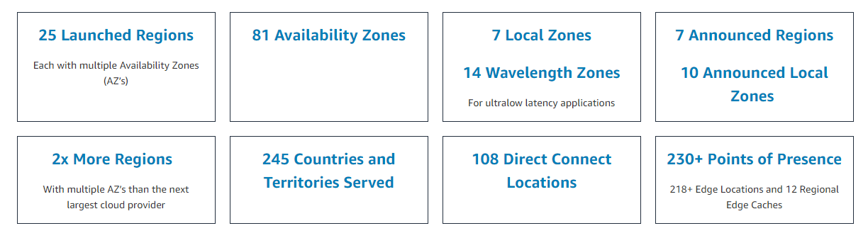
AWS Fundamentals & Core concepts - Training for New Joiner
-Amit Sapre (CIS Practice Team)
Module – 2 Cloud computing with AWS & Overview AWS Global Infrastructure-Basic Terminologies.
AWS Region, Availability Zone, Edge Location. (AWS GI Map, AWS service offerings listing , pay-as-you-go concept )
AWS Global Infrastructure Map
https://aws.amazon.com/about-aws/global-infrastructure/?pg=WIAWS-N&tile=learn_more

Slide 6
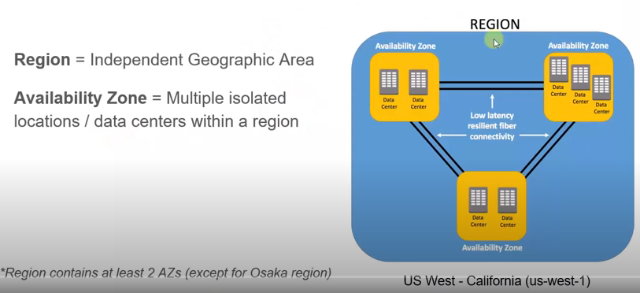
AWS Fundamentals & Core concepts - Training for New Joiner
-Amit Sapre (CIS Practice Team)
Module – 2 Cloud computing with AWS & Overview AWS Global Infrastructure-Basic Terminologies.
AWS Region, Availability Zone, Edge Location. (AWS GI Map, AWS service offerings listing , pay-as-you-go concept )
AWS CloudFront & Edge Locations
https://aws.amazon.com/cloudfront/features/?whats-new-cloudfront.sort-by=item.additionalFields.postDateTime&whats-new-cloudfront.sort-order=desc

Slide 7
AWS Fundamentals & Core concepts - Training for New Joiner
-Amit Sapre (CIS Practice Team)
Module – 2 Cloud computing with AWS & Overview AWS Global Infrastructure-Basic Terminologies.
AWS Region, Availability Zone, Edge Location. (AWS GI Map, AWS service offerings listing , pay-as-you-go concept )
AWS CloudFront & Edge Locations
https://aws.amazon.com/cloudfront/features/?whats-new-cloudfront.sort-by=item.additionalFields.postDateTime&whats-new-cloudfront.sort-order=desc
What is an Amazon AWS edge location?
An edge location is where end users access services located at AWS, the cloud computing division of US-headquartered Amazon. They are located in most of the major cities around the world and are specifically used by CloudFront (CDN) to distribute content to end users to reduce latency.
What advantages does deploying Amazon CloudFront provide?
By using Amazon CloudFront, the volume of application origin requests is automatically reduced. Content is stored in CloudFront's edge and regional caches and only fetched from origins when needed. The load on application origins can be further reduced by using Origin Shield to enable a centralized caching layer.

Slide 8
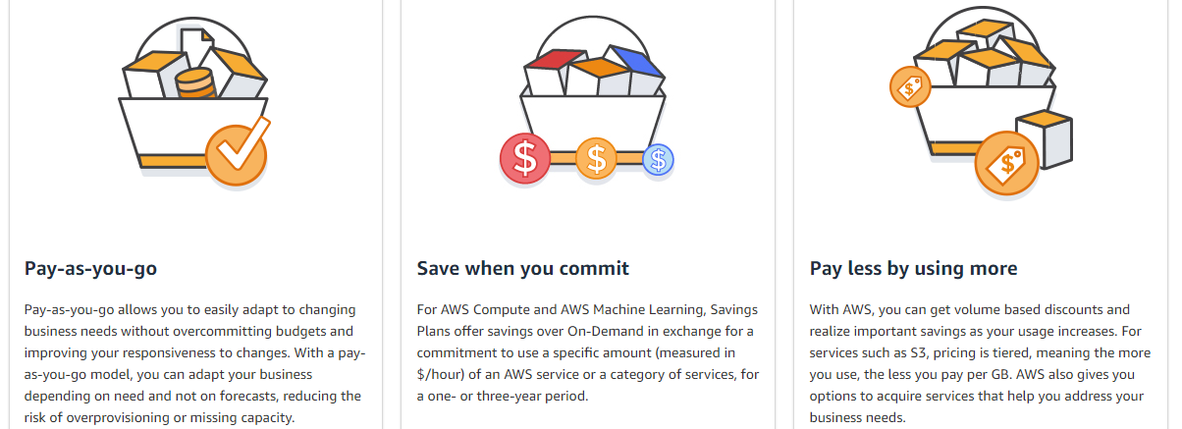
AWS Fundamentals & Core concepts - Training for New Joiner
-Amit Sapre (CIS Practice Team)
Module – 2 Cloud computing with AWS & Overview AWS Global Infrastructure-Basic Terminologies.
pay-as-you-go concept
AWS Pricing
https://aws.amazon.com/pricing/?pg=WIAWS-N&tile=learn_more

Slide 9
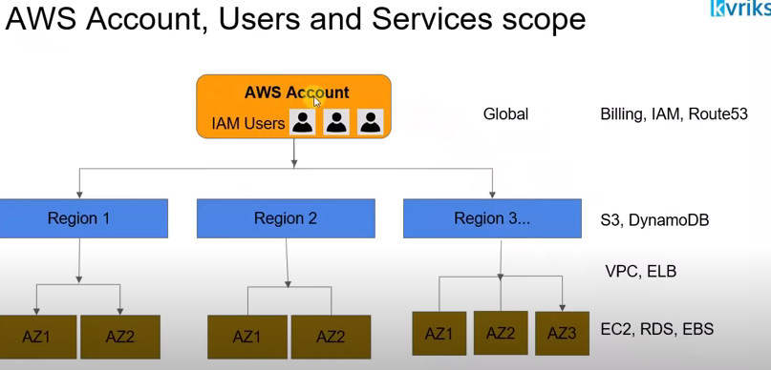
AWS Fundamentals & Core concepts - Training for New Joiner
-Amit Sapre (CIS Practice Team)
Module – 3 AWS FUNDAMENTALS
AWS Core Concepts & AWS Well-Architected and the Five Pillars
Module – 4 Getting Started with AWS
Creating AWS account, Connecting to AWS Console. Using Free Tier offerings

Slide 10
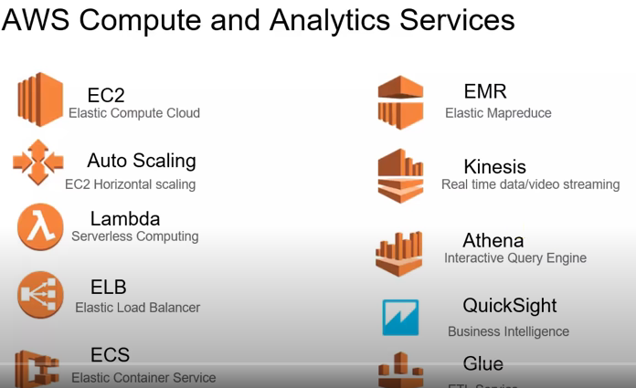
AWS Fundamentals & Core concepts - Training for New Joiner
-Amit Sapre (CIS Practice Team)

Slide 11
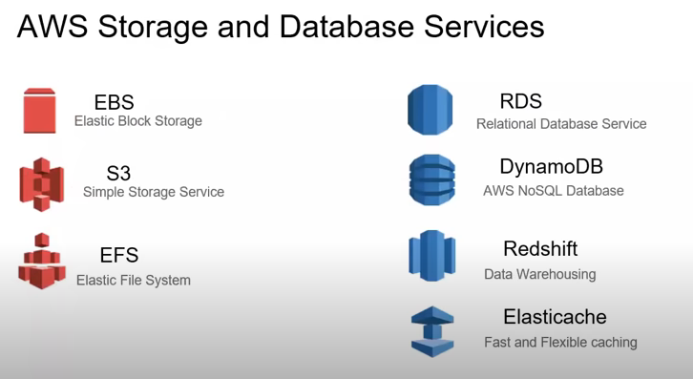
AWS Fundamentals & Core concepts - Training for New Joiner
-Amit Sapre (CIS Practice Team)

Slide 12
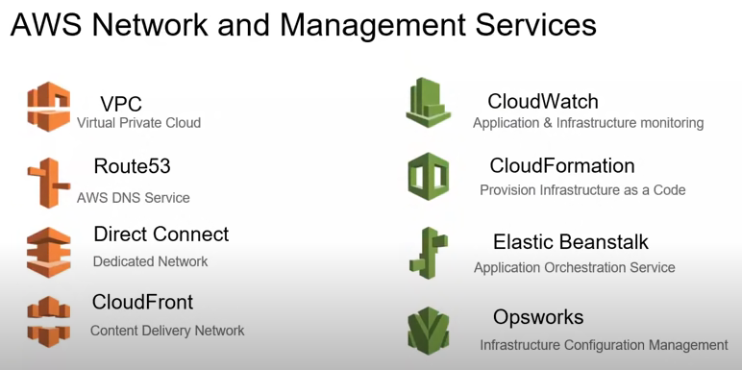
AWS Fundamentals & Core concepts - Training for New Joiner
-Amit Sapre (CIS Practice Team)

Slide 13
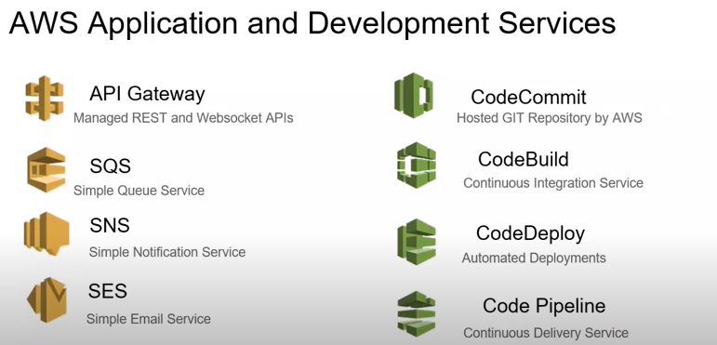
AWS Fundamentals & Core concepts - Training for New Joiner
-Amit Sapre (CIS Practice Team)

Slide 14
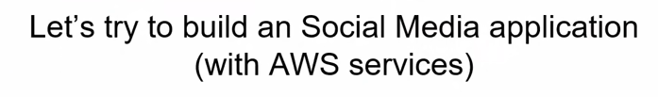
AWS Fundamentals & Core concepts - Training for New Joiner
-Amit Sapre (CIS Practice Team)
Now we will be watching Video to understand how most of these commonly used AWS services can be map in architectural point of view, and then will move to practical session.

Slide 15
AWS Fundamentals & Core concepts - Training for New Joiner
-Amit Sapre (CIS Practice Team)
Module – 5 Lab Session/Tutorials.
COMPUTE - Launch a Windows Virtual Machine
COMPUTE - Launch a WordPress Website
COMPUTE, STORAGE - Create object storage buckets
STORAGE- Store and Retrieve a File
SERVERLESS - Run a Serverless "Hello, World!"

Slide 16
AWS Fundamentals & Core concepts - Training for New Joiner
-Amit Sapre (CIS Practice Team)
Feedback –
Thank You for your time.

