Slide 1

Notes:
Welcome to <insert name of course>. In this course we will explore the concept of machine learning and perform machine learning on a wide variety of tasks. We're glad you're here and excited to explore this space with you.

Slide 2

Notes:
First, let's take a moment to meet your instructional staff. *Add slides and/or introduce any instructors and teachers assistants.*

Slide 3
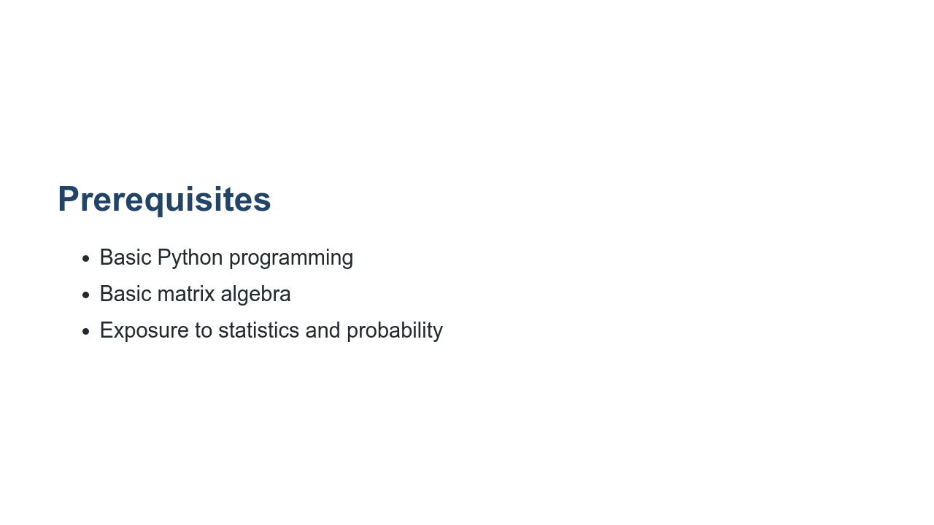
Notes:
We worked to have limited prerequisites for this course. For the most part we'll teach you everything you need to know from the ground up. There are a few things, however, that we hope you've already had exposure to. Those are listed on this slide. If you don't know (or remember) these, don't panic. We have labs for all of the prerequisites. For Python programming, we really only expect you to know the basics of the core language. It would be good if you know `if`, `else`, `for`, `while`, the built-in data types, and how to create your own functions. If you know list expansions and lambdas, even better! Also, if you already know another programming language, but not Python, that is probably fine, too. Python is really easy to learn, especially when you already have programming experience. This is an applied course, but we will do a little math along the way. For matrix algebra it would be nice if you knew how to add, subtract, and multiply matrices. Understanding dot products and transpositions would be helpful, too. For statistics and probability, we only lightly touch these concepts in the course. You should understand concepts like mean and median. We will touch a little on probabilistic concepts as well. We won't, however, get deep into t-tests and p-values.

Slide 4
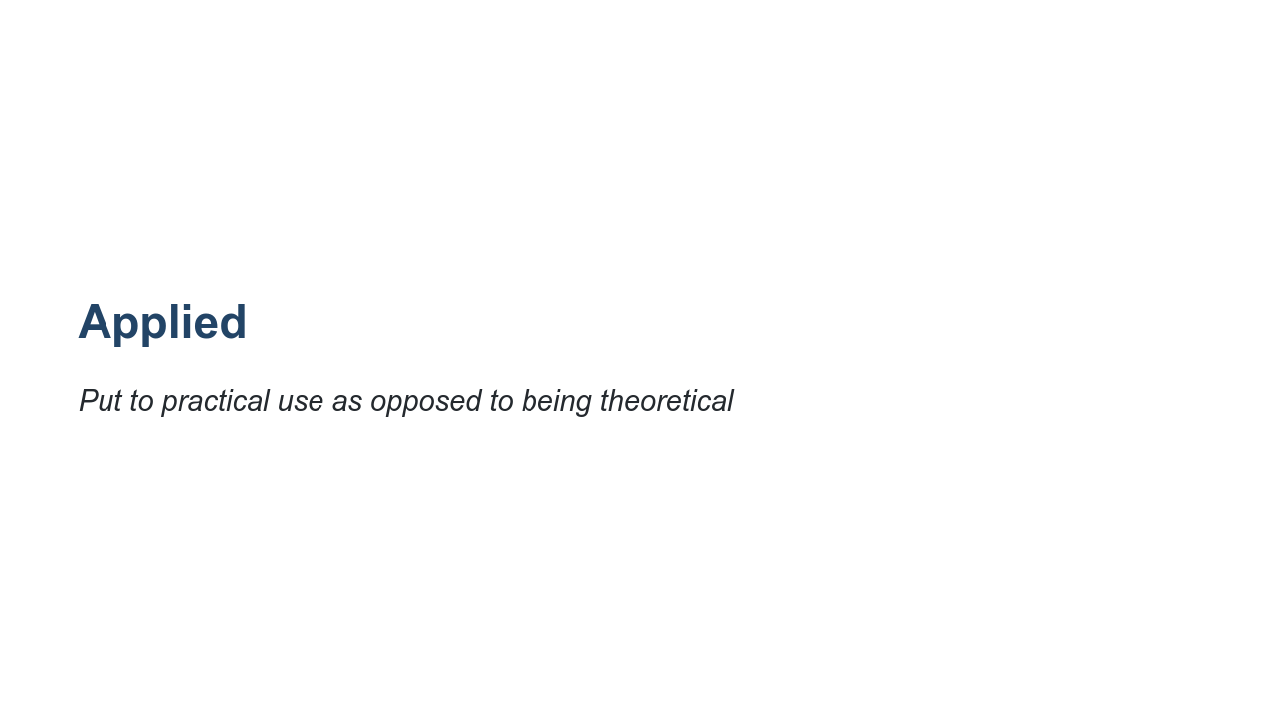
Notes:
Let's touch a bit more on what we'll actually be covering in this course by looking at the name of the course. The first word is 'Applied,' which means that we are going to put something to practical use. We aren't going to create new algorithms or methods for machine learning. Instead, we will take well-known models and apply them to different data sets in order to get some practical outcome. *Source: https://www.lexico.com/en/definition/applied

Slide 5
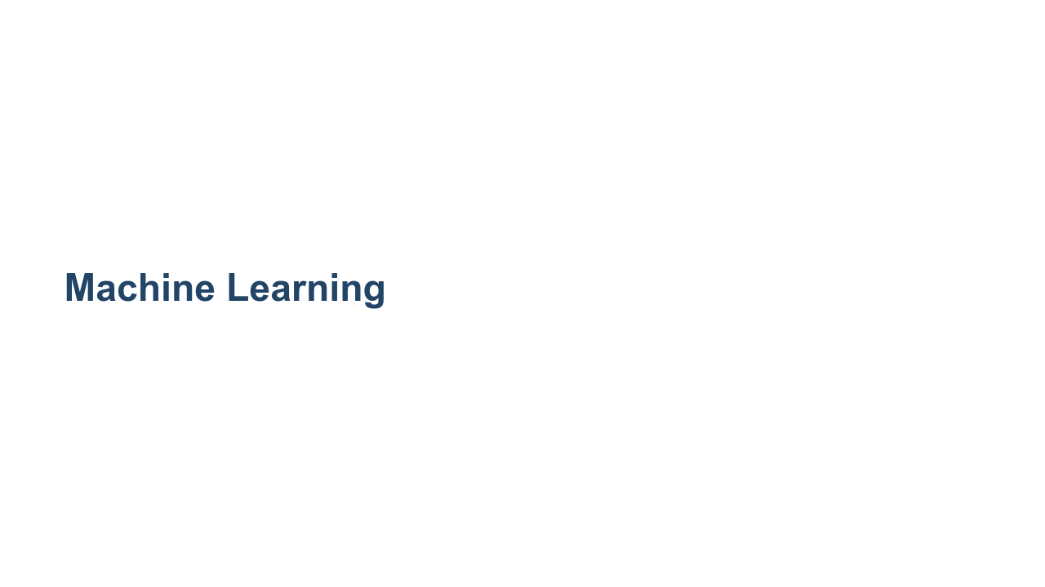
Notes:
What are we going to apply? We are going to apply machine learning techniques to data. But what does this mean? What is machine learning? *Prompt students to give their definitions of machine learning.*

Slide 6
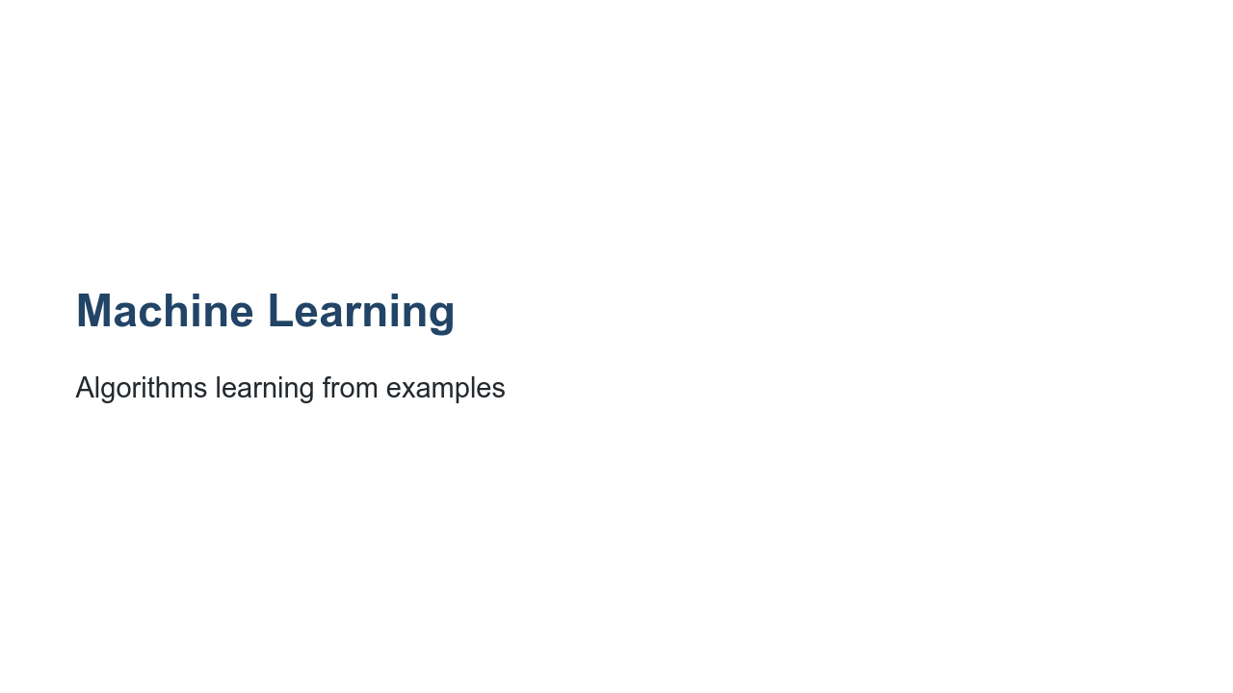
Notes:
Machine learning is all about algorithms learning from examples. What does that mean? And how is it different from standard programming? *Prompt the students to explain what 'learning from examples' means and how it is different from traditional programming?*

Slide 7
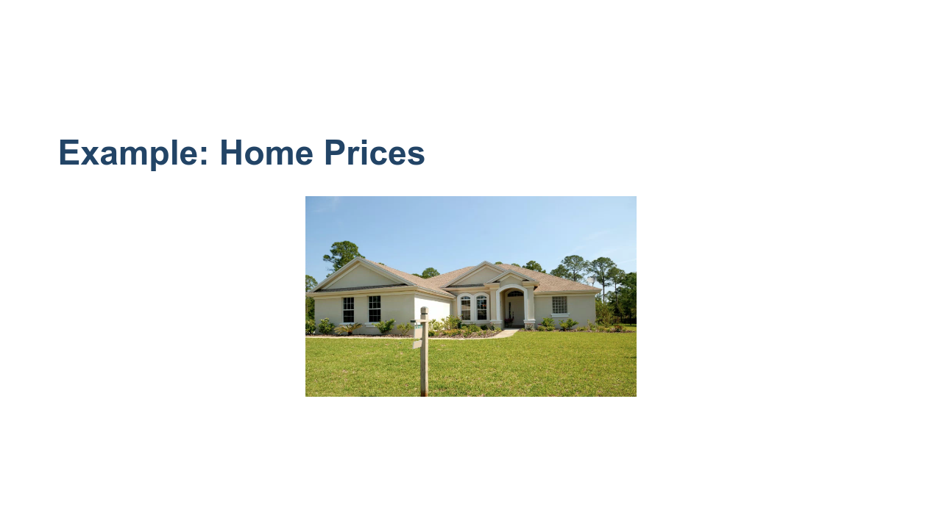
Notes:
Let's go through a quick example of how traditional programming and machine learning are different. Imagine you've been asked to create a home price predictor to help home sellers determine the amount they should sell their homes for. How would a traditional program be created to do this? * Image name: res/home-for-sale.png * Repo link: https://github.com/google/applied-machine-learning-intensive/tree/master/content/01_what_is_ml/00_introduction/res/home-for-sale.png * Source https://www.pexels.com/photo/white-and-brown-concrete-bungalow-under-clear-blue-sky-210617/ by Author Pixabay https://www.pexels.com/@pixabay under License https://www.pexels.com/creative-commons-images/.

Slide 8
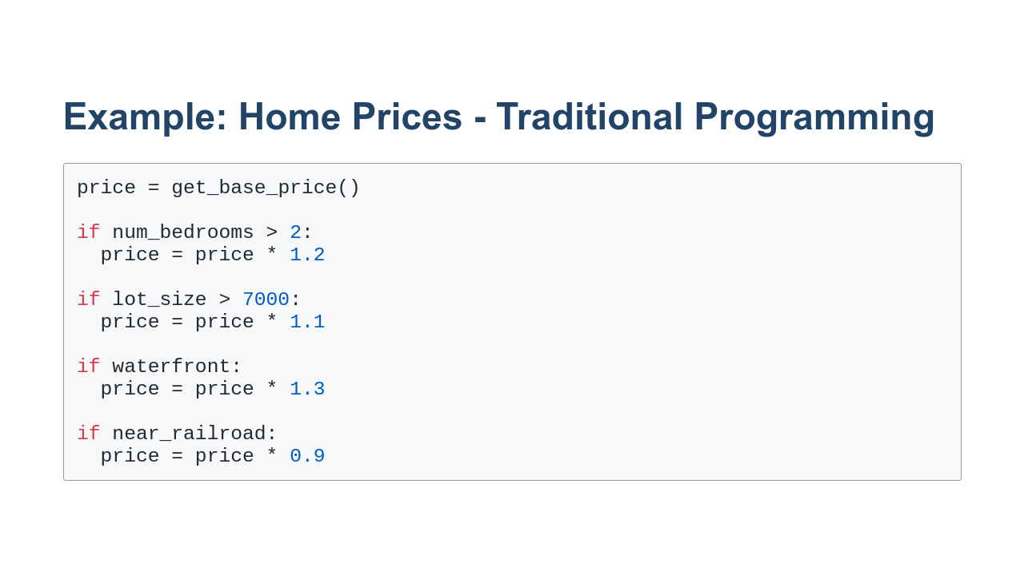
Notes:
With a traditional programming solution, programmers will do research, talk to subject matter experts, and come up with an algorithm for determining how to price a home. They might make adjustments for the number of bedrooms, lot size, and other features like the proximity to water or to train tracks. *Prompt the students to call out other features that might determine the price of a home. There should be quite a few features called out. Make sure that at least 10 are mentioned.* That was quite a list of attributes that might affect the price of a home. I'm sure that you know of even more that weren't mentioned. The list is huge and it really becomes difficult to maintain. It is fragile and is easily affected by the biases of the programmers, the amount of research work done on the subject, and the number of conditionals that the programmers can maintain.

Slide 9
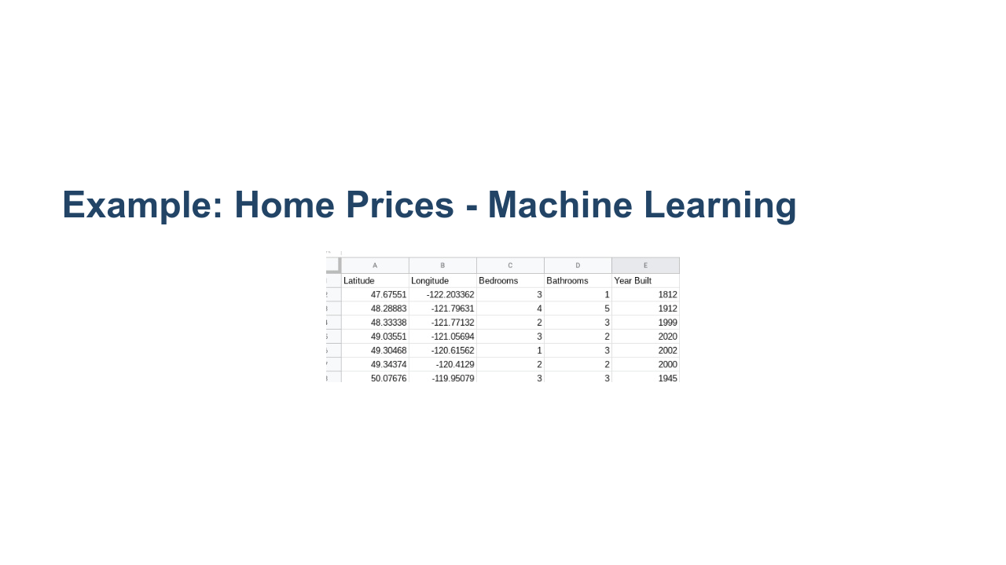
Notes:
Machine learning takes a different approach. With machine learning, programmers use proven model algorithms that analyze data automatically. This analysis of the data 'trains' the model without the programmers having to learn specific information about the data themselves. * Image name: res/home-data.jpg * Repo link: https://github.com/google/applied-machine-learning-intensive/tree/master/content/01_what_is_ml/00_introduction/res/home-data.jpg * Source https://github.com/google/applied-machine-learning-intensive/tree/master/content/01_what_is_ml/00_introduction/res/home-data.jpg by Author Google LLC under License Copyright [2020] Google LLC.

Slide 10
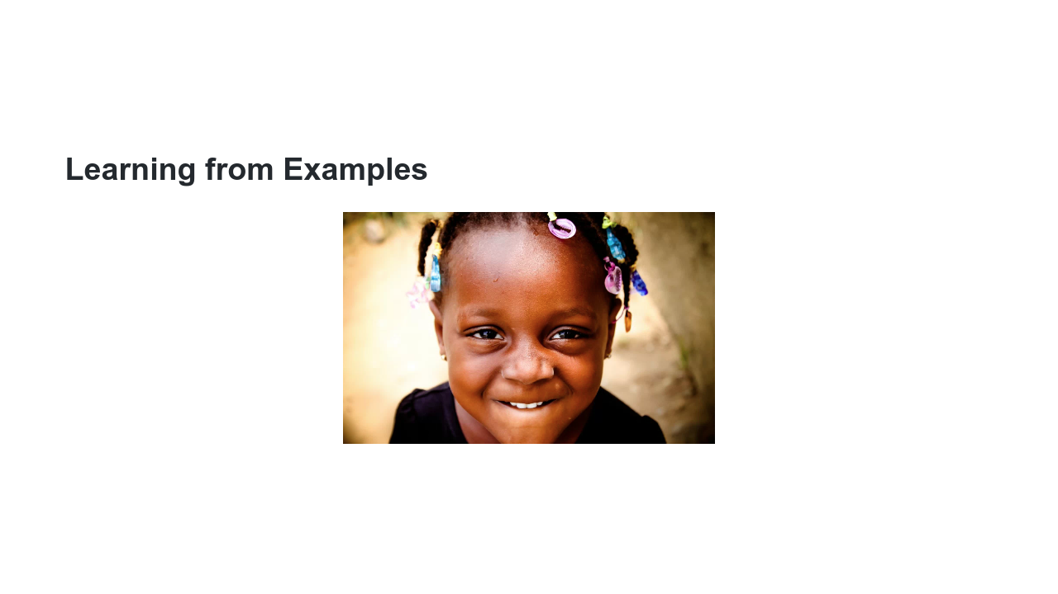
Notes:
Machine learning uses examples to identify patterns and make predictions on new examples. Imagine if you brought a young child to the zoo, and upon arriving at the lion exhibit, the child pointed at a lion and said, “It’s a kitty!” * Image name: res/toddler.png * Repo link: https://github.com/google/applied-machine-learning-intensive/tree/master/content/01_what_is_ml/00_introduction/res/toddler.png * Source https://pixabay.com/photos/african-child-black-child-child-2578559/ by Author kassoum_kone / kone kassoum https://pixabay.com/users/kassoum_kone-1914664/ under License https://pixabay.com/service/license/.

Slide 11
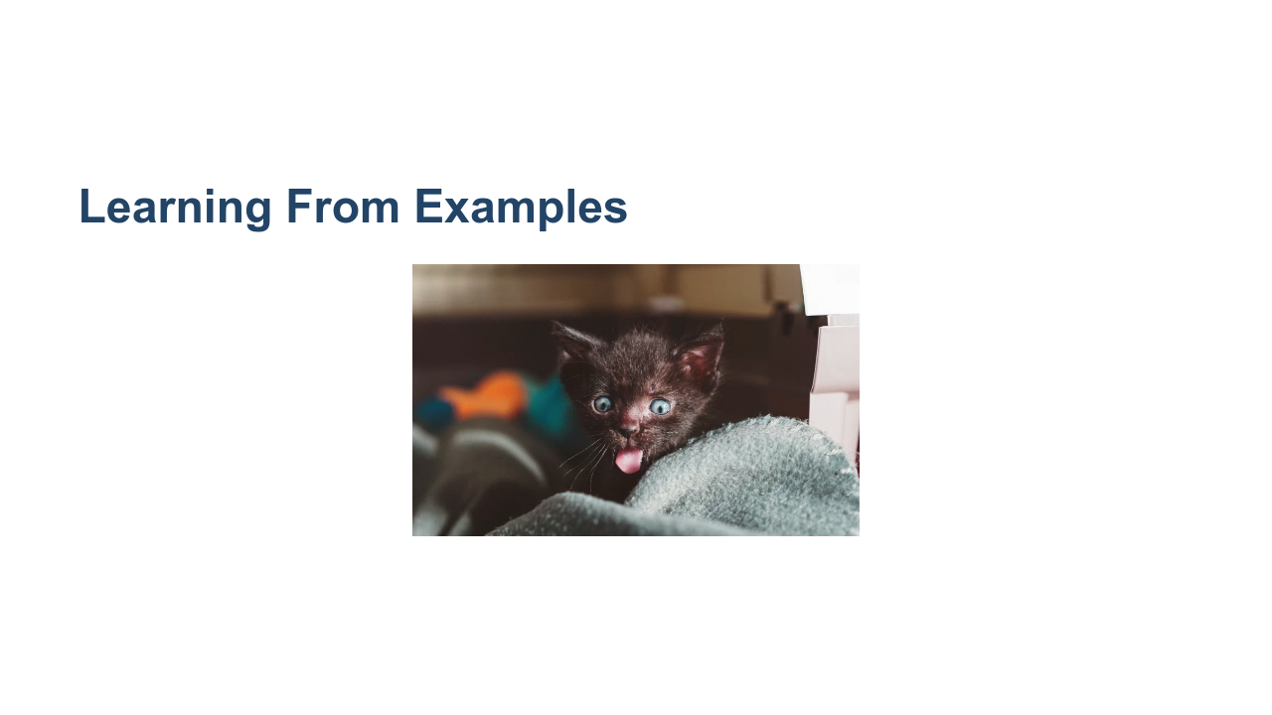
Notes:
Would you be surprised? Maybe the child has not seen a lion before, but does have a kitten at home, so they said the closest thing they could think of. * Image name: res/kitten.png * Repo link: https://github.com/google/applied-machine-learning-intensive/tree/master/content/01_what_is_ml/00_introduction/res/kitten.png * Source https://unsplash.com/photos/2Nca6Aum17o by Author Manki Kim https://unsplash.com/@kimdonkey under License https://unsplash.com/license.

Slide 12
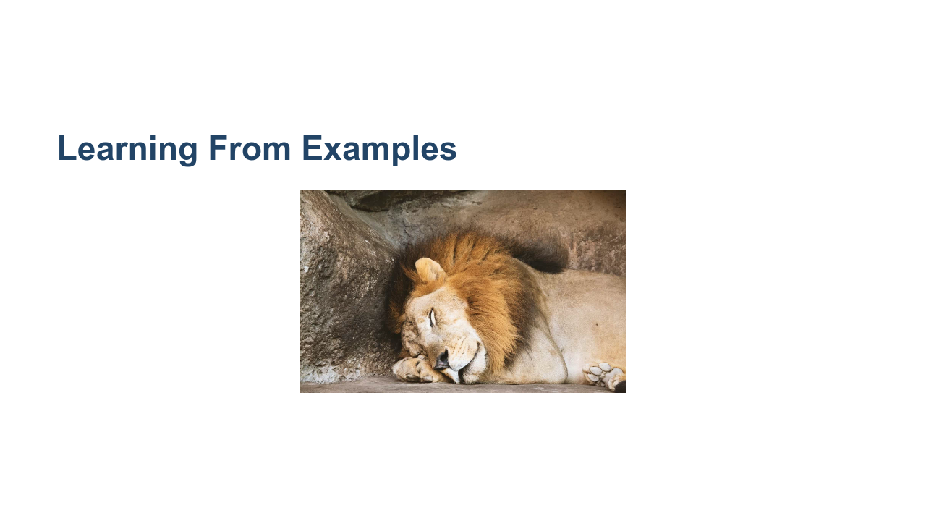
Notes:
You inform the child that this animal is a lion and continue your day at the zoo. * Image name: res/lion.png * Repo link: https://github.com/google/applied-machine-learning-intensive/tree/master/content/01_what_is_ml/00_introduction/res/lion.png * Source https://www.pexels.com/photo/lion-sleeping-beside-rock-1187987/ by Author Aldo Picaso https://www.pexels.com/@aldoalz under License https://www.pexels.com/license/.

Slide 13
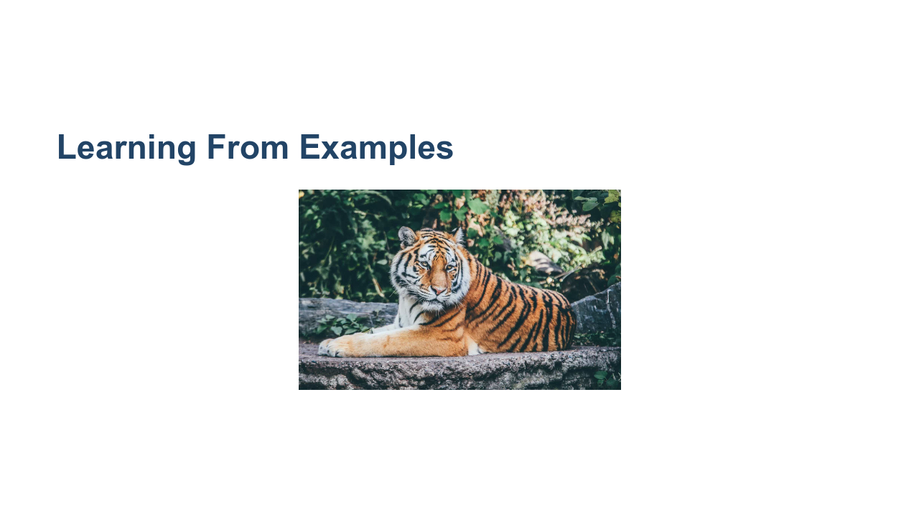
Notes:
Later, you arrive at the tiger cage and the child now says, “It’s a lion!” (Perhaps they now think all big cats are lions.) You might clarify for the child that tigers have stripes, while lions don’t. We expect children to learn from their surroundings, and when they get something wrong, we provide feedback to help them improve. The child's understanding of cats, lions, and tigers improves with feedback. Similarly, machine learning makes predictions based on feedback while learning from examples. * Image name: res/tiger.png * Repo link: https://github.com/google/applied-machine-learning-intensive/tree/master/content/01_what_is_ml/00_introduction/res/tiger.png * Source https://pixabay.com/photos/animal-tiger-big-cat-safari-1868911/ by Author Pexels / https://pixabay.com/users/pexels-2286921/ under License https://pixabay.com/service/license/.

Slide 14
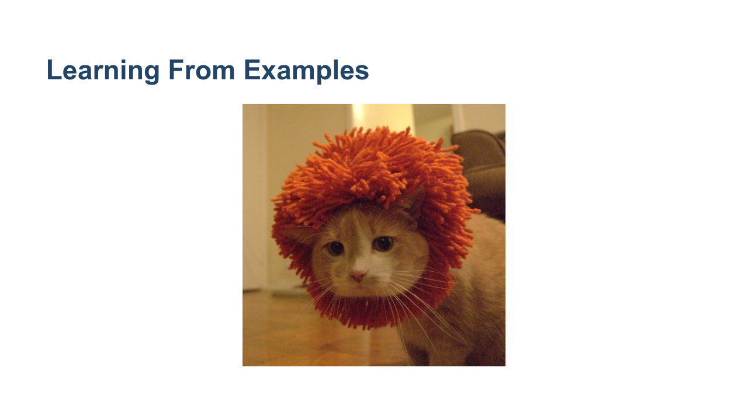
Notes:
A machine learning algorithm might have a hard time determining whether this is a cat or a lion. But then again, so might the child from the zoo. * Image name: res/cat-lion.jpg * Repo link: https://github.com/google/applied-machine-learning-intensive/tree/master/content/01_what_is_ml/00_introduction/res/cat-lion.jpg * Source https://github.com/google/applied-machine-learning-intensive/tree/master/content/01_what_is_ml/00_introduction/res/cat-lion.jpg by Author Google LLC under License Copyright [2020] Google LLC.

Slide 15
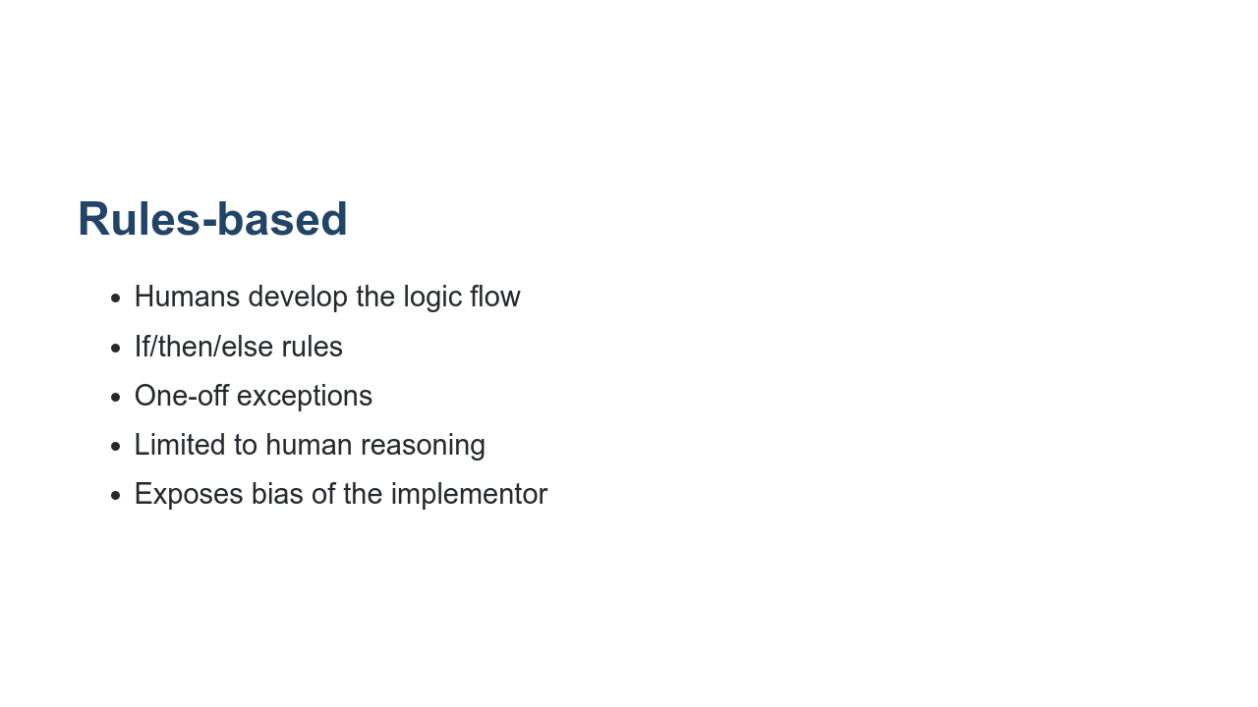
Notes:
Before machine learning, many problems used a “rules-based approach," which makes predictions based on a list of rules. In some situations it’s useful to have this human input, but it’s challenging to maintain as new rules are needed for each change in user needs or ecosystem. Consider the problem of deciding whether an animal picture is a lion. A rules-based approach might check for various things: if the animal has two ears, whiskers, walks on four legs, and is large. But what if you forget to include a rule for no stripes? What if the picture is of a lion cub, which isn’t large? References: https://en.wikipedia.org/wiki/Rule-based_system

Slide 16
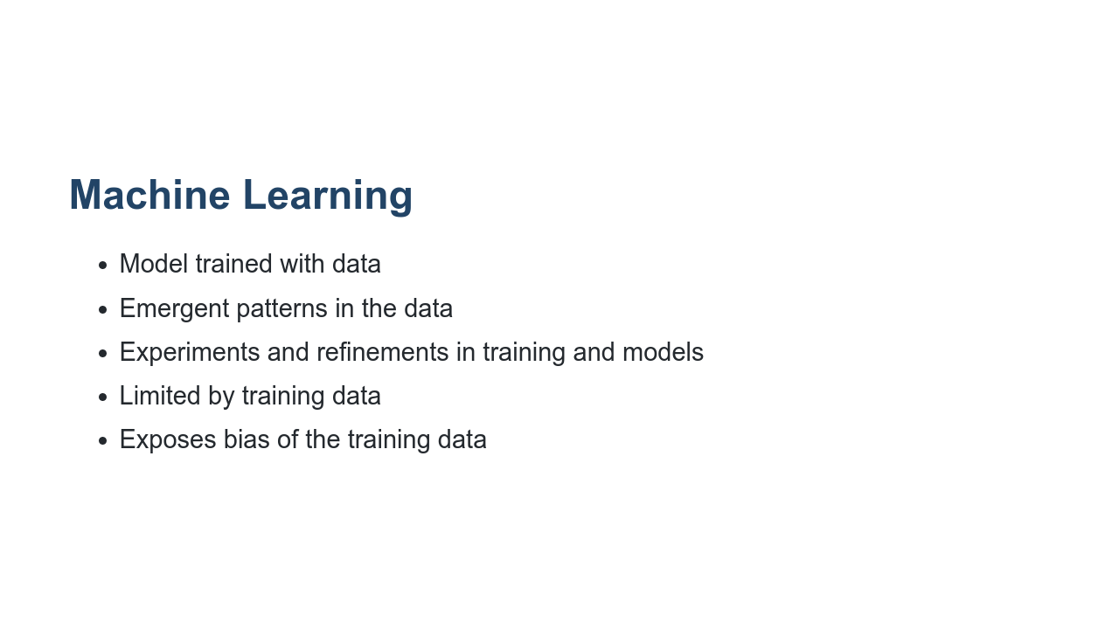
Notes:
A machine learning approach would be able to look through a large number of examples to find the patterns of what a lion looks like without being explicitly told. ML systems are easier to update as user needs and the ecosystem changes. Some more advantages and disadvantages of both approaches are shown here.

Slide 17
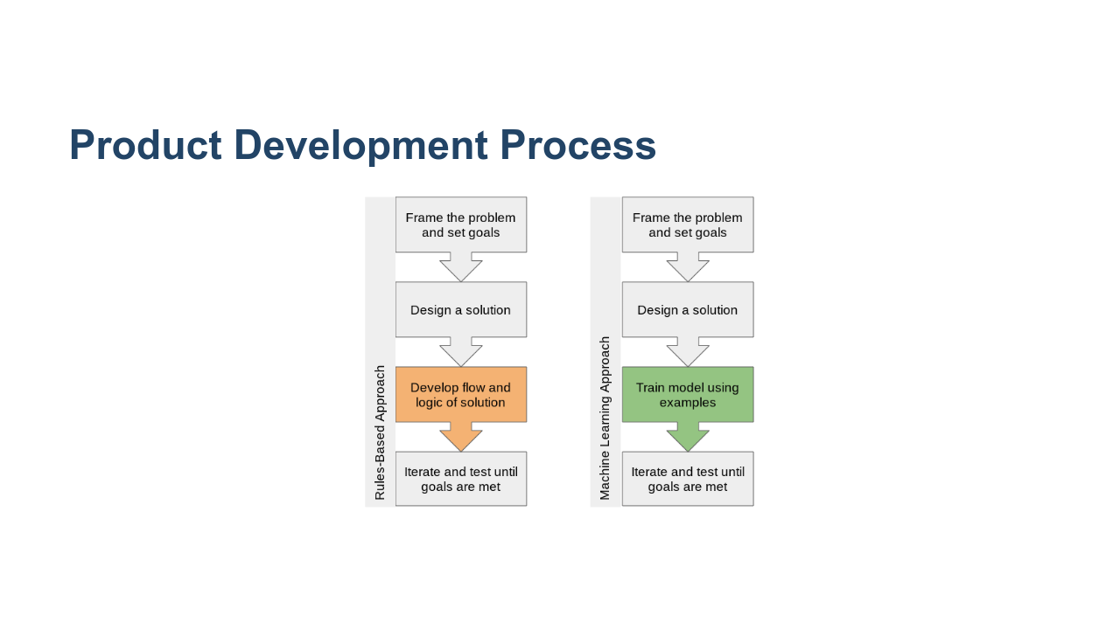
Notes:
Machine learning is an iterative process that requires large amounts of data to learn useful, generalizable patterns. Your first step when approaching a problem should always be to define a clear, user-focused goal. Then, decide whether to take a rules-based or machine learning approach based on how the advantages of each fit your goal. (Generally, if you have a large amount of diverse data, machine learning is the way to go.) No matter your approach, you’ll then need to test and refine your system until goals are met. * Image name: res/product-development-process.png * Repo link: https://github.com/google/applied-machine-learning-intensive/tree/master/content/01_what_is_ml/00_introduction/res/product-development-process.png * Source https://github.com/google/applied-machine-learning-intensive/tree/master/content/01_what_is_ml/00_introduction/res/product-development-process.png by Author Google LLC under License Copyright [2020] Google LLC.

Slide 18

Notes:
You'll encounter many terms in this class and in your machine learning work. Here’s an overview of some of the most important terms.

Slide 19

Notes:
What is artificial intelligence?

Slide 20
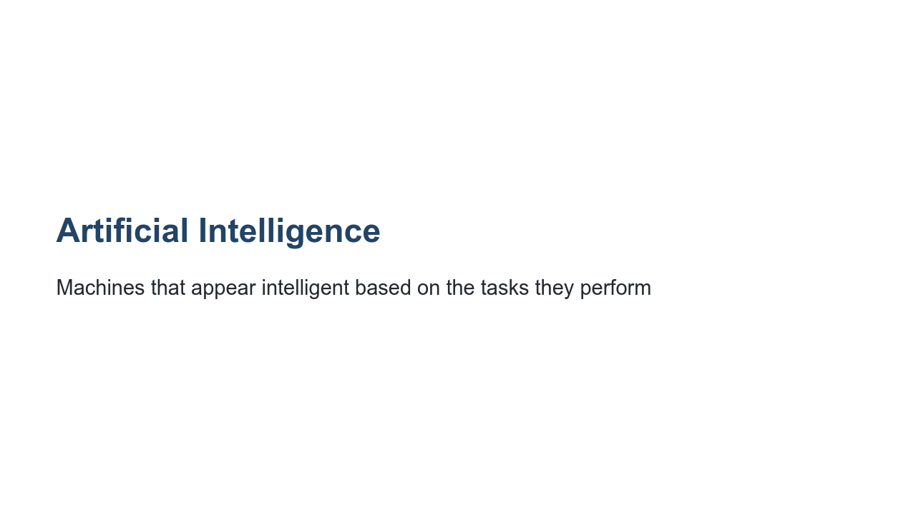
Notes:
You might think of crazy robots like in “Ex Machina," or chatbots like Google Home, but AI is a very broad field. In fact, machine learning is actually a specific field of AI.

Slide 21
Notes:
What is machine learning then?

Slide 22
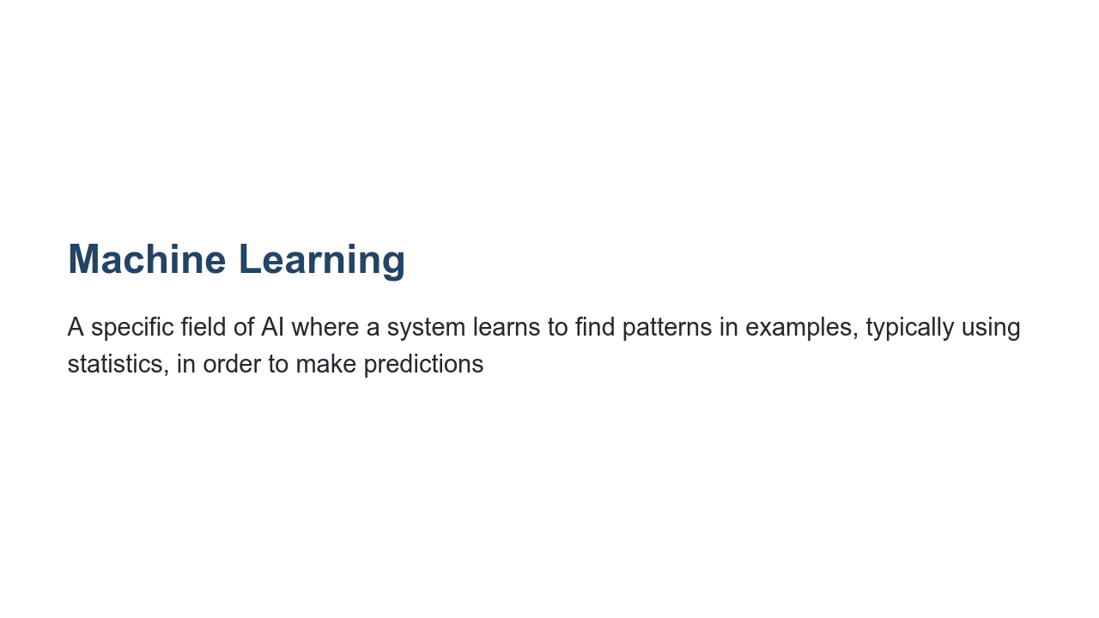
Notes:
Machine learning is a strategy through which AI can appear “intelligent” when performing tasks.

Slide 23
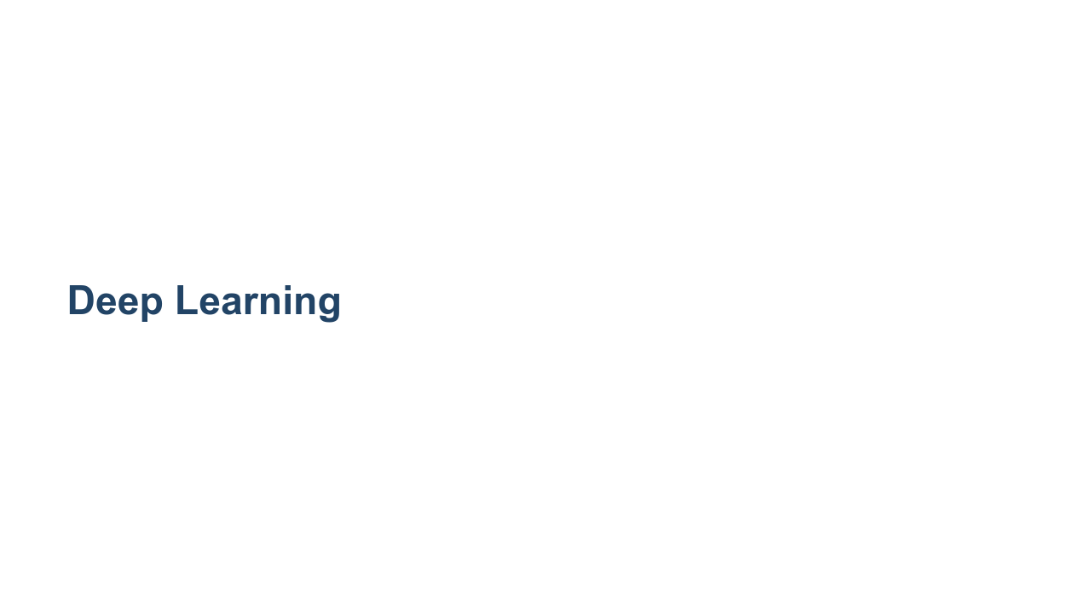
Notes:
“Deep learning” is a term that has become more and more widely used in recent years, due to the increasing availability of data.

Slide 24
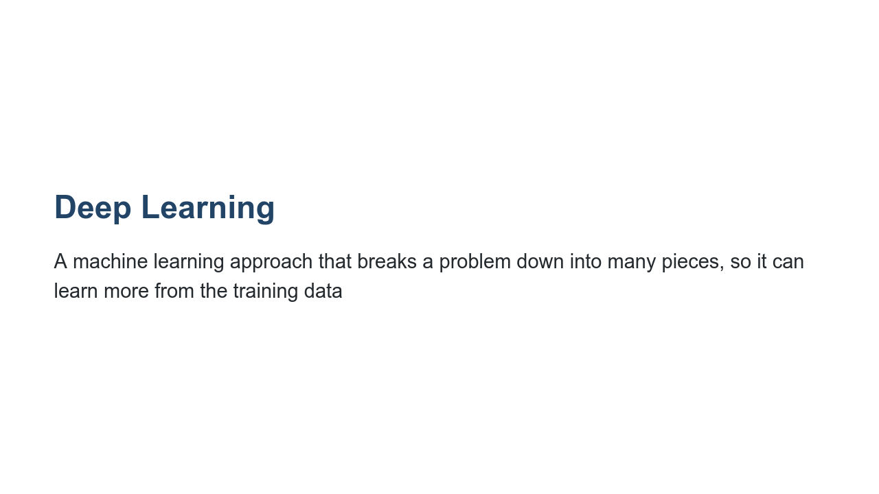
Notes:
Deep learning is a specific type of machine learning approach that gets its name from the large number of layers often used to build a neural network. Because these models are so complex, different layers can often learn different insights about the problem. For example, a neural network classifying images of animals could have a layer that examines the colors in the image and another that looks for shapes. The insights from layers like these can be combined to identify, for example, whether an image shows a lion or a tiger.

Slide 25
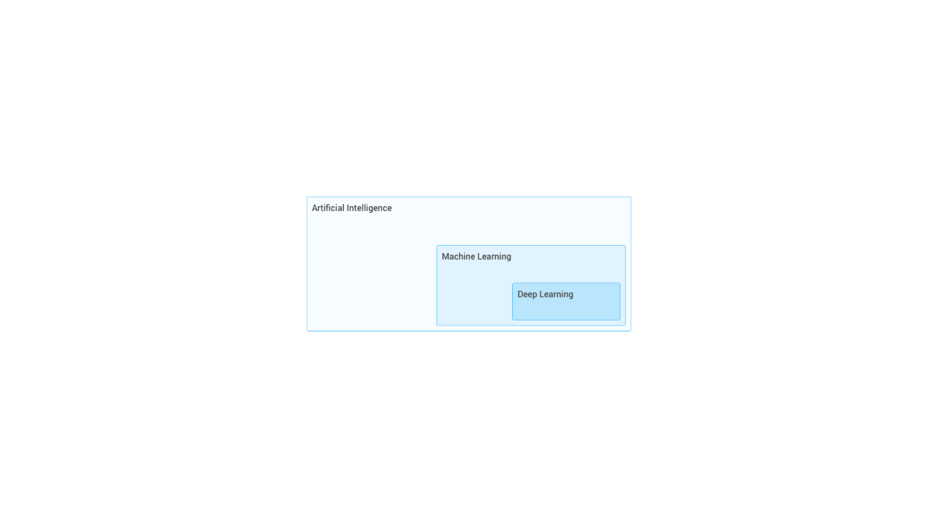
Notes:
Sometimes these terms are used interchangeably, but that’s not quite correct. Deep learning is a specific technique in machine learning, which is a subfield in AI. * Image name: res/deep-learning-hierarchy.png * Repo link: https://github.com/google/applied-machine-learning-intensive/tree/master/content/01_what_is_ml/00_introduction/res/deep-learning-hierarchy.png * Source https://github.com/google/applied-machine-learning-intensive/tree/master/content/01_what_is_ml/00_introduction/res/deep-learning-hierarchy.png by Author Google LLC under License Copyright [2020] Google LLC.

Slide 26

Notes:
Now let’s dive deeper into what goes into a machine learning system.

Slide 27
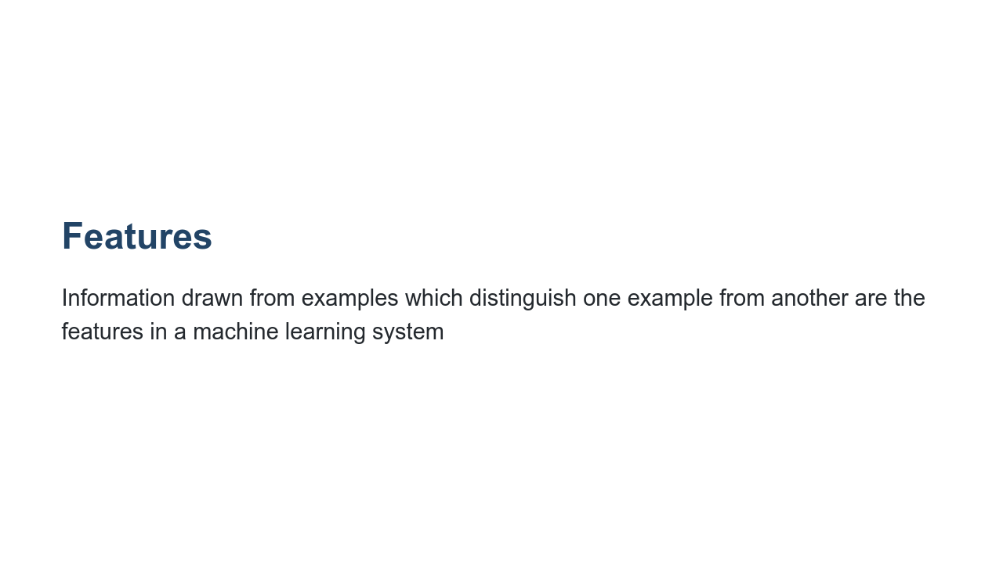
Notes:
For example, if we're trying to decide whether an image is of a lion or a tiger, useful features could be whether an animal has a mane or stripes. Some machine learning approaches (like deep learning) can automatically detect important features. But very often, you’ll need to define what features to include based on your specific goal.

Slide 28

Notes:
Say your goal is to give good video recommendations to viewers. Quick discussion: What features or distinguishing information might be useful? Examples include video topic, number of views, creator of video

Slide 29
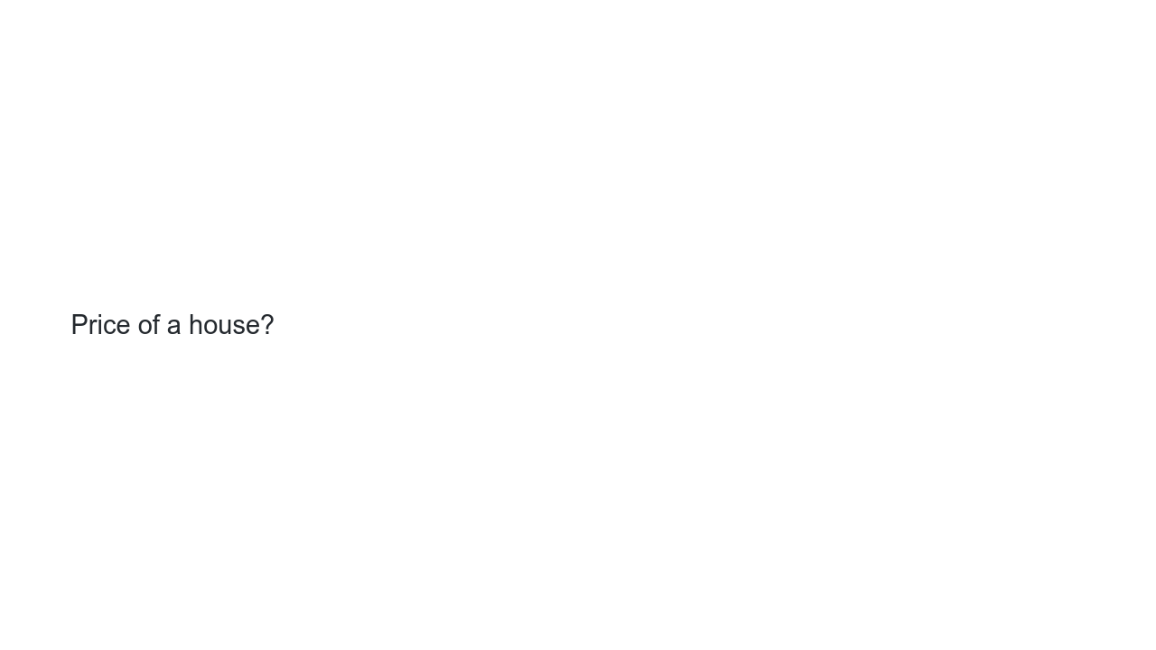
Notes:
Quick discussion: What if your goal is to predict the price of a house? Examples include location, number of bedrooms, size of property

Slide 30

Notes:
Quick discussion: What if you’re predicting which ad to display to someone using google search? Examples include user’s query, type of device, time of day

Slide 31

Notes:
These features are used in a model to make predictions.

Slide 32
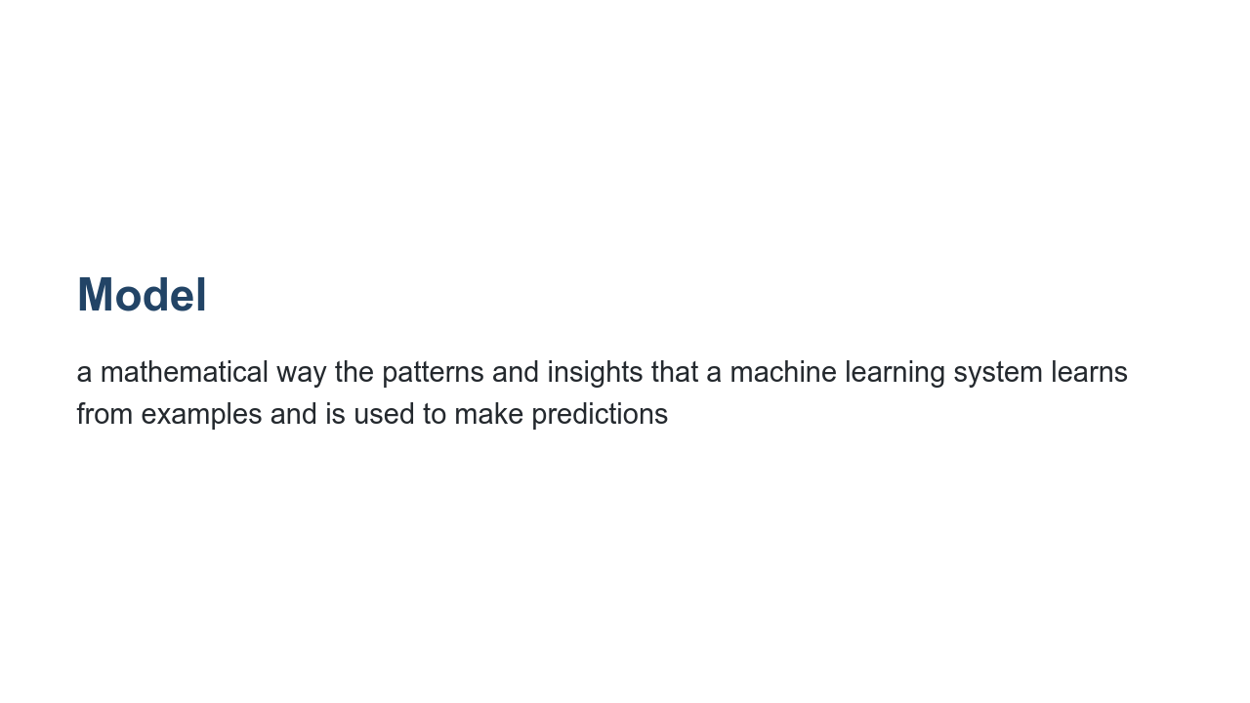
Notes:
A model specifies how your machine learning system will actually learn patterns and insights. The model will then make predictions based on what it learned. Different models perform better on different problems. We’ll discuss several common types of models in a later lecture. For example, (price of house) = 100 * (square footage of house). If the house is 1500ft^2, then we forecast the price to be $150,000.

Slide 33

Notes:
Teaching a model the difference between a lion photo and a tiger photo requires training data. Training data is a large set of examples related to the problem you are trying to solve. The model will make predictions based on the patterns found in the training data. In one type of machine learning, known as supervised learning, the examples are labeled. For example, the title of an image could be "lion" or "not a lion." The model could use these titles as feedback, learning better how to classify images. Especially with more data, models can become so complex that the details of how the model makes its predictions are difficult to understand. It’s important to continually evaluate and try to understand the output of your models.

Slide 34

Notes:
Machine learning makes predictions on new data based on previous examples (training data). If your lion-detecting model adequately distinguishes lions from tigers, the model is performing successfully. If not, you can experiment with additional training data or other approaches to improve the results. The data you use for testing should be representative of your problem and goal. Then your performance on the testing dataset should give you an idea of how your model will perform on totally new, real data.

Slide 35
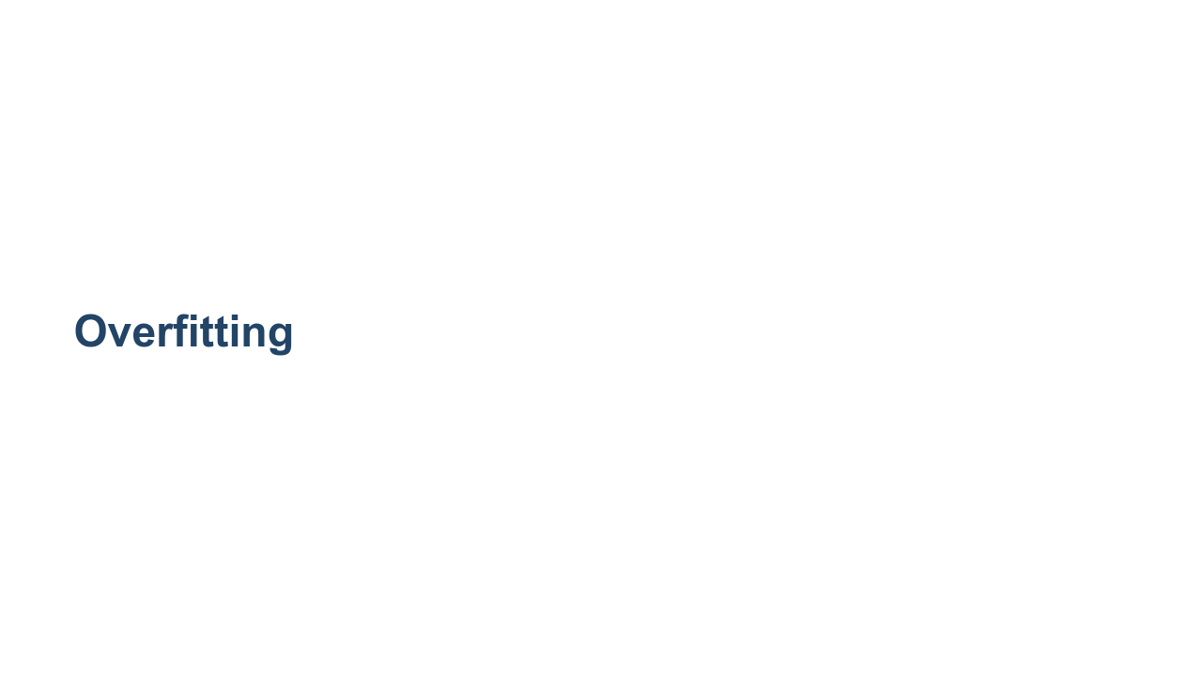
Notes:
It’s important to always have a separate training dataset and testing dataset. If you observe high performance on the training data but lower performance on the separate testing data, it’s a sign of overfitting.

Slide 36
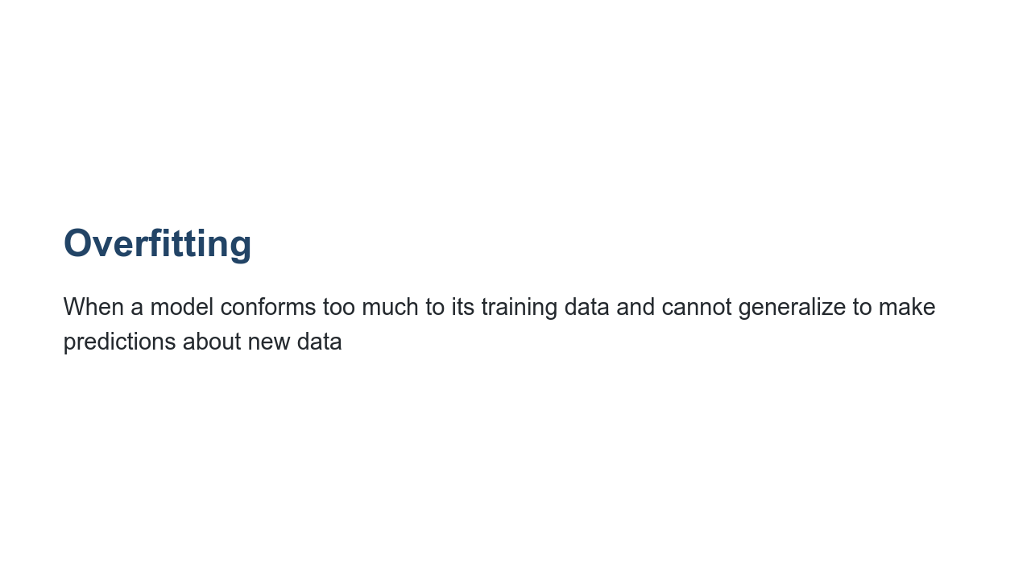
Notes:
Overfitting occurs when a model conforms too much to its training data and cannot generalize to make predictions about new data. For example, if none of the tigers in the training data have white fur, the model could assume all tigers have orange fur. Just like the child from the zoo, a machine learning model will do the best it can with the information it has. Overfitting can be mitigated by looking for blind spots and bias in data and processes. It might also be a sign you need more training data. We’ll have a deeper discussion of how to improve performance of machine learning models, including reducing overfitting, later in the class.

