Slide 1
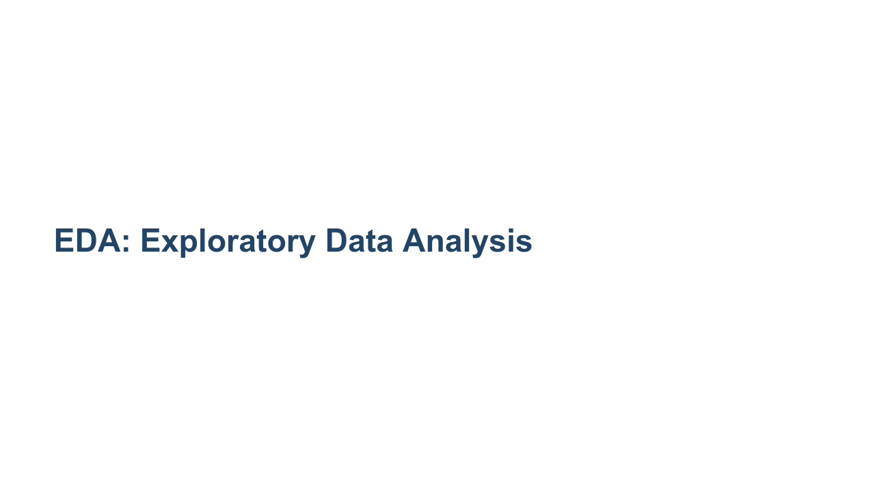
Notes:
Exploratory Data Analysis, EDA for short, is the term used for the process of analyzing your dataset. EDA involves loading your data and then using queries and visualizations to find out information about your dataset.

Slide 2
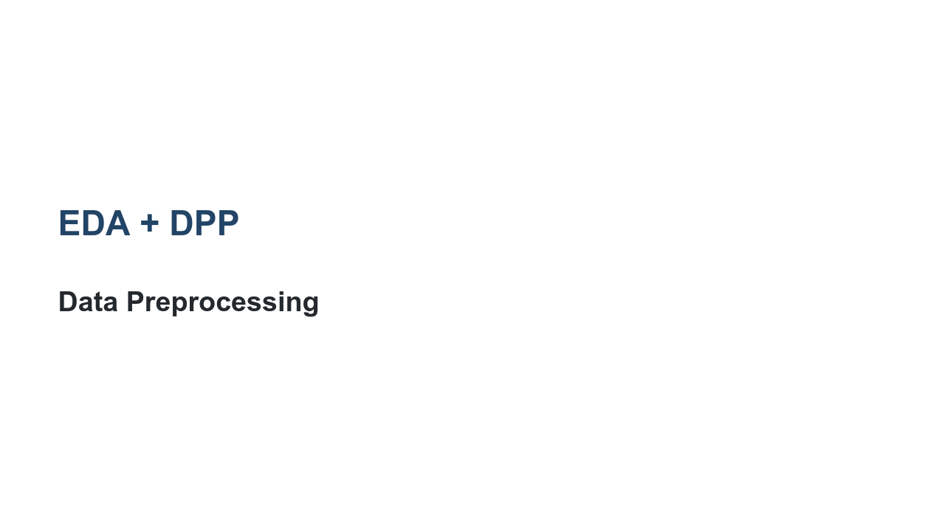
Notes:
Often you'll find that issues with the data actually prevent you from performing a quality exploratory data analysis. These issues can include missing values, impossible values, and values of the wrong type. There are scores of issues that can make analyzing your data difficult. Because of this, you'll often find yourself doing some preprocessing of your data while you are performing EDA. Strictly speaking, EDA is just analysis. In practice, data analysis and data preprocessing and manipulation are intertwined. As you look at your data more closely, you'll have to fix parts of it to look further.

Slide 3
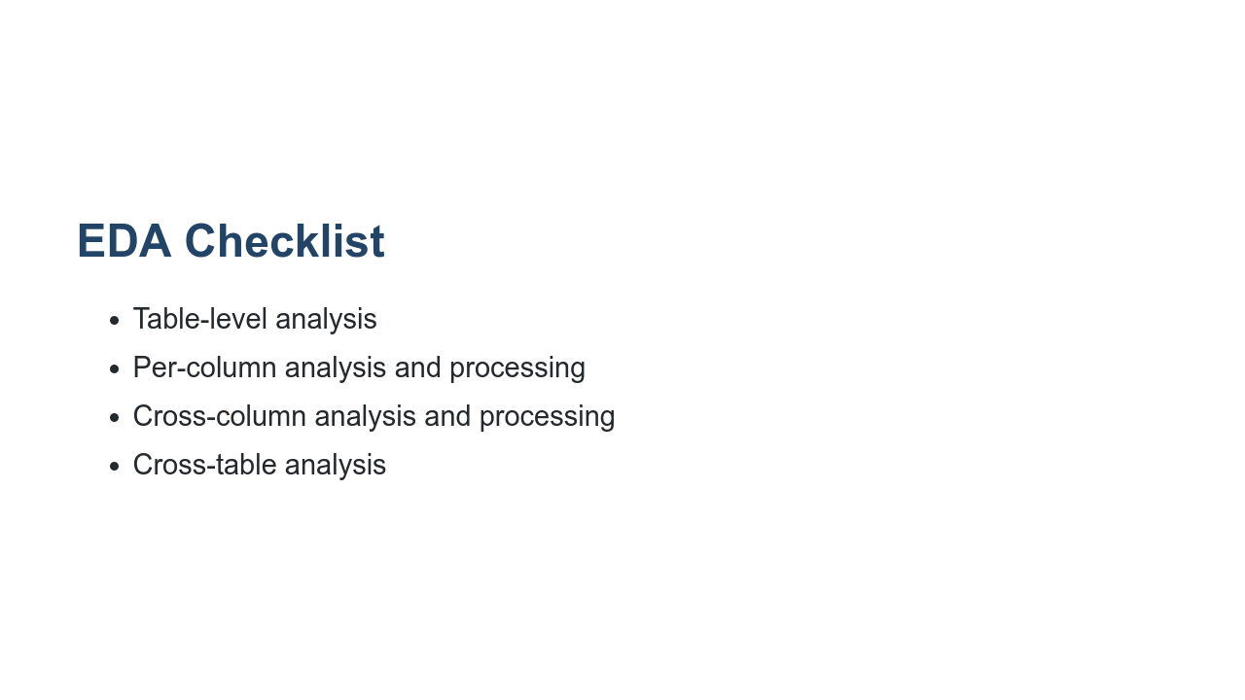
Notes:
There is no official EDA checklist. Every dataset is different. Every data scientist has a different approach. Some data scientists pre-formulate questions and then perform the analysis and preprocessing necessary to answer those questions. Some data scientists begin with a thorough check of each component of the data, fix obvious errors, and then explore through questions. Some of these questions are created during the initial cleaning pass. Your approach to EDA will also depend on the type of data you're working with. For example, are you looking at images and videos or tabular data (like we've been working within Pandas)? We will talk more about image data in a later unit of this course. If you're working with tabular data, then regardless of how you approach the analysis, you will likely gather a few distinct types of information: single-table information, single-column information, cross-column information, and then cross-table information.

Slide 4
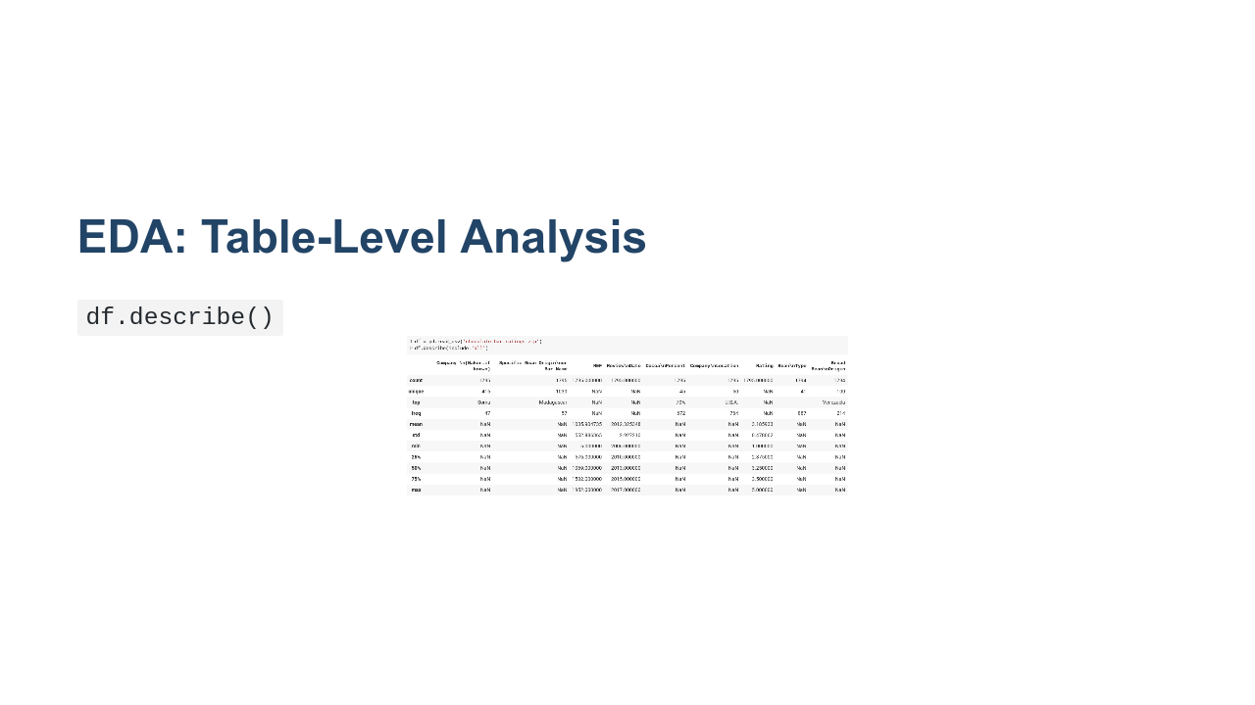
Notes:
Table-level analysis is all about getting to know data about an individual table or `DataFrame` of data as a whole. Using `describe()` we can see things like the column names and the row counts. In this example we can see that there are 1795 rows. We can see that some are missing values. We can also see the column names and can infer the column types by what statistics are printed. What other information can you see in this output? What other methods do we know that can provide us table-level analytics? * Image name: res/describe.png * Repo link: https://github.com/google/applied-machine-learning-intensive/tree/master/content/02_data/05_exploratory_data_analysis/res/describe.png * Source https://github.com/google/applied-machine-learning-intensive/tree/master/content/02_data/05_exploratory_data_analysis/res/describe.png by Author Google LLC under License Copyright [2020] Google LLC.

Slide 5
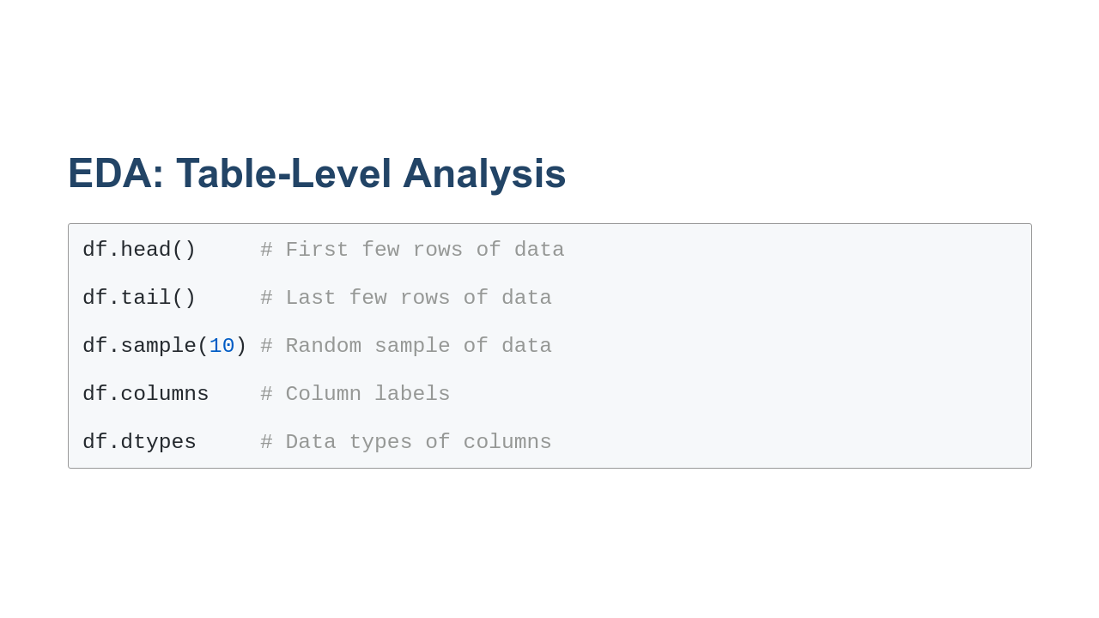
Notes:
Here are some examples of other table-level methods and attributes we can use to learn about the data in a `DataFrame`.

Slide 6
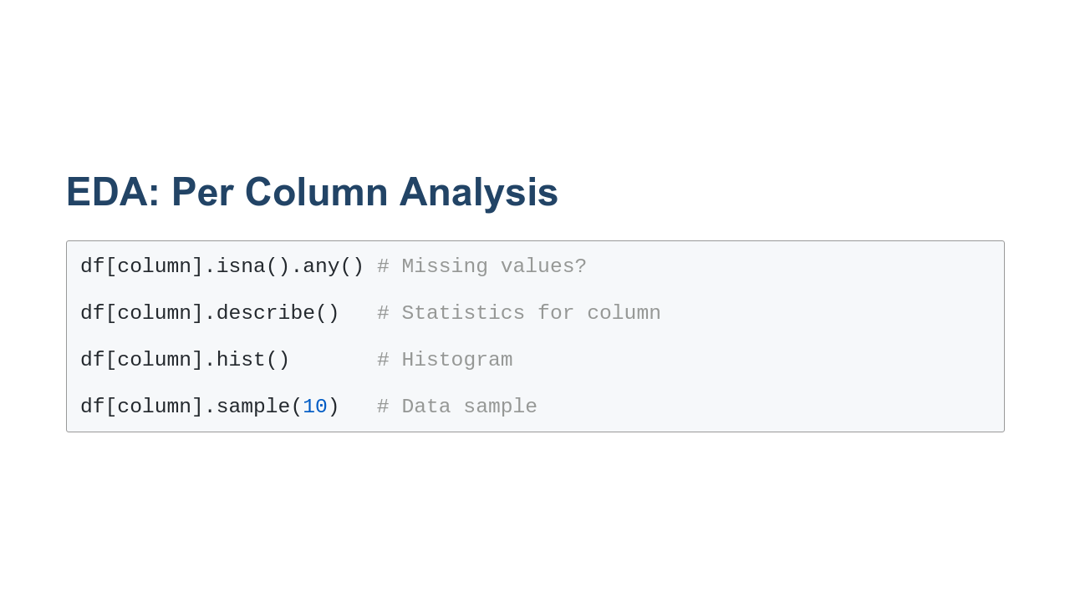
Notes:
Analysis of a single column/`Series` of data is similar to that of a `DataFrame`. You can use many of the same methods. Most statistics you can gather about a `DataFrame` can also be done for an individual column. Sometimes it is nice to look at these stats column-by-column, so you don't get overwhelmed with information.

Slide 7
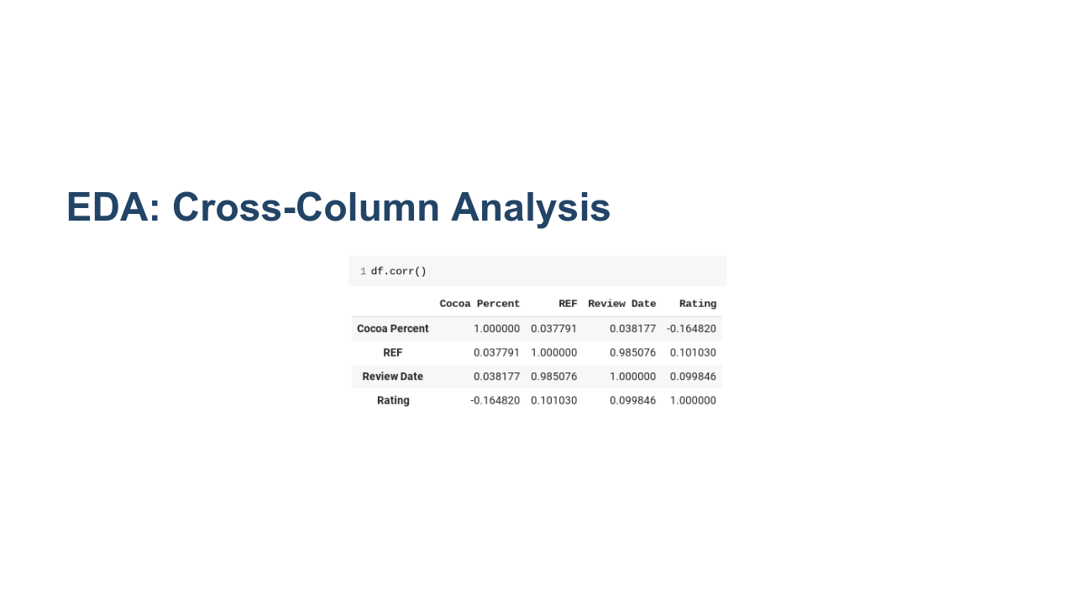
Notes:
Cross-column analysis simply means looking at the relationships among data across columns. This is often done visually, but it doesn't have to be. In the example shown, we can see the correlation between columns with a call to `corr()`. Recall that the Pearson correlation coefficient is used to measure the strength of a linear association between two variables. Note that along the diagonal, we have a correlation of 1.0, since each column is perfectly correlated with itself. A correlation coefficient of 1.0 means that for every positive increase in one variable, there is a positive increase of a fixed proportion in the other. Off the diagonal, we have values between -1 and 1 that indicate the correlation between two columns. A negative correlation means that for every positive change (increase) in one variable, there is a negative change (decrease) in the other variable. The magnitude of the correlation coefficient captures the strength of the correlation. * Image name: res/correlation.png * Repo link: https://github.com/google/applied-machine-learning-intensive/tree/master/content/02_data/05_exploratory_data_analysis/res/correlation.png * Source https://github.com/google/applied-machine-learning-intensive/tree/master/content/02_data/05_exploratory_data_analysis/res/correlation.png by Author Google LLC under License Copyright [2020] Google LLC.

Slide 8
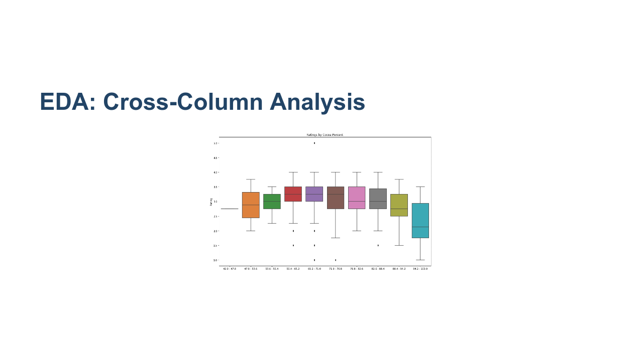
Notes:
Of course, many times visualizations are very helpful. Here we see a boxplot of two columns in a `DataFrame`. On the x-axis, we have the percent of cocoa in the chocolate. On the y-axis, we have the ratings. The line in the center of the box represents the median. We also see the quartiles and any outliers. * Image name: res/boxplot.png * Repo link: https://github.com/google/applied-machine-learning-intensive/tree/master/content/02_data/05_exploratory_data_analysis/res/boxplot.png * Source https://github.com/google/applied-machine-learning-intensive/tree/master/content/02_data/05_exploratory_data_analysis/res/boxplot.png by Author Google LLC under License Copyright [2020] Google LLC.

Slide 9
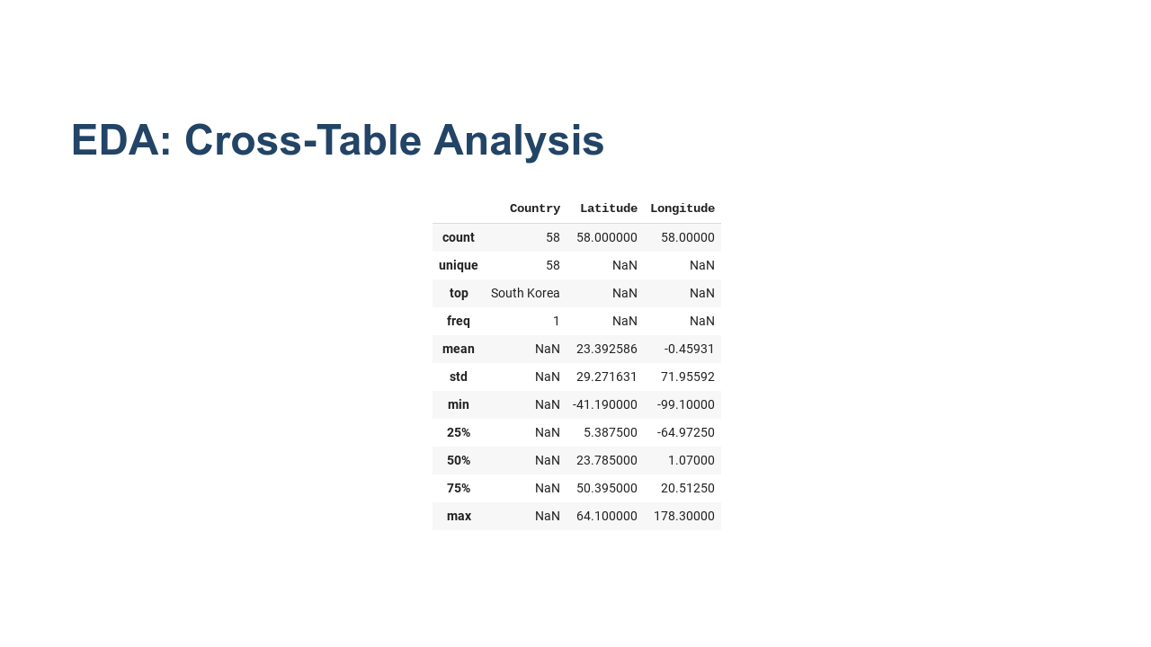
Notes:
Often we'll find ourselves working with many sources of data. Even data from the same data source is often provided as distinct files that later have to be merged. For example, here is a country table that contains geo-location data for a set of countries. If we have tables in our dataset with countries in them, we can merge the tables and do analysis based on location. This is really cross-table-cross-column analysis, but that is a lot to try to say. * Image name: res/country.png * Repo link: https://github.com/google/applied-machine-learning-intensive/tree/master/content/02_data/05_exploratory_data_analysis/res/country.png * Source https://github.com/google/applied-machine-learning-intensive/tree/master/content/02_data/05_exploratory_data_analysis/res/country.png by Author Google LLC under License Copyright [2020] Google LLC.

Slide 10
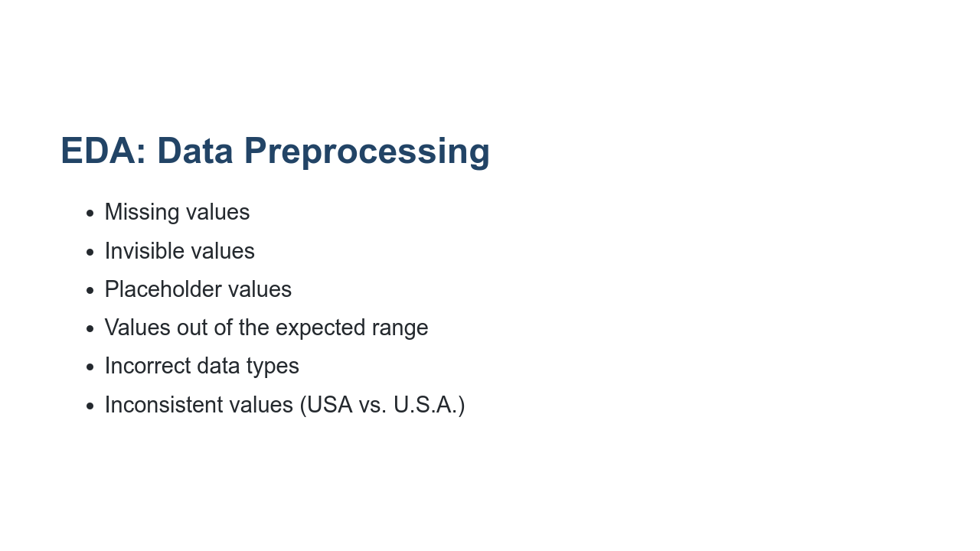
Notes:
As we mentioned earlier, it is difficult to successfully perform EDA without doing a bit of data preprocessing. Some common issues you'll encounter include those listed on this slide. Invisible values are probably the least self-explanatory. These are values where a space or some other invisible character is the only value at a data point. Technically the data isn't missing, so Pandas will not report it in an `isna()` check. However, the data present isn't actually meaningful. We'll see how to handle a case like this in the lab.

Slide 11
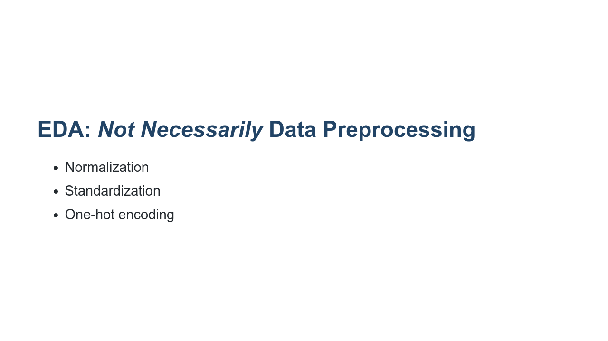
Notes:
There are some data processing techniques that aren't necessarily part of the EDA phase. A few of those are listed on this slide. These techniques are used to make your data more palatable to your model. We'll dig into each of these during this course. But here's a quick overview of each one on this list. * Normalization usually means rescaling the values into a range of [0,1]. * Standardization usually means rescaling data to have a mean of 0 and a standard deviation of 1. * One-hot encoding is a process of converting categorical variables into 0s and 1s (which is better for many ML algorithms). Your preprocessing steps are informed by your research questions and the model you intend to build to address your questions. Throughout this course, we will talk about when to use certain preprocessing techniques.

Slide 12
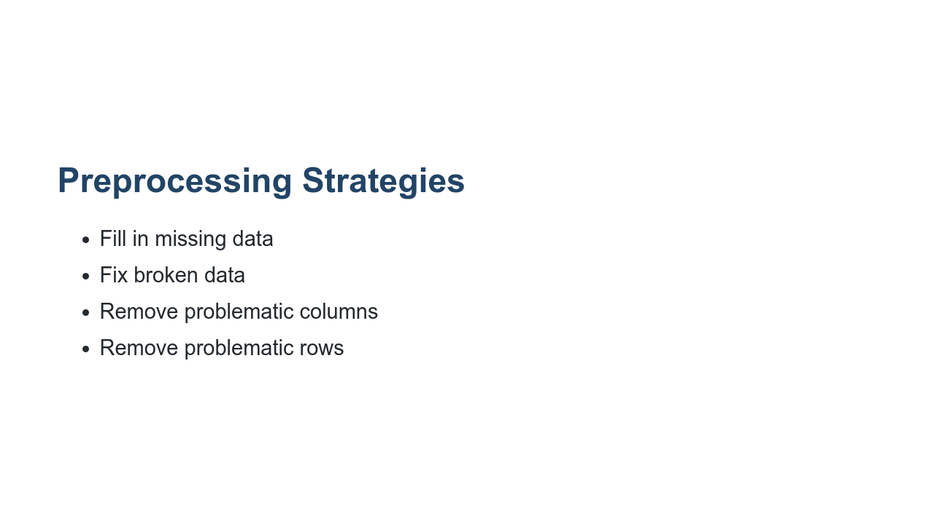
Notes:
What happens when you do find bad data? There are a few strategies. It is best to fill in and fix data wherever possible. Sometimes you just have to get rid of problematic data, though. There is no one-size fits all approach, and we will see many examples of these preprocessing steps in the lab and throughout the course.

Slide 13
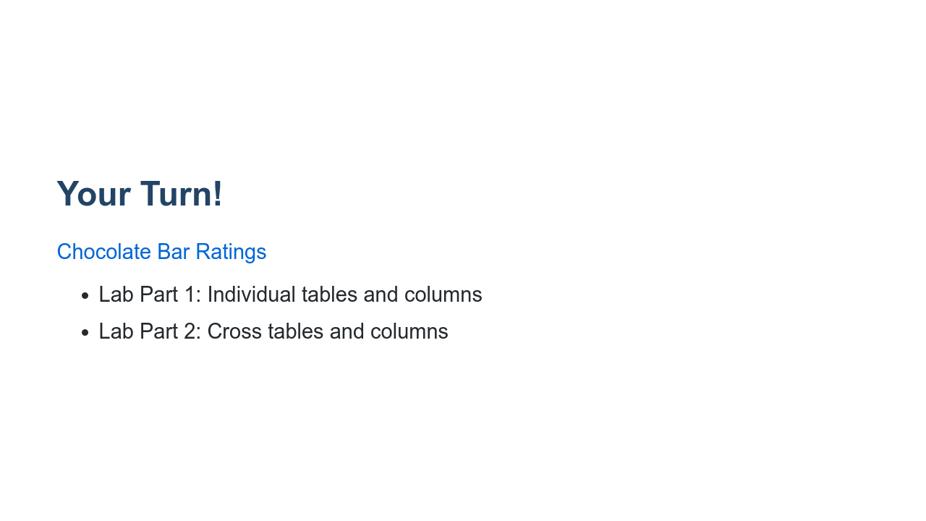
Notes:
It is about time for us to practice our EDA skills. We'll use tools we recently learned including Pandas, matplotlib, and seaborn. There are also some new concepts introduced in this lab, but it should mostly serve as an exercise in bringing the tools you have already learned together to perform exploratory data analysis and data preprocessing on a dataset. The lab is divided into two parts. Part 1 is all about individual table and column analysis and processing. Part 2 will build upon our work in part 1 and will bring in more tables to help us analyze our data. We'll also do some analysis of how columns relate to one another. Along the way we'll create some meaningful visualizations and answer questions about our dataset.

