Slide 1
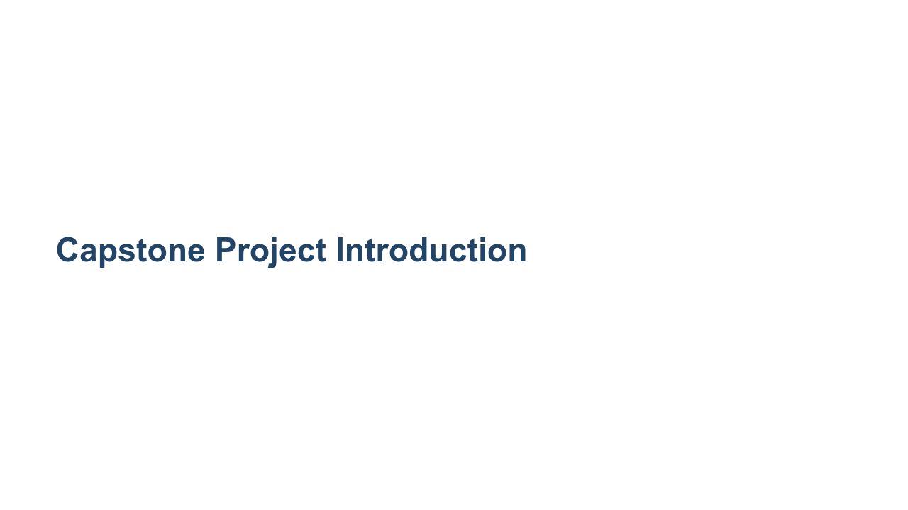
Notes:
Today we'll begin discussing the culminating assignment for this course: the capstone project. We'll begin by going over the project goals, guidelines, deliverables, and timeline in this presentation. Please feel free to ask questions as we go through. Later on we'll move into discussing project topic ideation and begin the process of forming teams.

Slide 2
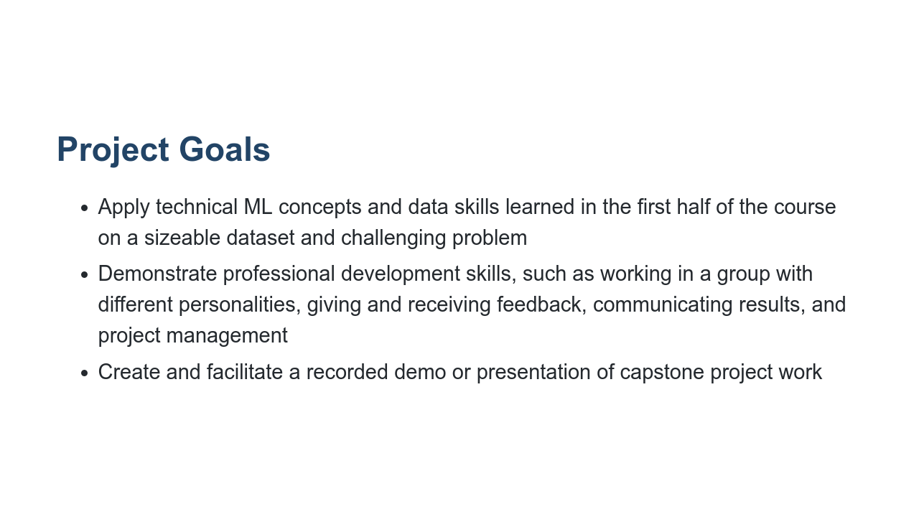
Notes:
A significant amount of this course and class time are intentionally devoted to the capstone project. We do this because employers want to see and hear about times you have worked collaboratively with other people in pursuit of a shared goal. Truthfully, that's much of professional life. You are better equipped to make your case to employers that you have experience working with others toward a technical goal if you have specific projects you can speak to, both listed on your resume and in your interview answers. The capstone project is one of those experiences, and it also allows you to apply the skills you've learned so far to address a specific question and present your results.

Slide 3
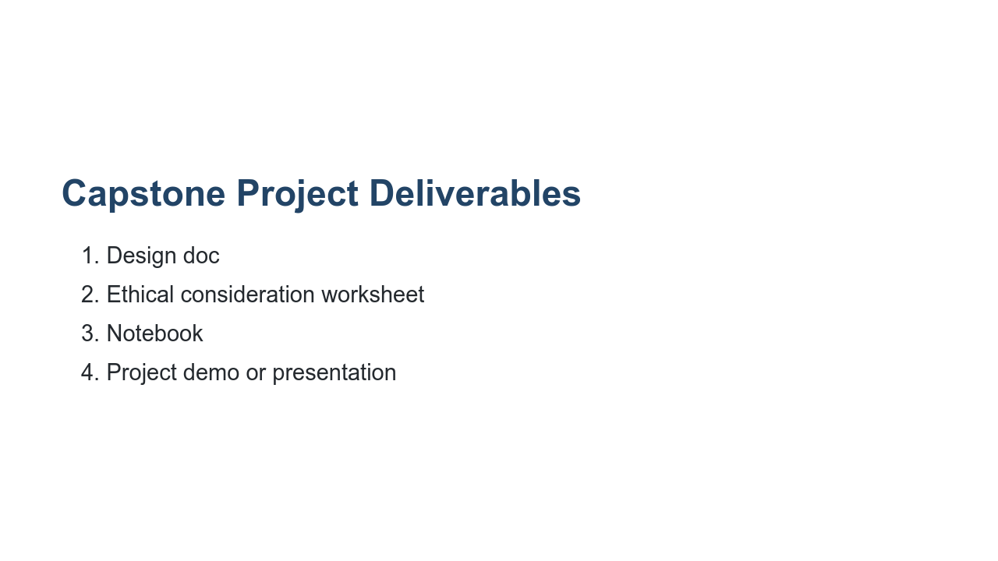
Notes:
Here are the deliverables for the capstone project. We'll go into each of them in more detail now.

Slide 4
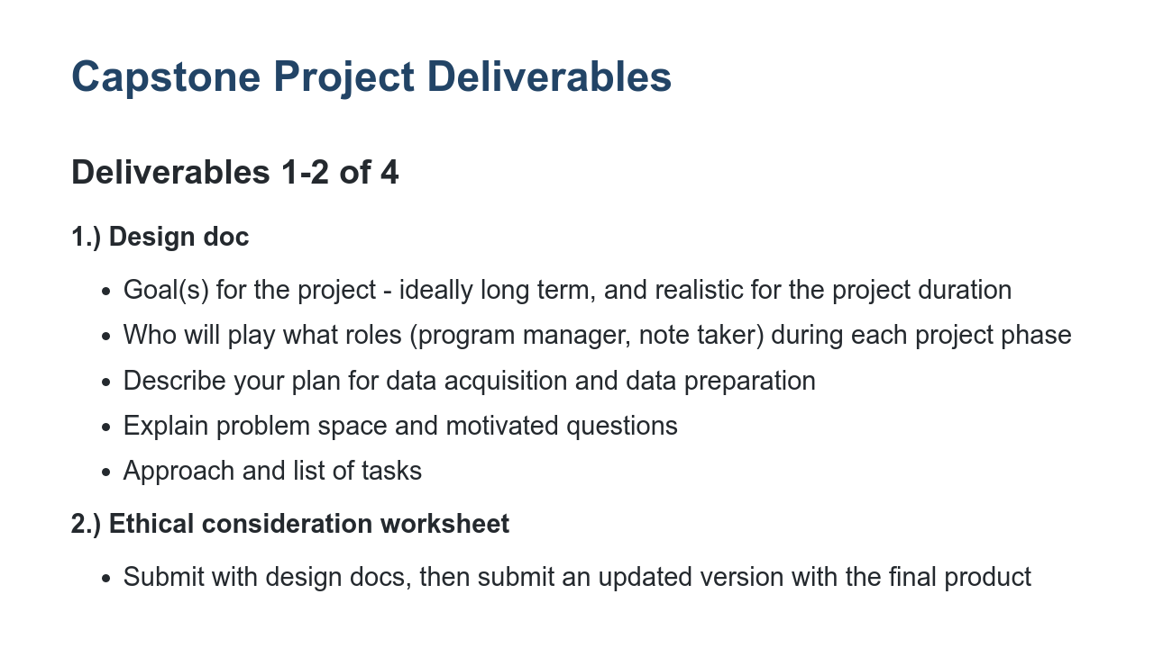
Notes:
First your team will complete a design doc that lays out the goals for your team's unique project, which team members will play what roles during each of the project phases, data-related information, what problem your project seeks to solve, and a list of tasks you'll complete in pursuit of that solution. Next you'll complete an ethical consideration worksheet that facilitates thought and discussion about the ethical implications of your project idea. Again, a template will be provided. You will submit this worksheet as part of the design docs. Then after you've worked more with your data and trained your model, you will submit an updated version of this worksheet with your final product. It is important to consider the ethical implications before you start a project, but also during each phase of development as things change and new information surfaces.

Slide 5
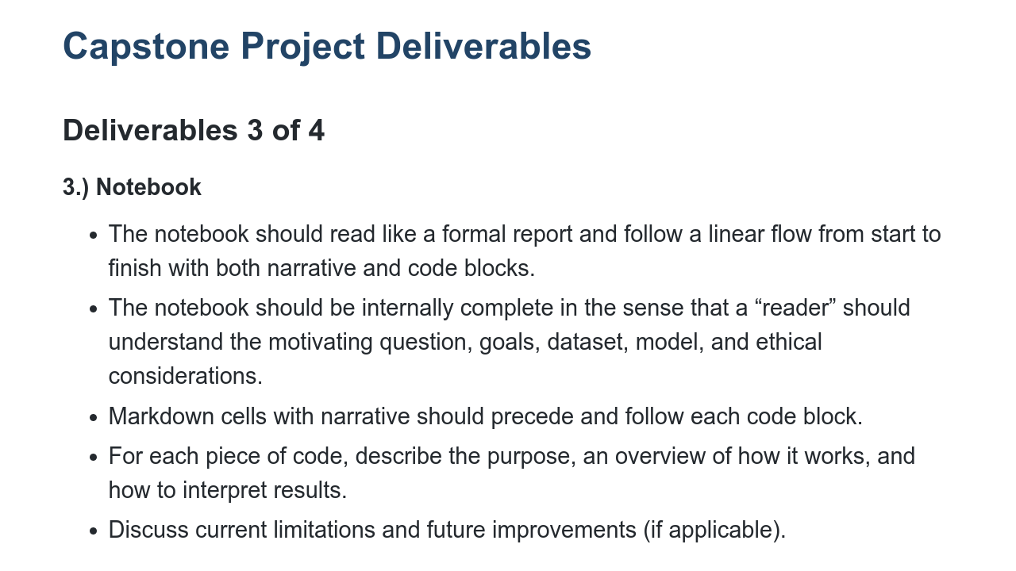
Notes:
In addition to the design doc and ethical consideration exercise, your team will submit a notebook of your project's narrative and code blocks that reads like a formal report. For each piece of code, you should describe the purpose, an overview of how it works, and how to interpret the results. If applicable, include a discussion of current limitations and future improvements.

Slide 6
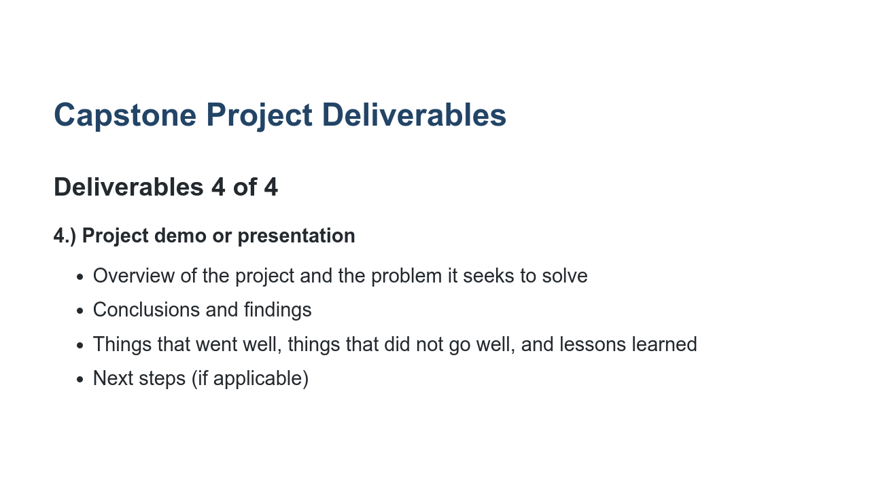
Notes:
Last is the project demo or presentation. The presentation is 15 minutes in length with 5 minutes for questions. Every member of your team is expected to speak and contribute. We'll get into the specific requirements for the project presentation later on in this discussion.

Slide 7
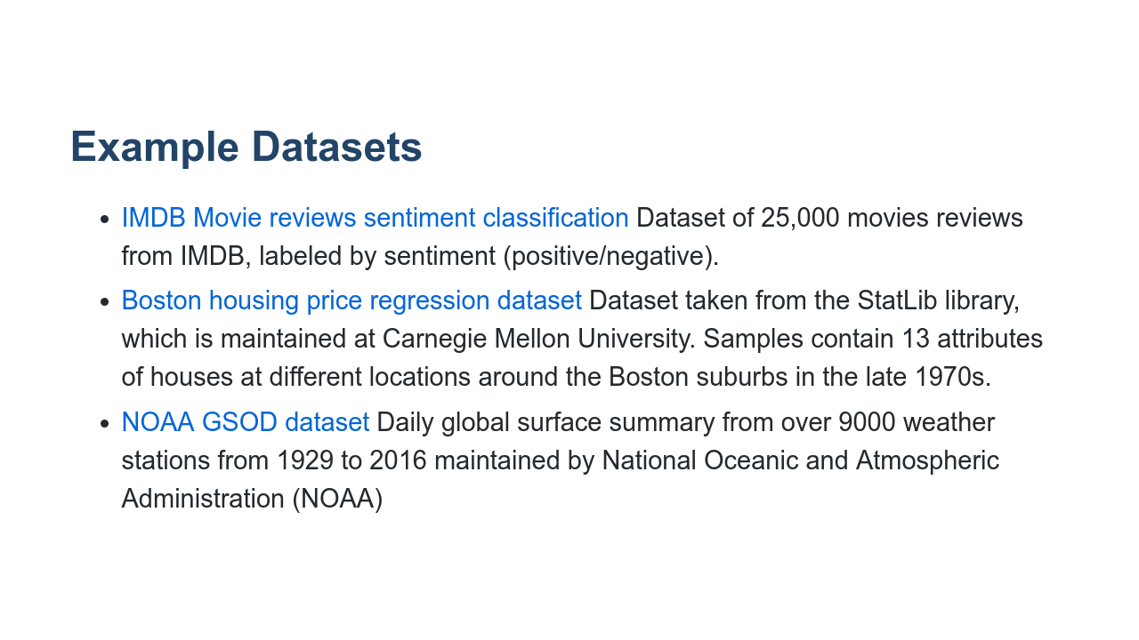
Notes:
Linked here are some datasets your team can consider using for your project. This is not an exhaustive list or rulebook. Instead, this list is intended to help you think about a few options, and hopefully spark more/different ideas!

Slide 8
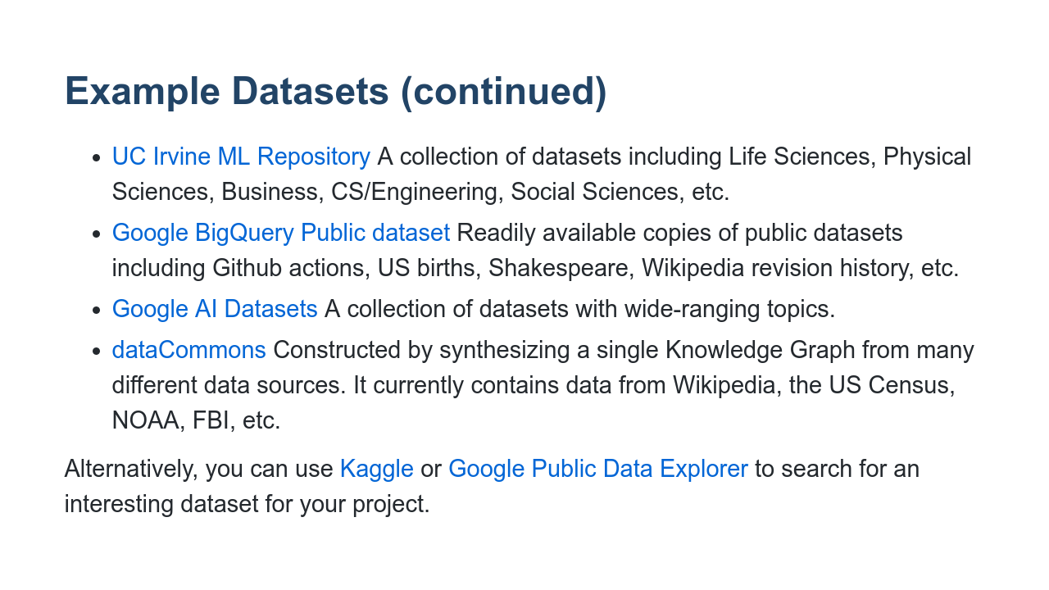
Notes:
More examples. Alternatively, Kaggle and Google Public Data Explorer have datasets to look through, too.

Slide 9
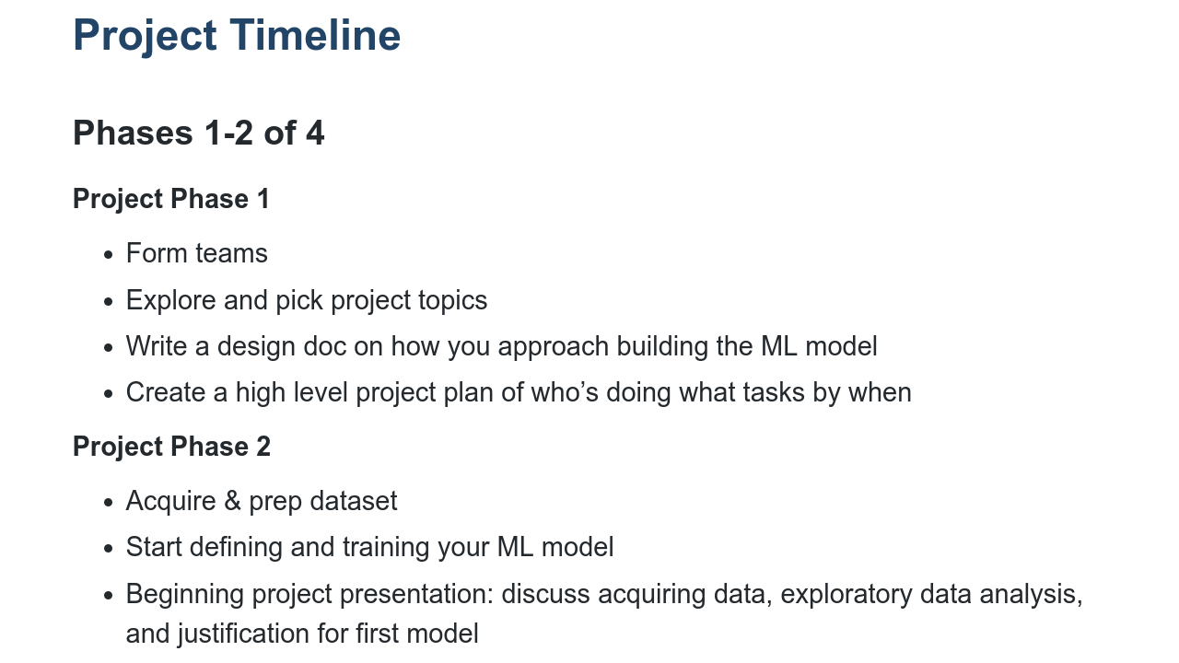
Notes:
There are four distinct phases of the capstone project. The first involves forming teams, exploring and picking project topics, and completing the design doc and project plan to guide your work. Please note a template will NOT be provided for the project plan. The project plan format will be up to your team to decide. You're welcome to use one from the project management session or create a new one. The second project phase includes acquiring and prepping your team's dataset, defining and training your ML model, and beginning designing your project presentation or demo.

Slide 10
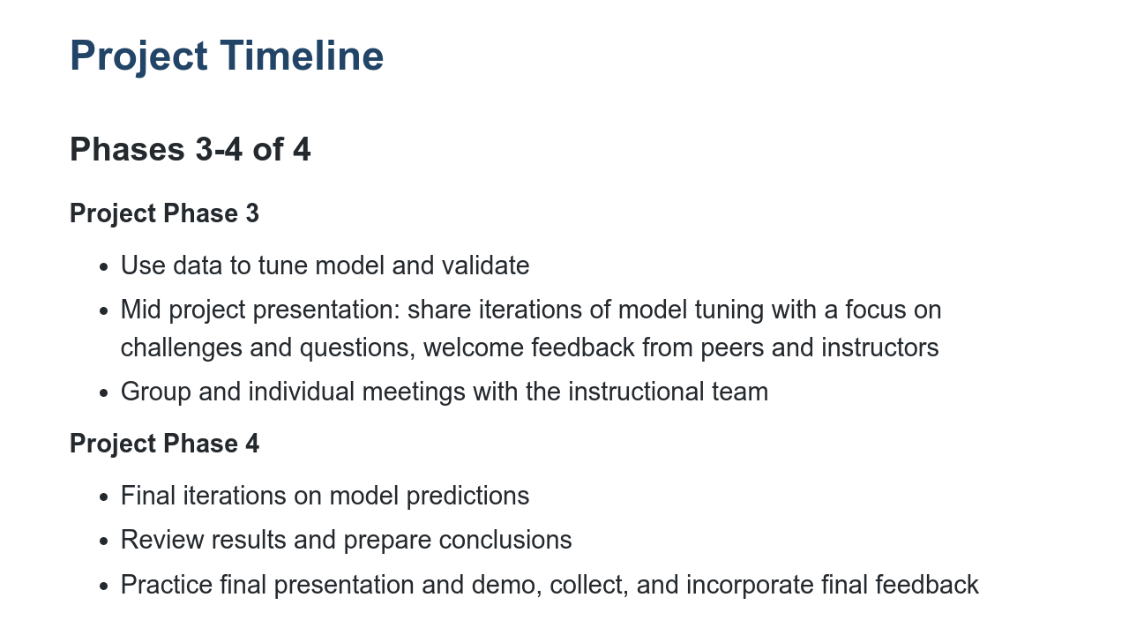
Notes:
The third project phase involves using data to tune and validate your model and continuing to work on your final presentation with peer and instructor feedback. The fourth phase includes final iterations on model predictions, reviewing results and preparing conclusions. And then, finally, you'll present your final presentations to the class. Now we'll transition into the expectations for your final presentations.

Slide 11
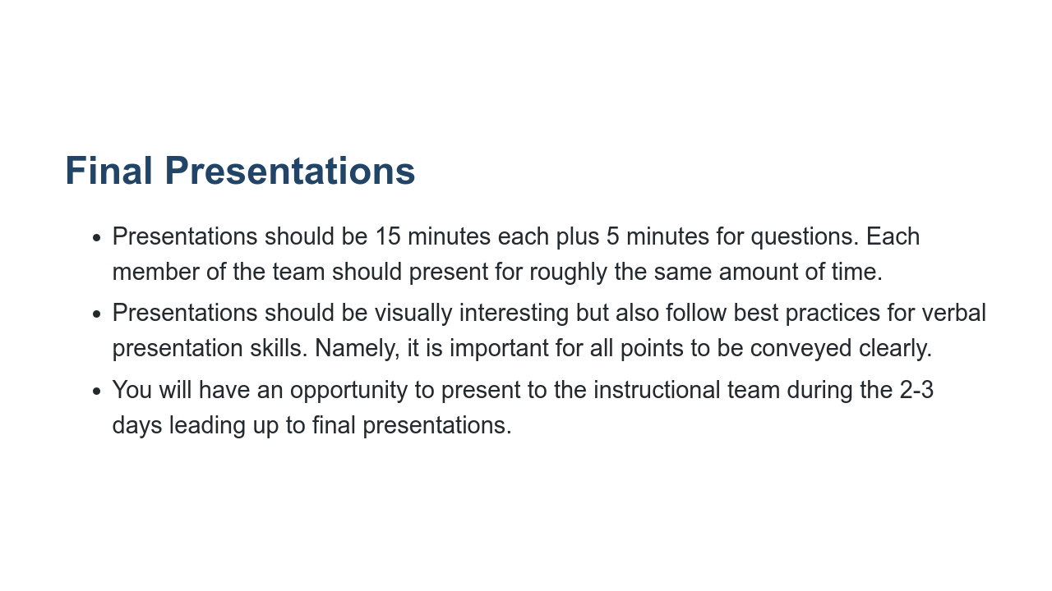
Notes:
Final presentations should include an overview of the project and the problem it seeks to solve, conclusions and findings, lessons learned, and a brief discussion of what went well and what didn't go well. It should include any next steps your team has as you consider future developments for your project. Each team's presentation should last 15 minutes, and there will be an additional five minutes allowed for Q&A. Every team member is expected to present for roughly the same amount of time. Please consider presentation best practices and make a presentation that is visually interesting and one that conveys your points clearly. It is important to practice your presentation several times to ensure that it is very high-quality. It will also help you prepare your timings and transitions. Students often underestimate the amount of practice that goes into a professional presentation, so practice practice practice!! You will also have opportunities to practice your presentation for instructional staff, and we recommend taking advantage of those opportunities to refine your team's presentation.

Slide 12
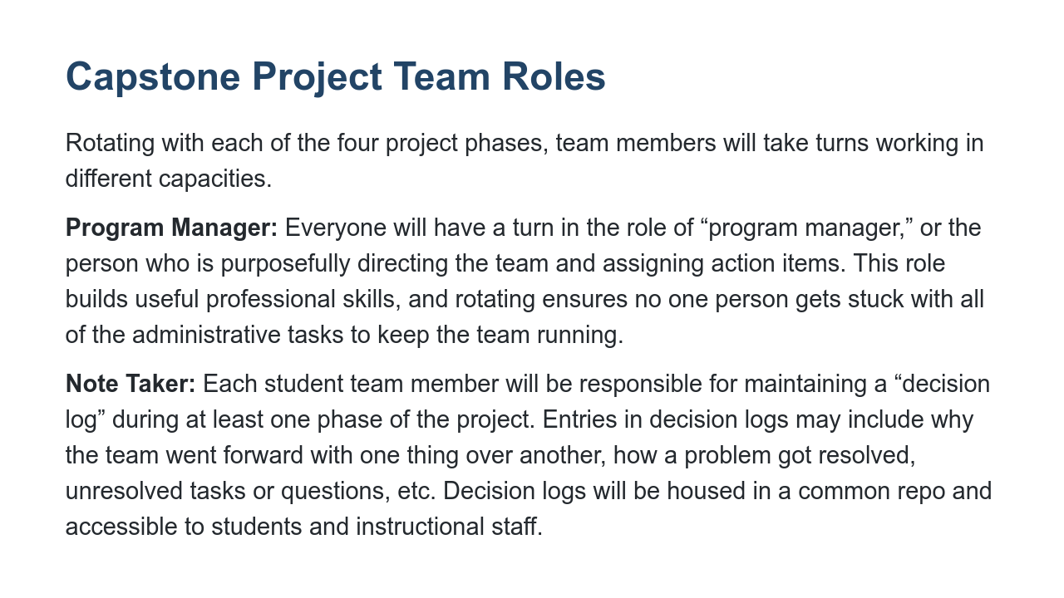
Notes:
Next we'll talk briefly about team roles. In order to share the leadership and administrative responsibilities required for such a project, as well as gain experience in both capacities, teams will rotate who is the program manager and who is the note taker. Program managers will assign tasks and keep the group on track during their respective turn in this role. Note takers will be in charge of keeping a decision log that will be accessible to students and instructional staff. This log will include why certain courses of action were taken and not others, along with any notes from discussion, points that the team needs to return to, etc.

Slide 13
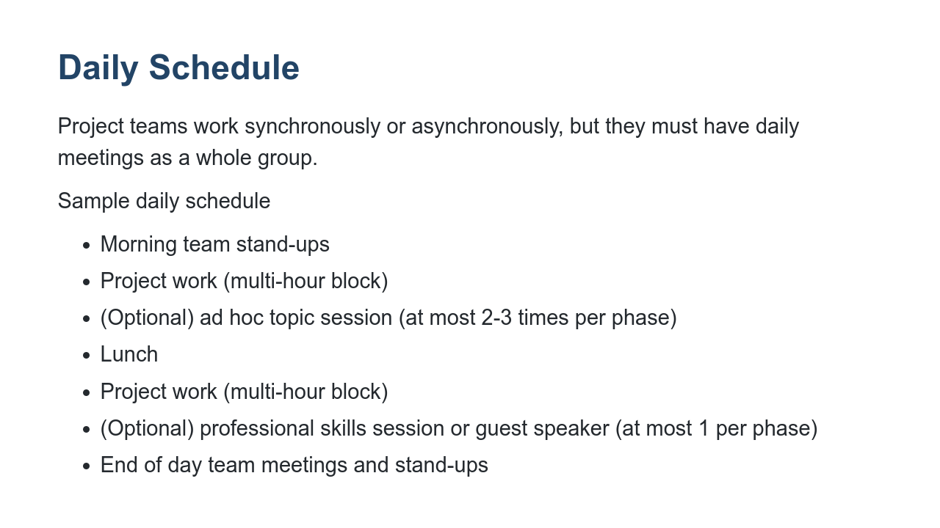
Notes:
During the capstone project phases, we will have morning and afternoon “standups.” This is a very common industry practice, and for good reason! They allow group members an opportunity to raise issues or ask for help regarding anything that's blocking their work. Every morning we'll take 10 minutes or less to share how your group will prioritize your time for the day and what you will feasibly get accomplished. Then at the end of the day, groups will come back together as a class to share what you accomplished during the day, anything you need help with, and what your focus will be the following day. This bookend standup structure will keep us on track and allow instructors to help as needed.

Slide 14

Notes:
We've covered our capstone project goals, deliverables, phases, team roles, final presentation expectations, and how our daily schedule will shift for the remainder of the course. Now that we have covered these basics, our next capstone-related session will get into project topic ideation and forming groups. Before we move on, however, what questions do you have on what we've gone over here?

