Slide 1


Slide 2
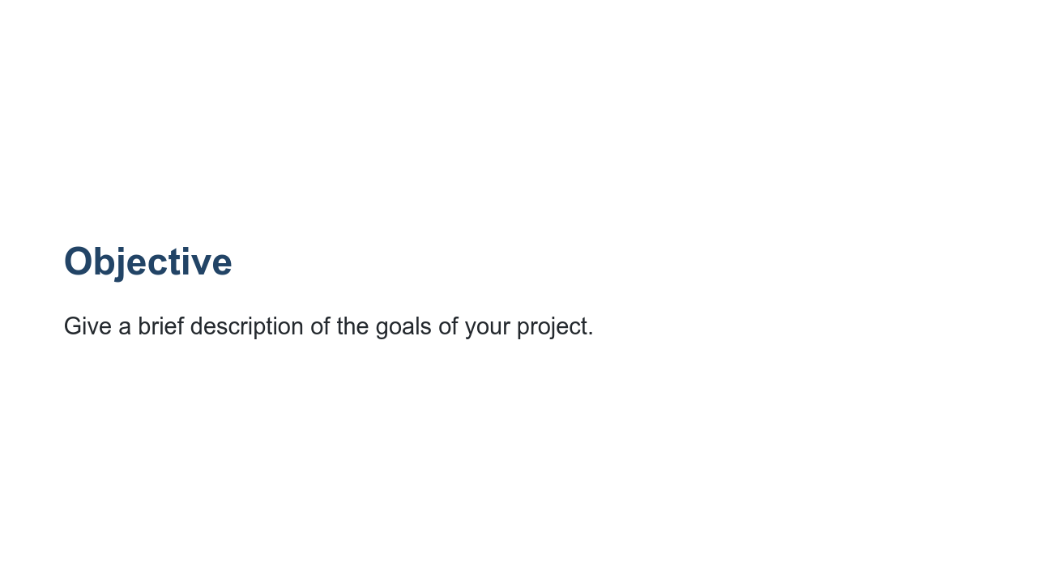
Notes:
What questions do you hope to address? What value will you be adding to the space?

Slide 3
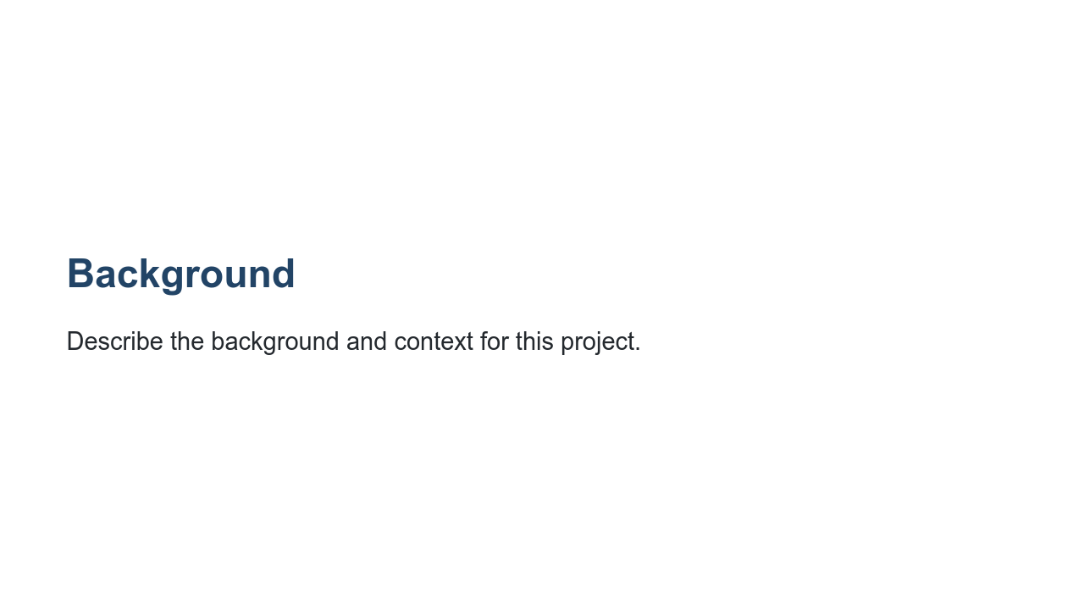
Notes:
What is the motivation for studying this topic? What other work has been done: what was good and where does it fall short? If your project is interdisciplinary, give an overview of the key ideas from the connecting disciplines.

Slide 4
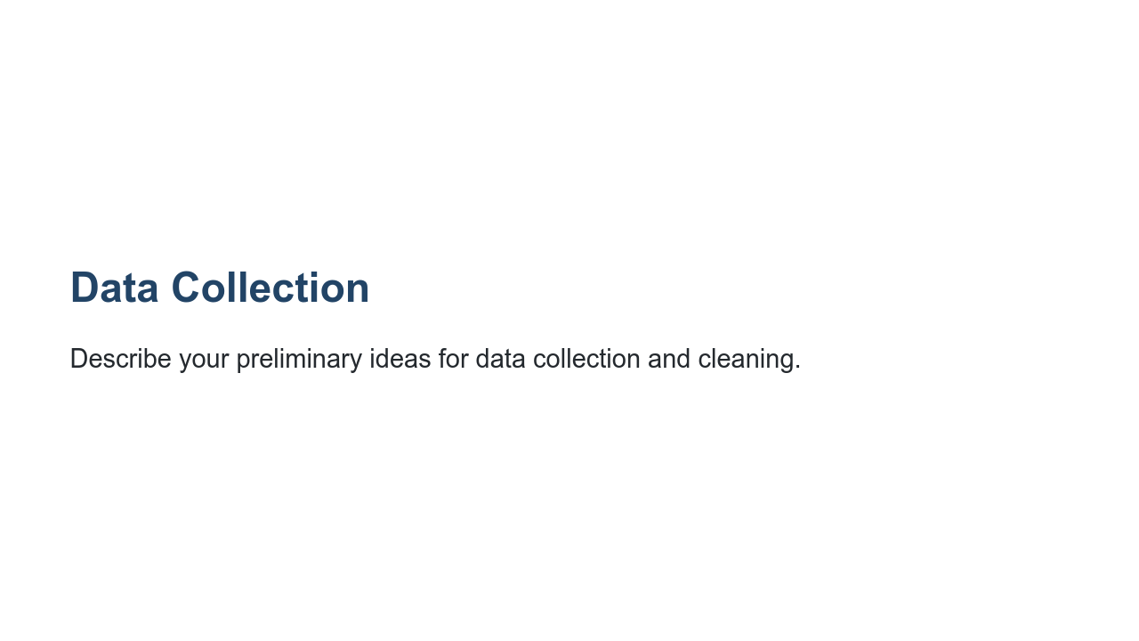
Notes:
Are you planning to use datasets that are already compiled? Will you need to pull supplemental information from additional sources? What plans do you have to clean and prepare your data? How much time are you budgeting for the data collection and cleaning process? *Note* Students frequently underestimate this step. It is important to remind them that sometimes 90 percent of this work is getting the data in a useable format.

Slide 5
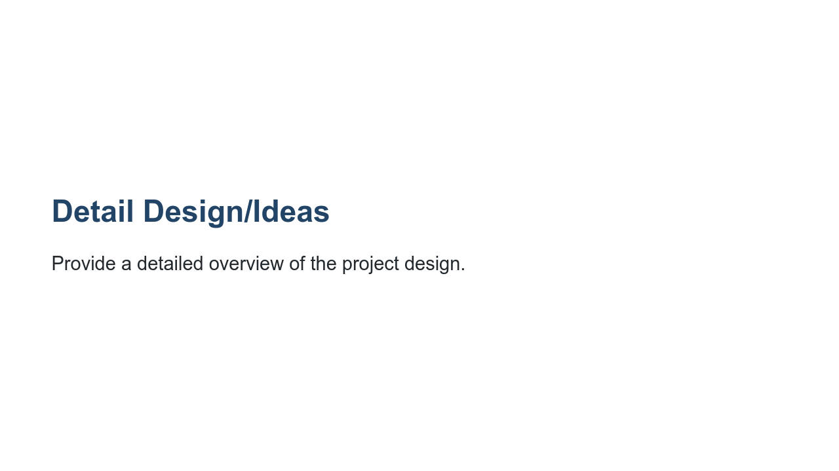
Notes:
How will you approach the problem? What ideas/experiments do you have planned? Tips: * Focus on design, not implementation. * A picture is worth a thousand words. A diagram or drawing of the data and model at times is much easier to understand than words. * If describing alternatives (e.g., approach, platform, algorithm), explain why it’s not part of your design. * If you take a different approach than originally designed, come back and update your design docs.

Slide 6
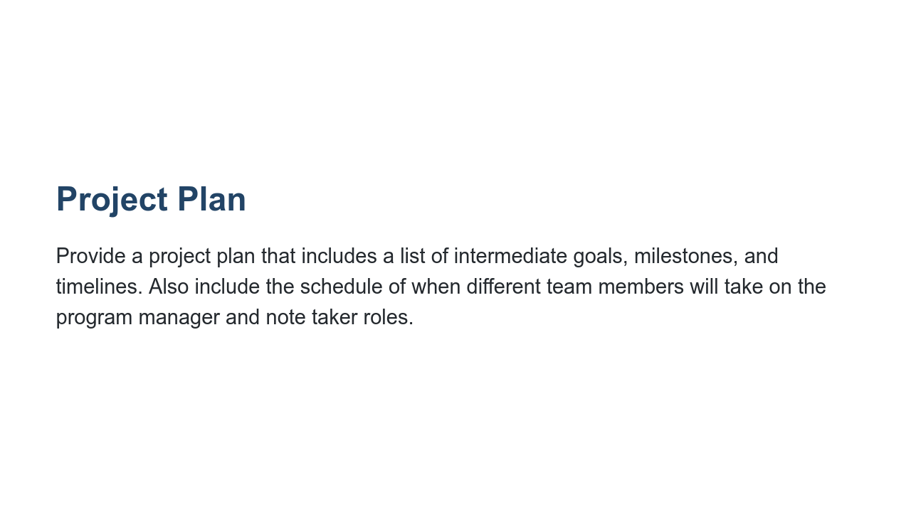
Notes:
You will update this project plan throughout the project. It will be a guide that keeps you on track and accountable. It may be helpful to think about the project management session as you create your plan.

Slide 7
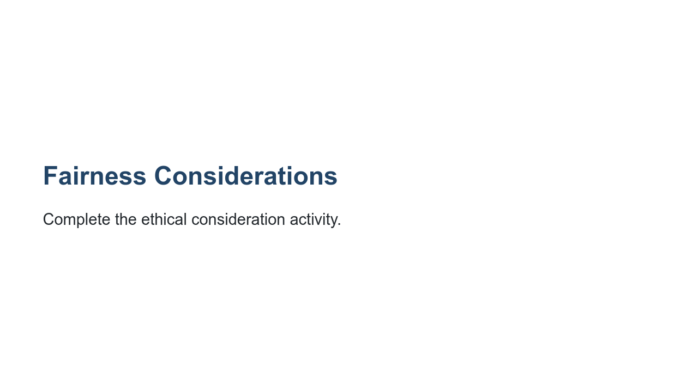
Notes:
You will also complete this again as part of your final project, as it is critical to consider ethical implications early and often throughout any project.

Slide 8
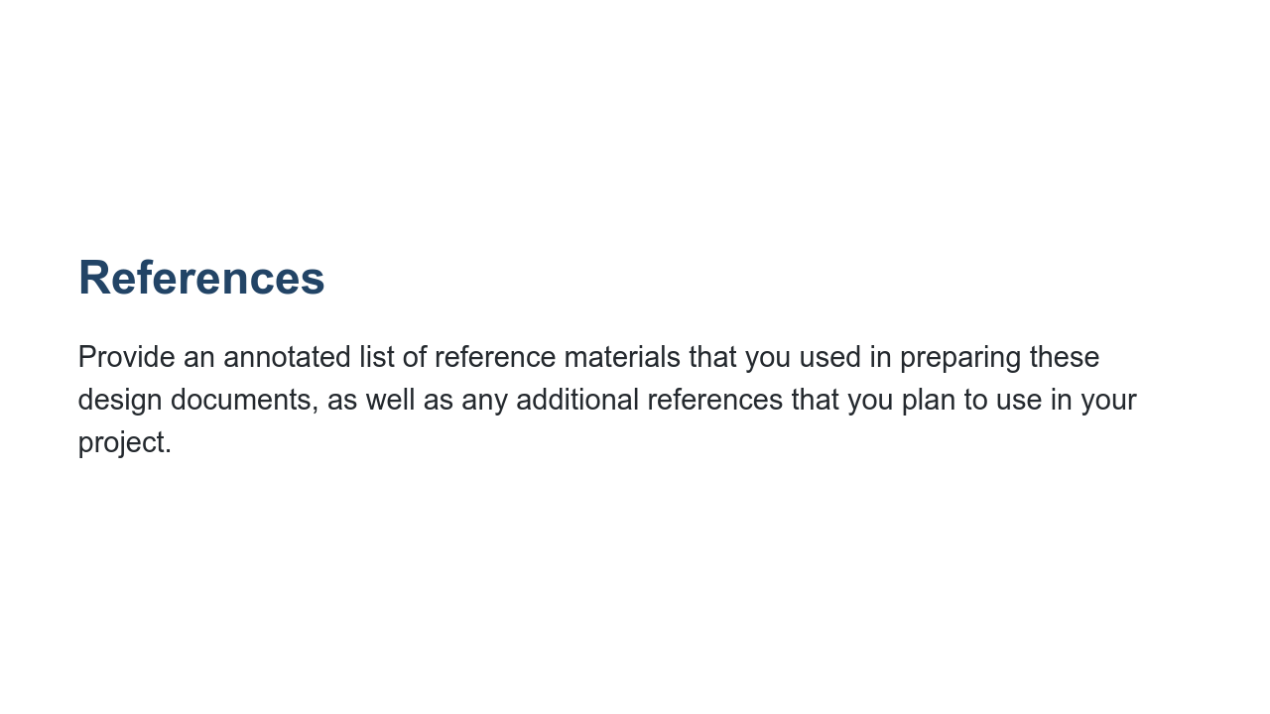
Notes:
For each reference provide a 1-2 sentence summary of the content and a brief description of how it was (or will be used).

