Slide 1
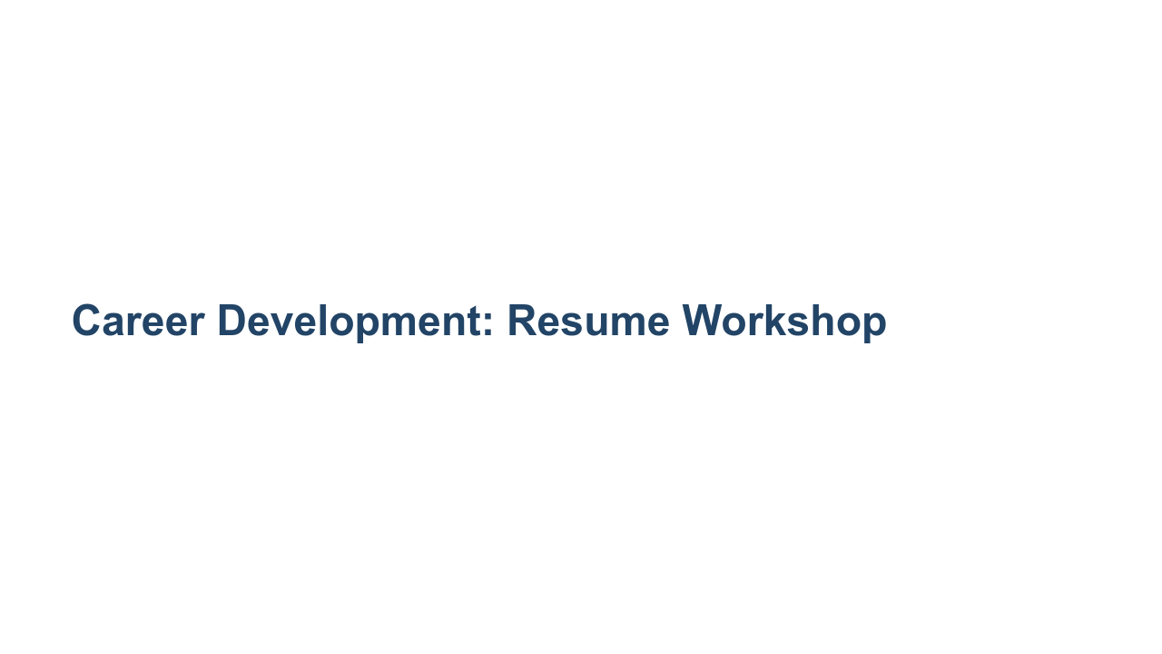
Notes:
Today we'll go over some best practices for your resume. My hope is to provide some very clear guidance regarding what recruiters look for in students’ technical resumes. I also want you to know that no two resumes can and should be the same because you’ve all had different experiences and have different interests. By the end of today’s session you’ll have some industry best practices that you can apply to your resume. Let's get started. [From your personal viewpoint, share why this workshop is important.]

Slide 2
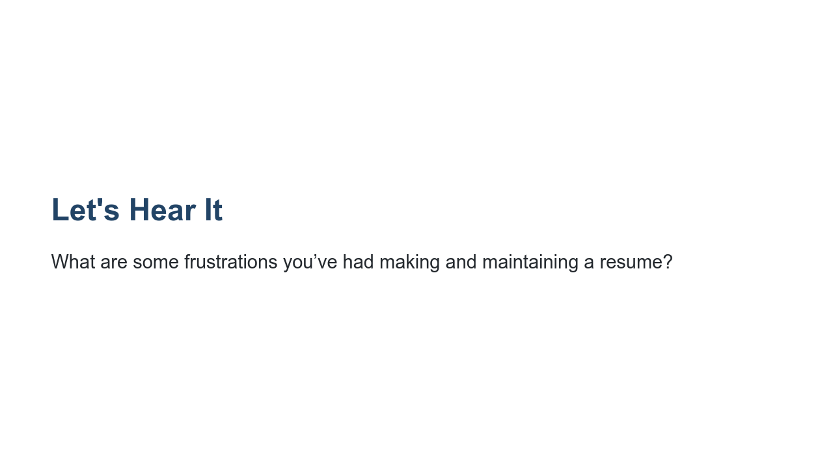
Notes:
Before we dive in, I’m curious to know what’s been challenging for you about creating and maintaining a resume? *Elicit student responses, and respond to each.* I hope today will clarify some of these questions you’ve had about resumes. Please ask questions as we go along if something is unclear or contradicts something you’ve heard before. I will do my best to answer, and if I don’t know the answer, I’ll find out and let you know!

Slide 3

Notes:
Here’s our agenda for today: general resume tips, resume structure (very important), a deep dive into each section, a chance for you to start putting these tips into practice, and instruction about where we’ll go with our newfound resume knowledge. * Image name: res/resumeworkshop01.jpg * Repo link: https://github.com/google/applied-machine-learning-intensive/tree/master/content/xx_career_development/02_resume_workshop/res/resumeworkshop01.jpg * Source https://unsplash.com/photos/p0QUpDUX8X8 by Author Denise Jans https://unsplash.com/@dmjdenise under License https://unsplash.com/license.

Slide 4
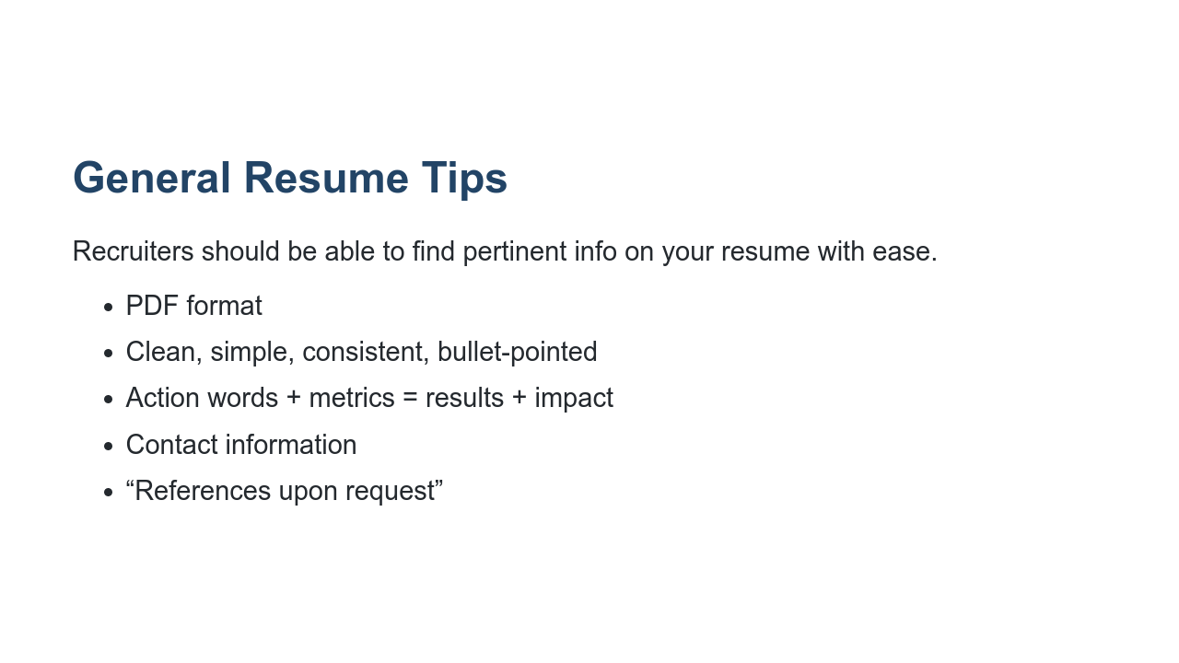
Notes:
Before we narrow in on specific tips we have for each section of your resume, let’s start with some general resume tips first. The people reviewing your resume are actively looking for reasons to interview you. Because of this, you want to ensure that the most pertinent, role-related information is clearly captured by your resume and can be found easily. To that end, keep these tips in mind: * PDF format: To avoid any formatting inconsistencies, which can happen during upload or file sharing, convert your resume into a PDF so that the formatting is retained without issues. * Clean, simple, consistent, bullet-pointed: Bullet points help make your resume more legible and organized. * Action words + metrics = results + impact: We’ll get more into this later, but you want to start each bullet point with an action verb (e.g., created, designed, improved) and include metrics to highlight the impact you had in each experience on your resume. * Contact information: In addition to your name, be sure to include your contact information - email preferred, phone number also helpful - and feel free to include a link to your personal website or github page. * “References upon request”: we don’t recommend using up space on your resume to list references. Feel free to use that space to tell us more about your experiences, leadership, skills, and interests. We will reach out to you for references down the line if we need more information.

Slide 5
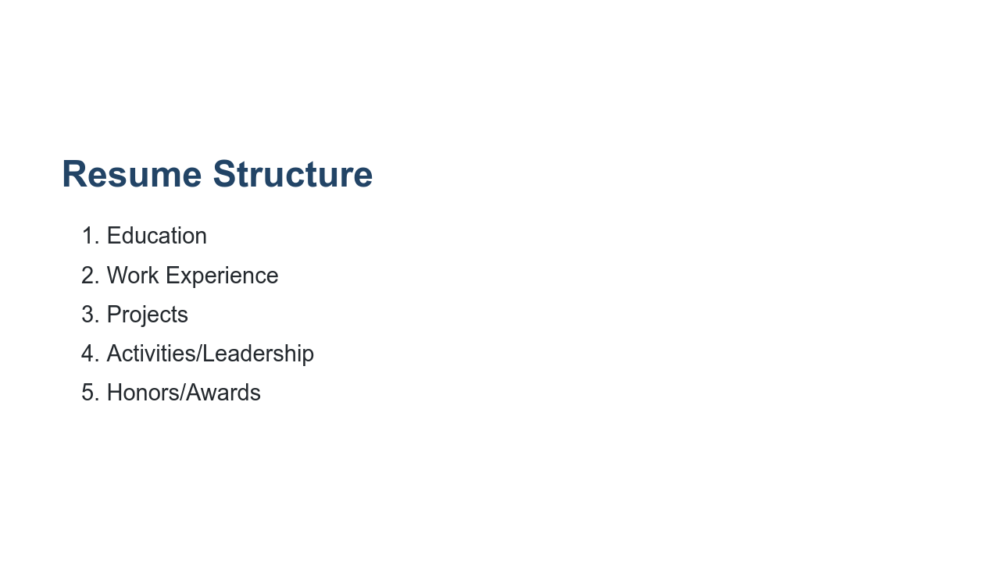
Notes:
Let’s talk about the primary components of your resume. There is a wide variety of different resume structures, and college career centers offer advice based on your industry, experiences, time in education, etc. Utilize whichever format feels the most comfortable for you depending on what you’d like to highlight, but keep in mind that this structure here [point to slide] helps recruiters find the most relevant information to determine your eligibility for technical internships and full-time opportunities.

Slide 6

Notes:
Now that you have a good idea of what your overall resume structure can look like, let’s dive deeper into each section for a more specific look at what information is helpful to include. We’ll start with your education. * Image name: res/resumeworkshop02.jpg * Repo link: https://github.com/google/applied-machine-learning-intensive/tree/master/content/xx_career_development/02_resume_workshop/res/resumeworkshop02.jpg * Source https://unsplash.com/photos/kUqqaRjJuw0 by Author Burst https://unsplash.com/@burst under License https://unsplash.com/license.

Slide 7
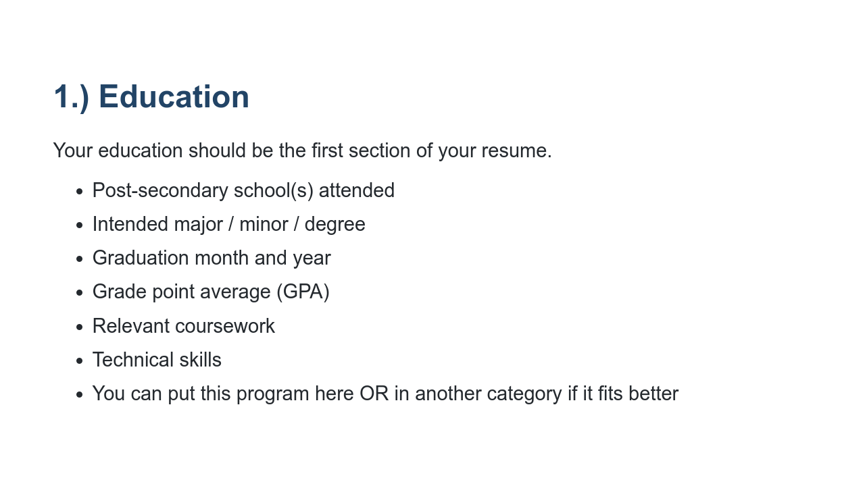
Notes:
Your education should be the first section of your resume (after your name and contact info, that is). Why do you think that is? Right! It's because you're students! Being a student is an important part of your story, especially when you’re submitting this resume for internship or university graduate roles. Let's take a closer look at what you should include and how. Post-secondary schools attended: Let recruiters know where you’re currently pursuing your education. If you’ve moved on to graduate school and/or transferred, be sure to include your previous institution as well. Intended major/minor/degree: Some universities don’t require you to pick a major until the end of your second year, so feel free to note your intended major here if you haven’t yet declared it. Graduation month/year: This is super important. Your graduation month and year helps recruiters determine your eligibility for certain roles. For example, if you’re graduating in May/June 2021 and do not intend to return to school next fall, you’re eligible for full-time university graduate opportunities. However, if you’re graduating in December 2020, you may be eligible for summer internships. GPA: Whether you list your cumulative or your major GPA, just be sure to note it clearly on your resume. Recruiters look at the coursework on your transcript to see how well you did in the courses that are most relevant to your technical career. (i.e., data structures and algorithms, upper-level math, etc.) Asterisked: Relevant coursework: If you’ve taken a data structures & algorithms, you should list it here. You’ll also want to include this section if you’re a non-CS major who wants to demonstrate CS knowledge and coursework, and/or if you’ve ‘specialized’ in a specific area and want to show advanced knowledge in specific areas (i.e., Cryptography, Embedded Systems, Machine Learning, AI, etc.) Technical skills: These should be listed in order of proficiency (strongest first, weakest last).

Slide 8
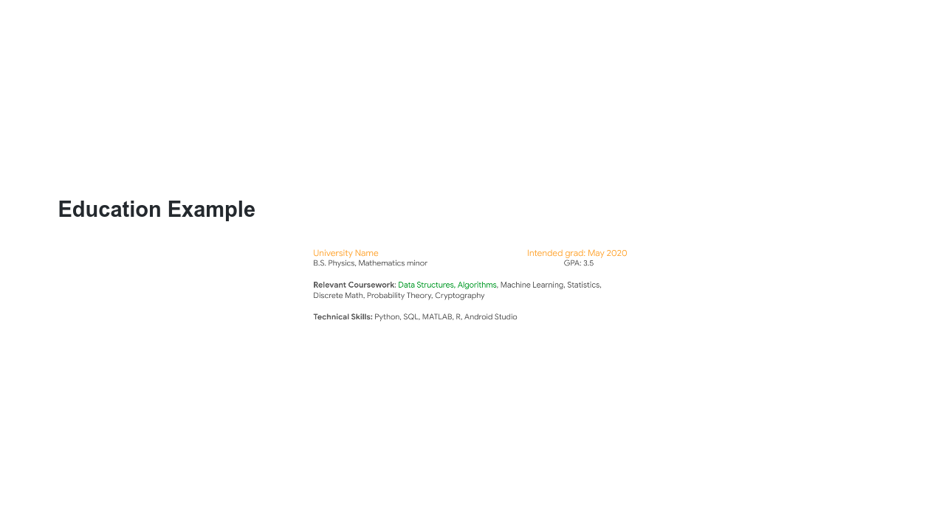
Notes:
While including your relevant coursework is not absolutely necessary, we do advise that you list data structures and/or algorithms on your resume if you’ve taken it. Technical skills: How you demonstrate your level of “proficiency” can vary. Here, it’s listed in the number of years of experience using that language. Whatever you decide, be sure to include most proficient -> least proficient. Even more importantly, include examples of how you gained those skills and used those languages in the body of the experience section of your resume. * Image name: res/resumeworkshop03.png * Repo link: https://github.com/google/applied-machine-learning-intensive/tree/master/content/xx_career_development/02_resume_workshop/res/resumeworkshop03.png * Source https://github.com/google/applied-machine-learning-intensive/tree/master/content/xx_career_development/02_resume_workshop/res/resumeworkshop03.png by Author Google LLC under License Copyright [2020] Google LLC.

Slide 9
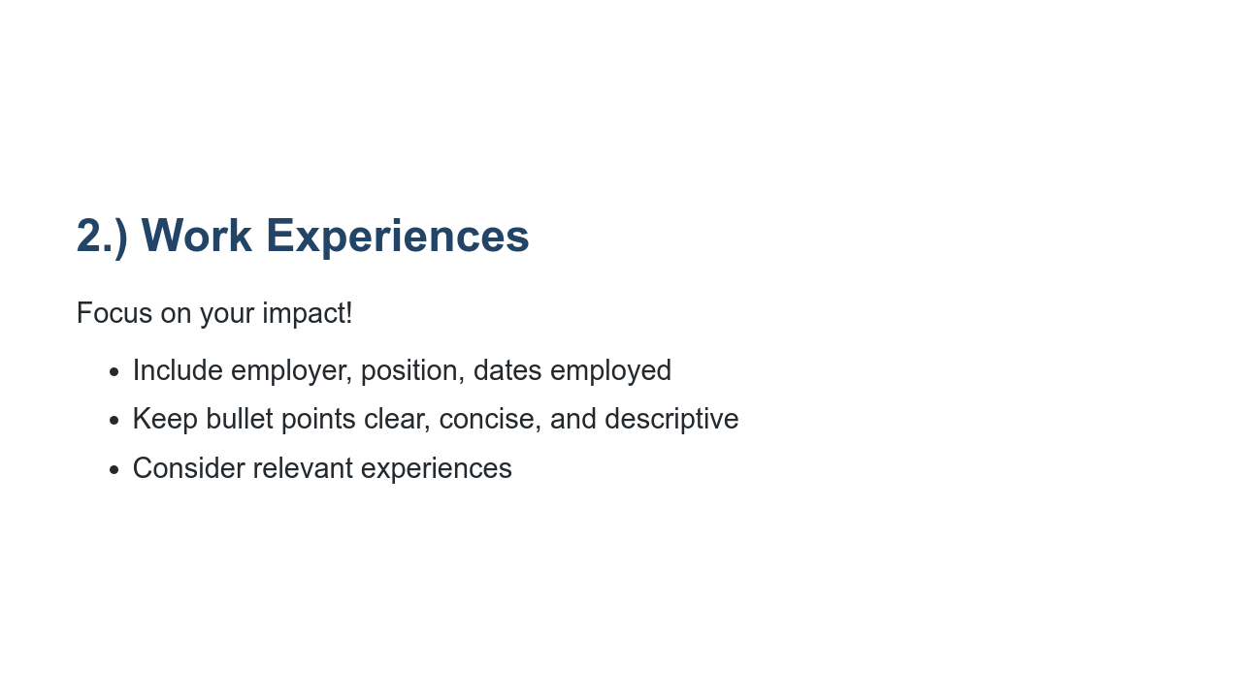
Notes:
Employers want to know how, when, and where you’ve already started to make an impact. This section of the resume is a great opportunity to do just that. * Include employer, position, dates employed: Also ensure that most recent experiences are listed first (reverse chronological order). * Keep bullet points clear, concise, and descriptive: I highly encourage bullet points and concise fragments over full sentences. * Consider relevant experiences: Especially if you’re running out of space on your one-page resume, consider leaving off the non-tech-related experience (e.g., worked the front desk at the library, restocked medical supplies at the hospital - these are important experience, but perhaps not for this role) in favor of the ones that are relevant to the role to which you’re applying. If you're early on in your tech career, you may not have technical work experiences, and that's okay! Internships, student groups, hacks/coding competitions and class projects can be added here under the heading “experiences” instead of “work experiences” until you build up your relevant tech experience throughout your time in college.

Slide 10
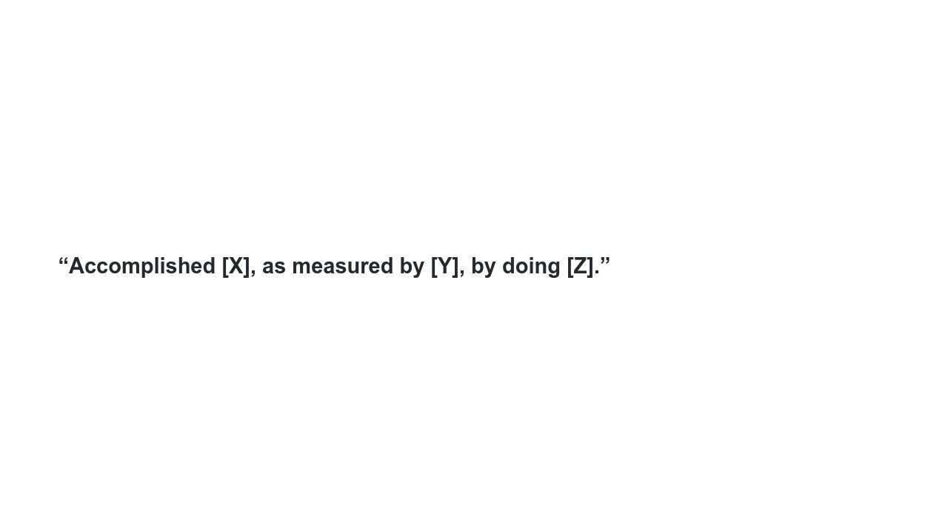
Notes:
What do we mean when we say “focus on impact?” This formula is from Google’s former Head of People Operations Laszlo Bock’s personal “winning formula” for resume-writing, which he published in an article on LinkedIn. Let’s break this down: Accomplished [X]: You’ve probably heard this tip before; start each bullet point with an action verb (e.g., “debugged,” “created,” “designed,” etc.) For tech, this is also your chance to let us know which languages/technologies you used. As measured by [Y]: this is where you can include any metric to support the impact you had. (e.g., increased server query response time by 15%) By doing [Z]: what you specifically did to achieve those results (e.g., by restructuring the API).

Slide 11
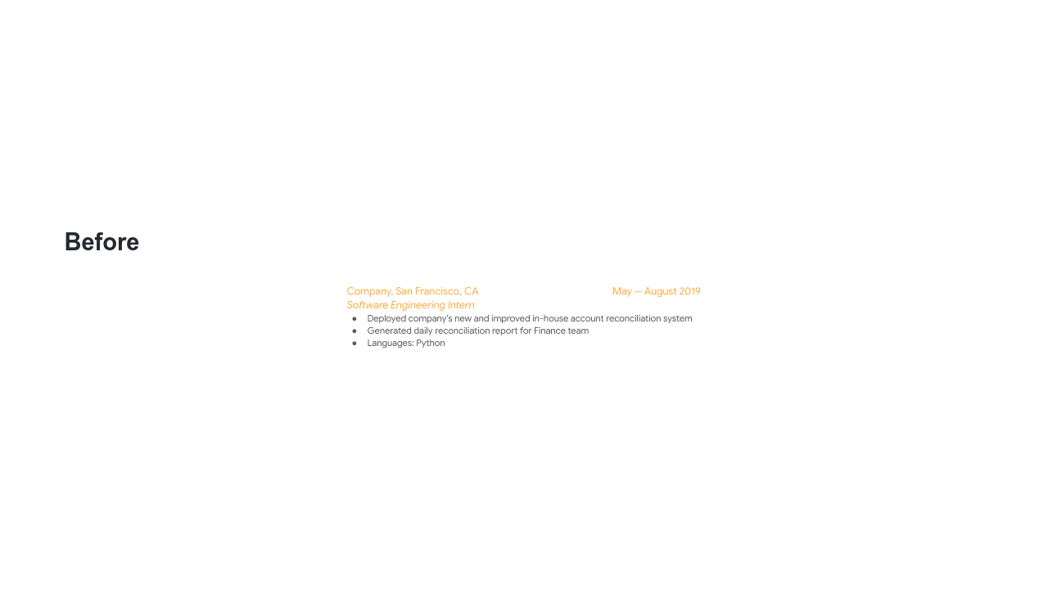
Notes:
This work experience description provides us with some information, but how could it be better? * Image name: res/resumeworkshop04.png * Repo link: https://github.com/google/applied-machine-learning-intensive/tree/master/content/xx_career_development/02_resume_workshop/res/resumeworkshop04.png * Source https://github.com/google/applied-machine-learning-intensive/tree/master/content/xx_career_development/02_resume_workshop/res/resumeworkshop04.png by Author Google LLC under License Copyright [2020] Google LLC.

Slide 12
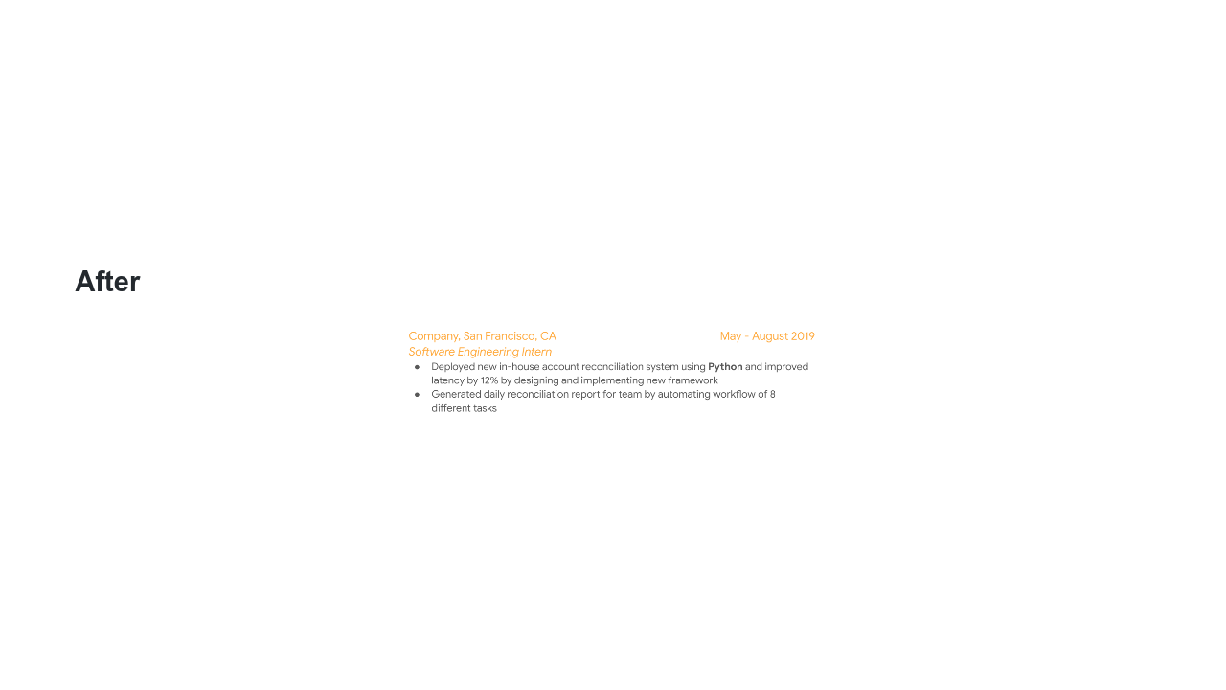
Notes:
I want to point a few things out here: * The language used is clearly marked and bolded. * Metrics are used to demonstrate improvement based on what candidate accomplished. * The description is important, even if you don’t have numbers to share. * Image name: res/resumeworkshop05.png * Repo link: https://github.com/google/applied-machine-learning-intensive/tree/master/content/xx_career_development/02_resume_workshop/res/resumeworkshop05.png * Source https://github.com/google/applied-machine-learning-intensive/tree/master/content/xx_career_development/02_resume_workshop/res/resumeworkshop05.png by Author Google LLC under License Copyright [2020] Google LLC.

Slide 13
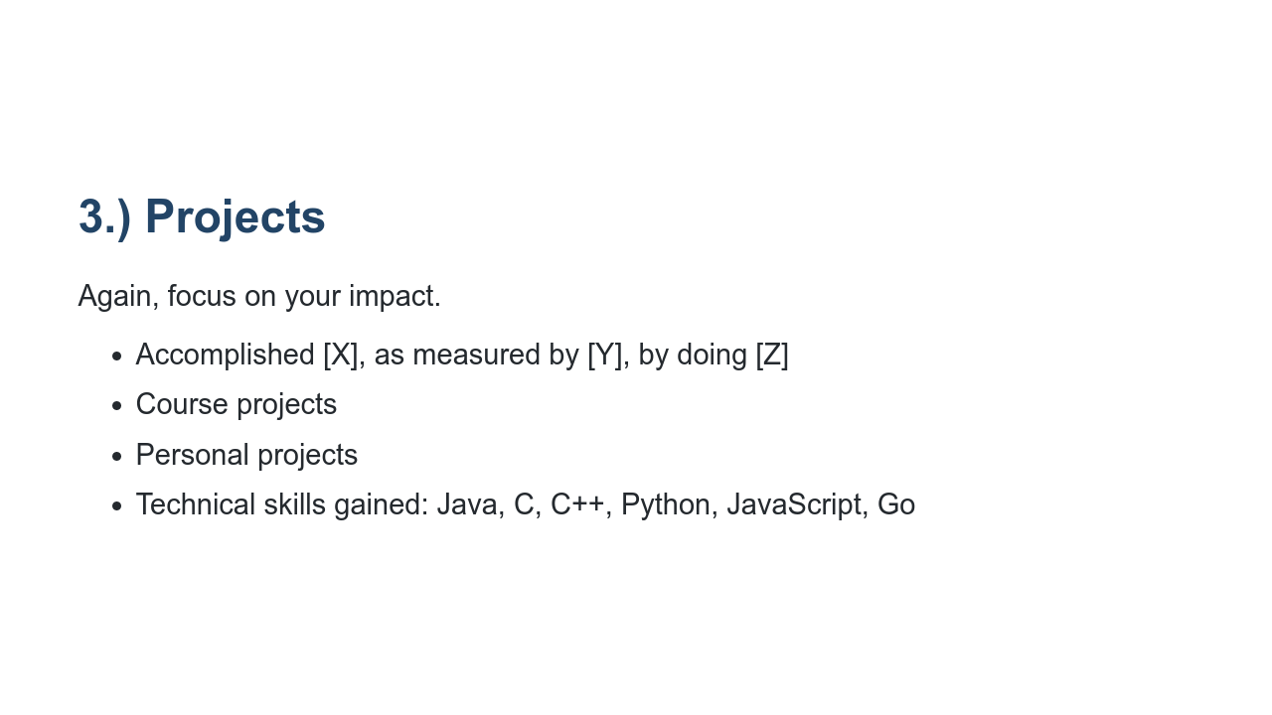
Notes:
As we mentioned before, early on in your technical career, you may not feel that you have enough “work experiences” to warrant its own section. That’s okay! Perhaps it makes more sense for you to have a “projects” section instead until you do have more industry experience. * Format: Continue emulating the same format “Accomplished X, as measured by Y, by doing Z” in this section to let recruiters know the technologies/languages you used to make an impact. Make sure to include metrics wherever possible to highlight the scope of your impact. * School/personal: Make clear which projects were for a class at school versus a personal project. Make sure you make it known if you were officially recognized or “awarded” for any of your projects (e.g., class project competition winner). Definitely list personal projects if you have them; hiring teams love to see that you code outside of classroom work. * Tech skills gained: Be sure to include the language you used so recruiters can see exactly how and when you improved your coding skills.

Slide 14
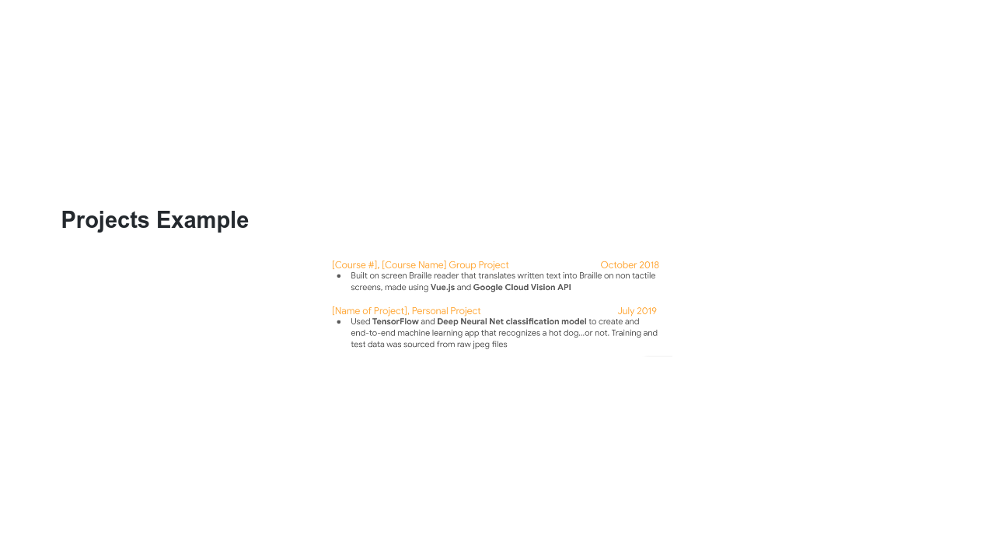
Notes:
I want to point out a few things here, too: * Notice the use of language/technologies: C++, Objective C. * There's a clear delineation of group (class) project vs. personal project. * This person listed 300+ downloads with 4.0 rating, which shows the impact and level of interest in the project. * Image name: res/resumeworkshop06.png * Repo link: https://github.com/google/applied-machine-learning-intensive/tree/master/content/xx_career_development/02_resume_workshop/res/resumeworkshop06.png * Source https://github.com/google/applied-machine-learning-intensive/tree/master/content/xx_career_development/02_resume_workshop/res/resumeworkshop06.png by Author Google LLC under License Copyright [2020] Google LLC.

Slide 15
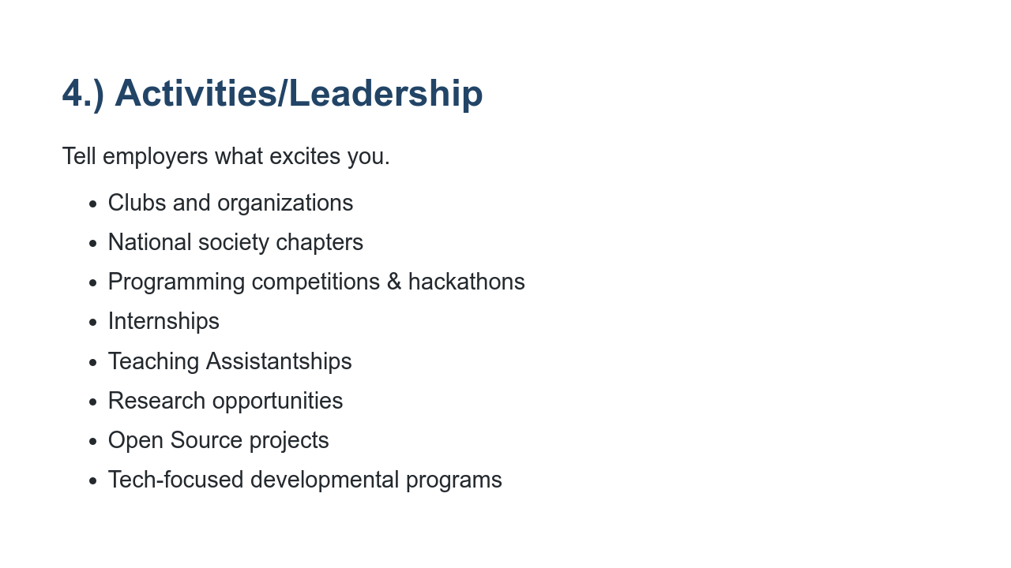
Notes:
Employers are often curious to know how you spend time outside of the classroom as well. Are you: * Part of computer science clubs or societies? * Part of national chapters like ACM or NSBE, or CS fraternities like UPE? * Into programming competitions (like Code Jam) or hackathons? Have you won? If so, out of how many competing teams/individuals? * Spending your summers interning at companies, big or small? * A TA for a CS course or advanced math class? * A research assistant for a professor at your school (or another school)? * Building your technical skills through open source projects (like Google Summer of Code)? * A graduate of a developmental program like CSSI (computer science summer institute) or CodeU? Employers want to know what excites you, so take this opportunity to let them know!

Slide 16
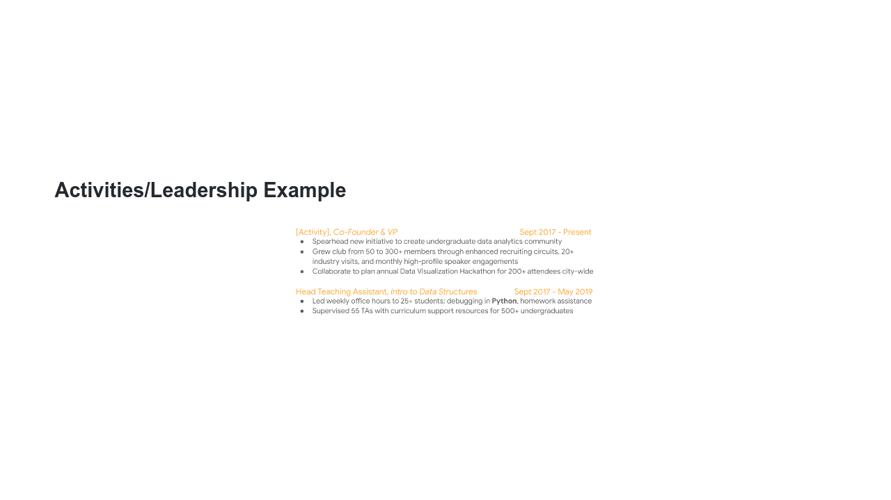
Notes:
It's important to include the following: * Demonstration of leadership on campus (created Data Analytics community) * Demonstration of problem-solving/strategic thinking to grow club * Mention of # of students impacted by TA * Mention of language most often used for debugging * Leadership of 55 TAs as Head TA impacting 500 students * Image name: res/resumeworkshop07.png * Repo link: https://github.com/google/applied-machine-learning-intensive/tree/master/content/xx_career_development/02_resume_workshop/res/resumeworkshop07.png * Source https://github.com/google/applied-machine-learning-intensive/tree/master/content/xx_career_development/02_resume_workshop/res/resumeworkshop07.png by Author Google LLC under License Copyright [2020] Google LLC.

Slide 17
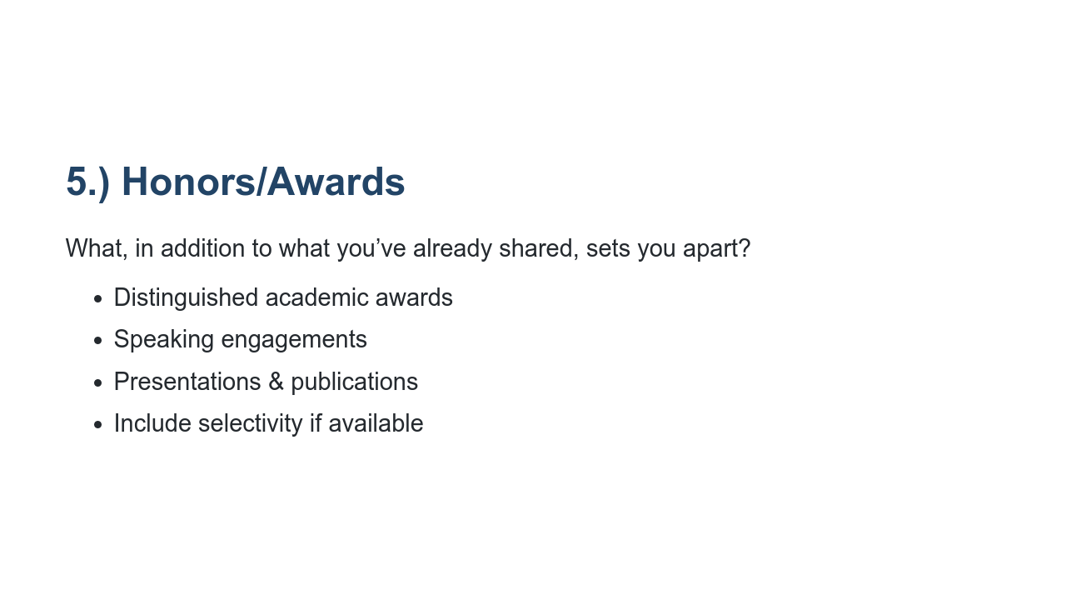
Notes:
Along your college journey, you may come across opportunities to: 1) be recognized for your work, and/or 2) to share your knowledge with others. Let employers know how and when you received additional recognition for your achievements. * Distinguished academic awards: What were the criteria? To how many recipients was it awarded? * Speaking engagements: What did you speak about? Which organization invited you? * Presentations & publications: What was your topic? Who was the audience? How big was the audience? * Include selectivity if available: This helps us understand the magnitude of these opportunities with metrics wherever possible.

Slide 18
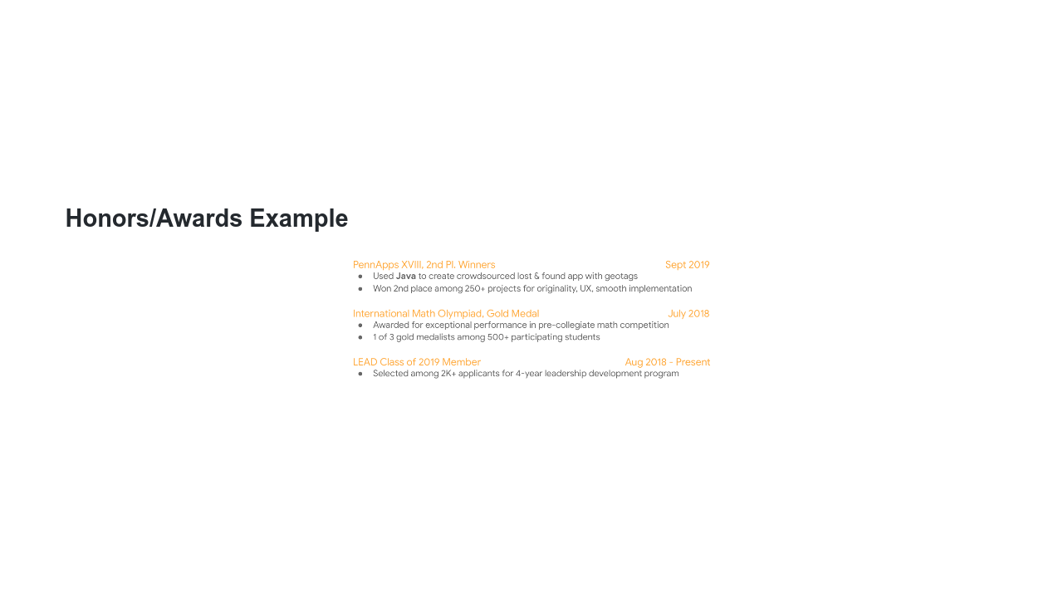
Notes:
Things to point out: Use of language: Java Clear mention of selectivity of each honor or award * Image name: res/resumeworkshop08.png * Repo link: https://github.com/google/applied-machine-learning-intensive/tree/master/content/xx_career_development/02_resume_workshop/res/resumeworkshop08.png * Source https://github.com/google/applied-machine-learning-intensive/tree/master/content/xx_career_development/02_resume_workshop/res/resumeworkshop08.png by Author Google LLC under License Copyright [2020] Google LLC.

Slide 19
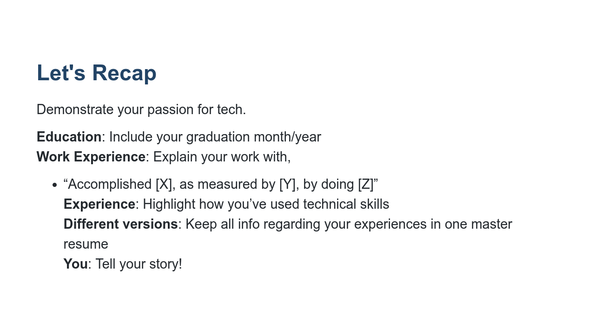
Notes:
Your resume should demonstrate your passion for tech (through involvement in activities/projects inside and outside of the classroom) and familiarity with key concepts/technical strengths (through projects, coursework, work experience & accomplishments.) * Always be sure to include your graduation month and year. Even if it changes later on, it’s super helpful for recruiters to know this to determine your eligibility for certain roles. * As often as you can, mirror the ‘accomplished X as measured by Y by doing Z’ to ensure that your impact is clear * As frequently as it’s true, include examples of how and when you’ve used Java, C, C++, Python, JavaScript, and Go. You can bold it on your resume if you’d like. * I recommend having one long master resume that includes all of your experiences. From there, make different versions of your resume that are best suited for the role you’re applying for * What you include on your resume tells your story.

Slide 20
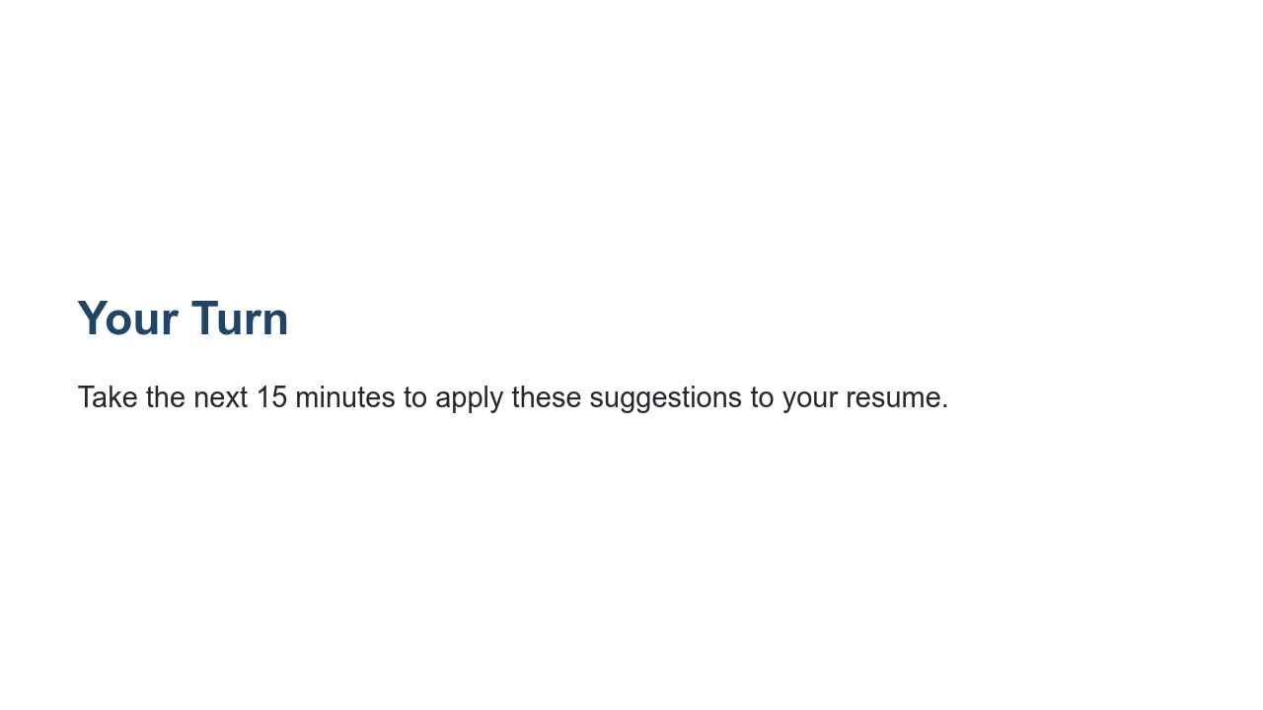
Notes:
Take the next 15 minutes to make some changes to your resume based off of this presentation. I am happy to answer questions as you work. [Circulate around the room and help students as they need.]

Slide 21
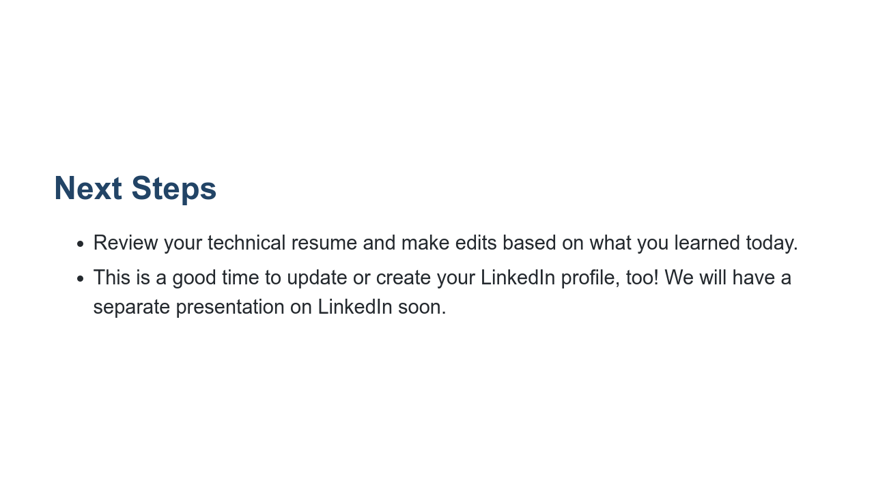
Notes:
Please continue to make changes to your resume based on what you learned today. This is a good time to update or create your LinkedIn profile, too! We will have a separate presentation on LinkedIn soon. What remaining questions do you have?

