Slide 1
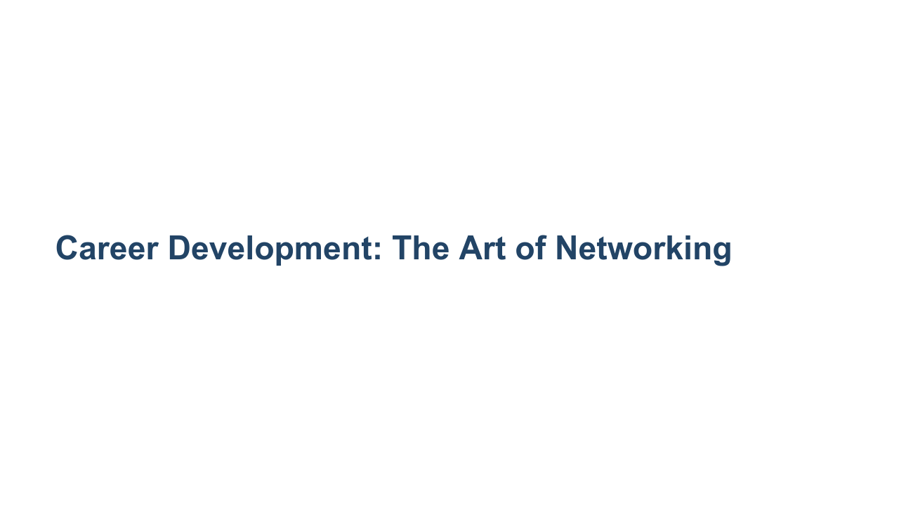
Notes:
This career development session is about the art of networking. If you’re thinking of a LAN, WAN, or MAN or linking computers together, we’re actually talking about a different type of networking today. But do hold on to the idea of creating a connection or link between two things. In this case, the link is between people.

Slide 2
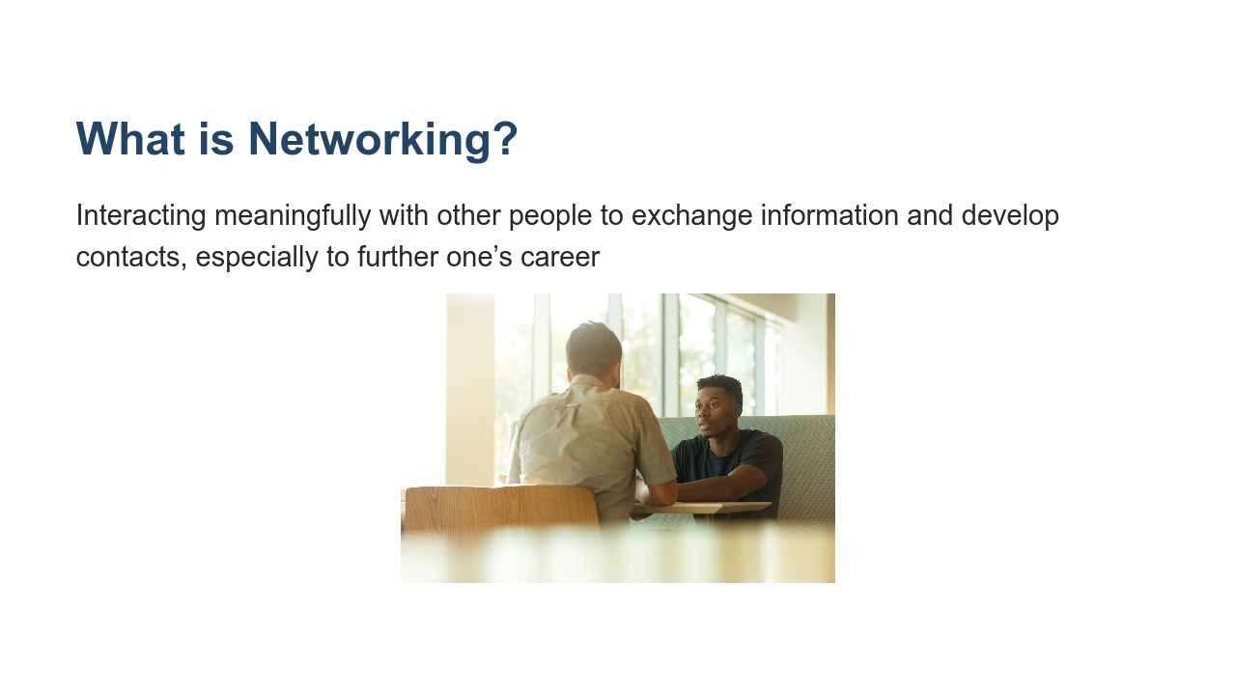
Notes:
* As college students you have many opportunities to begin making connections with others and building your network, so now is a great time to begin learning the skills of networking. * Many people believe that networking is something you’re born with; some people are just better than others. The truth is that anyone can learn how to network effectively, and you’ll also improve a lot with practice. * Image name: res/artofnetworking01.jpg * Repo link: https://github.com/google/applied-machine-learning-intensive/tree/master/content/xx_career_development/03_the_art_of_networking/res/artofnetworking01.jpg * Source https://unsplash.com/photos/W3Jl3jREpDY by Author LinkedIn Sales Navigator https://unsplash.com/@linkedinsalesnavigator under License https://unsplash.com/license.

Slide 3
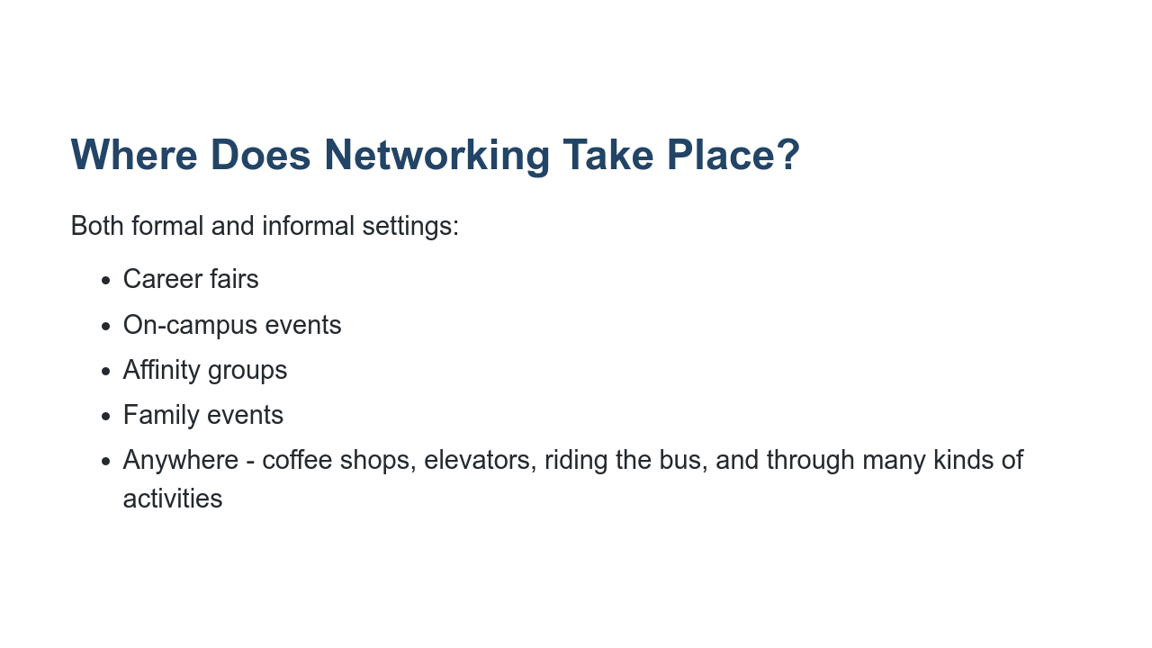
Notes:
* You may think networking only takes place in formal settings. like at a career fair or an advertised “networking” event. You should be extra prepared for those kinds of events where you know networking will be explicitly taking place, but you may be surprised to learn that meaningful networking can be accomplished almost anywhere. * Networking can happen in places you visit all the time, such as during your daily commute, at Starbucks, or even at your next family event. * You never know who you’ll meet, which is why you should practice networking skills so you’ll be absolutely ready to network whenever you meet people who could be helpful to you or to whom you could be helpful. *Feel free to share your own example of a time you or someone you know took advantage of a networking opportunity outside of a typical "networking" event. What was the result? What did you or this person learn? * It's important to read social cues and make sure it’s appropriate to strike up a conversation. If someone looks busy, is not receptive to a hello, or is on the phone, it might not be a good time to attempt networking.

Slide 4
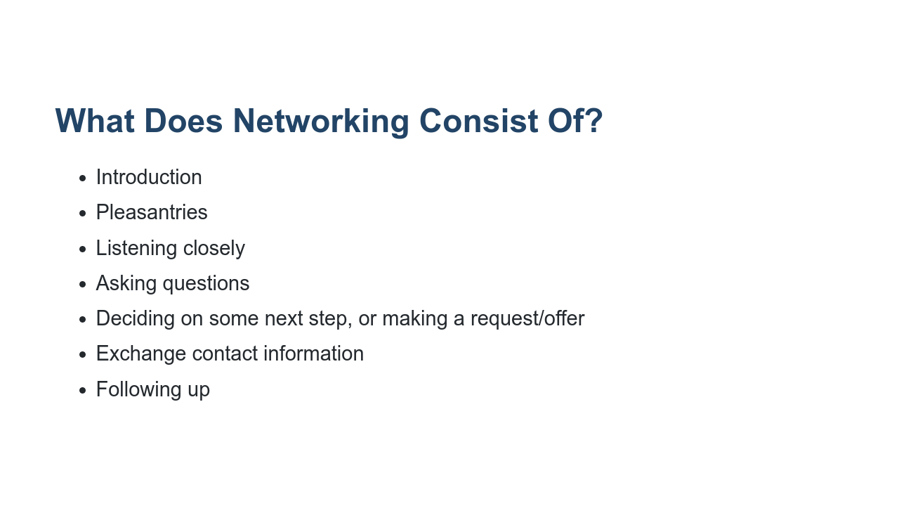
Notes:
* In a more formal setting, like a career fair where everyone is there expecting to hear about opportunities, networking would probably be more formulaic. You would introduce yourself by saying who you are and what you study or are there for. Perhaps you'd make a bit of small talk (the weather, have they visited here before, if they're an alum), depending on if others are waiting in line behind you. Then it's best to listen closely and either offer to follow up or make a request before parting. Then you’d need to follow up on whatever was decided. * For example, if you go to a career fair, you may walk up and say “Hi! How are you?” Maybe you follow that up with a tiny bit of small talk and then “I’m NAME, a senior at Spelman College, studying Computer Science. I’m interested in summer internships. "Is your company offering any summer internships in software engineering?” You can listen carefully and ask follow-up questions, including asking if the representative will take your resume, or if you should email it. You should also ask for a card or a way to stay in contact, and then make a request: “May I send you my resume for you to review?” or “May I follow up with you directly on the opportunities you mentioned?” Or the rep may say, “I’ll email you with opportunities." Either way, you’ve decided on next steps and you would go home and send a thank you email or any next step you decided on.

Slide 5
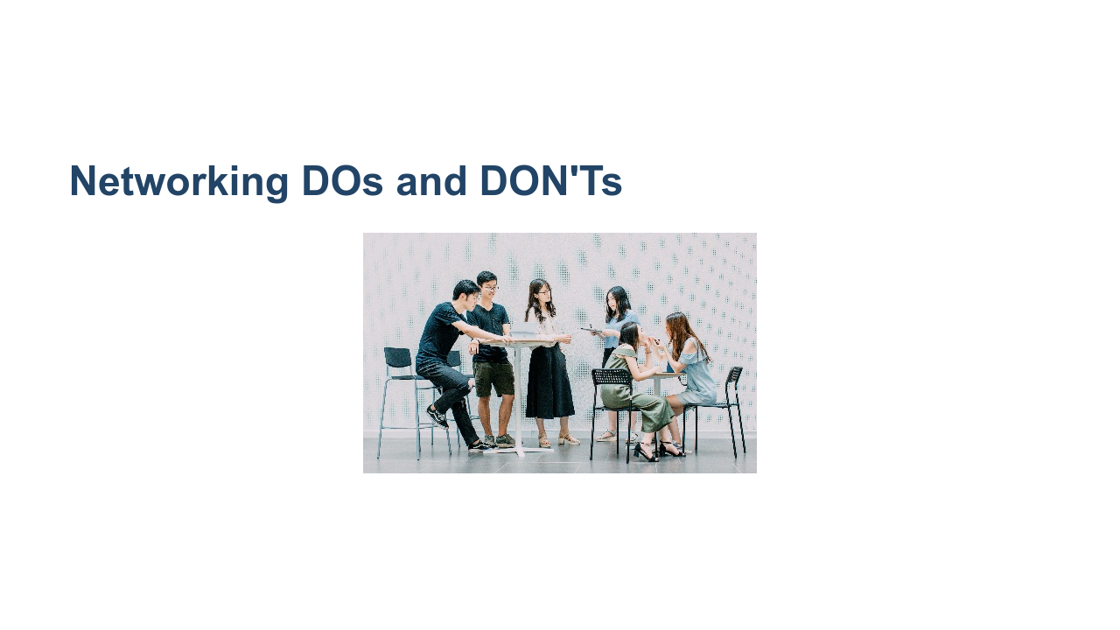
Notes:
In the next few slides, we will go over ways to effectively network, as well as some things that may detract from building a good network. * Image name: res/artofnetworking02.jpg * Repo link: https://github.com/google/applied-machine-learning-intensive/tree/master/content/xx_career_development/03_the_art_of_networking/res/artofnetworking02.jpg * Source https://unsplash.com/photos/1K8pIbIrhkQ by Author Akson https://unsplash.com/@akson under License https://unsplash.com/license.

Slide 6
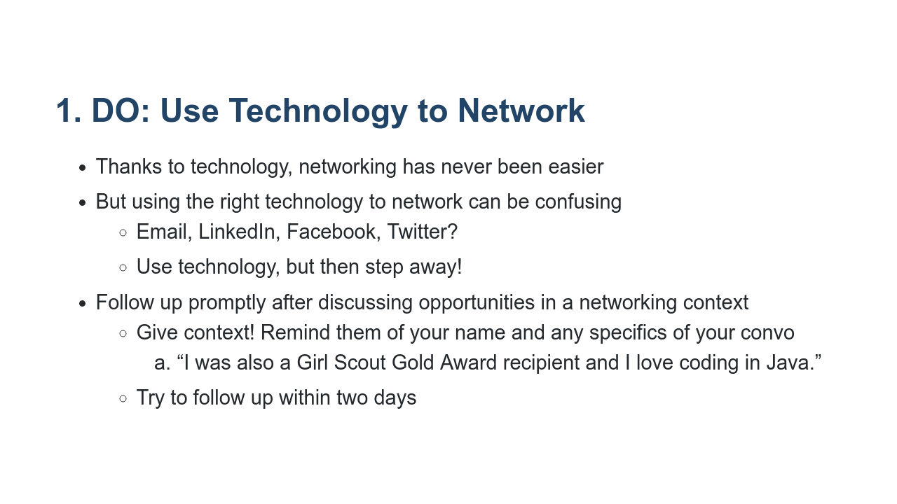
Notes:
* If you can believe it, you used to have to exchange paper resumes to network professionally, which made everything much slower and more complicated * Now, thanks to technology, we can network with one another more easily than ever before using a myriad of platforms. * The down side of that is that with so many options for connecting, it can be difficult to decide the right one. Social media is messy. Across Facebook, LinkedIn, Twitter, and other social networks, we are connected to a mix of close friends, college buddies, high school classmates, co-workers, bosses, former bosses, I-met-you-at-a-party-once acquaintances, and people we've never even seen face-to-face. It's important to understand the particular platform that you're using, as well as the type of relationship you have with a person, before attempting to leverage that connection for professional gain. Each social media platform has a certain reputation. For instance, LinkedIn is generally a business site, while Twitter is more "laid back" and often mixes professional and personal content. Respect the way that people use these sites. Adding a professional acquaintance as a friend on Facebook can be invasive, especially if that individual is a traditionalist who uses Facebook purely for personal contact with friends and family. Likewise, asking an old friend for a recommendation on LinkedIn might create awkwardness if the person has no experience with you in a professional capacity. LinkedIn is the quintessential social media site for forging business and work connections. Twitter can be a useful tool for interacting with the business as a whole, or for keeping up with their work, while Facebook and Instagram are more personal outlets. * Also, while technology is great for staying in touch and keeping track of contacts, nothing is a substitute for a face-to-face conversation and interaction, so whenever possible, be sure to schedule time to actually talk. Social networking is a way to keep track of relationships, but is not necessarily a way to build lasting relationships. * Along the same lines, when you meet someone through social media, ask for their preferred method of contact. Some people are big e-mailers, while others love talking on the phone or meeting for coffee. Respect their preferences.

Slide 7
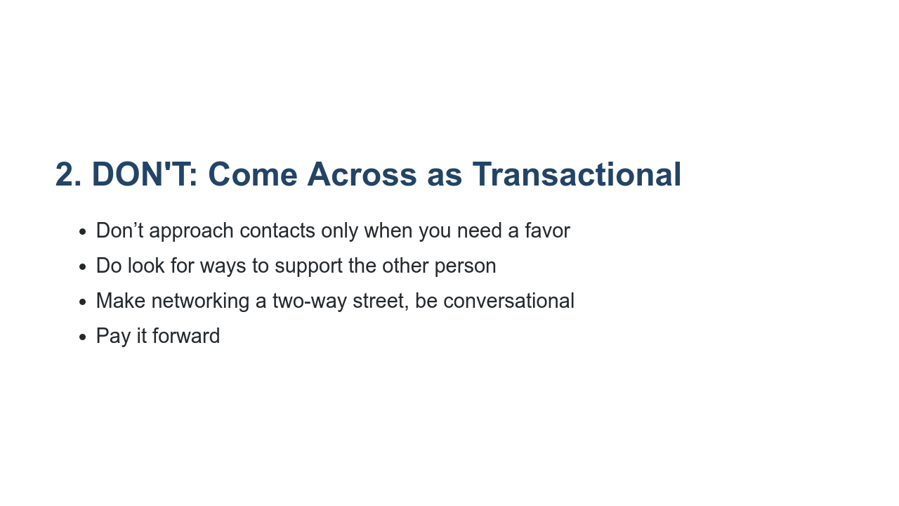
Notes:
* Continuously look for ways to give back to the people in your online networks. * Don't approach them only when you need a favor. Reach out to say hello or to contribute something you think will be valuable to them. * Networking is a two-way street. Plus, in the end, it's your reputation that counts. * Also, because you will benefit from networking, look for ways to also help others. Opportunities to help colleagues who may be younger than you or even just in need of networking help themselves will increase as you become more successful. Whether you pay it forward by introducing a friend to a contact you think could be helpful to them or eventually become a mentor yourself, it completes the full cycle when you’re also in a place to give back to others. * (Consider using a real world example of inappropriate use of calling people, LinkedIn requests, etc)

Slide 8
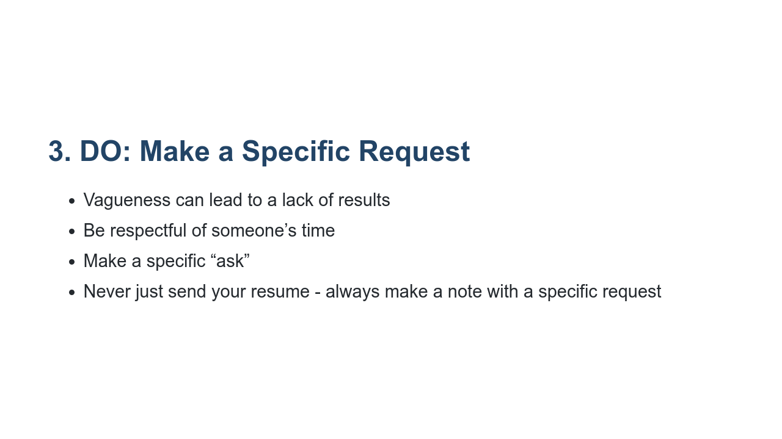
Notes:
* When you approach someone for career help via social media, know what you want out of the interaction and ask specific questions that show you've done your research. Often, people send messages along the lines of "I'm looking to go into marketing. Any advice or leads would be greatly appreciated!" or "Can you tell me more about this job?" in a Twitter DM. These types of messages are so broad that it's difficult to provide a meaningful and relevant response. * Working professionals are strapped for time. Make it easy for them to help you — specify what you're looking for. Is it the person's time? Connections to certain individuals? Advice on a particular topic? Knowledge about a company? Do you want them to act as a reference? Introduce you to a recruiter at their organization? Provide a critique of your resume? * Example: do not email a recruiter and say “I’m a junior CS student - where does my profile fit within Google? * What you could say is: I have a Math minor and know from reading that Chrome needs engineers with this background. Do you think there would be opportunities for me here? * You need to showcase your skills and value, show us you’ve done their research on roles and qualifications, and ask specific questions when you have them.

Slide 9
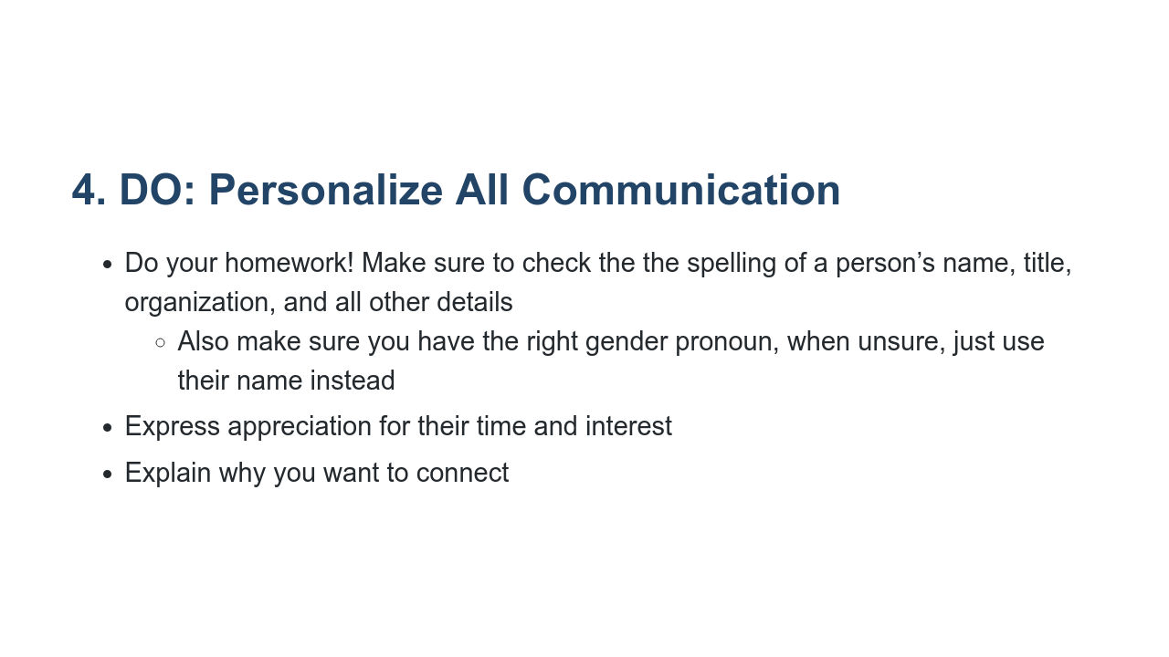
Notes:
* It will be important to your career going forward to have great attention to detail and to show this is something important to you, and you do that by showing you have done research * Tips: pay attention to detail, and if you know this is challenging for you, have a friend proofread important emails or read aloud to make sure everything makes sense before sending. * From LinkedIn connection requests to advice-seeking Facebook messages to 140-character chatter on Twitter, you should customize every communication sent on social networks. It shows that you value your unique connection with the recipient. It's easy for people to feel used when you send them a generic request or a message that's clearly copy-and-pasted to dozens of others (especially if you forget to change the names!). * For existing connections, express an understanding and appreciation for the relationship. When you reach out for advice, give consideration to the other person. Ask pertinent questions about them, especially if you've been out of touch for a while. Be honest and open. When requesting a recommendation on LinkedIn, for example, always customize your request to reflect how you value the person's endorsement. * For new relationships, explain why you want to connect with this particular individual. What is it about her background that makes her an appealing person to talk to? Show that you've done your homework. Know about the person's work history and professional accomplishments, as well as anything career-related you two have in common. Never send an introductory message to a potential connection asking, "So, what exactly does your company do?"

Slide 10
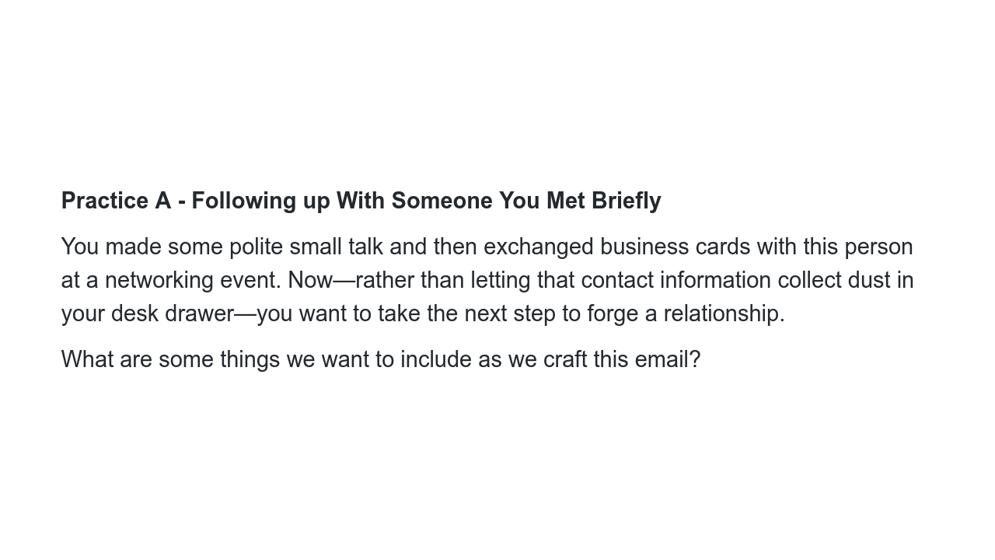
Notes:
**Ask a student to read the slide. Before clicking on the next slide, get some answers from the audience. Possible ideas: * Reference where you met** * Reference something you talked about * An ask - share an article, share you resume, ask a question about where they work, continue the conversation...etc

Slide 11
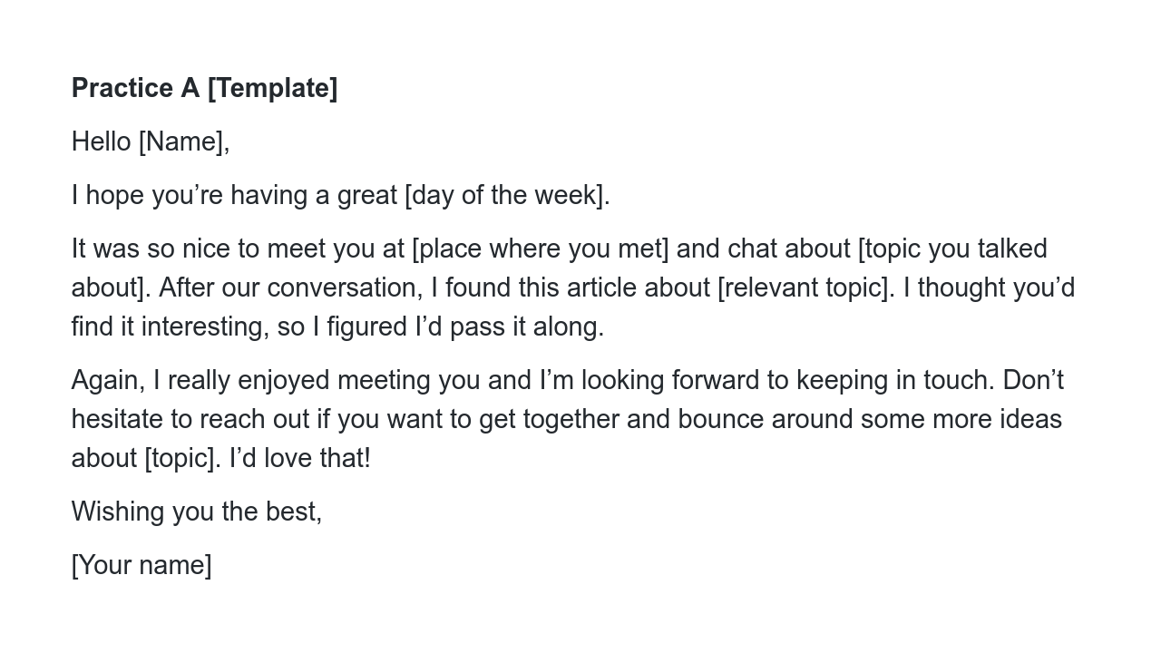
Notes:
This template is an example and certainly not the only way to follow up after meeting someone. Maybe you chatted about a particular resource, book, professor, product launch, study, job description, or any other thing you said you’d pass along. An article is just one way of working to begin solidifying the connection and not letting it drop off.

Slide 12
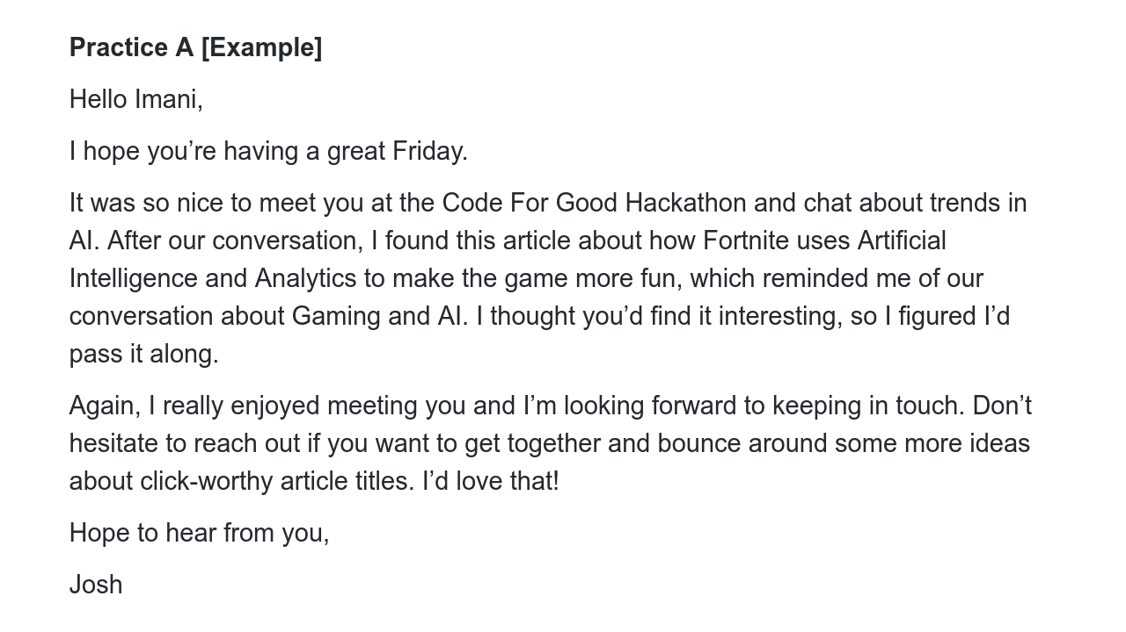
Notes:
Here, we went with an article to keep the conversation going - a great option if you aren’t sure of the exact next steps, but want to keep the conversation open and add this person to your professional network. You could also make your “ask” to pass along your resume. We’ll see an example next that simply asks for an informational meeting as a next step.

Slide 13
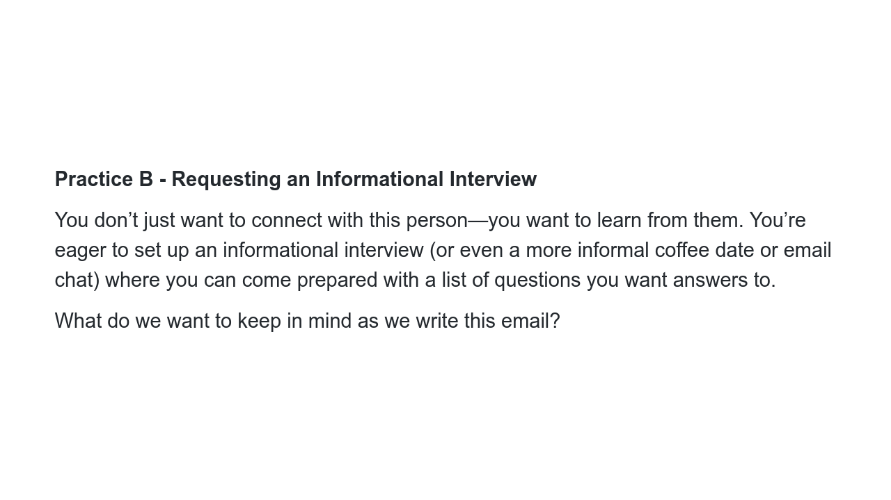
Notes:
Ask a student to read the slide. Before clicking on the next slide, get some answers from the audience. Possible ideas: * Who you are * How you know about them (or if you met them briefly - when and where) * An ask, in this case, to meet up * Meeting up is a BIG ask, so give them an “out” to possibly answer questions by email if they don’t have time to meet up

Slide 14
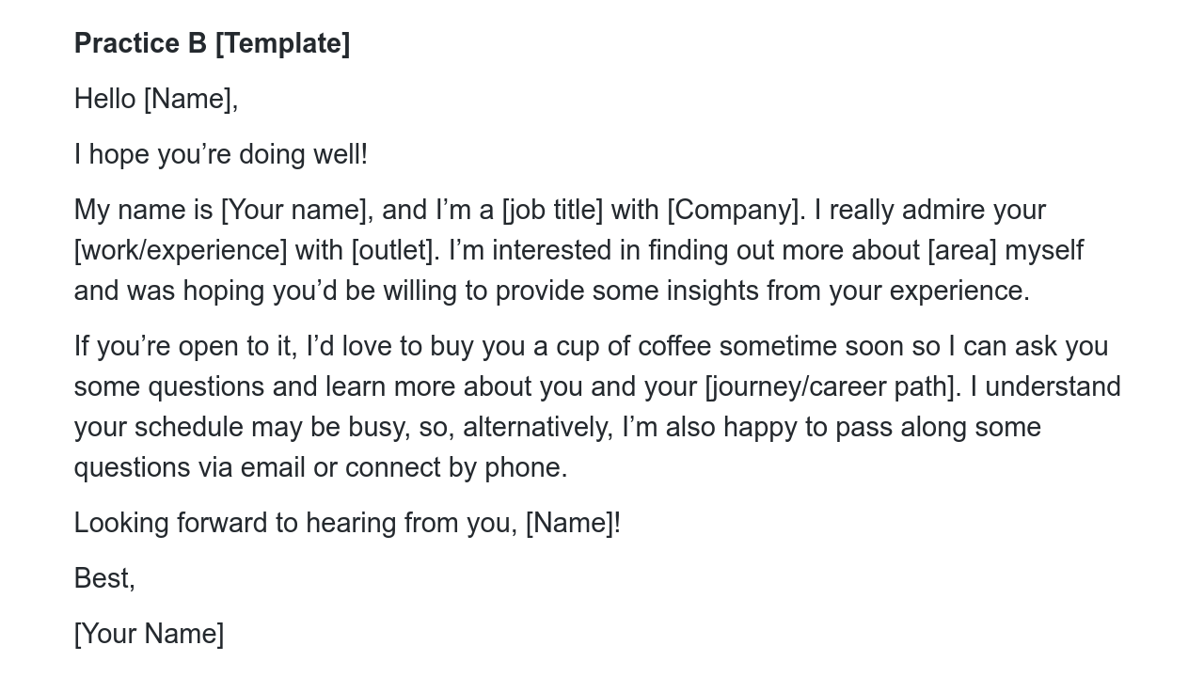
Notes:
The ask is for the informational meeting is there, but so is the option to follow up by email. This email template assumes you don’t know the person. If you DID know this person, you would just edit like the email we saw previously, adding how you know them to jog their memory and then going ahead with your ask for an informational meeting.

Slide 15
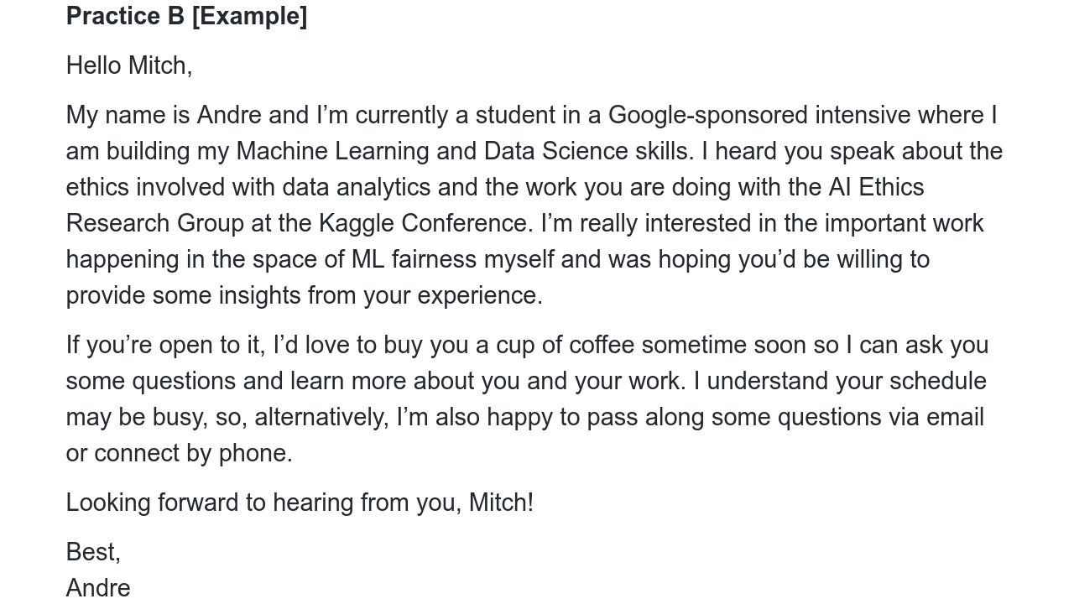
Notes:
Notice this is a very specific request Mitch is making. Also notice he is providing multiple options for Rachel to choose from regarding how to connect. If Rachel agrees to chat with Mitch, she is doing the favor and therefore should choose the medium.

Slide 16
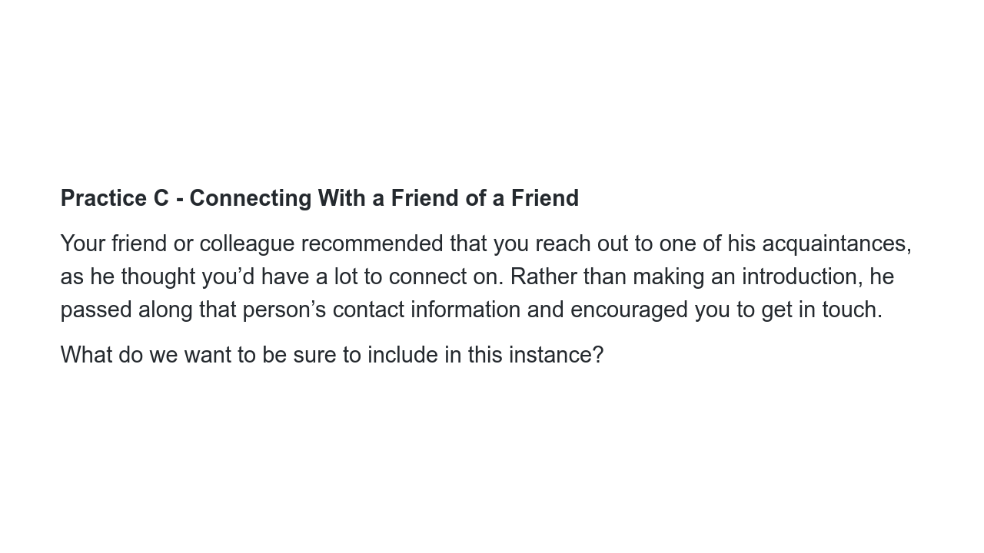
Notes:
Before clicking on the next slide, get some answers from the audience. Possible ideas: * The person you have in common * How you know that common contact * What did your mutual contact think you have in common? * An ask - why are you getting in touch with them?

Slide 17
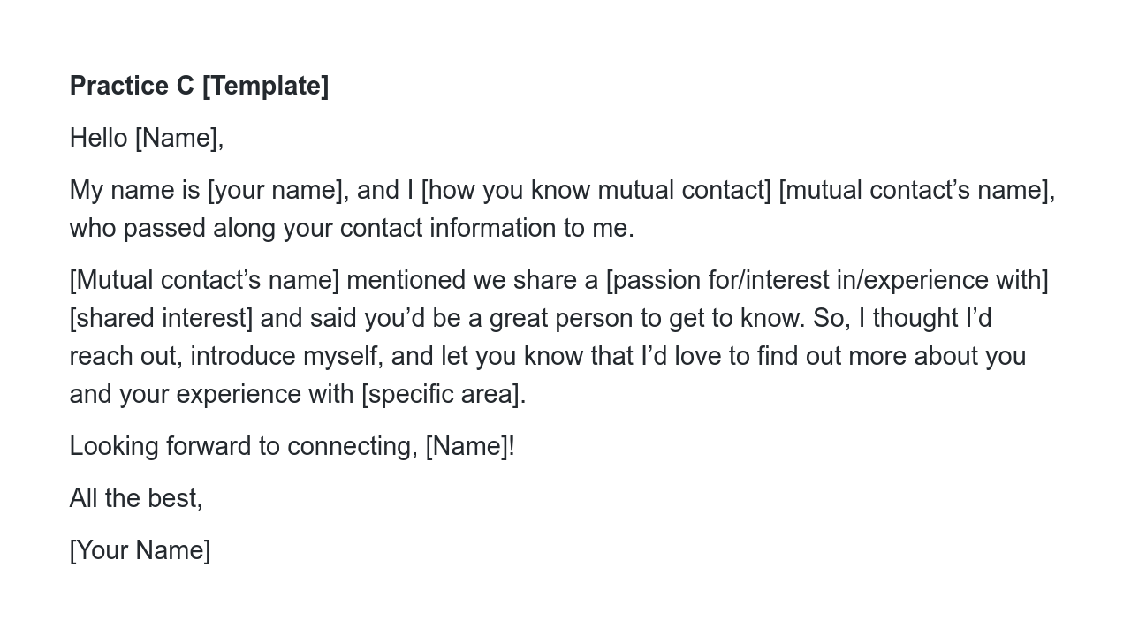
Notes:
Maybe it’s a shared passion or interest, or maybe it’s a job or career you may be interested in. You can tailor this template accordingly so that it meets your needs.

Slide 18
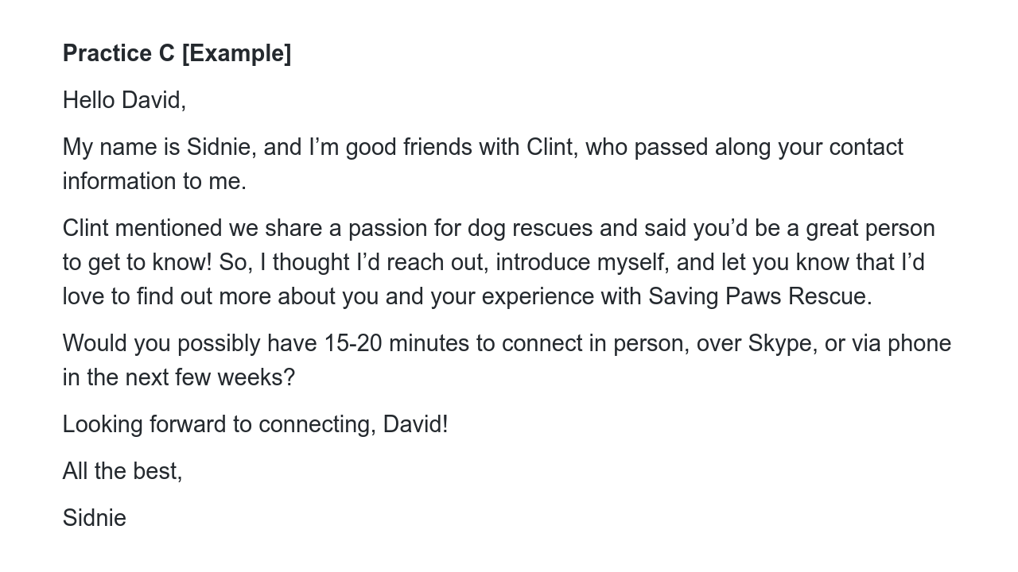
Notes:
Here’s a good reminder that these best practices can be used for personal networking and hobbies as well as purely professional.

Slide 19
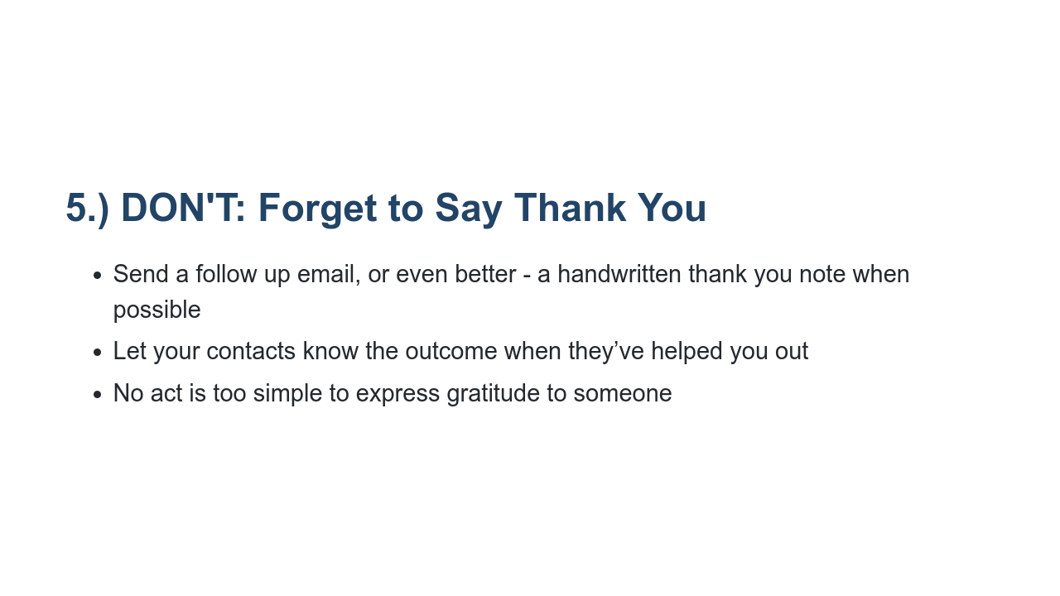
Notes:
* Always send someone a “thank you” email, even if it’s just to thank them for a brief conversation, if at all possible, it’s a great idea to send someone a thank you note if you can easily access their mailing address (you should use their professional mailing address) It will set you apart in a time when most people will use technology. Just make sure to use careful handwriting and spelling. * If someone connected you with an interview for a job, funding for a startup, or a donation to a cause you are championing, let them know the outcome, send an email letting them know you got the job, grew your company by 5%, or raised $5,000 for ALS research. Whatever the outcome, thank them for their time, making the connection, or their donation. * It's a simple step that many people miss. Show appreciation when someone does something nice for you online. Whether it's responding to a few questions, retweeting a link to your blog post, or even connecting you with one of their friends — it's always appropriate to express your gratitude. It's especially important to follow-up after someone has provided advice. People like to feel helpful, so let them know if their advice was useful for you.

Slide 20
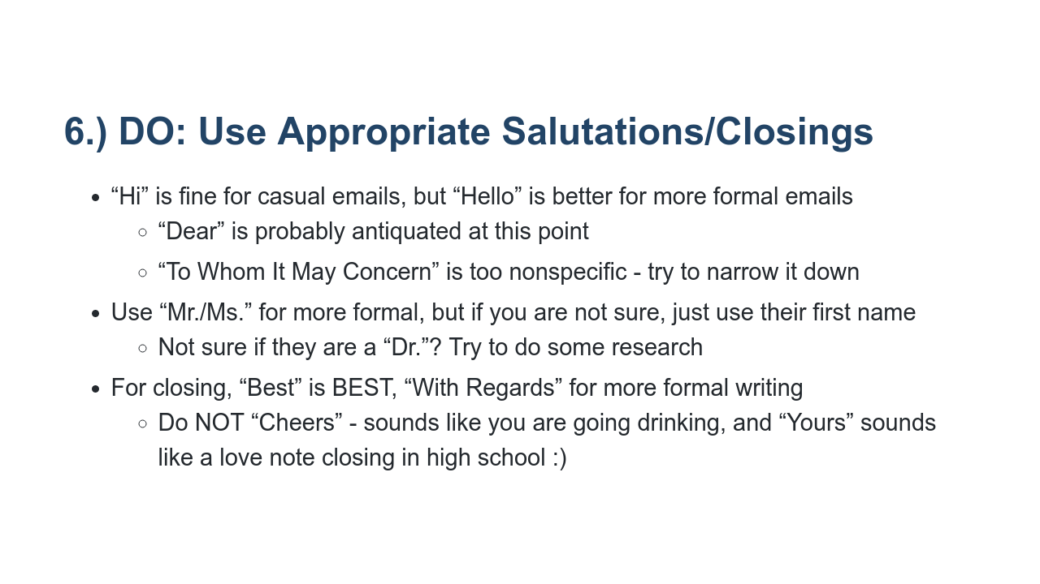
Notes:
* Just a quick note on how to open and close emails - you can show some personality here, within reason, but you don’t want your opening/closing/or subject line to be silly or distracting. * If you are not sure of the gender of the person you are emailing for some reason, use their name only. “Miss” and “Mrs.” guess at a woman’s married status and are pretty passeé now. “Mx.” is gaining traction as a gender neutral greeting, but hasn’t fully caught on yet. However, if someone refers to themselves this way, by all means use it * As a general rule, follow the lead of the person introducing you, or how the person refers to themselves. You always start more formally, unless the person is very close in age to you. If the person then asks you to refer to them by their first name, do that * If you’re not sure if someone has an MD or PhD and your research doesn’t give you an answer, use your best judgment. If they are faculty, you can always say “Professor” this still shows respect for their education and role, even if you aren’t sure of their credentials * For signing off, use your best judgment. I like “Best” - “Best Wishes” sounds a little too fluffy to me, but is still fine. “Regards” also works, but is pretty formal and a little stiff. Personally, “Cheers” and “Yours” don’t work for me. Does anyone have a signoff they use that they want advice on? [Elicit student contributions and respond to each.]

Slide 21
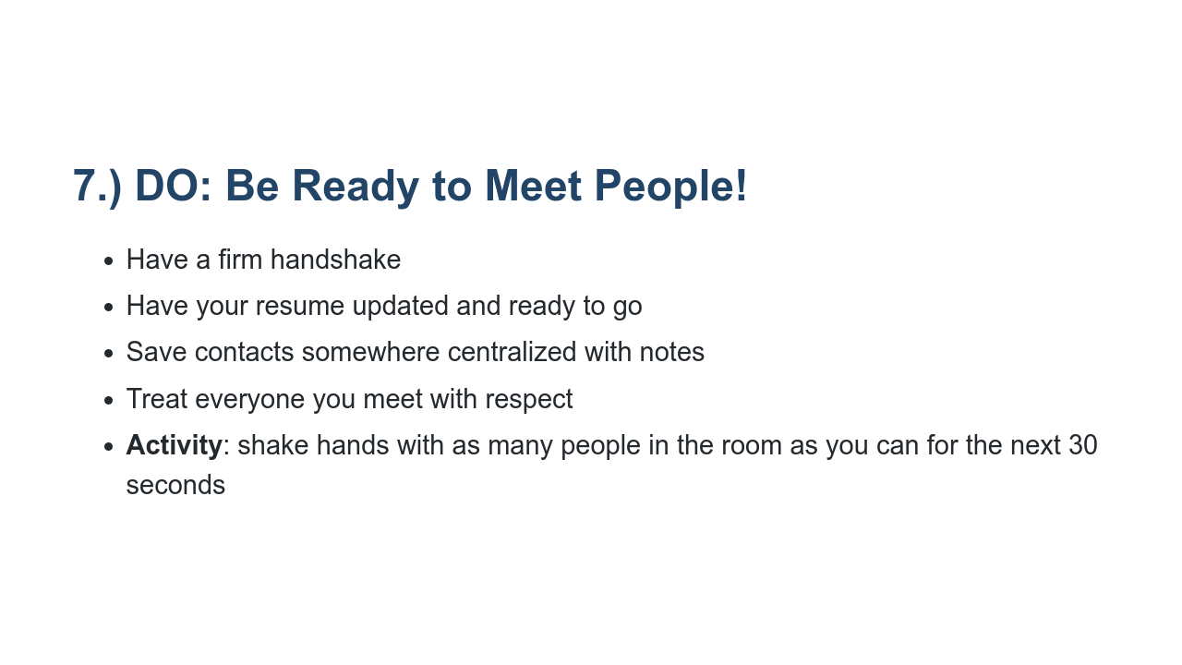
Notes:
* A firm handshake is still very important; avoid being TOO firm, but when you shake hands, firmly grasp the right hand of the person with your right hand only, then pump up and down once or twice only while making eye contact and exchanging names, saying “nice to meet” you and remembering to smile between all that! If you know you have sweaty hands (a lot of people do especially when they are nervous, subtly wipe your palms first as you walk up) * Always have your resume updated and ready to go, saved as a PDF, or on Google drive. Leave off the objective so you don’t have to continually personalize. Spend time after every new role you take adding that information. You wouldn’t believe how many opportunities people miss by not having an updated resume saved to their computers. * Business cards disappear easily, so transfer contacts to your phone, email or another centralized place. If possible, make a quick note of title, company, and anything else as a small note that will remind you of who this person is and what you talked about - they may not be someone you think will be an important contact now, but you never know, so try to keep a record and details to jog your memory. * Along those lines, you never know who will be in a position to help you or give you advice now or in the future, so remember to treat everyone with respect. * Set a timer for 30 seconds, make everyone get up and PRACTICE an appropriate handshake, eye contact, and a positive, confident introduction!

Slide 22
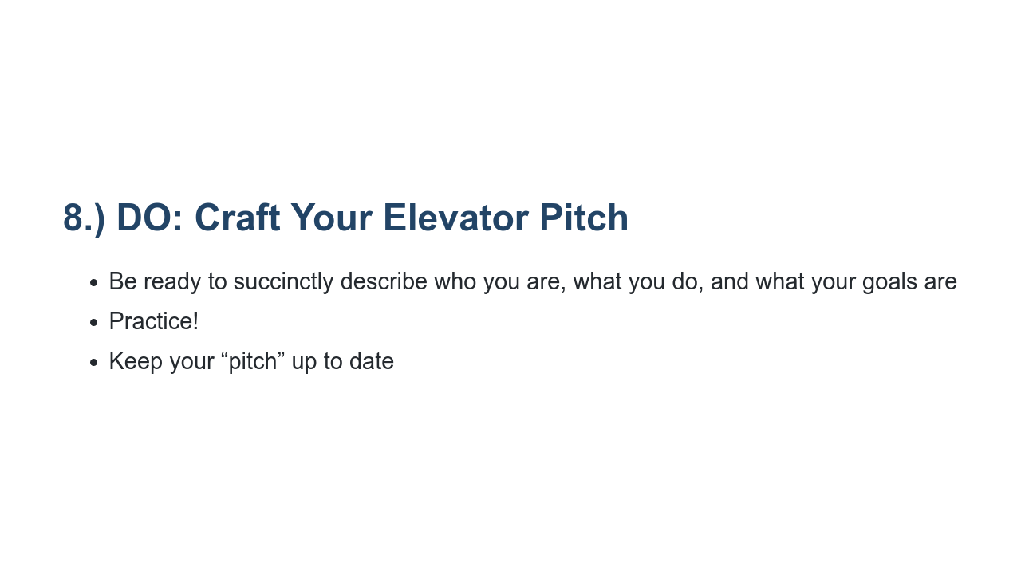
Notes:
* You should practice being able to describe who you are, what your goals are, and what you’re involved in. Trust me, you’ll use this at everything from career fairs to family weddings. * You may want to slightly tailor your pitch based on different roles you hold - for instance, you may have a “pitch” about where you go to school, what you want to study, and the kinds of careers or opportunities you are looking for when you got to something like a career fair, but if you are at a meeting for club presidents and you head up the Computer Science club, you may have a pitch of what your club does, how many members you have, and your goals for this year. * There will always be a reason to sell what you do in a very short window of time. It will always play in your favor if you maintain the ability to do that in a way that manages to cover who you are, what you do, and why it’s relevant. Try to come off as casual, efficient, and not forced or pushy. Easy, right? We know it’s not, which is why you should practice ahead of time. * In a mirror. Repeatedly. And, like a resume, elevator pitches need periodic updating.

Slide 23
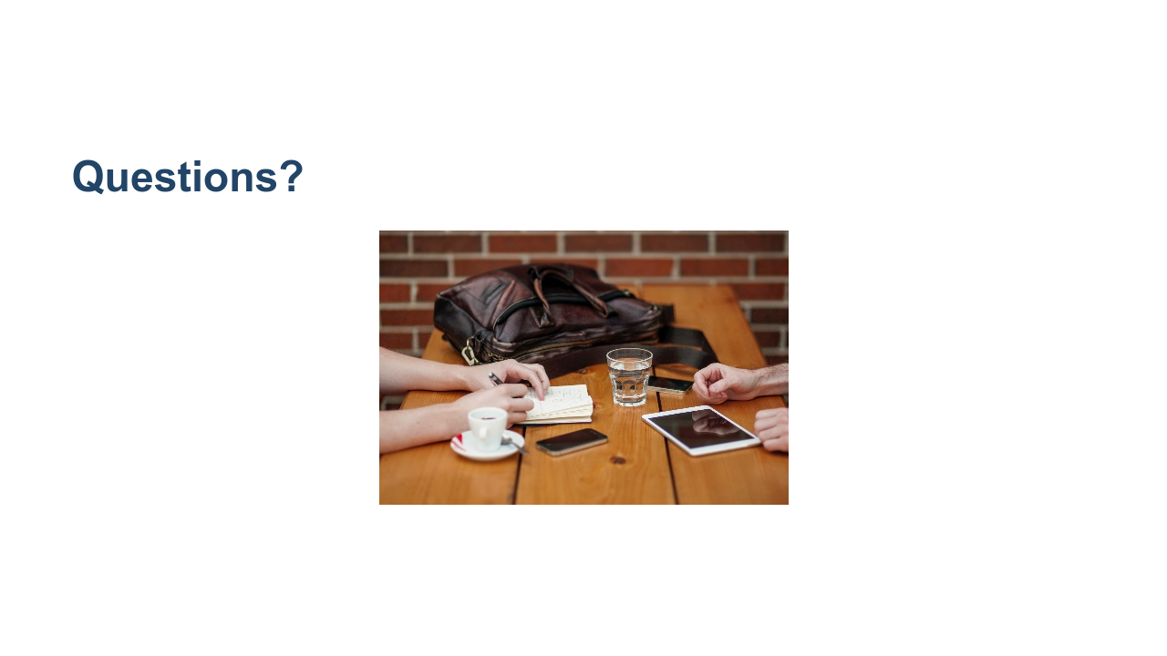
Notes:
What questions do you have? * Image name: res/artofnetworking03.jpg * Repo link: https://github.com/google/applied-machine-learning-intensive/tree/master/content/xx_career_development/03_the_art_of_networking/res/artofnetworking03.jpg * Source https://unsplash.com/photos/BbQLHCpVUqA by Author Alejandro Escamilla https://unsplash.com/@alejandroescamilla under License https://unsplash.com/license.

Slide 24
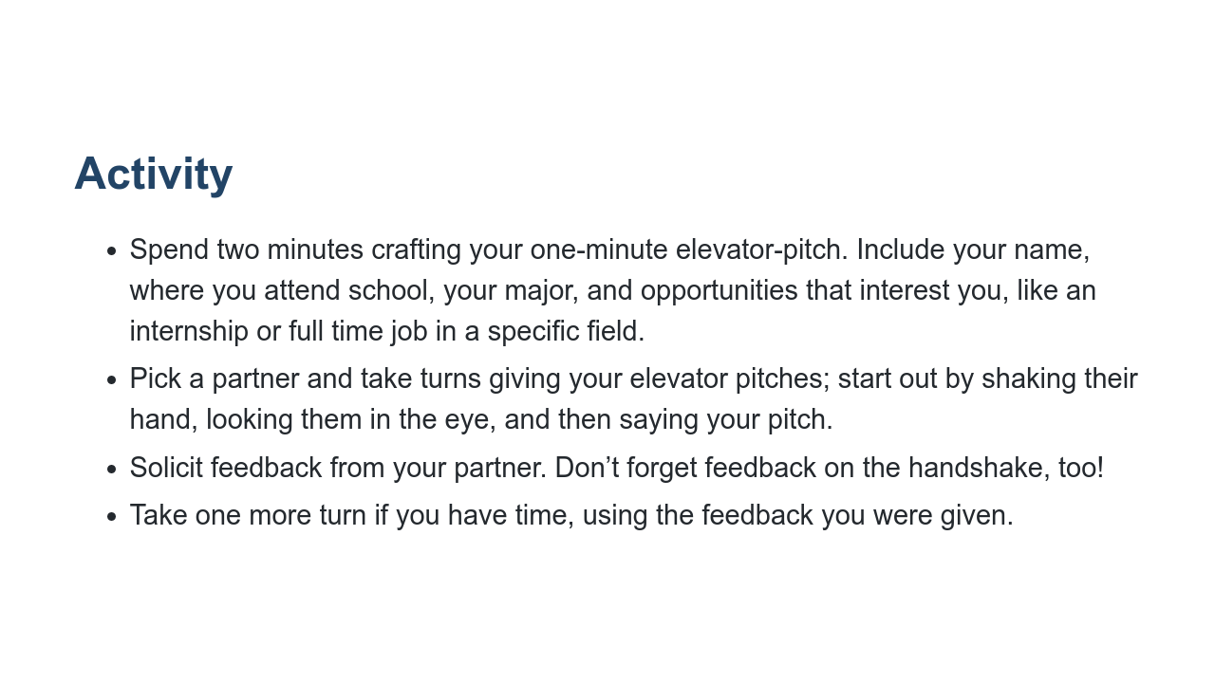
Notes:
Let’s craft or fine-tune our elevator pitches so we’re ready to meaningfully connect with people when those opportunities arise!

Slide 25
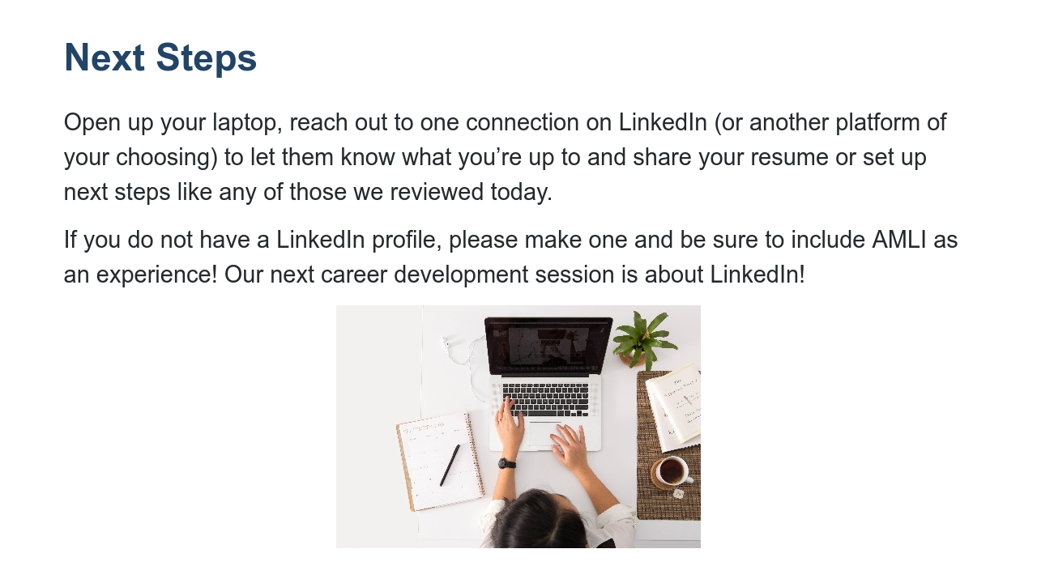
Notes:
Circulate to help students formulate emails, respond to recruiters, etc. If students say they don’t have anyone to reach out to - how about a faculty speaker, or just someone they can send a “thank you” and update to? Doesn’t have to be a cold email. * Image name: res/artofnetworking04.jpg * Repo link: https://github.com/google/applied-machine-learning-intensive/tree/master/content/xx_career_development/03_the_art_of_networking/res/artofnetworking04.jpg * Source https://unsplash.com/photos/DUmFLtMeAbQ by Author Avel Chuklanov https://unsplash.com/@chuklanov under License https://unsplash.com/license.

