Slide 1
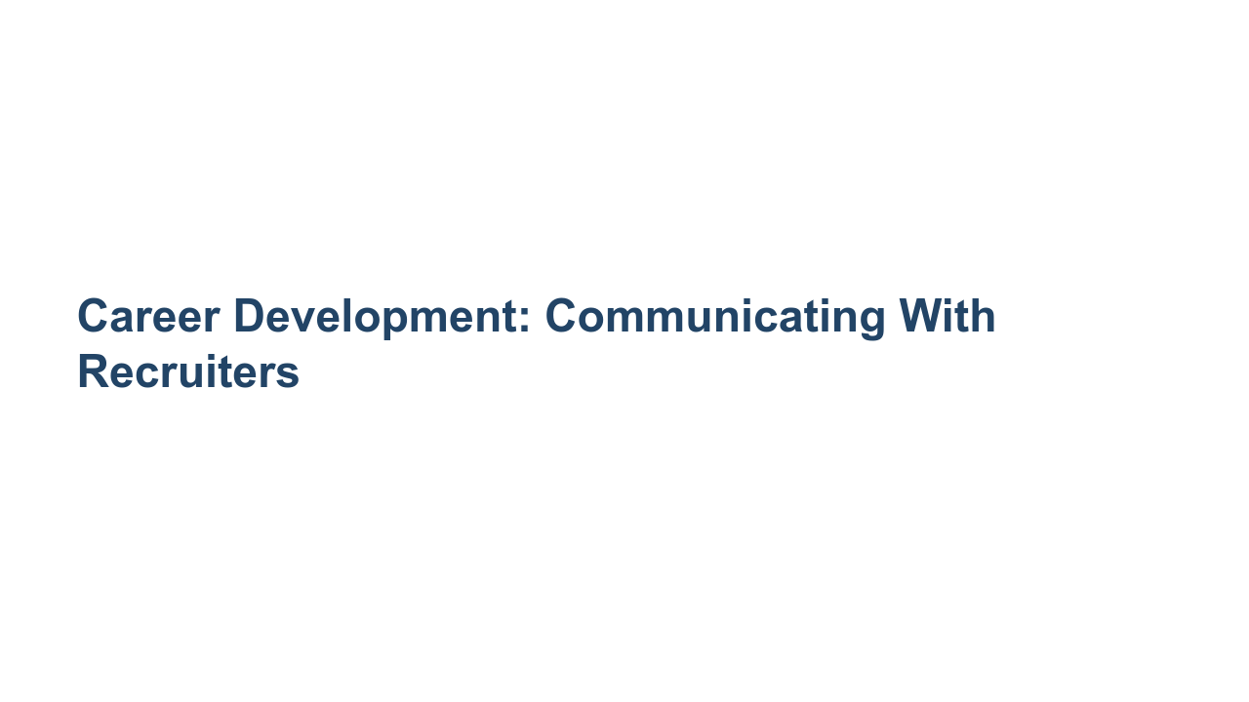
Notes:
Who has had experience working with a recruiter? What was the process like? Did you ever experience uncertainty about how often you should reach out to your recruiter or what you should/shouldn’t share? Hopefully this discussion will clear up some of that uncertainty and provide you with some best practices for communicating with recruiters that you can apply when you work with a recruiter next. Whether you’ve never worked with a recruiter or have worked with many, this session is for you. Let’s get started!

Slide 2
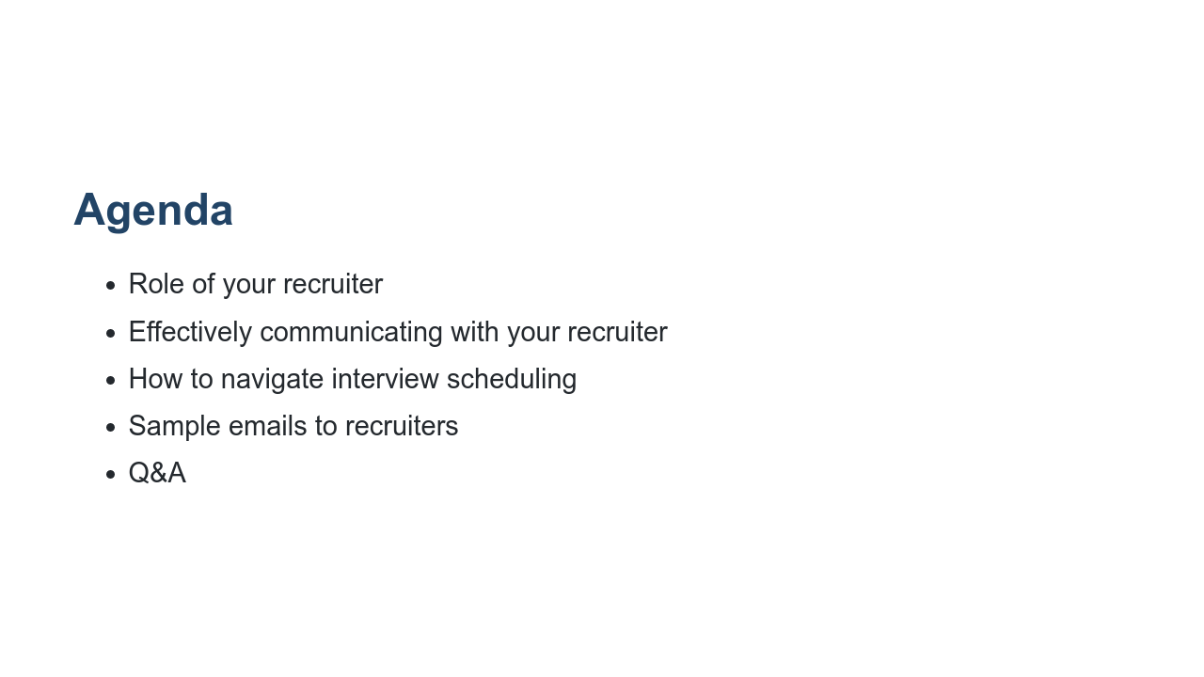
Notes:
First we’ll go over the role your recruiter serves in your hiring process. Their exact job responsibilities can vary by employer but are generally similar. Then we’ll talk about how to effectively communicate with your recruiter and how to navigate all the minor and major details of scheduling and participating in interviews. Then we’ll close out with some sample emails to bring more color to our discussion and Q&A.

Slide 3
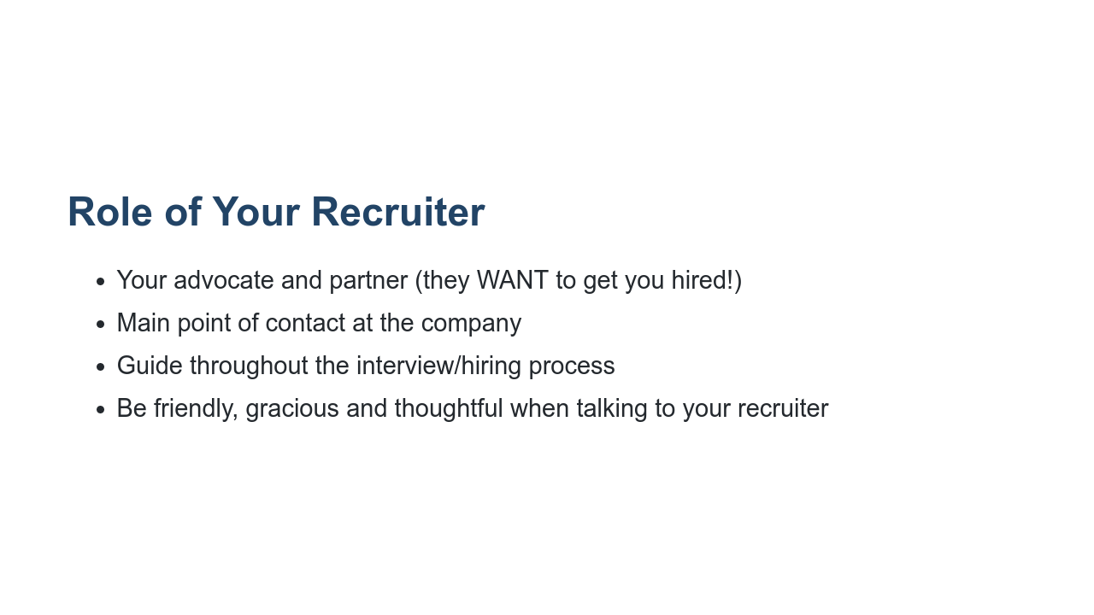
Notes:
* Your recruiter is your advocate and partner. Be kind, respectful, friendly, and honest in your communications. They’re there to help you, provide you with resources, and guide you through the interview and hiring processes. * While you may also be in touch with a hiring manager, your recruiter is typically your main point of contact during an interview process with a company. Make sure to keep them in the loop with any updates that affect your candidacy. * Your recruiter will also keep you updated, so keep an eye on your inbox! You should always respond to your recruiter within 48 hours. * Tip: It’s always good to express your thanks and show your appreciation. Your recruiters work hard to ensure your process is as informative, timely, and smooth as possible. Show your positivity and gratitude. It can go a long way!

Slide 4
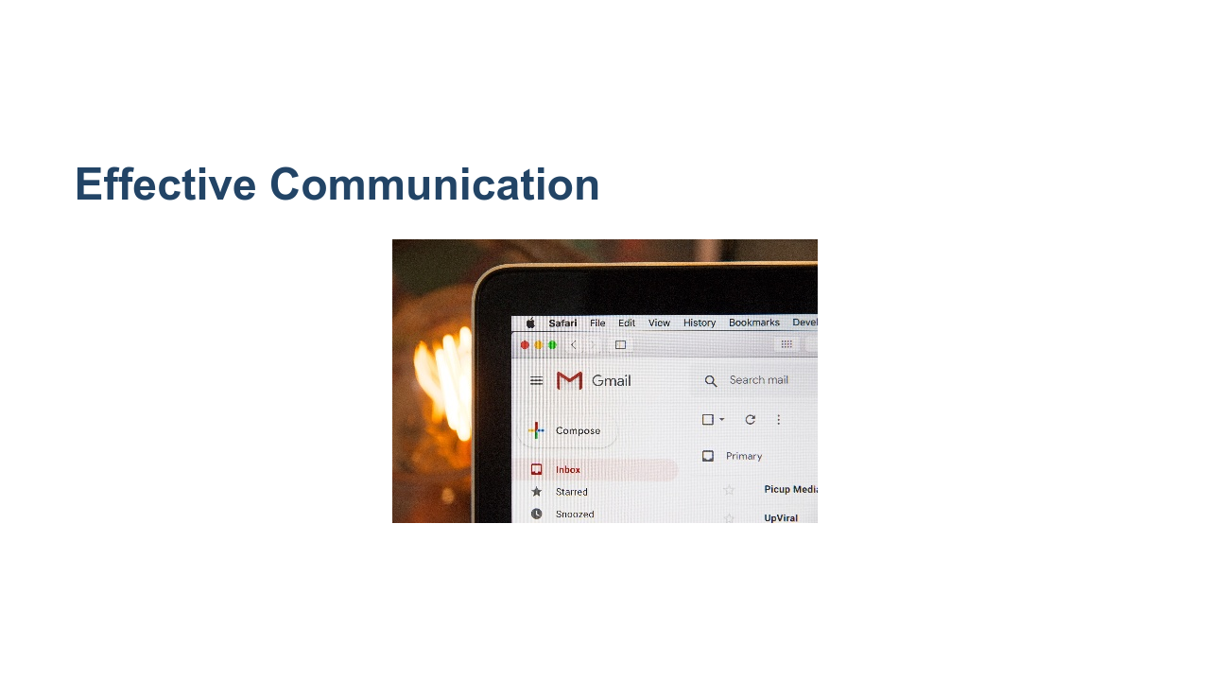
Notes:
Let’s move on to some guidelines for effectively communicating with your recruiter. * Image name: res/commrecruiter01.jpg * Repo link: https://github.com/google/applied-machine-learning-intensive/tree/master/content/xx_career_development/05_communicating_with_recruiters/res/commrecruiter01.jpg * Source https://unsplash.com/photos/3Mhgvrk4tjM by Author Stephen Phillips https://unsplash.com/@hostreviews under License https://unsplash.com/license.

Slide 5
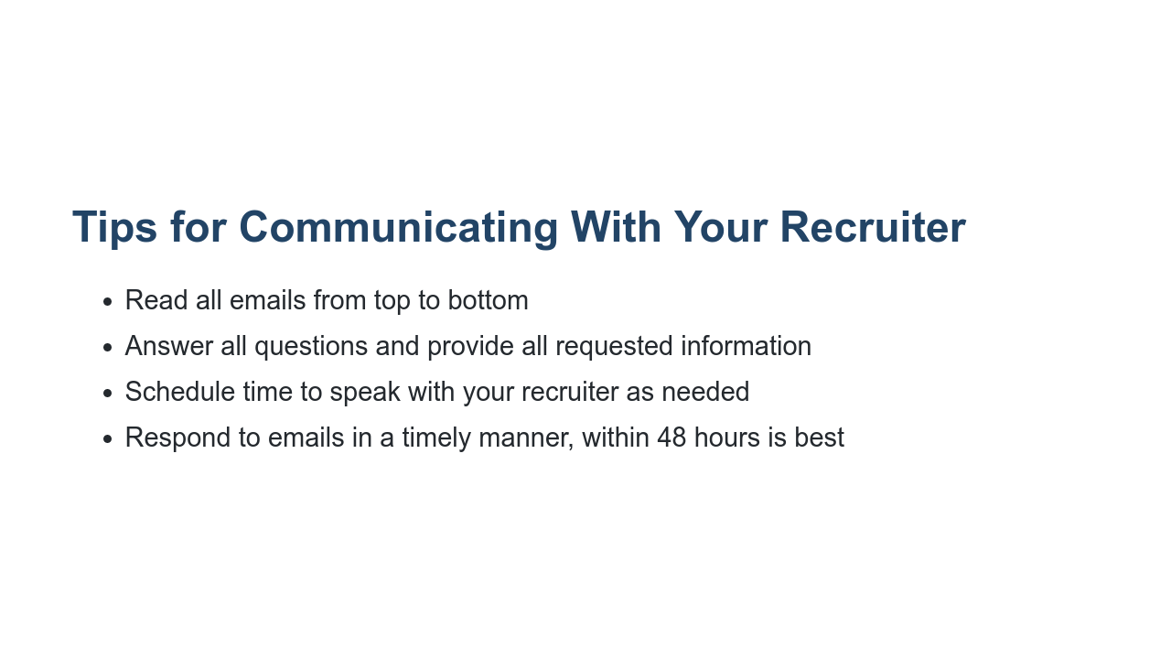
Notes:
It is important to follow these tips when communicating with recruiters: * Read all emails from top to bottom: Recruiter emails often have a lot of information in them, and they don’t want you to miss anything. Be sure to scroll down and look for FAQs in case they’ve included them. Save your emails with recruiters to refer back to them as needed. Also, be sure to read through all links or attached materials. * Answer all the questions and provide all requested information to save time; a lot of inefficiency is caused by emailing back and forth unnecessarily, and you don’t want to slow down your process if you can avoid it. * Some recruiters will have a link to their calendars in their emails so you can choose a good time that works best for you. Otherwise, they will ask you for your availability. Be aware of times zones and make explicit plans. Make sure the contact details you provide are accurate and that it is clear who will be contacting whom if you connect over phone or video. * Recruiters try to respond to candidates as soon as possible. It’s important you do the same! Things can move pretty quickly, and you want to ensure you are keeping your recruiter posted with the most updated information possible. At the same time, you want to be mindful of work/life balance; recruiters won’t be responding to emails late at night or during weekends and holidays.

Slide 6
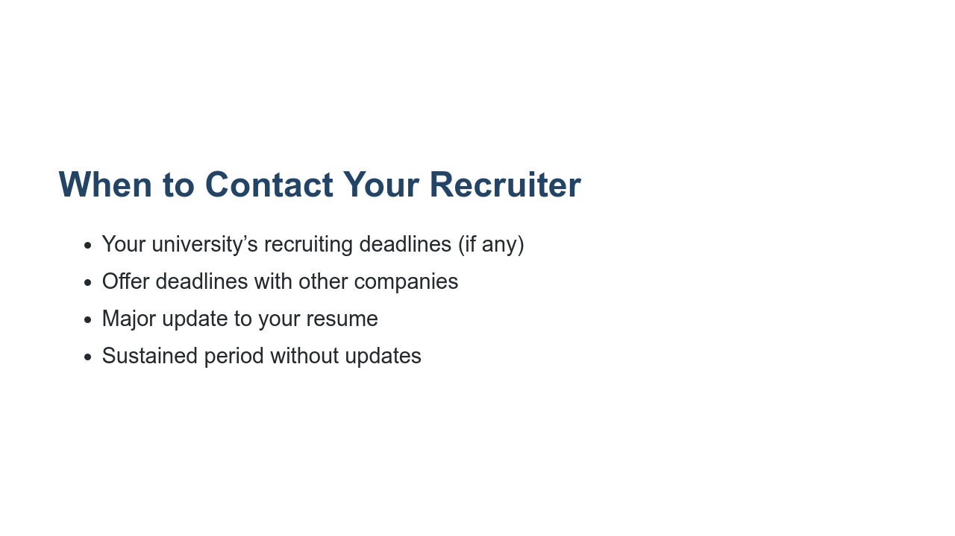
Notes:
Students often ask, “Should I update my recruiter about that?” Here are some guidelines for when you definitely want to communicate with your recruiter: * University deadlines: Some universities have specific guidelines on when its students are permitted to accept internship or full-time job offers. These guidelines exist to serve you and make sure you have sufficient time to make the best decision for yourself. Check to see if your university has NACE guidelines, and mark your calendar accordingly. * Company deadlines: If you’re interviewing with another company and receive an offer, let your recruiter know. You’ll hear recruiters refer to this as a “competing offer.” Having a competing offer can sometimes speed up the offer process at the other places where you’re interviewing. It would be a shame if you had to accept an offer with other possibilities on the table, so it’s important to be transparent with your recruiter to let them know if you have other offers or may soon. * Major update on your resume (e.g., new skill, award, conference, publication, etc.). Update your resume and send it as a PDF. * When you haven’t heard from your recruiter in a while (2+ weeks), you can reach out to check in and see if any progress has been made on their end or if they need anything from you. TIP: Always be truthful, open, and honest with your recruiter. If they have the full picture of your status and options, they can guide your process with their company more comprehensively.

Slide 7

Notes:
Now let’s move on to scheduling and completing interviews at a company. * Image name: res/commrecruiter02.jpg * Repo link: https://github.com/google/applied-machine-learning-intensive/tree/master/content/xx_career_development/05_communicating_with_recruiters/res/commrecruiter02.jpg * Source https://unsplash.com/photos/4PU-OC8sW98 by Author Christina https://unsplash.com/@wocintechchat under License https://unsplash.com/license.

Slide 8
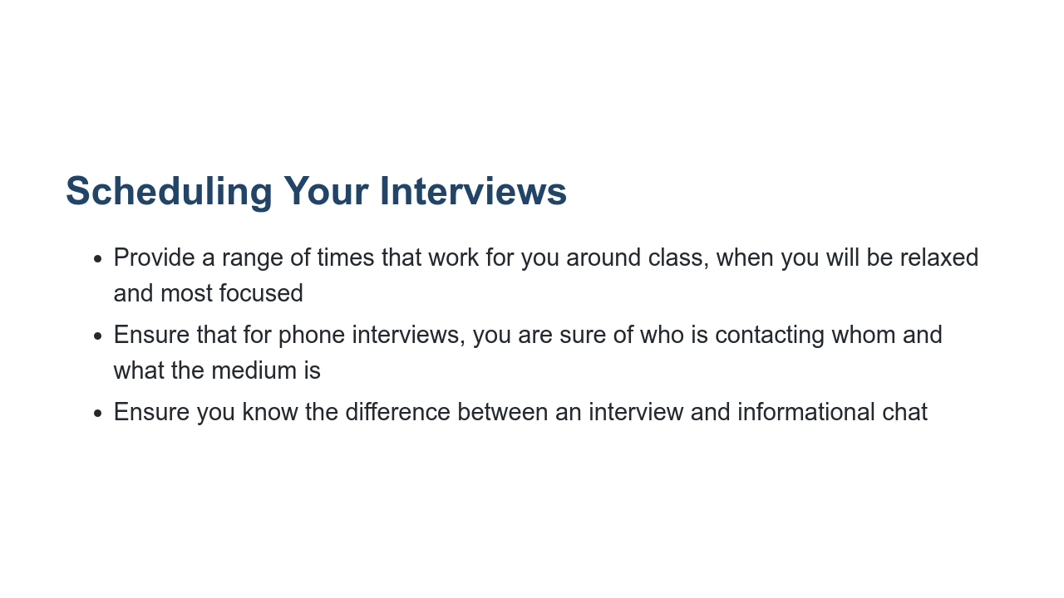
Notes:
* At most companies, recruiters will schedule your interviews, or they will introduce you to a recruiting coordinator. Oftentimes recruiting coordinators partner with recruiters and candidates to schedule your interviews. * Generally companies interview between 10am-4pm PST, Monday through Friday. * Everyone wants you to feel comfortable and at your best. * Provide times that work for you and your class schedule. * Make sure you know the format of any interview, as well as who will be contacting whom and when. If you’ll be using a format you’re not that familiar with, like coding on a Google Doc, then you should practice coding in a Google Doc. * Sometimes, depending on the company, a recruiter or someone else in the company may want to start with an informational chat before jumping into official interviews. These will usually consist of talking about the role, company, and your resume. Ensure you have your resume in front of you and can speak about the experiences you want to highlight most. Also, it is so important that you do some basic research on the company. It’s common in an informational session to be asked about your knowledge about the company, your willingness to relocate, and what interests you about working there. Be ready to answer very general questions meant to show you are serious about the job hunt.

Slide 9
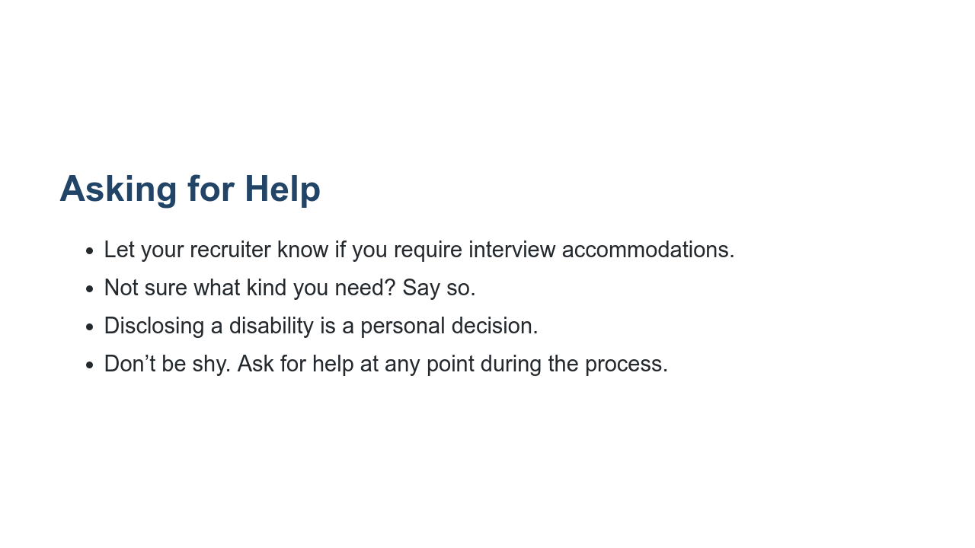
Notes:
* Companies should be committed to providing equal opportunities for everyone throughout their hiring process. * If you’re not sure what type of accommodations you might need, that's ok. Many companies have a specialist or team that will work directly to identify what types of accommodations you might require. If a company is too small to have a designated person or team for this important task, they should have a contractor or consultant who can assist. * Disclosing a disability or need for an accommodation is a personal decision. Ultimately the decision of whether or not to disclose is up to you, but you want to do everything you can to perform well in your interview and get the job or internship. Recruiters want that for you, too.

Slide 10
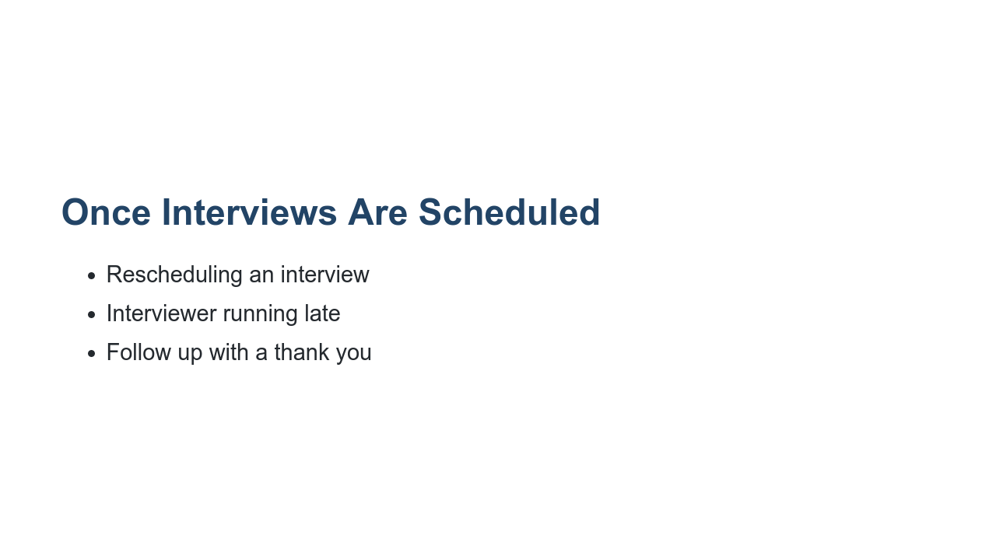
Notes:
Rescheduling an interview * If an interview absolutely needs to be rescheduled, let your recruiter and recruiting coordinator know on one email as soon as possible. It’s best practice to reply all to the email where your interview was originally scheduled. * Keep rescheduling to a minimum. If you’re sick or there’s an emergency, rescheduling is warranted. But once your interview date is set, make sure to prepare yourself for that day. * Rescheduling multiple times might make you more anxious, so it’s generally best to stick with your originally planned interview date. Interviewer is late * You’re waiting to start your interview and your interviewer is late. What do you do? Wait about 5-10 minutes. Interviewers are often going from meeting to meeting, and conference rooms may not be booked near each other. After 5-10 minutes, email your recruiter and recruiting coordinator (once again, on the same email thread), and let them know you haven’t heard from your interviewer yet. They’ll sort out what’s going on. Thank you * Most recruiters can’t share interviewers’ contact information with you directly, but feel free to send a note to your recruiter to pass along to your interviewer. * It’s always nice to thank your recruiting coordinator and recruiter for their help prepping you and getting you scheduled.

Slide 11

Notes:
Now that we’ve gone over some important information to consider when working with your recruiter, let’s put these best practices to use! Source: Photo by NeONBRAND on Unsplash * Image name: res/commrecruiter03.jpg * Repo link: https://github.com/google/applied-machine-learning-intensive/tree/master/content/xx_career_development/05_communicating_with_recruiters/res/commrecruiter03.jpg * Source https://unsplash.com/photos/IhsaTDKzdwg by Author NeONBRAND https://unsplash.com/@neonbrand under License https://unsplash.com/license.

Slide 12
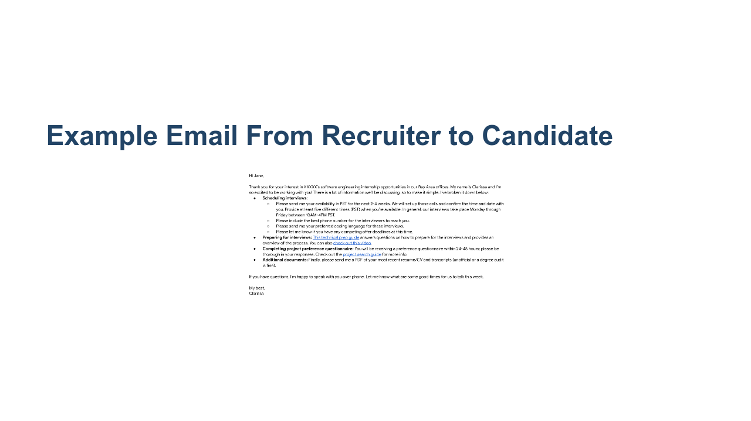
Notes:
*Have 1-2 student volunteers read this email from a recruiter out loud to the class.* * Image name: res/commrecruiter04.png * Repo link: https://github.com/google/applied-machine-learning-intensive/tree/master/content/xx_career_development/05_communicating_with_recruiters/res/commrecruiter04.png * Source https://github.com/google/applied-machine-learning-intensive/tree/master/content/xx_career_development/05_communicating_with_recruiters/res/commrecruiter04.png by Author Google LLC under License Copyright [2020] Google LLC.

Slide 13
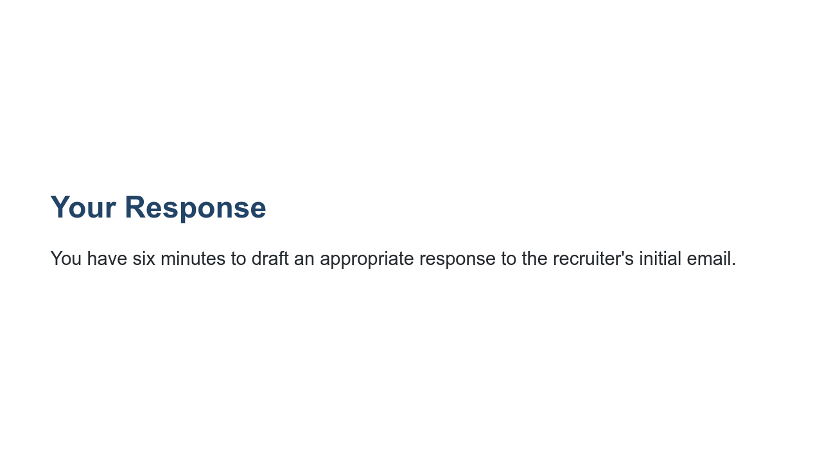
Notes:
Now, take six minutes to draft an appropriate response to your recruiter, Clarissa. I’ll switch the screen back so you can reference it while you type. *Revert to previous slide.* *Give students six minutes to write and then ask for 1-2 student volunteers to read their versions. Highlight 1-2 things students did well in their response.*

Slide 14
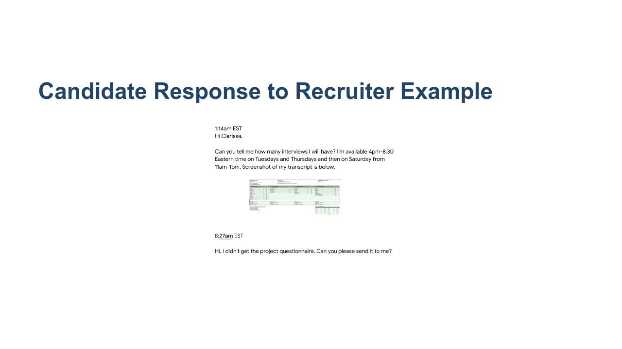
Notes:
Now that we’ve read an email exchange between a recruiter and candidate, take a look at this candidate’s response to their recruiter. Can you point out what’s wrong with the candidate’s response or what’s missing in this scenario? *Response should include: * The initial email from the recruiter states that there will be two technical interviews - remember to read all emails from top to bottom! * Availability for interviews is given in EST, not PST like the recruiter requested. * Availability for interviews is outside of general workings hours (late in the evening and on a Saturday). * Screenshot of transcript is pasted in body of email. Recruiter requested a PDF of both transcript and resume * Availability should be specific: for example, list dates as Tuesday, May 29 * The initial email from the recruiter says that the project questionnaire will be sent out within 24-48 hours. This usually means business hours. If you still haven’t received it within 48 business hours, you should reach out to your recruiter then. * Don’t expect an immediate response especially when it’s outside of our general working hours. Notice that this person was replying to their recruiter very early hours in EST. Remember, Googlers try to get back to everyone within 24 hours. * This person is sending multiple emails back to back. While it’s not necessarily a bad thing, it isn’t preferred for most recruiters. Keep your emails clear and concise. * It’s always nice to sign off with a thank you and your name! Be friendly! * Image name: res/commrecruiter05.png * Repo link: https://github.com/google/applied-machine-learning-intensive/tree/master/content/xx_career_development/05_communicating_with_recruiters/res/commrecruiter05.png * Source https://github.com/google/applied-machine-learning-intensive/tree/master/content/xx_career_development/05_communicating_with_recruiters/res/commrecruiter05.png by Author Google LLC under License Copyright [2020] Google LLC.

Slide 15
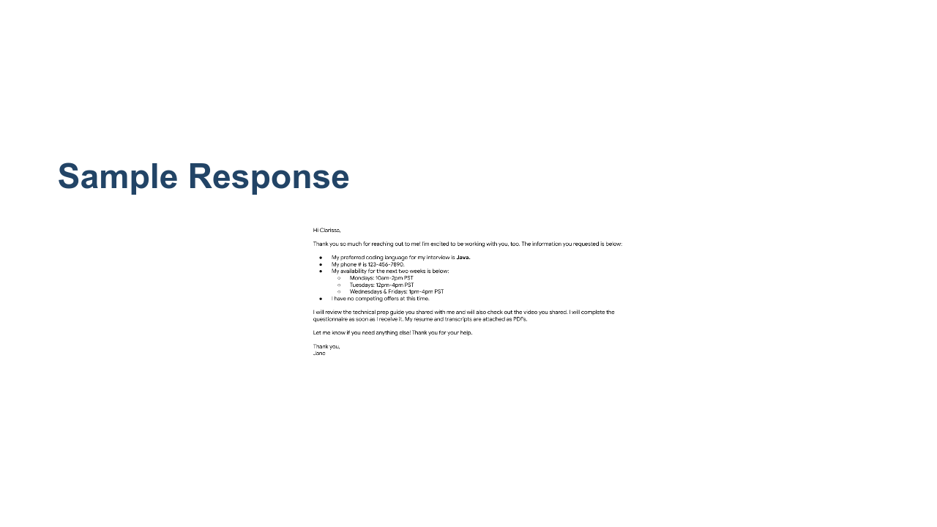
Notes:
Here’s a good example of a positive response from a candidate to a recruiter. What are some things Jane did well here? * Image name: res/commrecruiter06.png * Repo link: https://github.com/google/applied-machine-learning-intensive/tree/master/content/xx_career_development/05_communicating_with_recruiters/res/commrecruiter06.png * Source https://github.com/google/applied-machine-learning-intensive/tree/master/content/xx_career_development/05_communicating_with_recruiters/res/commrecruiter06.png by Author Google LLC under License Copyright [2020] Google LLC.

Slide 16
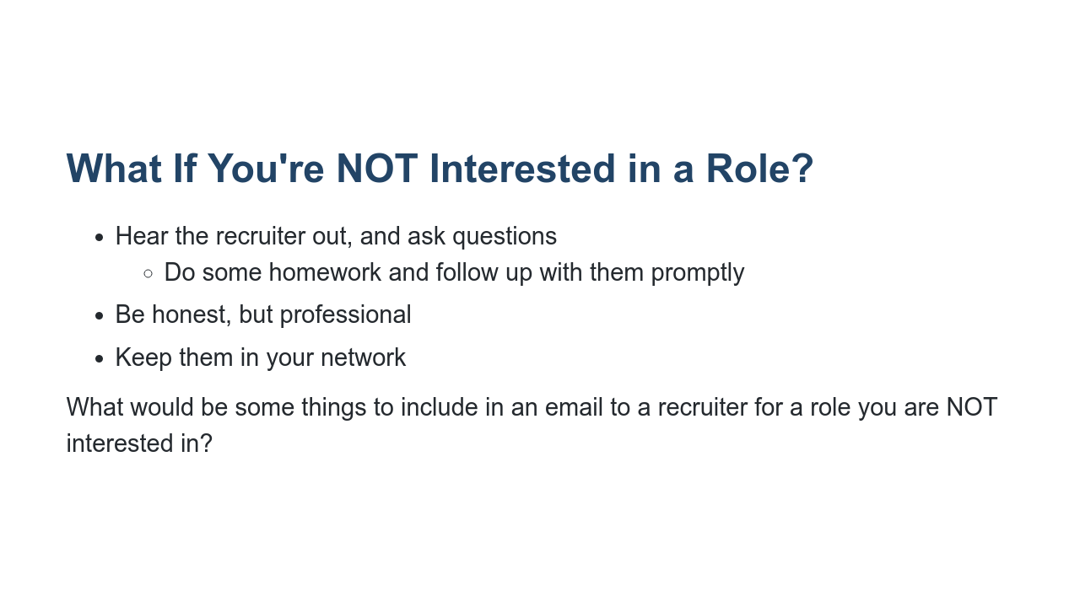
Notes:
* If a recruiter contacts you out of the blue, you should respond at least once. Ask clarifying questions and do some homework to see if the role is at all a good match for you. You don’t want them to waste your time, but don’t waste theirs, either. * It may not be the perfect role, but if it is at all interesting to you, you should go forward. You’ll learn a lot through the application process. * If an opportunity truly is not for you, you should respond honestly and courteously. You don’t have to write a long email or provide too much detail, but you can definitely feel free to give some feedback and you should follow up promptly. * It is not good professional etiquette to not respond, nor to lie. For example, don’t say you have a job if you don’t. * Remember you are still looking for a role and that people move around a lot. This recruiter could end up in a role or company years from now that could be your dream job, so you don’t want to burn bridges. Be polite, and if it seems like a good opportunity, you can ask to connect on LinkedIn or to be kept in mind for future roles that may be a better fit. What would be some things to include in an email to a recruiter for a role you are NOT interested in?

Slide 17
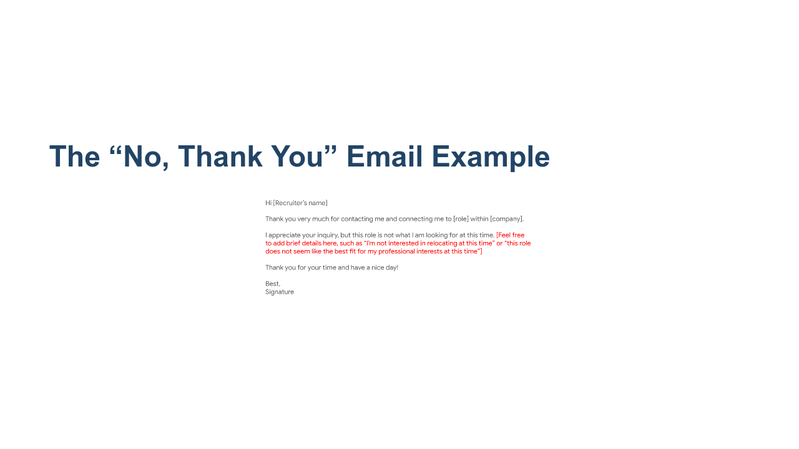
Notes:
This could be sent as an email or copied and pasted into LinkedIn messages. Just remember best practices of spelling the recruiter’s name correctly and making sure details are correct. If you want to connect over LinkedIn or otherwise, keep this person in your contacts (even if this role is not a good fit at this time), and then follow up promptly on doing so. Keep it brief. Even if you give a specific detail on why this is not a fit, you don’t have to get too specific. Remember that it is not okay to lie, so keep it honest and courteous. * Image name: res/commrecruiter07.png * Repo link: https://github.com/google/applied-machine-learning-intensive/tree/master/content/xx_career_development/05_communicating_with_recruiters/res/commrecruiter07.png * Source https://github.com/google/applied-machine-learning-intensive/tree/master/content/xx_career_development/05_communicating_with_recruiters/res/commrecruiter07.png by Author Google LLC under License Copyright [2020] Google LLC.

Slide 18
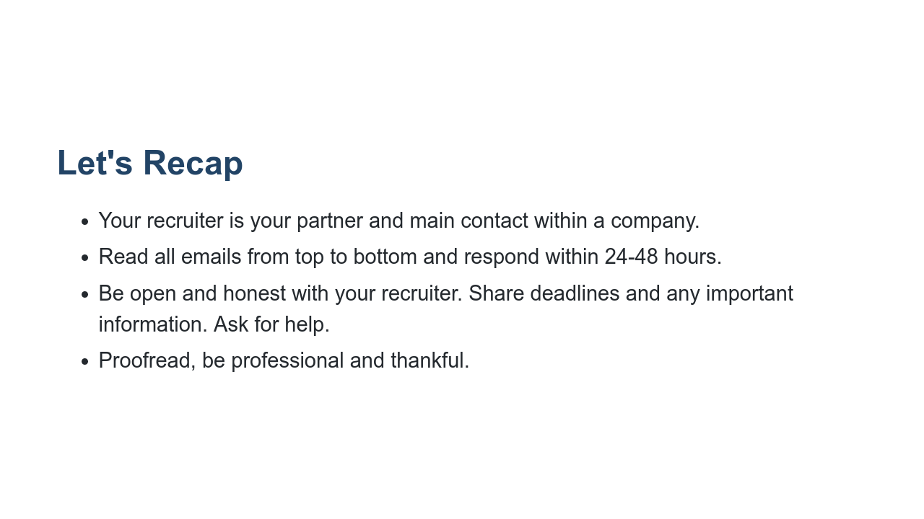
Notes:
Don’t forget you and your recruiter both want you to have a clear, efficient, and overall great hiring process, regardless of whether or not the job is a best fit for you. They are your advocate. Be sure you read all aspects of the emails they send you, links included, and respond to their emails within 48 hours at the latest. Be transparent with them about your offers and ask for help when you need it or when you feel uncertain about something. Be professional and be grateful for their time and work with you.

Slide 19

Notes:
Thank you all so much for participating today. What remaining questions do you have?

