Slide 1

Notes:
Big-O notation is the most common notation for analyzing time and space complexity for code. In this lesson, we'll explore how and why to make use of Big-O notation.

Slide 2
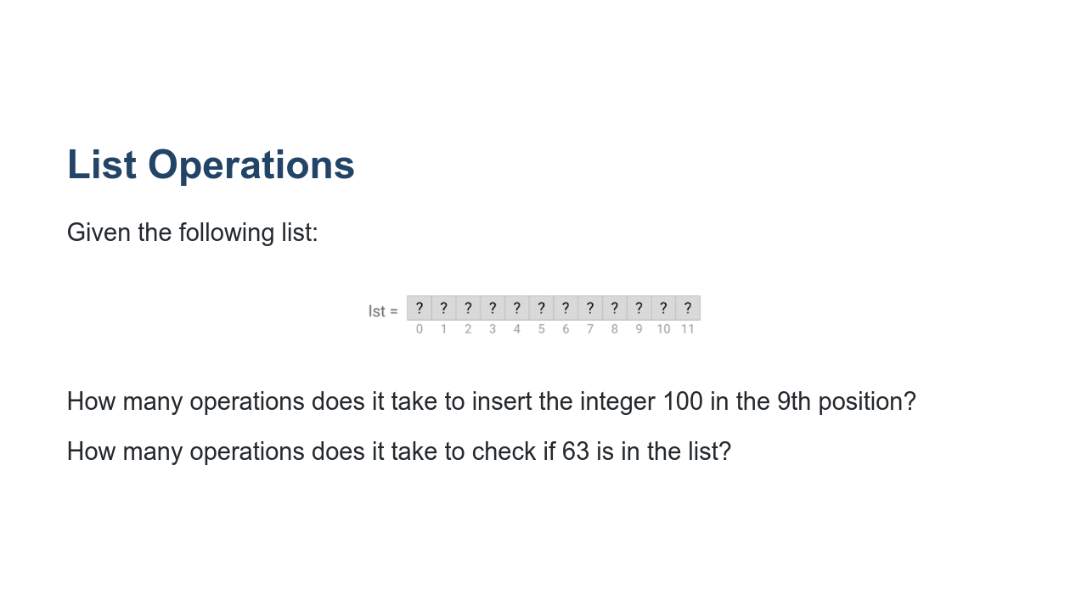
Notes:
First of all, it is important to note that this is a list with 12 unknown items. We know it's not empty, but we don't know what's in each position. How many operations does it take to insert the integer 100 in the 9th position? Lst[8] = 100 1 step If we had a larger list, would the number of steps change? No. Regardless of the size of the list, inserting an item into a chosen position always takes the same amount of time. This is called constant time. How many operations does it take to check if 63 is in the list? for item in lst: if item == 63: print(“Found!”) In the worst case, we don't find the item in the list. This would take 12 steps, where 12 is the length of the list. If we had a larger list, would the number of steps change? Yes! The bigger the list, the more steps. This is called linear time. Searching for an item in an unordered list is always at least linear. *Optional* Does that change if the list is sorted? Yes! We can do binary search. @Exercise (10 minutes) { Suggestion: do a binary search example on the board, and calculate how long it takes to search in the worst case (item not found). } * Image name: res/bigO01.png * Repo link: https://github.com/google/applied-machine-learning-intensive/tree/master/content/xx_misc/big_o/res/bigO01.png * Source https://github.com/google/applied-machine-learning-intensive/tree/master/content/xx_misc/big_o/res/bigO01.png by Author Google LLC under License Copyright [2020] Google LLC.

Slide 3
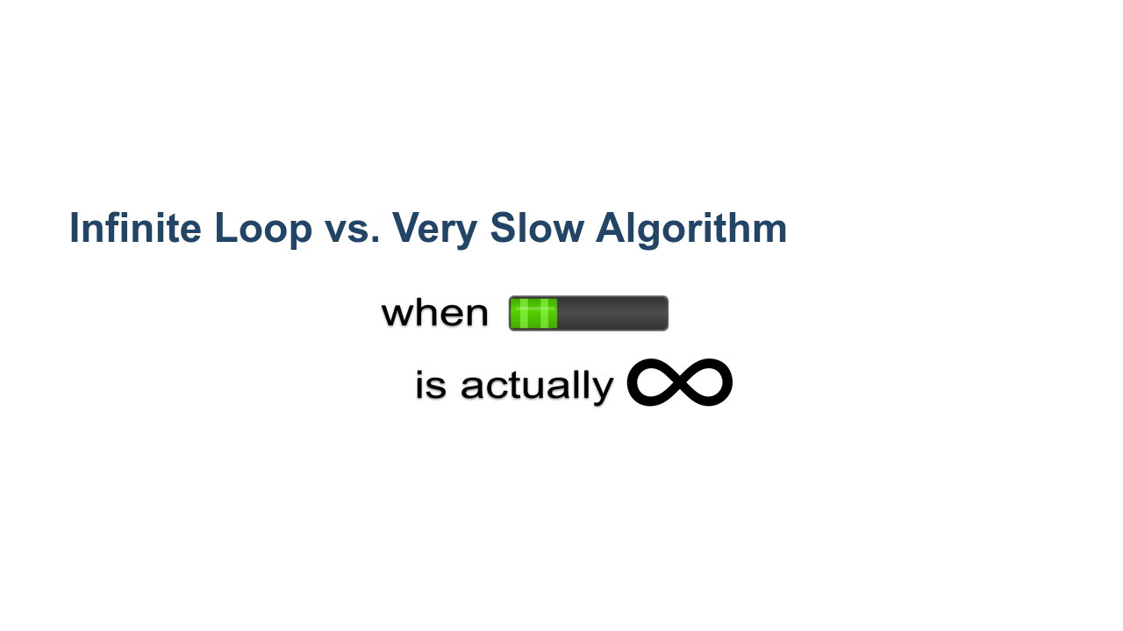
Notes:
*Suggestion: use whiteboard* Consider the code: i = 0 while i < len(lst): if item == 63: print(“Found!”) What’s the problem? This is an infinite loop. It’ll never stop executing, because it is never incremented. Sometimes when we are training a model we may seriously start to wonder if we have created an infinite loop. How do we know whether we have created an infinite loop or our model is simply taking a long time to train? Print statements / debugging messages help us track what’s going on and if any real progress is being made. We can also use these tools to estimate how much time there is left. The process of estimating how much time it should take for a piece of code to execute in the worst case is the basis of the concept of Big-O. * Image name: res/bigO02.png * Repo link: https://github.com/google/applied-machine-learning-intensive/tree/master/content/xx_misc/big_o/res/bigO02.png * Source https://pixabay.com/vectors/infinity-infinite-repeating-loop-1837436/ by Author GDJ https://pixabay.com/users/gdj-1086657/ under License https://pixabay.com/service/license/. * Source https://pixabay.com/vectors/progress-bar-download-level-4659081/by Author PixLoger https://pixabay.com/users/pixloger-783453/ under License https://pixabay.com/service/license/.

Slide 4
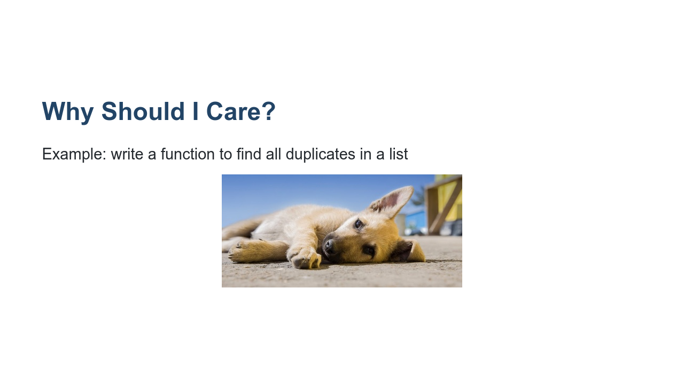
Notes:
What happens when you ask your computer to try out every possible combination of features? That’s something we’ll come across a lot when working with big data. When we write code, we need to be able to tell how much time that code is likely to take to execute based on the size of the input. Similarly, we need to know whether we have enough space in memory. Otherwise, how would we be able to tell whether you can run a given dataset through a model on a given computer? Just trying it out and risking running out of memory is not a good idea! And imagine if we leave our laptop running all day and then we need to close it to go home. Will we just lose all of our progress? Industry leaders work with problems like this at a much bigger scale. So it’s important to have the language and conceptual understanding of these limitations to be able to work efficiently. * Image name: res/bigO03.jpg * Repo link: https://github.com/google/applied-machine-learning-intensive/tree/master/content/xx_misc/big_o/res/bigO03.jpg * Source https://unsplash.com/photos/rEgveRa_5ds by Author Stas Svechnikov https://unsplash.com/@svechnikov under License https://unsplash.com/license.

Slide 5
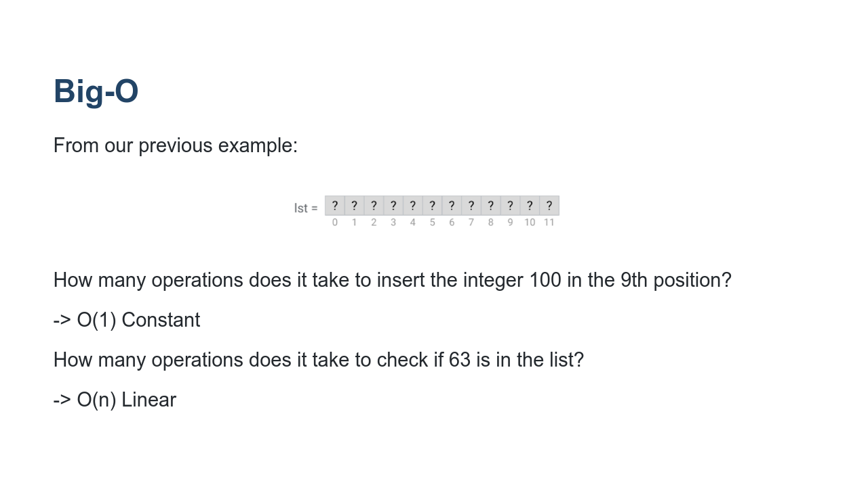
Notes:
Big O is a way to talk about this, to express runtime and space usage. * Image name: res/bigO01.png * Repo link: https://github.com/google/applied-machine-learning-intensive/tree/master/content/xx_misc/big_o/res/bigO01.png * Source https://github.com/google/applied-machine-learning-intensive/tree/master/content/xx_misc/big_o/res/bigO01.png by Author Google LLC under License Copyright [2020] Google LLC.

Slide 6
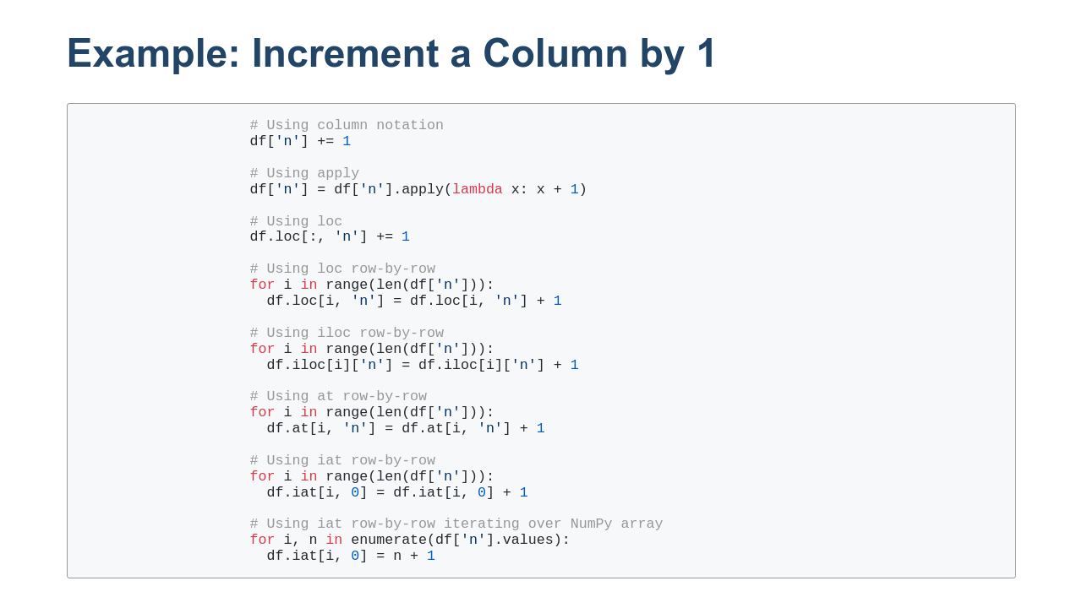
Notes:
Let's take a look at a real world example: incrementing the values in a column. There are myriad ways to do this in Pandas. We'll specifically look at the methods shown on this slide. You can see that we start with the eye-pleasing column notation and the work our way through various other methods trying to see which is more performant.

Slide 7
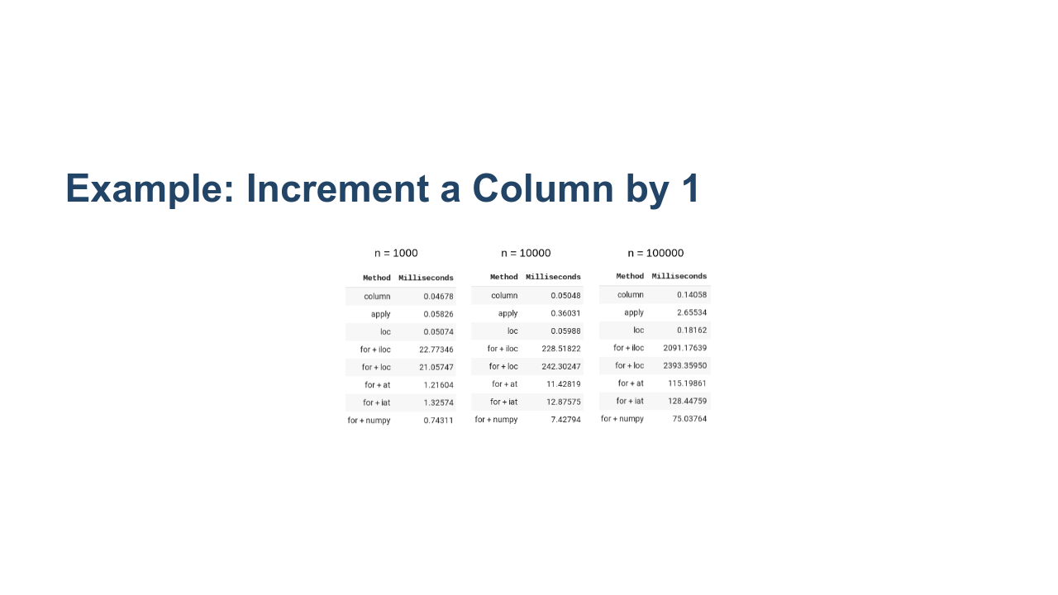
Notes:
So which is better? We timed multiple runs with different numbers of rows: 1000, 10000, and 100000. On smaller datasets we the column, apply, and loc methods all seem to do pretty well. Once the data size grows, we can see that column and loc are both very fast, especially compared to anything using a for loop. Pandas has many internal optimizations. Even the nice-looking column access syntax does trade off readability for speed. * Image name: res/bigO05.png * Repo link: https://github.com/google/applied-machine-learning-intensive/tree/master/content/xx_misc/big_o/res/bigO05.png * Source https://github.com/google/applied-machine-learning-intensive/tree/master/content/xx_misc/big_o/res/bigO05.png by Author Google LLC under License Copyright [2020] Google LLC.

Slide 8
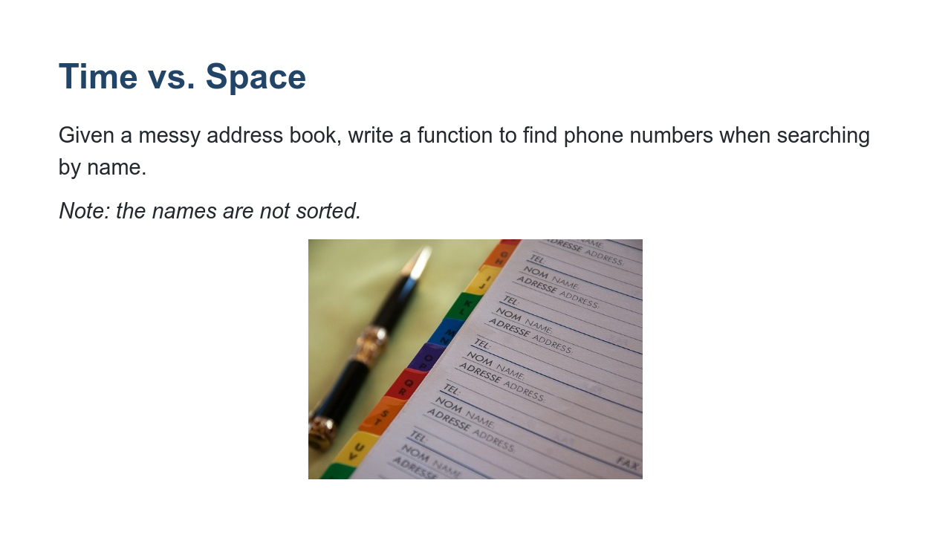
Notes:
time complexity vs space complexity Alternatives: https://repl.it/repls/SmartSelfreliantMysql # Option 1: Linear search O(n) # def get_phone(name, address_book): # for person in address_book: # if person.name == name: # return person.number # return "Not found" # Option 2: Sort and binary search O(n log n) # def get_phone(name, address_book): # sorted_book = sorted(address_book) # return bin_search(sorted_book, name) # def bin_search(lst, name): # if not lst or (len(lst) == 1 and lst[0] != name): # return "Not found" # middle = len(lst)//2 # if name < lst[middle].name: # return bin_search(lst[:middle], name) # elif name > lst[middle].name: # return bin_search(lst[middle:], name) # return lst[middle].number # Option 3: Hash Table O(n) # optimal_book = {} # def get_phone(name, address_book): # if not optimal_book: # for person in address_book: # optimal_book[person.name] = person.number # return optimal_book.get(name, "Not found") # Tests print(get_phone('Jordan Allen', my_address_book)) print(get_phone('Ju de Heer', my_address_book)) # Test code class Person: def __init__(self, name, number): self.name = name self.number = number def __eq__(self, other): """Overrides the default implementation""" if isinstance(other, Person): return self.name == other.name return NotImplemented def __lt__(self, other): """Overrides the default implementation""" if isinstance(other, Person): return self.name < other.name return NotImplemented def __gt__(self, other): """Overrides the default implementation""" if isinstance(other, Person): return self.name > other.name return NotImplemented def __str__(self): return "{} {}".format(self.name, self.number) my_address_book = [ Person('Jordan Allen', '415-232-9004'), Person('Becky Ohio', '510-346-3473'), Person('Austin Power', '301-345-5839'), Person('Mary McMillan', '345-353-6324')] * Image name: res/bigO06.jpg * Repo link: https://github.com/google/applied-machine-learning-intensive/tree/master/content/xx_misc/big_o/res/bigO06.jpg * Source https://pixabay.com/photos/diary-appointment-address-pen-2080422/ by Author jacmack34 / jacqueline macou https://pixabay.com/users/jackmac34-483877/ under License https://pixabay.com/service/license/.

Slide 9
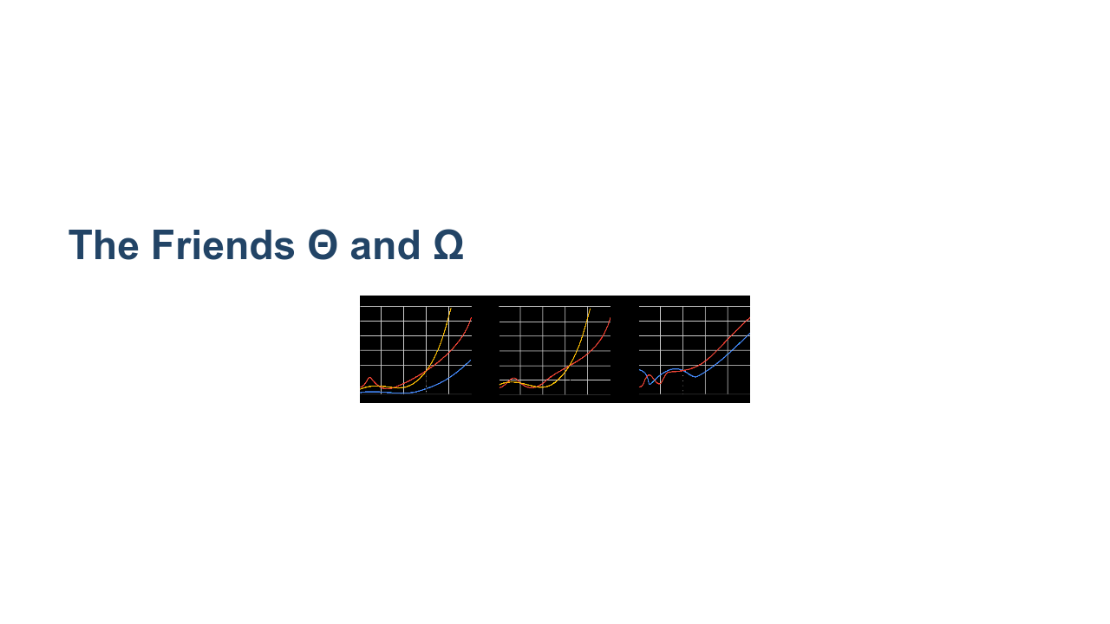
Notes:
Compare the idea of asymptotic analysis with finding limits at infinity. We really only care about arbitrarily big numbers. Give an example of O(1) with a 1 million constant vs O(n^2) with a 10 constant multiplier. def quadratic(lst): n = len(lst) for i in range(n): for j in range(n): for k in range(10): print("hello") def constant(lst): n = len(lst) for i in range(1000000): print("hello") Which is faster? Explain Omega (lower bound) and Theta (tight bound). Omega defines an asymptotic lower bound on a function. Theta bounds the function both above and below, so theta describes the true asymptotic behavior. In both of the cases above, the worst and best case are the same. They are an example of Theta. In our earlier search example, we had a return statement in the for loop. What happens in the best case? What about the worst? The best and worst case are not the same, so we use Omega and Big-O. Example: for loops without break statements vs while loop Explain theta with linear function ( c1* g(x) <= f(x) <= c2 * g(x) ) For example, in our earlier example, if we had: def quadratic(lst): n = len(lst) for i in range(n): for j in range(n): if n > 10: for k in range(10): print("hello") This is still Big Theta, because n^2 <= n^2 <= 10 * n^2 But in industry you really only need to know Big O * Image name: res/bigO07.png * Repo link: https://github.com/google/applied-machine-learning-intensive/tree/master/content/xx_misc/big_o/res/bigO07.png * Source https://github.com/google/applied-machine-learning-intensive/tree/master/content/xx_misc/big_o/res/bigO07.png by Author Google LLC under License Copyright [2020] Google LLC.

Slide 10
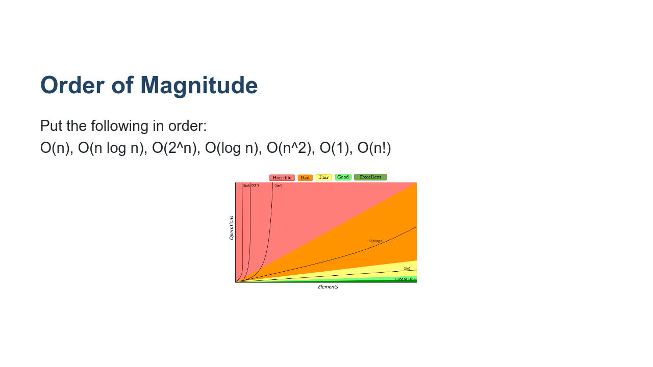
Notes:
Highlight most common (1, log n, n, n^2, etc) * Image name: res/bigO08.png * Repo link: https://github.com/google/applied-machine-learning-intensive/tree/master/content/xx_misc/big_o/res/bigO08.png * Source https://github.com/google/applied-machine-learning-intensive/tree/master/content/xx_misc/big_o/res/bigO08.png by Author Google LLC under License Copyright [2020] Google LLC.

Slide 11
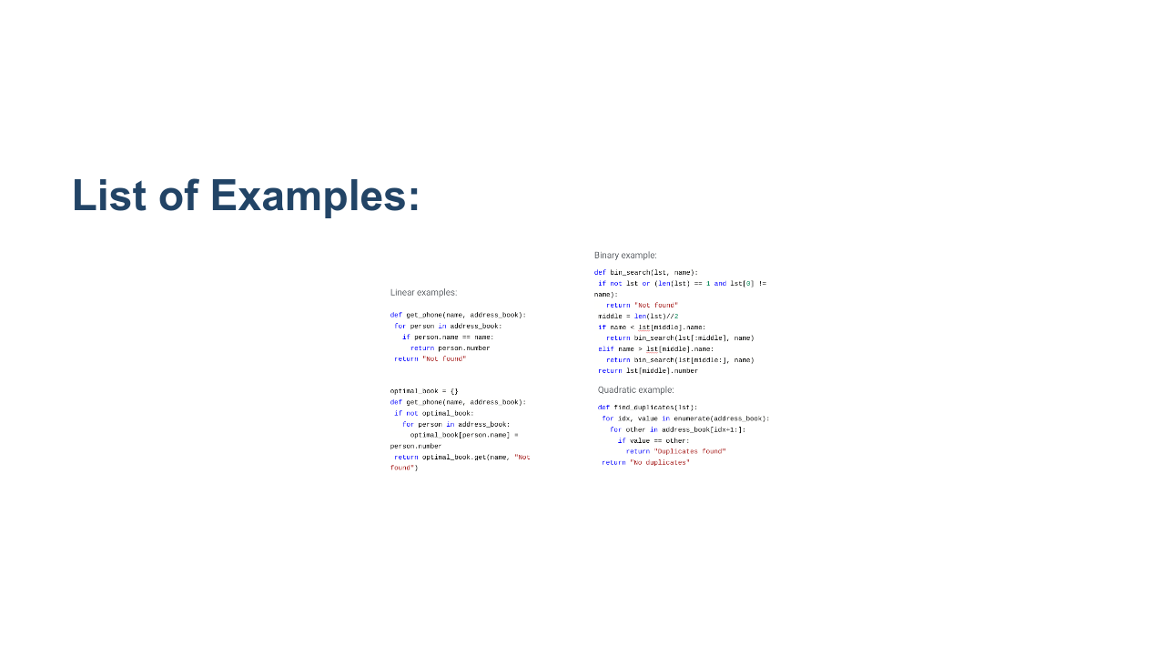
Notes:
Let's look at these examples together. Can anyone justify why we have labeled these pieces of code as linear, binary, and quadratic? * Image name: res/bigO09.png * Repo link: https://github.com/google/applied-machine-learning-intensive/tree/master/content/xx_misc/big_o/res/bigO09.png * Source https://github.com/google/applied-machine-learning-intensive/tree/master/content/xx_misc/big_o/res/bigO09.png by Author Google LLC under License Copyright [2020] Google LLC.

Slide 12

Notes:
There is additional practice with Big-O in the lab.

