Slide 1
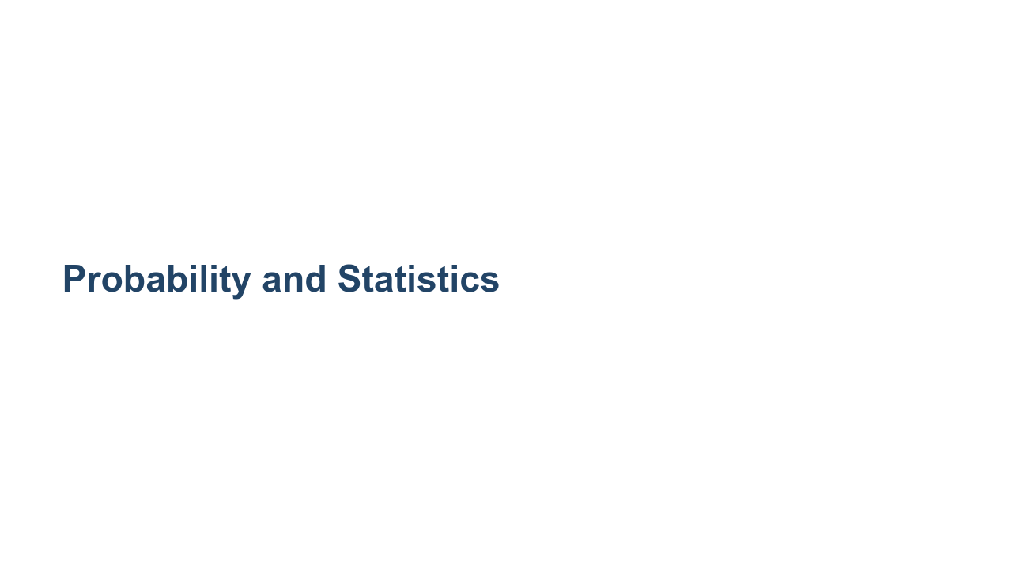

Slide 2
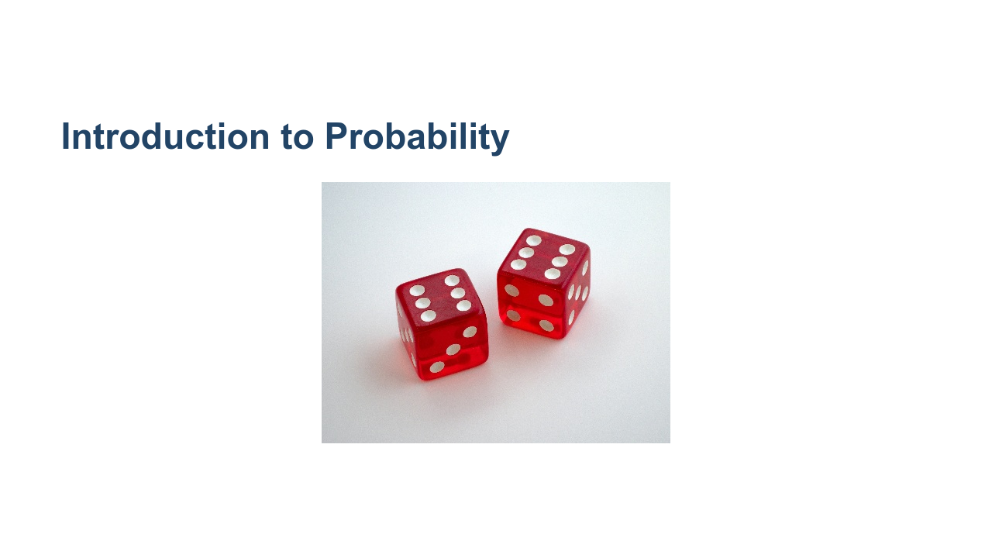
Notes:
This lecture focuses on rolling dice as an illustrative example of probability. We will introduce: - Random variables - Expected values - Conditional and joint probability - Bayes' Theorem * Image name: res/prob01.jpg * Repo link: https://github.com/google/applied-machine-learning-intensive/tree/master/content/xx_misc/probability_and_statistics/res/prob01.jpg * Source https://unsplash.com/photos/4aB1nGtD_Sg by Author Brett Jordan https://unsplash.com/@brett_jordan under License https://unsplash.com/license.

Slide 3
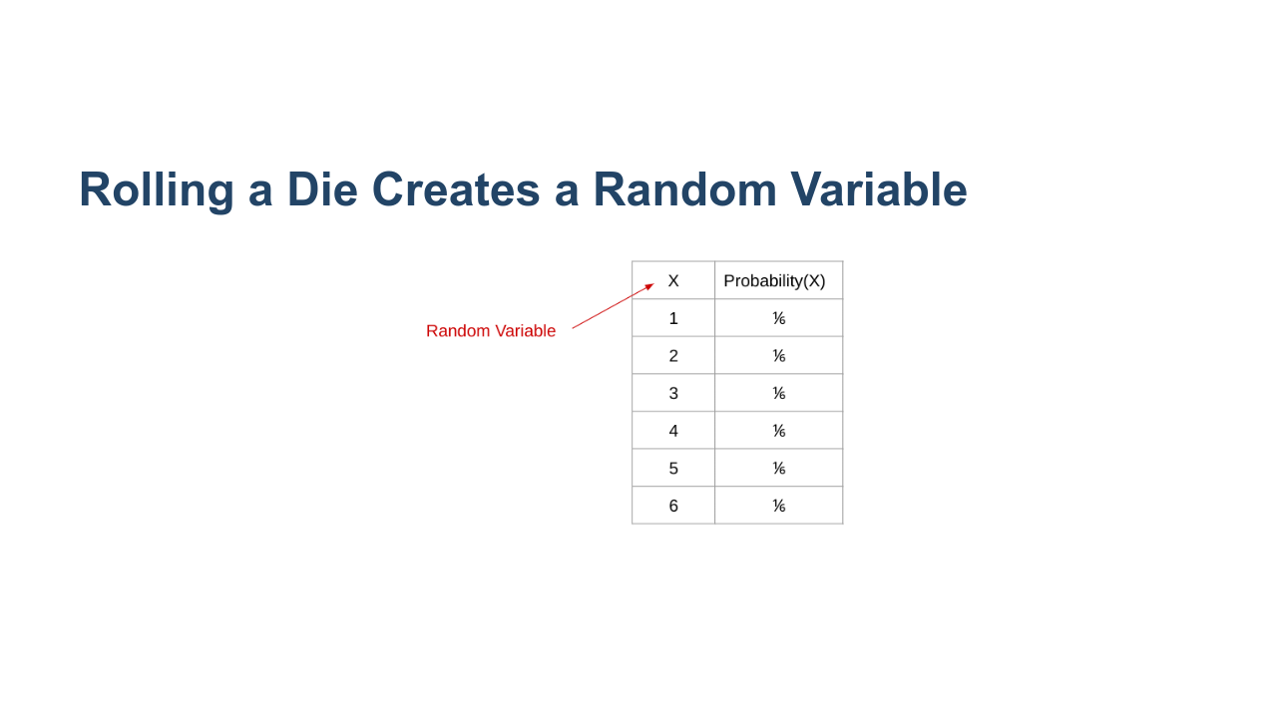
Notes:
X is a random variable, in that it can be any one of 6 values, and it achieves each of these values with a certain probability. In this case, we have a uniform distribution of 1/6. * Image name: res/prob02.png * Repo link: https://github.com/google/applied-machine-learning-intensive/tree/master/content/xx_misc/probability_and_statistics/res/prob02.png * Source https://github.com/google/applied-machine-learning-intensive/tree/master/content/xx_misc/probability_and_statistics/res/prob02.png by Author Google LLC under License Copyright [2020] Google LLC.

Slide 4
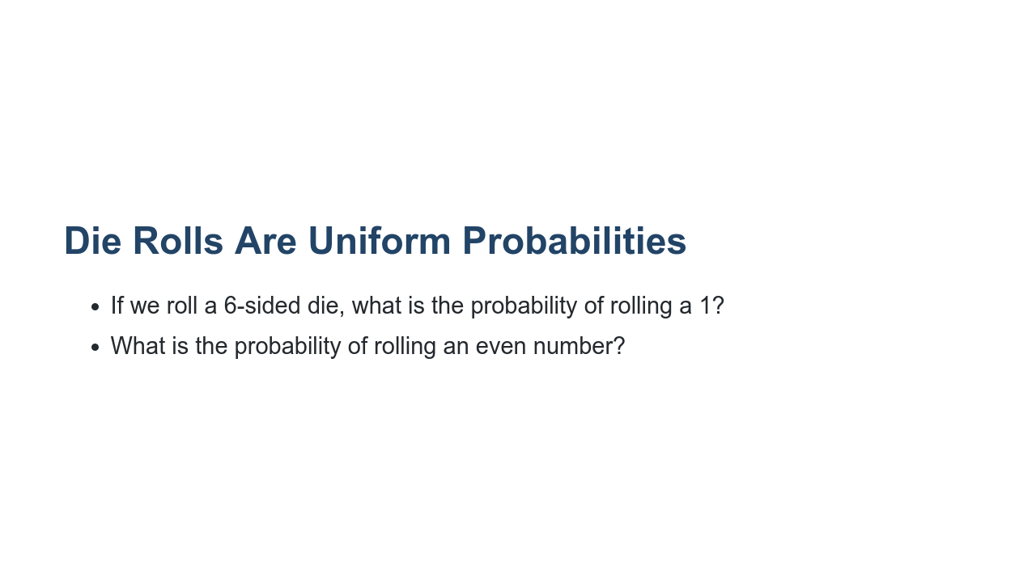
Notes:
For a die, the probability is equal for each value, but for other distributions the probabilities of achieving certain values can get much more complicated. Answers: * 1/6 * 1/2 = 1/6+1/6+1/6

Slide 5
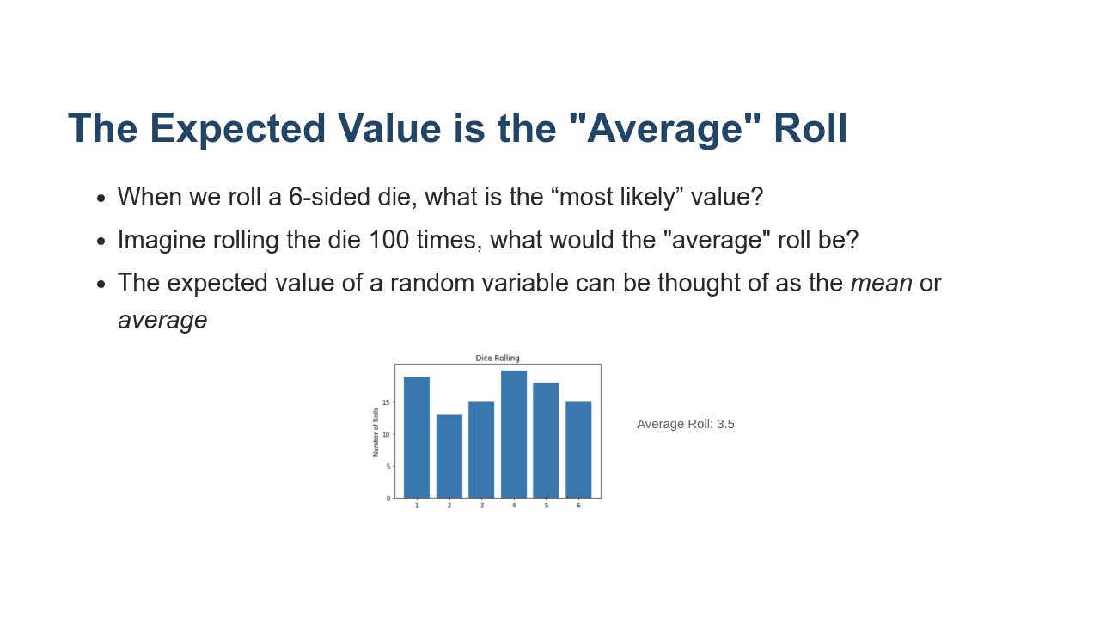
Notes:
Sometimes we want to know things about a random variable without having to observe it many times. For instance, we might want to know what value the random variable is “most likely” to achieve. To find this, we use the concept of an expected value. We commonly think of the expected value as being the mean. That is, over a long period of time with many observations of the random variable, the expected value would be the average value we would see. Answers: * 3.5 = 1*(1/6) + 2*(1/6) + 3*(1/6) + ... + 6*(1/6) * 3.5 = (1/100)*(100*1*(1/6) + 100*2*(1/6) + ... + 100*6*(1/6)) * Image name: res/prob03.png * Repo link: https://github.com/google/applied-machine-learning-intensive/tree/master/content/xx_misc/probability_and_statistics/res/prob03.png * Source https://github.com/google/applied-machine-learning-intensive/tree/master/content/xx_misc/probability_and_statistics/res/prob03.png by Author Google LLC under License Copyright [2020] Google LLC.

Slide 6
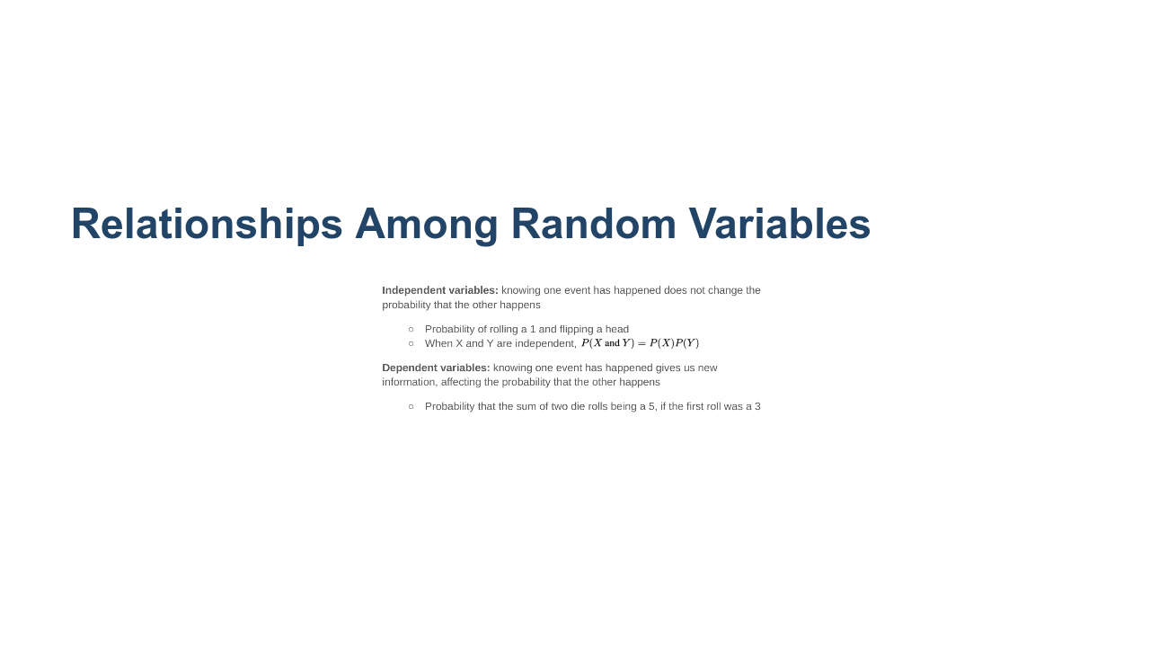
Notes:
We call the relationship between two random variables independent if the value of one random variable does not affect the value of the other. For example, if we roll a die, then flip a coin. Furthermore, we could roll a fair die once and observe that it came up a 4, then roll again. These two events are independent. We call the relationship between two random variables dependent if the value of one does affect the other. For example, say we want the probability that the sum of rolling a die twice is 5, if the first roll is a 3. The two variables involved here (the first and second roll) are dependent variables. * Image name: res/probstats01.png * Repo link: https://github.com/google/applied-machine-learning-intensive/tree/master/content/xx_misc/probability_and_statistics/res/probstats01.png * Source https://github.com/google/applied-machine-learning-intensive/tree/master/content/xx_misc/probability_and_statistics/res/probstats01.png by Author Google LLC under License Copyright [2020] Google LLC.

Slide 7
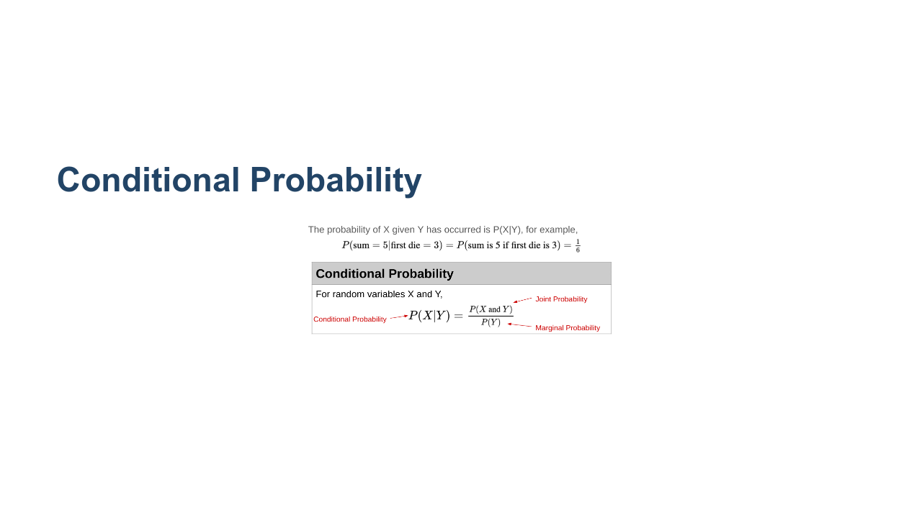
Notes:
Conditional probability, denoted P(X|Y), is the probability that X occurs given Y has already occurred. For example, P(sum = 5 | first roll = 3) = P(sum = 5 AND first roll = 3)/P(first roll = 3). We will go through this example in more detail on the next slide. Here are two additional definitions that may be useful. * Joint probability: the probability that both X and Y occur * Marginal probability: the probability that X occurs * Image name: res/prob22.png * Repo link: https://github.com/google/applied-machine-learning-intensive/tree/master/content/xx_misc/probability_and_statistics/res/prob22.png * Source https://github.com/google/applied-machine-learning-intensive/tree/master/content/xx_misc/probability_and_statistics/res/prob22.png by Author Google LLC under License Copyright [2020] Google LLC.

Slide 8
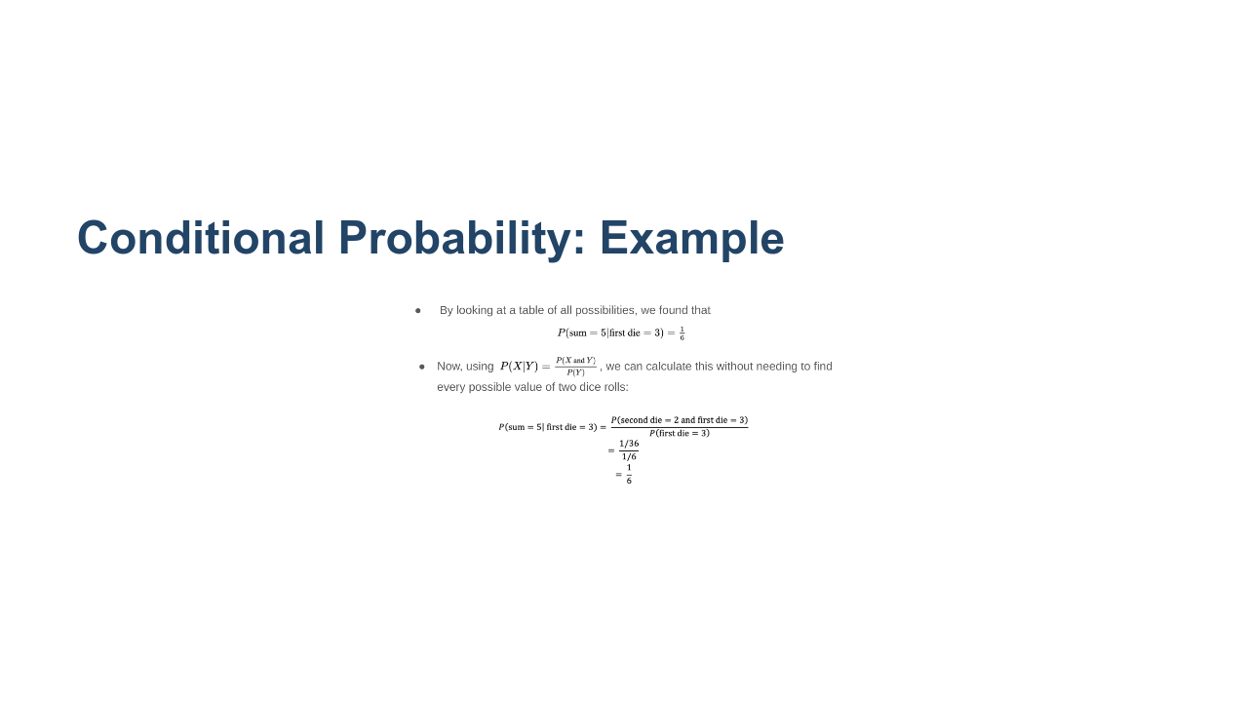
Notes:
Consider the example from the previous slide. Namely, P(sum = 5 | first roll = 3) = P(sum = 5 AND first roll = 3)/P(first roll = 3). Now, we think through the two pieces of this formula. The simpler part is probably the denominator. We have, P(first roll = 3) = 1/6. Now let's talk about the numerator. We have, P(sum = 5 AND first roll = 3). How can we get a sum of 5? (1,4) (4,1) (2,3) (3,2). We see that the only way to have the sum be 5 with a first roll of 3 is to roll a 2 on the second roll. Thus, the numerator, P(sum = 5 AND first roll = 3), is equivalent to P(second roll = 2 AND first roll = 3). These are now independent events and we can calculate their joint probability as the product of the individual probabilities. That is, P(second roll = 2 AND first roll = 3) = (1/6)(1/6) = 1/36. Therefore, we have P(sum = 5 | first roll = 3) = (1/36)/(1/6) = 1/6. * Image name: res/probstats06.png * Repo link: https://github.com/google/applied-machine-learning-intensive/tree/master/content/xx_misc/probability_and_statistics/res/probstats06.png * Source https://github.com/google/applied-machine-learning-intensive/tree/master/content/xx_misc/probability_and_statistics/res/probstats06.png by Author Google LLC under License Copyright [2020] Google LLC.

Slide 9
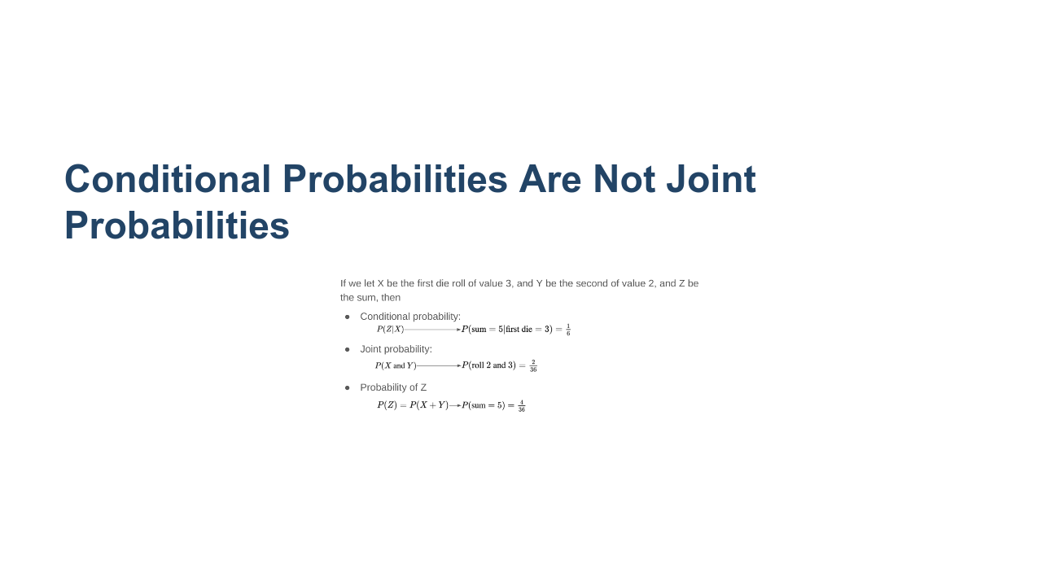
Notes:
The conditional probability is what we calculated on the previous slide. Let's look at the joint probability in this example. Here we are saying we roll a 2 and a 3 (but we are not being particular about the order). So we could first roll a 2, then a 3 or vice versa. So the numerator is 2, which is the total number of ways to roll a 2 and a 3 (when order doesn't matter). The denominator is the total number of combinations for two rolls. That is, (1, 1), (1, 2), (1,3), ... (1,6), (2,1), (2,2), ...(2,6), ... (6,6). There are 36 = 6*6 total possibilities. Therefore, we compute the joint probability of rolling a 2 and a 3 to be 2/36. Finally, let's look at the probability that the sum is 5. From the previous slide we saw that the possible ways to have the sum = 5 are given by (1,4), (4,1), (2,3), (3,2). There are four possibilities out of the 36 total combinations for two rolls. Therefore, the probability that the sum equals 5 is 4/36. * Image name: res/prob24.png * Repo link: https://github.com/google/applied-machine-learning-intensive/tree/master/content/xx_misc/probability_and_statistics/res/prob24.png * Source https://github.com/google/applied-machine-learning-intensive/tree/master/content/xx_misc/probability_and_statistics/res/prob24.png by Author Google LLC under License Copyright [2020] Google LLC.

Slide 10
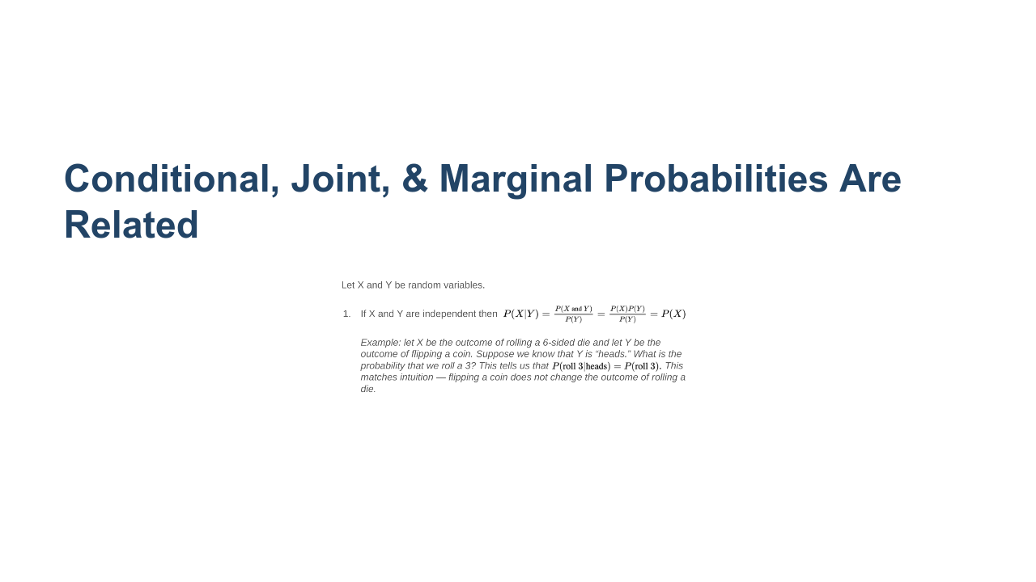
Notes:
The conditional probability between two independent events is simply the probability of X occurring. * Image name: res/prob25.png * Repo link: https://github.com/google/applied-machine-learning-intensive/tree/master/content/xx_misc/probability_and_statistics/res/prob25.png * Source https://github.com/google/applied-machine-learning-intensive/tree/master/content/xx_misc/probability_and_statistics/res/prob25.png by Author Google LLC under License Copyright [2020] Google LLC.

Slide 11
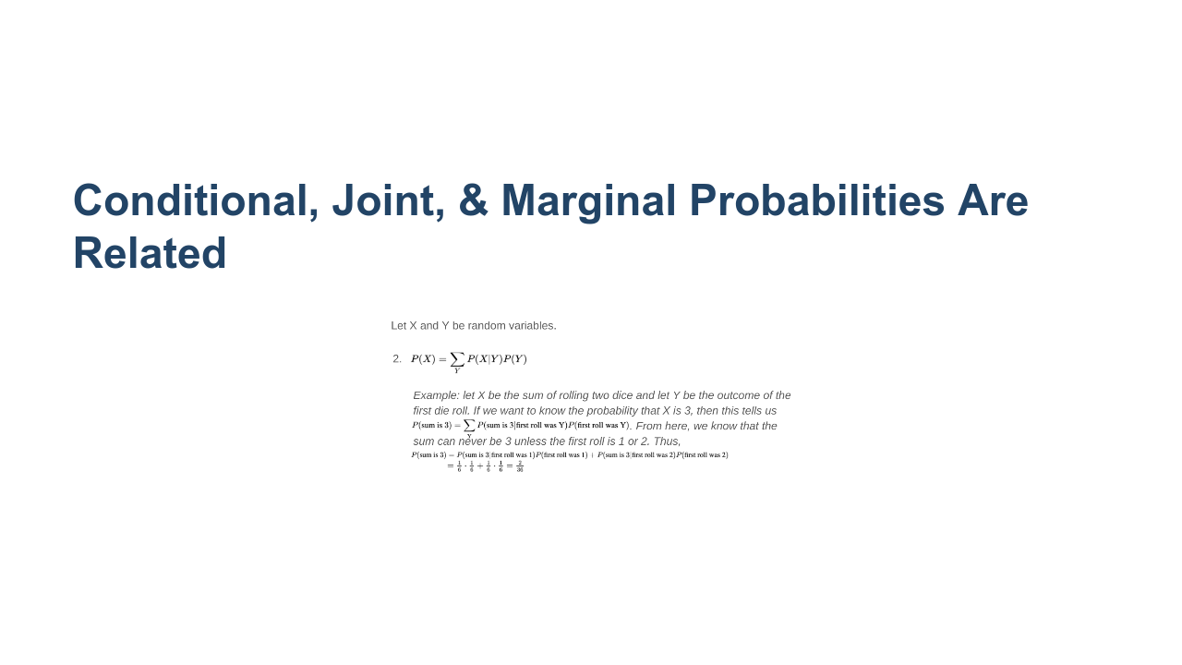
Notes:
We can recover the probability of X by summing the conditional probability of X given Y times the probability of Y, for every possible Y. * Image name: res/probstats02.png * Repo link: https://github.com/google/applied-machine-learning-intensive/tree/master/content/xx_misc/probability_and_statistics/res/probstats02.png * Source https://github.com/google/applied-machine-learning-intensive/tree/master/content/xx_misc/probability_and_statistics/res/probstats02.png by Author Google LLC under License Copyright [2020] Google LLC.

Slide 12
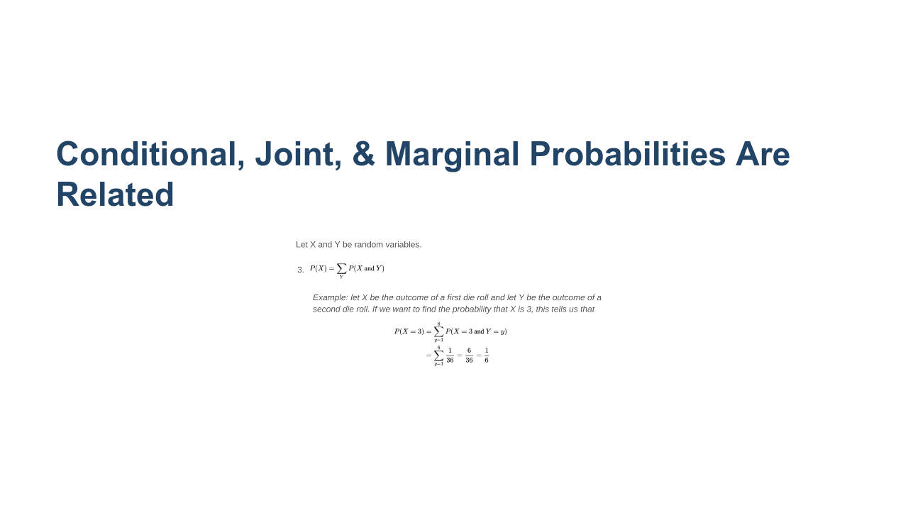
Notes:
We can recover the probability of X from summing the joint probabilities of X and Y for every possible Y. * Image name: res/prob27.png * Repo link: https://github.com/google/applied-machine-learning-intensive/tree/master/content/xx_misc/probability_and_statistics/res/prob27.png * Source https://github.com/google/applied-machine-learning-intensive/tree/master/content/xx_misc/probability_and_statistics/res/prob27.png by Author Google LLC under License Copyright [2020] Google LLC.

Slide 13
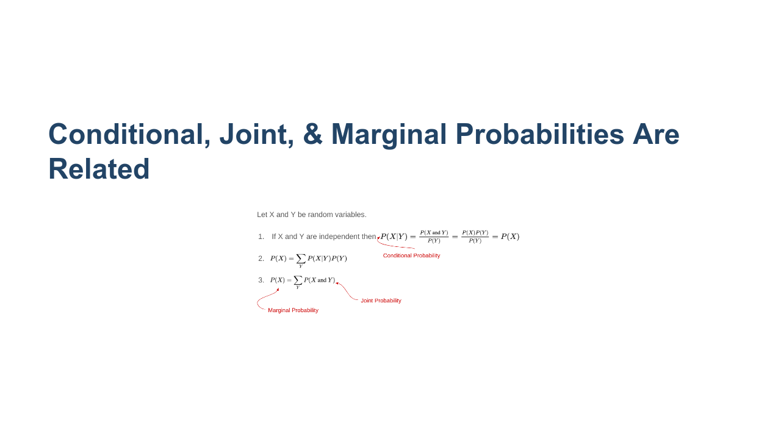
Notes:
Let's review the formulae we saw on the previous slides. * Image name: res/prob28.png * Repo link: https://github.com/google/applied-machine-learning-intensive/tree/master/content/xx_misc/probability_and_statistics/res/prob28.png * Source https://github.com/google/applied-machine-learning-intensive/tree/master/content/xx_misc/probability_and_statistics/res/prob28.png by Author Google LLC under License Copyright [2020] Google LLC.

Slide 14
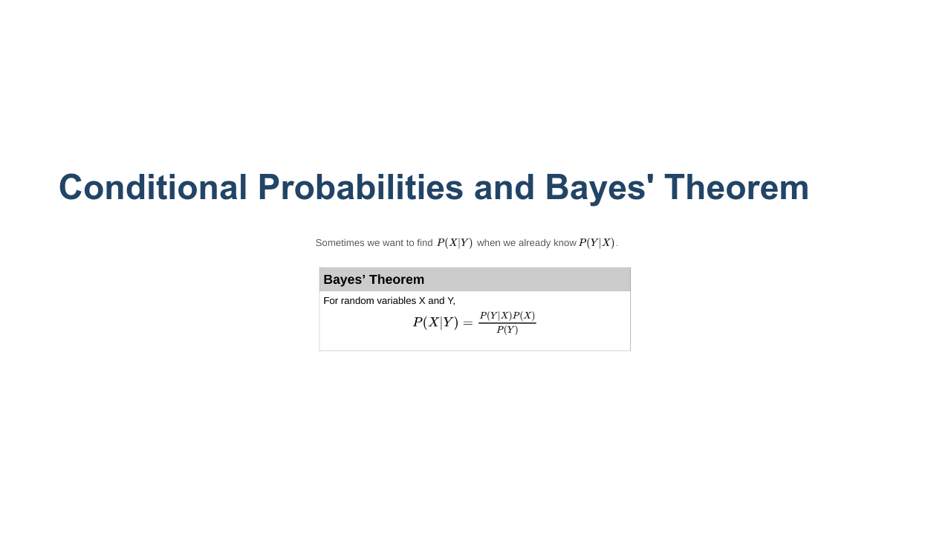
Notes:
Bayes' Theorem is a powerful result in probability. It allows us to find P(X|Y) if we know the probability of the reverse implication P(Y|X). This theorem will come up again when we talk about using Naive Bayes in machine learning. * Image name: res/prob36.png * Repo link: https://github.com/google/applied-machine-learning-intensive/tree/master/content/xx_misc/probability_and_statistics/res/prob36.png * Source https://github.com/google/applied-machine-learning-intensive/tree/master/content/xx_misc/probability_and_statistics/res/prob36.png by Author Google LLC under License Copyright [2020] Google LLC.

Slide 15
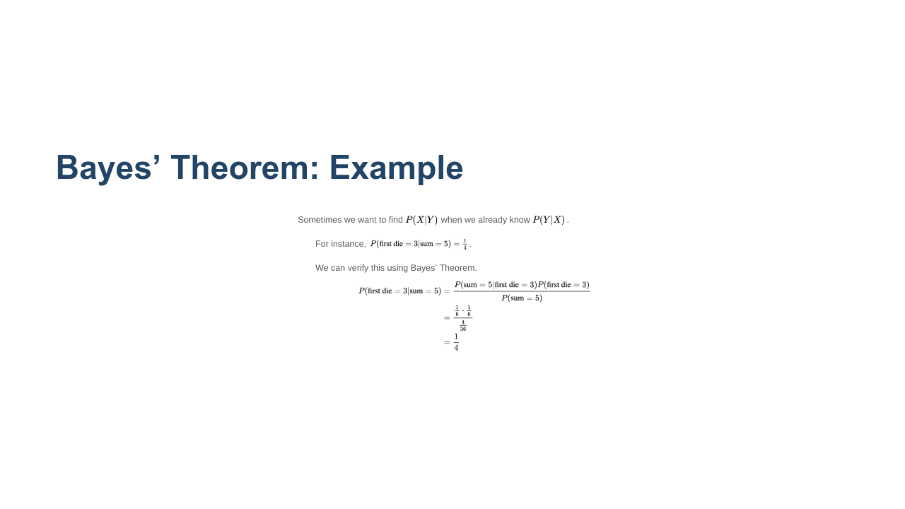
Notes:
Let's look at an example. Suppose we want to calculate P(first die = 3 | sum = 5). Note this is the reverse implication from our previous example which was P(sum = 5 | first roll = 3). We can use Bayes' Theorem and the conditional probability that we already computed. * Image name: res/probstats03.png * Repo link: https://github.com/google/applied-machine-learning-intensive/tree/master/content/xx_misc/probability_and_statistics/res/probstats03.png * Source https://github.com/google/applied-machine-learning-intensive/tree/master/content/xx_misc/probability_and_statistics/res/probstats03.png by Author Google LLC under License Copyright [2020] Google LLC.

Slide 16
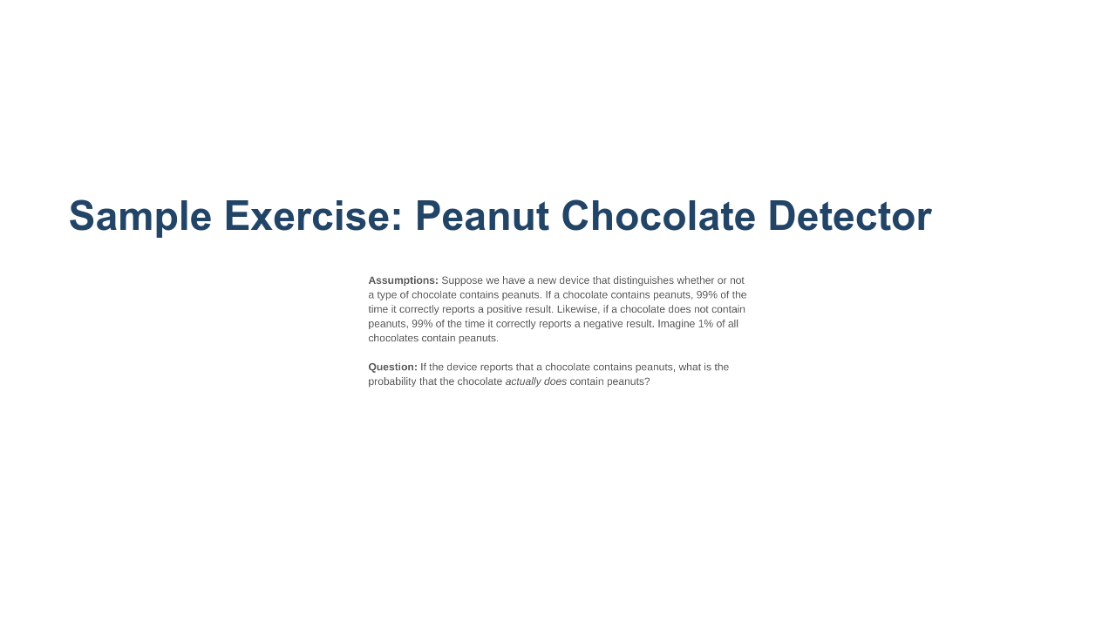
Notes:
Bayes’ Theorems might seem unnecessarily complicated for solving dice problems, but it can be very useful in Machine Learning contexts. @Exercise (10 minutes) { Give students time to think about this problem in groups. Prompt them for P(p|d), P(d|p) and P(not d|not p) to get them started. } * Image name: res/probstats04.png * Repo link: https://github.com/google/applied-machine-learning-intensive/tree/master/content/xx_misc/probability_and_statistics/res/probstats04.png * Source https://github.com/google/applied-machine-learning-intensive/tree/master/content/xx_misc/probability_and_statistics/res/probstats04.png by Author Google LLC under License Copyright [2020] Google LLC.

Slide 17
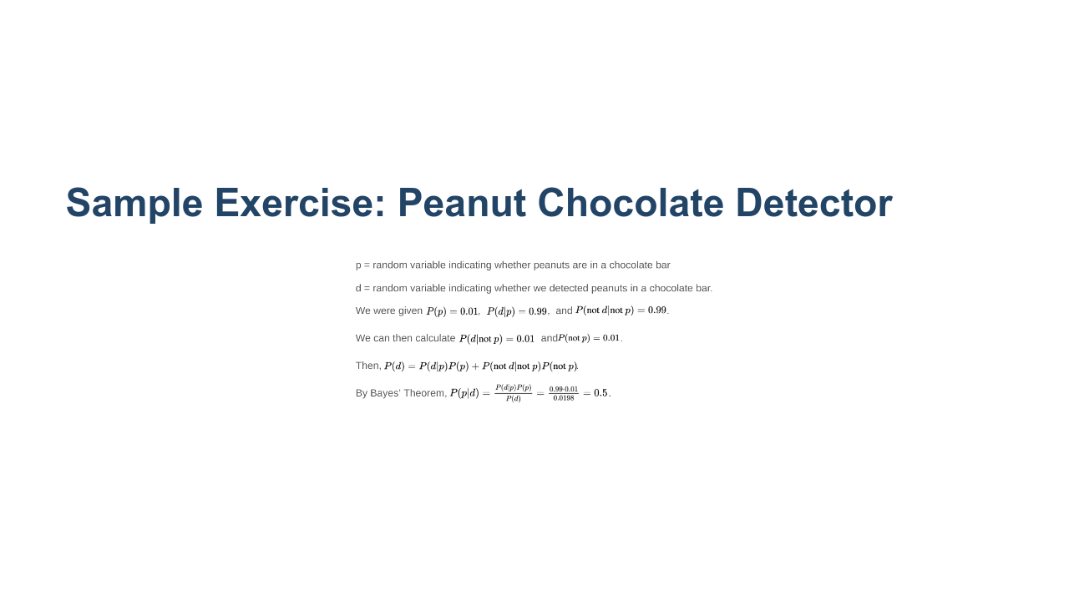
Notes:
Ask students to discuss the implications of P(p|d) being relatively low even when P(d|p) and P(not d|not p) are high. * Image name: res/probstats05.png * Repo link: https://github.com/google/applied-machine-learning-intensive/tree/master/content/xx_misc/probability_and_statistics/res/probstats05.png * Source https://github.com/google/applied-machine-learning-intensive/tree/master/content/xx_misc/probability_and_statistics/res/probstats05.png by Author Google LLC under License Copyright [2020] Google LLC.

Slide 18

Notes:
Now let's take a look at the lab where we will work with these ideas in more detail.

