Slide 1
Chapter 8: Deadlocks

Slide 2
Outline
System Model
Deadlock Characterization
Methods for Handling Deadlocks
Deadlock Prevention
Deadlock Avoidance
Deadlock Detection
Recovery from Deadlock

Slide 3
Chapter Objectives
Illustrate how deadlock can occur when mutex locks are used
Define the four necessary conditions that characterize deadlock
Identify a deadlock situation in a resource allocation graph
Evaluate the four different approaches for preventing deadlocks
Apply the banker’s algorithm for deadlock avoidance
Apply the deadlock detection algorithm
Evaluate approaches for recovering from deadlock

Slide 4
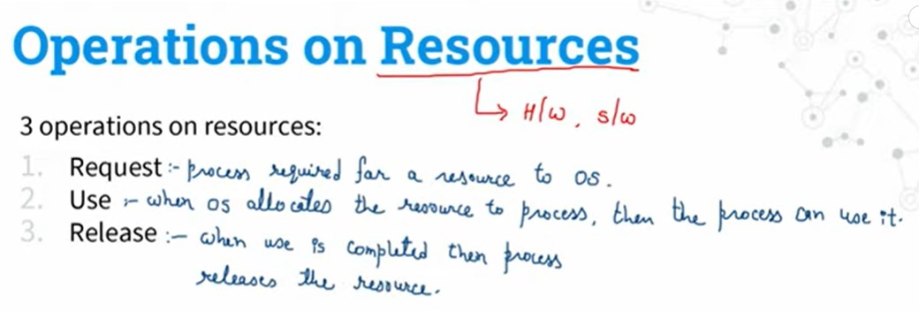

Slide 5
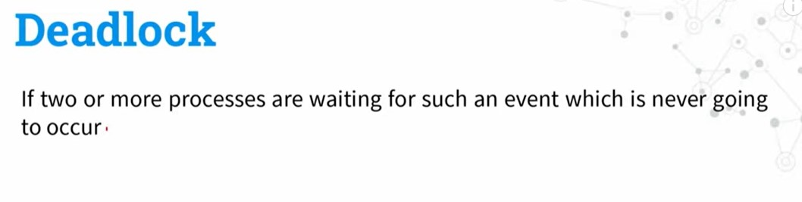

Slide 6
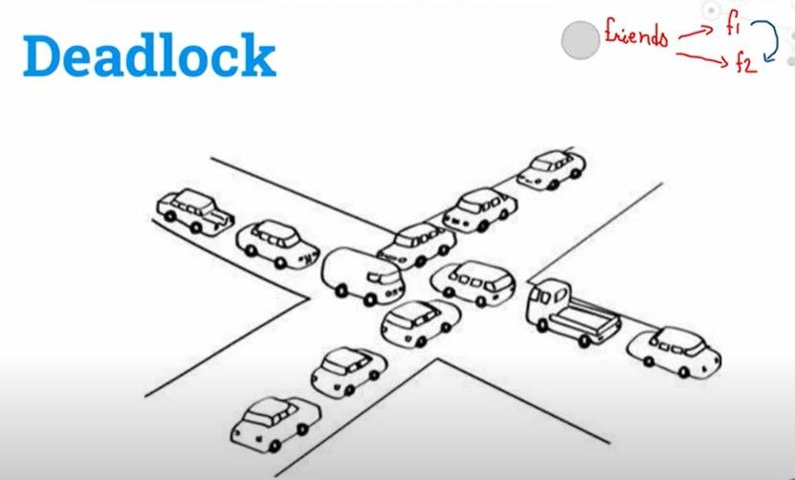

Slide 7
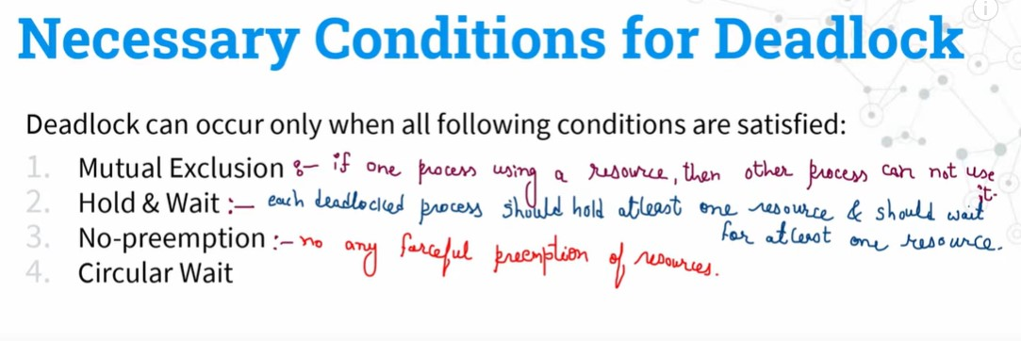

Slide 8
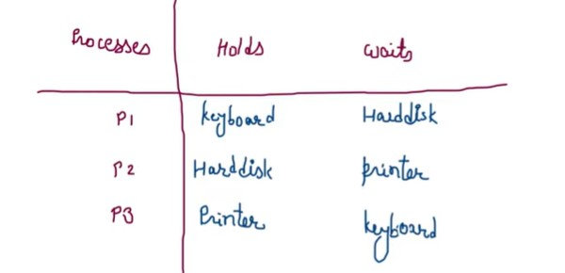

Slide 9
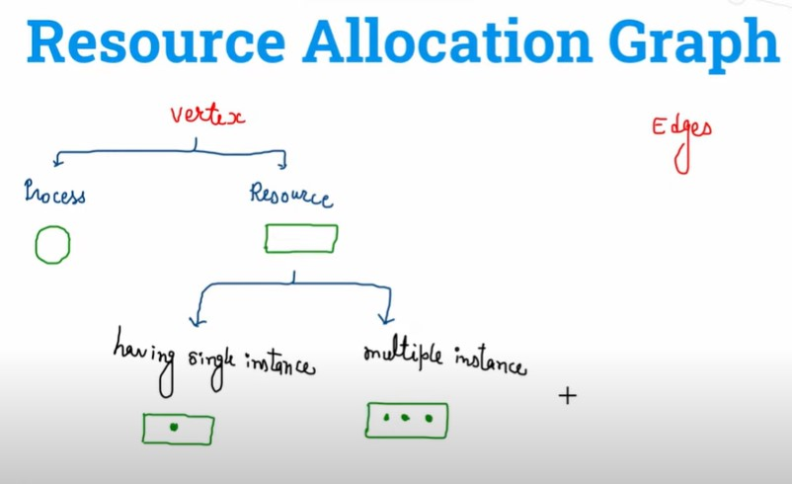
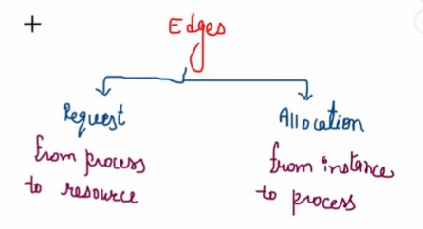

Slide 10
System Model
System consists of resources
Resource types R₁, R₂, . . ., R_{m}
CPU cycles, memory space, I/O devices
Each resource type R_{i} has W_{i} instances.
Each process utilizes a resource as follows:
request
use
release

Slide 11
Deadlock with Semaphores
Data:
A semaphore S₁ initialized to 1
A semaphore S₂ initialized to 1
Two threads T₁ and T₂
T₁:
wait(s₁)
wait(s₂)
T₂:
wait(s₂)
wait(s₁)

Slide 12
Deadlock Characterization
Deadlock can arise if four conditions hold simultaneously.
Mutual exclusion: only one thread at a time can use a resource
Hold and wait: a thread holding at least one resource is waiting to acquire additional resources held by other threads
No preemption: a resource can be released only voluntarily by the thread holding it, after that thread has completed its task
Circular wait: there exists a set {T₀, T₁, …, T_{n}} of waiting threads such that T₀ is waiting for a resource that is held by T₁, T₁ is waiting for a resource that is held by T₂, …, T_{n–1} is waiting for a resource that is held by T_{n}, and T_{n} is waiting for a resource that is held by T₀.

Slide 13
Resource-Allocation Graph
A set of vertices V and a set of edges E.
V is partitioned into two types:
T = {T₁, T₂, …, T_{n}}, the set consisting of all the threads in the system.
R = {R₁, R₂, …, R_{m}}, the set consisting of all resource types in the system
request edge – directed edge T_{i} → R_{j}
assignment edge – directed edge R_{j} → T_{i}

Slide 14
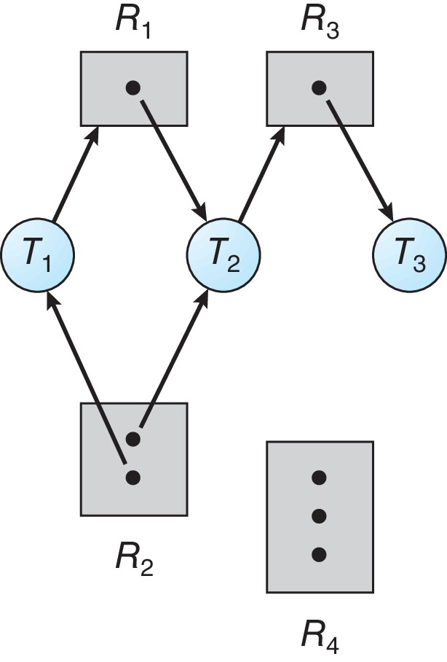
Resource Allocation Graph Example
One instance of R₁
Two instances of R₂
One instance of R₃
Three instance of R₄
T₁ holds one instance of R₂ and is waiting for an instance of R₁
T₂ holds one instance of R₁, one instance of R₂, and is waiting for an instance of R₃
T₃ is holds one instance of R₃

Slide 15
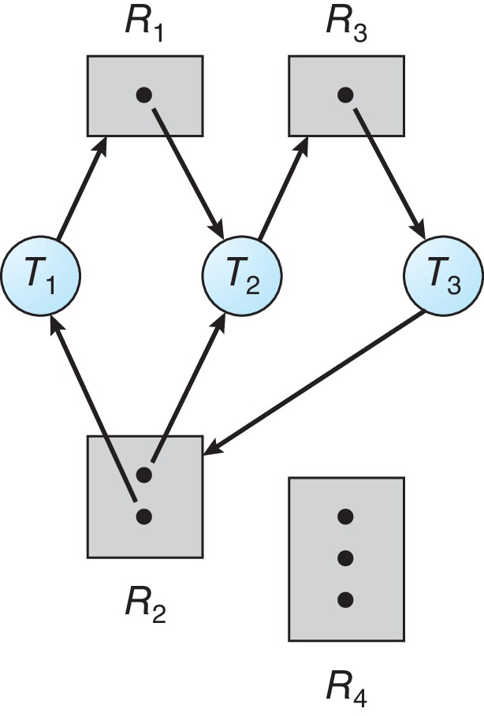
Resource Allocation Graph with a Deadlock

Slide 16
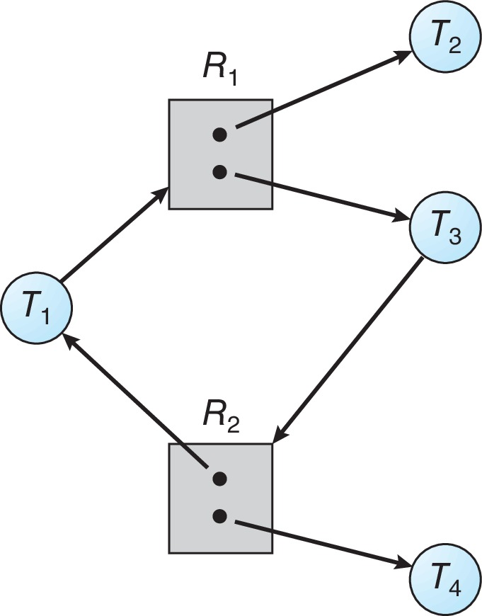
Graph with a Cycle But no Deadlock

Slide 17
Basic Facts
If graph contains no cycles ⇒ no deadlock
If graph contains a cycle ⇒
if only one instance per resource type, then deadlock
if several instances per resource type, possibility of deadlock

Slide 18
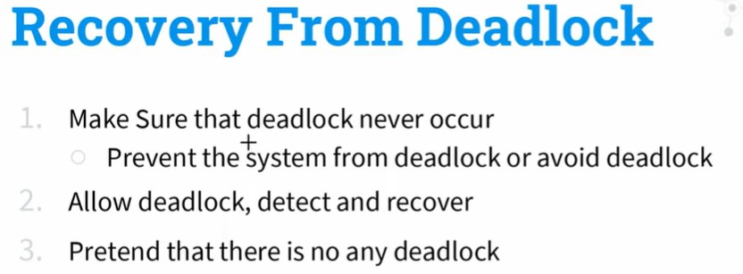

Slide 19
Deadlock Prevention
Invalidate one of the four necessary conditions for deadlock:
Mutual Exclusion – not required for sharable resources (e.g., read-only files); must hold for non-sharable resources
Hold and Wait – must guarantee that whenever a thread requests a resource, it does not hold any other resources
Require threads to request and be allocated all its resources before it begins execution or allow thread to request resources only when the thread has none allocated to it.
Low resource utilization; starvation possible

Slide 20
Deadlock Prevention (Cont.)
No Preemption:
If a process that is holding some resources requests another resource that cannot be immediately allocated to it, then all resources currently being held are released
Preempted resources are added to the list of resources for which the thread is waiting
Thread will be restarted only when it can regain its old resources, as well as the new ones that it is requesting
Circular Wait:
Impose a total ordering of all resource types, and require that each thread requests resources in an increasing order of enumeration

Slide 21
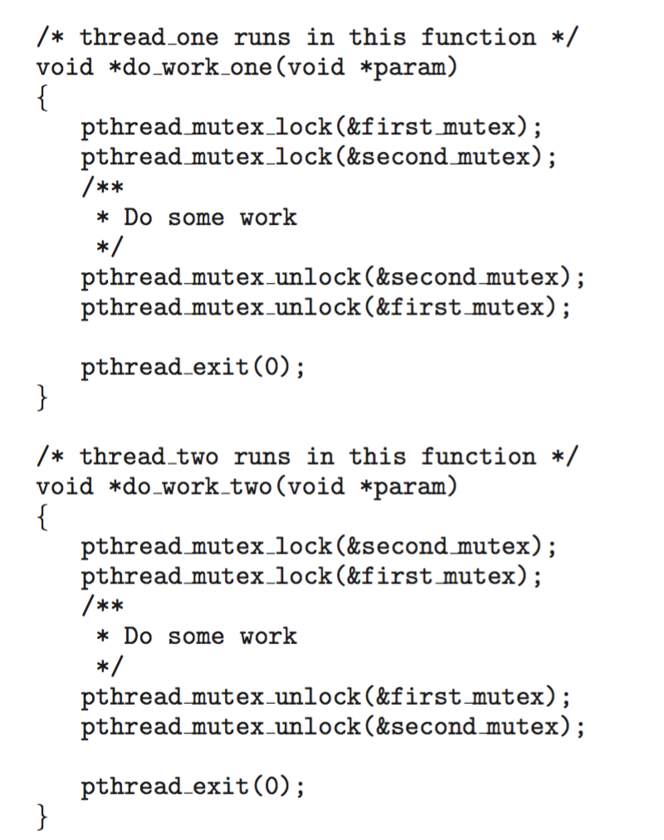
Circular Wait
Invalidating the circular wait condition is most common.
Simply assign each resource (i.e., mutex locks) a unique number.
Resources must be acquired in order.
If: first_mutex = 1 second_mutex = 5 code for thread_two could not be written as follows:

Slide 22
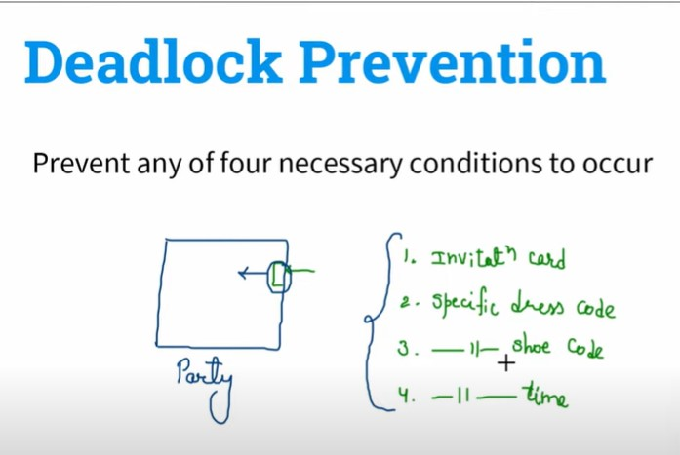

Slide 23
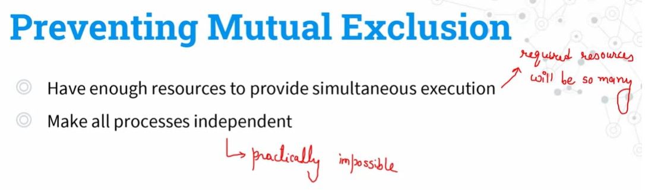
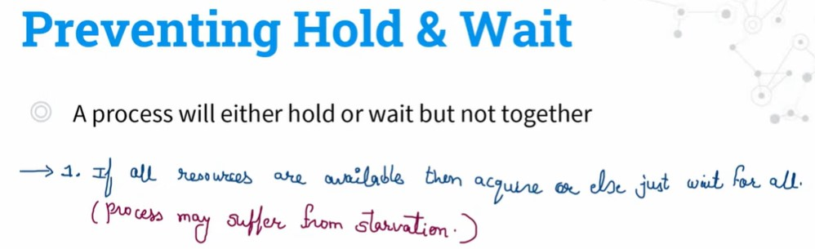

Slide 24
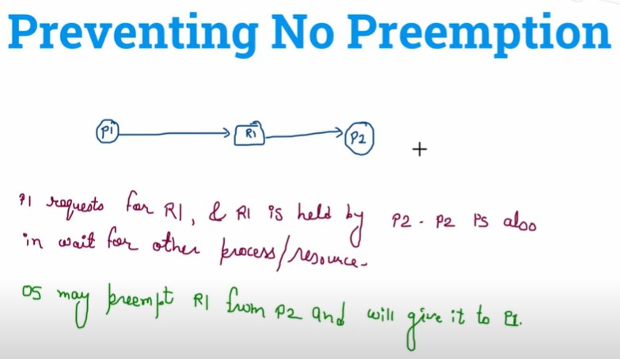
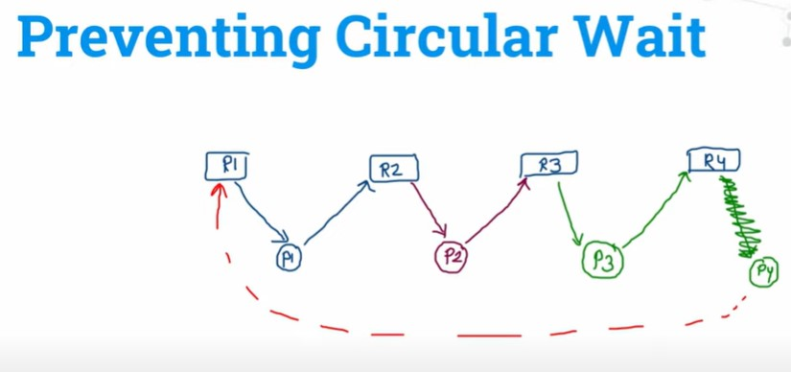

Slide 25
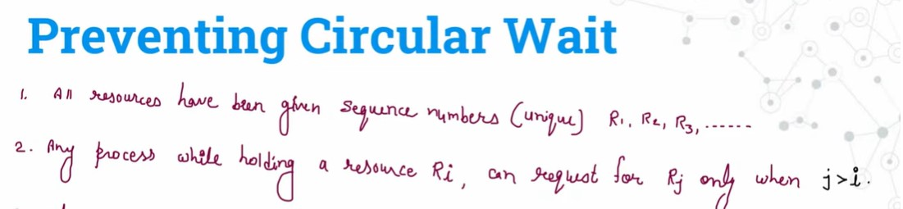
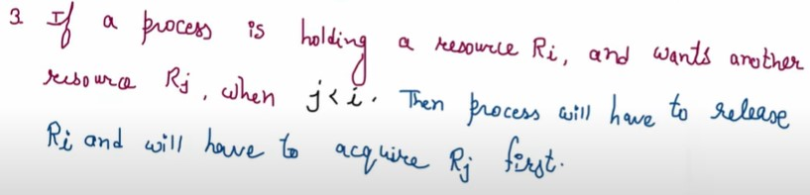

Slide 26
Methods for Handling Deadlocks
Ensure that the system will never enter a deadlock state:
Deadlock prevention
Deadlock avoidance
Allow the system to enter a deadlock state and then recover
Ignore the problem and pretend that deadlocks never occur in the system.

Slide 27
Deadlock Avoidance
Requires that the system has some additional a priori information available
Simplest and most useful model requires that each thread declare the maximum number of resources of each type that it may need
The deadlock-avoidance algorithm dynamically examines the resource-allocation state to ensure that there can never be a circular-wait condition
Resource-allocation state is defined by the number of available and allocated resources, and the maximum demands of the processes

Slide 28
Safe State
When a thread requests an available resource, system must decide if immediate allocation leaves the system in a safe state
System is in safe state if there exists a sequence <T₁, T₂, …, T_{n}> of ALL the threads in the systems such that for each T_{i}, the resources that T_{i} can still request can be satisfied by currently available resources + resources held by all the T_{j}, with j < I
That is:
If T_{i} resource needs are not immediately available, then T_{i} can wait until all T_{j} have finished
When T_{j} is finished, T_{i} can obtain needed resources, execute, return allocated resources, and terminate
When T_{i} terminates, T_{i +1} can obtain its needed resources, and so on

Slide 29
Basic Facts
If a system is in safe state ⇒ no deadlocks
If a system is in unsafe state ⇒ possibility of deadlock
Avoidance ⇒ ensure that a system will never enter an unsafe state.

Slide 30
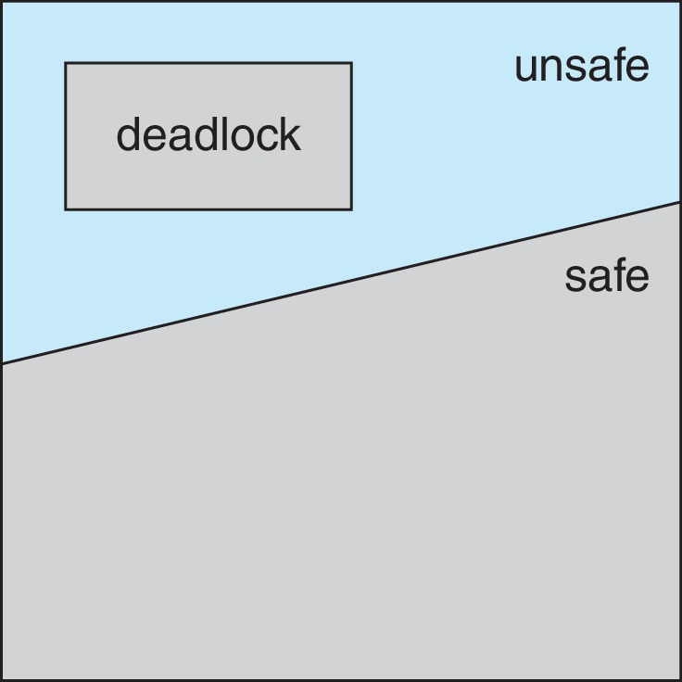
Safe, Unsafe, Deadlock State

Slide 31
Avoidance Algorithms
Single instance of a resource type
Use a resource-allocation graph
Multiple instances of a resource type
Use the Banker’s Algorithm

Slide 32
Resource-Allocation Graph Scheme
Claim edge T_{i} → R_{j} indicated that process T_{j} may request resource R_{j}; represented by a dashed line
Claim edge converts to request edge when a thread requests a resource
Request edge converted to an assignment edge when the resource is allocated to the thread
When a resource is released by a thread, assignment edge reconverts to a claim edge
Resources must be claimed a priori in the system

Slide 33
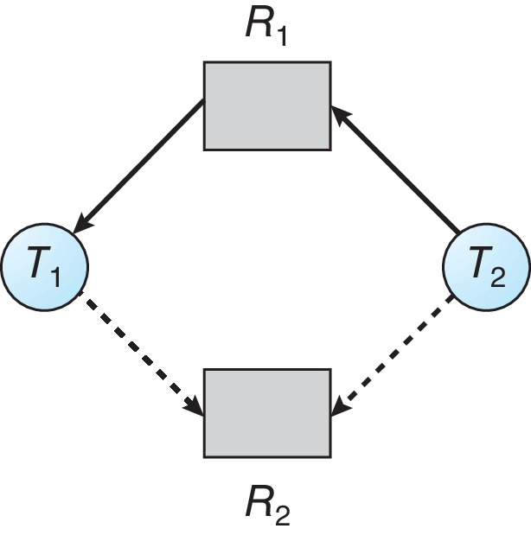
Resource-Allocation Graph

Slide 34
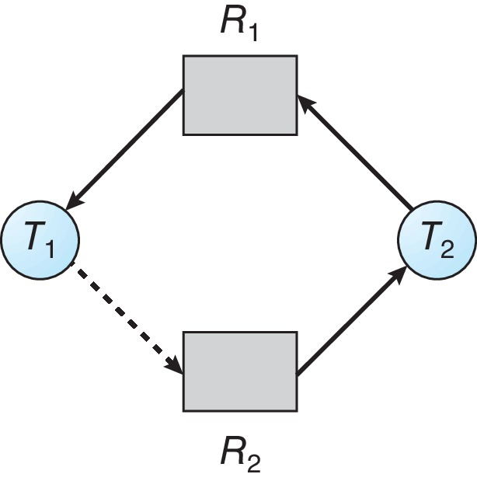
Unsafe State In Resource-Allocation Graph

Slide 35
Resource-Allocation Graph Algorithm
Suppose that thread T_{i} requests a resource R_{j}
The request can be granted only if converting the request edge to an assignment edge does not result in the formation of a cycle in the resource allocation graph

Slide 36
Banker’s Algorithm
Multiple instances of resources
Each thread must a priori claim maximum use
When a thread requests a resource, it may have to wait
When a thread gets all its resources it must return them in a finite amount of time

Slide 37
Data Structures for the Banker’s Algorithm
Let n = number of processes, and m = number of resources types.
Available: Vector of length m. If available [j] = k, there are k instances of resource type R_{j} available
Max: n x m matrix. If Max [i,j] = k, then process T_{i} may request at most k instances of resource type R_{j}
Allocation: n x m matrix. If Allocation[i,j] = k then T_{i} is currently allocated k instances of R_{j}
Need: n x m matrix. If Need[i,j] = k, then T_{i} may need k more instances of R_{j} to complete its task
Need [i,j] = Max[i,j] – Allocation [i,j]

Slide 38
Safety Algorithm
Let Work and Finish be vectors of length m and n, respectively. Initialize:
Work = Available
Finish [i] = false for i = 0, 1, …, n- 1
Find an i such that both:
(a) Finish [i] = false
(b) Need_{i} ≤ Work
If no such i exists, go to step 4
Work = Work + Allocation_{i} Finish[i] = true go to step 2
If Finish [i] == true for all i, then the system is in a safe state

Slide 39
Resource-Request Algorithm for Process P_{i}
Request_{i} = request vector for process T_{i}. If Request_{i} [j] = k then process T_{i} wants k instances of resource type R_{j}
If Request_{i} ≤ Need_{i} go to step 2. Otherwise, raise error condition, since process has exceeded its maximum claim
If Request_{i} ≤ Available, go to step 3. Otherwise T_{i} must wait, since resources are not available
Pretend to allocate requested resources to T_{i} by modifying the state as follows:
Available = Available – Request_{i};
Allocation_{i} = Allocation_{i} + Request_{i};
Need_{i} = Need_{i} – Request_{i};
If safe ⇒ the resources are allocated to T_{i}
If unsafe ⇒ T_{i} must wait, and the old resource-allocation state is restored

Slide 40
Example of Banker’s Algorithm
5 threads T₀ through T₄;
3 resource types:
A (10 instances), B (5instances), and C (7 instances)
Snapshot at time T₀:
Allocation Max Available
A B C A B C A B C
T₀ 0 1 0 7 5 3 3 3 2
T₁ 2 0 0 3 2 2
T₂ 3 0 2 9 0 2
T₃ 2 1 1 2 2 2
T₄ 0 0 2 4 3 3

Slide 41
Example (Cont.)
The content of the matrix Need is defined to be Max – Allocation
Need
A B C
T₀ 7 4 3
T₁ 1 2 2
T₂ 6 0 0
T₃ 0 1 1
T₄ 4 3 1
The system is in a safe state since the sequence < T₁, T₃, T₄, T₂, T₀> satisfies safety criteria

Slide 42
Example: P₁ Request (1,0,2)
Check that Request ≤ Available (that is, (1,0,2) ≤ (3,3,2) ⇒ true
Allocation Need Available
A B C A B C A B C
T₀ 0 1 0 7 4 3 2 3 0
T₁ 3 0 2 0 2 0
T₂ 3 0 2 6 0 0
T₃ 2 1 1 0 1 1
T₄ 0 0 2 4 3 1
Executing safety algorithm shows that sequence < T₁, T₃, T₄, T₀, T₂> satisfies safety requirement
Can request for (3,3,0) by T₄ be granted?
Can request for (0,2,0) by T₀ be granted?

Slide 43
Deadlock Detection
Allow system to enter deadlock state
Detection algorithm
Recovery scheme

Slide 44
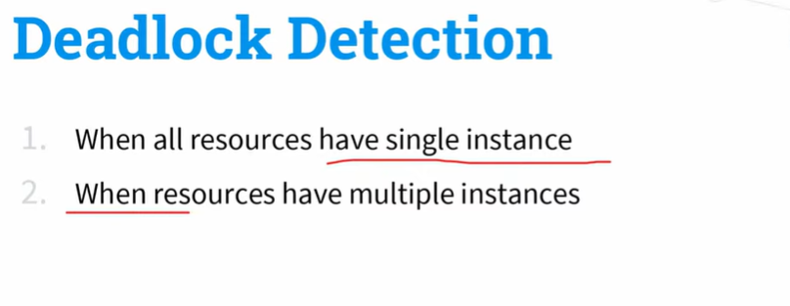
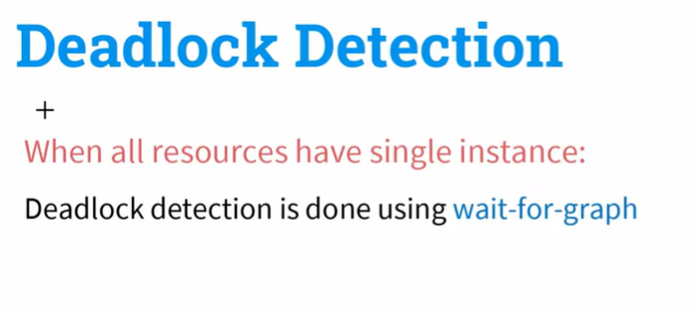

Slide 45
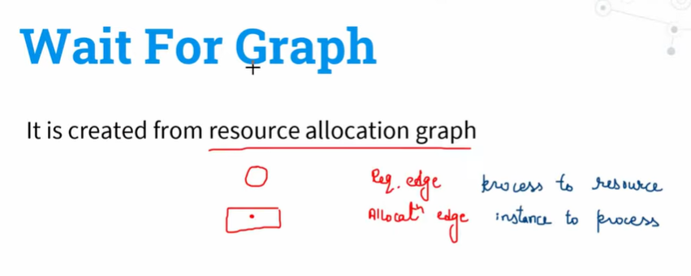

Slide 46
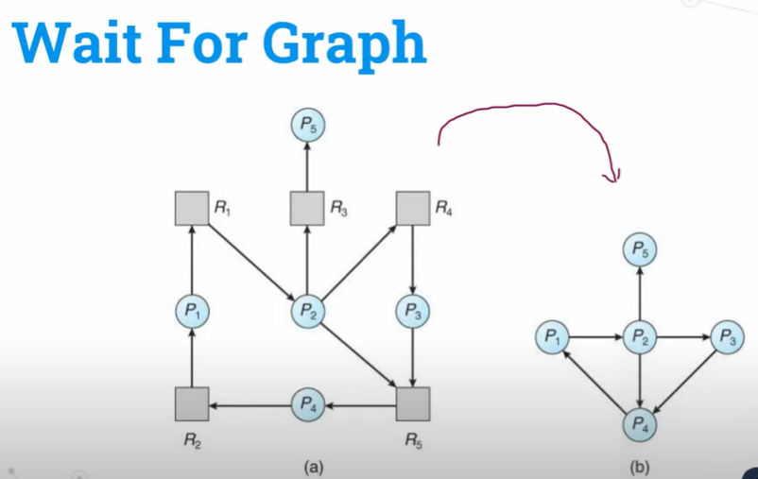

Slide 47
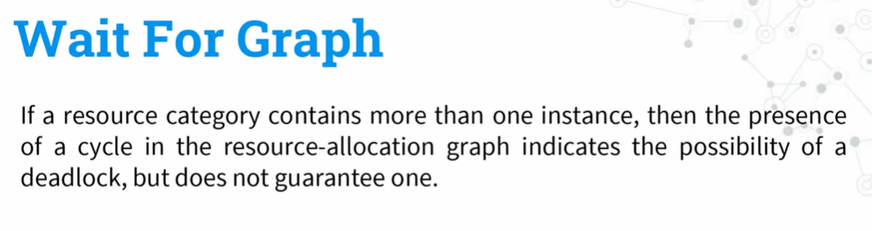

Slide 48

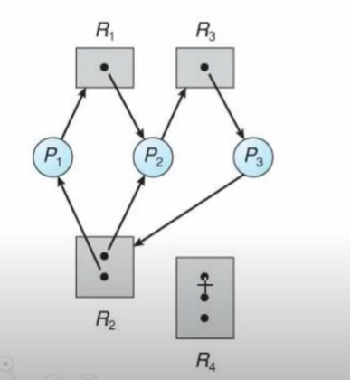

Slide 49
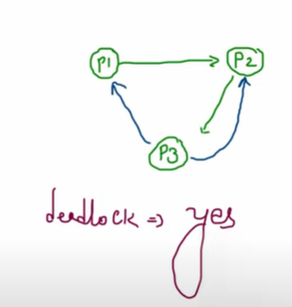

Slide 50
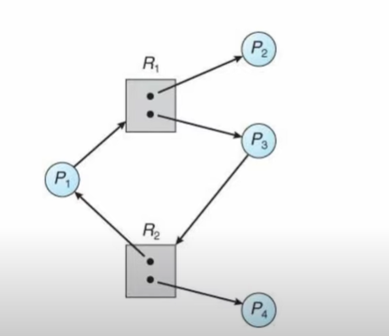

Slide 51
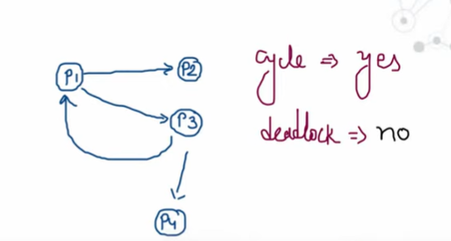

Slide 52
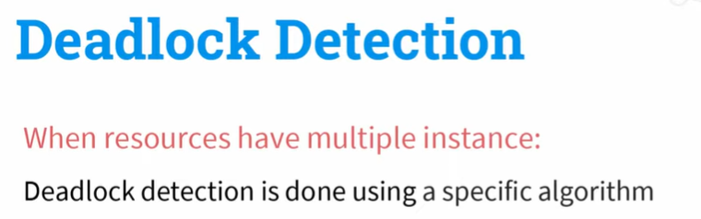

Slide 53
Single Instance of Each Resource Type
Maintain wait-for graph
Nodes are threads
T_{i} → T_{j} if T_{i} is waiting for T_{j}
Periodically invoke an algorithm that searches for a cycle in the graph. If there is a cycle, there exists a deadlock
An algorithm to detect a cycle in a graph requires an order of n² operations, where n is the number of vertices in the graph

Slide 54
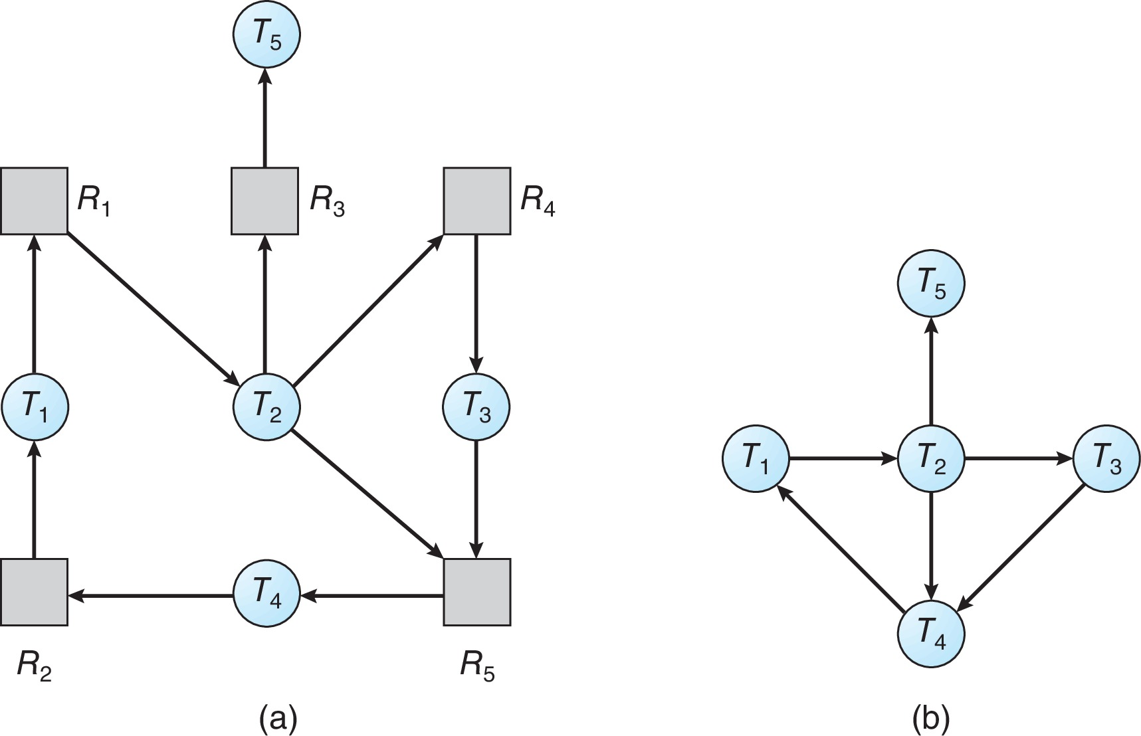
Resource-Allocation Graph and Wait-for Graph
Resource-Allocation Graph
Corresponding wait-for graph

Slide 55
Several Instances of a Resource Type
Available: A vector of length m indicates the number of available resources of each type
Allocation: An n x m matrix defines the number of resources of each type currently allocated to each thread.
Request: An n x m matrix indicates the current request of each thread. If Request [i][j] = k, then thread T_{i} is requesting k more instances of resource type R_{j}.

Slide 56
Detection Algorithm
Let Work and Finish be vectors of length m and n, respectively Initialize:
Work = Available
For i = 1,2, …, n, if Allocation_{i} ≠ 0, then Finish[i] = false; otherwise, Finish[i] = true
Find an index i such that both:
Finish[i] == false
Request_{i} ≤ Work
If no such i exists, go to step 4

Slide 57
Detection Algorithm (Cont.)
Work = Work + Allocation_{i} Finish[i] = true go to step 2
If Finish[i] == false, for some i, 1 ≤ i ≤ n, then the system is in deadlock state. Moreover, if Finish[i] == false, then T_{i} is deadlocked
Algorithm requires an order of O(m x n²) operations to detect whether the system is in deadlocked state

Slide 58
Example of Detection Algorithm
Five threads T₀ through T₄; three resource types A (7 instances), B (2 instances), and C (6 instances)
Snapshot at time T₀:
Allocation Request Available
A B C A B C A B C
T₀ 0 1 0 0 0 0 0 0 0
T₁ 2 0 0 2 0 2
T₂ 3 0 3 0 0 0
T₃ 2 1 1 1 0 0
T₄ 0 0 2 0 0 2
Sequence <T₀, T₂, T₃, T₁, T₄> will result in Finish[i] = true for all i

Slide 59
Example (Cont.)
T₂ requests an additional instance of type C
Request
A B C
T₀ 0 0 0
T₁ 2 0 2
T₂ 0 0 1
T₃ 1 0 0
T₄ 0 0 2
State of system?
Can reclaim resources held by thread T₀, but insufficient resources to fulfill other processes; requests
Deadlock exists, consisting of processes T₁, T₂, T₃, and T₄

Slide 60
Detection-Algorithm Usage
When, and how often, to invoke depends on:
How often a deadlock is likely to occur?
How many processes will need to be rolled back?
one for each disjoint cycle
If detection algorithm is invoked arbitrarily, there may be many cycles in the resource graph and so we would not be able to tell which of the many deadlocked threads “caused” the deadlock.

Slide 61
Recovery from Deadlock: Process Termination
Abort all deadlocked threads
Abort one process at a time until the deadlock cycle is eliminated
In which order should we choose to abort?
Priority of the thread
How long has the thread computed, and how much longer to completion
Resources that the thread has used
Resources that the thread needs to complete
How many threads will need to be terminated
Is the thread interactive or batch?

Slide 62
Recovery from Deadlock: Resource Preemption
Selecting a victim – minimize cost
Rollback – return to some safe state, restart the thread for that state
Starvation – same thread may always be picked as victim, include number of rollback in cost factor

Slide 63
End of Chapter 8

