Slide 1
Unit 2: Processes
Process Concept
Process Scheduling
Operations on Processes
Inter-process Communication (IPC)
Examples of IPC Systems
Communication in Client-Server Systems

Slide 2
Objectives
To introduce the notion of a process -- a program in execution, which forms the basis of all computation
To describe the various features of processes, including scheduling, creation and termination, and communication
To explore interprocess communication using shared memory and message passing
To describe communication in client-server systems

Slide 3
Process Concept
Process – a program in execution; process execution must progress in sequential fashion
Program is passive entity stored on disk (executable file), process is active
  Program becomes process when executable file loaded into memory
Execution of program started via GUI mouse clicks, command line entry of its name, etc
One program can be several processes
  Consider multiple users executing the same program

Slide 4
Process Structure
A process is more than the program code, which is sometimes known as the text section.
It also includes the current activity:
  The value of the program counter
  The contents of the processor's registers.
It also includes the process stack, which contains temporary data (such as function parameters, return addresses, and local variables)
It also includes the data section, which contains global variables.
It may also include a heap, which is memory that is dynamically allocated during process run time.

Slide 5
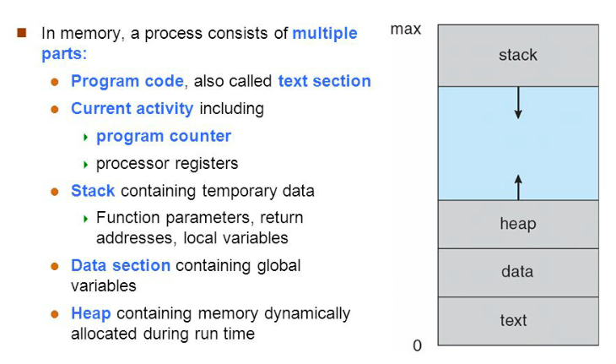
Process in Memory

Slide 6
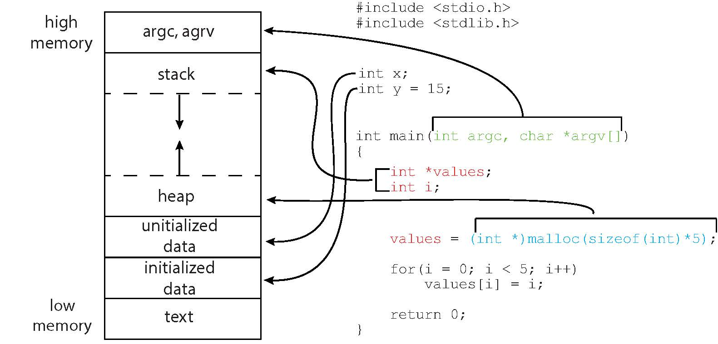
Figure Memory Layout

Slide 7

Process State
As a process executes, it changes state
  new: The process is being created
  running: Instructions are being executed
  waiting: The process is waiting for some event to occur
  ready: The process is waiting to be assigned to a processor
  terminated: The process has finished execution
Diagram of Process State

Slide 8
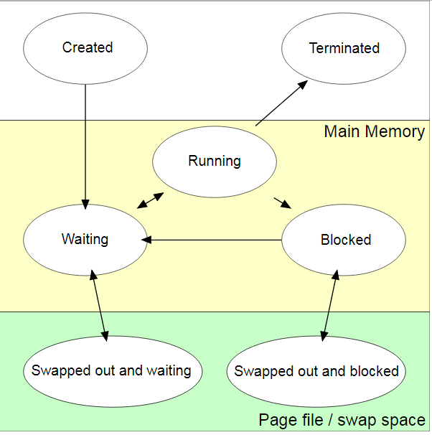

Slide 9
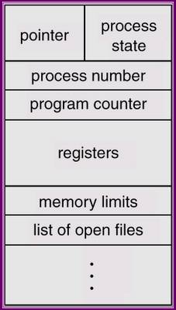
Process Control Block (PCB)
Information associated with each process
(also called task control block)
Process state – running, waiting, etc
Program counter – location of instruction to next execute
CPU registers – contents of all process-centric registers
CPU scheduling information- priorities, scheduling queue pointers
Memory-management information – memory allocated to the process
Accounting information – CPU used, clock time elapsed since start, time limits
I/O status information – I/O devices allocated to process, list of open files

Slide 10

Ready Queue And Various I/O Device Queues

Slide 11
Threads
So far, process has a single thread of execution
Consider having multiple program counters per process
  Multiple locations can execute at once
    Multiple threads of control -> threads
Need storage for thread details, multiple program counters in PCB
Covered in the next chapter

Slide 12
Process Scheduling
Maximize CPU use
  Quickly switch processes onto CPU for time sharing
Process scheduler selects among available processes for next execution on CPU
Maintains scheduling queues of processes
  Job queue – set of all processes in the system
  Ready queue – set of all processes residing in main memory, ready and waiting to execute
  Device queues – set of processes waiting for an I/O device
  Processes migrate among the various queues

Slide 13

Representation of Process Scheduling
Queuing diagram represents queues, resources, flows

Slide 14
Schedulers
Short-term scheduler (or CPU scheduler) – selects which process should be executed next and allocates a CPU
  Sometimes the only scheduler in a system
  Short-term scheduler is invoked frequently (milliseconds) ⇒ (must be fast)
Long-term scheduler (or job scheduler) – selects which processes should be brought into the ready queue
  Long-term scheduler is invoked infrequently (seconds, minutes) ⇒ (may be slow)
  The long-term scheduler controls the degree of multiprogramming
Processes can be described as either:
  I/O-bound process – spends more time doing I/O than computations, many short CPU bursts
  CPU-bound process – spends more time doing computations; few very long CPU bursts
Long-term scheduler strives for good process mix

Slide 15
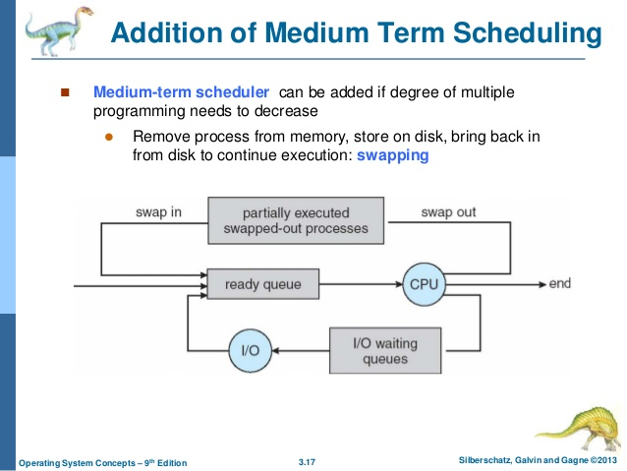

Slide 16
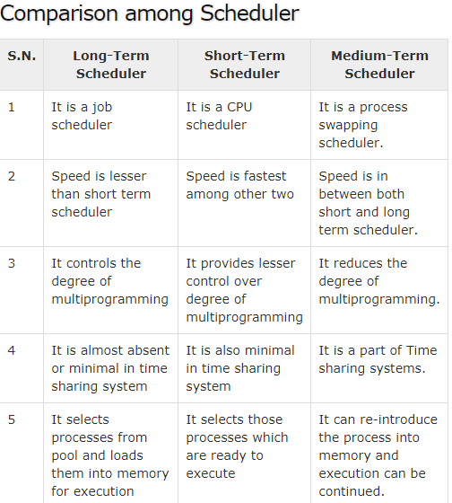

Slide 17
Context Switch
When CPU switches to another process, the system must save the state of the old process and load the saved state for the new process via a context switch
Context of a process represented in the PCB
Context-switch time is pure overhead; the system does no useful work while switching
  The more complex the OS and the PCB ➔ the longer the context switch
Time dependent on hardware support
  Some hardware provides multiple sets of registers per CPU ➔ multiple contexts loaded at once

Slide 18

CPU Switch From Process to Process

Slide 19
Operations on Processes
System must provide mechanisms for:
  process creation,
  process termination,
  and so on as detailed next

Slide 20
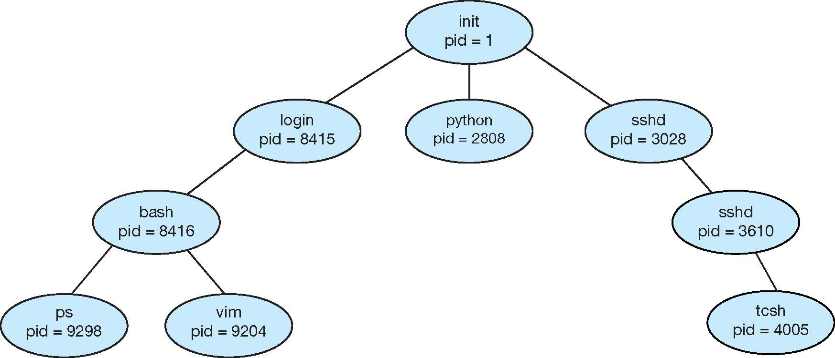
Process Creation
A process may create other processes.
Parent process create children processes, which, in turn create other processes, forming a tree of processes
Generally, a process is identified and managed via a process identifier (pid)
A Tree of Processes in UNIX

Slide 21
Process Creation (Cont.)
Resource sharing among parents and children options
  Parent and children share all resources
  Children share subset of parent’s resources
  Parent and child share no resources
Execution options
  Parent and children execute concurrently
  Parent waits until children terminate

Slide 22

Process Creation (Cont.)
Address space
  A child is a duplicate of the parent address space.
  A child loads a program into the address space.
UNIX examples
  fork() system call creates new process
  exec() system call used after a fork()replaces the process’ memory space with a new program

