Slide 1

SMART INDIA HACKATHON 2026
NidhiSetu
Problem Statement ID – SIH26265
Problem Statement Title – Streamline of security deposit/ FDR portal.
Theme – Smart Automation
PS Category – Software
Team ID – [Team ID]
Team Name (Registered on portal) – [Team Name]
Notes:
One line per member. Say: PS SIH26265 from AICTE's Regulation Bureau, Smart Automation, software.

Slide 2
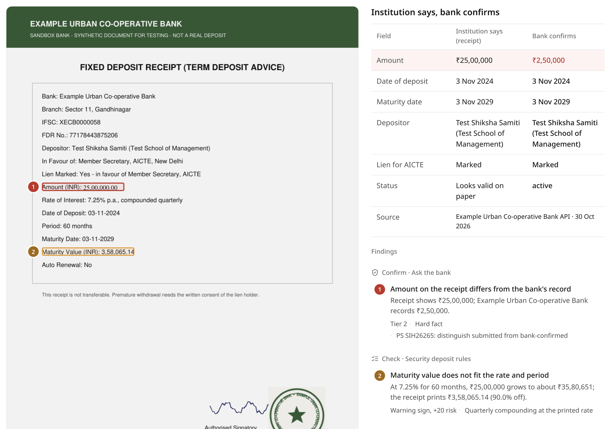
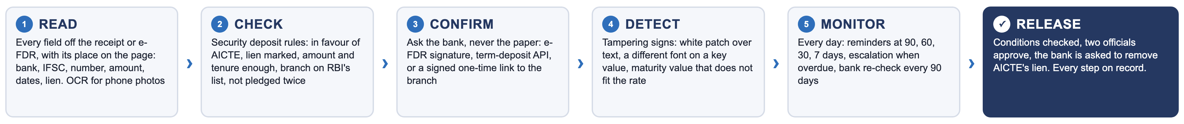
NidhiSetu
[Team Name]
Every security deposit confirmed with the bank, and tracked from submission to release
❖ Proposed Solution (Describe your Idea/Solution/Prototype)
Detailed explanation of the proposed solution
How it addresses the problem
Innovation and uniqueness of the solution
Reads each FDR or e-FDR: amount, bank, IFSC, dates, lien; OCR for phone photos
Checks the deposit rules: in favour of AICTE, lien, amount, tenure, branch
Asks the bank: e-FDR signature, term-deposit API, or a signed branch link
Tracks the lifecycle: reminders at 90/60/30/7 days, escalation, renewal
Release workflow: conditions checked, two officials, discharge letter to the bank
A deposit today is a paper receipt checked once. In Chandigarh, ₹116.84 crore of FDRs the bank had never issued went unnoticed for over a year (Tribune, Mar 2026)
NidhiSetu shows what the institution says next to what the bank confirms, for every FDR, on day one
A bank re-check every 90 days finds an early closure in about 45 days, not at maturity
Bank-confirmed, not paper-trusted: 3 tiers; never uses a QR or phone printed on the receipt
Continuous re-confirmation, so a closed deposit cannot hide
Pledge registry: one FDR cannot secure two institutions
Tamper evidence: white patches, font changes, maturity-value arithmetic
Maker-checker release, hash-chained audit trail
Working prototype: the receipt says ₹25 lakh, the bank says ₹2.5 lakh; numbered boxes mark the evidence
80/80 forgeries caught 0/60 false alarms
0.14 s per receipt on a laptop CPU · 140 labelled test receipts
Demo video: [add unlisted link] Live prototype: [add link] Code: [add GitHub link]
Notes:
30 seconds. Open with Chandigarh: ₹116.84 crore of FDRs that the bank never issued, and nobody noticed for a year. NidhiSetu asks the bank on day one and again every quarter. Point at the screenshot: receipt ₹25 lakh, bank ₹2.5 lakh, the white patch is box 1. Point at the green box: measured, not promised. Close: the officer decides; the bank's record decides what is true.

Slide 3
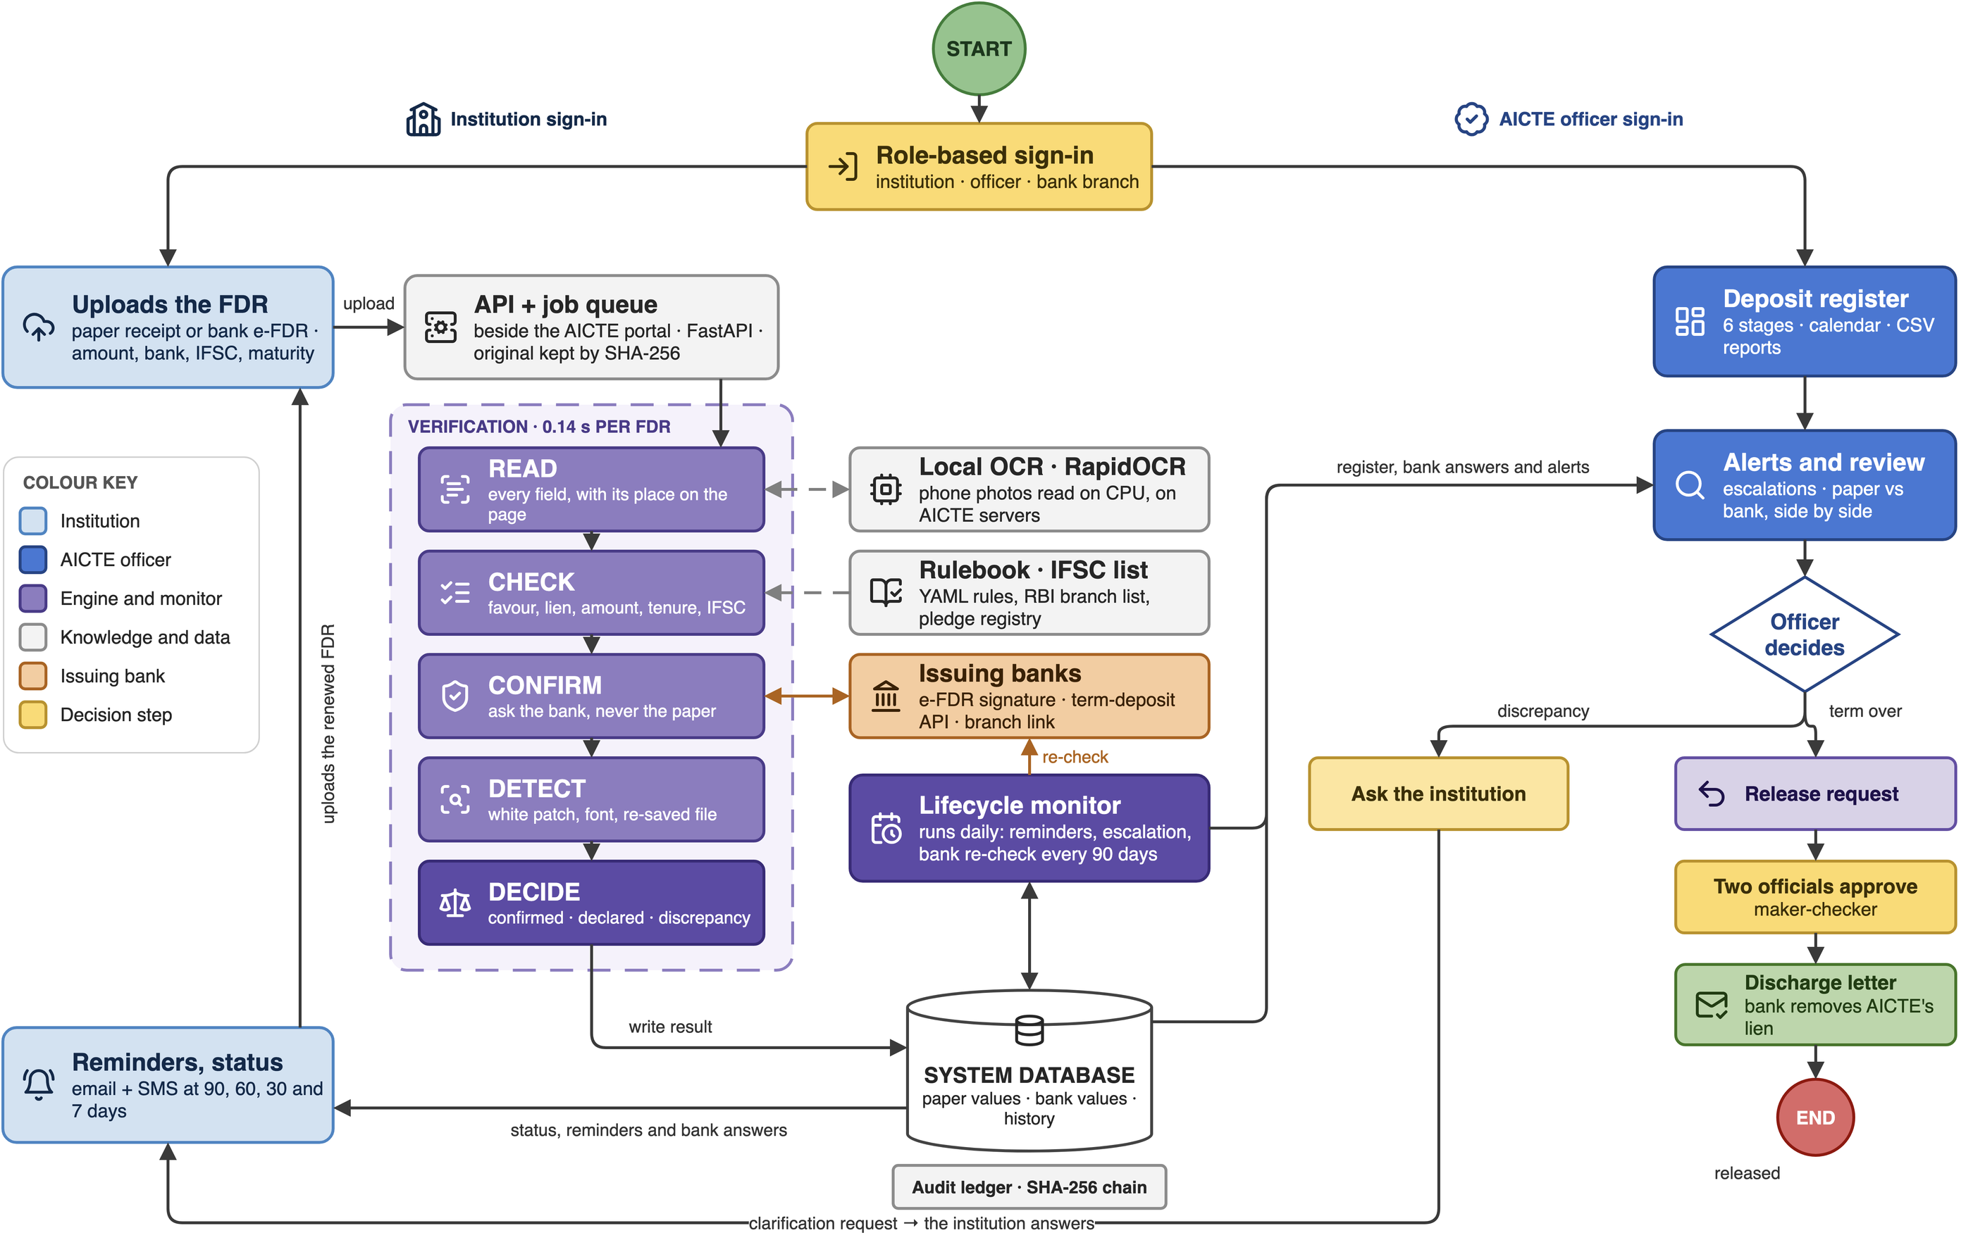
TECHNICAL APPROACH
[Team Name]
Technologies to be used (e.g. programming languages, frameworks, hardware)
Methodology and process for implementation (Flow Charts/Images/ working prototype)
FastAPI · Python 3.12: typed API; Python owns the PDF, OCR and signature libraries (vs Node.js: weak PDF tooling)
PostgreSQL 16: every instrument with paper and bank values side by side; demo runs the same code on SQLite (vs MongoDB: weak transactions for financial records)
Redis + RQ workers: the daily monitor and bank re-checks run as jobs (vs Celery: heavier; Kafka: overkill)
MinIO (S3) on NIC / MeghRaj: receipts stored by SHA-256, encrypted (vs local disk: does not scale)
pyHanko: verifies the bank's PAdES signature on an e-FDR; catches edits after signing
RapidOCR (PP-OCR, ONNX): reads phone photos on a CPU (vs cloud OCR: financial data leaves AICTE)
Bank channel adapters: e-FDR, term-deposit API, signed branch link; Account Aggregator next (vs letters to branches: weeks, no trail)
RBI IFSC list + rapidfuzz: the branch must exist; OCR-tolerant name matching (vs exact match: photos fail)
React 18 + TypeScript on UX4G 3.0: the Government of India design system, accessibility bar (vs a custom look)
Role-based sign-in + SHA-256 hash chain: maker-checker roles; tamper-evident log (vs blockchain: same proof, no cost)
100% open source · ₹0 licence · CPU only, no GPU
1 Built lifecycle portal, bank sandbox, monitor, 6 passing tests
2 Measured 140 labelled receipts, 8 forgery patterns
3 Pilot our college's deposit records, then one regional office
Notes:
Left: every choice has a reason and a rejected alternative; ask us about any of them. Right, follow the arrows: the institution uploads the FDR; five engines read it, check the rules, ask the bank, look for tampering and decide. The lifecycle monitor runs every day: reminders, escalation, and a bank re-check every 90 days. The officer sees paper and bank side by side, asks the institution to explain a discrepancy, or starts a release that two different officials must approve before the bank is asked to remove AICTE's lien. The renewal loop on the left closes the cycle. The diagram is an editable draw.io file in our repo.

Slide 4
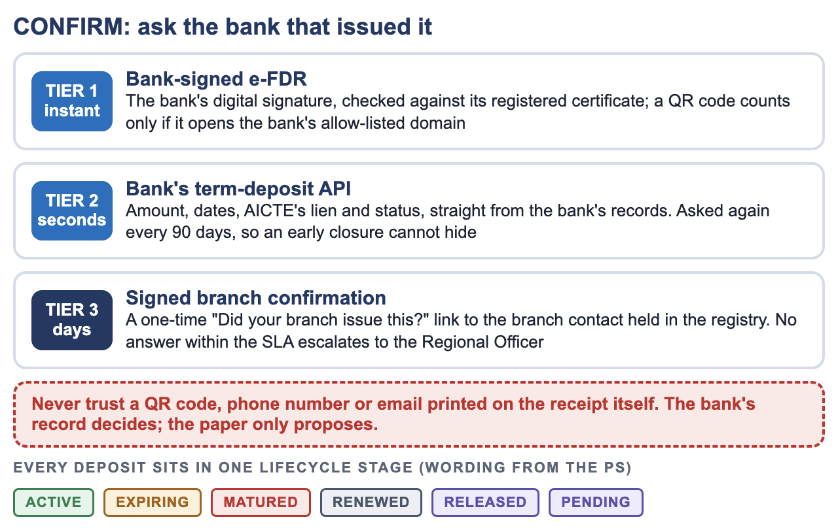
FEASIBILITY AND VIABILITY
[Team Name]
Analysis of the feasibility of the idea
Technical
Economic
Operational
Legal & data
Built and running today; banks already issue e-receipts and share term deposits through AA
₹0 licence; replaces verification letters and follow-up calls; NIC cloud
Fits the Regulation Bureau's steps; officers keep every decision
On-prem, role-based, encrypted; bank checks only where authorised
80/80
forgeries caught
0/60
false alarms (20 phone photos)
0.14 s
per receipt, laptop CPU
45 days
to catch an early closure (paper: 1,178)
Measured on 140 synthetic receipts (8 patterns from reported cases) and a 10,000-deposit simulation; the pilot measures real-world rates.
Potential challenges and risks
Strategies for overcoming these challenges
Challenge or risk | Strategy
Bank has no API (a small co-operative bank) | Tier 3 signed branch link; no answer within the SLA escalates; AA consent as banks join
Bank service down or slow | Stays "awaiting bank", never "fake"; retried automatically
Genuine receipt flagged (phone photo, OCR) | OCR-tolerant matching: 0/20 false alarms on photos; officer sees the evidence first
FD closed after it was submitted | Bank re-check every 90 days; lien must show at the bank, not only on paper
A clever PDF edit | The bank's record decides, not the file; forensics is a second signal
Rules or amounts change | Rulebook in YAML, versioned per cycle; no code change
Viability
Pilot: our college's deposit records (with permission), then one AICTE regional office, then national
Reuse: UGC, NCTE, PCI and any department that holds FDRs as security, like the municipal bodies in the 2026 cases
Sustainable: open source under AICTE; each bank is onboarded once, through an adapter
Scale estimate: if AICTE holds ~20,000 deposits, quarterly re-checks are ~220 bank calls a day; one worker does that in under a minute
Notes:
Say the false-alarm answer first, judges always ask it: zero on 60 genuine receipts, including phone photos. Then the 45 days: that is what continuous re-confirmation buys. Right side: the three tiers explain how we confirm even when a bank has no API.

Slide 5
IMPACT AND BENEFITS
[Team Name]
Potential impact on the target audience
Benefits of the solution (social, economic, environmental, etc.)
R
AICTE Regulation Bureau
One register for every deposit; reminders and escalations automatic; release with a full trail
Social
Economic
Deposits that back approvals are real
Faster, transparent release for genuine institutions
Fewer disputes: every step on record
A fake or closed FDR is caught in weeks, not years
Officer time saved on letters and follow-up
₹0 licence, no per-check fee
I
Honest institutions
Upload once, get reminded before maturity, get the deposit released without chasing letters
B
Banks
Answer once through an API or a one-click link, instead of letters and phone calls
Environmental
Governance
Paperless from upload to discharge letter
No couriered receipts or verification letters
Bank e-FDRs preferred over paper
Institution's claim and bank's record kept apart, as the PS asks
Two officials on every release
Tamper-evident audit trail
S
Students and the public
The security behind each approved institution is real money at a bank, not a piece of paper
Why it matters: reported cases
₹116.84 Cr
₹150 Cr
₹64 Cr
IFN 760 COV
of Chandigarh MC's FDRs were not in the bank's system; nobody noticed for over a year (The Tribune, Mar 2026)
of Panchkula MC's fixed deposits did not exist; found only on a maturity transfer request (Moneylife, Mar 2026)
swindled from Telugu Akademi's fixed deposits using forged FDRs and letters (Moneylife, 2021)
Bank guarantees travel bank-to-bank on SFMS, the only valid mode (PNB). NidhiSetu gives FDRs a bank-side check
Notes:
Who benefits, then the cases. Each number has its source on the card; do not round them up. The last card is the design idea: bank guarantees already need the bank's own message; we give FDRs the same.

Slide 6
RESEARCH AND REFERENCES
[Team Name]
Details / Links of the reference and research work
How NidhiSetu compares with what exists today
Research, standards and sources
 | Paper file + letters | Spreadsheet tracker | NeSL e-BG | Account Aggregator | NidhiSetu
Bank confirms the deposit | Letters | No | BGs only | With consent | Yes
Covers FDRs held as security | Yes | Yes | No | Data only | Yes
Reminders before maturity | No | Manual | n/a | No | Yes
Catches an early closure | At maturity | No | n/a | If re-fetched | Every 90 d
Two-official release, audit trail | Partly | No | n/a | No | Yes
Paper vs bank, side by side | No | No | n/a | No | Yes
1. PS SIH26265, AICTE Regulation Bureau (sih.gov.in)
2. AICTE, Simple steps for making security deposit online
3. The Tribune, Chandigarh MC: Rs 116 crore FDR scandal unfolds, 11 Mar 2026
4. Moneylife, ₹150 crore FD discrepancy in Panchkula MC account, Mar 2026
5. Business Today, CBI arrests ex-bank officials in Haryana FD fraud case, 30 Jun 2026
6. Moneylife, ED to probe Rs64 crore Telugu Akademi fixed deposit fraud
7. PNB, Bank guarantees transmitted through SFMS IFN 760 / 760 COV
8. CSB Bank, Electronic bank guarantee through NeSL
9. Sahamati, Account types activated by banks on AAs (term deposits)
10. Sahamati, Glossary of AA terms (TD: term / fixed deposit)
11. Razorpay IFSC dataset, built from RBI NEFT/RTGS lists
12. ETSI EN 319 142 (PAdES): PDF digital signatures
13. Du et al., PP-OCR: a practical ultra lightweight OCR system, arXiv:2009.09941
14. UX4G 3.0, Government of India design system
15. GIGW 3.0: Indian government web guidelines (WCAG 2.1 AA)
What exists, and what we build on
NeSL e-BG: banks already issue bank guarantees electronically with instant verification; we bring that idea to FDRs
Account Aggregator: term deposits are a listed data type; our next bank channel, with the institution's consent
RBI IFSC lists (open dataset): every branch on a receipt must exist
Stakeholder input: [add one line from your college's accounts officer or AICTE coordinator]
Data and test assets (all free)
Labelled test set we built: 140 receipts, 8 forgery patterns from the cases above
Sandbox banks: our own CA for signed e-FDRs, a term-deposit API, branch links
10,000-deposit simulation of early closures: paper check vs 90-day re-check
Rules: AICTE security deposit norms, configurable per cycle (PS allows synthetic data)
Notes:
If asked why not just use NeSL: it covers bank guarantees, not FDRs held as security. If asked about Account Aggregator: it is the right long-term channel and we have it as Tier 2 next; the institution consents once.

