Slide 1

SMART INDIA HACKATHON 2026
SatyaPatra
Problem Statement ID – SIH26261
Problem Statement Title – AI-Powered Application Validation, Document Authentication and Regulatory Compliance Verification
Theme – Smart Automation
PS Category – Software
Team ID – [Team ID]
Team Name (Registered on portal) – [Team Name]
Notes:
One line per member. Say: PS SIH26261 from AICTE, Smart Automation, software.

Slide 2
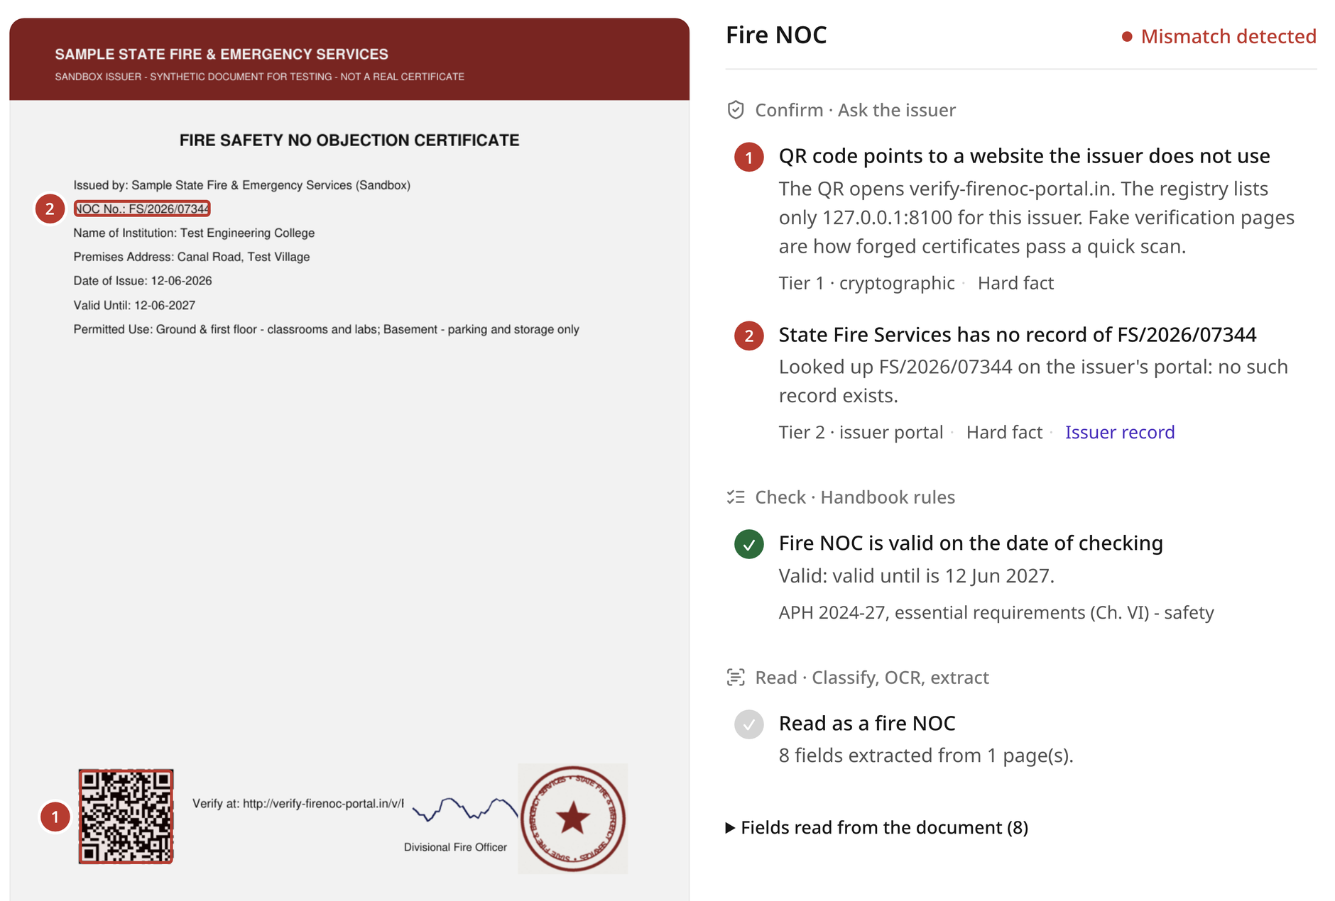
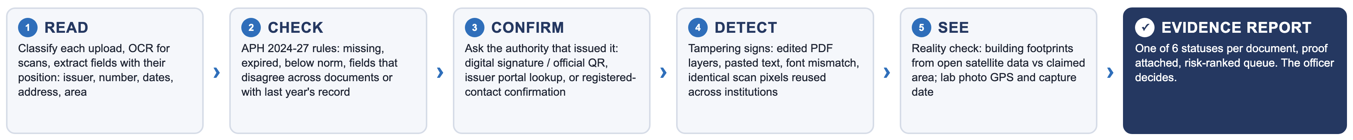
SatyaPatra
[Team Name]
Every AICTE approval document, confirmed with the authority that issued it, with the proof on screen
❖ Proposed Solution (Describe your Idea/Solution/Prototype)
Detailed explanation of the proposed solution
How it addresses the problem
Innovation and uniqueness of the solution
Reads every upload: PDF text with positions, OCR for scans and photos
Applies the APH 2024-27 rulebook: missing, expired, below-norm, mismatched
Asks the issuer: signature, issuer portal, or a one-click confirm link
Finds tampering: white patches, edits after signing, fake seals
Gives 1 of the 6 PS statuses, risk 0-100, evidence boxed on the page
Today a forged NOC passes until someone checks by hand: Hyderabad police booked 8 junior colleges after 76 fire NOCs were sent back to the issuer (Aug 2026)
SatyaPatra makes that check the default for every document, in under a second
Officers start with the riskiest files; every flag cites its rule and source
Verify at source, 3 tiers; never trusts a QR or phone printed on the document
Cross-institution memory: same seal scan or faculty at two colleges
Satellite reality check of built-up area
Seal-specimen matching (ORB + RANSAC)
On-prem AI, ₹0 licence, data stays with AICTE
Working prototype (UX4G-based console): forged NOC flagged; numbered boxes mark the evidence
120/120 forgeries caught 0/75 false alarms
0.14 s per PDF on a laptop CPU · 195 labelled test documents
Demo video: [add unlisted link] Live prototype: [add link] Code: [add GitHub link]
Notes:
30 seconds. Open with Hyderabad: 76 fire NOCs checked by hand, 8 colleges booked. SatyaPatra does that check for every document at upload. Point at the screenshot: the red boxes are the evidence. Point at the green box: measured, not promised. Close: the officer decides; we make sure they decide on the truth.

Slide 3
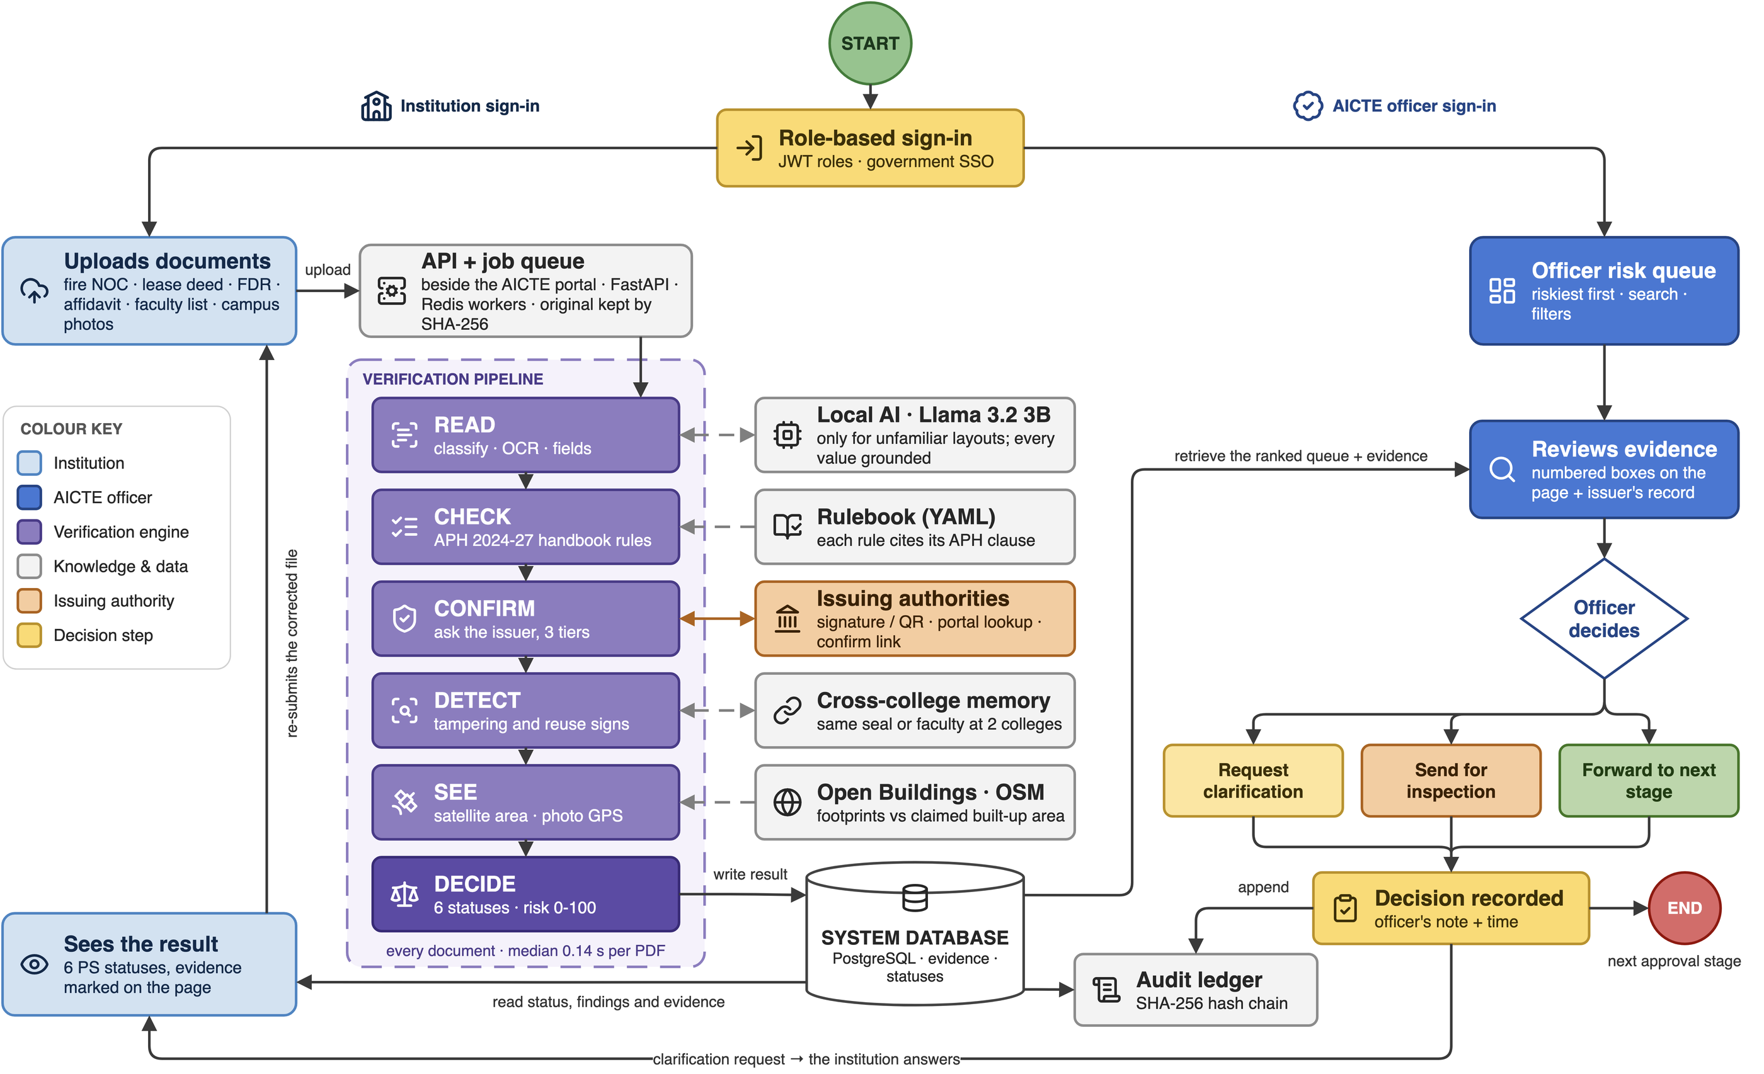
TECHNICAL APPROACH
[Team Name]
Technologies to be used (e.g. programming languages, frameworks, hardware)
Methodology and process for implementation (Flow Charts/Images/ working prototype)
FastAPI · Python 3.12: typed async API; Python owns document AI (vs Node.js: weak PDF and vision libraries)
PostgreSQL 16 (+ PostGIS at scale): ACID evidence records; the demo runs the same code on SQLite (vs MongoDB: weak joins for audit-grade records)
Redis + RQ workers: add workers in approval season (vs Celery: heavier; Kafka: overkill at this scale)
MinIO (S3) on NIC / MeghRaj: originals stored by SHA-256, encrypted (vs local disk: does not scale)
RapidOCR (PP-OCR models, ONNX): CPU, layout-robust, Apache-2.0 (vs cloud OCR: data leaves AICTE)
pyHanko: validates PAdES signatures to the issuer's certificate; detects edits after signing
OpenCV ORB + RANSAC: rotation-proof seal matching (vs image hashes: in our tests fakes scored as close as genuine)
Ollama + Llama 3.2 3B: local AI only for unfamiliar layouts, every value grounded (vs cloud LLM APIs: data leaves, per-token cost)
React 18 + TypeScript on UX4G 3.0 tokens: the Government of India design system, Noto Sans, accessibility bar (vs a custom look: no GIGW alignment)
Role-based sign-in + SHA-256 hash chain: government SSO via OIDC; tamper-evident log (vs blockchain: same proof, no cost)
100% open source · ₹0 licence · CPU only, no GPU
1 Built 5 engines, issuer sandbox, console, 6 passing tests
2 Measured 195 labelled documents, 8 forgery types
3 Pilot Our college's EoA, then one regional office
Notes:
Left: every choice has a reason and a rejected alternative; ask us about any of them. Right, follow the arrows: the institution and the officer sign in with their own roles. Every upload goes through the API queue into five engines: Read, Check against the APH rulebook, Confirm with the issuing authority, Detect tampering using cross-college memory, See the campus on satellite data, then Decide one of the six PS statuses. Results land in the database. The officer's queue reads them riskiest first; the officer decides; every decision is written to the hash-chained ledger; a clarification goes back to the institution, which re-submits. The diagram is an editable draw.io file in our repo.

Slide 4
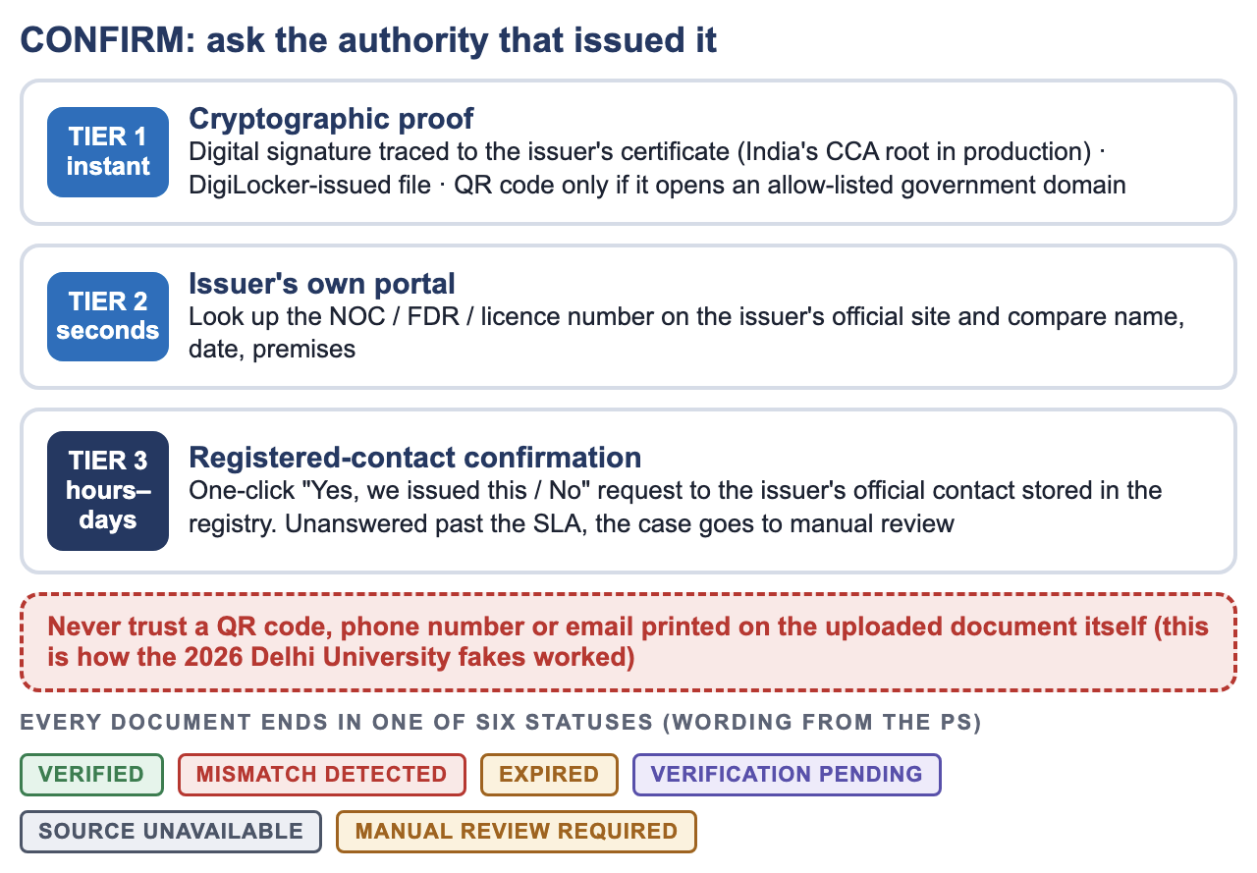
FEASIBILITY AND VIABILITY
[Team Name]
Analysis of the feasibility of the idea
Technical
Economic
Operational
Legal & data
Built and running today; every part is mature open source
₹0 licence, no per-document fee, runs on existing NIC cloud
Plugs in beside the AICTE portal; officers keep the decision
On-prem, role-based, salted ID hashes; built for DPDP Act 2023
120/120
forgeries caught
0/75
false alarms
0.14 s
per PDF, laptop CPU
6 of 8
forgery types hit by 2+ independent signals
Measured on our labelled test set (195 synthetic documents, forgery types modelled on reported cases). The pilot measures real-world rates.
Potential challenges and risks
Strategies for overcoming these challenges
Challenge or risk | Strategy
Genuine document flagged by mistake | Soft signals alone never mark a forgery; evidence shown; institution can reply
Issuer has no API (a city fire office) | 3-tier ladder; no reply within SLA goes to manual review
Phone scans and photographed documents | OCR built in (0/15 false alarms on phone scans); unclear or handwritten fields go to manual review
Forgers adapt to the detector | Issuer confirmation cannot be faked; detector is one signal of many
Approval-season peak load | Queue + more workers; issuer answers cached; ~0.14 s per PDF
Handbook changes every cycle | Rules in YAML with clause IDs, versioned by year, no code change
Viability
Pilot: our college's EoA (with permission), then one AICTE regional office, then national
Reuse: UGC, NCTE, PCI and state boards face the same forged-certificate problem
Sustainable: open source under AICTE; no vendor lock-in
Scale estimate: if ~9,000 institutions send ~30 documents each, ~2.7 lakh documents at ~1 s each take under 2 days on 32 CPU cores
Notes:
Say the false-positive answer first, judges always ask it. Then the green band: measured, with the caveat. Right side: the three tiers explain how we confirm even when an issuer has no API.

Slide 5
IMPACT AND BENEFITS
[Team Name]
Potential impact on the target audience
Benefits of the solution (social, economic, environmental, etc.)
S
Students and parents
Real labs, real faculty and fire-safe buildings behind every approval
Social
Economic
Fire, building and lab claims actually checked
Students get the faculty they pay for
Approved degrees stay trustworthy
Officer hours saved on routine checks
Public money not lost to fake institutions or fake FDRs
₹0 licence, no per-document fee
A
AICTE officers
Start with the riskiest files; routine checks automated; decisions backed by evidence
I
Honest institutions
Self-check before submitting; fewer deficiency rounds; faster approval
Environmental
Governance
Paperless verification end to end
Fewer courier and travel trips to re-verify
Satellite screening before any site visit
Same rules for every application
Tamper-evident record of every decision
Reusable by UGC, NCTE, PCI, state boards
R
Issuing authorities
Forged copies of their certificates caught early; one-click confirmation
Why it matters: reported cases
8 of 76
1 in 3
353
₹144 Cr
fire NOCs sent back for checking led to 8 Hyderabad junior colleges being booked for forgery (Siasat, Aug 2026)
technical institutes were caught filing false data for AICTE approval (Hindustan Times, Apr 2017)
full-time faculty on the payrolls of 2 to 11 engineering colleges at once (DT Next, Jul 2024)
in scholarships went to 830 fake or non-operational institutions (CBI FIR via Scroll, FY18-FY22)
Notes:
Who benefits, then the four numbers. Each number has a source on the card; do not round them up.

Slide 6
RESEARCH AND REFERENCES
[Team Name]
Details / Links of the reference and research work
How SatyaPatra compares with what exists today
Research papers, standards and sources
 | Manual scrutiny | DigiLocker | Paid KYC / forgery APIs | Generic OCR | SatyaPatra
Confirms with the issuer | Partly | Its own docs | ID docs | No | Yes
NOC, lease, FDR, affidavit | Yes | Few | No | Extracts | Yes
Evidence for every flag | Varies | n/a | Score | No | Yes
Memory across institutions | No | No | No | No | Yes
Checks buildings and photos | Visits | No | No | No | Screens
No per-document fee | Yes | Yes | Paid | Paid | Yes
1. PS SIH26261, AICTE (sih.gov.in)
2. AICTE Approval Process Handbook 2024-27
3. Qu et al., Robust Tampered Text Detection in Document Images (DocTamper), CVPR 2023
4. Rublee et al., ORB: an efficient alternative to SIFT or SURF, ICCV 2011, doi:10.1109/ICCV.2011.6126544
5. Fischler & Bolles, Random Sample Consensus, CACM 1981, doi:10.1145/358669.358692
6. Du et al., PP-OCR: a practical ultra lightweight OCR system, arXiv:2009.09941
7. Sirko et al., Continental-scale building detection (Open Buildings), arXiv:2107.12283
8. ETSI EN 319 142 (PAdES): PDF digital signatures
9. GIGW 3.0: Indian government web guidelines (WCAG 2.1 AA)
10. Siasat, Eight colleges booked for forging HYDRAA chief's signature, Aug 2026
11. ThePrint/PTI, DU plans AI tool after manipulated documents, 20 Jul 2026
12. Careers360/PTI, Delhi basement shown as store room in documents, Jul 2024
13. Hindustan Times, One in 3 tech institutes filed false data for AICTE nod, 13 Apr 2017
14. DT Next, Ghost faculties: Anna Univ sends notices to 100 colleges, 2024
15. Scroll, 830 fake institutes got Rs 144 crore in scholarships (CBI), Aug 2023
What we learned from earlier SIH work
SIH 2024: an AI-supported AICTE approval portal (K L University) automated the workflow. We verify what flows through it
SIH 2022 (official winners list): AICTE one-point student/faculty verification; CertiSetu scholarship verification
Stakeholder input: [add one line from your college's AICTE coordinator]
Data and test assets (all free)
Labelled test set we built: 195 documents, 8 forgery types (PS allows synthetic data)
Rules: APH 2024-27; public EoA letters (mandatory disclosure) for real layouts
DocTamper for tamper-model training; Open Buildings + OpenStreetMap for footprints
Sandbox issuer PKI (our own CA) to test real PDF signatures end to end
Notes:
If asked about DigiLocker: it only holds documents issued into it; most fire NOCs, lease deeds and affidavits are not there. We use it as one Tier 1 source.

