Slide 1
Ethanol-Powered vehicle Profitable or Disaster
Team members,
Nikhil Mogre
Tejaswini Adigopul
Shivam Kumar
Amith B J

Slide 2
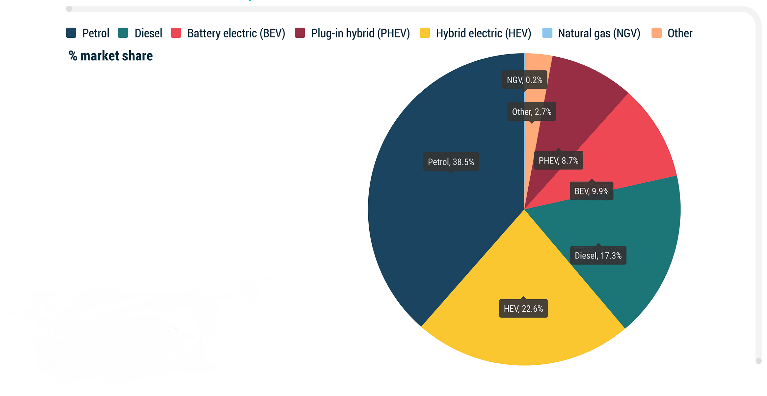




Market shares of vehicles in India

Slide 3
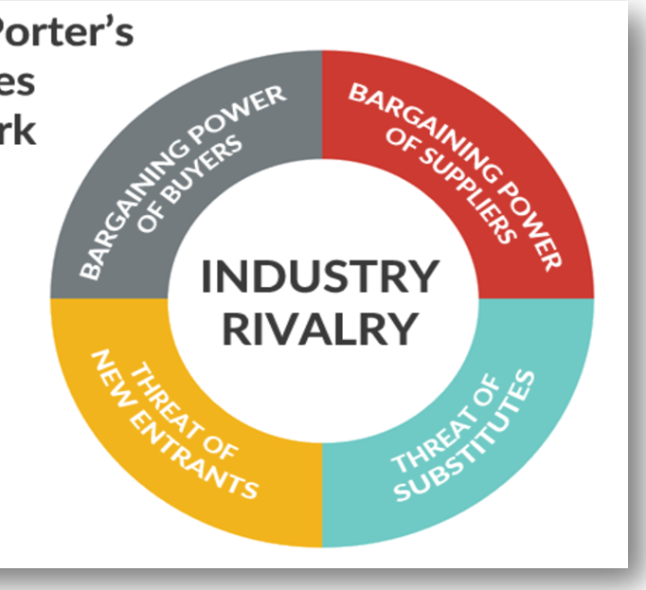
Porters 5 Forces: Automobile Industry
1.Competition in the industry
The cost of Ethanol blended petrol is less than pure petrol.
2.Bargaining power of Buyers
The price of petrol and diesel increases unstably, so customers have no other option to bargain other than going for low-cost fuels.
Surplus availability of raw material.
The cost of an E-vehicle is more.
Government incentives and support.
Ethanol vehicles are less expensive than E-vehicles.
Govt has taken the initiative of making all new vehicles E-20 compatible by 2025.
The availability of petrol and diesel depends on geopolitical situations.

Slide 4
3.Threat of substitute products
One of the main substitutes is E-vehicles because it’s more efficient than other fuels but vehicles are expensive compared to other vehicles.
We don’t have a sufficient amount of CNG for use of all vehicles in India.
Govt is promoting ethanol fuels as a substitute for crude fuels.
4.Bargaining power of suppliers
We have surplus ethanol suppliers.
Extreme weather condition contributes to the rising cost of ethanol.
5.Threats of new entrants
It takes a lot of time to charge EVs and it’s still in R&D.
Hydrogen vehicles are way to expensive for a normal person.
CNG is an imported
From this we can conclude, Flex fuel vehicles are good to enter the Indian market

Slide 5
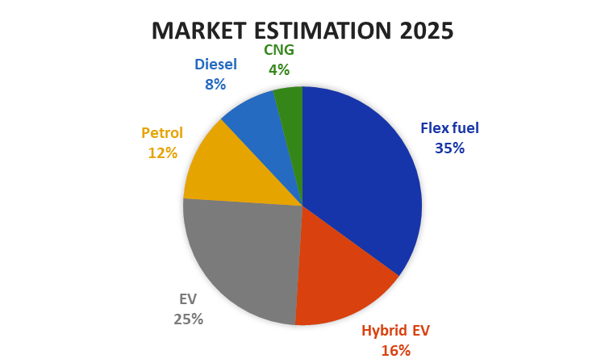
Estimated market share of ethanol
Flex fuel can acquire 80% of the petrol market,
30% can be acquired from the Diesel market (only 30% because mostly heavy vehicles need mileage and flex fuels have 15-25% less mileage than diesel),
we can acquire 10% from hybrid E-vehicles (hybrid vehicles are also good so less taken),
So, we estimate that Ethanol or flex fuel vehicle can acquire 35% of the Indian market by 2025.

Slide 6
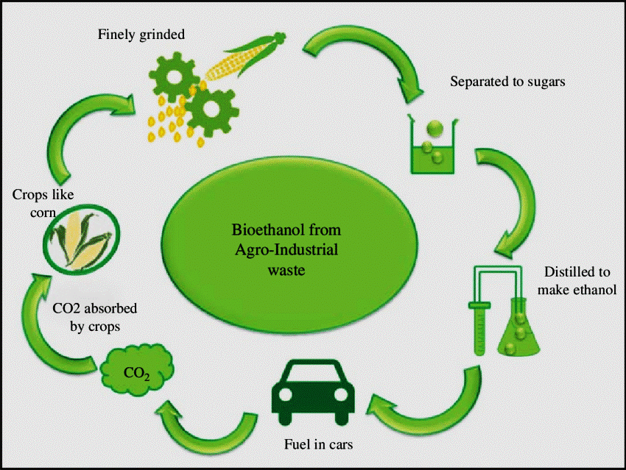
Now, How Ethanol is produced
Mostly ethanol is produced from Sugarcane, maize, cereal, rice, etc.

Slide 7
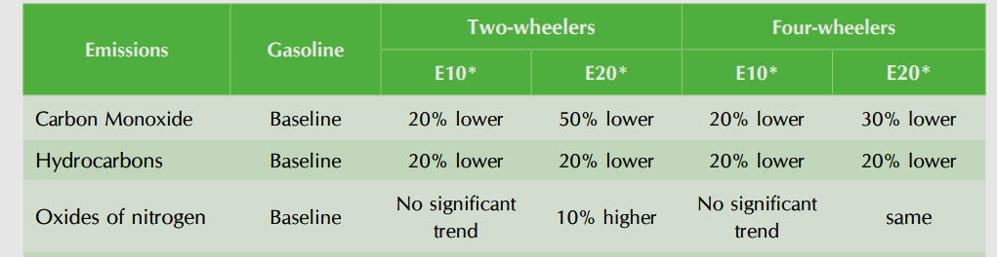
Why Ethanol powered vehicle is good for short term
Import of crude oil will decrease – saves approx. 4 Billion USD per annum. (Athmanirbhar)
We can create ethanol from rice straw, which will stop stubble burning. (stubble burning- the practice of burning rice straw after cultivation)
Flex fuel as a fuel has less cost compared to gasoline or petrol.
Ethanol creates about 35-80% less emissions than petrol, depending on how it’s made and what the actual ethanol content is. petrol produces 2.35 kilograms of carbon dioxide burned.
Greatly benefits farmers of India.
Increased power and performance compared to petrol.

Slide 8
Can ethanol vehicles be an alternative to E-vehicle?
In short term Ethanol would be more feasible, because:
EV: India doesn’t have the proper charging infrastructure.
EV: High cost of EV.
EV: Charging duration is way high and it’s still in development.
EV: At present 68.7% of electricity is produced from coal.
Ethanol: Saves 4 billion USD per annum from foreign imports of crude oil.
Ethanol: At present, will help farmers.
Ethanol: Stops pollution from stubble burning.

Slide 9
Why E-vehicles are future on the Long-term
Now Electric vehicles are just vehicles that run on electric battery and has electric motor instead of combustion engine.
Why EV vehicles are good for the long term?
The availability of fossil fuels is limited, and their use is destroying our planet.
Toxic emissions from petrol and diesel vehicles lead to long-term, adverse effects on public health.
The emissions impact of electric vehicles is much lower than petrol or diesel vehicles.
From an efficiency perspective, electric vehicles can convert around 60% of the electrical energy from the grid to power the wheels, but petrol or diesel cars can only convert 17%-21% of the energy stored in the fuel to the wheels. That is a waste of around 80%.

Slide 10
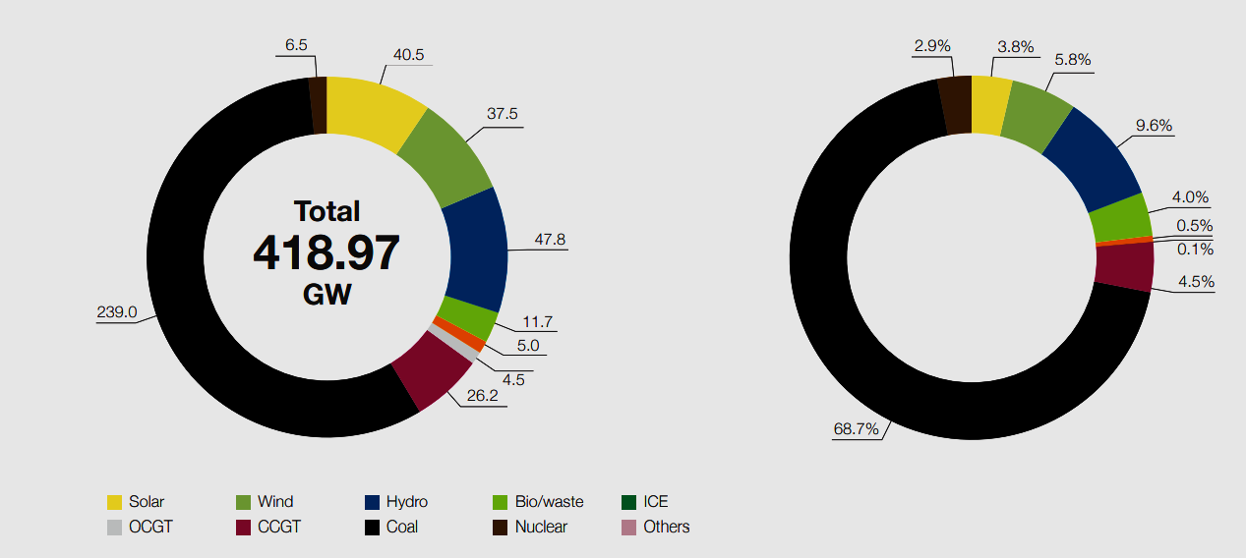
This is the present Electricity production in India

Slide 11
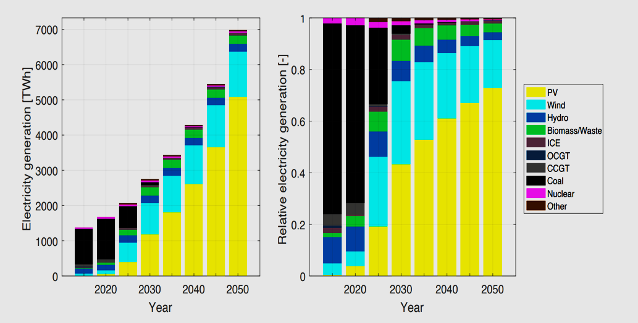
This will be the Future of India
SOLAR

Slide 12
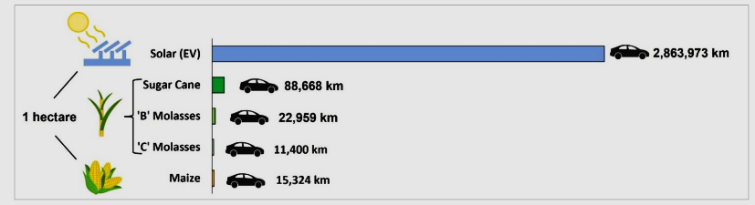
How EV’s can save the Environment
Just one electric car on the roads can save an average of 1.5 million grams of CO2.
Decreases noise pollution.
Use of solar panels to charge EVs at home.
An electric vehicle charged from solar energy generated on one hectare of land can drive 32 times further than an electric vehicle running on ethanol derived from one hectare of sugar cane. The difference is even higher for other feedstocks.
Click here for Experiment Link

Slide 13
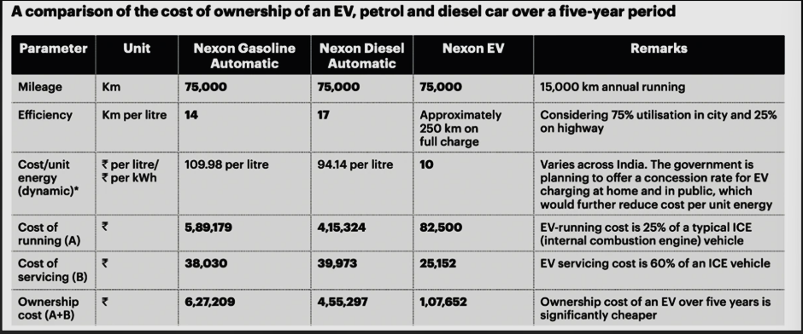
Total cost of ownership of EV
*The total cost of ownership (TCO) is the cost to buy something plus the cost to operate it over its useful life.
*On the other side of the coin, the more km you drive the more cost-efficient EVs to get. ICE vehicles give around 40% efficiency whereas EVs are almost 90% efficient. The range and efficiency of EVs become better as time goes on. So, in the longer term, the ownership cost of an electric vehicle might be less.

Slide 14
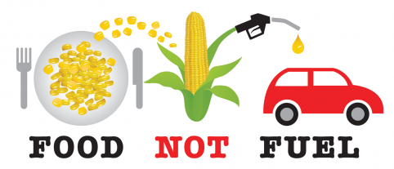
Failure mode analysis of ethanol as a fuel
Ethanol production depends on the weather, so its an unpredictable process.
As ethanol production will need more food crops in its production. It will unstabilize food security in India.
Fuel efficiency from any ethanol-blended petrol is less than that of 'pure' petrol. A vehicle running on pure ethanol will deliver a fuel economy of 30 to 35 percent less than a pure petrol vehicle.
Ethanol has low energy compared to petrol: The Caloric value of ethanol is 7,000 kcal/kg and for petrol, it’s 11,000 kcal/kg.

Slide 15

Should we sacrifice Food, land and water for the comfort of living and transportation//
To achieve 20% blending by 2025 India needs 10 billion litres of ethanol.
The State of Food Security and Nutrition in the World, 2020 report, 189.2 million people are undernourished in India. By this measure, 14% of the population is undernourished in India. Also, 51.4% of women of reproductive age between 15 to 49 years are anaemic.
India slipped six places on Global Hunger Index 2022 to take 107th position out of 121 countries ranked.
Going for a 20 percent blending target would lead to increased sugarcane, rice, and maize cultivation, which in turn will use more arable land and groundwater. Which leads to low food security and the poor will become poorer.

Slide 16
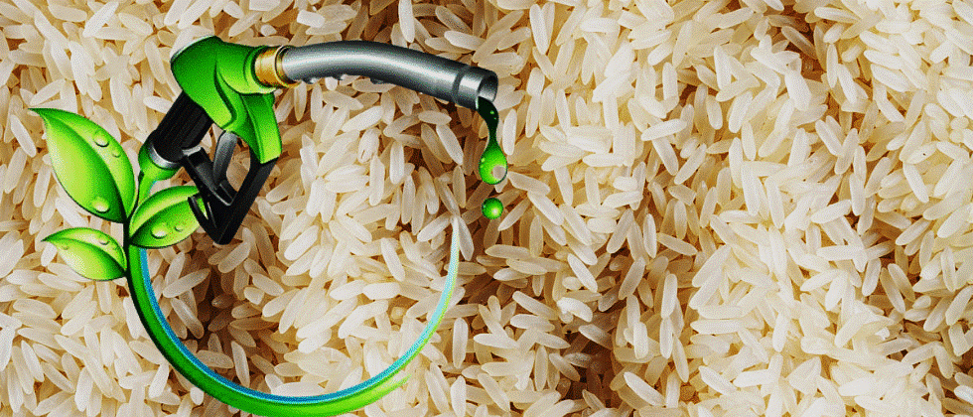
You need way more water for making Ethanol from Rice
It requires 4000 Litres of water to produce 1 kg of rice.
The water requirement of rice is higher than any other crop.
The FCI had before used a 3-lakh tonne of rice from its godown.
Now the point is it would take approx. 120000Cr liters of water just to make that 3-lakh tonne of rice.
Also, you might have heard of stubble burning(i.e., burning rice straw)
Stubble burning is an important contributor to air pollution. And because it’s a seasonal problem, it can cause air pollution.
(paddy residue is not used for fodder)

Slide 17
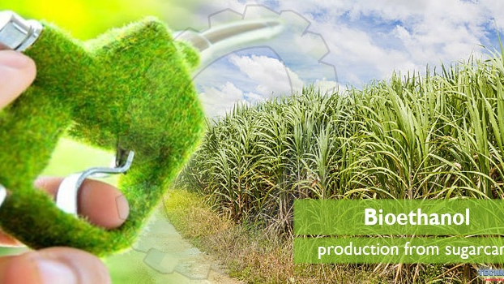
Ethanol from sugarcane requires a lot of water
For the year 2020-22 it was projected 8.5% of ethanol to be mixed with petrol.
Also for year 2025 it was projected it would require 10 Billion
Litres of ethanol.(90% is made from sugarcane)
(From 1 tonne sugar cane = 127 litres ethanol)
According to waterfootprint.org It takes about 210 litres of water to produce 1 kg of sugar cane.
For making 9 Billion litres of ethanol we can say that approx. 15,000 Billion litres of water is needed just to cultivate sugarcane.
Which is like Three per cent of drinkable water in India.

Slide 18
So, we conclude from all the slides above,
It’s better to go for ethanol or flex-fuel vehicles for short-term (10-20) Years.
#Because of all the food security, soil erosion, depleting groundwater, and low efficiency compared to solar.
And while reaching 2050 we will have all the infrastructure and energy capacity(Renewable) for the large Indian EV market.

Slide 19
Thank you bearing

Slide 20

Challenges
Time management.
Understanding case study frameworks.
Gathering all information.

