Slide 1
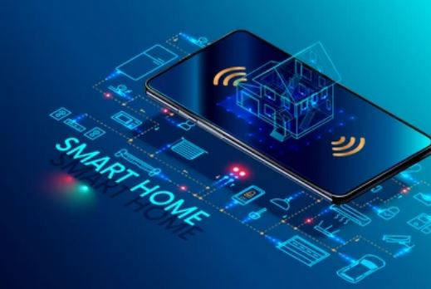
COMPUTER NETWORK
SMART SECURITY SYTEM
-Amitha Sanka(368)
-Lalita Lochana GB(366)
-Shamrina Karimun Abdul(367)
-Arvind Anoop(374)

Slide 2
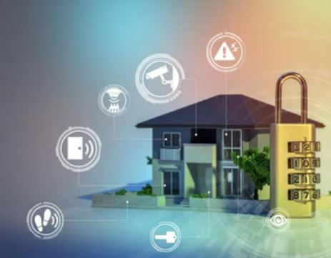
ABSTRACT
This report describes the network design of smart security system.
In this network topology the home gateway, door, webcam, smart phone ,motion detector , siren alarm are the devices that are connected in wireless media.
Establishing a system which is aimed at providing safety and reduce exposure to common hazards and alert as soon as they occur
We have used Cisco Packet Tracer for designing the network topology. It’s general design which can be implemented at any higher level to provide secured system.

Slide 3
NETWORK REQUIREMENTS
In Smart Security Network topology, we have Home Gateway, Motion Detector, Door, Webcam, Siren alarm and smart phone. There is a data flow between the devices within the home system. Our network requirements include End devices and Wireless devices.
To control this smart object and motion detector and Home Gateway used, since it provide programming environment for controlling smart object connected to it and provide controlling mechanisms by registering smart device to Home Gateway respectively .

Slide 4
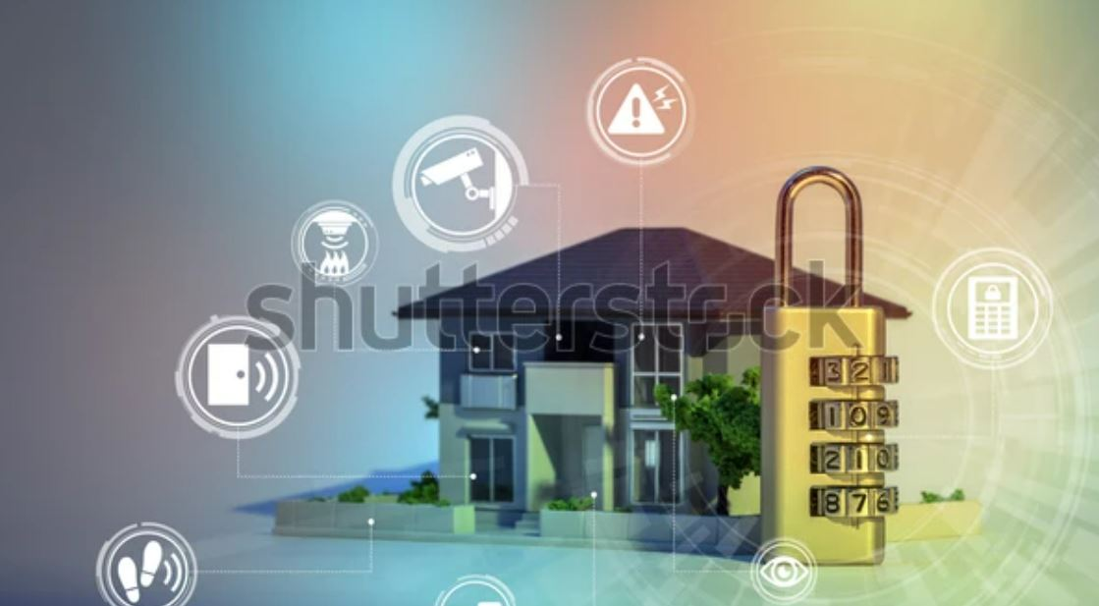
IMPLEMENTATION
Home Gateway have 4 Ethernet ports in addition to a wireless access point configured with the "Home Gateway" SSID (see fig 2).To secure wireless connection WEP / WPA-PSK / WPA2 enterprise can be configured on home gateway. T
The Home Gateway internal (LAN) IP address is 192.168.25.1 but it can also be accessed through its Internet facing IP address
Home gateway also works as DHCP server by assigning IP address to each smart device that connected to it.

Slide 5
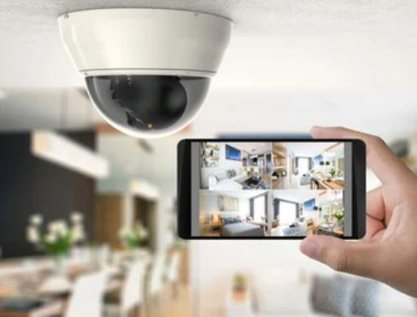
Security Actions Performed
When a person appears in front of the door. Motion detector is switched on and then webcam and siren are set to action
When no person appears in front of the door the motion detector is not switched on also the webcam and siren are put switched off

Slide 6
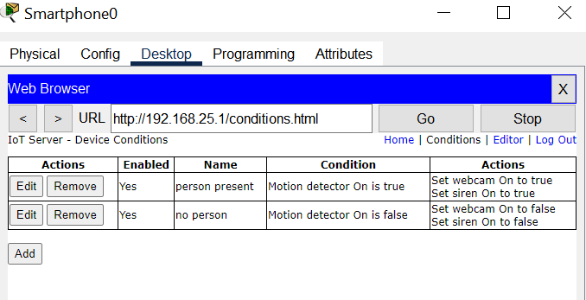
SECURITY ACTIONS PERFORMED

Slide 7
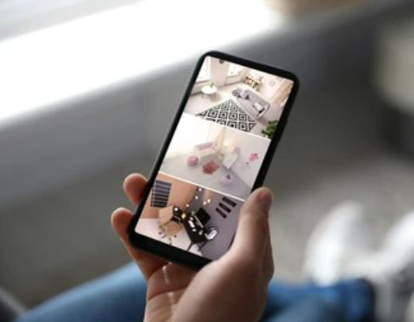
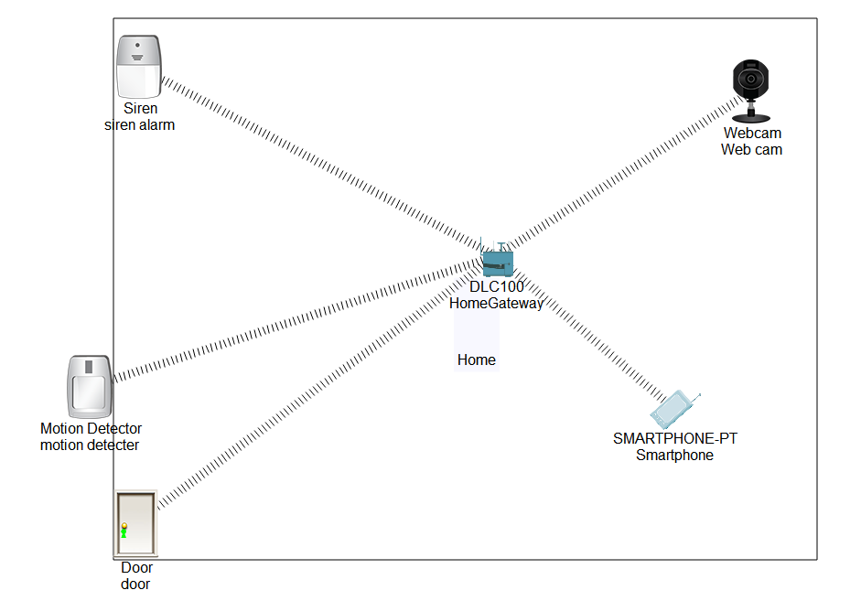
ARCHITECTURE/DESIGN

Slide 8
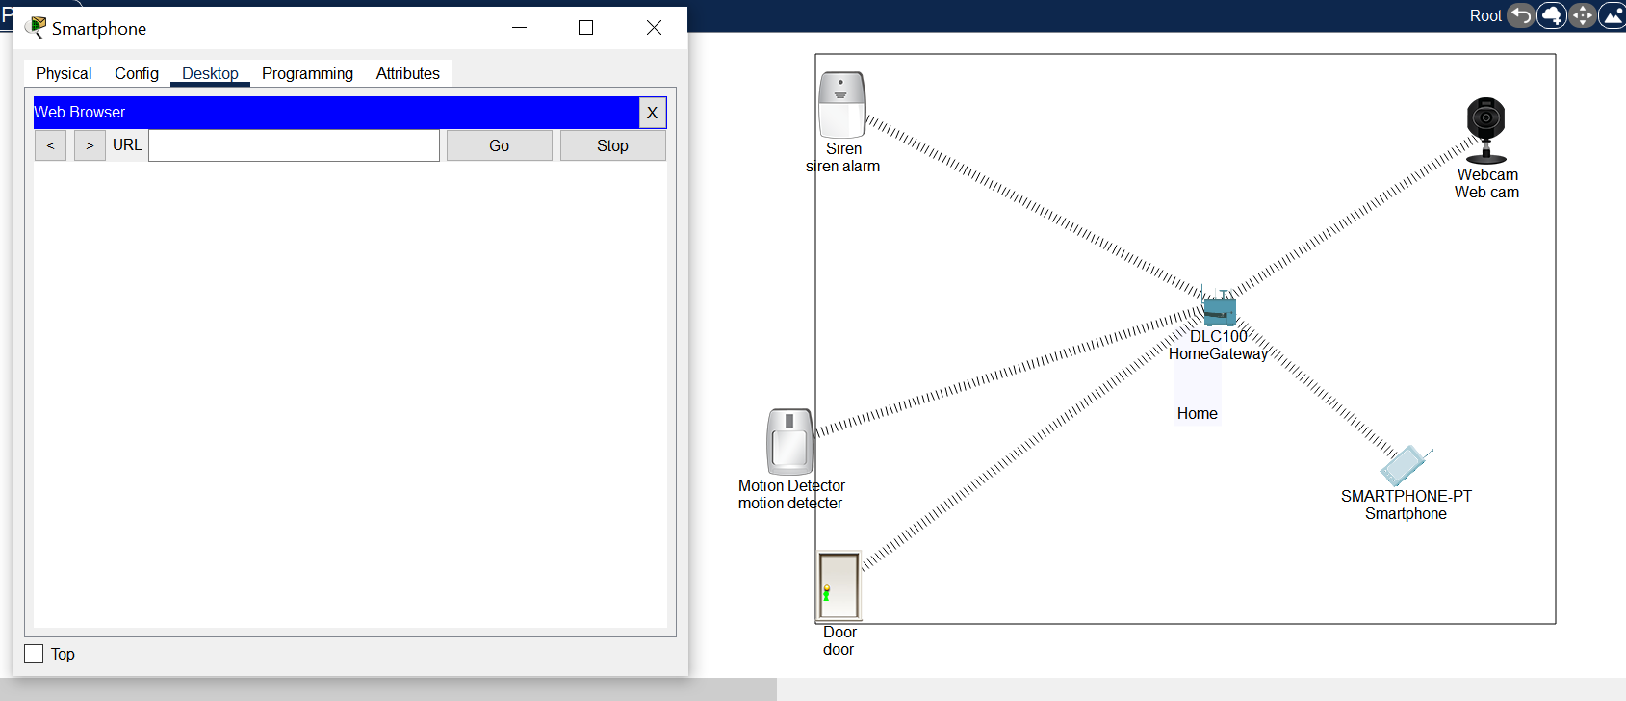
DEMONSTRATION

Slide 9
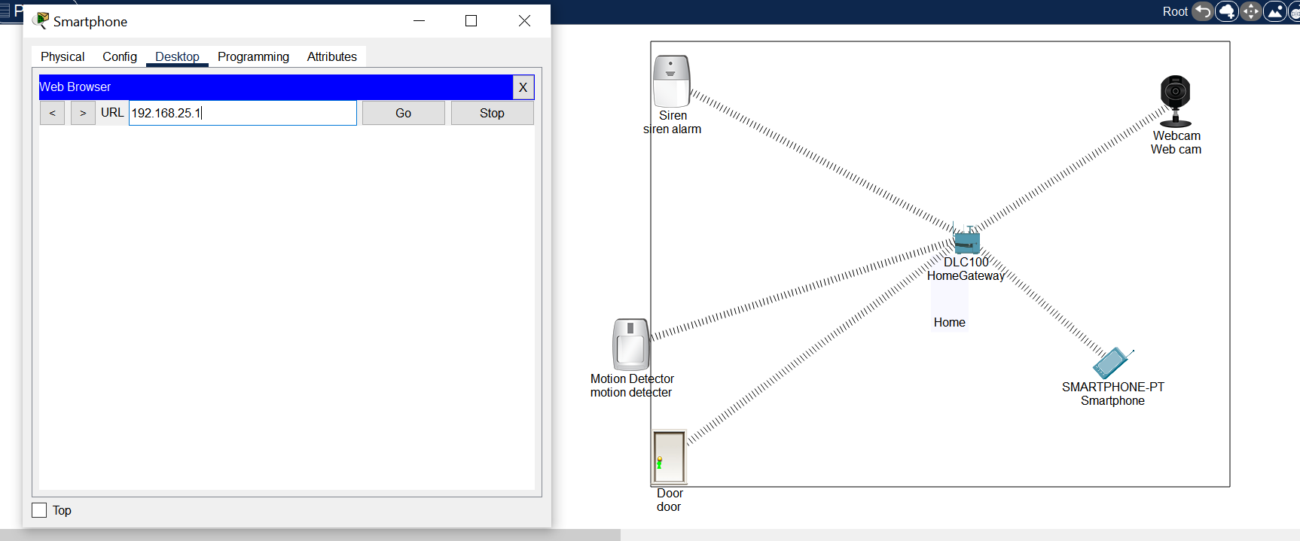
DEMONSTRATION

Slide 10
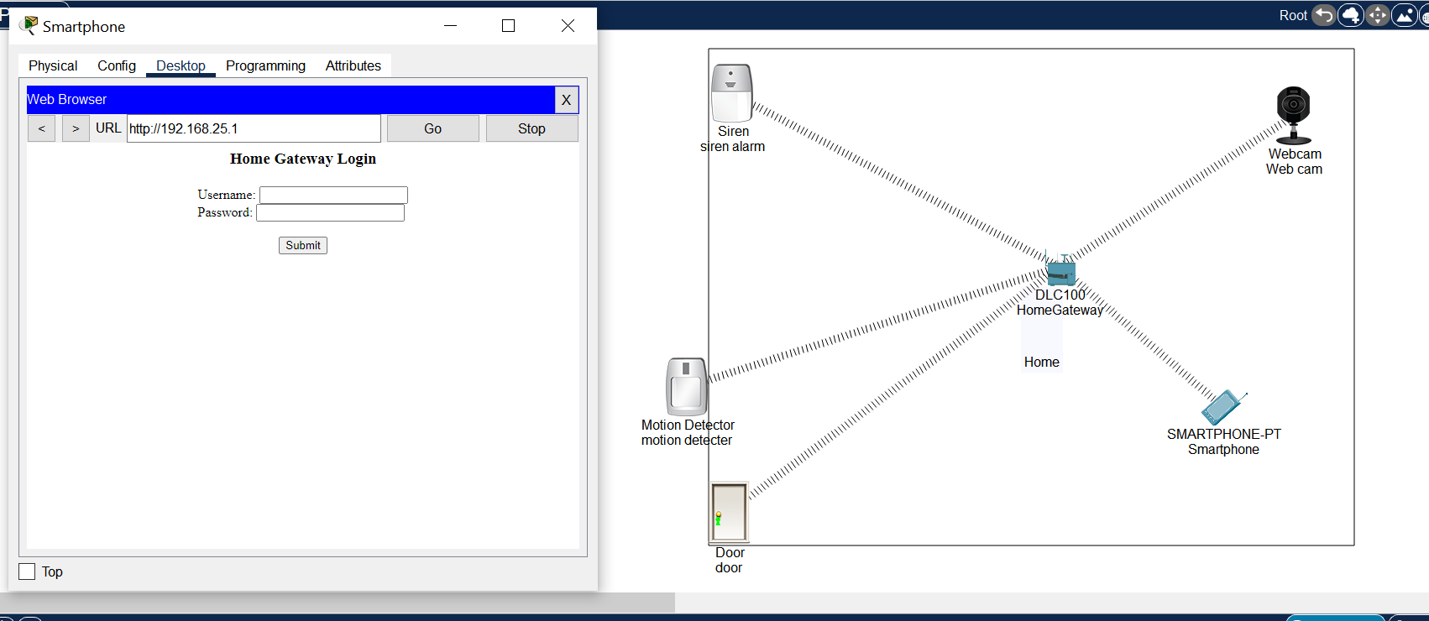
DEMONSTRATION

Slide 11
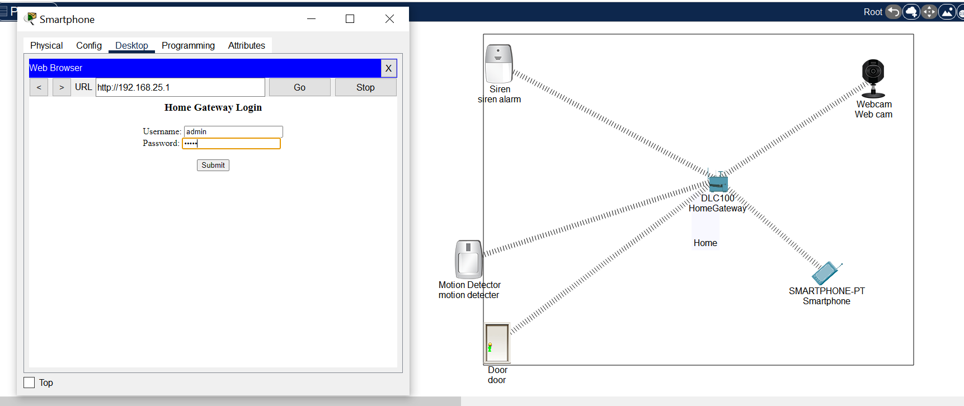
DEMONSTRATION

Slide 12
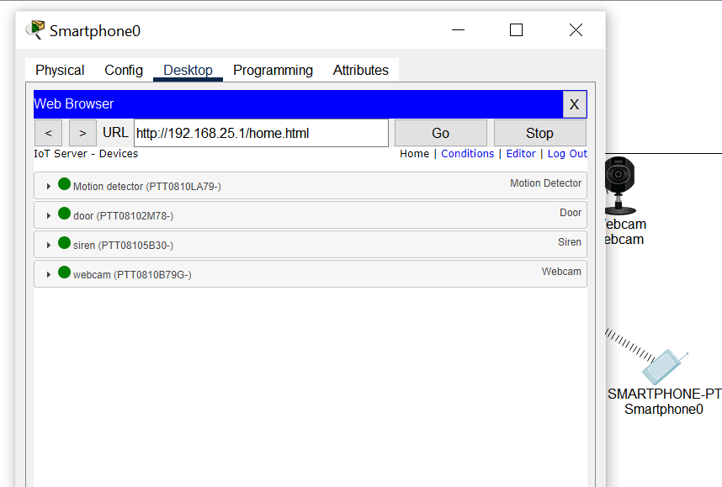
DEMONSTRATION

Slide 13
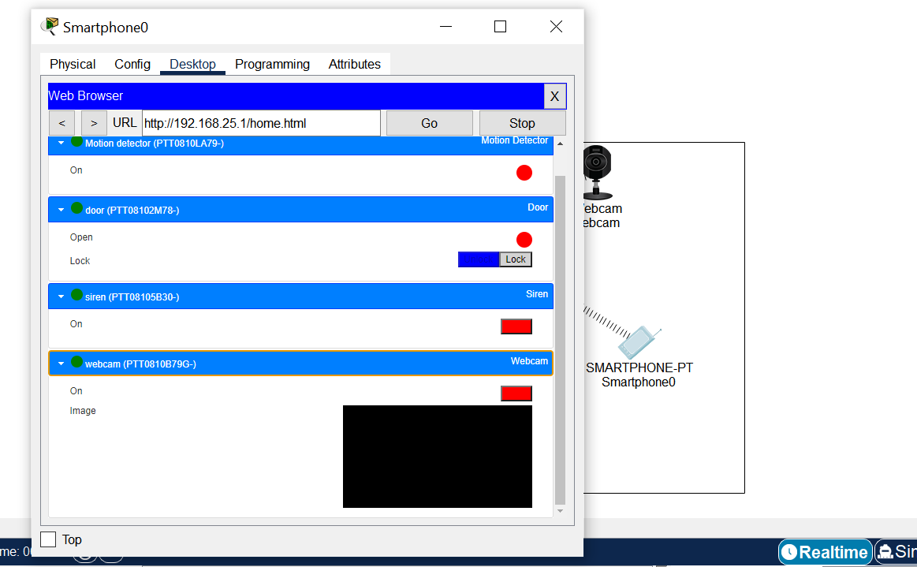
DEMONSTRATION

Slide 14
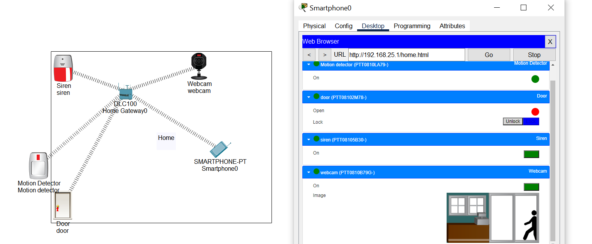
DEMONSTRATION

Slide 15
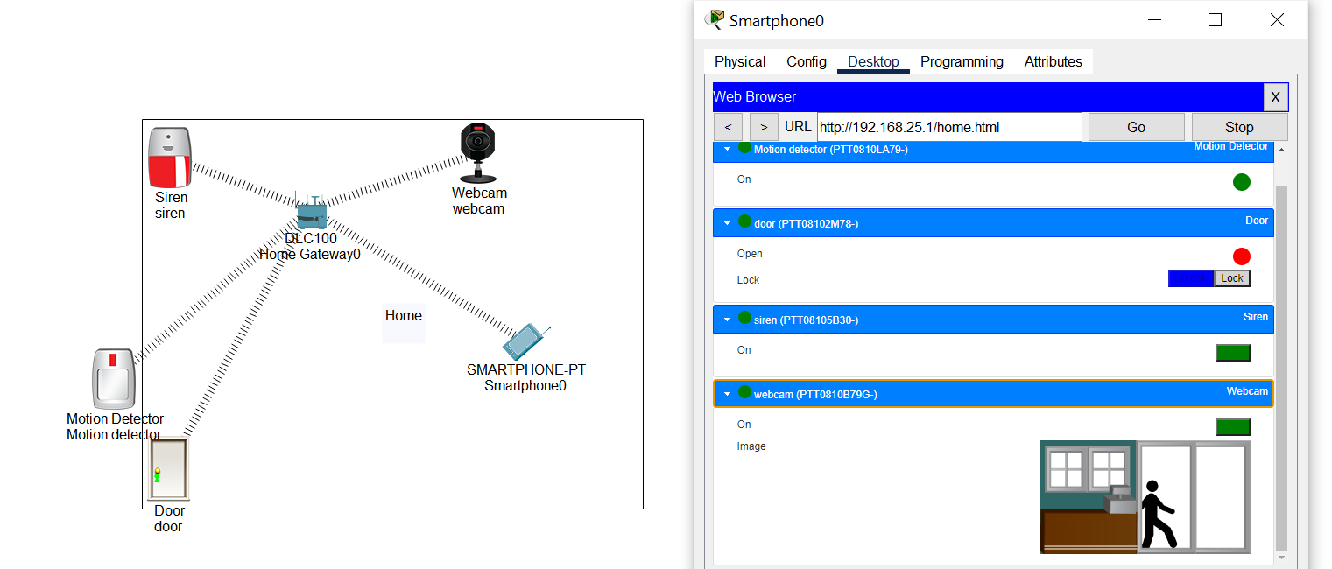
DEMONSTRATION

Slide 16
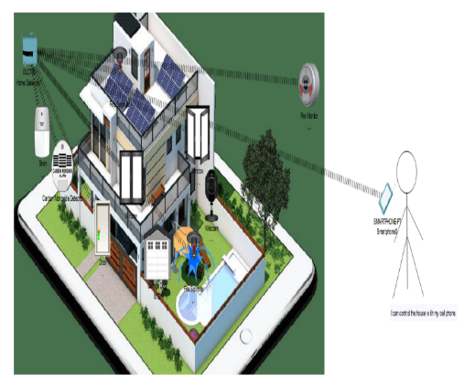
CONCLUSION
Hence, the smart security is constructed successfully using cisco packet tracer, where you can identify who tries to enter your restricted area and gives you the flexibility to have the control of permitting them in or out.

Slide 17
REFERENCES
Internet Sources:
https://www.studocu.com/en-gb/document/kingston-university/network-security/smart-home-using-cisco-packet-tracer/14467719
https://www.researchgate.net/publication/337801367_Smart_Home_Security_Based_on_Smart_phone_Using_Cisco_Packet_Tracer_72
https://www.ijesird.com/jan2.PDF
http://troindia.in/journal/ijcesr/vol5iss2part7/8-12.pdf

Slide 18
THANK YOU

