Slide 1
What Is Cross-Validation?

Slide 2
Cross validation is a technique meant to assess how well a machine learning model performs on an independent data set.
Through cross-validation we estimate the prediction accuracy of our model on other data than those used for fitting the model (also called first seen data).

Slide 3
A good machine learning model is stable, i.e. it has a satisfactory prediction accuracy on any data set.
To evaluate the model stability we use cross-validation.

Slide 4
Cross-validation approaches in machine learning:
validation set approach
leave-one-out cross-validation (LOOCV)
k-fold cross-validation

Slide 5
Validation Set Approach

Slide 6
The validation set approach (or two-fold cross-validation) consists of randomly splitting the original data set into two sets: a training set and test set (or validation set).
The training set is used to fit the model and the test set is used to estimate the model prediction accuracy.

Slide 7
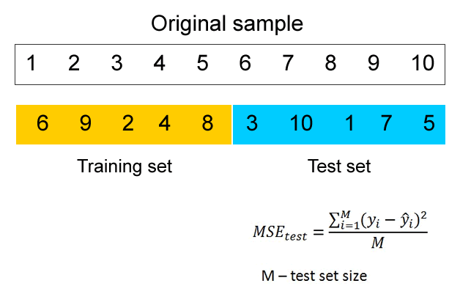

Slide 8
Drawbacks of the validation set approach:
Since the training set is smaller that the total sample, there is a risk of under-fitting in this set (the training set error could be larger, i.e. the model bias could be high).
The test set error could depend a good deal on the data included in the test set. If we change the test set (i.e. select different sample observations for this set), the new test set error may be very different.

Slide 9
Leave-One-Out Cross-Validation (LOOCV)

Slide 10
The leave-one-out cross-validation approach uses only one observation in the sample as the test set and fits the model on the other observations.
So if the sample size is N, the training set will have N-1 observations and the test set one observation only.

Slide 11
The model is fitted a number of times equal to the sample size. Each time, a different observation will form the test set. A test set error is computed for this observation.
The overall test error is computed as an average of the test errors of the individual observations.

Slide 12
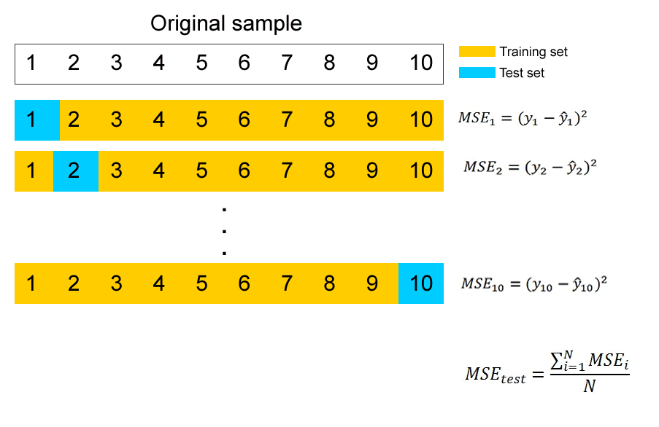

Slide 13
Advantages of LOOCV:
reduced bias
the test set error is always the same
Disadvantage:
time consuming to implement

Slide 14
K-Fold Cross-Validation

Slide 15
The k-fold cross-validation approach consists of randomly splitting the original sample in k subsamples of approximately equal sizes.
One of the subsamples is retained as the test set, while the model is fitted on the remaining k-1 subsamples. So the model is fitted k times in total.

Slide 16
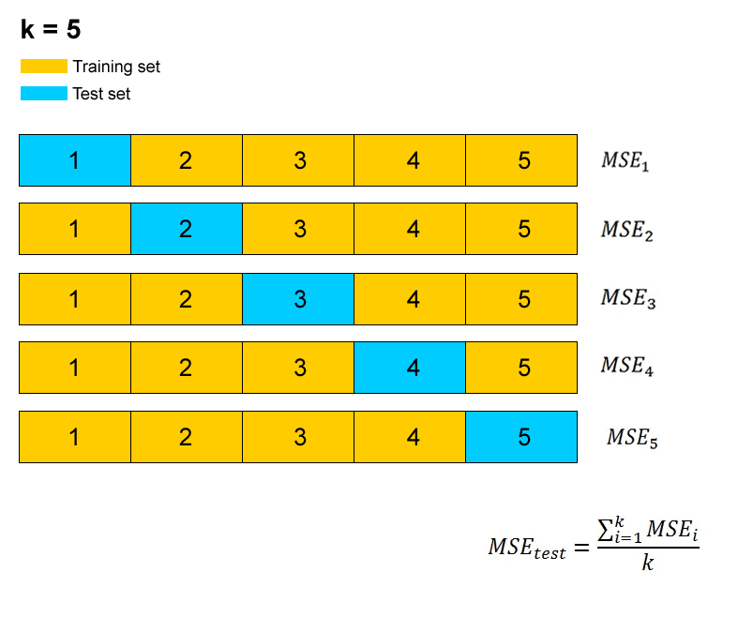

Slide 17
The k-fold cross-validation approach is popular because it is less computationally intensive than the leave-one-out approach.
It is particularly useful when we fit a model that contains parameters and want to adjust or “fine tune” the value of these parameters. The optimal value of a parameter is the value that gets the highest prediction accuracy in the test set.

Slide 18
Procedure to find out the optimal value of a model parameter:
define a range of (discrete) values for the parameter
perform the k-fold cross-validation using each value in the range
estimate the prediction accuracy in the test set for each value (using either the MSE or the percentage of correct classifications)
identify the value that corresponds to the best prediction accuracy (smallest MSE or greatest percentage of correct classifications).

