Slide 1
What Is Machine Learning?

Slide 2
Machine learning is a science that enables computer applications to learn without being explicitly programmed.
In principle, machine learning develops models or algorithms that can predict an output value with an acceptable error margin, based on a set of known input values. To build these models, advanced statistical analysis techniques are employed.

Slide 3
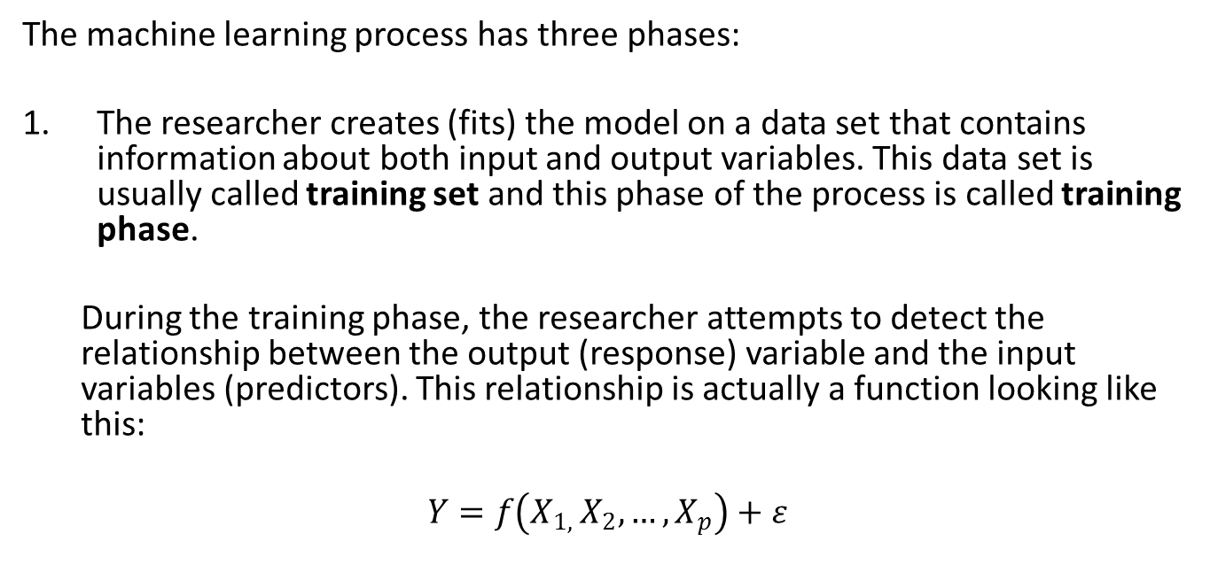
The machine learning process has three phases:
The researcher creates (fits) the model on a data set that contains information about both input and output variables. This data set is usually called training set and this phase of the process is called training phase.
During the training phase, the researcher attempts to detect the relationship between the output (response) variable and the input variables (predictors). This relationship is actually a function looking like this:
$$Y=f\left(X_{1, }X_{2},…,X_{p}\right)+ε$$

Slide 4
After training the model, the researcher tests it on another data set, called test set or sometimes validation set. The test set also contains information about both input and output variables. In this phase, the estimation error in the test set is computed.
In the validation phase several alternative models can be compared, to establish which of them has the smallest prediction error on the test set. Moreover, in this phase we can fine tune (adjust) some model parameters through cross-validation.

Slide 5
Finally, the validated model is applied on new data. These data contain information about the input variables only (not the output). In this phase we actually use our model to predict unknown output values. To assess the quality of our model, we have to wait until the output values become known.
As soon as this happens, we can add the new data to our training set and re-train our model. So machine learning is an iterative process.

Slide 6
Supervised vs. Unsupervised Learning

Slide 7
The machine learning techniques can be divided into two main groups:
supervised learning techniques
unsupervised learning techniques

Slide 8
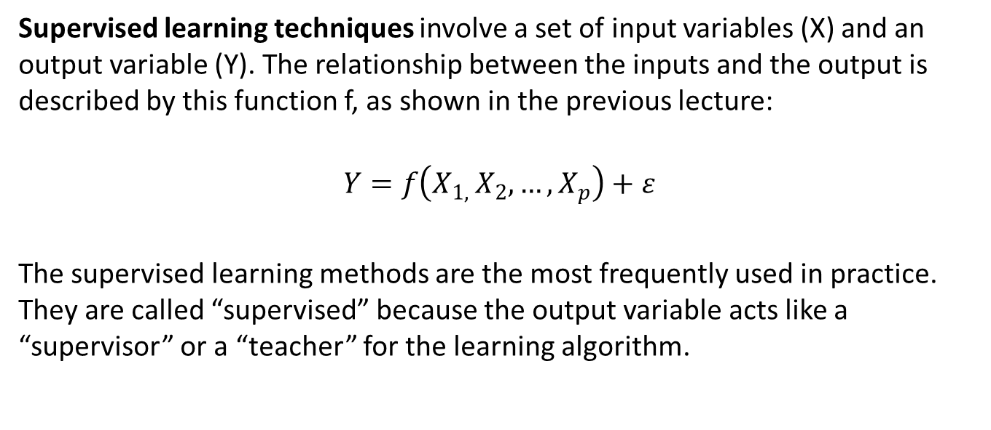
Supervised learning techniques involve a set of input variables (X) and an output variable (Y). The relationship between the inputs and the output is described by this function f, as shown in the previous lecture:
$$Y=f\left(X_{1, }X_{2},…,X_{p}\right)+ε$$
The supervised learning methods are the most frequently used in practice. They are called “supervised” because the output variable acts like a “supervisor” or a “teacher” for the learning algorithm.

Slide 9
Supervised Learning Methods
OLS regression
subset selection regression
penalized regression
PLS regression
logistic regression
penalized logistic regression
discriminant analysis (linear and quadratic)
naïve Bayes estimation
K nearest neighbor
support vector machine
decision trees
neural networks

Slide 10
Unsupervised learning is about finding hidden structures and patterns in our data.
The unsupervised learning techniques do not involve an output variable. So it is impossible to compute the estimation error, or the prediction accuracy. In consequence, we don’t have a way to validate our solution.

Slide 11
Unsupervised Learning Methods
factor analysis
cluster analysis (hierarchical and k-means)

Slide 12
Prediction vs. Inference

Slide 13
Most of the times, the supervised machine learning techniques are used to predict the values of the response variable Y based on the values of the independent variables (X₁, X₂, …, X_{p}).
When we have a new set of values for the predictors, we will be able to forecast the output variable knowing these values.

Slide 14
Examples:
predict the agricultural production based on factors like air temperature, precipitations, soil capacity and quantity of fertilizer
estimate the probability that a patient has a heart attack based on information like gender, age, weight, whether they smoke, whether they drink alcohol etc.

Slide 15
If prediction is our single goal, we are not very interested in the shape of the function f. All we want is to obtain accurate estimates for the output variable Y.
The models used for prediction only can be “black box” type models.

Slide 16
In many situations we are interested in measuring the effect of one or more particular predictors on the response variable.
In other words, we want to use our supervised model for inference.

Slide 17
For example…
How does the response variable behaves when a certain predictor value changes? For example, would the agricultural production grow if we increased the quantity of fertilizer? Is the probability of getting a heart attack higher for smokers?
Which are the most important predictors? What is the most important factor that influences the agricultural production? What is the most significant predictor of a (possible) future heart attack?

Slide 18
If we want to use our model for inference, we must know the shape of the function f (the nature of relationship between the inputs and the outputs).

Slide 19
Machine learning techniques listed that can be used for prediction only (“black box”):
discriminant analysis
naïve Bayes estimation
k nearest neighbor
support vector machine
decision trees
neural networks

Slide 20
Machine learning techniques listed that can be used for both prediction and inference:
regression analysis (OLS, best subset, penalized, PLS)
logistic regression
penalized logistic regression

Slide 21
Restrictive Models vs. Flexible Models

Slide 22
Some supervised machine learning methods are pretty restrictive, i.e. they allow a limited number of shapes for the function f. Examples:
linear regression
logistic regression

Slide 23
Other machine learning techniques are more flexible, allowing many possible shapes for the function f. Examples:
support vector machine
random forests
neural networks

Slide 24
Flexible models tend to have better prediction accuracy than restrictive models.
Despite that, in many cases we may prefer a restrictive model.

Slide 25
The restrictive models are easier to understand and interpret. This is very important especially when we have to do inference.
If we use our model to make predictions only, the interpretability is not of big interest. Therefore, we can select a flexible model if it ensures a high prediction accuracy.

Slide 26
Often times, restrictive models have better prediction accuracy on new data. A flexible model can perform greatly in the data set it was created on; however, when we apply the same model on new data, the predictive accuracy could be modest.
On the other hand, restrictive models can have a good predictive accuracy in new data sets.

Slide 27
Computing Prediction Accuracy Regression Models

Slide 28
Depending on the nature of the response variable, machine learning models can be divided into two groups:
regression models, where the response variable is numeric (quantitative) – e.g., agricultural production, stock price, number of violent crimes etc.
classification models, where the response variable is categorical (qualitative) – e.g., buys/does not buy the product, will get/will not get a heart attack etc.

Slide 29
The regression models we’ll study in this course:
OLS regression
best subset selection regression
penalized regression
PLS regression
regression trees

Slide 30
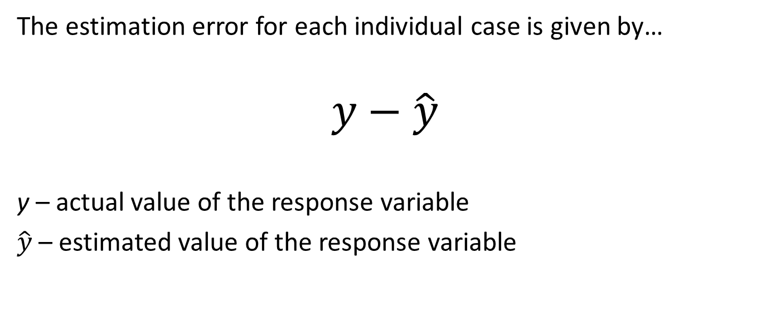
The estimation error for each individual case is given by…
$$y−\hat{y}$$
y – actual value of the response variable
$\hat{y}$ – estimated value of the response variable

Slide 31
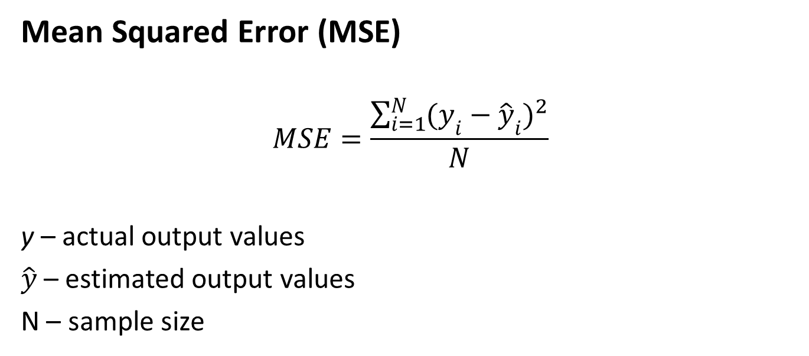
Mean Squared Error (MSE)
$$MSE=\frac{\sum_{i=1}^{N}{{(y_{i}−{\hat{y}}_{i})}^{2}}}{N}$$
y – actual output values
$\hat{y}$ – estimated output values
N – sample size

Slide 32
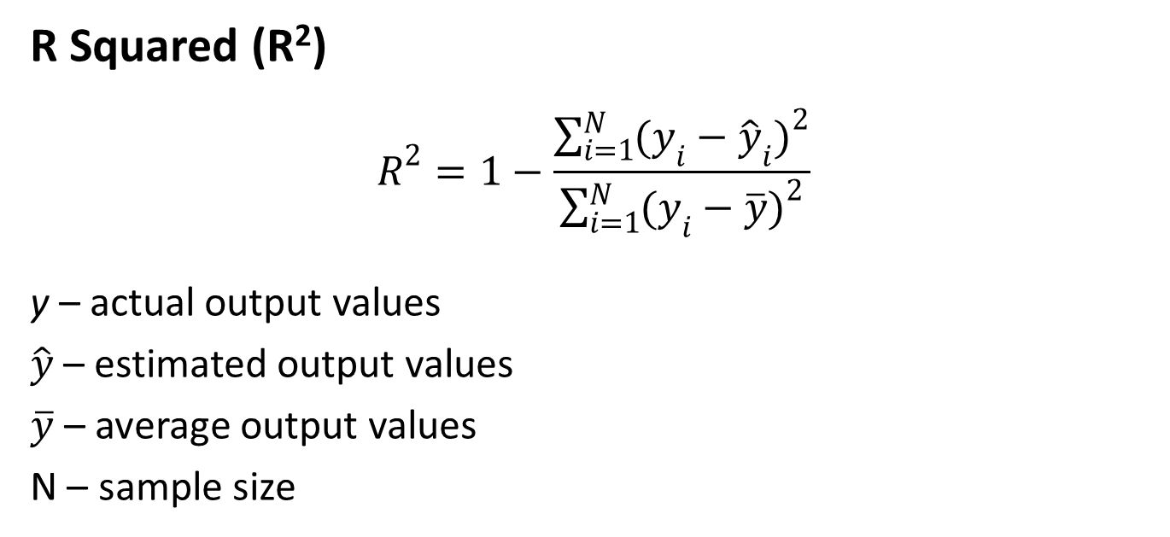
R Squared (R²)
$$R^{2}=1−\frac{\sum_{i=1}^{N}{{(y_{i}−{\hat{y}}_{i})}^{2}}}{\sum_{i=1}^{N}{{(y_{i}−\overline{y})}^{2}}}$$
y – actual output values
$\hat{y}$ – estimated output values
$\overline{y}$ – average output values
N – sample size

Slide 33
R squared indicator is comprised between and 1.
Example of interpretation: if R squared is equal to 0.80, 80% of the variation in the response variable is determined by the predictors.

Slide 34

Adjusted R Squared
$$R_{adj}^{2}=1−\frac{(1−R^{2})(N−1)}{N−p−1}$$
N – sample size
p – number of predictors

Slide 35
Computing Prediction Accuracy Classification Models

Slide 36
Depending on the nature of the response variable, machine learning models can be divided into two groups:
regression models, where the response variable is numeric (quantitative) – e.g., agricultural production, stock price, number of violent crimes etc.
classification models, where the response variable is categorical (qualitative) – e.g., buys/does not buy the product, will get/will not get a heart attack etc.

Slide 37
Classification models are more common in practice than regression models, because the output variable is most of the times related either to…
a decision (option) – buy a product or not, subscribe to a newsletter or not, take a medicine or not etc.
a possibility – getting an illness, getting bankrupt, failing (or taking) an exam etc.

Slide 38
The classification techniques we’ll study in this course:
logistic regression
discriminant analysis
naïve Bayes estimation
K nearest neighbor
support vector machine
classification trees
neural networks

Slide 39
The prediction accuracy of a classification model is given by the percentage of the correctly classified cases.
To compute this percentage, we can use a tool called classification table or confusion table (or confusion matrix).

Slide 40
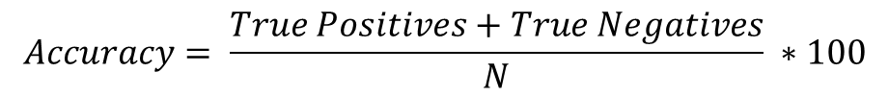
Real values Predicted values | Yes | No
Yes | True Positives | False Positives
No | False Negatives | True Negatives
$$Accuracy= \frac{True Positives+True Negatives}{N} ∗100$$
N - sample size

Slide 41
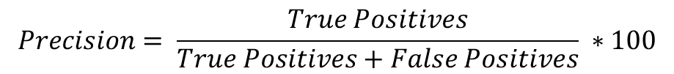
Real values Predicted values | Yes | No
Yes | True Positives | False Positives
No | False Negatives | True Negatives
$$Precision= \frac{True Positives}{True Positives+False Positives} ∗100$$

Slide 42
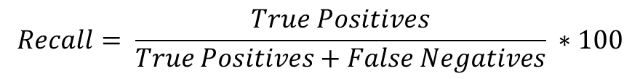
Real values Predicted values | Yes | No
Yes | True Positives | False Positives
No | False Negatives | True Negatives
$$Recall= \frac{True Positives}{True Positives+False Negatives} ∗100$$

Slide 43
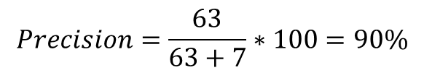
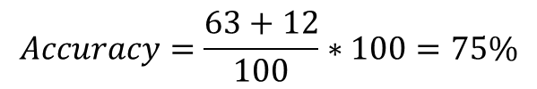
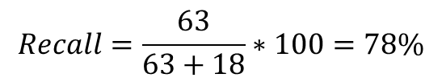
Real values Predicted values | Buy | Does not buy | Total
Buy | 63 | 7 | 70
Does not buy | 18 | 12 | 30
Total | 81 | 19 | 100
$$Accuracy=\frac{63+12}{100}∗100=75\%$$
$$Precision=\frac{63}{63+7}∗100=90\%$$
$$Recall=\frac{63}{63+18}∗100=78\%$$

Slide 44
Bias-Variance Tradeoff

Slide 45
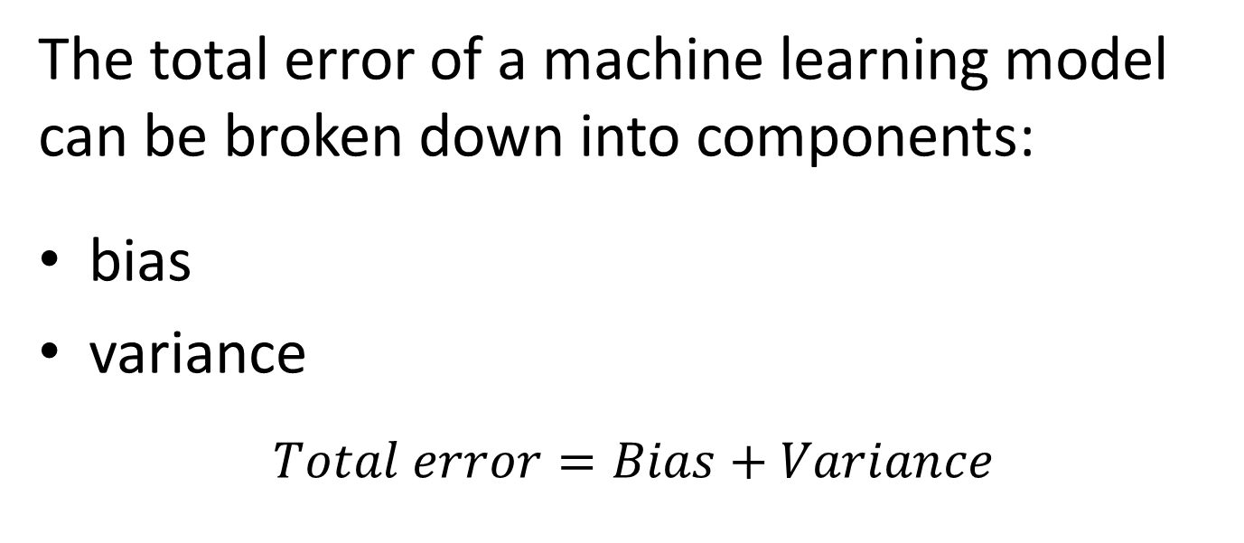
The total error of a machine learning model can be broken down into components:
bias
variance
$$Total error=Bias+Variance$$

Slide 46
Bias represents the difference between the actual values of the response variable and the estimated values, computed using the model function f.
Variance represents the modifications suffered by the function f when we build the model on a different data set.

Slide 47
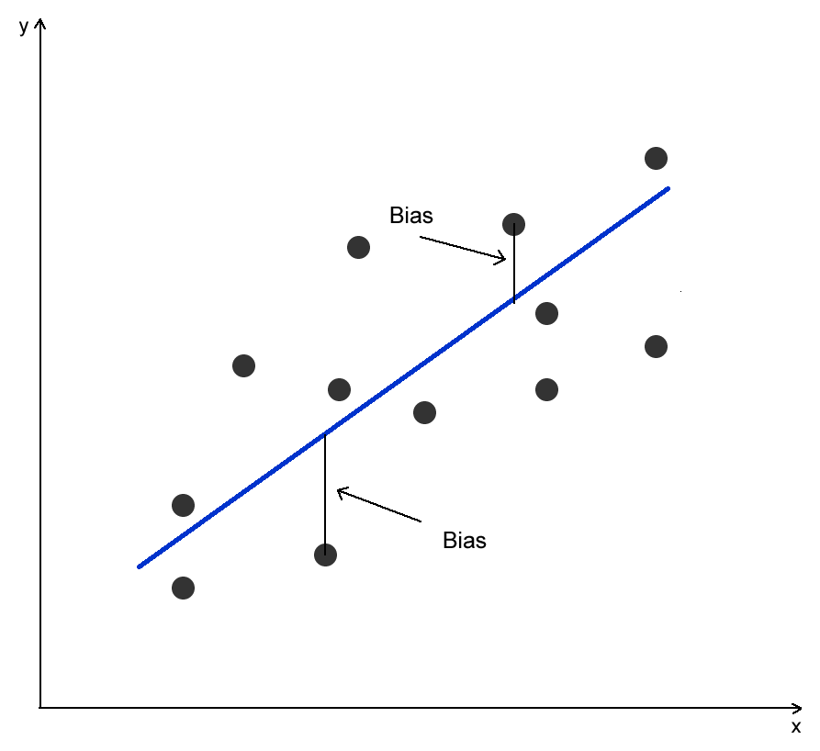

Slide 48
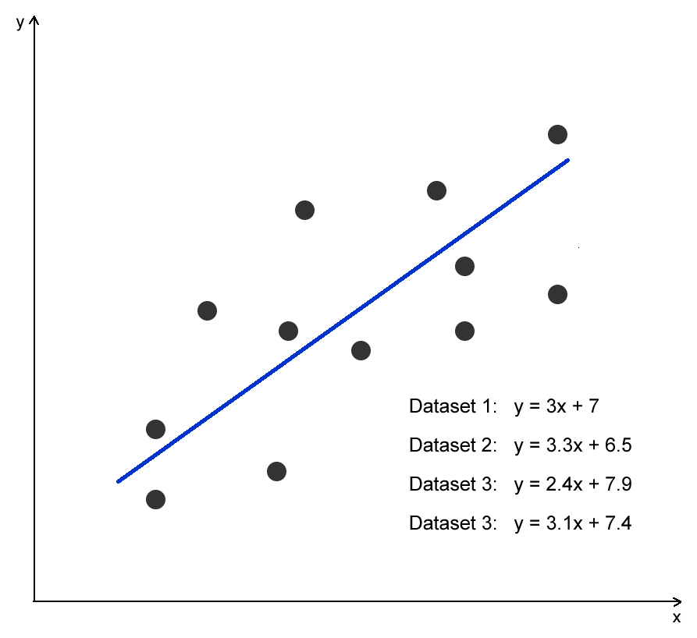

Slide 49
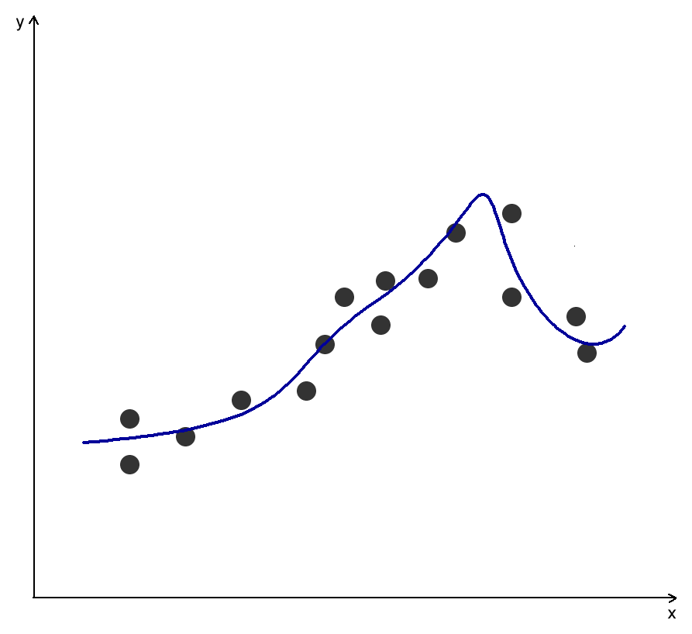

Slide 50
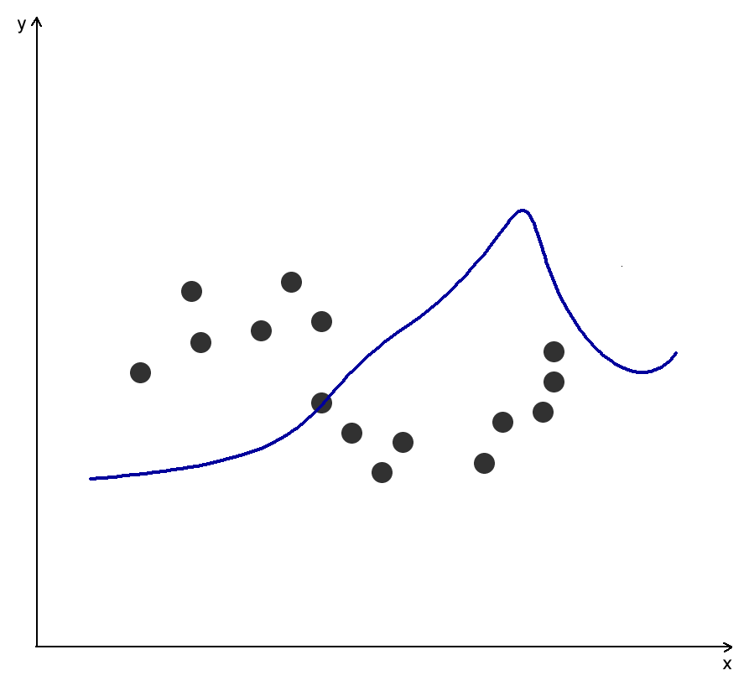

Slide 51
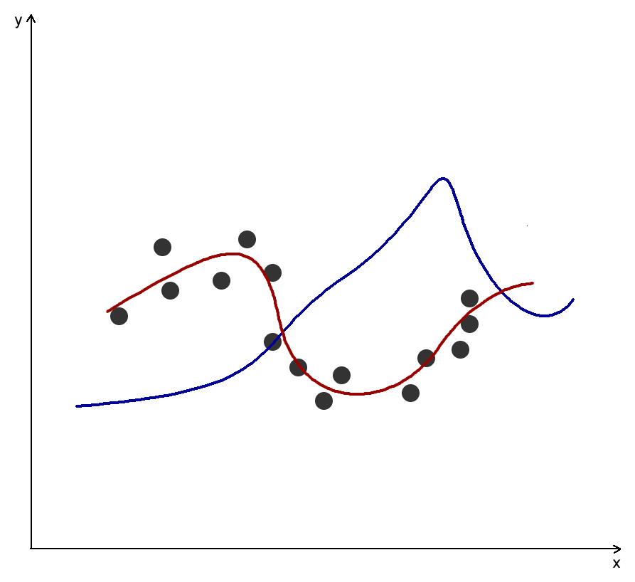

Slide 52
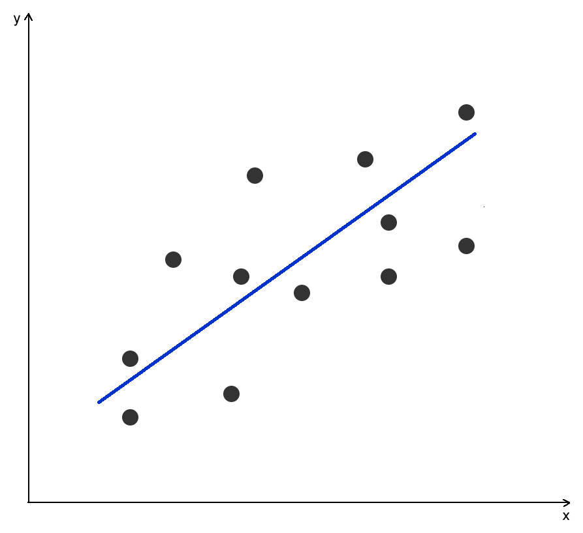
Restrictive model (linear)
High bias
Low variance
Flexible model (non-linear)
Low bias
High variance

Slide 53
Choosing the right machine learning model is about making a trade-off between bias and variance.

Slide 54
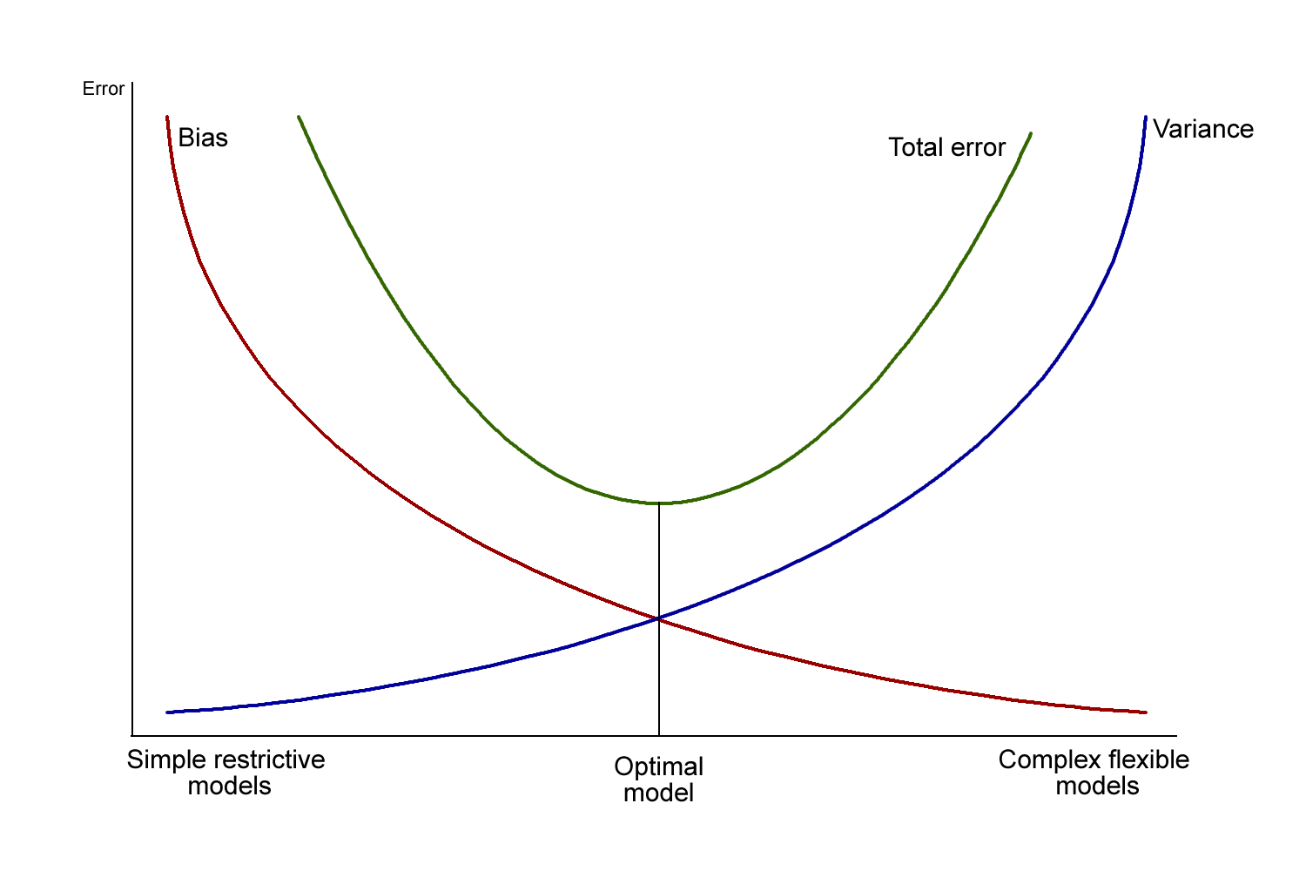
Bias-Variance Tradeoff

Slide 55
Practical procedure:
develop several alternative models in the training set
estimate the prediction accuracy of each model in the test set
choose the model that has the best accuracy in the test set

