Slide 1
Penalized Regression (1) Ridge Regression

Slide 2
The penalized regression techniques use all the predictors in the model, but introduce a penalty that constrains (or regularize) the regression coefficients. Some of the coefficients are forced to shrink (decrease towards zero).
The penalized techniques are also called shrinkage techniques.

Slide 3
Most popular penalized regression methods:
ridge regression
lasso

Slide 4
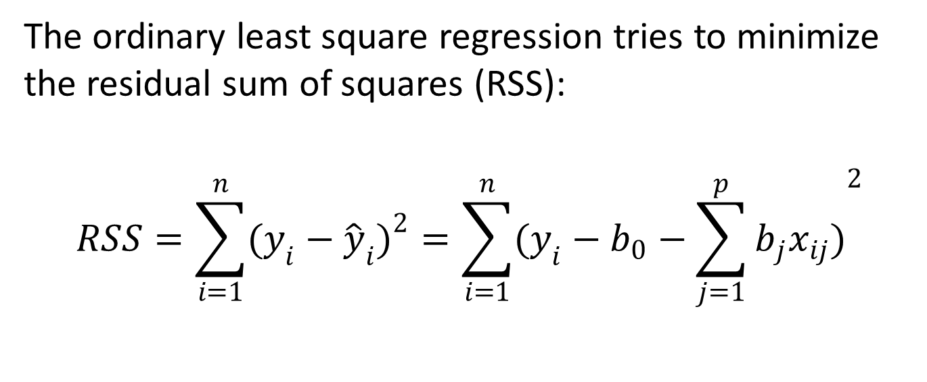
Ridge regression
The ordinary least square regression tries to minimize the residual sum of squares (RSS):
$$RSS=\sum_{i=1}^{n}{{(y_{i}−{\hat{y}}_{i})}^{2}}=\sum_{i=1}^{n}{{(y_{i}−b_{0}−\sum_{j=1}^{p}{b_{j}x_{ij}})}^{2}}$$

Slide 5
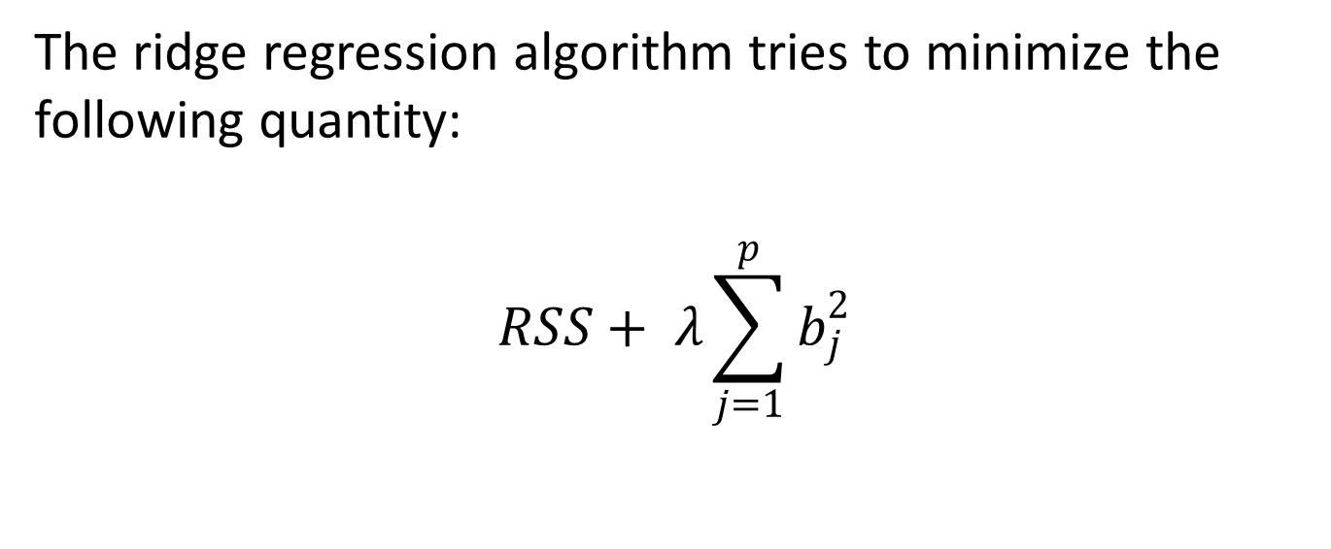
Ridge regression
The ridge regression algorithm tries to minimize the following quantity:
$$RSS+ λ\sum_{j=1}^{p}{b_{j}^{2}}$$

Slide 6
Ridge regression
Predictors:
numbUrban: number of people living in urban areas
householdsize: mean people per household
medIncome: median household income
PctPopUnderPov: percentage of people under the poverty level
PctLess9thGrade: percentage of people 25 and over with less than a 9th grade education
PctUnemployed: percentage of people 16 and over, in the labor force and unemployed
NumImmig: total number of people known to be immigrants
NumInShelters: number of people in homeless shelters

Slide 7
Ridge regression
Predictors:
NumStreet: number of homeless people counted in the street
racepctblack: percentage of population that is african-american
racePctWhite: percentage of population that is caucasian
racePctAsian: percentage of population that is of asian heritage
racePctHisp: percentage of population that is of hispanic heritage
pctWPubAsst: percentage of households with public assistance income
PopDens: population density in persons per square mile
HousVacant: number of vacant households

Slide 8
Ridge regression
Dependent variable:
burglPerPop: number of burglaries per 100K population

