Slide 1
Penalized Regression (2) Lasso

Slide 2
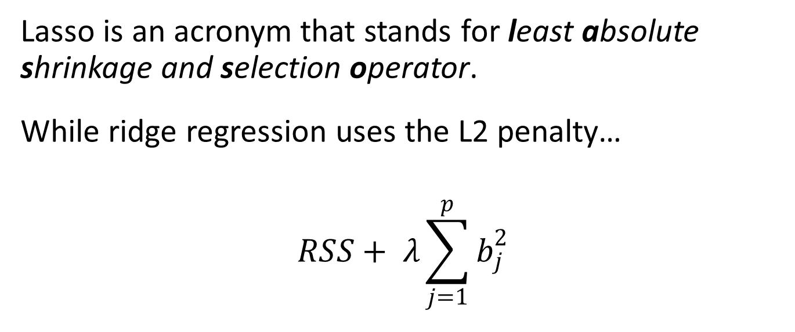
Lasso is an acronym that stands for least absolute shrinkage and selection operator.
While ridge regression uses the L2 penalty…
$$RSS+ λ\sum_{j=1}^{p}{b_{j}^{2}}$$

Slide 3

Lasso
…the lasso regression tries to minimize the following:
$$RSS+ λ\sum_{j=1}^{p}{\left|b_{j}\right|}$$

Slide 4
Ridge regression
Predictors:
numbUrban: number of people living in urban areas
householdsize: mean people per household
medIncome: median household income
PctPopUnderPov: percentage of people under the poverty level
PctLess9thGrade: percentage of people 25 and over with less than a 9th grade education
PctUnemployed: percentage of people 16 and over, in the labor force and unemployed
NumImmig: total number of people known to be immigrants
NumInShelters: number of people in homeless shelters

Slide 5
Ridge regression
Predictors:
NumStreet: number of homeless people counted in the street
racepctblack: percentage of population that is african-american
racePctWhite: percentage of population that is caucasian
racePctAsian: percentage of population that is of asian heritage
racePctHisp: percentage of population that is of hispanic heritage
pctWPubAsst: percentage of households with public assistance income
PopDens: population density in persons per square mile
HousVacant: number of vacant households

Slide 6
Ridge regression
Dependent variable:
burglPerPop: number of burglaries per 100K population

