Slide 1
Binomial Logistic Regression

Slide 2
The binomial logistic regression is used when the dependent variable is dichotomous and the independent variables are continuous, ordinal or nominal.
It belongs to the category of supervised machine learning techniques with a categorical response variable.

Slide 3
The logistic regression allows us to determine the probability for a given case to be in a particular class (category) of the dependent variable.

Slide 4
p – probability of success
1 - p – probability of failure
p / (1 - p) – the odds that the predicted event happens

Slide 5
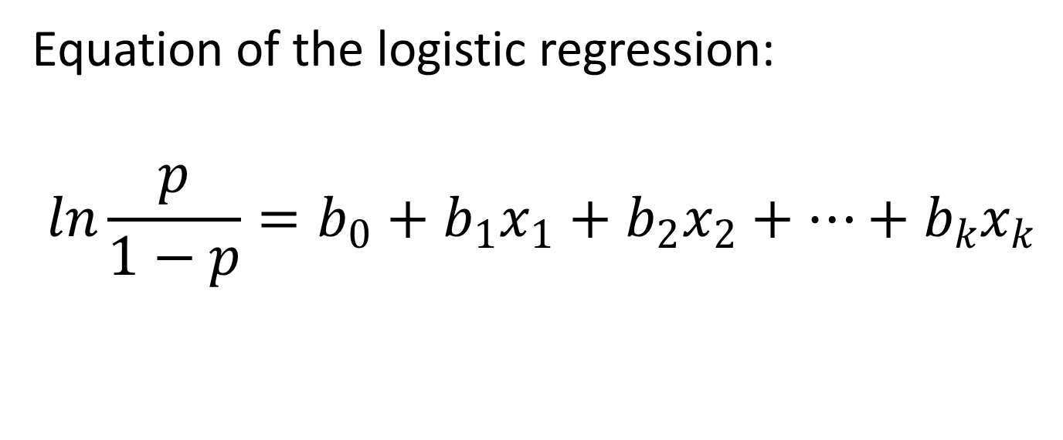
Equation of the logistic regression:
$$ln\frac{p}{1−p}=b_{0}+b_{1}x_{1}+b_{2}x_{2}+…+b_{k}x_{k}$$

Slide 6
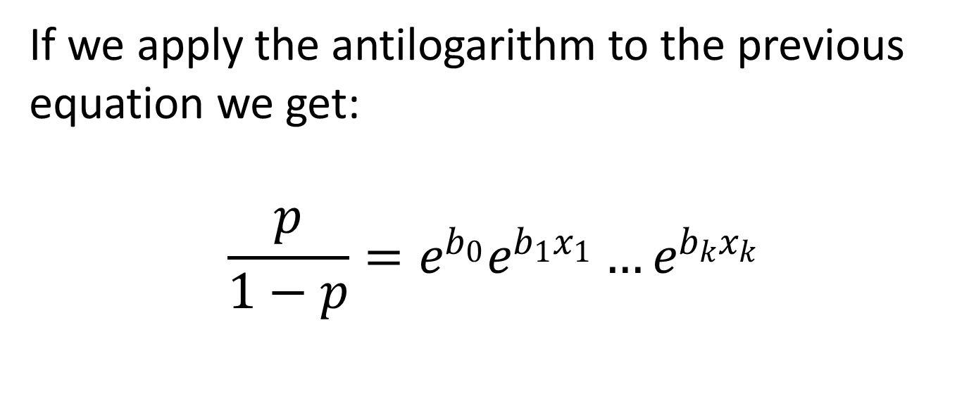
If we apply the antilogarithm to the previous equation we get:
$$\frac{p}{1−p}=e^{b_{0}}e^{b_{1}x_{1}}…e^{b_{k}x_{k}}$$

Slide 7
Topics related to the logistic regression:
how to run the logistic regression in R and how to interpret the coefficients
how to estimate the prediction accuracy for a logistic regression (how to know if our model does a good job as far as prediction is concerned).
how to build the ROC curve and compute the area under the curve
how to validate a logistic regression

Slide 8
ROC Curve
The ROC curve summarizes the performance of a logistic regression model. ROC stands for Receiver Operating Characteristics.

Slide 9
ROC Curve
It is built based on two indicators:
sensitivity – the ability of the model to predict that an event will happen when it actually happens (in other words, the ability to predict the true positives)
specificity – the ability of the model to predict that an event will not happen when it actually does not happen (in other words, the ability to predict the true negatives).

Slide 10
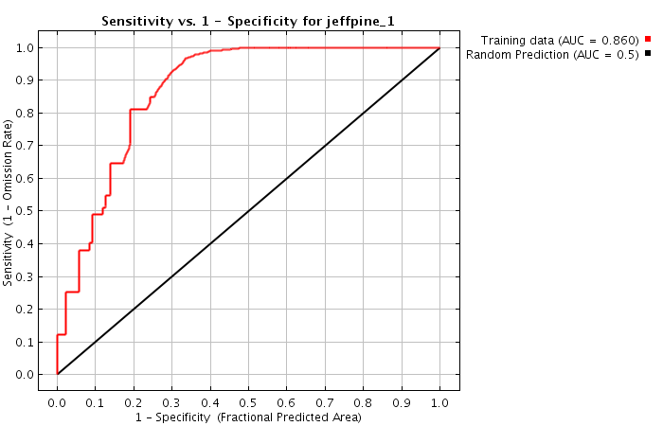

Slide 11
ROC Curve
The accuracy of the model is given by the area under the curve (AUC). This area is comprised between 0.50 and 1.
if AUC is close to 0.50, the model is useless for prediction
the closer AUC is to 1, the better the model

