Slide 1
Naïve Bayes Estimation

Slide 2
The naïve Bayes classifier (naïve Bayes estimator) is a machine learning technique based on the Bayes theorem. It belongs to the category of supervised machine learning techniques with a categorical response variable.

Slide 3
The naïve Bayes technique assumes that all predictors are independent, i.e. all the pairs of predictors are uncorrelated. This is a very strong assumption; this is why the method is called “naïve”.
Another strong assumption for the naïve Bayes classifier is that the numeric predictors are normally distributed.

Slide 4

Bayes Theorem
Probability of B given A
(likelihood)
$$P\left(A | B\right)=\frac{P\left(A\right)∗P(B|A)}{P(B)}$$
Prior probability of A
Probability of A given B
(conditional probability)
Prior probability of B

Slide 5
Bayes Theorem
dependent variable: Y
p predictors: X₁, X₂, …, X_{p}.

Slide 6

Bayes Theorem
Probability of (X₁, X₂, …, X_{p}) given Y
(likelihood)
$$P\left(Y | X_{1}, X_{2},…,X_{p}\right)=\frac{P\left(Y\right)∗P(X_{1}, X_{2},…,X_{p}|Y)}{P(X_{1}, X_{2},…,X_{p})}$$
Prior probability of Y
Probability of Y given (X₁, X₂, …, X_{p})
(conditional probability)
Prior probability of (X₁, X₂, …, X_{p})

Slide 7
Suppose we have to predict whether a customer would respond to a direct mailing campaign knowing their income.
The income is measured on three levels: low, medium and high.

Slide 8
Income | Responded?
Low | No
Medium | Yes
Medium | No
High | Yes
Low | No
Low | Yes
High | Yes
High | No
High | Yes
Low | No
Medium | Yes
Medium | No
Medium | No
Medium | Yes
High | Yes

Slide 9
 | Yes | No
Low | 1 | 3 | 4
Medium | 3 | 3 | 6
High | 4 | 1 | 5
 | 8 | 7 | 15

Slide 10
We are going to compute the probability of getting a response (the probability of yes) for each income level. To assign each customer to a class (yes or no) we use the following rule:
if p(yes) ≥ 0.50, prediction = yes
if p(yes) < 0.50, prediction = no

Slide 11
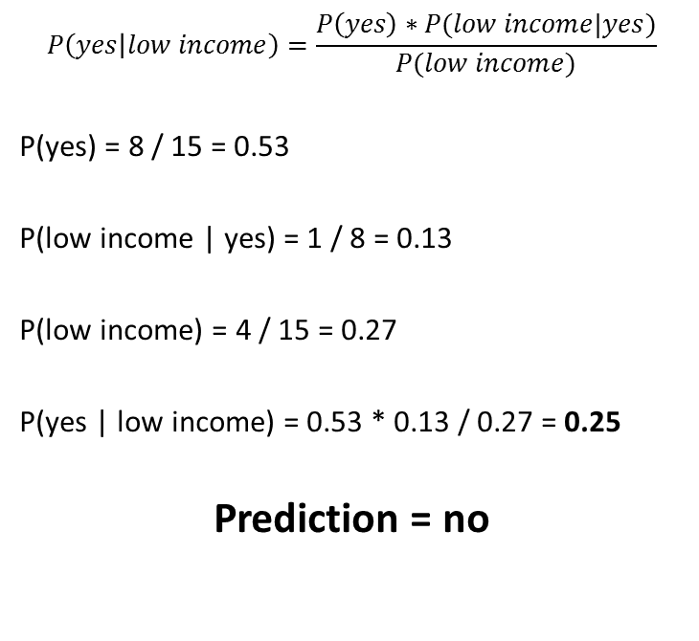
$$P\left(yes | low income\right)=\frac{P\left(yes\right)∗P(low income|yes)}{P(low income)}$$
P(yes) = 8 / 15 = 0.53
P(low income | yes) = 1 / 8 = 0.13
P(low income) = 4 / 15 = 0.27
P(yes | low income) = 0.53 * 0.13 / 0.27 = 0.25
Prediction = no
 | Yes | No
Low | 1 | 3 | 4
Medium | 3 | 3 | 6
High | 4 | 1 | 5
 | 8 | 7 | 15

Slide 12
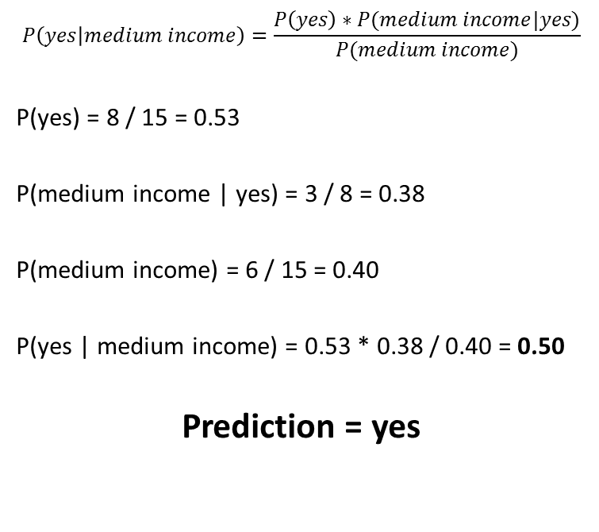
$$P\left(yes | medium income\right)=\frac{P\left(yes\right)∗P(medium income|yes)}{P(medium income)}$$
P(yes) = 8 / 15 = 0.53
P(medium income | yes) = 3 / 8 = 0.38
P(medium income) = 6 / 15 = 0.40
P(yes | medium income) = 0.53 * 0.38 / 0.40 = 0.50
Prediction = yes
 | Yes | No
Low | 1 | 3 | 4
Medium | 3 | 3 | 6
High | 4 | 1 | 5
 | 8 | 7 | 15

Slide 13
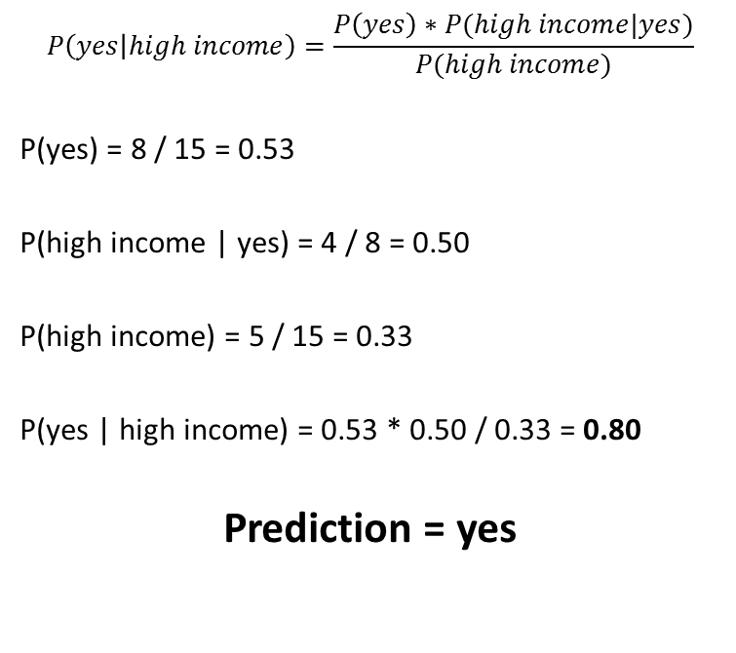
$$P\left(yes | high income\right)=\frac{P\left(yes\right)∗P(high income|yes)}{P(high income)}$$
P(yes) = 8 / 15 = 0.53
P(high income | yes) = 4 / 8 = 0.50
P(high income) = 5 / 15 = 0.33
P(yes | high income) = 0.53 * 0.50 / 0.33 = 0.80
Prediction = yes
 | Yes | No
Low | 1 | 3 | 4
Medium | 3 | 3 | 6
High | 4 | 1 | 5
 | 8 | 7 | 15

Slide 14
Income | Responded? | Prediction
Low | No | No
Medium | Yes | Yes
Medium | No | Yes
High | Yes | Yes
Low | No | No
Low | Yes | No
High | Yes | Yes
High | No | Yes
High | Yes | Yes
Low | No | No
Medium | Yes | Yes
Medium | No | Yes
Medium | No | Yes
Medium | Yes | Yes
High | Yes | Yes
Prediction accuracy:
10 / 15 = 66.7%

