Slide 1
K Nearest Neighbor

Slide 2
The K-nearest neighbor technique (KNN) is a non-parametric method used for both classification and regression. However, most of the times it is used for classification problems, where the response variable is categorical.

Slide 3
Each new observation is classified based on the values of its closest observations (or closest neighbors). The distance between observation is computed using one of the most popular distance functions; usually Euclidian, Manhattan or Minkowski.

Slide 4
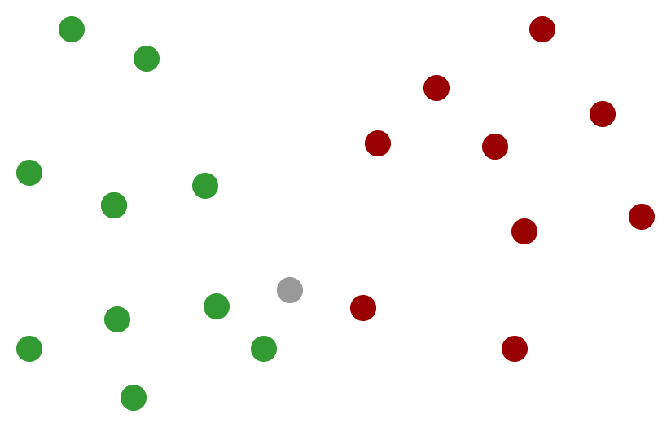

Slide 5
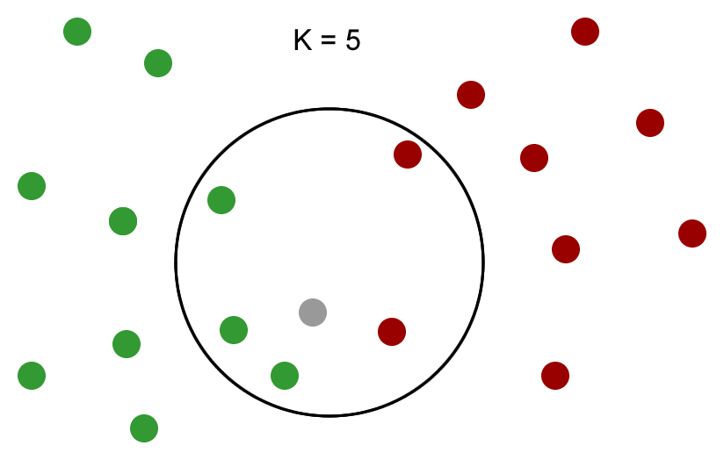

Slide 6
We are going to compute…
the average distance from the gray point to the green points and
the average distance from the gray point to the red points
We will predict the color of the gray point based on the lowest of these two averages.

Slide 7
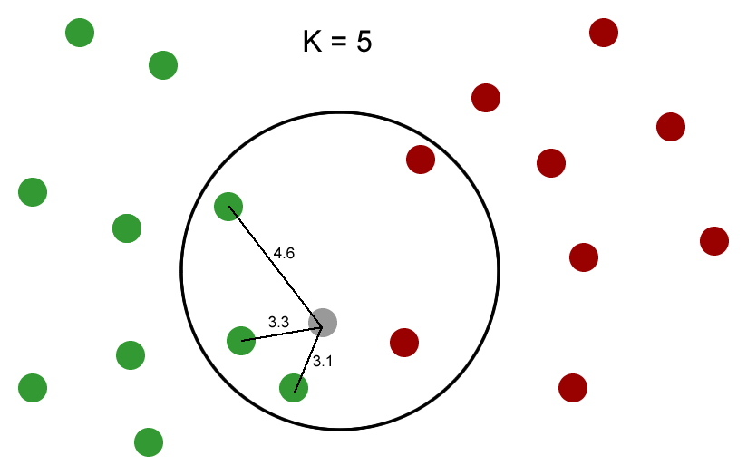
Average distance to the green points:
(3.1 + 3.3 + 4.6) / 3 = 3.7

Slide 8
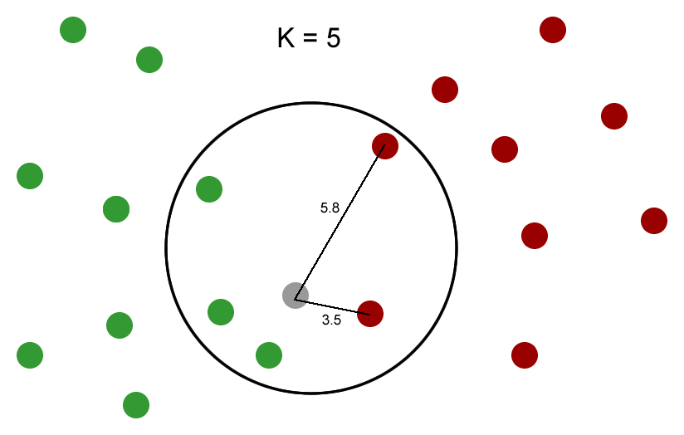
Average distance to the red points:
(3.5 + 5.8) / 2 = 4.7

Slide 9
The value of K is important in the KNN algorithm, because the prediction accuracy in the test set depends on it. The optimal value of K is the value that leads to the highest prediction accuracy. In practice, this value is identified through cross-validation.

Slide 10
K is the parameter that controls for the bias-variance trade-off in our model.
a small K leads to low bias and high variance
greater values of K tend to lead to larger bias but lower variance (better prediction accuracy in the test set)

Slide 11
The KNN method works best with numeric predictors. It is strongly advisable that the predictors are standardized before starting the analysis.

