Slide 1
Support Vector Machine

Slide 2
Support vector machine (SVM) is a supervised machine learning technique used mostly for classification problems with two classes. So the SVM method can only be applied when our population has two classes (groups) only.

Slide 3
The idea behind this technique is to separate the classes using a decision boundary. This boundary is…
a line in a two-dimensional plane (the case of two predictors)
a plane in a three-dimensional space (the case of three predictors)
a hyperplane in a p-dimensional space (the case of p predictors, p > 3)

Slide 4
The SVM technique is a generalization of other two classification methods:
the maximal margin classifier
the support vector classifier

Slide 5
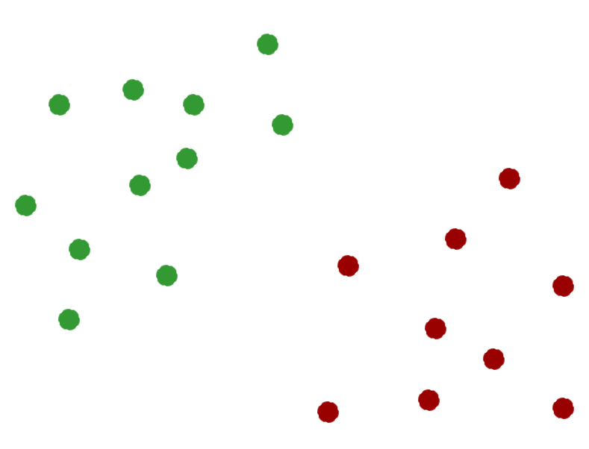
Maximal Margin Classifier

Slide 6
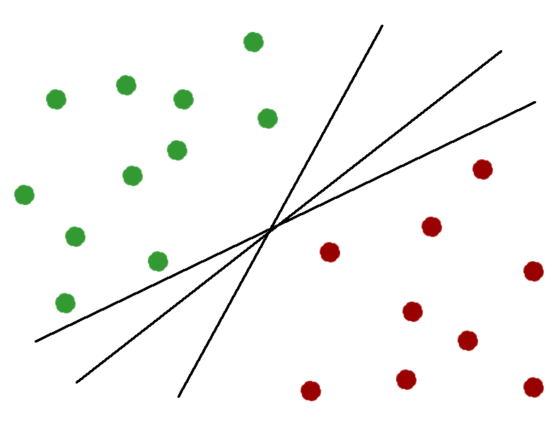
Maximal Margin Classifier

Slide 7
Maximal Margin Classifier
The best boundary is the line placed at the largest distance from the closest data points in each group.
This distance is called margin, so the optimal boundary is called maximal margin classifier.

Slide 8
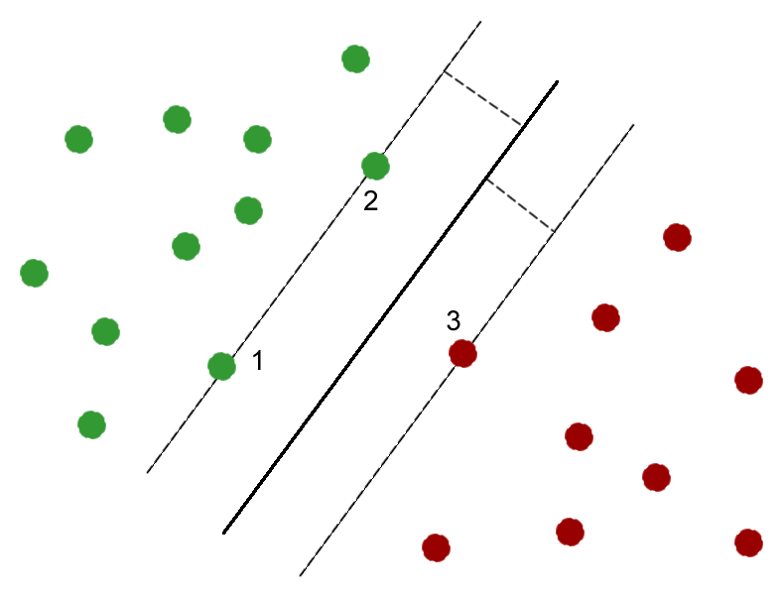
Maximal Margin Classifier

Slide 9
Maximal Margin Classifier
The maximal margin classifier technique has a major drawback: it works only when the two classes are completely separable, as in our case here.

Slide 10
Support Vector Classifier
The support vector classifier technique can be applied when the classes in our population are not completely separable, which is always the case when we work with real data.

Slide 11
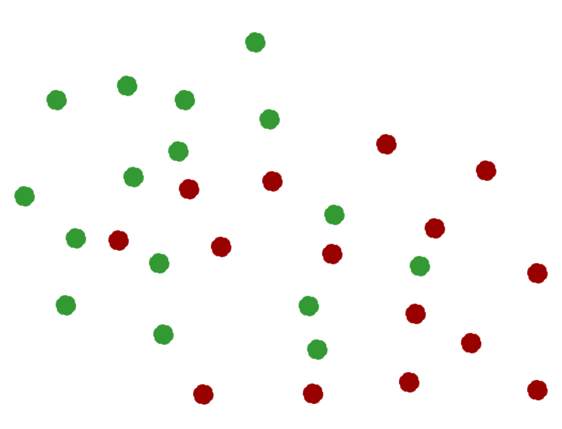
Support Vector Classifier

Slide 12
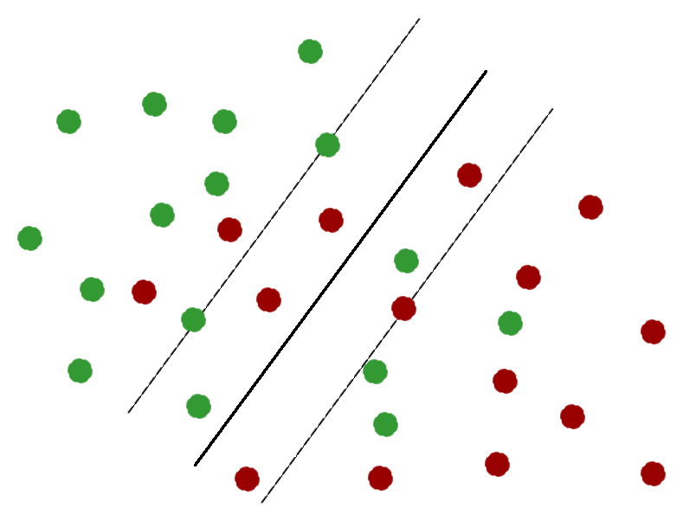
Support Vector Classifier

Slide 13
Support Vector Classifier
The number of data points that transgress the margins represent the cost or budget of our classification model. This cost depends on the dimension of the margin. The greater the margin, the bigger the cost.

Slide 14
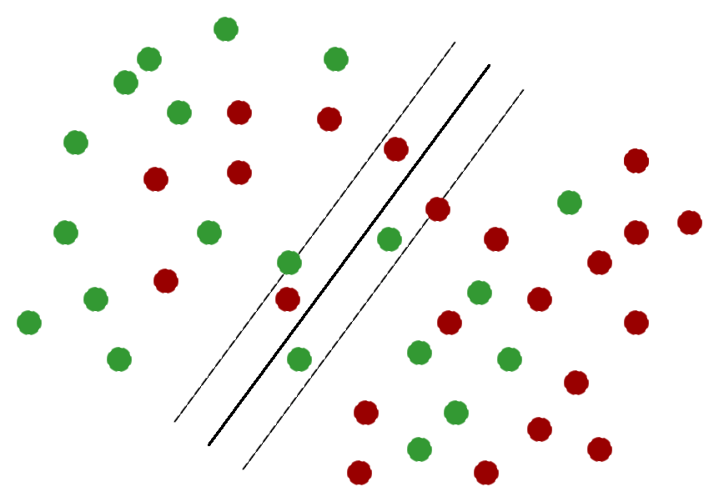
Support Vector Classifier

Slide 15
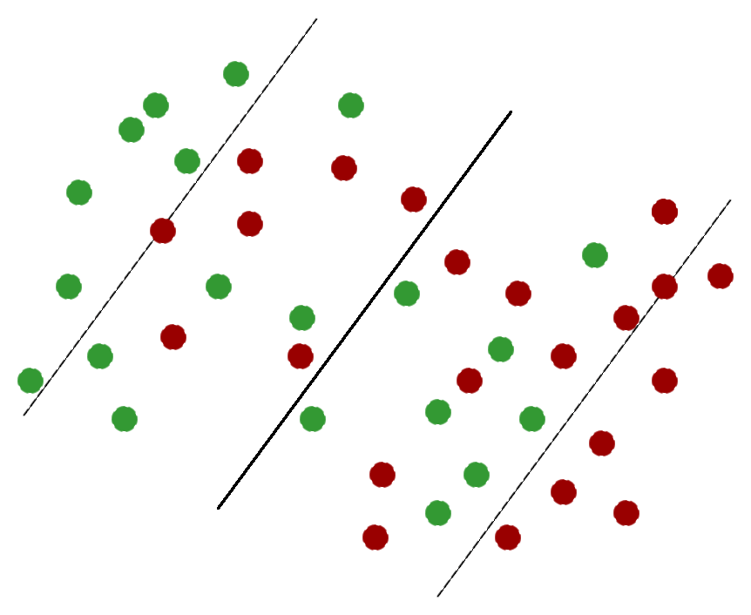
Support Vector Classifier

Slide 16
Support Vector Classifier
Bias-variance trade-off:
high cost = high bias and low variance
low cost = low bias and high variance

Slide 17
Support Vector Machine
The SVM uses a method called “kernel method” in order to transform the data and find the best hyperplane that separates the data points.
The kernel functions transform the original data space into a higher-dimensional space, where the data points are hopefully linearly separable.

Slide 18
Support Vector Machine
Types of kernel functions:
linear kernel. For this kernel, the boundary that best separates the points is likely linear. For the linear kernel, the only parameter we have to specify is the cost (budget) – the acceptable number of misclassifications.

Slide 19
Support Vector Machine

Slide 20
Support Vector Machine
non-linear kernels, which tend to be more useful when the number of dimensions (i.e. predictors) is small. There are two types of non-linear kernels:
polynomial kernels, which allows for curved boundaries between classes. For a polynomial kernel we have to specify (besides cost) the degree of the polynomial; if the degree is equal to 1 we have a linear kernel.
radial kernels, which can create closed regions in the data space. For a radial kernel we have to specify (besides cost) an important parameter called gamma. A good starting value for gamma is 0.1; the optimal value can be found through cross-validation.

Slide 21
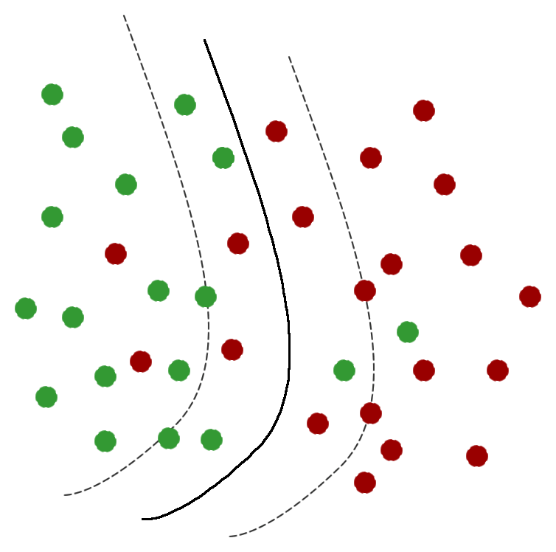
Support Vector Machine

Slide 22
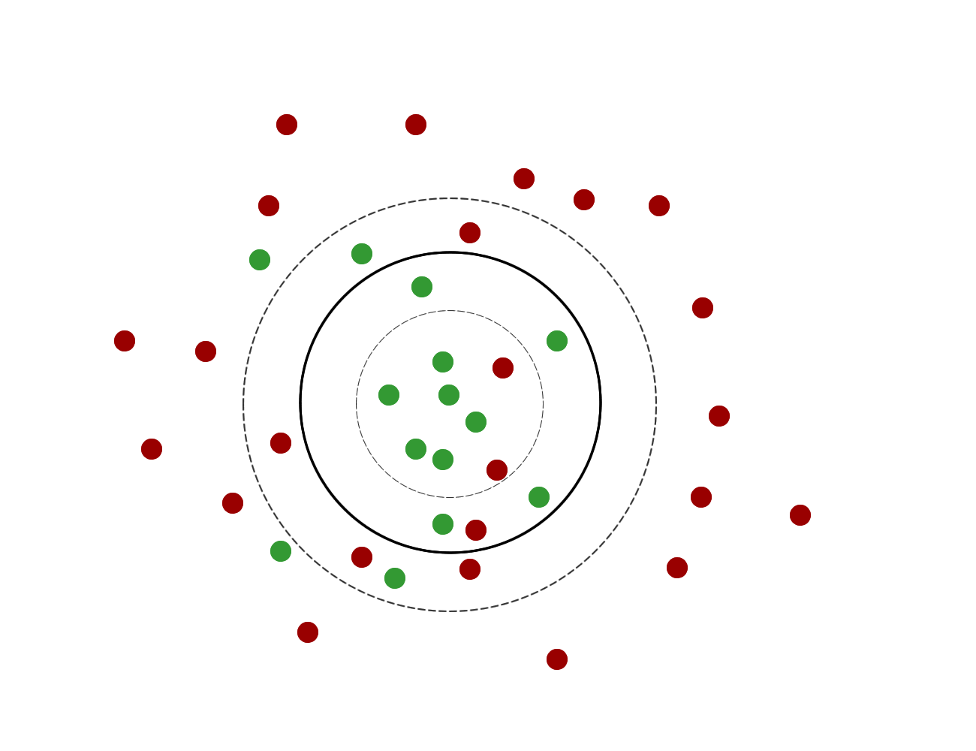
Support Vector Machine

Slide 23
Support Vector Machine
What kernel should we use?
In practice, it is advisable to start with the linear kernel and see if it does a good job or not. If not, we can try a non-linear kernel.

Slide 24
Support Vector Machine
Conditions to meet in order to run an SVM analysis:
All the predictors must be numeric (quantitative).
The target variable must be binary (dichotomous).
The target variable must be coded numerically (e.g. 1 – yes, 2 – no).

