Slide 1
Decision Trees

Slide 2
A decision tree is a supervised predictive technique that involves splitting (or segmenting) the values of the predictors using a set of splitting rules. As a result, our sample will be divided into homogeneous subsets.
To predict the target variable for a new observation we have to establish to which subset that observation belongs, based on the predictors values.

Slide 3
Suppose we have to predict the patient’s risk of getting a vascular disease based on three predictors: whether they smoke, whether they exercise regularly and whether they keep a diet.
The risk is measured on two levels: low and high.

Slide 4
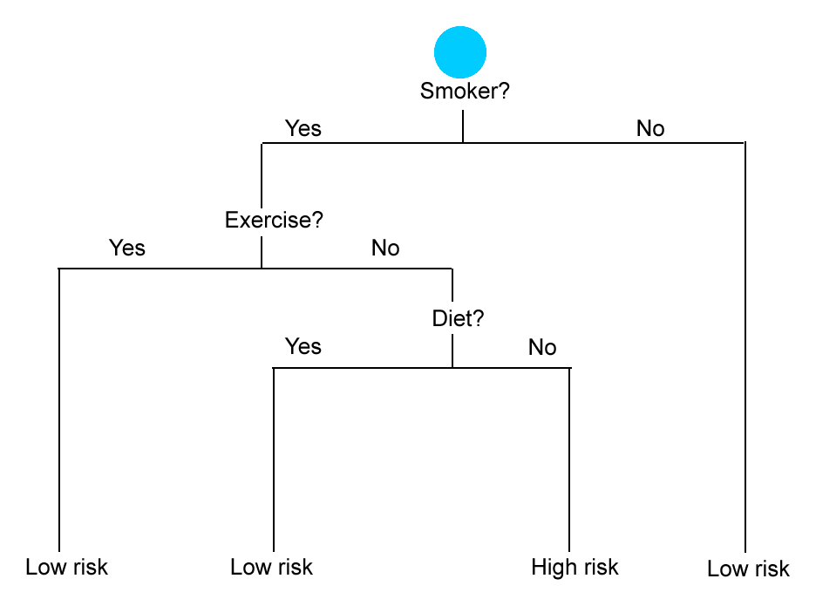
Decision Tree Example

Slide 5
The set of rules for our decision tree:
If Smoker = No Then Risk = Low
If Smoker = Yes AND Exercise = Yes Then Risk = Low
If Smoker = Yes AND Exercise = No AND Diet = Yes Then Risk = Low
If Smoker = Yes AND Exercise = No AND Diet = No Then Risk = High

Slide 6
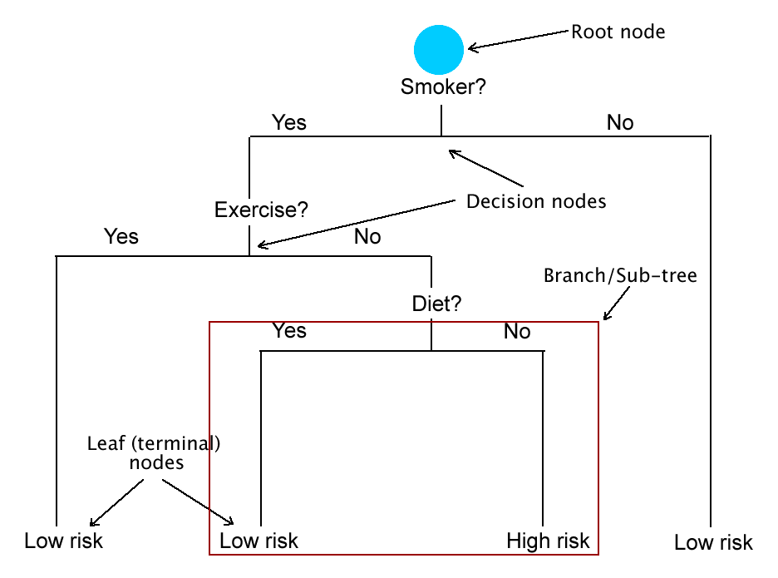
Decision Tree Components

Slide 7
A decision tree growing process uses two types of criteria:
Decision criteria. Based on these criteria, we decide where to split the tree, i.e. how to choose the split nodes in order to get homogeneous subsets in the end. Various splitting algorithms can be used, depending on the type of tree.
A stopping criterion. This criterion tells us when to stop splitting (when to stop growing the tree). The most usual stopping criterion is the minimum number of cases in the leaf nodes. When this number goes below the minimum, the tree building algorithm stops.

Slide 8
The tree building approach presented here is called recursive binary splitting (because each node is split into two sub-nodes).
The most common algorithm for growing binary trees is called CART (Classification and Regression Trees).

Slide 9
Introduction to CART

Slide 10
There are two types of decision trees in machine learning:
Regression trees, used when the dependent (target) variable is continuous (numeric).
Classification trees, used when the dependent variable is categorical.

Slide 11
Regression Trees
In a regression tree, the values of the terminal nodes represent the mean values of the dependent variable in each subset of the sample. So the predictions for the new observations are made using the mean values.
Let’s suppose that we have to predict the house prices based on two variables: surface in square feet and type of residential area (urban/rural).

Slide 12
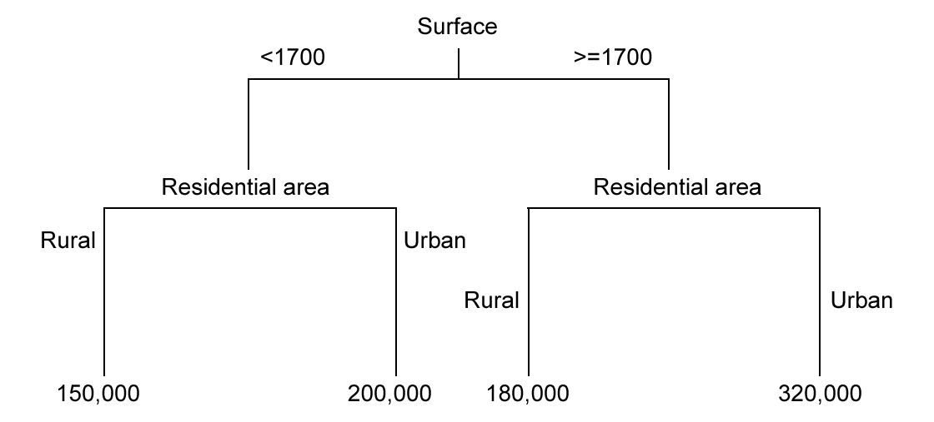
Regression Trees

Slide 13
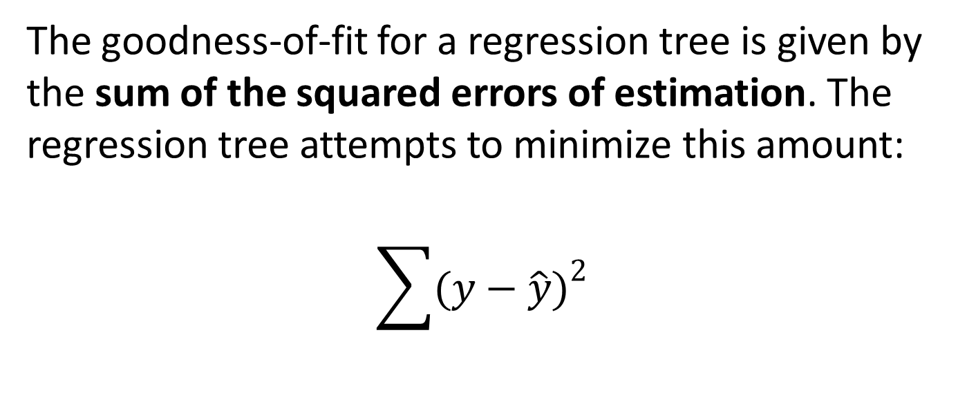
Regression Trees
The goodness-of-fit for a regression tree is given by the sum of the squared errors of estimation. The regression tree attempts to minimize this amount:
$$\sum{{(y−\hat{y})}^{2}}$$

Slide 14
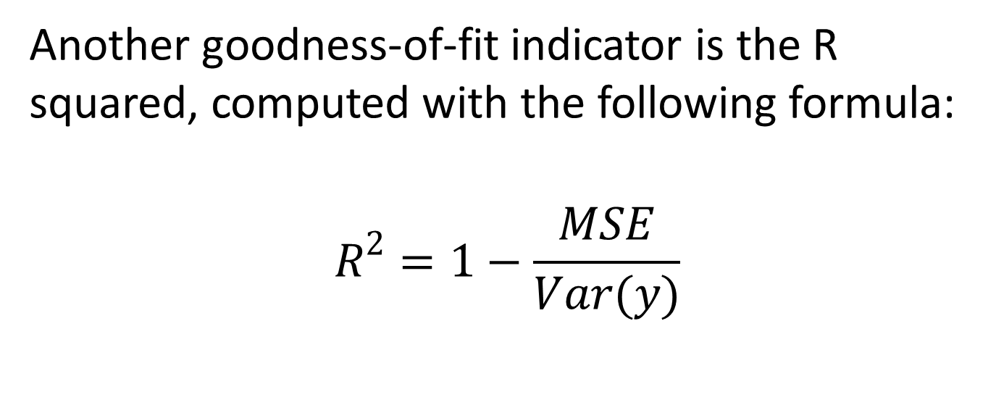
Regression Trees
Another goodness-of-fit indicator is the R squared, computed with the following formula:
$$R^{2}=1−\frac{MSE}{Var(y)}$$

Slide 15

Regression Trees
where
$$MSE= \frac{\sum{{(y−\hat{y})}^{2}}}{n}$$
$$Var\left(y\right)=\frac{\sum{{(y−\overline{y})}^{2}}}{n−1}$$

Slide 16
Classification Trees
In a classification tree, the value of each terminal node is the mode of the observations in the corresponding subset.
Let’s suppose we have to predict whether a customer would buy a product based on their income and gender.

Slide 17
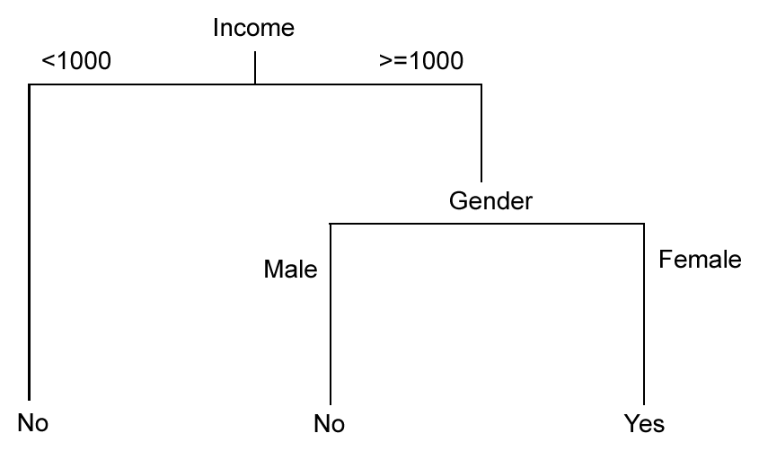
Classification Trees

Slide 18
Classification Trees
For a classification tree, the goodness-of-fit (or prediction accuracy) is given by the percentage of correctly classified cases.

Slide 19
Advantages and Disadvantages of Decision Trees

Slide 20
Advantages of decision trees:
They are easy to explain in layman’s terms.
They are easy to visualize and interpret (especially when they are small).
They can handle all type of predictors (quantitative and qualitative, numeric or string).
Decision tree learning is a non-parametric method, so it makes no assumption about the variables distribution.
They work well in case of non-linear relationships between variables.

Slide 21
Disadvantages of decision trees:
They may lead to overfitting in the training set.
They usually have a high variance, i.e. they have a smaller predictive accuracy in the test set. Decision trees have a lower predictive performance than other methods studied in this course.

Slide 22
The second disadvantage (the high variance) can be sometimes surpassed by using a few special techniques meant to improve the prediction accuracy in the test set:
pruning
bagging
random forests
boosting

Slide 23
Pruning

Slide 24
Pruning
Pruning is a technique that reduces the size of a decision tree, with the hope of improving the predictive performance in the test set.
By pruning we cut some branches of the initial tree, obtaining a simpler sub-tree.

Slide 25
Pruning
The sub-tree could have…
higher bias (i.e. lower predictive accuracy in the training set)
lower variance (i.e. higher predictive accuracy in the test set).
A simpler tree can be also easier to visualize and interpret.

Slide 26
Pruning
How much should we prune the tree?
A possible answer: we prune until we find the tree that has the lowest test set error. This test set error can be approximated using the cross-validation error that the R program computes for us.
This method is called cost complexity pruning.

Slide 27
Pruning
Our strategy:
first, grow a large tree (as shown in the previous lectures)
then prune the tree until we hopefully get a simpler sub-tree with a better test set prediction accuracy.

Slide 28
Bagging and Random Forests

Slide 29
Bagging
Bagging stands for bootstrap aggregation. It consists of dividing the training set into a big number of training subsets using bootstrapping. A separate tree is grown for each subset, each tree using all the predictors in the model.

Slide 30
Bagging
Afterwards we compute a single predicted value for each case in the training set. This value is obtained as follows:
for the regression trees, by averaging the tree predictions
for the classification trees, using the mode of the predictions.

Slide 31
Bagging
Each individual tree has a low bias and a high variance. By aggregating the predicted outcomes we can reduce the variance (i.e. get better prediction accuracy in the test set).
To achieve good results with bagging, we must generate a high number of training subsets (hundreds or thousands).

Slide 32
Random Forests
The random forests technique is similar to bagging: a big number of training subsets are generated, and a separate tree is fit in each subset. However, in random forests each tree uses a random sample of predictors at every splitting node. So all predictors are not used in each tree.

Slide 33
Random Forests
The number of predictors used in every splitting node is computed as follows:
for the regression trees it is the half of the total number of predictors
for the classification trees it is approximately the square root of the total number of predictors.

Slide 34
Random Forests
The predicted outcomes are computed like in the bagging technique. The random forests variance is likely lower because the individual trees are independent (de-correlated).

Slide 35
Boosting

Slide 36
Boosting
Like bagging, boosting consists of building multiple trees, compute a predictive outcome for each tree and then aggregate these outcomes to come up with a single predicted value for each case.
Unlike bagging, boosting grows each tree based on information from the previous ones. So the trees built with boosting are not independent. Boosting does not involve bootstrapping.

Slide 37
Boosting
With boosting, we start by building small trees, many of them with one split only. Afterwards, more complex trees are grown, using an algorithm that improves the predictive accuracy of the initial trees. Finally, a single boosted model is created. The predictive power of this model is usually much bigger than that of the initial models (trees).

Slide 38
Boosting
The boosting process is controlled by three parameters:
the number of trees, which should be large (hundreds or thousands)
the shrinkage parameter, also called learning rate (denoted with λ). This parameter controls the speed of the boosting process, i.e. the speed at which the trees are grown. If lambda is big our model will be a fast learner, while if lambda is small our model will be a slow learner.
the number of splits in each tree, which influences the complexity of the boosted model.

