Slide 1
Neural Networks

Slide 2
An artificial neural network (ANN), also known as neural network (NN), is a computational structure composed of a number of interconnected data processors called neurons or nodes.
They are inspired from the structure of biological nervous systems.

Slide 3
Neural networks are powerful modeling tools because they can detect complex, nonlinear relationships between inputs and outputs.
They have applications in many different fields like marketing, finance, medicine, physics, IT, linguistics etc.

Slide 4
They can solve difficult tasks like…
image recognition
hand writing recognition
medical diagnosis
gene recognition
face recognition
agricultural production estimates
cash flow forecasting and optimization
employee selection
energy demand forecasting etc.

Slide 5
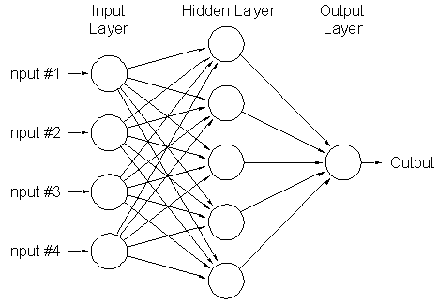

Slide 6
The neural networks could be divided into two big classes:
Feedforward networks. In a feedforward network, the information (signals) is transmitted in one direction only: from the input to the output layer (passing through the hidden layers).
Recurrent networks (aka feedback or interactive networks). In a recurrent network, the information can travel both ways (from input to output and conversely) by using loops.

Slide 7
A feedforward network with three or more layers (one input, one output and one or more hidden layers) is called multilayer perceptron (MLP).

Slide 8
What Happens Inside of a Neuron?

Slide 9
Operations performed in a hidden layer neuron:
summation
activation

Slide 10
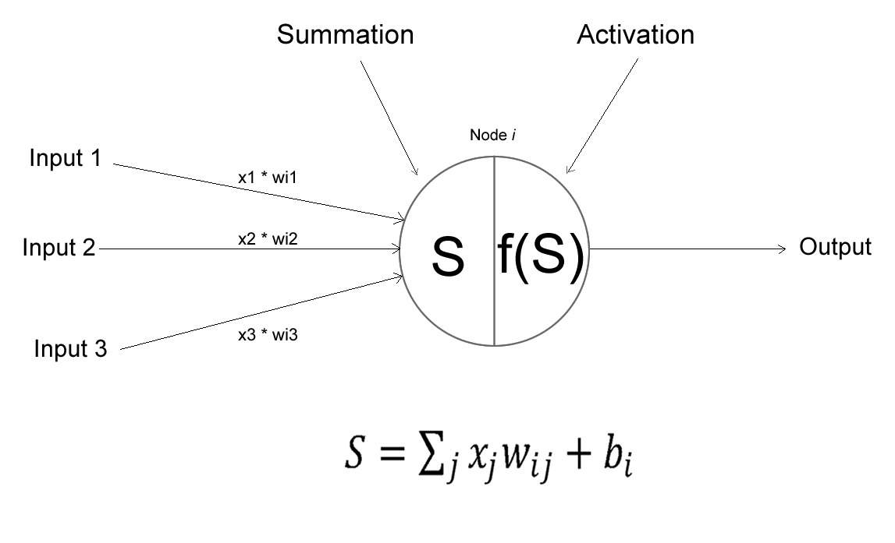

Slide 11
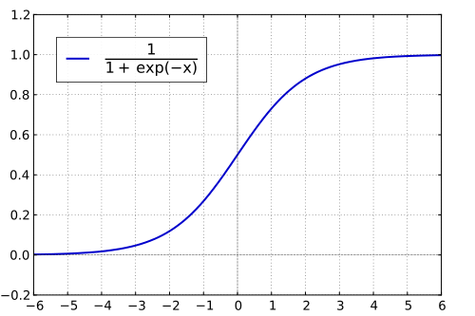
Logistic function (sigmoid)

Slide 12
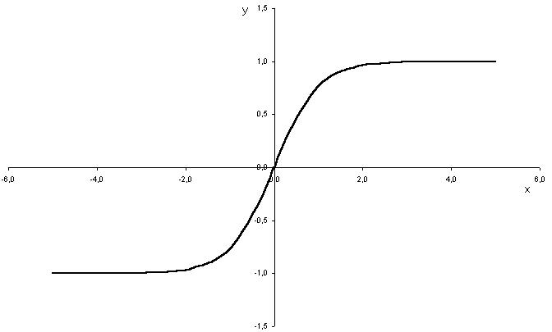
Hyperbolic tangent function (tanh)

Slide 13
Neural Network Learning Process

Slide 14
The learning process of a neural network is composed of four phases:
Initialization
Feed forward
Error evaluation
Backpropagation and weights adjustment

Slide 15
Phase 1 Initialization
At this phase, the first set of weights is generated (usually at random).

Slide 16
Phase 2 Feed forward
At this phase, the signal is transmitted from the input layer to the output layer, passing through the hidden layer(s). The hidden layer neurons perform the operations of summation and activation.

Slide 17
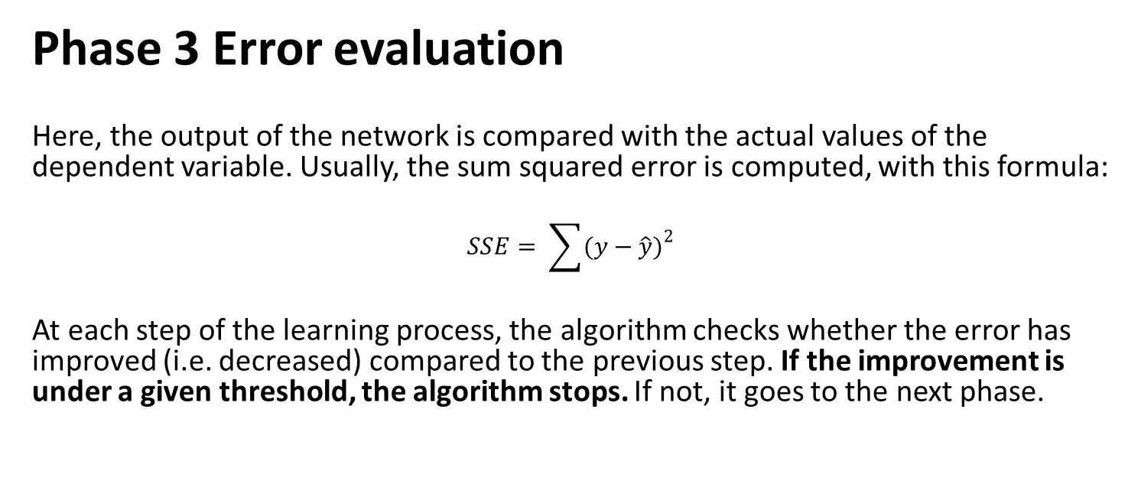
Phase 3 Error evaluation
Here, the output of the network is compared with the actual values of the dependent variable. Usually, the sum squared error is computed, with this formula:
$$SSE= \sum{{(y−\hat{y})}^{2}}$$
At each step of the learning process, the algorithm checks whether the error has improved (i.e. decreased) compared to the previous step. If the improvement is under a given threshold, the algorithm stops. If not, it goes to the next phase.

Slide 18
Phase 4 Backpropagation and weights adjustment
The error is propagated backwards through the network and the weights are adjusted with the goal of reducing the error. The learning process starts over. This process continues until the error decrease falls under the specified threshold.
To adjust the weights (and the biases) in the hidden layer neurons, the gradient descent technique is used.

Slide 19
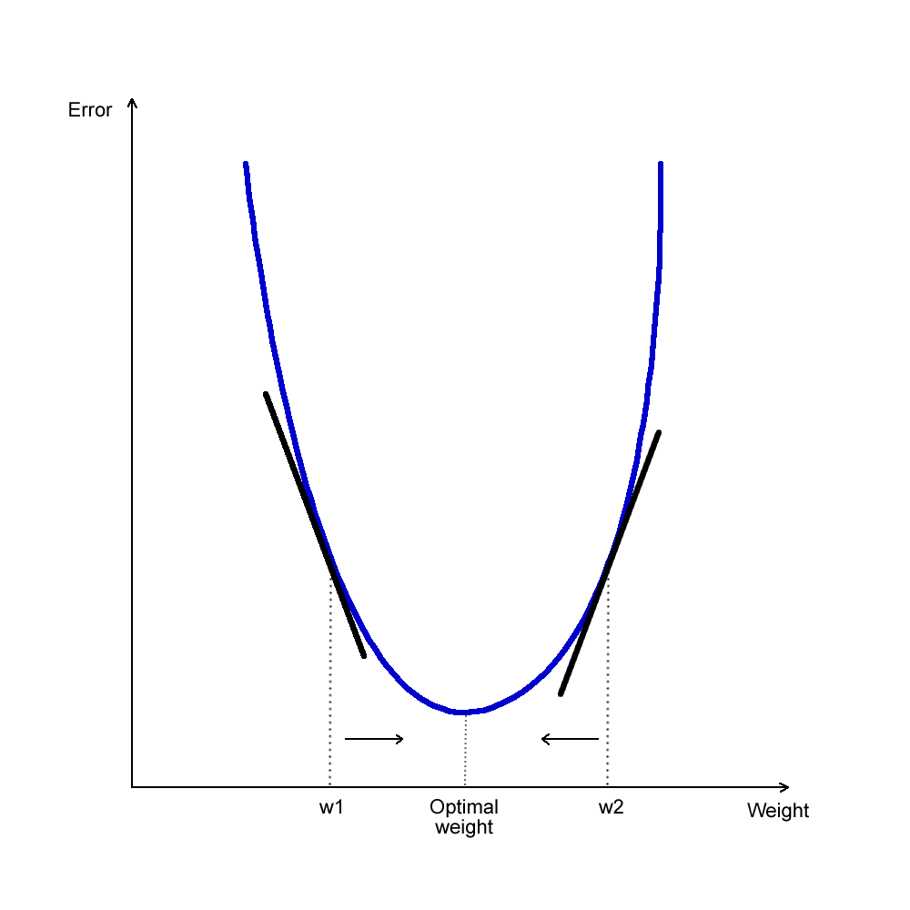
Gradient Descent

Slide 20
How Many Layers and Nodes?

Slide 21
A multilayer perceptron can usually achieve a good performance with one hidden layer only. Each new layer adds complexity to the network and makes it more difficult to train.
So we should attempt to build a neural network with as few hidden layers as possible (one).

Slide 22
The number of neurons in the hidden layer should be the average between the number of inputs and the number of outputs.

