Slide 1

NLP_FAKE_REAL_NEWS

Slide 2
Content:-
1. Aim
2. EDA(Exploratory Data Analysis)
. Data cleaning
. Data preprocessing
3.Visualization
4. Model Selection & Training
5. Deployment
.Final web page
6.Conclusion

Slide 3
Aim
The aim of this project is to develop and train a machine learning model capable of accurately classifying news articles as either "real" or "fake," based on a dataset of approximately 40,000 articles. This model will assist in combating misinformation by automating the identification of fake news articles, thus enabling users to make more informed decisions while consuming news.

Slide 4
Importing libraries
When working on a machine learning project, especially one focused on text classification (like identifying "real" vs. "fake" news), you will need to import a set of libraries to handle various tasks such as data preprocessing, model training, evaluation, and visualization. Here is a breakdown of the necessary libraries.
Data Handling :- (pandas, numpy)
Text Preprocessing (re,ntkle,string)
Modeling (sklearn, tensorflow, keras)
Evaluation (sklearn.metrics)
Visualization (matplotlib, seaborn)

Slide 5
Exploratory Data Analysis(EDA) Overview
EDA has been performed under two classifications:
Descriptive Statistics(mean, median, mode, standard deviation, range, quartiles and so on)
Graphical Methods(Visualizations)

Slide 6
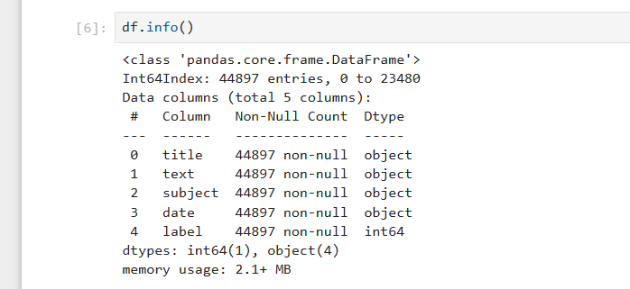
Data cleaning
Since theirs is No missing value in our data set, so we worked on the data as it is.

Slide 7
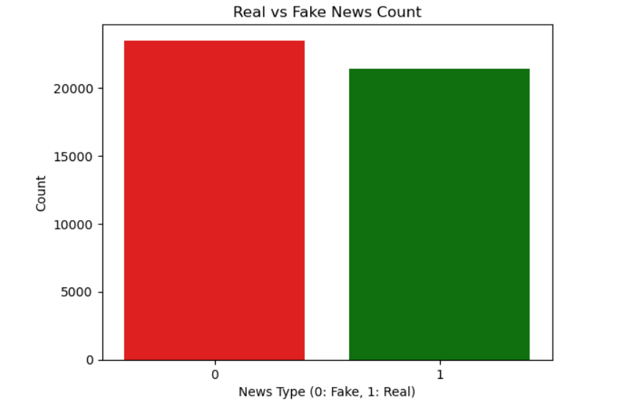
Visualization

Slide 8
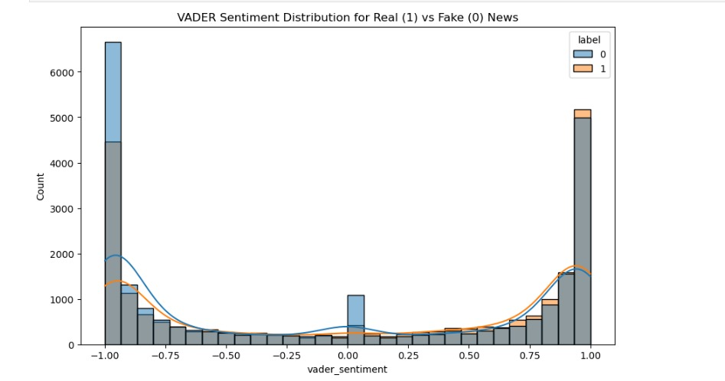
Data preprocessing
This step performs text preprocessing for both datasets (true_data and fake_data) to prepare them for analysis or model training. It removes punctuation, numbers, and stopwords, converts text to lowercase, and tokenizes it. The cleaned text is stored in a new clean_text column for each dataset. This ensures the data is standardized and irrelevant information is removed, improving model performance.
sentiment analysis Purpose of VADER Sentiment Analysis :Adds sentiment (vader_sentiment) as a feature to enhance model accuracy. Helps understand the emotional tone of text, with compound scores indicating positive, negative, or neutral sentiment. Useful for exploring patterns between sentiment and truthfulness in news articles.

Slide 9
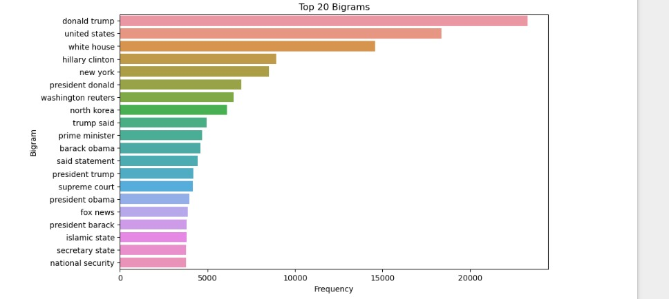
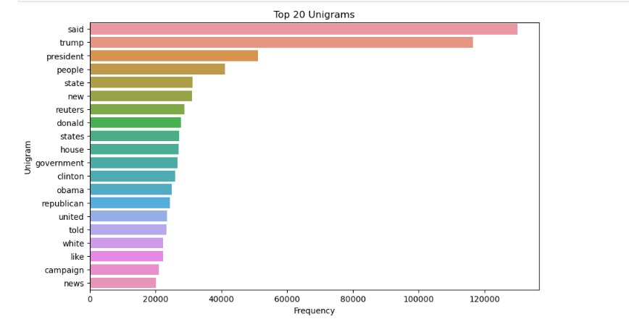
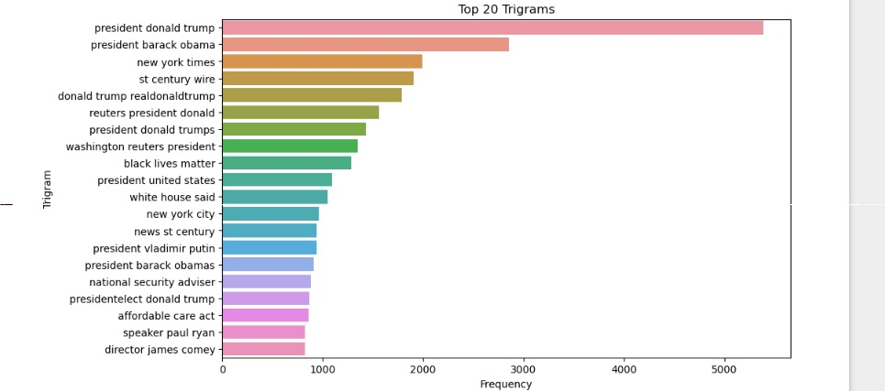
N-Gram Analysis:
Identifies frequent word patterns (unigrams, bigrams, trigrams) in text data.
It Helps To uncover key phrases or terms associated with specific contexts (e.g., "breaking news").
And Enhances feature engineering for text classification tasks by capturing context and sequence of words.
Also Improves understanding of text structure for insights and model performance.

Slide 10
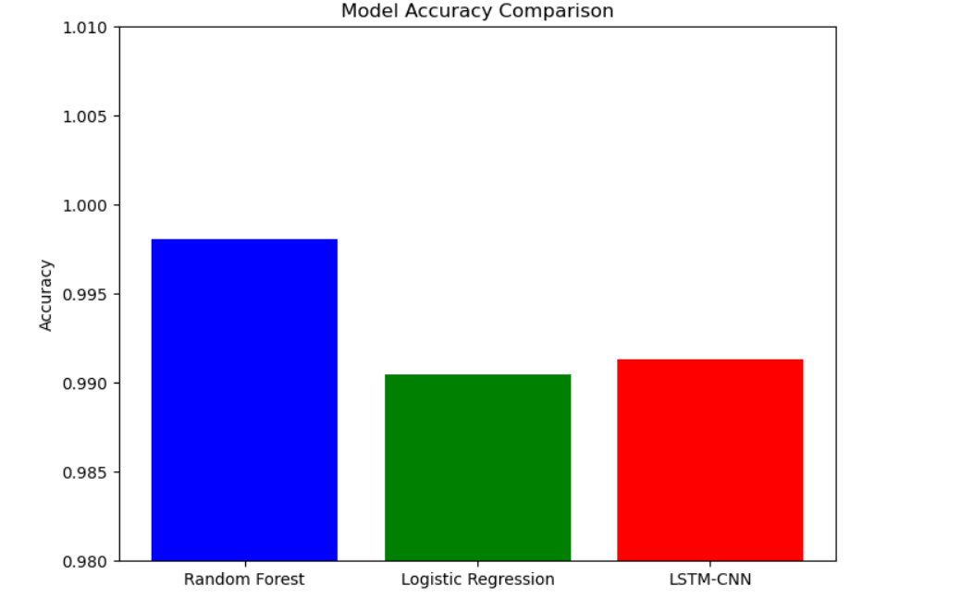
Model Selection & Training
Model selection is used to choosing the most appropriate model for a given problem, balancing accuracy, interpretability, scalability, and other factors.
Model training is the process where the chosen model learns from data, with the goal of optimizing its performance while avoiding overfitting and underfitting.
We tried these following Models(algorithm)
'Random Forest’
'Logistic Regression’
'LSTM-CNN'
The 'Random Forest’ is the best model for Our dataset. It has the highest R-squared on the testing set and the lowest RMSE, indicating that it captures the most variance and provides the most accurate predictions.

Slide 11

Deployment
Deployment, in the context of software and machine learning, refers to the process of making a system, application, or model available for use in a production environment.
Step1:- First, we installed the virtualenv package, which was used to create Python environments.
Step2:- We created a virtual environment and named it NLP_FAKE_REAL_NEWS.
Step3:- Then , we copied the necessary files (e.g., trained models, scripts, configuration files, etc.) into the NLP_FAKE_REAL_NEWS folder.
Step4:-We navigated to the Scripts directory inside our created virtual environment.
Step5:- We activated the virtual environment, which meant switching the Python setup to use a specific environment where we had installed Python and the necessary packages just for our project.
Step6:- Once our environment was activated, we installed Streamlit using pip.
Step7:- After installing, we ran the Streamlit app.
After doing all the steps we got this

Slide 12
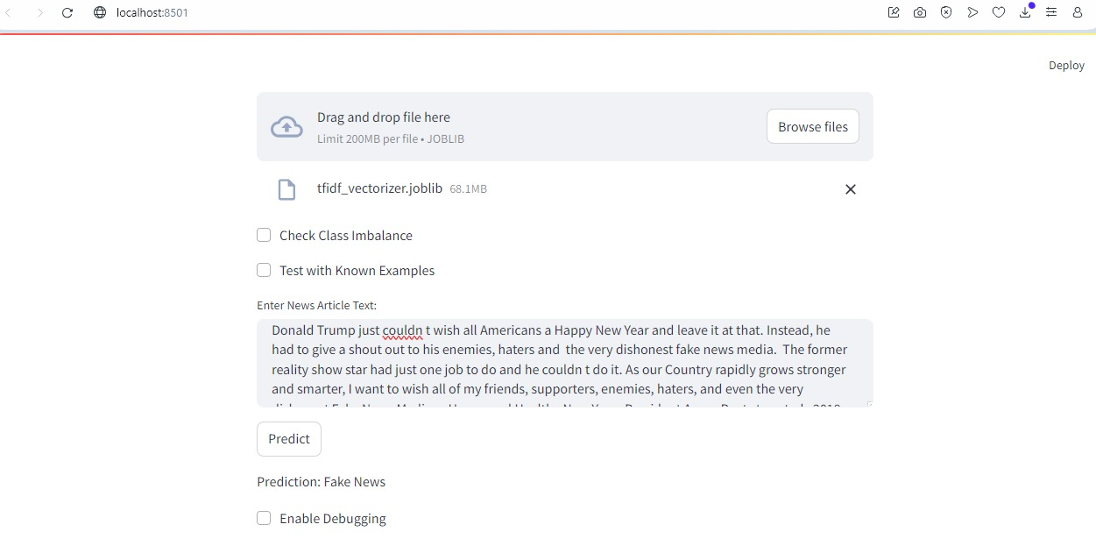
Final Web Page

Slide 13
Conclusion
In conclusion, this project sets out to create a highly accurate machine learning model capable of classifying news articles as either "real" or "fake" using a dataset of 40,000 articles. By automating the detection of misinformation, the model aims to significantly reduce the spread of fake news, helping users make more informed decisions while consuming media. With its potential to improve the reliability of news sources and combat the growing issue of misinformation, this model represents a critical step toward fostering a more trustworthy information ecosystem.

Slide 14
Thank
You

